Slide 1
Phase Celebration Review Set
Do all of these, or at least be sure you can do all of these correctly.
Calculators and reference tables. DO ALL THE MATH.

Slide 2
1. Convert 105 kPa into atm
2. Convert 795 mmHg into kPa

Slide 3
1. Convert 105 kPa into atm 105 kPa X 1.0 atm = 1.04 atm (3 SF) 101.3 kPa
2. Convert 795 mmHg into kPa 795 mmHg X 101.3 kPa = 106 kPa (3 SF) 760 mmHg

Slide 4
3. Convert 1.20 atm into kPa
4. Convert 95.0 mmHg into mm Hg

Slide 5
3. Convert 1.20 atm into kPa 1.20 atm X 101.3 kPa = 122 kPa (3 SF) 1.0 atm
4. Convert 95.0 mmHg into mm Hg 95.0 kPa X 760 mmHg = 710. kPa (2 SF) 101.3 kPa

Slide 6
5. What is the vapor pressure of ethanoic acid at 323 Kelvin?
6. What is the boiling point of propanone at 190 kPa?

Slide 7
5. What is the vapor pressure of ethanoic acid at 323 Kelvin? At 323 Kelvin (50°C) the vapor pressure is only about 8 kPa. This stuff has strong Intermolecular attractions
6. What is the boiling point of propanone at 190 kPa? Propanone boils at 190 kPa at about 76°C.

Slide 8
7. At 40 kPa, what is the order of the liquids on table H with the lowest to the highest boiling point?

Slide 9
7. At 40 kPa, what is the order of the liquids on table H with the lowest to the highest boiling point? At ANY kPA, propanone will boil first (at the lowest BP temp), followed by ethanol, water and then lastly by ethanoic acid. Propanone has the weakest IMF.

Slide 10
8. At any pressure, which of these 4 table H liquids has the strongest intermolecular bonding? How can you tell that?
9. The normal boiling point for any liquid is at what pressure? (what is normal?)

Slide 11
8. At any pressure, which of these 4 table H liquids has the strongest intermolecular bonding? How can you tell that? Ethanoic acid has the strongest inter molecular bonding and it shows by having the highest boiling point. It takes more energy to boil ethanoic acid than the others because of this.
9. The normal boiling point for any liquid is at what pressure? (what is normal?) Normal boiling point means boiling point at normal pressure, which is 101.3 kPa, or 1.0 atm or 760 mmHg, or 14.7 psi.

Slide 12
11. Which would have a higher melting point, an ionic compound or a molecular one?
12. What is the difference between an ionic and a molecular solids?

Slide 13
11. Which would have a higher melting point, an ionic compound or a molecular one? Ionic compounds almost always have a higher melting point than molecular ones. Think about NaCl_{(S)} and H₂O_{(S)}
12. What is the difference between an ionic and a molecular solids? Ionic ones are made of ions, molecular compounds form from 2 or more atoms sharing electrons, not ions. Examples would be NaCl which melts ≈ 801°C vs. molecular candle wax C₂₀H₄₂ which melts ≈ 120°C.

Slide 14
14. Remind yourselves of the difference between solids, liquids and gases.

Slide 15
14. Remind yourselves of the difference between solids, liquids and gases.
Gases have no definite shape or volume, they easily expand to fit into any container of any size.
Liquids have definite volume, but fit into the bottom of any container.
Solids have definite volume and definite shape, they do not conform to the container.

Slide 16
Be able to put the following symbols onto any heating curve, or any cooling curve, in the right places. Also know the phase at any point, or the phase (or phases) for any segment. Label left to right, A to F.
KE ↓ ↔ ↑
PE ↓ ↑ ↔
Temp ↓ ↔ ↑
& solid, liquid, gas

Slide 17
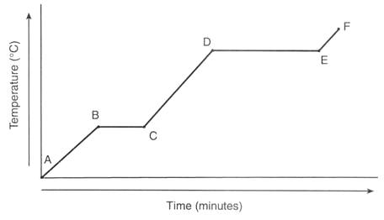
Heating Curve for Anything
Heat ADDED at a constant rate

Slide 18
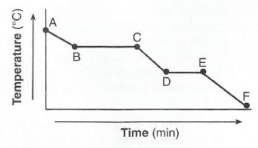
Cooling Curve for Anything
Heat REMOVED at a constant rate

Slide 19
Phase Diagram for Water
The Critical Point is OUT OF SCALE. That point is at 374°C and 22,000 atm!
Do you KNOW 6 phase changes and where they go?
CP
NFP
NBP
101.3 kPa
TP
0°C 100°C

