Slide 1
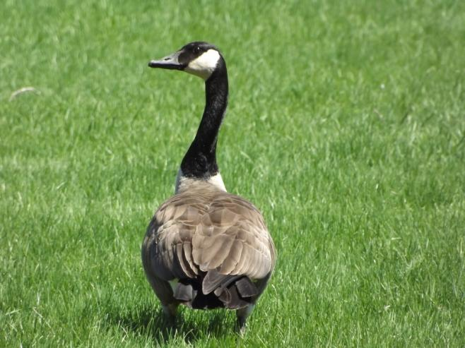
Acids and bases always starts with a good story.
A long time ago, in a galaxy far, far away…

Slide 2
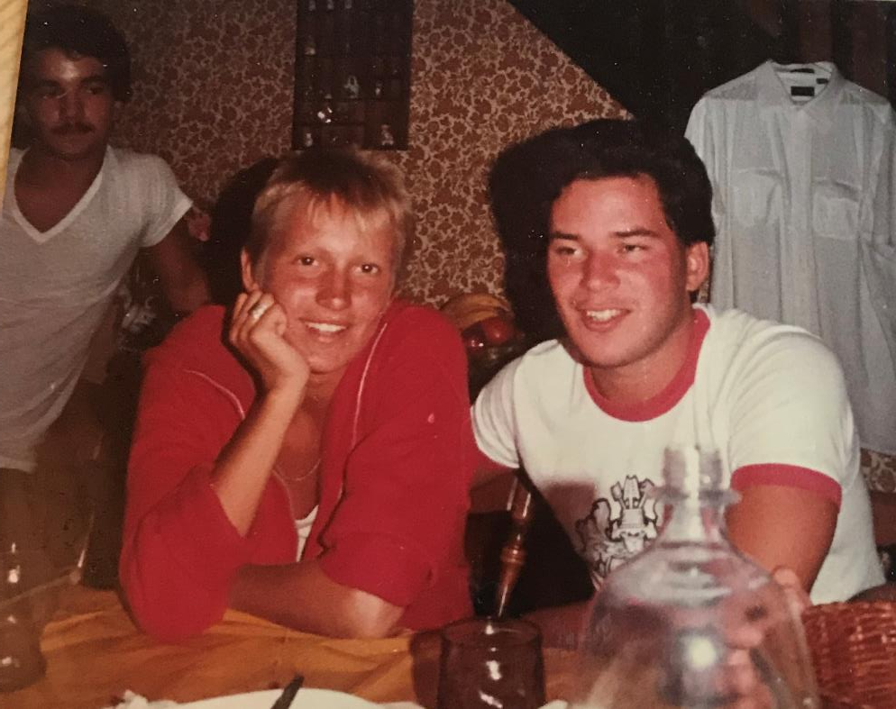

Slide 3
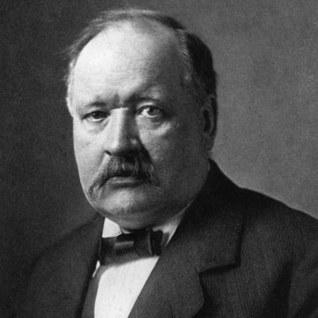
Please note, a great mustache!
1. Svante Arrhenius Father of Acids and Bases, Nobel Prize Winner, and a man from Sweden.
The Arrhenius Theory covers nearly 99% of all acids + bases, and allowed chemists of all levels to finally grasp what acids and bases were, how they worked, and what happens when you put them together.
There are other theories, for the other 1% of solutions that are acids and bases, including ammonia, but the Arrhenius theory is nearly perfect.

Slide 4
The standard theory (Arrhenius) states that:
2. ACIDS are aqueous solutions with an excess of H⁺¹ ions.
3. BASES are aqueous solutions with an excess of OH⁻¹ ions.
ACIDS 4. Acids we need to know are listed in table K.
In our class we will discuss all eight acids, hydrochloric, nitrous, nitric, sulfurous, sulfuric, phosphoric, carbonic, and acetic acid (which is also known as ethanoic acid during organic chem, and as vinegar over dinner).

Slide 5
Near the top of Table K, write: STRONGEST ACIDS
and near the bottom write: WEAKEST ACIDS
5. Acids are strong when there are lots of H⁺¹ ions in solution. Acids that dissociate well are strong acids.
When HCl nearly all the HCl becomes H⁺¹ + Cl⁻¹ ions
6. The more hydrogen ions in solution, the stronger the acid.
HCl dissociates very well. At the top of the list, the acids dissociate the easiest.
7. Further down, especially acetic acid (vinegar) the acids do not dissociate well at all. Those acids dissolve into water as a polar molecules, few ionize.
H₂O

Slide 6
 | Acid goes in water → Dissociates this way
9 | HCl_{(G)}
10 | HNO_{2(G)}
11 | H₂SO_{4(G)}
12 | H₃PO_{4(G)}
14 | HC₂H₃O_{2(G)}
water
water
water
water
water

Slide 7
 | Acid goes in water → Dissociates this way
9 | HCl_{(G)} H⁺¹_{(AQ)} + Cl⁻¹_{(AQ)}
10 | HNO_{2(G)} H⁺¹_{(AQ)} + NO₂⁻¹_{(AQ)}
11 | H₂SO_{4(G)} (H₂SO_{4(AQ)}) + 2H⁺¹_{(AQ)} + SO₄⁻²_{(AQ)}
12 | H₃PO_{4(G)} (H₃PO_{4(AQ)}) + 3H⁺¹_{(AQ)} + PO₄⁻³_{(AQ)}
14 | HC₂H₃O_{2(G)} (HC₂H₃O_{2(AQ)}) + H⁺¹_{(AQ)} + C₂H₃O₂⁻¹_{(AQ)}
water
water
water
water
water

Slide 8
BASES 15. You need to know all the bases in table L.
In our class we will discuss all 4 bases, sodium hydroxide, potassium hydroxide, calcium hydroxide, and ammonia.
ALL aqueous ionic compound containing hydroxides are also bases, such as LiOH, RbOH, Sr(OH)₂, etc.

Slide 9
BASES 16. Ammonia does not have hydroxide in its formula, but since it is a common and “normal” part of our regular lives, we will learn an alternate theory to explain how it is a base, but not now.
17. Arrhenius Bases have more OH⁻¹ than H⁺¹.

Slide 10
Near the top, write: STRONGEST BASES
and near the bottom – WEAKEST BASES
Bases are strong when there are lots of OH⁻¹ ions in solution, because the compounds dissociate well.
18. The more OH⁻¹ ions in solution, the stronger the base. Stronger bases, like NaOH is put into water, nearly all of the NaOH becomes Na⁺¹ and OH⁻¹ ions
19. Ammonia follows a different process, it forms a relatively weaker base.

Slide 11
20. Strong acids & strong bases have lots of ions in solution.
Strong acids & strong bases are good electrolytes, they will conduct electricity well because of all the loose ions they have in solution.
21. All acids and all bases are electrolytes.
22. Their electrolyte strengths (their ability to conduct electricity) are in top to bottom order on tables K + L.

Slide 12
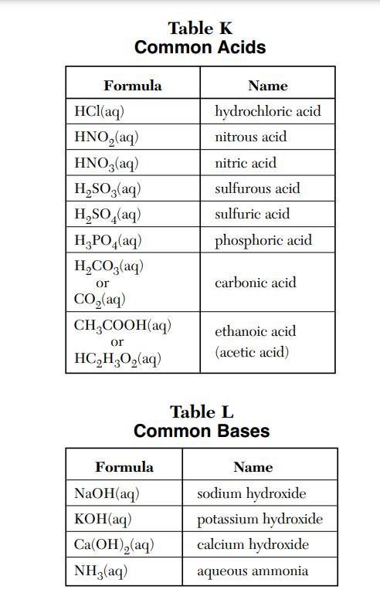
Mark up your tables now…
Best Electrolytes (most ions)
Weakest electrolytes
(fewer ions)
Best Electrolytes (most ions)
Weakest electrolytes (fewer ions)
Strongest acids
(most H⁺¹_{(AQ)})
Weakest acids
(most H⁺¹_{(AQ)})
Strongest bases
(most OH⁻¹_{(AQ)})
Weakest base (fewest OH⁻¹_{(AQ)})

Slide 13
Arrhenius theory states 1. that aqueous solutions with excess hydrogen ions are acids.
2. that aqueous solutions with excess hydroxide ions are bases.
And it goes on to say…
23. Acids + bases → a salt + water or: Acids + bases are neutralized into salt + water

Slide 14
24. Salts are ionic compounds (metal + nonmetal).
This type of chemical reaction is called the
Acid Base Neutralization Reaction.

Slide 15
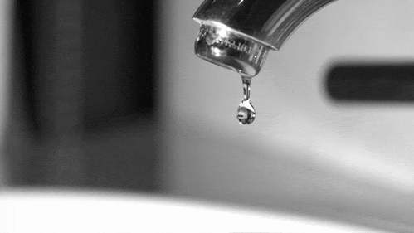
Water, wata, aqua, etc.
26. The formula for water is H₂0_{(L)}
27. That could also be HOH_{(L)}

Slide 16
28. Let’s balance the classic Acid Base Neutralization reaction first, then lots more…
HCl_{(AQ)} + NaOH_{(AQ)}
The hydrogen ion, and the hydroxide ion are both red. Those ions make the acid and the base. The acid ion and the base ion combine, and neutralize. The other ions make the salt.

Slide 17
28
HCl_{(AQ)} + NaOH_{(AQ)} NaCl_{(AQ)} + HOH_{(L)}
acid ion base ion acid/base neutralized
Left over “salt”, this time it is sodium chloride

Slide 18
Balance these acid base neutralization reactions, most of the formulas are on tables K and L.
29. Nitric acid + potassium hydroxide
30. Hydrochloric acid and calcium hydroxide

Slide 19
29. HNO_{3(AQ)} + KOH_{(AQ)} KNO_{3(AQ)} + HOH_{(L)}
acid ion + base ion → salt + acid/base neutralized
30. 2HCl_{(AQ)} + Ca(OH)_{2(AQ)} CaCl_{2(AQ)} + 2HOH_{(L)}

Slide 20
Balance these acid base neutralization reactions, most of the formulas are on tables K and L.
31. Phosphoric acid plus lithium hydroxide
32. Nitric Acid and Magnesium hydroxide

Slide 21
31. H₃PO_{4(AQ)} + 3LiOH_{(AQ)} Li₃PO_{4(AQ)} + 3HOH_{(L)}
acid ion + base ion → salt + acid/base neutralized
32. 2HNO_{3(AQ)} + Mg(OH)_{2(AQ)} Mg(NO₃)_{2(AQ)} + 2HOH_{(L)}

Slide 22
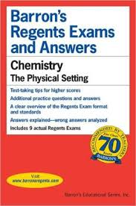
Read the Acid Base BASICS
Go to arbuiso.com and look at the side of the home page and find the acid base link. Click it: look over what’s there.
Buy a Red Barron’s Regents Review book as soon as possible.
The blue book is not as good and costs more money.

Slide 23
Acid Base Class # 2
OBJECTIVES: The alternate theory explaining ammonia,
pH: the strengths of acids and bases, and Acid base indicator chemicals

Slide 24
33.
99%
of acids and bases follow the ARRHENIUS theory. Acids have excess H⁺¹ ions in solution, while Bases have excess OH⁻¹ ions in solution. They combine into salt and water.
1%
Ammonia is a weak base, but does not follow the Arrhenius theory; it has no OH⁻¹ in it’s formula.
34. An alternate theory (Bronsted-Lowry Theory) defines ammonia as a base because of how it acts when put into water even though it has no hydroxide ions in it’s formula.
What follows on the next slide MUST be memorized. No questions, no exceptions, nothing. Memorize it or you will be sad.

Slide 25
NH_{3(G)} + HOH_{(L)} NH₄⁺¹_{(AQ)} + OH⁻¹_{(AQ)}
37. When put into water, only about 25% of the molecules of ammonia create ions. Most ammonia dissolves into water as a polar molecule and remains “whole”

Slide 26
Ammonia “ACCEPTS” a H⁺¹ ion, so it’s a base.
NH_{3(G)} + HOH_{(L)} NH₄⁺¹_{(AQ)} + OH⁻¹_{(AQ)}
Water “DONATES” a H⁺¹ ion, so it’s an acid.

Slide 27
Ammonia “ACCEPTS” a H⁺¹ ion, so it’s a base.
NH_{3(G)} + HOH_{(L)} NH₄⁺¹_{(AQ)} + OH⁻¹_{(AQ)}
Water “DONATES” a H⁺¹ ion, so it’s an acid.
It’s important to point this out… this is dopey but at the same time it’s not.
In high school chem, it’s the hydroxide ions in solution that make a base, and this solution of aqueous ammonia CLEARLY provides for that.
On the other hand, water is NEUTRAL, we all get that, and this “theory”, although correct, is too technical for beginners.
Any compound that “accepts a H⁺¹ cation” is a base, and any compound that can “donate this H⁺¹ cation” is an acid. Don’t fight it, memorize it. I’m not kidding.
It’s always a point on the regents exam, you will get it or you won’t, your choice.

Slide 28
38. Acid + base makes a salt and water. Finish the word equations, then BALANCE these.
Carbonic acid + lithium hydroxide →
H₂CO_{3(AQ)} + LiOH_{(AQ)} →

Slide 29
38. Acid + base makes a salt and water. Finish the word equations, then BALANCE these.
Carbonic acid + lithium hydroxide → lithium carbonate + water
H₂CO_{3(AQ)} + 2LiOH_{(AQ)} → Li₂CO_{3(AQ)} + 2HOH_{(L)}
Acetic acid + calcium hydroxide →

Slide 30
38. Acid + base makes a salt and water. Finish the word equations, then BALANCE these.
Carbonic acid + lithium hydroxide → lithium carbonate + water
H₂CO_{3(AQ)} + 2LiOH_{(AQ)} → Li₂CO_{3(AQ)} + 2HOH_{(L)}
Acetic acid + calcium hydroxide → calcium acetate + water
2HC₂H₃O_{2(AQ)} + Ca(OH) _{2(AQ)} → Ca(C₂H₃O₂)_{2(AQ)} + 2HOH_{(L)}
Phosphoric acid + sodium hydroxide →

Slide 31
38. Acid + base makes a salt and water. Finish the word equations, then BALANCE these.
Carbonic acid + lithium hydroxide → lithium carbonate + water
H₂CO_{3(AQ)} + 2LiOH_{(AQ)} → 2HOH_{(L)} + Li₂CO_{3(AQ)}
Acetic acid + calcium hydroxide → calcium acetate + water
2HC₂H₃O_{2(AQ)} + Ca(OH) _{2(AQ)} → Ca(C₂H₃O₂)_{2(AQ)} + 2HOH_{(L)}
Phosphoric acid + sodium hydroxide → sodium phosphate + water
H₃PO_{4(AQ)} + 3NaOH_{(AQ)} → Na₃PO_{4(AQ)} + 3HOH_{(L)}

Slide 32
Table M Acid Base Indicators
39. Acid Base indicators are compounds that change color, depending upon the pH (hydrogen ion concentration) of the solution. Acid Base Indicators are (mostly weak acids) that work by dynamic equilibrium.
The molecules are one color, the ions another. The “stress” of adding more acid, or more base, causes a LeChatlier shift forward or reverse.

Slide 33
40. Phenolphthalein works like this…
water
HC₂₀H₁₃O₄ H⁺¹_{(AQ)} + C₂₀H₁₃O₄⁻¹_{(AQ)}
The molecule is colorless the ion is HOT PINK!
ADD ACID H⁺¹ ions
ADD BASE OH⁻¹ ions

Slide 34
40. Phenolphthalein works like this…
water
HC₂₀H₁₃O₄ H⁺¹_{(AQ)} + C₂₀H₁₃O₄⁻¹_{(AQ)}
The molecule is colorless the ion is HOT PINK!
ADD ACID H⁺¹ ions
ADD BASE OH⁻¹ ions
It’s so important NOW to notice this:
Adding base ions is the SAME THING as removing H⁺¹ ions.
Base ions (hydroxides) combine with the acid ions forming water.
Adding base ions removes hydrogen ions. That is why this shift occurs.

Slide 35
41. This is Bromthymol blue indicator. It is also a weak acid, and “works” the same way as the phenolphthalein, but with different colors and at a different concentration of acid or base present.
water
HC₂₇H₂₇Br₂O₅S H⁺¹_{(AQ)} + C₂₇H₂₇Br₂O₅S⁻¹_{(AQ)}
YELLOW MOLECULE BLUE ANION
Becomes yellow Add acid H⁺¹
Add base OH⁻¹ becomes blue

Slide 36
41. This is Bromthymol blue indicator. It is also a weak acid, and “works” the same way as the phenolphthalein, but with different colors and at a different concentration of acid or base present.
water
HC₂₇H₂₇Br₂O₅S H⁺¹_{(AQ)} + C₂₇H₂₇Br₂O₅S⁻¹_{(AQ)}
YELLOW MOLECULE BLUE ANION
Becomes yellow Add acid H⁺¹
Add base OH⁻¹ Becomes blue

Slide 37
Find the titration math formula on the back of the reference table, and let’s FIX IT
Then we’ll explain.

Slide 38
Titration Formula
(Molarity of Acid ions)(volume of acid) = (molarity of Base ions)(volume of base)
(M_{A})(V_{A}) = (M_{B})(V_{B})
Change it to:
(#H⁺¹)(M_{A})(V_{A}) = (M_{B})(V_{B})(#OH⁻¹)

Slide 39
42. (#H⁺¹)(M_{A})(V_{A}) = (M_{B})(V_{B})(#OH⁻¹)
43. Where…
#H⁺¹ = # H⁺¹ ions in the acid formula
M_{A} is the molarity of this acid
V_{A} is the volume of this acid
M_{B} is the molarity of this base
V_{B} is the volume of this base #OH⁻¹ = # OH⁻¹ ions in the base formula

Slide 40
You have to know where you’re starting with either the acid or the base, you can only have one unknown.
44. If 7.91 mL of 1.25 M H₂CO_{3(AQ)} is neutralized by 16.2 mL of NaOH, what is the molarity of this base?
Write this formula, do the math.
(#H⁺¹)(M_{A})(V_{A}) = (M_{B})(V_{B})(#OH⁻¹)

Slide 41
44. If 7.91 mL of 1.25 M H₂CO_{3(AQ)} is neutralized by 16.2 mL of NaOH, what’s the molarity of this base? Write the formula, do the math.
(#H⁺¹)(M_{A})(V_{A}) = (M_{B})(V_{B})(#OH⁻¹)
(2)(1.25 M)(7.91 mL) = (M_{B})(16.2 mL)(1)

Slide 42
44. If 7.91 mL of 1.25 M H₂CO_{3(AQ)} is neutralized by 16.2 mL of NaOH, what’s the molarity of this base? Write the formula, do the math.
(#H⁺¹)(M_{A})(V_{A}) = (M_{B})(V_{B})(#OH⁻¹)
(2)(1.25 M)(7.91 mL) = (M_{B})(16.2 mL)(1)
19.775 = (M_{B})(16.2 mL)
1.22 M = (M_{B})

Slide 43
45. If 25.8 mL of HCl of 2.75 Molarity will neutralize 43.8 mL of calcium hydroxide, what is the molarity of this base?
Start with this formula…
(#H⁺¹)(M_{A})(V_{A}) = (M_{B})(V_{B})(#OH⁻¹)

Slide 44
45. If 25.8 mL of HCl of 2.75 Molarity will neutralize 43.8 mL of calcium hydroxide, what is the molarity of this base?
Start with the formula…
(#H⁺¹)(M_{A})(V_{A}) = (M_{B})(V_{B})(#OH⁻¹)
(1)(2.75 M)(25.8 mL) = (M_{B})(43.8 mL)(2) 0.810 M = M_{B}

Slide 45
46. It takes 12.4 mL of 1.90 M HCl to neutralize 104 mL of NaOH. What is the molarity of the base?
(#H⁺¹)(M_{A})(V_{A}) = (M_{B})(V_{B})(#OH⁻¹)

Slide 46
46. It takes 12.4 mL of 1.90 M HCl to neutralize 104 mL of NaOH. What is the molarity of the base?
(1)(M_{A})(V_{A}) = (M_{B})(V_{B})(1)

Slide 47
46. It takes 12.4 mL of 1.90 M HCl to neutralize 104 mL of NaOH. What is the molarity of the base?
(1)(M_{A})(V_{A}) = (M_{B})(V_{B})(1)
(1.90 M)(12.4 mL) = (M_{B})(104 mL)

Slide 48
46. It takes 12.4 mL of 1.90 M HCl to neutralize 104 mL of NaOH. What is the molarity of the base?
(1)(M_{A})(V_{A}) = (M_{B})(V_{B})(1)
(1.90 M)(12.4 mL) = (M_{B})(104 mL)
0.227 M = M_{B}
An important note here…

Slide 49
(1)(M_{A})(V_{A}) = (M_{B})(V_{B})(1)
(1.90 M)(12.4 mL) = (M_{B})(104 mL)
0.227 M = M_{B}
An important note here…
You’re not wasting your effort here by multiplying by (1) on both sides. You are reminding yourself that SOMETIMES the ACID:BASE ratios are not 1:1 and you are ALWAYS are being careful with the math.

Slide 50
CLASS 3: Measuring the strengths of acids & bases.
47. We will use the pH scale (little p, capital H) measures how acidic or basic a solution is.
48. It’s an odd scale, it runs 0-14.
49. A pH of 7 is perfectly “balanced” as neither acid or base. We call that NEUTRAL. Lower pH are acids, higher than 7 is a base.

Slide 51
50.
Strongest acids have LOW pH. Weaker acids are closer to pH 7.
0 1 2 3 4 5 6 7 8 9 10 11 12 13 14
pH

Slide 52
50.
Strongest acids have LOW pH. Weaker acids are closer to pH 7.
0 1 2 3 4 5 6 7 8 9 10 11 12 13 14
pH
Weaker bases are closer to pH 7. Strongest bases have HIGH pH.

Slide 53
50.
Strongest acids have LOW pH. Weaker acids are closer to pH 7.
0 1 2 3 4 5 6 7 8 9 10 11 12 13 14
pH
Weaker bases are closer to pH 7. Strongest bases have HIGH pH.
pH 7 means NOT ACID or BASE. The H⁺¹ ions = the OH⁻¹ ions exactly. If a solution has no ions at all, or if it has no H⁺¹ ions or OH⁻¹ ions, it’s neutral

Slide 54
51. First, the pH scale is a logarithm scale. That means small changes in numbers are really changes in EXPONENTS.
52. The pH scale is an exponent scale (liker the Richter scale) - each whole number change in pH is a 10X change in strength of the acid ions. An acid of pH 3.5 is 10X stronger than an acid of pH 4.5
A weak acid of pH 6.0 is much weaker than an acid with pH of 3.0, it’s 1000X weaker. Vinegar is pH 3, so even though it’s 1000X stronger acid than milk is, you can eat it and still be happy.
A lemon has juice with pH about 2.0 and a car battery has a pH 1.0. Stomach acid approaches pH of less than 1.

Slide 55
0 1 2 3 4 5 6 7 8 9 10 11 12 13 14
pH
Using this chart, let’s count how much stronger or weaker these solutions are from their partners in the chart. NOTE: acids are stronger than other acids, or weaker. Bases are compared to each other as well. We will not compare acids to bases (apples and oranges!). It can be done mathematically, but we’re just having fun!
Compare these solutions
ex | pH of solution A | pH of solution B | comparison
ex | 2.5 | 5.5 | 3 whole number change = 10x10x10 Solution A is 1000X more acidic than B

Slide 56
0 1 2 3 4 5 6 7 8 9 10 11 12 13 14
pH
 | pH of Solution A | pH of Solution B | compare these two
53 | 7.9 | 9.9 | 10x10 or solution A is 100x less basic than B
54 | 1.0 | 6.0
55 | 13.1 | 7.1
56 | 1.2 | 5.2

Slide 57
0 1 2 3 4 5 6 7 8 9 10 11 12 13 14
pH
 | pH of Solution A | pH of Solution B | compare these two
53 | 7.9 | 9.9 | 10x10 or solution A is 100x less basic than B
54 | 1.0 | 6.0
55 | 13.1 | 7.1
56 | 1.2 | 5.2

Slide 58
0 1 2 3 4 5 6 7 8 9 10 11 12 13 14
pH
 | pH of Solution A | pH of Solution B | compare these two
53 | 7.9 | 9.9 | 10x10 or solution A is 100x less basic than B
54 | 1.0 | 6.0 | 10x10x10x10x10 or solution A is 100,000X more acidic than solution B
55 | 13.1 | 7.1
56 | 1.2 | 5.2

Slide 59
0 1 2 3 4 5 6 7 8 9 10 11 12 13 14
pH
 | pH of Solution A | pH of Solution B | compare these two
53 | 7.9 | 9.9 | 10x10 or solution A is 100x less basic than B
54 | 1.0 | 6.0 | 10x10x10x10x10 or solution A is 100,000X more acidic than solution B
55 | 13.1 | 7.1
56 | 1.2 | 5.2

Slide 60
0 1 2 3 4 5 6 7 8 9 10 11 12 13 14
pH
 | pH of Solution A | pH of Solution B | compare these two
53 | 7.9 | 9.9 | 10x10 or solution A is 100x less basic than B
54 | 1.0 | 6.0 | 10x10x10x10x10 or solution A is 100,000X more acidic than solution B
55 | 13.1 | 7.1 | 10x10x10x10x10x10 or solution A is 1,000,000X more basic than solution B
56 | 1.2 | 5.2

Slide 61
0 1 2 3 4 5 6 7 8 9 10 11 12 13 14
pH
 | pH of Solution A | pH of Solution B | compare these two
53 | 7.9 | 9.9 | 10x10 or solution A is 100x less basic than B
54 | 1.0 | 6.0 | 10x10x10x10x10 or solution A is 100,000X more acidic than solution B
55 | 13.1 | 7.1 | 10x10x10x10x10x10 or solution A is 1,000,000X more basic than solution B
56 | 1.2 | 5.2

Slide 62
0 1 2 3 4 5 6 7 8 9 10 11 12 13 14
pH
 | pH of Solution A | pH of Solution B | compare these two
53 | 7.9 | 9.9 | 10x10 or solution A is 100x less basic than B
54 | 1.0 | 6.0 | 10x10x10x10x10 or solution A is 100,000X more acidic than solution B
55 | 13.1 | 7.1 | 10x10x10x10x10x10 or solution A is 1,000,000X more basic than solution B
56 | 1.2 | 5.2 | 10x10x10x10 or solution A is 10,000X more acidic than solution B

Slide 63
Measuring the strengths of acids and bases.
Let’s look at the math formula, which is not part of our class, but real.
57. pH = -log[H⁺¹]
58. Which means pH, the strength of an acid = to the negative logarithm of the Molarity of hydrogen ions

Slide 64
What the math means…
A pH of 0 means that the concentration of H⁺¹ in solution is 1x10⁰ moles H⁺¹/liter = 1 mole of H⁺¹ ions/liter
A pH of 1 means that the concentration of H⁺¹ in solution is 1x10⁻¹ moles H⁺¹/liter = one tenth of a mole of H⁺¹/liter
A pH of 2 means that the concentration of H⁺¹ in solution is 1x10⁻² moles H⁺¹/liter = one 100th of a mole of H⁺¹ /liter
It’s the negative of the exponent that is the pH.

Slide 65
H⁺¹ concentration
pH 14 =
pH 13 =
pH 10 =
pH 8.25 =
pH 7.99 =
1x10⁻¹⁴ moles H⁺¹ ions/liter
1x10⁻¹³ moles H⁺¹ ions/liter
1x10⁻¹⁰ moles H⁺¹ ions/liter
1x10^{-8.25} moles H⁺¹ ions/liter
1x10^{-7.99} moles H⁺¹ ions/liter
59. What ever the negative of the exponent of the molarity of the acid ions is, that’s the pH of the solution.

Slide 66
We do not have to do log math ever.
This is to show you that the numbers are based in real math and science, and not “made up”.
It’s all good, relax again.

Slide 67
In our class we will ONLY compare whole number pH differences. To compare an acid pH of 2.35 with a second acid of pH 5.44 would be TOO HARD for us. We do know that the first acid is more acidic than the second.
Next, how can we measure pH without numbers? We can use a variety of acid base indicators.
Take out Table M now.

Slide 68
In our class we will ONLY compare whole number pH differences. To compare an acid pH of 2.35 with a second acid of pH 5.44 would be TOO HARD for us. We do know that the first acid is more acidic than the second.
Next, how can we measure pH without numbers? We can use a variety of acid base indicators.
Take out Table M now.

Slide 69
Let’s look at METHYL ORANGE, the first indicator on table M.
3.1 4.4 7
60. This table CLEARLY says that Methyl Orange changes color from red to yellow between pH 3.1 and 4.4
All solutions with pH 3.1 or lower will be red with this indicator.
All solutions with pH above 4.4 will be yellow.
If by chance the solution is between pH 3.3 - pH 4.1 that solution presents as an “orangy” color.
61. Acid Base indicators “indicates” ranges of pH, not specific pH.

Slide 70
Table M, in order with approximate color changes
Methyl orange
Bromthymol blue
Phenolphthalein
Litmus
Bromcresol green
Thymol blue

Slide 71
Class 5
62. If 782.2 mL of KOH base to neutralize 1500. mL of sulfuric acid that has a 1.56 M, what is the molarity of this base? Hint: write the acid and base formula every time!

Slide 72
62. If 782.2 mL of KOH base to neutralize 1500. mL of sulfuric acid that has a 1.56 M, what is the molarity of this base? Sulfuric acid is H₂SO₄
(#H⁺¹)(M_{A})(V_{A}) = (M_{B})(V_{B})(#OH⁻¹)
(2)(M_{A})(V_{A}) = (M_{B})(V_{B})(1)
(2)(1.56 M)(1500. mL) = (M_{B})(782.2 mL)(1)
5.98 M = M_{B}

Slide 73
63. What volume of 3.75 M H₂SO_{4(AQ)} is necessary to exactly neutralize 34.7 liters of 1.88 M KOH?

Slide 74
63. What volume of 3.75 M H₂SO_{4(AQ)} is necessary to exactly neutralize 34.7 liters of 1.88 M KOH?
(#H⁺¹)(M_{A})(V_{A}) = (M_{B})(V_{B})(#OH⁻¹)
(2)(M_{A})(V_{A}) = (M_{B})(V_{B})(1)
(2)(3.75 M)(V_{A}) = (1.88 M)(34.7 L)(1)
V_{A} =
V_{A} = 8.70 Liters (3SF)
(1.88 M)(34.7 L)(1) (2)(3.75 M)

Slide 75
64 . 12.45 mL of 2.00 M H₃PO₄ is exactly neutralized with 25.33 mL Sr(OH)₂. What is the molarity of the base?

Slide 76
64. 12.45 mL of 2.00 M H₃PO₄ is exactly neutralized with 25.33 mL Sr(OH)₂. What is the molarity of the base?
(#H⁺¹)(M_{A})(V_{A}) = (M_{B})(V_{B})(#OH⁻¹)
(3)(M_{A})(V_{A}) = (M_{B})(V_{B})(2)
(3)(2.00 M)(12.45 mL) = (M_{B})(25.33 mL)(2)
= M_{B} = 1.47 M KOH
(3)(2.00 M)(12.45 mL) (25.33 mL)(2)

Slide 77
Acid Base Class #4
OB: some of the loose ends of acids + bases, reviewing how acid base indicators work, etc.

Slide 78
65. Acid Base indicators are mostly weak acids.
66. When you put these indicators into solutions containing H⁺¹ ions or OH⁻¹ ions, they will undergo a LeChatleier's Shift , shifting forward or reverse.
Let’s look at the molecule phenolphthalein, since we used it in lab.

Slide 79
Phenolphthalein is a weak acid, which means it’s a molecule with a H⁺¹ ion that sometimes ionizes off the molecule.
The formula for phenolphthalein is:
HC₂₀H₁₃O₄
Show the dissociation of phenolphthalein when it is put into H₂0

Slide 80
Phenolphthalein in dynamic equilibrium…
HC₂₀H₁₃O₄ H⁺¹_{(AQ)} + C₂₀H₁₃O₄⁻¹_{(AQ)}
water
colorless molecule pink anion
ADD BASE ADD ACID

Slide 81
The next slide contains the worst part of chemistry all year (for me). I must teach you this, I don’t understand why, there is NO NEED to try to grasp this other than it’s on the regents exam.
Forgive me, in advance.

Slide 82
Svante Arrhenius won a Nobel Prize for his theory of acids and bases.
Bronsted + Lowry made a name for themselves with ammonia being a base with their “alternate theory”.
Another way to “understand” acids is this silly idea… \ 67. The H⁺¹ ions from the acid “join” with the H₂O molecules forming hydronium ions: H⁺¹ + H₂O H₃O⁺¹

Slide 83
68. The acid exists as part of a water molecule, called the hydronium ion. The H⁺¹ ion becomes one with water.
You can believe this if you like, you might even see it on the regents, but it seems unnecessary, just extra vocabulary.
69. Hydronium ion: a theoretical model for acids, whereby the hydrogen ions become one with water and exists as H₃O⁺¹

Slide 84
70. 4 ways acids can be described
H⁺¹_{(AQ)} Svante Arrhenius was right
Any compound that donates a H⁺¹ ion, according to the Bronsted-Lowry theory (NH₃, ammonia is a base because it ACCEPTS a H⁺¹ ion)
H₃O⁺¹ the weirdo hydronium ion
p⁺¹ or just as protons (what really is a hydrogen ion, if a hydrogen ion is a proton plus an electron, and the electron ionizes away to an anion, all that’s left is a proton.)

Slide 85
71. Balance these chemical equations from these word equations…
Hydrochloric acid + calcium hydroxide yields…
Sulfuric acid + ammonium hydroxide yields…
Nitrous acid + lithium hydroxide yields…

Slide 86
71. Write 4 balanced chemical equations for these word equations…
2HCl_{(AQ)} + Ca(OH)_{2(AQ)} CaCl_{2(AQ)} + 2HOH_{(L)}
potassium chloride and water
H₂SO_{4(AQ)} + 2NH₄OH_{(AQ)} (NH₄)₂SO_{4(AQ)} + 2HOH_{(L)} ammonium sulfate and water
HNO_{2(AQ)} + LiOH_{(AQ)} LiNO_{2(AQ)} + HOH_{(L)} lithium nitrite and water

Slide 87
Take out reference tables and notes (start #72 today) Calculator too.
Acid Base HW’s due yesterday, today and tomorrow.
Wednesday is Acid Base Titration classwork, and the Titration Lab is going to be on Friday.
Celebration is still on Tuesday, all good.

Slide 88
72. Show the dissociation for sulfurous acid into water. Use phase symbols. 73. Show the dissociation of potassium hydroxide in water as well. Use phase symbols.

Slide 89
72 + 73. Show the dissociation for sulfurous acid into water, then the dissociation of potassium hydroxide in water as well. Use phase symbols.
H₂SO_{3(G)} H⁺¹_{(AQ)} + H⁺¹_{(AQ)} + SO₃⁻²_{(AQ)}
KOH_{(S)} K⁺¹_{(AQ)} + OH⁻¹ _{(AQ)}
water
water

Slide 90
74. How many milliliters of 1.25 M NaOH base can 12.0 mL of 2.50 M HCl acid neutralize?

Slide 91
75. How many milliliters of 1.25 M NaOH base can 12.0 mL of 2.50 M HCl acid neutralize?
(1)(M_{A})(V_{A}) = (M_{B})(V_{B})(1)
(1)(2.50 M)(12.0 mL) = (1.25 M)(V_{B})(1)
24.0 mL = V_{B}
This is an important time to point out that this acid is monoprotic (one H⁺¹) per molecule.
That word, monoprotic, is vocabulary now. The base is also a “single hydroxide” base.

Slide 92
75. How many mL of H₃PO₄ acid of 1.15 M is needed to exactly neutralize 56.0 mL of 2.50 M Mg(OH)₂?

Slide 93
75. How many mL of H₃PO₄ acid of 1.15 M is needed to exactly neutralize 56.0 mL of 2.50 M Mg(OH)₂? (triprotic acid, double base)
(3)(M_{A})(V_{A}) = (M_{B})(V_{B})(2)
(3)(1.15 M)(V_{A}) = (2.50 M)(56.0 mL)(2)
V_{A} = 81.2 mL

Slide 94
76. How many mL of 0.760 M NaOH is required to neutralize 145 mL of 4.33 M HCl acid?

Slide 95
76 . How many mL of 0.760 M NaOH is required to neutralize 145 mL of 4.33 M HCl acid?
(1)(M_{A})(V_{A}) = (M_{B})(V_{B})(1)
(4.33 M)(145 mL) = (0.760 M)(V_{B})
826 mL = V_{B}

Slide 96
Bromthymol Blue is an acid base indicator on table M, and it’s a weak acid. It does not dissociate well. It’s chemical formula be written as:
HC₂₇H₂₇Br₂O₅S
77. Show this in dynamic equilibrium with the hydrogen ion and its larger anion. The molecule in water is yellow, and in a base, the anion appears blue. Include that under your dynamic equilibrium as well.

Slide 97
water
HC₂₇H₂₇Br₂O₅S H⁺¹_{(AQ)} + C₂₇H₂₇Br₂O₅S⁻¹_{(AQ)}
YELLOW BLUE
Add base OH⁻¹
Add acid H⁺¹

Slide 98
water
HC₂₇H₂₇Br₂O₅S H⁺¹_{(AQ)} + C₂₇H₂₇Br₂O₅S⁻¹_{(AQ)}
YELLOW BLUE
Add base OH⁻¹
Add acid H⁺¹
LOOK AT TABLE M Bromthymol blue changes from yellow to blue from 6.0 to 7.6 Does this make sense? (yes)

Slide 99
78. Here are 3 problems in a row. You must write the formula, put in the correction multipliers where necessary, and fill in the formula’s second line. You do not have to complete the problems, just show the proper set up and formula.
You neutralize 134 mL of 2.45 M H₃PO_{4(AQ)} with 202 mL of KOH_{(AQ)}. What is the molarity of the base?
A bottle of 2,012 mL of 4.00 M NaOH_{(AQ)} is spilled in lab. You use a weak sulfuric acid of just 0.450 M to clean up. How many mL are used? 45.6 mL nitric acid is neutralized with 33.2 mL calcium hydroxide solution of 1.24 M. What is strength of the acid?

Slide 100
(#H⁺¹)(M_{A}V_{A}) = (M_{B}V_{B})(#OH⁻¹) (3)(2.45 M)(134 mL) = (M_{B})(202 mL)(1) (#H⁺¹)(M_{A}V_{A}) = (M_{B}V_{B})(#OH⁻¹) (2)(0.450 M)(V_{A}) = (4.00 M)(2012 mL)(1) sulfuric acid is DIPROTIC (two ions per molecule)
(#H⁺¹)(M_{A}V_{A}) = (M_{B}V_{B})(#OH⁻¹) (1)(M_{A})(45.6 mL) = (1.24 M)(33.2 mL)(2)
78.

Slide 101
[H⁺¹]
[OH⁻¹]
0 7 14
acids The pH scale bases
79. Draw this diagram above. Write that stuff below. Strong acids H⁺¹ ions > OH⁻¹ ions Strong bases H⁺¹ ions < OH⁻¹ ions
At neutral pH 7.0 the H⁺¹ = OH⁻¹ (or there are no ions)

Slide 102
At pH 2.5 the hydrogen ion concentration is
1 x 10^{-2.5} moles H⁺¹ ions per liter of solution.
Make sure, right now, you see where the exponent goes when describing the pH.
What is the pH of these 2 solutions?
80: 1 x 10^{-6.5} moles H⁺¹ ions per liter of solution.
81: 1x 10^{-11.3} moles H⁺¹ ions per liter of solution.

Slide 103
What is the pH of these 2 solutions?
80: 1 x 10^{-6.5} moles H⁺¹ ions per liter of solution.
This solution has a pH of 6.5
81: 1x 10^{-11.3} moles H⁺¹ ions per liter of solution.
This solution has a pH of 11.3

Slide 104
HELLO! Today, notes 82 to the end.
Tomorrow is the Acid Base Titration Lab
Acid Base HW due now. Celebration is Tuesday.
Do your back lab reports ASAP
So far only 5 students qualify for the regents exam.

Slide 105
Let’s compare solutions on the left, to solutions on the right.
 | Solution 1 | Solution 2 | Solution 1 is…
ex | pH 4.3 | pH 6.3 | 100x more acidic
82 | pH 11.2 | pH 13.2
83 | pH 1.2 | pH 0.2
84 | pH 12.0 | pH 8.0
85 | pH 1.3 | pH 6.3

Slide 106
Let’s compare solutions on the left, to solutions on the right. Copy these 5 pairs, then use the example to do 128 →
 | Solution 1 | Solution 2 | Solution 1 is…
ex | pH 4.3 | pH 6.3 | 100x more acidic
82 | pH 11.2 | pH 13.2 | 100 x less basic
83 | pH 1.2 | pH 0.2 | 10x less acidic
84 | pH 12.0 | pH 8.0 | 10,000x more basic
85 | pH 1.3 | pH 6.3 | 100,000x more acidic

Slide 107
Acid Base Indicator Color changes. What color would each be?
Methyl orange indicator into an ammonia solution.
Bromthymol blue indicator into vinegar.
Thymol blue into your deionized water.
Litmus into your potassium hydroxide.
Bromcresol green into Mr. Arbuiso’s Mixed Berry seltzer.

Slide 108
Acid Base Indicator Color changes. What color would each be?
Methyl orange indicator into an ammonia solution. YELLOW
Bromthymol blue indicator into vinegar. YELLOW
Thymol blue into your deionized water. YELLOW
Litmus into your potassium hydroxide. BLUE
Bromcresol green into Mr. Arbuiso’s Watermelon seltzer. PROBABLY BLUE, it’s a really weak acid, and you get detention now for ruining a good can of seltzer!

Slide 109
87. Finish this drawing, include all arrows and labels, to completely outline how ammonia is a base according to the Bronsted-Lowry Theory… Include 2 clear sentences that explain why ammonia is a base, and what the heck water is here.
NH_{3(G)} + H₂O_{(L)}

Slide 110
87.
NH₃ + H₂O NH_{4(AQ)}⁺¹ + OH⁻¹_{(AQ)}
Ammonia accepts the H⁺¹ ion, NH₃ is a base
Water donates the H⁺¹ ion, therefore water is an acid
We really know that Svante was so smart, it’s the left over hydroxides that form the base properties, including being slippery on your fingers. THE PRODUCTS ARE BOTH IONS!

Slide 111
Thymol Blue is an acid base indicator, it’s a weak acid. It’s formula is: HC₂₇H₂₉O₅S
88. Show the dissociation of this weak acid in water, then stress it with adding acid and then adding base. What is the color of the molecule, what color is the anion?

Slide 112
Thymol Blue is an acid base indicator, it’s a weak acid. It’s formula is: HC₂₇H₂₉O₅S
Show the dissociation of this weak acid in water, then stress it with adding acid and then adding base. What is the color of the molecule, what color is the anion?
HC₂₇H₂₉O₅S H⁺¹ + C₂₇H₂₉O₅S⁻¹
Add acid
Add base
Molecule is Anion is Yellow Blue
water
Between 8.0 and 9.6 it is a shade of green

Slide 113
Thymol Blue is an acid base indicator, it’s a weak acid. It’s formula is: HC₂₇H₂₉O₅S
Show the dissociation of this weak acid in water, then stress it with adding acid and then adding base. What is the color of the molecule, what color is the anion?
HC₂₇H₂₉O₅S H⁺¹ + C₂₇H₂₉O₅S⁻¹
Add acid
Add base
Molecule is Anion is Yellow Blue
water
Between 8.0 and 9.6 it is a shade of green

Slide 114
Methyl Orange is an acid base indicator, it’s a weak acid. It’s formula is: HC₁₄H₁₃N₃NaO₃S
89. Show the dissociation of this weak acid in water, then stress it with adding acid and then adding base. What is the color of the molecule, what color is the anion?

Slide 115
Methyl Orange is an acid base indicator, it’s a weak acid. It’s formula is: HC₁₄H₁₃N₃NaO₃S
Show the dissociation of this weak acid in water, then stress it with adding acid and then adding base. What is the color of the molecule, what color is the anion?
HC₁₄H₁₃N₃NaO₃S H⁺¹ + C₁₄H₁₃N₃NaO₃S⁻¹
Add acid
Add base
Molecule is RED
water
Between 3.1 and 4.4 it is a shade of orange
Anion is YELLOW

Slide 116
HC₁₄H₁₃N₃NaO₃S H⁺¹ + C₁₄H₁₃N₃NaO₃S⁻¹
Add acid
Add base
water
This works the same way, adding acid means adding H⁺¹ ions, which encourages the reverse reaction.
Adding base OH⁻¹ ions is the same as removing the acid H⁺¹ ions, as they get converted into water. The forward reaction continues.

Slide 117
90. There are 4 ways to describe an acid. Go
1.
2.
3.
4.

Slide 118
There are 4 ways to describe an acid. Go
1. As H⁺¹_{(AQ)} as per Svante
2. As protons in water as per the hipsters
3. As compounds that can donate H⁺¹ ions, like the HOH in the alternate theory (Bronsted-Lowry)
4. As the dreaded H₃O⁺¹ cations (be one with the water)

Slide 119
91. How many hydrogen ions are present per liter in a solution with a pH of 3.0?
This is hard

Slide 120
91. How many hydrogen ions are present per liter in a solution with a pH of 3.0?
This is hard
The molarity of H⁺¹ is 1 x 10⁻³ moles per liter.
That is one-thousandth of a mole.
1 mole has 6.02 x 10²³ hydrogen ions.
One- thousandth of that is 6.02 x 10²⁰ hydrogen ions.

Slide 121
92. Show the dissociation of a strong acid like HCl and a weak acid like ethanoic acid in dynamic equilibrium.
HCl
HC₂H₃O₂
Think : put ONE MOLE
of each of these into water.

Slide 122
92. Show the dissociation of a strong acid like HCl and a weak acid like ethanoic acid in dynamic equilibrium.
HCl H⁺¹_{(AQ)} + Cl⁻¹_{(AQ)}
HC₂H₃O₂ H⁺¹_{(AQ)} + C₂H₃O₂⁻¹_{(AQ)}
Think : put ONE MOLE
of each of these into water.

Slide 123
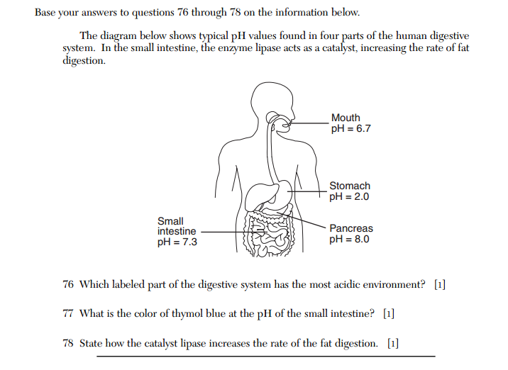
June 2012 Regents problems.
Note: it looks like Biology, they love to “mix” things up like this.
It’s all easy chem, go slowly.

Slide 124
Stomach
A pH 7.3 makes it yellow
Catalysts decrease the activation energy or offer an alternate pathway forward. Do not say it speeds up the reaction! (of course it does, answer the question!)

