Slide 1
Thermochemistry
1. The chemistry that measures the energy (HEAT) released or absorbed in a chemical reaction, or during melting or freezing, or condensing or vaporizing of substances, or even in the formation of solutions.
2. Thermo = heat, the energy changes that happen in a chemical reaction.
3. Sometimes heat is given off which is exothermic
4. Sometimes energy is absorbed to make the reaction happen, this is endothermic.

Slide 2
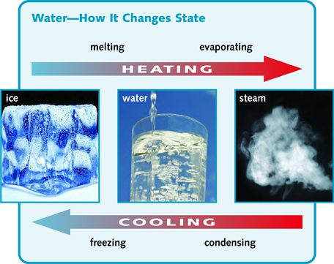
You must ADD energy to melt solids → liquid ex: H₂O_{(S)} → H₂O_{(L)}
You must REMOVE energy to freeze liquid → solid ex: H₂O_{(L)} → H₂O_{(S)}
You must ADD energy to vaporize liquid → gas ex: H₂O_{(L)} → H₂O_{(G)}
You must REMOVE energy to condense gas → liquid ex: H₂O_{(G)} → H₂O_{(L)}

Slide 3
Heating Curve
F
D
BP
E
9. On a heating curve, temperature goes up and so does the kinetic energy during AB, CD, and EF
B
MP
C
A
Heat added at a constant rate →

Slide 4
Heating Curve
F
D
BP
E
10. On a heating curve, temperature is steady, and so is the KE during BC and DE. The POTENTIAL ENERGY RISES here.
B
MP
C
A
Heat added at a constant rate →

Slide 5
A
Cooling curve
C
CP
B
K E L V I N
11. On a cooling curve, temperature goes down and so does the kinetic energy during AB, CD, and EF
E
FP
D
F
Heat removed at a constant rate (time)

Slide 6
A
Cooling curve
C
CP
B
K E L V I N
12. On a cooling curve, temperature is steady and so is the kinetic energy during BC and DE. The POTENTIAL ENERGY decreases here.
E
FP
D
F
Heat removed at a constant rate (time)

Slide 7
14. Thermochem is part of how much energy it takes to melt, or warm up, or vaporize a substance on a heating curve.
15. Thermochem is also part of how much energy it takes to condense, cool down, or freeze a substance on a cooling curve.
16. Even though we won’t do much work below freezing, substances like ICE or any other solids can be really cold or warmer, but remain solid. For example: Antarctic ice can be as cold as 235 Kelvin, while in Vestal the ice hardly gets colder than 260 Kelvin. Ice could be warmed up from 235 K to 260 K and still be ice (solid and cold).
17. And, steam (water gas) forms at 373 Kelvin, but it could also get to be much hotter. Really hot steam could cool down from 425 K to 395 K but still be gas. Hot steam to cool steam, but steam still.
18. Thermochem measures all of that energy (and more).

Slide 8
19. Thermochem will also help us to measure the amount of heat released in a chemical reaction (exothermic) or how much heat is absorbed in a chemical reaction (endothermic).
20. How much heat is going to be very mathematical when we get to in next week. It’s called the DELTA H written as this: ΔH that is THE CHANGE IN HEAT 21. The energy is IN PROPORTION to the mole ratio, so we can do math (stoichiometry) to the chemical and energy parts of a balanced thermochemical equation.

Slide 9
22. Table B contains 3 important (new) Physical Constants for H₂O 23. H_{F} is the heat of fusion constant. This is the energy that must be REMOVED to freeze one gram of water at 273 K or 0°C or to be ADDED to melt one gram of ice.
Every substance has its own H_{F}
The 334 Joules/gram is the constant for H₂O.
Table B
Physical Constants for Water
Heat of Fusion | 334 J/g
Heat of Vaporization | 2260 J/g
Specific Heat Capacity of H₂O_{(L)} | 4.18 J/g·K

Slide 10
26. H_{V} is the heat of vaporization constant. This is the energy that must be REMOVED to condense 1 gram of steam at 373 K or 100°C or to be ADDED to vaporize 1 gram of water.
27. Every substance has its own H_{V}
28. The 2260 Joules/gram is the constant for H₂O.
Table B
Physical Constants for Water
Heat of Fusion | 334 J/g
Heat of Vaporization | 2260 J/g
Specific Heat Capacity of H₂O_{(L)} | 4.18 J/g·K

Slide 11
29. Capital “C” is the specific heat capacity constant for water. This is the energy required to change the temperature of 1 gram of LIQUID water by 1 K or 1°C
30. Every substance has its own “C” value
31. The 4.18 J/g·K is the constant for Liquid H₂O.
Table B
Physical Constants for Water
Heat of Fusion | 334 J/g
Heat of Vaporization | 2260 J/g
Specific Heat Capacity of H₂O_{(L)} | 4.18 J/g·K

Slide 12
32. Liquid water has a rather HIGH C value. It’s hard to change the temperature of water because it requires a lot of joules per gram. For example, metals like IRON have a C = 0.45 J/g·K
That is why a swimming pool (around here) needs a heater, the Sun just can’t warm it up quickly.
Table B
Physical Constants for Water
Heat of Fusion | 334 J/g
Heat of Vaporization | 2260 J/g
Specific Heat Capacity of H₂O_{(L)} | 4.18 J/g·K

Slide 13
Heating Curve for 1 gram H₂O
F
D
BP
E
33. Fill in table
BC | melting | 334 J/g
CD | warming | 4.18 J/g·K
DE | vaporizing | 2260 J/g
B
MP
C
A
Heat added at a constant rate →
34. The reason BC < DE is because if heat is being added AT A CONSTANT RATE, then it takes less time to add 334 J/g than it does to add 2260 J/g. (obviously!)

Slide 14
Cooling curve for 1 gram of H₂O
A
B
C
CP
35. Fill in table
BC | condensing | 2260 J/g
CD | cooling | 4.18 J/g·K
DE | freezing | 334 J/g
E
FP
D
F
Heat removed at a constant rate (time)
36. The reason BC > DE is because if heat is being removed AT A CONSTANT RATE, then it takes more time to remove 2260 J/g than it does to remove 334 J/g. (obviously!)

Slide 15
ENERGY UNIT CONVERSIONS
37. There are 4 units for energy in our class. Joules we have noticed in our constants so we’ll get to them second.
(did that make sense?)(ha!)

Slide 16
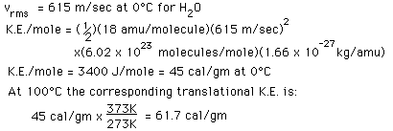
We’ll start at the beginning to make it easy…
Kidding!

Slide 17
38. A calorie is the amount of energy required to raise the temperature of one gram of pure water by exactly 1 Kelvin or 1.0°Centigrade.
39. This is a lower case “c” calorie. A FOOD CALORIE sounds like a calorie, but it is different (sorry).

Slide 18
A calorie is a small amount of energy. Imagine, one gram of water, about 5 droplets, and the amount of energy required to make it go from 294 K to just 295 K is one calorie.
That’s really the same as it changing from 21°C to 22°C (you can do the math if you don’t believe me.
A FOOD CALORIE is really a kilo-calorie 1 Calorie = 1000 calories
We will use “cal” for calories, and Calories for Calories 1 C = 1000 cal

Slide 19
It takes 1000 cal = 1 Calorie
A joule is tiny. It takes 4.18 Joules = 1 cal
1000 joules is called a KILO-JOULE
Under Table B, in small ink, write these out: 4.18 J = 1 cal 1000 cal = 1 C 1000 joules = 1 kJ

Slide 20
48. You will get used to these units. In size order, from BIGGEST to smallest, here goes: 1 C > 1 kJ > 1 cal > 1 joule
We will be doing some MATH practice now, converting units of energy to other units. Get a calculator, go slowly, make conversion factors from your equalities under Table B, talk to your friends, cross your fingers.

Slide 21
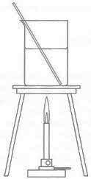
49. It takes 354 calories to make 354 g H₂O at 7°C to warm to 8°C. How many joules is 354 cal?
7°C
354 mL

Slide 22
49. It takes 354 calories to make 354 g H₂O at 7°C to warm to 8°C. How many joules is 354 cal?
354 cal 1
4.18 Joules 1 cal
X
= 1479.72 cal = 1480 cal (3 SF)

Slide 23
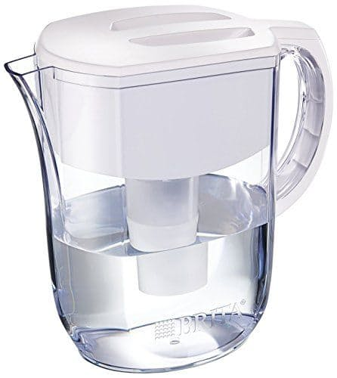
50. If you remove 5675 cal from 5675 g of H₂O at 297 K, it will cool to 296 K. How many Food Calories is 5675 cal?
Put me in the fridge!

Slide 24
50. If you remove 5675 cal from 5675 g of H₂O at 297 K, it will cool to 296 K. How many Food Calories is 5675 cal?
5675 cal 1
1 C 1000 cal
X
= 5.675 C (4 SF)

Slide 25
51. Convert 3429 cal into kilojoules. (kJ)

Slide 26
51. Convert 3429 cal into kilojoules. (kJ) 3429 cal 1 14300 J 1
4.18 J 1 cal
X
= 14333.22 J = 14300 J
1 kJ 1000 J
X
= 14.3 kJ (3 SF)

Slide 27
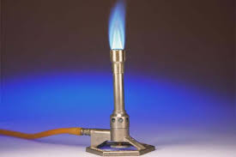
52. When one mole of methane (CH₄) combusts at room temperature, exactly 890.4 kJ are released in this exothermic reaction. Convert 890.4 kJ into cal.

Slide 28
52. When one mole of methane (CH₄) combusts at room temperature, exactly 890.4 kJ are released in this exothermic reaction. Convert 890.4 kJ into cal. 890.4 kJ 1 890,400 J 1
1000 J 1 kJ
X
= 890,400 J
1 cal 4.18 J
X
= 21304 cal (4 SF L)

Slide 29
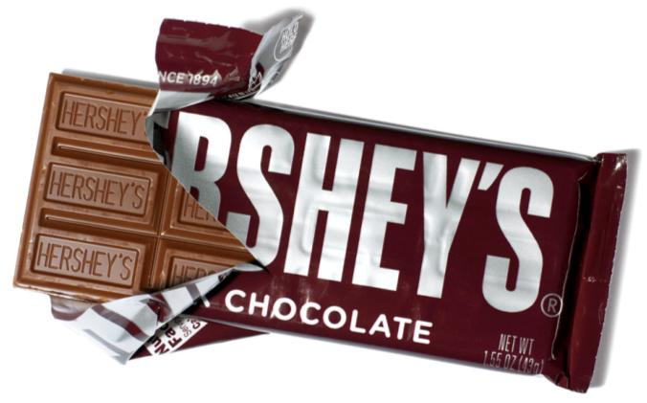
53. There are 225 Calories in a medium sized Hershey bar. Convert 225 C into joules.

Slide 30
53. There are 226 Calories in a medium sized Hershey bar. Convert 225 C into joules. 226 C 1 226,000 cal 1
1000 cal 1 C
X
= 226,000 cal
4.18 J 1 cal
X
= 944,680 J = 945,000 J (3 SF)

Slide 31
To melt ice it takes 334 Joules/gram. To melt lots of grams takes a formula and a calculator. LOOK at the back of the reference table, find HEAT. There are 3 heat (thermochem) formulas to review now.

Slide 32
55. The three formulas are as follows: q = mCΔT q = mH_{F} q = mH_{V}
FILL INTO your notes
q = the HEAT in joules
m = the MASS in grams
C = the Specific Heat Capacity Constant
ΔT = the CHANGE IN TEMP
H_{F} = the Heat of Fusion Constant
H_{V} = the Heat of Vaporization Constant

Slide 33
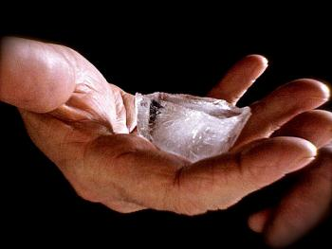
56. How many joules of energy does it take to melt an ice cube of 83.0 grams? q = mH_{F} This means that the energy (q) would be equal to the mass of the ice cube (83.0 g) times the heat of fusion constant (the amount of energy required to melt EACH gram of ice, which is 334 J/g). DO THE MATH NOW, 3 SF.

Slide 34
56. How many joules of energy does it take to melt an ice cube of 83.0 grams? q = mH_{F} q = (83.0g)(334 J/g) q = 27722 J q = 27,700 J (3 SF) Each gram gets the 334 J to melt

Slide 35
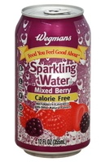
57. How many joules of energy are required to freeze 355 mL of water at 273K?

Slide 36
57. How many joules of energy are required to freeze 355 mL of water at 273K? q = mH_{F} q = (355 g)(334 J/g) = 118,570 J = 119,000 J (3 SF)

Slide 37
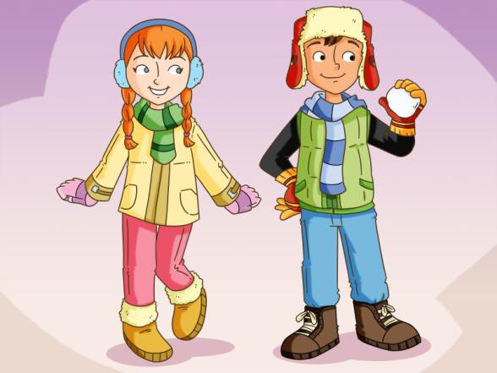
58. How many joules required to melt a snow ball of 415 g?

Slide 38
58. How many joules required to melt a snow ball of 415 g? q = mH_{F} q = (415 g)(334 J/g) = 138,610 J = 139,000 J (3 SF) This is just plain easy. Use the correct formula.

Slide 39
59. This is important: Use the q = mH_{F} formula ONLY when stuff is melting or freezing. For water, this is at 273 K or 0°C. If your stuff is condensing, or vaporizing, at the HOT PHASE CHANGE TEMP, for water 373 K or 100°C, then use the other formula: q = mH_{V}

Slide 40
60. When 12.5 grams of water at 373 K but still liquid - is vaporized, how many joules does it take to blow it apart into a gas? Use the Heat of Vaporization formula q = mH_{V} (do the math now)

Slide 41
60. When 12.5 grams of water at 373 K but still liquid - is vaporized, how many joules does it take to blow it apart into a gas? q = mH_{V} = (12.5 g)(2260 J/g) = 28250 J = 28300 J (3 SF)

Slide 42
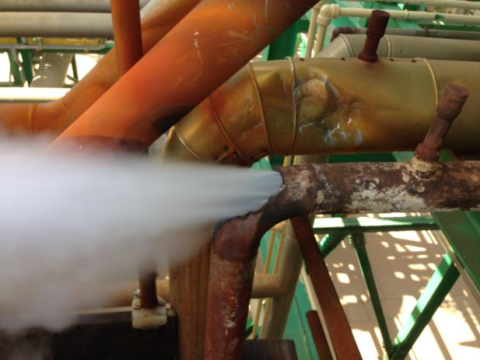
61. A big steam pipe breaks and releases 625 grams of steam onto a wall. How much energy is released when the steam condenses? Use q = mH_{V} (do the math now)

Slide 43
61. A big steam pipe breaks and releases 625 grams of steam onto a wall. How much energy is released when the steam condenses? q = mH_{V} q = (625 g)(2260 J/g) = 1,412,500 J = 1,410,000 J (3 SF)

Slide 44
62. Making water change temperature (or any substance really) is DIFFERENT than phase changing it. There is a temperature change, and requires a formula that takes that temperature change into account. The change in temperature is called the ΔT.

Slide 45
63. FOR BC, use q = mH_{F} FOR DE, use q = mH_{V}
F
Heating Curve
D
BP
E
64. FOR CD, there is a temperature change, so we need to use the OTHER formula - with ΔT
B
MP
C
A
Heat added at a constant rate →

Slide 46
65. How much energy is needed to be removed to cool a glass of water (325 grams) from (room temp) 296 K down to “drinkable-cool” of 284 K? Use q = mCΔT

Slide 47
65. How much energy is needed to be removed to cool a glass of water (325 grams) from (room temp) 296 K down to “drinkable-cool” of 284 K? Use q = mCΔT q = (325 g)(4.18 J/g·K)(12.0 K) q = 16302 J = 16300 J (3 SF)

Slide 48
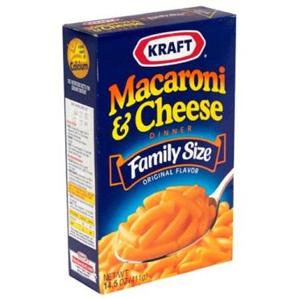
66. A pot holds 650. grams of water at room temperature (24.0°C) You think to make some mac and cheese and turn on the stove to heat the water. It heats up to 95.0°C when your BFF shows up with pizza and you turn off the stove. How much energy would your Dad say you wasted heating up this water for nothing?
Let’s find out: q = mCΔT

Slide 49
66. A pot holds 650. grams of water at room temperature (24.0°C) You think to make some mac and cheese and turn on the stove to heat the water. It heats up to 95.0°C when your BFF shows up with pizza and you turn off the stove. How much energy would your Dad say you wasted heating up this water for nothing?
See that?
q = mCΔT q = (650. g)(4.18 J/g·K)(71.0K)
q = 192,907 J = 193,000 J (3 SF)

Slide 50
67. In this problem, the water changes temperature from 24.0 to 95.0°C If we convert those temps first, the water changes from 297 K to 368 K. The ΔT = 71.0 Kelvin (3 SF)
95.0 – 24.0°C = 71.0°C (3 SF) The change in temp is the same even though the actual numerals are different.
Centigrade is NOT the same as Kelvin, but the change in C is equal to the change in K.

Slide 51
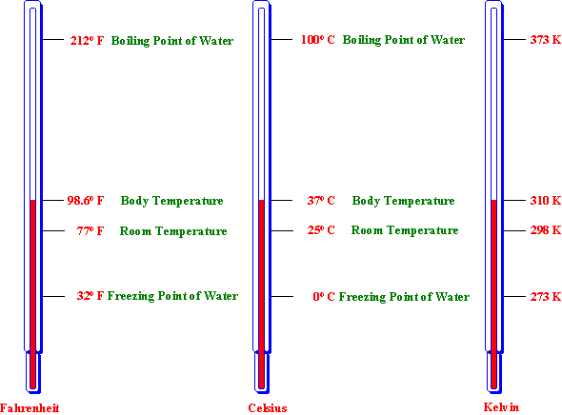
68. If water changes from 0° to 25°C, the ΔT is 25°C (look)
69. If water changes from 273 to 298 K, the ΔT is 25 Kelvin (look)
70. This is important! 273 ≠ 0 and 25 ≠ 298, but the difference between 0 to 25 and 273 to 298 is 25 both times!
71. The ΔT Kelvin = ΔT°Centigrade

Slide 52
72. If there is a change of temperature, there is ONLY one formula to choose.
73. If there is melting or freezing, there is ONLY one formula to choose.
74. If there is condensing or vaporizing, there is ONLY one formula to choose.
75. Choose wisely, you must. Temperature change q = mCΔT Melting/Freezing q = mH_{F}
Condensing/Vaporizing q = mH_{V}

Slide 53
76. When something like iron melts, it has its own melting point which is sort of high compared to water. It has its own heat of fusion constant too.
77. When you warm up iron on the way to melting it, it takes a certain amount of energy to make each gram get hotter by 1 Kelvin or by 1° centigrade. Every substance has it’s own specific heat capacity constant.
78. Every substance has a unique H_{F}, H_{V}, and a unique “C” constant.
Even though we do not have a list of them in the reference tables, using our formulas, we can solve for them with the info inside of a problem, or if we are given them in the problem, use them in the proper formulas. We can also solve for m, H_{F}, H_{V}, C, and ΔT. Let’s practice that now.

Slide 54
79. How many grams of water can be frozen when you remove 87,500 joules from it?

Slide 55
79. How many grams of water can be frozen when you remove 87,500 joules from it? q = mH_{F} 87,500 J = (m)(334 J/g)
87,500 J 334 J/g
= m 261.976 g = 262 grams (3 SF)

Slide 56
80. How many grams of water can be heated by 25.5 K when it absorbs 17,500 joules?

Slide 57
80. How many grams of water can be heated by 25.5 K when it absorbs 17,500 joules?
q = mCΔT 17,500 J = (m)(4.18 J/g·K)(25.5 K) 17,500 J (4.18 J/g·K)(25.5 K) 17,500 J 106.59J/g
= m = m = 164 grams (3 SF)

Slide 58
81. What is the HEAT OF FUSION for candle wax if it takes 3388 Joules to melt a whole birthday candle with mass of 23.04 grams?

Slide 59
81. What is the HEAT OF FUSION for candle wax if it takes 3388 Joules to melt a whole birthday candle with mass of 23.04 grams? q = mH_{F} 3388 J = (23.04 g)(H_{F}) 3366 J 23.014 g
= H_{F} = 147.0 J/g

Slide 60
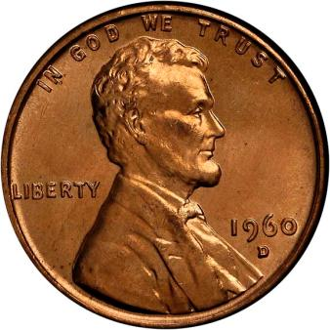
82. What is the C of Cu, if it takes 951 joules to warm up 41.63 grams of copper from 294.5 K up to 352.9 Kelvin?

Slide 61
82. What is the C of Cu, if it takes 951 joules to warm up 41.63 grams of copper from 294.5 K up to 352.9 Kelvin? q = mCΔT 951 J = (41.63 g)(C)(58.40 K) 951 J (41.63 g)(58.40 K)
= C = 0.391 J/g·K 3 SF

Slide 62
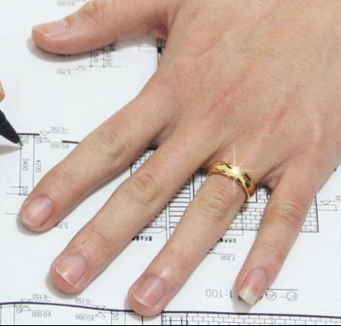
83. What is the specific heat capacity constant for GOLD if it takes 271 joules to warm up a ring with mass of 34.2 g from room temp (294.0 K) to a “too hot to wear” temperature of 355.5 Kelvin?

Slide 63
83. What is the specific heat capacity constant for GOLD if it takes 271 joules to warm up a ring with mass of 34.2 g from room temp (294.0 K) to a “too hot to wear” temperature of 355.5 Kelvin? q = mCΔT 271 J = (34.2 g)(C)(61.5 K) 271 J (34.2 g)(61.5 K)
= C = C (3 SF)
0.129 J/g·K

Slide 64
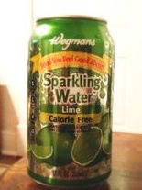
84. When a 355 mL can of seltzer, is warmed from a temperature of 293 K by adding 64,000 Joules of energy to it, what is the final temperature? Assume the seltzer is just water.

Slide 65
84. When a 355 mL can of seltzer, is warmed from a temperature of 293 K by adding 64,000 Joules of energy to it, what is the final temperature? Assume the seltzer is just water. q = mCΔT 64,000 J = (355 g)(4.18 J/g·K)(ΔT) 64,000 J (355 g)(4.18 J/g·K) 64,000 J 1483.9 J/K
= ΔT = ΔT = 43 K
293 K + 43 K 336 K SF L

Slide 66
85. When 51.1 g copper at 381.5 K emits 1788 Joules, it cools down. What is the final temp if C_{Cu} = 0.391 J/g·K ?

Slide 67
85. When 51.1 g Cu at 381.5 K emits 1788 Joules, it cools down. What is the final temp if C_{Cu} = 0.391 J/g·K ? q = mCΔT 1788 J = (51.1 g)(0.391 J/g·K)(ΔT) 1788 J 19.9801 J/g·K
= ΔT = 89.4 K
381.5 K - 89.4 K 292 K

Slide 68
The C of Cu Lab Explained
Copper, like all substances has a specific heat capacity constant.
That is the amount of energy to change the temperature of one gram of copper by 1 Kelvin, or 1°C.
It can heat up, or cool off, the energy is the same. It either is added to HEAT UP, or removed to COOL DOWN.

Slide 69
We are going to heat up a mass of copper. We will know how many grams we start with. It goes into a test tube, dry, and that tube goes into BOILING water for about 9 minutes.
After that time, the heat of the water will transfer to the copper. We will be able to assume that the temperature of the copper is the same temperature as the water is.
We can’t take the temperature of the copper directly, it’s pellets. After that time we can be sure that the energy has transferred equally into the copper.
Remember this:
Energy cannot be created or destroyed in a chemical reaction, or a physical change, but it can be transferred.
It’s happen here in this lab.

Slide 70
We will have to pout this HOT COPPER into the styrofoam cup system that we will discuss now.
Take a larger styrofoam cup, and fill it half way with deionized water. Mass the water exactly. Put a smaller cup on top, and stick a thermometer through the top. Measure the water temp carefully, to the nearest 10th degree centigrade.
THINK hard now. You know the mass of the water, you measured the temperature of this water, and you know that water has a C = 4.18 J/g·K
If something were to make that water hotter (say some HOT COPPER you could pour in) you could measure the temperature change (the ΔT)

Slide 71
If you know the mass of water, the C for water, and the ΔT for water, you could calculate the number of joules it took to make that change in the water with q = mCΔT. (right? Yes, you could!)
Where did that energy come from to make the water hotter?

Slide 72
Of course it came from the HOT COPPER you just shot into it. The energy came from the copper, so you know how many joules it provided.
Think again: do you know the mass of the copper? How about the ΔT for the copper? (yes, the starting HOT temp for the copper, and the coldest the copper gets, which is the hottest the water gets).
Using the q = mCΔT again, you can solve for the C of Cu.
It’s really 0.391 J/gK, now do your percent error.

Slide 73
86. There is no easy way to directly measure the energy that is in food. An indirect way has been well figured out, using a machine called a calorimeter.
The food is burned up in a sealed box containing oxygen, and the heat that it gives off, the energy that is inside the food, is used to heat pure water. This water is carefully measured, and the energy gained by the water changes its temperature. This temperature change is pushed through our q = mC∆T formula, and you can calculate the number of joules it took to heat up the water, and then convert the joules into cal, then into calories.
It seems harder than it is, but it is easy enough to do tomorrow.
In our Dorito’s Lab we will use a five cent calorimter machine. Real calorimeters are much more complex, and insulated. They measure all of the energy gain, we will “do” the same thing, but MOST of our energy will get lost to the air.
We’ll do the same process, just get poor results. Terrible measuring, great learning!

Slide 74
87. Let’s draw and label a calorimeter now. Picture on next slide.

Slide 75
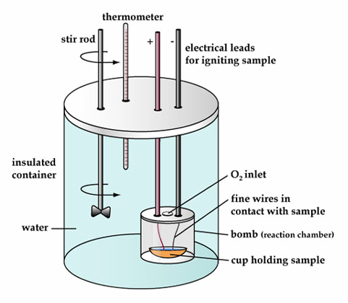
Food goes into the cup. It’s sealed in the “bomb” with oxygen. The electricity leads are attached. This is placed into a certain mass of pure water, at measured temperature. The stirrer moves the water around and makes sure it’s all at the same temperature. At some point you spark and burn the food. Heat is released into the water and the temperature rises.
Using q = mC∆T, calculate the number joules required to make that temperature change, convert to cal, then Calories.

Slide 76
88. Let’s assume that there is exactly 2120. mL of water in our bomb calorimeter and it’s at exactly 295.0 K. After burning up our food sample, the temperature of the water rises to 354.5 K. How many Calories of energy are in this food sample?

Slide 77
88. Let’s assume that there is exactly 2120. mL of water in our bomb calorimeter and it’s at exactly 295.0 K. After burning up our food sample, the temperature of the water rises to 354.5 K. How many Calories of energy are in this food sample? q = mCΔT
q = (2120. g)(4.18 J/g·K)(59.50 K)
q = 527,265.2 J
527,265.2 J 1
1 cal 4.18 J
X
= 126,140 cal
126,140 cal = 126.1 Calories (4 SF)

Slide 78
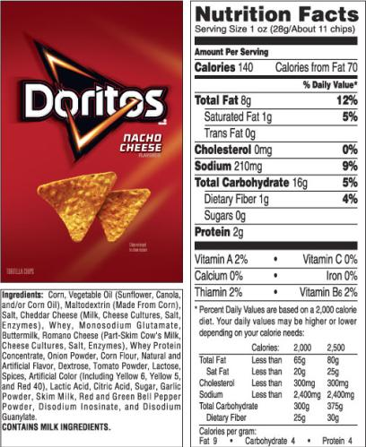
Doritos Lab Explained
We do not have $5000 to buy a high tech calorimeter to measure the amount of energy in Doritos chips, but we can still TRY to do that with our own equipment and measure our results against the nutritional information on the package.
Doritos have a serving size of 28 grams (what ever that means!) We could measure the number of grams in ONE CHIP and do a proportion to discover how many Calories are in our chip.
Then we can do the measuring of how much energy is in the chip, and do a percent error.

Slide 79
SO, if Doritos are 140 C per 28 grams, do this math to find out how many Calories are in YOUR PARTICULAR chip.
28 g YOUR CHIP MASS 140 C X Calories cross multiply, and find out how many Calories are in YOUR chip.
That’s your Actual Value, for % Error.
=

Slide 80
Instead of a $5000 Calorimeter, we will use one of your teacher’s old seltzer cans. They work, just not so good. Because they are not such great Calorimeters, you will ALSO get to use a piece of aluminum foil, which you can use to guide the heat energy to the “seltzer can Calorimeter” to lessen the heat loss.
It is NOT the price that makes a difference, it is that the real machines have almost NO HEAT LOSS. All heat produced by the burning of the food heats the surrounding water. The heat gained by the water is the same heat lost by the food burning.
If you can calculate the heat gained by the water (you can, use q = mCΔT), you can assign that heat as to coming from the chip.
Convert your joules into cals, and then into Calories.
This is your measured value for % Error.
Any partners who manage a % Error smaller than -80%, I will shake your hand in HONOR.

Slide 81
In truth, we will lose nearly all of the heat (~90%) to the air. But, the process is exactly the same as in a high tech nutrition lab. They burn food, measure how much hotter a measured amount of water gets, and they do the q = mCΔT formula, then convert their joules into cals, and those cals into Calories.
Then they print it on the packages. They have a % Error less than 1% because they have insulation.

Slide 82
The End of Thermochemistry is just more Stoichiometry
For a $1, what is the character’s name, and what is the actor’s name? (fun, not real money)

Slide 83
Take out Table I now.
89. Table I is called the Heats of Reaction table.
Unusually it is at standard pressure but not standard temperature.
It’s at 101.3 kPa and 298 Kelvin which is room temperature.

Slide 84
The very first reaction is a common one, you have done this many times this year. The combustion of methane (Bunsen Burner gas). Look here and at the table.
CH_{4(G)} + 2O_{2(G)} → CO_{2(G)} + 2H₂O_{(G)}
This shows how ONE mole of methane combines with TWO moles of oxygen to form ONE mole of carbon dioxide and TWO moles of water.
92. The mole ratio here is 1:2:1:2 and you already knew that!
Good start.

Slide 85
CH_{4(G)} + 2O_{2(G)} → CO_{2(G)} + 2H₂O_{(G)}
There is a funky column at right, called the ΔH, which is called the “DELTA H” or the change in heat for the reaction.
93. This reaction has a ΔH = -890.4 kJ
94. Which means this reaction gives off 890.4 kilo-Joules of heat energy when one mole of methane combusts at standard pressure and 298 K room temperature.
Exactly that amount of energy. 95. What’s with the negative sign?

Slide 86
There is a little asterisk almost hiding next to the (kJ)* at the top, see it now?
At the bottom of the table, outside the line, under that first line of text, where it clearly says 96. A minus sign indicates an exothermic reaction.
Energy is like MONEY, you have it or not, but you CANNOT have negative money.

Slide 87
You can have energy, any number of kilo-Joules you want. You could have Joules, or even cal or Calories if you like. You could have no energy too. You can’t have negative energy.
On a graph, which you won’t learn about for 2 more months, the energy of an exothermic reaction starts higher at the beginning of a reaction, and less at the end (since energy is released to the Universe). On the graph, the energy total is lower (more negative) than it was. The energy is not negative, but the ΔH is.
97. If the ΔH is a + number, that means the reaction is ENDOTHERMIC.
98. In an exothermic reaction, energy is a PRODUCT (it’s given off)
99. In an endothermic reaction, energy is a REACTANT (it’s absorbed to make the reaction go).

Slide 88
Here is something way cool…
100. Well, now I’m telling you that ENERGY is also in the mole ratio as well.
101. The mole ratio for the combustion of CH₄ is now: 1 : 2 : 1 : 2 : 890.4 kJ

Slide 89
So you know how if you wanted to you could answer a question like this one:
If 23.4 moles of methane combust, how many molecules of water form?
Now you can also do this one: 102. If 23.4 moles of CH₄ combust, how much energy is released?
Follow along slowly, then you can try a few on your own.

Slide 90
102. If 23.4 moles of CH₄ combust, how much energy is released?
CH₄ energy
1 890.4 kJ
23.4 X kJ
MR
X = (890.4)(23.4) = 20,835.36 kJ
X = 20,800 kJ with 3 SF

Slide 91
103. Propane gas, C₃H₈ combusts according to Table I. How much energy (in kJ) is released when 5.75 moles C₃H₈ combusts? (find this on Table I, it’s the 2nd reaction)

Slide 92
103. Propane gas, C₃H₈ combusts according to Table I. How much energy is released when 5.75 moles C₃H₈ combusts? C₃H₈ + 5 O₂ → 3CO₂ + 4 H₂O ΔH = -2219.2 kJ
Which is: C₃H₈ + 5 O₂ → 3CO₂ + 4 H₂O + 2219.2 kJ exothermic, energy is a product
MR
C₃H₈ energy
1 2219.2 kJ
5.75 X kJ
X = 12760.4 kJ
X = 12,800 kJ with 3 SF

Slide 93
104. How much energy is absorbed by the reaction of 99.0 moles of HI_{(G)} forming?

Slide 94
104. How much energy is absorbed by the reaction of 99.0 moles of HI_{(G)} forming? H_{2(G)} + I_{2(G)} → 2HI _{(G)} ΔH = +53.0 kJ 53.0 kJ + H_{2(G)} + I_{2(G)} → 2HI _{(G)} (energy is a reactant)
MR
HI energy
2 53.0 kJ
99.0 X kJ
2X = 5247 kJ
X = 2623.5 kJ
X = 2620 kJ with 3 SF

Slide 95
In real life (and here) multistep thermochem problems exist. If a kid is annoying, sometimes someone (lovingly) puts a snowball down the back of his coat against his skin. He wiggles around as it melts, and as the cold water warms up to his body temperature. (haha).
105. How much energy is required to melt a snow ball at 273 Kelvin up to body temperature of 294 Kelvin? (think hard) This is 2 steps (melting, then warming)

Slide 96
105. How much energy is required to melt a snow ball at 273 Kelvin up to body temperature of 294 K? q = mH_{F} q = (155 g)(334 J/g) = 51770 J = 51,800 J
q = mCΔT q = (155 g)(4.18 J/g.K)(21.0 K) = 13605.9 J = 13,600 J
ANSWER = 51,800 J + 13,600 J = 65,400 J with 3 SF

Slide 97
When steam condenses on a kitchen window, the water then cools down, another opportunity to do a two-step thermochem problem (cue the applause again)
106. If 16.3 grams of steam at exactly 373 K condenses onto a kitchen window, then cools quickly to 305 K. How much energy was released?

Slide 98
106. If 16.3 grams of steam at exactly 373 K condenses onto a kitchen window, then cools quickly to 305 K. How much energy was released? q = mH_{V} q = (16.3 g)(2260 J/g) = 36,838 J = 36,800 J
q = mCΔT q = (16.3 g)(4.18 J/g.K)(68.0 K) = 4633.112 J = 4630 J
36,800 J + 4630 J = 41430 J = 41,400 J 3 SF

Slide 99
Water is a common enough substance in your life that the regents will not remind you what phase changes it might go through in any problem. You will have to determine that from the temperatures in the problem.
Ice can be colder than 273 K (0°C) and can be made colder or warmer while staying a solid. Water phase changes at 273 K.
When ever there is a temperature change (ice can change temp) we use the basic heat formula: q = mCΔT
If water is liquid, we use the 4.18 J/g·K constant.
When the H₂O is solid ice, it has a different constant,
107. C_{ICE} = 2.10 J/g·K
When you are given information like this, you must use it in your problems, like the next slide will do. Write the ice constant near table B in your reference table now.

Slide 100
108. You obtain a snowball (255 g) at -5.00°C and put it in the back of your friend’s shirt. It melts then warms up to body temperature of 36.0°C. How much energy does that take? (do math on next slide)
q = mH_{F}
268 K
309 K
q=mCΔT
q=mCΔT
-5.00°C
0°C
36.0°C
C = 4.18 J/g·K
C = 2.10 J/g·K

Slide 101
108. For fun, you obtain a snowball (255 g) at -5.00°C and put it in the back of your friend’s shirt. It melts then warms up to body temperature of 36.0°C. How much energy does that take?
q=mCΔT = (255g)(2.10J/g·K)(5.00 K) = 2677.5 J
q = mH_{F} = (255g)(334J/g) = 85,170 J
q=mCΔT = (255g)(4.18J/g·K)(36.0K) = 38,372.4 J
126,219.9 J
1,260,000 J with 3 SF
Thermochem is like eating out in a fancy restaurant, multi courses with ONE total bill.
Add up the parts - sum.for total

Slide 102
66.
A
Cooling curve for Chromium metal
C
1
B
K E L V I N
109. A. What temps are 1 + 2?
B. What’s PE doing BC and CD?
C. What’s KE doing AB and DE
D. Why is BC longer than DE?
E. Which thermochem formula do you use for BC?
F. How about for EF?
E
2
D
F
Heat removed at a constant rate (time)

Slide 103
66.
Cooling curve for Chromium metal
A
KE
PE
C
2944
B
q = mH_{V}
K E L V I N
PE
109. Why is BC longer than DE?
BC represents the condensation phase change for chromium gas to liquid, which is a “bigger” energy event that the freezing of chromium.
KE
E
2180
D
q = mCΔT
F
Heat removed at a constant rate (time)

Slide 104
Converting balanced chemical equations into balanced thermochemical equations.
110. Look at table I, choose the second equation: propane combusts. Write the balanced chemical equation with the ΔH
111. Write a balanced thermochemical equation
112. Find the most endothermic equation on Table I, write the balanced chemical equation with the ΔH
114. Write the balanced thermochemical equation for this reaction too.

Slide 105
Converting balanced chemical equations into balanced thermochemical equations.
Look at table I, choose the second equation, propane combusts. Write the balanced chemical equation with the ΔH, then, write a balanced thermochemical equation below it (properly).
110. C₃H₈ + 5O₂ → 3CO₂ + 4H₂0 ΔH= -2219.2 kJ
111. C₃H₈ + 5O₂ → 3CO₂ + 4H₂0 + 2219.2 kJ
Energy is a PRODUCT in an exothermic reaction
Then, write the most endothermic equation of all, with the ΔH, then below that one, the balanced thermochemical equation properly.
112. 2C + H₂ → C₂H₂ ΔH = +227.4 kJ
114. 2C + H₂ + 227.4 kJ → C₂H₂
Energy is a REACTANT in an endothermic reaction

Slide 106
115. You decide to warm up some water for oatmeal. How much energy does it take to warm up 354 mL of water from 24.5°C to the boiling point and to let 7.50 grams vaporize making the teapot whistle. Be careful and do good calculations.

Slide 107
115. You decide to warm up some water for oatmeal. How much energy does it take to warm up 354 mL of water from 24.5°C to the boiling point and to let 7.50 grams vaporize making the teapot whistle. Be careful and do good calculations. q = mCΔT = (354 g)(4.18 J/g·K)(75.5 K) = 111,718.86 J q = mH_{V} = (7.50 g)(2260 J/g) = 16950 J
111,718.86 J + 16960J = 128,668.86 J
129,000 Joules with 3SF

Slide 108
116. Write the balanced thermochemical equation for the synthesis of aluminum oxide, then calculate how much energy is released (or absorbed) when you form 21.0 moles of Al₂O₃.

Slide 109
116. Write the balanced thermochemical equation for the synthesis of aluminum oxide, then calculate how much energy is released (or absorbed) when you form 21.0 moles of Al₂O₃.
4Al + 3O₂ → 2Al₂O₃ + 3351 kJ
Energy
Al₂O₃
3351 kJ
2
X kJ
21.0
MR
2x = 70371 x = 35,185.5 kJ 35,200 kJ with 3 SF

Slide 110
117. Draw the heating curve for phosphorous. Indicate the actual MP and BP. Label graph points ABCDEF left to right.
What formula would you use
For BC
For CD
For DE
What happens to PE + KE at BC and CD?

Slide 111
117. Heating Curve for Phosphorous
F
D
554 K
E
BC use: q = mH_{F}
CD use: q = mCΔT
DE use: q = mH_{V}
B
317 K
C
A
Heat added at a constant rate →
BC: KE steady, PE increases
CD: KE increases, PE steady

Slide 112
118. 45.0 g of an unknown metal absorbs 1.51 kJ of heat. The temperature changes from 268 K to 345 K. What is the specific heat capacity constant for this metal?

Slide 113
118. 45.0 g of an unknown metal absorbs 1.51 kJ of heat. The temperature changes from 268 K to 345 K. What is the specific heat capacity constant for this metal?
q = mCΔT
1510 J = (45.0g)(C)(77.0K)
1510J (45.0g)(77.0K)
= C = 0.436 J/g·K
3465g·K

Slide 114
119. Which takes more energy?
Melting 50.0 g of ice or
vaporizing 50.0 g of water into steam?

Slide 115
119. Which takes more energy?
Melting 50.0 g of ice or vaporizing 50.0 g of water into steam?
No math needed, just think…
H_{F} constant for water is 334 J/g
H_{V} constant for water is 2260 J/g
It will take more than 7X the energy to vaporize than melt

Slide 116
120. Which takes more energy?
Heating 23.0 mL of water from 274 K to 299 K
or
Heating 23.0 mL of water from 299 K to 323 K?

Slide 117
120. Which takes more energy?
Heating 23.0 mL of water from 274 K to 299 K, or,
Heating 23.0 mL of water from 299 K to 323 K?
Think. The ΔT for the first one is 25.0 K
The ΔT for the second one is only 24.0 K
NO PHASE CHANGES to think about, so the first one requires slightly more energy (4.18 J/g because it’s one more temperature unit of ΔT)

Slide 118
121. Which takes more energy?
Vaporizing 21.0 g water from 373 K liquid to gas or
Changing the temp of 100.0 g H₂O by 97.0 K?

Slide 119
121. Which takes more energy?
Vaporizing 21.0 g water from 373 K liquid to gas, or,
100 g water from 274 K to 371 K?
q = mH_{V} = (21.0g)(2260J/g) = 47,460 J = 47,500 J 3SF
q = mCΔT = (100.0g)(4.18J/g·K)(97.0K) = 40,500 J 3SF
The first one takes more energy!

Slide 120
122. Which has the LOWEST AVERAGE KINETIC ENERGY?
100 mL water at 51.0°C
100 mL water at 50.0°C
175 mL water at 49.0°C
175 mL water at 23.0°C

Slide 121
122. Which has the LOWEST AVERAGE KINETIC ENERGY?
100 mL water at 50.0°C
100 mL water at 50.0°C
175 mL water at 49.0°C
1750 mL water at 23.0°C
Lowest temp = lowest average KE always.
Same in reverse: Highest temp = Highest Average KE

Slide 122
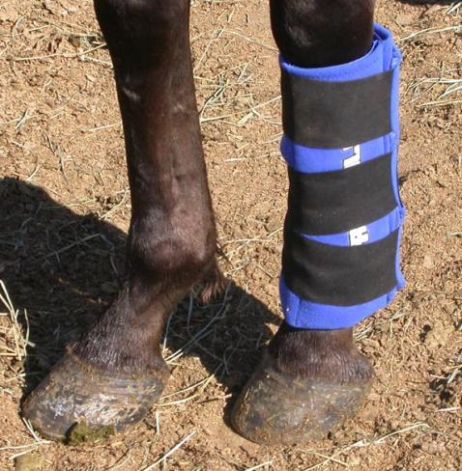
This horse has a boo boo.
That’s an ICE PACK on his leg.
123. Describe the thermochem:
Heat flows from ice pack → leg C. Heat flows from leg → ice pack
Cold flows from ice pack → leg D. Cold flows from leg → ice pack

Slide 123
Energy can be transferred. Heat is energy, cold is THE LACK OF ENERGY.
123. C. Heat flows from leg → ice pack
Cold cannot flow.
Think:
What happens to you when you jump into a cold pool?
Heat leaves your body and you get chilly. The COLD DOES NOT FLOW INTO YOU.

