Slide 1
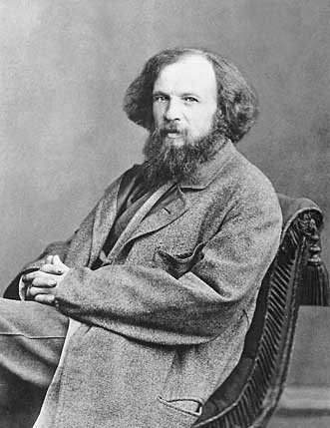
OB: Trends of the Periodic Table 1. Dimitri Mendeleev created the first modern periodic table, ours is modeled on it.

Slide 2
2 The COLUMNS on the table are called _________________, there are ________ on the table.
3 The ROWS that go across the table to the right are called ___________________, there are _____ of these. Look at your periodic table now, touch numbers 1-18 for the groups, then touch 1-7 for the periods.

Slide 3
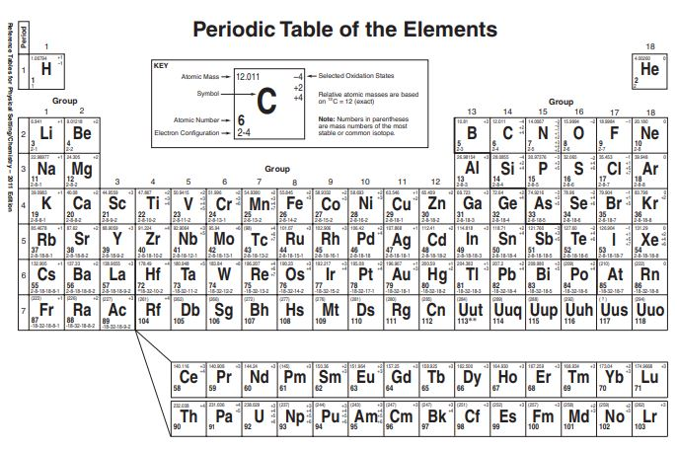
4. Group 1 (Li to Fr) are called the ALKALI metals

Slide 4
5. Group 2 (Be to Ra) are called the ALKALINE EARTH metals

Slide 5
6. Group 3-12 plus under the staircase are called the TRANSITIONAL metals

Slide 6
7. To the right of the staircase, AND
Hydrogen
Are called the NONMETALS

Slide 7
8. Group 17 are called the HALOGENS they are also nonmetals

Slide 8
9. Group 18 are called the Noble Gases they are also nonmetals

Slide 9
10. seven atoms that touch the staircase are called the METALLOIDS NOT Al or Po

Slide 10
11. the 2 rows at the bottom of the table are called the INNER TRANSITIONAL metals.
They fit inside group 3

Slide 11
12. Atoms in the same group share many chemical properties, because the have the same number of valence (or outermost)
electrons. which means these atoms in the group will bond in similar ways. Examples: all make 1:1 compounds: LiCl, NaCl, and KCl All make 1:2 compounds: BeBr₂, MgBr₂, CaBr₂

Slide 12
What’s up with the name of this table?
14. What does PERIODIC even mean here?

Slide 13
What’s up with the name of this table?
What does PERIODIC even mean here? Periodic refers to a pattern or normal repetition of things. Magazines are periodicals, they come periodically.
Sports Illustrated comes weekly. National Geographic comes monthly. When I was a kid, there was a men’s magazine called Gentlemen’s Quarterly. It came 4x per year (once per quarter). Now it’s GQ - and it comes 10X per year.

Slide 14
15. The elements of the Periodic Table are arranged in order of increasing atomic number. That means by increasing number of PROTONS.

Slide 15
16. The Periodic Law
When the elements are arranged in order of increasing atomic number there is a periodic repetition of similar chemical properties - in the groups.
This works because of the weird shape of the table.

Slide 16
17. Similar properties “show up” periodically, IN THE GROUPS.
18. At the top of the table, this happens every 8 atoms, but starting in the middle, it’s every 18 atoms.

Slide 17
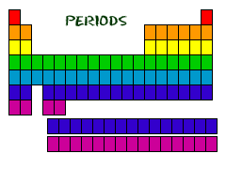
19. The periods of the table go left to right.
20. The periods contain many elements that have very different properties.
21. Period numbers go 1 to 7. They correspond to the number of electron orbitals that all of the atoms in that period have.
1
Periods ↔
2
3
4
5
6
7
6
7

Slide 18
22. The period number (1-7) is indicative of how many electron orbitals each atom in the period has.
period | Example element | Electron configuration | Number of electron orbitals
1 | H
2 | Be
3 | S
4 | Mn
5 | Xe
6 | Ba
7 | Ra

Slide 19
22. The period number (1-7) is indicative of how many electron orbitals each atom in the period has.
period | Example element | Electron configuration | Number of electron orbitals
1 | H | 1 | 1
2 | Be
3 | S
4 | Mn
5 | Xe
6 | Ba
7 | Ra

Slide 20
22. The period number (1-7) is indicative of how many electron orbitals each atom in the period has.
period | Example element | Electron configuration | Number of electron orbitals
1 | H | 1 | 1
2 | Be | 2-2 | 2
3 | S
4 | Mn
5 | Xe
6 | Ba
7 | Ra

Slide 21
22. The period number (1-7) is indicative of how many electron orbitals each atom in the period has.
period | Example element | Electron configuration | Number of electron orbitals
1 | H | 1 | 1
2 | Be | 2-2 | 2
3 | S | 2-8-6 | 3
4 | Mn
5 | Xe
6 | Ba
7 | Ra

Slide 22
22. The period number (1-7) is indicative of how many electron orbitals each atom in the period has.
period | Example element | Electron configuration | Number of electron orbitals
1 | H | 1 | 1
2 | Be | 2-2 | 2
3 | S | 2-8-6 | 3
4 | Mn | 2-8-13-2 | 4
5 | Xe
6 | Ba
7 | Ra

Slide 23
22. The period number (1-7) is indicative of how many electron orbitals each atom in the period has.
period | Example element | Electron configuration | Number of electron orbitals
1 | H | 1 | 1
2 | Be | 2-2 | 2
3 | S | 2-8-6 | 3
4 | Mn | 2-8-13-2 | 4
5 | Xe | 2-8-18-18-8 | 5
6 | Ba
7 | Ra

Slide 24
22. The period number (1-7) is indicative of how many electron orbitals each atom in the period has.
period | Example element | Electron configuration | Number of electron orbitals
1 | H | 1 | 1
2 | Be | 2-2 | 2
3 | S | 2-8-6 | 3
4 | Mn | 2-8-13-2 | 4
5 | Xe | 2-8-18-18-8 | 5
6 | Ba | 2-8-18-18-8-2 | 6
7 | Ra

Slide 25
22. The period number (1-7) is indicative of how many electron orbitals each atom in the period has.
period | Example element | Electron configuration | Number of electron orbitals
1 | H | 1 | 1
2 | Be | 2-2 | 2
3 | S | 2-8-6 | 3
4 | Mn | 2-8-13-2 | 4
5 | Xe | 2-8-18-18-8 | 5
6 | Ba | 2-8-18-18-8-2 | 6
7 | Ra | 2-8-18-32-18-8-2 | 7

Slide 26
The numbers in the element boxes on periodic table help us know many things.
Locate the carbon atom in the key (the big one at top)
Find Atomic Mass, Atomic Number, Electron Configuration, and selected Oxidation Numbers.
The mass is the mass of the protons and the neutrons in the nucleus
23. Each of these subatomic particles fits into this table, you should memorize this.
Particle | Location | Charge | Mass | symbol
Proton
Neutron
Electron

Slide 27
The numbers in the element boxes on periodic table help us know many things.
Locate the carbon atom in the key (the big one at top)
Find Atomic Mass, Atomic Number, Electron Configuration, and selected Oxidation Numbers.
The mass is the mass of the protons and the neutrons in the nucleus
23. Each of these subatomic particles fits into this table, you should memorize this.
Particle | Location | Charge | Mass | symbol
Proton | Nucleus | +1 | 1 amu | p⁺
Neutron
Electron

Slide 28
The numbers in the element boxes on periodic table help us know many things.
Locate the carbon atom in the key (the big one at top)
Find Atomic Mass, Atomic Number, Electron Configuration, and selected Oxidation Numbers.
The mass is the mass of the protons and the neutrons in the nucleus
23. Each of these subatomic particles fits into this table, you should memorize this.
Particle | Location | Charge | Mass | symbol
Proton | Nucleus | +1 | 1 amu | p⁺
Neutron | Nucleus | none | 1 amu | n°
Electron

Slide 29
The numbers in the element boxes on periodic table help us know many things.
Locate the carbon atom in the key (the big one at top)
Find Atomic Mass, Atomic Number, Electron Configuration, and selected Oxidation Numbers.
The mass is the mass of the protons and the neutrons in the nucleus
23. Each of these subatomic particles fits into this table, you should memorize this.
Particle | Location | Charge | Mass | symbol
Proton | Nucleus | +1 | 1 amu | p⁺
Neutron | Nucleus | none | 1 amu | n°
Electron | Outside the nucleus | ̶ 1 | Zero in H.S. | e ̶

Slide 30
Another way to write this information (for cobalt) would be this:
This shows the average mass of cobalt to be 59 amu, and that it has an atomic number of 27.
24. Calculate the number of protons, neutrons and electrons for this element now.
Co
59 27

Slide 31
Co
Mass = total number of p⁺ and n° = 59 minus atomic number = p⁺ -27
Gives us the left over neutrons = 32
The atomic number is the number of protons, which is the same as the number of electrons (the positives = the negatives).
24. Cobalt has 27 protons, 27 electrons, and 32 neutrons.
59 27

Slide 32
25. List ALL of the nonmetals (by symbol, in numeric order)

Slide 33
25. List ALL of the nonmetals (by symbol, in numeric order)
H, He
B, C, N, O, F, Ne Si, P, S, Cl, Ar,
As, Se, Br, Kr
Te, I, Xe, At, Rn
Count them, there are
22
Non metals

Slide 34
26. List all of the metalloids by symbol and name

Slide 35
26. List all of the metalloids by symbol and name
B for boron (NM) Si for silicon (NM) Ge for germanium (NM) As for arsenic (NM) Sb for antimony (M) Te for tellurium (M) At for astatine (NM)
Count them, there are
7
Metalloids
Two other METALS touch the staircase, Al and Po (the dog food exception to this trend)

Slide 36
27. How many elements are METALS?

Slide 37
27. How many elements are METALS?
We won’t list them all. All elements are metals except the nonmetals.
There are
118 elements – 22 nonmetals = 96 metals

Slide 38
Start Class #2 here
#28 - #42

Slide 39
28. There are seven trends that we examine as group trends (patterns going down a group), or period trends (patterns going across the table).
29. These trends are: atomic radius (size), cation + anion sizes, net nuclear charge, electronegativity value, atomic mass, metallic and nonmetallic properties, and 1st ionization energy.

Slide 40
30. What is the group trend for atomic mass?
To figure it out we need to look at a group, and write out the atomic masses in order to see if there is a pattern. Use group 2. Fill in the chart now. Then we will describe this with as few words as possible.
Atom | Mass in amu
Be
Mg
Ca
Sr

Slide 41
30. What is the group trend for atomic mass?
The group trend for atomic mass is increasing.
Atom | Mass in amu
Be | 9
Mg | 24
Ca | 40
Sr | 88

Slide 42
31. What is period trend for atomic mass.
Atom | Na | Mg | Al | Si
Mass in amu

Slide 43
31. What is period trend for atomic mass. The period trend for atomic mass is increasing.
Atom | Na | Mg | Al | Si
Mass in amu | 23 | 24 | 27 | 28

Slide 44
32. What is the group trend for atomic radius (size)?
To figure it out we need to look at a group, and what the pattern is. Use group 1. Fill in this chart. Then we will describe the trend with as few words as possible.
Atom | RADIUS in pm
Li
Na
K
Rb

Slide 45
32. What is the group trend for atomic radius (size)?
The group trend for atomic radius is INCREASING.
What’s going on with this trend? Why does this trend exist?
Atom | RADIUS in pm
Li | 130.
Na | 160.
K | 200.
Rb | 215

Slide 46
32. What is the group trend for atomic radius (size)?
The group trend for atomic radius is INCREASING.
What’s going on with this trend? Why does this trend exist? Each period below has ONE MORE ELECTRON ORBITAL than the atom above it, so yes, this is sensible.
Atom | RADIUS in pm
Li | 130.
Na | 160.
K | 200.
Rb | 215

Slide 47
33. What is the period trend for atomic radius (size)?
To figure it out we need to look at a period, write out the atomic radii - in order, to see what the pattern is. Use period 2. Fill in this chart now, then use as few words as possible to state the trend.
Atom | Li | Be | B | C
Mass in amu

Slide 48
33. What is the period trend for atomic radius (size)?
To figure it out we need to look at a period, write out the atomic radii - in order, to see what the pattern is. Use period 2. Fill in this chart now, then use as few words as possible to state the trend.
Atom | Li | Be | B | C
Mass in amu | 130. | 99 | 84 | 75

Slide 49
33. What is the period trend for atomic radius (size)?
To figure it out we need to look at a period, write out the atomic radii - in order, to see what the pattern is. Use period 2. Fill in this chart now, then use as few words as possible to state the trend.
The period trend for atomic radius is decreasing. How is this possible? The reason for this is a little more complicated.
Atom | Li | Be | B | C
Mass in amu | 130. | 99 | 84 | 75

Slide 50
The period trend for atomic radius is decreasing. How is this possible? The reason for this is a little more complicated.
All atoms in period 2 have 2 orbitals. As we move across the table, the number of orbitals is constant, but the number of protons in the center of the atom – in the nucleus – increases.
More protons means more positive charge in the nucleus. This creates a stronger and stronger inward attraction, which pulls the atoms smaller, they shrink as we move to the right.
The smallest atom in the period has the most protons – the noble gas.

Slide 51
Net Nuclear Charge Trend
36. The SUM TOTAL of charges inside the NUCLEUS is net nuclear charge.
Since inside the nucleus are only protons (positive charges) and neutrons (no charges), the net nuclear charge is always positive.
In fact, if you FORGET the positive sign, it’s wrong.

Slide 52
37. State the group trend for Net Nuclear Charge?
The number of protons, with a positive sign, is the net nuclear charge since the electrons ARE NOT in the nucleus, and the neutrons have no charge.
Atom | Atomic Number | Net Nuclear Charge
Be
Mg
Ca
Sr
Ba

Slide 53
37. State the group trend for Net Nuclear Charge?
Atom | Atomic Number | Net Nuclear Charge
Be | 4
Mg | 12
Ca | 20
Sr | 38
Ba | 56

Slide 54
37. The group trend for Net Nuclear Charge is increasing.
Atom | Atomic Number | Net Nuclear Charge
Be | 4 | +4
Mg | 12 | +12
Ca | 20 | +20
Sr | 38 | +38
Ba | 56 | +56

Slide 55
38. State the Period Trend for Net Nuclear Charge
Atom | K | Ca | Sc | Ti
Atomic number
Net Nuclear Charge

Slide 56
38. State the Period Trend for Net Nuclear Charge
Atom | K | Ca | Sc | Ti
Atomic number | 19 | 20 | 21 | 22
Net Nuclear Charge

Slide 57
38. State the Period Trend for Net Nuclear Charge
Atom | K | Ca | Sc | Ti
Atomic number | 19 | 20 | 21 | 22
Net Nuclear Charge | +19 | +20 | +21 | +22

Slide 58
38. The Period Trend for Net Nuclear Charge is Increasing.
Atom | K | Ca | Sc | Ti
Atomic number | 19 | 20 | 21 | 22
Net Nuclear Charge | +19 | +20 | +21 | +22

Slide 59
First Ionization Energy
This trend requires a quick vocabulary word, and then some “reality” since NY only wants you to be able to deal with the trend, but not really “get” it. It’s all good.

Slide 60
First Ionization Energy
First Ionization Energy is the amount of energy required to make a mole of atoms into a mole of +1 cations. It’s the amount of energy needed to pull off a mole of electrons from a mole of atoms. They’re listed on Table S.

Slide 61
No writing, think: From Table S…
Changing a mole of Lithium atoms into a mole of Li⁺¹ cations takes 520. kJ/mole (520 kilo-joules per mole)
1 mole Li⁰ → 1 mole Li⁺¹ + 1 mole of electrons
To make that happen (the electrons don’t fall off), it takes energy.
How much? 520 kJ – which is the 1st Ionization energy for Lithium

Slide 62
No writing, keep thinking:
What about a mole of Magnesium?
To change 1 mole of Mg atoms into 1 mole of Mg⁺¹ cations takes 738 kJ/mole.
But WHAT are Mg⁺¹ cations? They don’t even exist.

Slide 63
To make a mole of Mg⁺² cations: Step one: the 1st Ionization energy is required to do this:
1 mole Mg⁰ → 1 mol Mg⁺¹ + 1 mole of electrons
Step two: the 2nd Ionization Energy is needed to do this: 1 mol Mg⁺¹ → 1 mol Mg⁺² + 1 mole of electrons FOR MAGNESIUM The 1st Ionization energy is 738 kJ/mole The 2nd Ionization energy is 2371 kJ/mole
It’s “harder” to take the second electrons off, the positive/negative tug of war is being won by the protons (12 vs. 11 now). Mg⁺¹ never forms, this is JUST a data chart you need to use. NYS does not think you smart enough to handle that, but they think it’s okay to let you think it’s possible to have a Mg⁺¹ cation. They stink.

Slide 64
No writing, think:
For Aluminum, there’s a 1st Ionization energy, a 2nd Ionization Energy, and a 3rd Ionization energy too.
Fluorine, a nonmetal does not usually become a cation, but they can be forced to temporarily. It takes A LOT of energy.
First Ionization Energy is just a trend, and some very loose chemistry. Don’t worry about it. This is about you reading the data chart only, and it’s not hard.

Slide 65
Fill in the chart
41. State the group trend for 1st Ionization energy.
Group 1 atoms | 1st ionization energy | Electron configuration
Li | kJ/mole
Na | kJ/mole
K | kJ/mole
Rb | kJ/mole

Slide 66
Fill in the chart
41. State the group trend for 1st Ionization energy.
Group 1 atoms | 1st ionization energy kJ/mole | Electron configuration
Li | 520. kJ/mole
Na | 496 kJ/mole
K | 419 kJ/mole
Rb | 403 kJ/mole

Slide 67
Fill in the chart
41. State the group trend for 1st Ionization energy.
Group 1 atoms | 1st ionization energy kJ/mole | Electron configuration
Li | 520. kJ/mole | 2-1
Na | 496 kJ/mole | 2-8-1
K | 419 kJ/mole | 2-8-8-1
Rb | 403 kJ/mole | 2-8-18-8-1

Slide 68
Fill in the chart
41. The group trend for 1st ionization energy is decreasing. Why?
Group 1 atoms | 1st ionization energy kJ/mole | Electron configuration
Li | 520. kJ/mole | 2-1
Na | 496 kJ/mole | 2-8-1
K | 419 kJ/mole | 2-8-8-1
Rb | 403 kJ/mole | 2-8-18-8-1

Slide 69
42. The reason that it “gets easier” to turn a mole of atoms into a mole of cations as we move down a group, is that the electrons that have to be removed are further from the nucleus, and are being attracted inward with less attraction. The distance from the nucleus “hurts” more than the increase of protons “helps” hold onto the electrons.
The ATOMIC SIZE increases, and the valence electrons that get liberated to form +1 cations are much further from the positive nucleus.
Lithium 130. pm
Sodium 160. pm
Potassium 200. pm
Rubidium 215 pm

Slide 70
Period Trend for 1st Ionization Energy
Atom | Rb | Sr | Y | Zr
1st Ionization Energy | kJ/mole | kJ/mole | kJ/mole | kJ/mole
43. State the period trend for 1st Ionization Energy

Slide 71
Period Trend for 1st Ionization Energy
Atom | Rb | Sr | Y | Zr
1st Ionization Energy | 403 kJ/mole | 549 kJ/mole | 600. kJ/mole | 640. kJ/mole
43. State the period trend for 1st Ionization Energy

Slide 72
Period Trend for 1st Ionization Energy
Atom | Rb | Sr | Y | Zr
1st Ionization Energy | 403 kJ/mole | 549 kJ/mole | 600. kJ/mole | 640. kJ/mole
43. The period trend for 1st Ionization Energy is increasing.

Slide 73
Period Trend for 1st Ionization Energy
Atom | Rb | Sr | Y | Zr
1st Ionization Energy kJ/mole | 403 | 549 | 600. | 640.
The period trend for 1st Ionization Energy is increasing
44. The reason is that the number of protons increases across a period, with the same number of orbitals, so the attraction by the nucleus increases, making these electrons harder to “pull off” to make cations.

Slide 74
Metallic vs. Non Metallic Properties
The whole Periodic Table is made up of nonmetals and metals. 22 nonmetals and 96 metals. (7 are metalloids too).
45. Metallic properties include…..
46. Non metallic properties include….
You need to know lots of them.

Slide 75
45. Metallic Properties being malleable and ductile, have the ability to conduct heat or electricity, they form cations not anions, they are shiny (have luster), they are dense, they have lower specific heat capacity constants, etc. | 46. Nonmetallic Properties not being malleable or ductile (they are brittle or not even solids), do not conducting heat or electricity well, they only form anions (the noble gases don’t form ions at all), they aren’t lustrous (most are gases!), they are less dense, they have higher specific heat capacity constants.

Slide 76
47. If you could rank all of the metals in all properties, and score out who wins the most times, the most metallic element is francium.
48. If you measured all of the non metals on all of the nonmetallic property list, the most non-metallic element is helium.

Slide 77
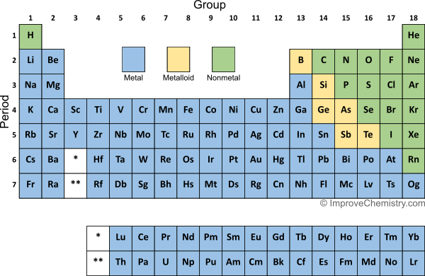
This is dopey
Which element is the most metallic, strontium, copper or lead?
At

Slide 78
This is dopey
Which element is the most metallic, strontium, copper or lead?
Sr is the MOST METALLIC, it’s the closest to francium!
At

Slide 79
This is dopey
50. Which element is the most nonmetallic
At

Slide 80
This is dopey
50. Which element is the most nonmetallic Neon is the closest to helium, therefore it wins here!
At

Slide 81
Cation Sizes and Anion Sizes
We have no charts to look over to determine the actual sizes of any ions, but we can still figure out the trends of cation sizes and of anion sizes by thinking about the size of the ATOMS.
51. How big is a PICOMETER (pm)???
Table C says a “pico” is one 10⁻¹² of a whole
Or 10¹² picometers = one meter.
10⁻¹² m = one trillionth of a meter

Slide 82
52 group 1 CATIONS | Electron configurations of cations | 53. group 17 ANIONS | Electron configurations of anions
Li⁺¹ |  | F⁻¹
Na⁺¹ |  | Cl⁻¹
K⁺¹ |  | Br⁻¹
Rb⁺¹ |  | I⁻¹

Slide 83
52 group 1 CATIONS | Electron configurations of cations | 53. group 17 ANIONS | Electron configurations of anions
Li⁺¹ | 2 | F⁻¹
Na⁺¹ | 2-8 | Cl⁻¹
K⁺¹ | 2-8-8 | Br⁻¹
Rb⁺¹ | 2-8-18-8 | I⁻¹

Slide 84
52 group 1 CATIONS | Electron configurations of cations | 53. group 17 ANIONS | Electron configurations of anions
Li⁺¹ | 2 | F⁻¹ | 2-8
Na⁺¹ | 2-8 | Cl⁻¹ | 2-8-8
K⁺¹ | 2-8-8 | Br⁻¹ | 2-8-18-8
Rb⁺¹ | 2-8-18-8 | I⁻¹ | 2-8-18-18-8

Slide 85
52 group 1 CATIONS | Electron configurations of cations | 53. group 17 ANIONS | Electron configurations of anions
Li⁺¹ | 2 | F⁻¹ | 2-8
Na⁺¹ | 2-8 | Cl⁻¹ | 2-8-8
K⁺¹ | 2-8-8 | Br⁻¹ | 2-8-18-8
Rb⁺¹ | 2-8-18-8 | I⁻¹ | 2-8-18-18-8
The group trend for Cation Size is increasing
The group trend for Anion Size is increasing.

Slide 86
Cation Sizes and Anion Sizes
55. Cations are always MUCH smaller than their atoms because they LOSE a whole orbital when they lose their valence electrons.
Anions are always a bit larger than the atoms they formed from because the additional electrons in the valence orbital stretch it out to full size.

Slide 87
CATIONS Period 3 → | Na⁺¹ | Mg⁺² | Al⁺³
56. Electron configurations
ANION in Period 3 → | N⁻³ | O⁻² | F⁻¹
57. Electron configurations
58. State the Period Trend for Cation size 59. State the Period Trend for Anion size

Slide 88
CATIONS Period 3 → | Na⁺¹ | Mg⁺² | Al⁺³
56. Electron configurations | 2-8 | 2-8 | 2-8
ANION in Period 3 → | N⁻³ | O⁻² | F⁻¹
57. Electron configurations
58. State the Period Trend for Cation size 59. State the Period Trend for Anion size

Slide 89
CATIONS Period 3 → | Na⁺¹ | Mg⁺² | Al⁺³
56. Electron configurations | 2-8 11 protons + 10 electrons | 2-8 12 protons + 10 electrons | 2-8 13 protons + 10 electrons
ANION in Period 3 → | N⁻³ | O⁻² | F⁻¹
57. Electron configurations
58. State the Period Trend for Cation size 59. State the Period Trend for Anion size

Slide 90
CATIONS Period 3 → | Na⁺¹ | Mg⁺² | Al⁺³
56. Electron configurations | 2-8 11 protons + 10 electrons | 2-8 12 protons + 10 electrons | 2-8 13 protons + 10 electrons
ANION in Period 3 → | N⁻³ | O⁻² | F⁻¹
57. Electron configurations | 2-8 | 2-8 | 2-8
58. State the Period Trend for Cation size 59. State the Period Trend for Anion size

Slide 91
CATIONS Period 3 → | Na⁺¹ | Mg⁺² | Al⁺³
56. Electron configurations | 2-8 11 protons + 10 electrons | 2-8 12 protons + 10 electrons | 2-8 13 protons + 10 electrons
ANION in Period 3 → | N⁻³ | O⁻² | F⁻¹
57. Electron configurations | 2-8 7 protons + 10 electrons | 2-8 8 protons + 10 electrons | 2-8 9 protons + 10 electrons
58. State the Period Trend for Cation size 59. State the Period Trend for Anion size

Slide 92
CATIONS Period 3 → | Na⁺¹ | Mg⁺² | Al⁺³
56. Electron configurations | 2-8 11 protons + 10 electrons | 2-8 12 protons + 10 electrons | 2-8 13 protons + 10 electrons
ANION in Period 3 → | N⁻³ | O⁻² | F⁻¹
57. Electron configurations | 2-8 7 protons + 10 electrons | 2-8 8 protons + 10 electrons | 2-8 9 protons + 10 electrons
58. The Period Trend for Cation size is decreasing. 59. The Period Trend for Anion size is decreasing.

Slide 93
60. The period trend for anion size is decreasing. With more and more protons pulling the SAME NUMBER OF ELECTRONS, each anion will gets smaller and smaller. Just like atoms, and just like cations.

Slide 94
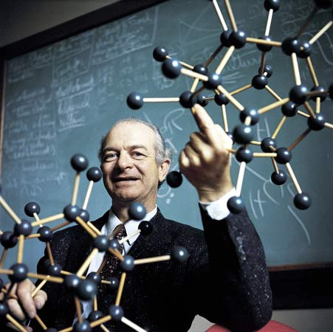
Electronegativity
the idea that generated a Nobel Prize for Dr. Linus Pauling
This guy is the ONLY person ever to win 2 Nobel Prizes by himself. Some others shared two prizes, but, he’s really the man.

Slide 95
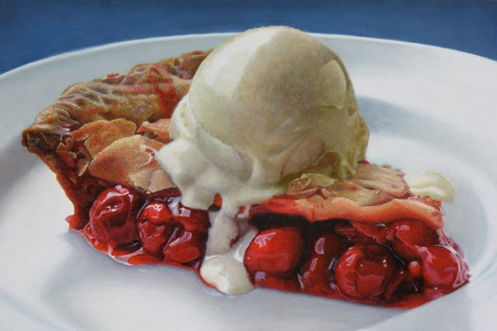
61. Electronegativity is defined as the tendency to gain an electron when two atoms bond.
Bonding is a very complicated matter. We haven’t learned much about it yet. Think about this, atoms bond by sharing electrons (or transferring them) to other atoms. Not all share fairly. Some do share more fairly than others, and some share their electrons perfectly. Electronegativity is a measure of how well these electrons are shared, and how polar the bond will be because of that. We will spend LOTS of time on this soon, but the trend is easy to deal with, but you should understand the vocabulary word too.
YOU
ME

Slide 96
Electronegativity values are in Table S with all the other good numbers.

Slide 97
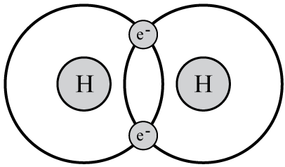
62. Draw… Let’s imagine two hydrogen atoms bonding. They both have electronegativity values of 2.2
2.2 2.2
Both atoms “pull” to get the other atoms electron a “2.2” amount. Since they are the same, they share the two electrons exactly the same, balanced. This is a nonpolar bond.

Slide 98
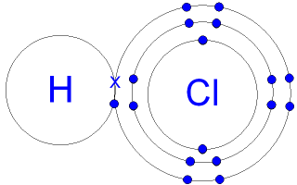
63. Draw… Let’s imagine HCl bonding now. The both have electronegativity values of 2.2 and 3.2
2.2 3.2
Cl “pulls” a 3.2 amount, but H only pulls a 2.2 amount. This makes the sharing very unfair. Chlorine gets the electron from hydrogen MOST of the time. This is a polar bond.
H

Slide 99
64. Draw the diagram below. It shows hydrogen monochloride having a single bond that is polar. Since chlorine has a greater electronegativity value than hydrogen (3.2 vs. 2.2) chlorine pulls the electron from hydrogen much more (think 90% of the time). That means the bond is polar, the chlorine side is more negative with the extra electron, and the hydrogen side is more positive, having “lost” this electron most of the time.
65. The arrow itself is called a dipole arrow, it shows the polarity of the bond. The arrow head is where the electron “goes” and is more negative, the arrow tail has a “positive” sign, showing hydrogen is left more positive.
H ̶ Cl

Slide 100
66. Fill in the electronegativity values in group 2 and group 17?
Group 1 Atoms | Group 1 electronegativity values
Li
Na
K
Rb
Group 17 Atoms | Group 17 electronegativity values
F
Cl
Br
I
67. State the group trend for electronegativity value. is decreasing.
The reason for this is that electrons would be added into the outermost (valence) orbital, which is always further & further from the nucleus as you add orbitals going down a group. There is less pull inward.

Slide 101
66. Fill in the electronegativity values in group 2 and group 17?
Group 1 Atoms | Group 1 electronegativity values
Li | 1.0
Na | 0.9
K | 0.8
Rb | 0.8
Group 17 Atoms | Group 17 electronegativity values
F
Cl
Br
I
67. State the group trend for electronegativity value. is decreasing.
The reason for this is that electrons would be added into the outermost (valence) orbital, which is always further & further from the nucleus as you add orbitals going down a group. There is less pull inward.

Slide 102
66. Fill in the electronegativity values in group 2 and group 17?
Group 1 Atoms | Group 1 electronegativity values
Li | 1.0
Na | 0.9
K | 0.8
Rb | 0.8
Group 17 Atoms | Group 17 electronegativity values
F | 4.0
Cl | 3.2
Br | 3.0
I | 2.7
67. State the group trend for electronegativity value. is decreasing.
The reason for this is that electrons would be added into the outermost (valence) orbital, which is always further & further from the nucleus as you add orbitals going down a group. There is less pull inward.

Slide 103
66. Fill in the electronegativity values in group 2 and group 17?
Group 1 Atoms | Group 1 electronegativity values
Li | 1.0
Na | 0.9
K | 0.8
Rb | 0.8
Group 17 Atoms | Group 17 electronegativity values
F | 4.0
Cl | 3.2
Br | 3.0
I | 2.7
67. The group trend for electronegativity value is decreasing.
The reason for this is that electrons would be added into the outermost (valence) orbital, which is always further & further from the nucleus as you add orbitals going down a group. There is less pull inward.

Slide 104
68. Fill in the Electronegativity Values.
Period 2 | Li | Be | B | C | N | O | F | Ne
Electro Negativity Values
69. State the period trend for electronegativity.
70. Explain the “value” for electronegativity for neon.

Slide 105
68. Fill in the Electronegativity Values.
Period 2 | Li | Be | B | C | N | O | F | Ne
Electro Negativity Values | 1.0 | 1.6 | 2.0 | 2.6 | 3.0 | 3.4 | 4.0 | ---
69. State the period trend for electronegativity.
70. Explain the “value” for electronegativity for neon.

Slide 106
68. Fill in the Electronegativity Values.
Period 2 | Li | Be | B | C | N | O | F | Ne
Electro Negativity Values | 1.0 | 1.6 | 2.0 | 2.6 | 3.0 | 3.4 | 4.0 | ---
69. The period trend for electronegativity is increasing.
70. Explain the “value” for electronegativity for neon.

Slide 107
68. Fill in the Electronegativity Values.
Period 2 | Li | Be | B | C | N | O | F | Ne
Electro Negativity Values | 1.0 | 1.6 | 2.0 | 2.6 | 3.0 | 3.4 | 4.0 | ---
69. The period trend for electronegativity is increasing.
70. Neon is a noble gas. It has NO TENDENCY to gain electrons in bonding, or to even make bonds.

Slide 108
68. Fill in the Electronegativity Values.
Period 2 | Li | Be | B | C | N | O | F | Ne
Electro Negativity Values | 1.0 | 1.6 | 2.0 | 2.6 | 3.0 | 3.4 | 4.0 | ---
71. The reason the period trend for electronegativity increases, is that in any period the atoms add protons but have the same number of orbitals. The extra protons pull electrons more towards the nucleus. This pulls the atoms tighter (smaller) each box to the right.

Slide 109
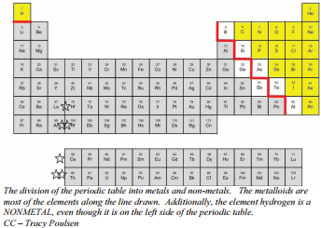
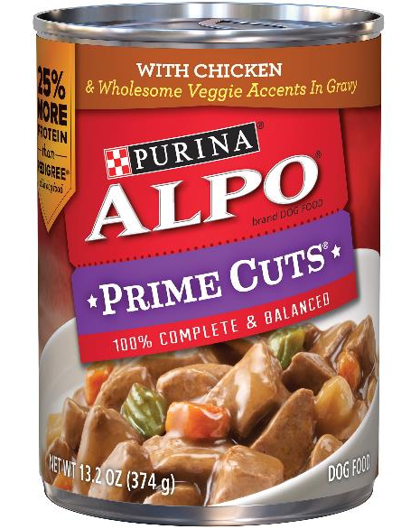
Exceptions to the trends.
72. The first trend you learned about wasn’t even called a trend back then. We learned that nine atoms touch the staircase on the periodic table, but only 7 atoms are metalloids. These two: Al & Po are the “dog food exception, because I have a can of Alpo dog food.

Slide 110
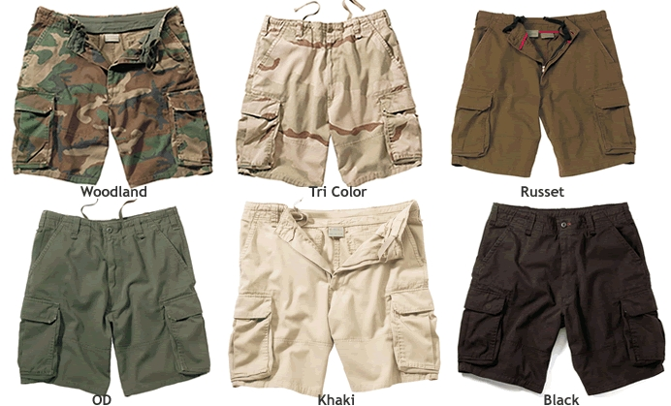
Most trends have exceptions. On the Periodic table, and off.
September
October
November
December
TODAY

Slide 111
Wearing pants is not the end of the trend, it’s an exception to the trend.
A trend is a pattern that is predictable and repetitive, but it can go oops.
73. What are the atomic masses of these elements in period 4?
atoms | Mn | Fe | Co | Ni | Cu
amu | 54.9380 | 55.845 | 58.9332 | 58.693 | 64.456
trend | ↑ | ↑ | ↑ | ↓ | ↑
74. Nickel does NOT DESTROY the trend, it’s an exception.

Slide 112
Atoms | Li | Be | B | C | N | O | F | Ne
Radius in pm | 130. | 99 | 84 | 75 | 71 | 64 | 60 | 62
 | start | ↓ | ↓ | ↓ | ↓ | ↓ | ↓ | ↑
75. The period trend for atomic radius is decreasing (to fluorine). Neon is an exception to this trend.
No big deal.

Slide 113
76. Fill in table. Noble gases have no tendency to make bonds ever, so they don’t have electronegativity values either, right? Look them up now.
Symbol | Name | Electronegativity value
2 -
10 -
18 -
36 -
54 -
86 -

Slide 114
Looks like there’s an exception here too!
Symbol | Name | Electronegativity value
2 - He | helium | ----
10 - Ne | neon | ----
18 - Ar | argon | ----
36 - Kr | krypton | ----
54 - Xe | xenon | 2.6
86 - Rn | radon | ----
EXCEPTION

Slide 115
78. Are there exceptions to Net Nuclear Charge?
Think hard.

Slide 116
78. Are there exceptions to Net Nuclear Charge?
Think hard.
No, the table adds ONE PROTON per box in every period, and lots of protons going down in the groups. This trend is perfect.

Slide 117
Predict the actual sizes of these cations and anions
Atom | Electron configuration | Radius | Ion | Electron configuration | Radius
Lithium
Magnesium
Scandium
Oxygen
Phosphorous

Slide 118
Predict the actual sizes of these cations and anions
Atom | Electron configuration | Radius | Ion | Electron configuration | Radius
Lithium | 2-1 | 32 pm
Magnesium
Scandium
Oxygen
Phosphorous

Slide 119
Predict the actual sizes of these cations and anions
Atom | Electron configuration | Radius | Ion | Electron configuration | Radius
Lithium | 2-1 | 32 pm | Li⁺¹ | 2
Magnesium
Scandium
Oxygen
Phosphorous

Slide 120
Predict the actual sizes of these cations and anions
Atom | Electron configuration | Radius | Ion | Electron configuration | Radius
Lithium | 2-1 | 32 pm | Li⁺¹ | 2 | 24 pm
Magnesium
Scandium
Oxygen
Phosphorous

Slide 121
Predict the actual sizes of these cations and anions
Atom | Electron configuration | Radius | Ion | Electron configuration | Radius
Lithium | 2-1 | 32 pm | Li⁺¹ | 2 | 24 pm
Magnesium | 2-8-2 | 140. pm
Scandium
Oxygen
Phosphorous

Slide 122
Predict the actual sizes of these cations and anions
Atom | Electron configuration | Radius | Ion | Electron configuration | Radius
Lithium | 2-1 | 32 pm | Li⁺¹ | 2 | 24 pm
Magnesium | 2-8-2 | 140. pm | Mg⁺² | 2-8
Scandium
Oxygen
Phosphorous

Slide 123
Predict the actual sizes of these cations and anions
Atom | Electron configuration | Radius | Ion | Electron configuration | Radius
Lithium | 2-1 | 32 pm | Li⁺¹ | 2 | 24 pm
Magnesium | 2-8-2 | 140. pm | Mg⁺² | 2-8 | 125 pm
Scandium
Oxygen
Phosphorous

Slide 124
Predict the actual sizes of these cations and anions
Atom | Electron configuration | Radius | Ion | Electron configuration | Radius
Lithium | 2-1 | 32 pm | Li⁺¹ | 2 | 24 pm
Magnesium | 2-8-2 | 140. pm | Mg⁺² | 2-8 | 125 pm
Scandium | 2-8-9-2 | 159 pm | Sc⁺³ | 2-8-8
Oxygen
Phosphorous

Slide 125
Predict the actual sizes of these cations and anions
Atom | Electron configuration | Radius | Ion | Electron configuration | Radius
Lithium | 2-1 | 32 pm | Li⁺¹ | 2 | 24 pm
Magnesium | 2-8-2 | 140. pm | Mg⁺² | 2-8 | 125 pm
Scandium | 2-8-9-2 | 159 pm | Sc⁺³ | 2-8-8 | 138 pm
Oxygen
Phosphorous

Slide 126
Predict the actual sizes of these cations and anions
Atom | Electron configuration | Radius | Ion | Electron configuration | Radius
Lithium | 2-1 | 32 pm | Li⁺¹ | 2 | 24 pm
Magnesium | 2-8-2 | 140. pm | Mg⁺² | 2-8 | 125 pm
Scandium | 2-8-9-2 | 159 pm | Sc⁺³ | 2-8-8 | 138 pm
Oxygen | 2-6 | 64. pm
Phosphorous

Slide 127
Predict the actual sizes of these cations and anions
Atom | Electron configuration | Radius | Ion | Electron configuration | Radius
Lithium | 2-1 | 32 pm | Li⁺¹ | 2 | 24 pm
Magnesium | 2-8-2 | 140. pm | Mg⁺² | 2-8 | 125 pm
Scandium | 2-8-9-2 | 159 pm | Sc⁺³ | 2-8-8 | 138 pm
Oxygen | 2-6 | 64. pm | O⁻² | 2-8
Phosphorous

Slide 128
Predict the actual sizes of these cations and anions
Atom | Electron configuration | Radius | Ion | Electron configuration | Radius
Lithium | 2-1 | 32 pm | Li⁺¹ | 2 | 24 pm
Magnesium | 2-8-2 | 140. pm | Mg⁺² | 2-8 | 125 pm
Scandium | 2-8-9-2 | 159 pm | Sc⁺³ | 2-8-8 | 138 pm
Oxygen | 2-6 | 64. pm | O⁻² | 2-8 | 71 pm
Phosphorous

Slide 129
Predict the actual sizes of these cations and anions
Atom | Electron configuration | Radius | Ion | Electron configuration | Radius
Lithium | 2-1 | 32 pm | Li⁺¹ | 2 | 24 pm
Magnesium | 2-8-2 | 140. pm | Mg⁺² | 2-8 | 125 pm
Scandium | 2-8-9-2 | 159 pm | Sc⁺³ | 2-8-8 | 138 pm
Oxygen | 2-6 | 64. pm | O⁻² | 2-8 | 71 pm
Phosphorous | 2-8-5 | 109 pm

Slide 130
Predict the actual sizes of these cations and anions
Atom | Electron configuration | Radius | Ion | Electron configuration | Radius
Lithium | 2-1 | 32 pm | Li⁺¹ | 2 | 24 pm
Magnesium | 2-8-2 | 140. pm | Mg⁺² | 2-8 | 125 pm
Scandium | 2-8-9-2 | 159 pm | Sc⁺³ | 2-8-8 | 138 pm
Oxygen | 2-6 | 64. pm | O⁻² | 2-8 | 71 pm
Phosphorous | 2-8-5 | 109 pm | P⁻³ | 2-8-8

Slide 131
Predict the actual sizes of these cations and anions
Atom | Electron configuration | Radius | Ion | Electron configuration | Radius
Lithium | 2-1 | 32 pm | Li⁺¹ | 2 | 24 pm
Magnesium | 2-8-2 | 140. pm | Mg⁺² | 2-8 | 125 pm
Scandium | 2-8-9-2 | 159 pm | Sc⁺³ | 2-8-8 | 138 pm
Oxygen | 2-6 | 64. pm | O⁻² | 2-8 | 71 pm
Phosphorous | 2-8-5 | 109 pm | P⁻³ | 2-8-8 | 116 pm

Slide 132
80. Cations are always much smaller than their atoms WHY? Anions are always slightly bigger than the atoms they formed from, WHY?

Slide 133
80. Cations are always much smaller than their atoms WHY? Cations LOSE a whole orbital when they “lose” electrons. Anions are always slightly bigger than the atoms they formed from, WHY?

Slide 134
80. Cations are always much smaller than their atoms WHY? Cations LOSE a whole orbital when they “lose” electrons. Anions are always slightly bigger than the atoms they formed from, WHY? Gaining electrons “fills” that valence orbital, stretching it out to full size.

Slide 135
Relative scales & arbitrary scales… Electronegativity (Dr. Linus was a fun guy, but not a fungi)
81. A relative scale compares all members of the group to one set standard.

Slide 136
Relative scales & arbitrary scales… Electronegativity (Dr. Linus was a fun guy, but not a fungi)
81. A relative scale compares all members of the group to one set standard.
82. Electronegativity is a relative scale, all atoms are relative to fluorine. Pauling determined that fluorine has the greatest tendency to gain electrons when making a bond, and ranked all other atoms to it.

Slide 137
Relative scales & arbitrary scales… Electronegativity (Dr. Linus was a fun guy, but not a fungi)
81. A relative scale compares all members of the group to one set standard.
82. Electronegativity is a relative scale, all atoms are relative to fluorine. Pauling determined that fluorine has the greatest tendency to gain electrons when making a bond, and ranked all other atoms to it.
83. An arbitrary scale is one that uses numbers that don’t really matter. Pauling choose 4.0 for the highest EN value, given to fluorine. All other atoms were given values ranked down to zero.
He could have use 100 as his top value, or eleven, or anything. He just picked 4.0 for his own reason. There are not 4.0 somethings, in fact there isn’t even a unit.

Slide 138
Relative scales & arbitrary scales… Electronegativity (Dr. Linus was a fun guy, but not a fungi)
81. A relative scale compares all members of the group to one set standard.
82. Electronegativity is a relative scale, all atoms are relative to fluorine. Pauling determined that fluorine has the greatest tendency to gain electrons when making a bond, and ranked all other atoms to it.
83. An arbitrary scale is one that uses numbers that don’t really matter. Pauling choose 4.0 for the highest EN value, given to fluorine. All other atoms were given values ranked down to zero.
He could have use 100 as his top value, or eleven, or anything. He just picked 4.0 for his own reason. There are not 4.0 somethings, in fact there isn’t even a unit.
84. Electronegativity is BOTH a RELATIVE SCALE & an ARBITRARY SCALE.

Slide 139
Last Point, not really related to Periodic Table, but stuck in here to keep in mind…
85. ALLOTROPES
An allotrope is a chemically pure form of an atom that is structurally bonded together differently and therefore has different chemical and physical properties.

Slide 140
Last Point, not really related to Periodic Table, but stuck in here to keep in mind…
85. ALLOTROPES
An allotrope is a chemically pure form of an atom that is structurally bonded together differently and therefore has different chemical and physical properties.
Carbon: it comes in powdery solid, graphite solid, and diamond solid. It also comes in C₆₀ “bucky balls” named Buckminster Fullerenes. All pure carbon, all physically different.
Oxygen: you breathe is O₂ while the gas called ozone is O₃. Both are pure oxygen, but they both have different properties.

