Slide 1
Bonding Lab
This is the second biggest lab of the year (after the Chemical Reactions Lab). It counts for 75 points, it is huge.
It is so important that you grasp what bonding is and how it all works.
In chemistry we have stuff (matter) and how it works (bonding). This is nearly half of the course, and that is why we will work hard to learn it, not work to fill in the boxes fastest.
Doing this lab is different than getting it done. We will spend a lot of time building and touching and thinking about the molecular models. Their shapes as well as the kinds of bonds they make will be a major learning accomplishment for you.
In the coming days you will build about 40 models. These kits are amazing because they fit together in the same shape as the molecules they model for. They’re the same shapes are the invisibly small molecules.
Some molecules are bent and some are straight, and on paper a lot of things look possible. If you make up the diagrams you are supposed to copy from your model, it will be obvious. I will know you faked it.

Slide 2
When 2 or more nonmetals bond together, they share electrons, they form covalent bonds, trying to follow the octet rule,
more importantly, filling up all the shells – even the baby sized shells that hold only 2 electrons.
Bonds can be polar or nonpolar, depending upon the difference in the two electronegativity values.
The greater the difference, the more polar the bond is.
If there is no difference in electronegativity values, the bond is nonpolar.
Bonds that share 1 pair of electrons is called a single bond.
Bonds that share 2 pair of electrons is called a double bond.
Bonds that share 3 pair of electrons is called a triple bond.
Two single bonds is not the same as a double bond.
Single bonds, double bonds, and triple bonds can be nonpolar.
Single bonds, double bonds, and triple bonds can be polar.
There are SIX DIFFERENT COMBOS of covalent bonds.

Slide 3
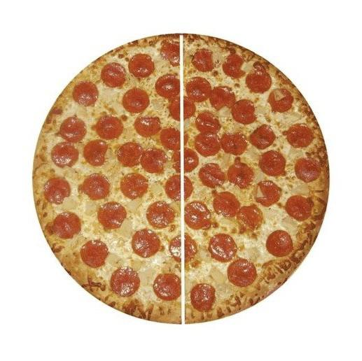
If you come over to my house to
eat pizza with me, and I make a
perfectly round pizza, and cut it
with my sword, if I cut through
the center point, we would each
always get exactly half.
The circle has what is called
RADIAL SYMMETRY,
which is if you cut it in half, through the center, at any angle, you get 2 exactly equal halves.

Slide 4
Molecules have shapes, and in your mind, you can cut them through the center, to see if they have radial symmetry,
if they are “balanced” molecules.
If a molecule has radial symmetry (it’s balanced) it’s a
NONPOLAR MOLECULE
If a molecule does not have radial symmetry
(it’s out of balance) it’s a
POLAR MOLECULE

Slide 5
Now we have polar and nonpolar bonds, and
Polar and Nonpolar molecules. 2 kinds of polarity.
Bond polarity due to electronegativity differences.
Molecular Polarity due to shape (radial symmetry).

Slide 6

Dessert will be a giant homemade Gingerbread Cookie! (to share)
There is only one perfect cut to get two equal halves.
If you cut side to side, you don’t get quite equal halves.
You might trick your little brother into accepting the “bottom half” while you get the “top half”, but you can’t trick me!
This shape DOES NOT HAVE RADIAL SYMMETRY.
It does have one line of symmetry (like most mammals do), but
Radial symmetry means cut through the center point
AT ANY ANGLE for two equal halves.

Slide 7
Ammonia and Methane, do they have radial symmetry?
Which molecules are POLAR or NONPOLAR molecules?
Both have single polar covalent bonds.
H
H―N―H
H―C―H
H
H

Slide 8
Bonding Lab
You will make the models, you will draw the Lewis Dot Diagrams for each one, then the structural diagrams for each one, they you will decide if the molecule has radial symmetry or not.
Does this molecule have radial symmetry? YES = Nonpolar molecule
Does this molecule have radial symmetry? NO = Polar molecule
Most important, MAKE THE MODELS
Use sticks for single bonds. Double or triple bonds require springs.
Make models and do not take them apart until we discuss them, models in hand.

Slide 9
Which balls do I use for which atoms?
BLACK | 4 holes, use for atoms with 4 valence electrons that need to bond 4x to get to an octet | Carbon or Silicon
YELLOW | 1 hole, this is reserved for Hydrogen only | Hydrogen only
BLUE | 3 holes, use for atoms with 5 valence electrons that need to bond 3x to get an octet | Nitrogen or Phosphorous or Arsenic
RED | 2 holes, use for atoms with 6 valence electrons that need to bond 2x to get an octet | Oxygen or Sulfur or Selenium or Tellurium
ORANGE | These all have 1 hole drilled in each. We can use them for any atoms that have 7 valence electrons and need to bond 1x to get an octet. In a molecule like CH₂Cl₂ use 2 of the same color for both chlorine atoms. It doesn’t matter which color you choose, just be consistent inside that molecule. | F or Cl or Br or I
PURPLE |  | F or Cl or Br or I
GREEN |  | F or Cl or Br or I

