Slide 1
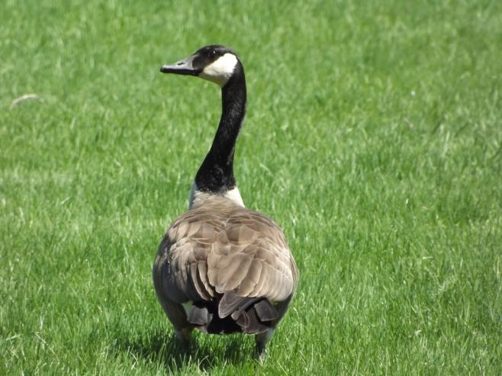
Acids and bases always starts with a good story.
A long time ago, in a galaxy far, far away…

Slide 2
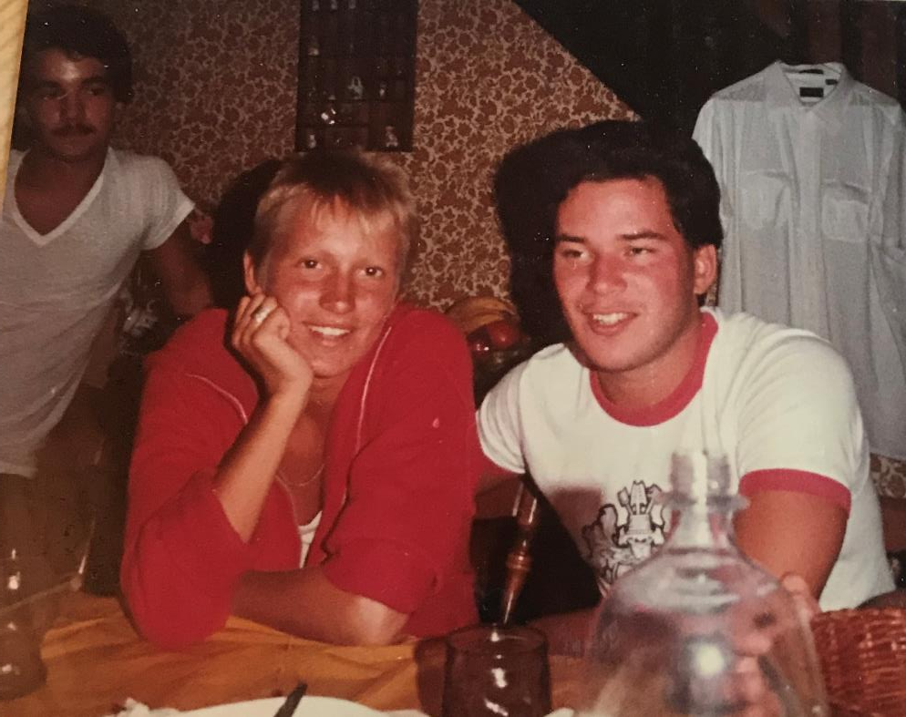

Slide 3
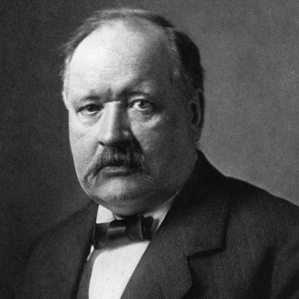
1. Svante Arrhenius
Father of Acids and Bases,
Nobel Prize Winner,
and a man from Sweden.
The Arrhenius Theory covers nearly 99% of all acids + bases, and allowed chemists of all levels to finally grasp what acids and bases were, how they worked, and what happens when you put them together.
There are other theories, for the other 1% of solutions that are acids and bases, including ammonia, but the Arrhenius theory is nearly perfect.

Slide 4
The standard theory (Arrhenius) states that:
2. ACIDS are aqueous solutions
that contain hydrogen ions H⁺¹
3. BASES are aqueous solutions
that contain hydroxide OH⁻¹

Slide 5
When you react an acid with base
you always get a salt and water.
(sing)
Acid and Base make salt and water.
Acid and Base make salt and water.
Acid and Base make salt and water.

Slide 6
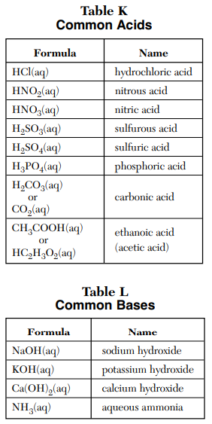
Acids we need to know
are listed in table K
Bases we need to know
are listed in table L

Slide 7
Take out your tables K and L now… we need to write on them.
To carbonic acid,
add the word SELTZER
To ethanoic/acetic acid, add the word
VINEGAR
Strongest acids
top of the list
weakest acids
bottom of the list
Strongest bases top of the list
Weakest bases bottom of the list

Slide 8
8. Acids are strong because they dissociate well
9. Acids are weird, they are molecular
compounds, that share electrons in covalent
bonds. But when you put them into water
they ionize!
HCl_{(G)} H⁺¹_{(AQ)} + Cl⁻¹_{(AQ)}
water
Although this is in dynamic equilibrium, and the ions do form back into molecules of HCl, when you make this solution, normally it is 100% ionic and zero percent molecular.
The “balance” is skewed totally in the forward direction. It’s dynamic equilibrium, but it’s 99.9999% ions at all times. Water separates the HCl into ions very well.

Slide 9
Acid goes in water → Dissociates this way
10 | HNO_{2(G)} H⁺¹_{(AQ)} + NO₂⁻¹_{(AQ)}
11 | HNO_{3(G)} H⁺¹_{(AQ)} + NO₃⁻¹_{(AQ)}
12 | H₂SO_{3(G)} H⁺¹_{(AQ)} + HSO₃⁻¹_{(AQ)}
water
water
water

Slide 10
Acid goes in water → Dissociates this way
10 | HNO_{2(G)} H⁺¹_{(AQ)} + NO₂⁻¹_{(AQ)}
11 | HNO_{3(G)} H⁺¹_{(AQ)} + NO₃⁻¹_{(AQ)}
12 | H₂SO_{3(G)} H⁺¹_{(AQ)} + HSO₃⁻¹_{(AQ)}
water
Almost none
stays molecular
Almost ALL ionizes
water
Almost none
stays molecular
Almost ALL ionizes
water
About 60%
stays molecular
Lots of H⁺¹ ions, but less than acids above

Slide 11
Acid goes in water → Dissociates this way
14 | H₃PO_{4(G)} H⁺¹_{(AQ)} + H₂PO₄⁻²_{(AQ)}
15 | HC₂H₃O_{2(G)} H⁺¹_{(AQ)}+ C₂H₃O₂⁻¹_{(AQ)}
16 | Acids are molecular, and in equilibrium, just counting H⁺¹ cations is a formula is not the way to decide their strength. Table K lists them in strength order.
water
water

Slide 12
Acid goes in water → Dissociates this way
14 | H₃PO_{4(G)} H⁺¹_{(AQ)} + H₂PO₄⁻²_{(AQ)}
15 | HC₂H₃O_{2(G)} H⁺¹_{(AQ)}+ C₂H₃O₂⁻¹_{(AQ)}
16 | Acids are molecular, and in equilibrium, just counting H⁺¹ cations is a formula is not the way to decide their strength. Table K lists them in strength order.
water
About 85%
stays molecular
Not many H⁺¹ ions loose in solution
water
About 96%
stays molecular
Very Few H⁺¹ ions loose in solution

Slide 13
17. BASES are listed in Table L. They are also
listed in strength order.
NaOH is the strongest base
it has the most OH⁻¹ anions in solution.
18. ALL aqueous ionic compound containing
OH⁻¹ anions are bases.
examples: LiOH, RbOH, Sr(OH)₂, etc.

Slide 14
19. Ammonia is NH₃, it has no hydroxides,
but it is a base.
This requires another theory
(coming soon but not today)
20. These are not all the same thing…
Ammonia is a molecule: NH₃
Ammonium is a cation: NH₄⁺¹
Urea forms from ammonia: (NH₂)₂CO

Slide 15
Electrolytes have loose mobile ions in solution.
The more ions in solution, the better the solution conducts
electricity, the stronger electrolyte it is.
Strong acids & strong bases have lots of ions in solution.
24. Strong acids & strong bases are good electrolytes
25. All acids and all bases are electrolytes.
26. Their electrolytic strength (ability to conduct electricity)
depends upon how well they dissociate in water.

Slide 16
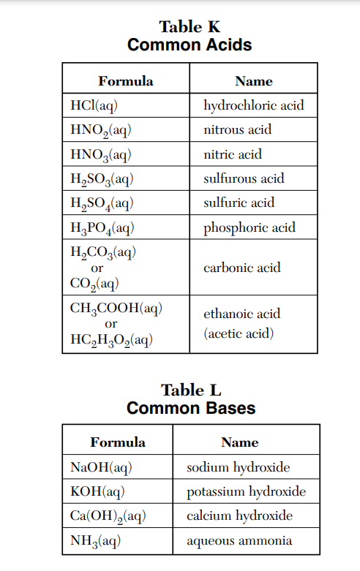
27. Mark up table K and table L now…
Best Electrolytes (most ions)
Weakest electrolytes (fewer ions)
Best Electrolyte (most ions)
Weakest electrolyte (fewer ions)

Slide 17
28. This name of this new
chemical reaction is
Acid Base
Neutralization Reaction

Slide 18
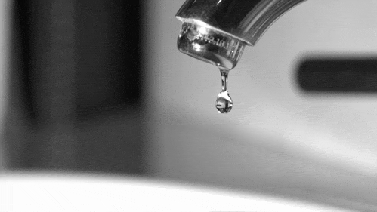
Water, wata, aqua, etc.
29. The formula for water is H₂O_{(L)}
30. The formula for water is HOH_{(L)}

Slide 19
31. Balance hydrochloric acid and sodium hydroxide react…
Hydrochloric acid | and | Sodium hydroxide | forms | Sodium chloride | and | Water
Arrhenius theory states…

Slide 20
31. Balance hydrochloric acid and sodium hydroxide react…
Hydrochloric acid | and | Sodium hydroxide | forms | Sodium chloride | and | Water
HCl_{(AQ)} | + | NaOH_{(AQ)} | → | NaCl_{(AQ)} | + | HOH_{(L)}
Arrhenius theory states…
acid | + | base | makes | salt | + | water

Slide 21
32. Balance nitric acid and potassium hydroxide react…
Nitric acid | and | Potassium hydroxide | forms |  | and
HNO_{3(AQ)} | + | KOH_{(AQ)} | → |  | +

Slide 22
32. Balance nitric acid and potassium hydroxide react…
Nitric acid | and | Potassium hydroxide | forms | Potassium nitrate | and | Water
HNO_{3(AQ)} | + | KOH_{(AQ)} | → | KNO_{3(AQ)} | + | HOH_{(L)}

Slide 23
33. Balance hydrochloric acid and calcium hydroxide react…
Hydrochloric acid | and | Calcium hydroxide | forms | Calcium Chloride | and | Water
 | + |  | → |  | +

Slide 24
33. Balance hydrochloric acid and calcium hydroxide react…
Hydrochloric acid | and | Calcium hydroxide | forms | Calcium Chloride | and | Water
2HCl_{(AQ)} | + | Ca(OH)_{2(AQ)} | → | CaCl_{2(AQ)} | + | 2HOH_{(L)}

Slide 25
34. Balance phosphoric acid and lithium hydroxide react…
Phosphoric acid | and | lithium hydroxide | forms | Lithium phosphate | and | Water
 | + |  | → |  | +

Slide 26
34. Balance phosphoric acid and lithium hydroxide react…
Phosphoric acid | and | lithium hydroxide | forms | Lithium phosphate | and | Water
H₃PO_{4(AQ)} | + | 3LiOH_{(AQ)} | → | Li₃PO_{4(AQ)} | + | 2HOH_{(L)}

Slide 27
35. Balance nitric acid and magnesium hydroxide react…
Nitric acid | and | Magnesium hydroxide | forms | Magnesium nitrate | and | Water
 | + |  | → |  | +

Slide 28
35. Balance nitric acid and magnesium hydroxide react…
Nitric acid | and | Magnesium hydroxide | Calcium hydroxide | forms | Magnesium nitrate | Lithium phosphate | and | and | Water | Water
2HNO_{3(AQ)} | + | Mg(OH)_{2(AQ)} | Ca(OH)_{2(AQ)} | → | Mg(NO₃)_{2(AQ)} | Li₃PO_{4 (AQ)} | + | + | 2HOH_{(L)} | 2HOH_{(L)}
Arrhenius theory states…
acid | + |  | base | makes |  | salt | + |  |  | water

Slide 29
Acid Base Class #2 OBJECTIVES:
A. Master the alternate theory explaining
how ammonia is a base,
B. Acid base chemical indicators

Slide 30
36. | Acid and Base Theories
99% | of acids and bases follow the ARRHENIUS theory. Acids have excess H⁺¹ ions in solution, while Bases have excess OH⁻¹ ions in solution. They combine into salt and water.
1% | Ammonia does not follow the Arrhenius theory. It is a weak base and it has no OH⁻¹ in its formula.

Slide 31
37. An alternate theory (the Bronsted-Lowry Theory)
defines ammonia as a base because of what happens
when it dissolves into water.
What follows on the next slide MUST be memorized. No questions, no exceptions, nothing. Memorize it or you will be sad.

Slide 32
NH_{3(G)} + HOH_{(L)} NH₄⁺¹_{(AQ)} + OH⁻¹_{(AQ)}

Slide 33
38
Ammonia “ACCEPTS” a H⁺¹ ion, so it’s a base.
NH_{3(G)} + HOH_{(L)} NH₄⁺¹_{(AQ)} + OH⁻¹_{(AQ)}
Water “DONATES” a H⁺¹ ion, so it’s an acid.
39. When put into water, only about 25% of the
molecules of ammonia create ions. Most NH₃
is dissolved as polar molecules. Not all form into
ammonium and hydroxide ions.

Slide 34
Ammonia “ACCEPTS” a H⁺¹ ion, so it’s a base.
NH_{3(G)} + HOH_{(L)} NH₄⁺¹_{(AQ)} + OH⁻¹_{(AQ)}
Water “DONATES” a H⁺¹ ion, so it’s an acid.
This is dopey but at the same time it’s not.
In high school chem, the hydroxide ions in solution that make a base.
This solution of aqueous ammonia CLEARLY has hydroxide ions in solution.
Water is NEUTRAL. We know that. This theory is too technical for beginner chemists.
Any compound that “accepts a H⁺¹ cation” is a base.
Any compound that can “donate a H⁺¹ cation” is an acid. Don’t fight it, memorize it.
This is always one point on the regents exam; you’ll get it, or not, it’s a choice.

Slide 35
40. Balance these acid base neutralization reactions (finish word equations too)
Carbonic acid + lithium hydroxide → lithium carbonate + water

Slide 36
40. Balance these acid base neutralization reactions (finish word equations too)
Carbonic acid + lithium hydroxide → lithium carbonate + water
H₂CO_{3(AQ)} + 2LiOH_{(AQ)} → 2HOH_{(L)} + Li₂CO_{3(AQ)}
Acetic acid + calcium hydroxide → calcium acetate + water

Slide 37
40. Balance these acid base neutralization reactions (finish word equations too)
Carbonic acid + lithium hydroxide → lithium carbonate + water
H₂CO_{3(AQ)} + 2LiOH_{(AQ)} → 2HOH_{(L)} + Li₂CO_{3(AQ)}
Acetic acid + calcium hydroxide → calcium acetate + water
2HC₂H₃O_{2(AQ)} + Ca(OH) _{2(AQ)} → Ca(C₂H₃O₂)_{2(AQ)} + 2HOH_{(L)}
Phosphoric acid + sodium hydroxide → sodium phosphate + water

Slide 38
39. Balance these acid base neutralization reactions (finish word equations too)
Carbonic acid + lithium hydroxide → lithium carbonate + water
H₂CO_{3(AQ)} + 2LiOH_{(AQ)} → 2HOH_{(L)} + Li₂CO_{3(AQ)}
Acetic acid + calcium hydroxide → calcium acetate + water
2HC₂H₃O_{2(AQ)} + Ca(OH) _{2(AQ)} → Ca(C₂H₃O₂)_{2(AQ)} + 2HOH_{(L)}
Phosphoric acid + sodium hydroxide → sodium phosphate + water
H₃PO_{4(AQ)} + 3NaOH_{(AQ)} → Na₃PO_{4(AQ)} + 3HOH_{(L)}

Slide 39
Table M Acid Base Indicators
41. Acid Base indicators are compounds that change color,
depending upon the pH (hydrogen ion concentration)
of the solution.
Acid Base Indicators are weak acids that work
by dynamic equilibrium.
The molecules are one color, the ions another.
The “stress” of adding more acid, or more base,
causes a LeChatlier shift forward or reverse.

Slide 40
42. Phenolphthalein works like this…
water
HC₂₀H₁₃O₄ H⁺¹_{(AQ)} + C₂₀H₁₃O₄⁻¹_{(AQ)}
The molecule is colorless the ion is HOT PINK!
ADD ACID H⁺¹ ions
ADD BASE OH⁻¹ ions

Slide 41
42. Phenolphthalein works like this…
water
HC₂₀H₁₃O₄ H⁺¹_{(AQ)} + C₂₀H₁₃O₄⁻¹_{(AQ)}
The molecule is colorless the ion is HOT PINK!
ADD ACID H⁺¹ ions
ADD BASE OH⁻¹ ions
It’s so important NOW to notice this
Adding base ions is the SAME THING as removing H⁺¹ ions.
Base ions (hydroxides) combine with the acid ions forming water.
Adding base ions removes hydrogen ions.
That is why this shift occurs.

Slide 42
43. This is Bromthymol blue indicator. It is also a weak acid,
it “works” the same way as the phenolphthalein, but at a
different concentration of acid or base & different colors
water
HC₂₇H₂₇Br₂O₅S H⁺¹_{(AQ)} + C₂₇H₂₇Br₂O₅S⁻¹_{(AQ)}
YELLOW MOLECULE BLUE ANION
Becomes yellow Add acid H⁺¹
Add base OH⁻¹ becomes blue

Slide 43
43. This is Bromthymol blue indicator. It is also a weak acid,
it “works” the same way as the phenolphthalein, but at a
different concentration of acid or base & different colors
water
HC₂₇H₂₇Br₂O₅S H⁺¹_{(AQ)} + C₂₇H₂₇Br₂O₅S⁻¹_{(AQ)}
YELLOW MOLECULE BLUE ANION
Becomes yellow Add acid H⁺¹
Add base OH⁻¹ Becomes blue

Slide 44
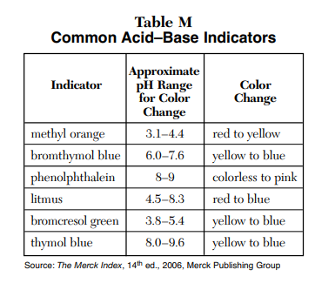
Let’s say the names of all the acid base indicators now.
Some are odd, but you will get used to them.
They give you a HINT of what the strength of the acid or base is.
We will learn about pH soon.
But for now, a pH of 7 is neutral,
it is neither acid nor base.
pH below 7 is an acid, the lower the pH
the stronger the acid.
pH above 7 is a base, the higher the pH
the stronger the base.
It is pH, not PH and not ph.
We will learn, don’t you worry.

Slide 45
Find the titration math formula on the back of the reference table,
and let’s
FIX IT
Then we’ll explain.

Slide 46
Titration Formula
(Molarity of Acid ions)(volume of acid) = (molarity of Base ions)(volume of base)
(M_{A})(V_{A}) = (M_{B})(V_{B})
Change it to:
(#H⁺¹)(M_{A})(V_{A}) = (M_{B})(V_{B})(#OH⁻¹)

Slide 47
44. (#H⁺¹)(M_{A})(V_{A}) = (M_{B})(V_{B})(#OH⁻¹)
Where…
#H⁺¹ = the number of H⁺¹ ions in the acid formula
M_{A} is the molarity of this acid
V_{A} is the volume of this acid
M_{B} is the molarity of this base
V_{B} is the volume of this base
#OH⁻¹ = the number of OH⁻¹ ions in the base formula

Slide 48
In acid base math problems, you can only have one unknown.
45. If 7.91 mL of 1.25 M H₂CO_{3(AQ)} is
neutralized by 16.2 mL of NaOH, what is
the molarity of this base?
Write this formula, do the math.
(#H⁺¹)(M_{A})(V_{A}) = (M_{B})(V_{B})(#OH⁻¹)

Slide 49
In acid base math problems, you can only have one unknown.
45. If 7.91 mL of 1.25 M H₂CO_{3(AQ)} is
neutralized by 16.2 mL of NaOH, what is
the molarity of this base?
Write this formula, do the math.
(#H⁺¹)(M_{A})(V_{A}) = (M_{B})(V_{B})(#OH⁻¹)
(2)(1.25 M)(7.91 mL) = (M_{B})(16.2 mL)(1)

Slide 50
In acid base math problems, you can only have one unknown.
45. If 7.91 mL of 1.25 M H₂CO_{3(AQ)} is
neutralized by 16.2 mL of NaOH, what is
the molarity of this base?
Write this formula, do the math.
(#H⁺¹)(M_{A})(V_{A}) = (M_{B})(V_{B})(#OH⁻¹)
(2)(1.25 M)(7.91 mL) = (M_{B})(16.2 mL)(1)
19.775 = (M_{B})(16.2 mL)
1.22 M = (M_{B})

Slide 51
46. If 25.8 mL of HCl of 2.75 Molarity will neutralize
43.8 mL of calcium hydroxide, what is the molarity of
this base?
Start with this formula…
(#H⁺¹)(M_{A})(V_{A}) = (M_{B})(V_{B})(#OH⁻¹)

Slide 52
46. If 25.8 mL of HCl of 2.75 Molarity will neutralize
43.8 mL of calcium hydroxide, what is the molarity of
this base?
Start with the formula…
(#H⁺¹)(M_{A})(V_{A}) = (M_{B})(V_{B})(#OH⁻¹)
(1)(2.75 M)(25.8 mL) = (M_{B})(43.8 mL)(2)
0.810 M = M_{B}

Slide 53
47. It takes 12.4 mL of 1.90 M HCl to neutralize
104 mL of NaOH. What is the molarity of the base?
(#H⁺¹)(M_{A})(V_{A}) = (M_{B})(V_{B})(#OH⁻¹)

Slide 54
47. It takes 12.4 mL of 1.90 M HCl to neutralize
104 mL of NaOH. What is the molarity of the base?
(1)(M_{A})(V_{A}) = (M_{B})(V_{B})(1)
(1.90 M)(12.4 mL) = (M_{B})(104 mL)

Slide 55
47. It takes 12.4 mL of 1.90 M HCl to neutralize
104 mL of NaOH. What is the molarity of the base?
(1)(M_{A})(V_{A}) = (M_{B})(V_{B})(1)
(1.90 M)(12.4 mL) = (M_{B})(104 mL)
0.227 M = M_{B}
An important note here…

Slide 56
(1)(M_{A})(V_{A}) = (M_{B})(V_{B})(1)
(1.90 M)(12.4 mL) = (M_{B})(104 mL)
0.227 M = M_{B}
An important note here…
You’re not wasting your effort here by multiplying by (1) on both sides.
You are reminding yourself that SOMETIMES
the ACID:BASE ratios are not 1:1 and
you
are ALWAYS are being careful with the math.

Slide 57
CLASS 3 OBJECTIVE:
Measuring the strengths of acids & bases with pH

Slide 58
CLASS 3 OBJECTIVE:
Measuring the strengths of acids & bases with pH
48. We will use the pH scale, it measures how
acidic or basic a solution is.
pH is an odd scale: it runs from 0-14
A pH below 7 is an acid
A pH higher than 7 is a base.

Slide 59
49
Strongest acids have LOW pH. Weaker acids are closer to pH 7.
0 1 2 3 4 5 6 7 8 9 10 11 12 13 14
pH

Slide 60
50
Strongest acids have LOW pH. Weaker acids are closer to pH 7.
0 1 2 3 4 5 6 7 8 9 10 11 12 13 14
pH
Weaker bases are closer to pH 7. Strongest bases have HIGH pH.

Slide 61
51
Strongest acids have LOW pH. Weaker acids are closer to pH 7.
0 1 2 3 4 5 6 7 8 9 10 11 12 13 14
pH
Weaker bases are closer to pH 7. Strongest bases have HIGH pH.
pH 7 means NOT ACID or BASE.
The H⁺¹ ions = the OH⁻¹ ions exactly. If a solution has no ions at all,
or if it has no H⁺¹ ions or OH⁻¹ ions, it’s neutral

Slide 62
52. First, the pH scale is a logarithm scale.
That means small changes in value or strength are
really changes in EXPONENTS.
53. The pH scale is an exponent scale
(liker the Richter scale)
each whole number change in pH is a 10X change
in strength of the acid ions.
A pH 3.5 acid is 10X stronger than a pH 4.5 acid.

Slide 63
0 1 2 3 4 5 6 7 8 9 10 11 12 13 14
pH
Using this chart, let’s count how much stronger or weaker these solutions are from their partners in the chart. NOTE: acids are stronger than other acids, or weaker. Bases are compared to each other as well. We will not compare acids to bases
(apples and oranges!). It can be done mathematically, but we’re just having fun!
Compare these solutions
ex | pH of solution A | pH of solution B | comparison
ex | 2.5 | 5.5 | 3 whole number change = 10x10x10 Solution A is 1000X more acidic than B

Slide 64
0 1 2 3 4 5 6 7 8 9 10 11 12 13 14
pH
 | pH of Solution A | pH of Solution B | compare these two
54 | 7.9 | 9.9
55 | 1.0 | 6.0
56 | 13.1 | 7.1
57 | 1.2 | 5.2

Slide 65
0 1 2 3 4 5 6 7 8 9 10 11 12 13 14
pH
 | pH of Solution A | pH of Solution B | compare these two
54 | 7.9 | 9.9 | 10x10 or solution A is 100x less basic than B
55 | 1.0 | 6.0
56 | 13.1 | 7.1
57 | 1.2 | 5.2

Slide 66
0 1 2 3 4 5 6 7 8 9 10 11 12 13 14
pH
 | pH of Solution A | pH of Solution B | compare these two
54 | 7.9 | 9.9 | 10x10 or solution A is 100x less basic than B
55 | 1.0 | 6.0
56 | 13.1 | 7.1
57 | 1.2 | 5.2

Slide 67
0 1 2 3 4 5 6 7 8 9 10 11 12 13 14
pH
 | pH of Solution A | pH of Solution B | compare these two
54 | 7.9 | 9.9 | 10x10 or solution A is 100x less basic than B
55 | 1.0 | 6.0 | 10x10x10x10x10 or solution A is 100,000X more acidic than solution B
56 | 13.1 | 7.1
57 | 1.2 | 5.2

Slide 68
0 1 2 3 4 5 6 7 8 9 10 11 12 13 14
pH
 | pH of Solution A | pH of Solution B | compare these two
54 | 7.9 | 9.9 | 10x10 or solution A is 100x less basic than B
55 | 1.0 | 6.0 | 10x10x10x10x10 or solution A is 100,000X more acidic than solution B
56 | 13.1 | 7.1
57 | 1.2 | 5.2

Slide 69
0 1 2 3 4 5 6 7 8 9 10 11 12 13 14
pH
 | pH of Solution A | pH of Solution B | compare these two
54 | 7.9 | 9.9 | 10x10 or solution A is 100x less basic than B
55 | 1.0 | 6.0 | 10x10x10x10x10 or solution A is 100,000X more acidic than solution B
56 | 13.1 | 7.1 | 10x10x10x10x10x10 or solution A is 1,000,000X more basic than solution B
57 | 1.2 | 5.2

Slide 70
0 1 2 3 4 5 6 7 8 9 10 11 12 13 14
pH
 | pH of Solution A | pH of Solution B | compare these two
54 | 7.9 | 9.9 | 10x10 or solution A is 100x less basic than B
55 | 1.0 | 6.0 | 10x10x10x10x10 or solution A is 100,000X more acidic than solution B
56 | 13.1 | 7.1 | 10x10x10x10x10x10 or solution A is 1,000,000X more basic than solution B
57 | 1.2 | 5.2

Slide 71
0 1 2 3 4 5 6 7 8 9 10 11 12 13 14
pH
 | pH of Solution A | pH of Solution B | compare these two
54 | 7.9 | 9.9 | 10x10 or solution A is 100x less basic than B
55 | 1.0 | 6.0 | 10x10x10x10x10 or solution A is 100,000X more acidic than solution B
56 | 13.1 | 7.1 | 10x10x10x10x10x10 or solution A is 1,000,000X more basic than solution B
57 | 1.2 | 5.2 | 10x10x10x10 or solution A is 10,000X more acidic than solution B

Slide 72
Measuring the strengths of acids and bases.
Let’s look at the math formula, which is not part of our class, but real.
58. pH = -log[H⁺¹]
59. Which means
pH, the strength of an acid is equal to
the negative logarithm of the Molarity
of hydrogen ions in solution.

Slide 73
What the math means…
A pH of 0 means that the concentration of H⁺¹ in solution is
1x10⁰ moles H⁺¹/liter = 1 mole of H⁺¹ ions/liter
A pH of 1 means that the concentration of H⁺¹ in solution is
1x10⁻¹ moles H⁺¹/liter = one tenth of a mole of H⁺¹/liter
A pH of 2 means that the concentration of H⁺¹ in solution is
1x10⁻² moles H⁺¹/liter = one 100th of a mole of H⁺¹ /liter
It’s the negative of the exponent that is the pH.

Slide 74
H⁺¹ concentration
pH 14 =
pH 13 =
pH 10 =
pH 8.25 =
pH 7.99 =
1x10⁻¹⁴ moles H⁺¹ ions/liter
1x10⁻¹³ moles H⁺¹ ions/liter
1x10⁻¹⁰ moles H⁺¹ ions/liter
1x10^{-8.25} moles H⁺¹ ions/liter
1x10^{-7.99} moles H⁺¹ ions/liter
60. What ever the negative of the exponent of the molarity of the acid ions is, that’s the pH of the solution.

Slide 75
We do not have to do log math ever.
This is to show you that the numbers are based in real math and science, and not “made up”.
It’s all good, relax again.

Slide 76
In our class we will ONLY compare
whole number pH differences.
To compare a pH of 2.35 with a pH 5.44
would be TOO HARD for us.
We know that the first acid is more acidic than the second.
Next, how can we measure pH without numbers?
We can use a variety of acid base indicators.
Take out Table M now.

Slide 77

Let’s look at METHYL ORANGE, the first indicator on table M.
3.1 4.4 7
61. This table CLEARLY says that Methyl Orange changes color
from red to yellow between pH 3.1 and 4.4
All solutions with pH 3.1 or lower will be red with this indicator.
All solutions with pH above 4.4 will be yellow.
If by chance the solution is between pH 3.3 - pH 4.1 that solution presents as an “orangey” color.
62. Acid Base indicators “indicates” ranges of pH, not specific pH.

Slide 78



Table M, in order
with approximate color changes
Methyl orange
Bromthymol blue
Phenolphthalein
Litmus
Bromcresol green
Thymol blue
LOOK and think, no writing about this.

Slide 79
Class 4 Math Practice
Reference tables
and calculators out.

Slide 80
63. If 782.2 mL of KOH base to neutralize 1500. mL
of H₂SO₄ that has a 1.56 M,
what is the molarity of this base?
Hint: write the acid and base formula every time!

Slide 81
63. If 782.2 mL of KOH base to neutralize 1500. mL
of H₂SO₄ that has a 1.56 M,
what is the molarity of this base?
(2)(M_{A})(V_{A}) = (M_{B})(V_{B})(1)
(2)(1.56 M)(1500. mL) = (M_{B})(782.2 mL)(1)
5.98 M = M_{B}

Slide 82
64. What volume of 3.75 M H₂SO_{4(AQ)} is
necessary to exactly neutralize 34.7 liters
of 1.88 M KOH?

Slide 83
64. What volume of 3.75 M H₂SO_{4(AQ)} is
necessary to exactly neutralize 34.7 liters
of 1.88 M KOH?
(#H⁺¹)(M_{A})(V_{A}) = (M_{B})(V_{B})(#OH⁻¹)
(2)(M_{A})(V_{A}) = (M_{B})(V_{B})(1)
(2)(3.75 M)(V_{A}) = (1.88 M)(34.7 L)(1)
V_{A} =
V_{A} = 8.70 Liters (3SF)
(1.88 M)(34.7 L)(1)
(2)(3.75 M)

Slide 84
65. 12.45 mL of 2.00 M H₃PO₄ is exactly
neutralized with 25.33 mL Sr(OH)₂.
What is the molarity of the base?

Slide 85
65. 12.45 mL of 2.00 M H₃PO₄ is exactly
neutralized with 25.33 mL Sr(OH)₂.
What is the molarity of the base?
(#H⁺¹)(M_{A})(V_{A}) = (M_{B})(V_{B})(#OH⁻¹)
(3)(M_{A})(V_{A}) = (M_{B})(V_{B})(2)
(3)(2.00 M)(12.45 mL) = (M_{B})(25.33 mL)(2)
= M_{B} = 1.47 M KOH
(3)(2.00 M)(12.45 mL)
(25.33 mL)(2)

Slide 86
Acid Base Class #4
OBJECTIVES
We will wrap up some of the loose ends of acids + bases, reviewing acid base chemistry.

Slide 87
66. Acid Base indicators are mostly weak acids.
67. When you put these indicators into solutions containing H⁺¹ ions or OH⁻¹ ions, they will undergo
a LeChatleier's Shift , shifting forward or reverse.
Let’s look at the molecule phenolphthalein,
since we used it in lab.

Slide 88
Phenolphthalein is a weak acid, which means it’s a molecule with a H⁺¹ ion that sometimes ionizes off the molecule.
The formula for phenolphthalein is:
HC₂₀H₁₃O₄
Show the dissociation of phenolphthalein
when it is put into H₂0

Slide 89
68. Which way does the equilibrium shift
when adding acid or base?
Phenolphthalein in dynamic equilibrium…
HC₂₀H₁₃O₄ H⁺¹_{(AQ)} + C₂₀H₁₃O₄⁻¹_{(AQ)}
water
colorless molecule pink anion
ADD BASE
ADD ACID

Slide 90
68. Which way does the equilibrium shift
when adding acid or base?
Phenolphthalein in dynamic equilibrium…
HC₂₀H₁₃O₄ H⁺¹_{(AQ)} + C₂₀H₁₃O₄⁻¹_{(AQ)}
water
colorless molecule pink anion
ADD BASE
ADD ACID

Slide 91
The next slide contains the worst part of chemistry all year (for me). I must teach you this, I don’t understand why, there is NO NEED to try to grasp this other than it’s on the regents exam.
Forgive me, in advance.

Slide 92
Svante Arrhenius won a Nobel Prize for his theory
of acids and bases.
Bronsted + Lowry made a name for themselves with ammonia being a base with their “alternate theory”.
Another way to “understand” acids is this silly idea…
69. The H⁺¹ ions from the acid “join” with the
H₂O molecules forming hydronium ions:
H⁺¹ + H₂O H₃O⁺¹

Slide 93
70. The acid exists as part of a water molecule, called the hydronium ion.
The H⁺¹ ion becomes one with water.
You can believe this if you like, you might even see it on
the regents, but it seems unnecessary, just extra vocabulary.
71. Hydronium ion: a model for acids,
whereby the hydrogen ions become
one with water and exists as H₃O⁺¹ ions.

Slide 94
72 | 4 ways acids can be described
H⁺¹ | Svante Arrhenius was right
NH₃ theory | Any compound that donates a H⁺¹ ion, according to the Bronsted-Lowry theory (NH₃ ammonia is a base because it ACCEPTS a H⁺¹ ion)
H₃O⁺¹ | the weirdo hydronium ion
p⁺¹ | or just as protons (what really is a hydrogen ion, if a hydrogen ion is a proton plus an electron, and the electron ionizes away to an anion, all that’s left is a proton.)

Slide 95
73. Balance these chemical equations from these word equations…
Hydrochloric acid + calcium hydroxide yields…
Sulfuric acid + ammonium hydroxide yields…
Nitrous acid + lithium hydroxide yields…

Slide 96
73. Balance these chemical equations from these word equations…
2HCl_{(AQ)} + Ca(OH)_{2(AQ)} CaCl_{2(AQ)} + 2HOH_{(L)}
potassium chloride + water
H₂SO_{4(AQ)} + 2NH₄OH_{(AQ)} (NH₄)₂SO_{4(AQ)} + 2HOH_{(L)}
ammonium sulfate + water
HNO_{2(AQ)} + LiOH_{(AQ)} LiNO_{2(AQ)} + HOH_{(L)}
lithium nitrite + water

Slide 97
Take out reference tables and notes (start #74 today) Calculator too.
Acid Base HW’s due yesterday, today and tomorrow.
Wednesday is Acid Base Titration classwork, and the Titration Lab is going to be on Friday.
Celebration is still on Tuesday, all good.

Slide 98
74. Show the dissociation for sulfurous acid into water. Use phase symbols.
75. Show the dissociation of potassium hydroxide in water as well. Use phase symbols.

Slide 99
74 + 75
H₂SO_{3(G)} H⁺¹_{(AQ)} + H⁺¹_{(AQ)} + SO₃⁻²_{(AQ)}
KOH_{(S)} K⁺¹_{(AQ)} + OH⁻¹ _{(AQ)}
water
water

Slide 100
76. How many milliliters of 1.25 M NaOH base
can 12.0 mL of 2.50 M HCl acid neutralize?

Slide 101
76. How many milliliters of 1.25 M NaOH base
can 12.0 mL of 2.50 M HCl acid neutralize?
(1)(M_{A})(V_{A}) = (M_{B})(V_{B})(1)
(1)(2.50 M)(12.0 mL) = (1.25 M)(V_{B})(1)
24.0 mL = V_{B}
This is an important time to point out that this
acid is monoprotic (one H⁺¹) per molecule.
That word, monoprotic, is vocabulary now.
The base is a “single hydroxide” base.

Slide 102
77. How many mL of H₃PO₄ acid of 1.15 M is needed
to neutralize 56.0 mL of 2.50 M Mg(OH)₂?
(triprotic acid, double base)

Slide 103
77. How many mL of H₃PO₄ acid of 1.15 M is needed
to neutralize 56.0 mL of 2.50 M Mg(OH)₂?
(triprotic acid, double base)
(3)(M_{A})(V_{A}) = (M_{B})(V_{B})(2)
(3)(1.15 M)(V_{A}) = (2.50 M)(56.0 mL)(2)
V_{A} = 81.2 mL

Slide 104
78. How many mL of 0.760 M NaOH is
required to neutralize 145 mL of
4.33 M HCl acid?

Slide 105
78. How many mL of 0.760 M NaOH is
required to neutralize 145 mL of
4.33 M HCl acid?
(1)(M_{A})(V_{A}) = (M_{B})(V_{B})(1)
(4.33 M)(145 mL) = (0.760 M)(V_{B})
826 mL = V_{B}

Slide 106
Bromthymol Blue is an acid base indicator on table M, and it’s a weak acid. It does not dissociate well. Its formula is…
HC₂₇H₂₇Br₂O₅S
79. Show this in dynamic equilibrium with
the hydrogen ion and its larger anion.
The molecule in water is yellow, and in a base,
the anion appears blue. Include that under your dynamic equilibrium as well.

Slide 107
79
water
HC₂₇H₂₇Br₂O₅S H⁺¹_{(AQ)} + C₂₇H₂₇Br₂O₅S⁻¹_{(AQ)}
YELLOW BLUE
Add base OH⁻¹
Add acid H⁺¹

Slide 108
79 LOOK AT TABLE M Bromthymol blue changes from
yellow → blue from 6.0 to 7.6 Right? (yes)
water
HC₂₇H₂₇Br₂O₅S H⁺¹_{(AQ)} + C₂₇H₂₇Br₂O₅S⁻¹_{(AQ)}
YELLOW BLUE
Add base OH⁻¹
Add acid H⁺¹

Slide 109
80. Here are 3 problems in a row. You must write the formula, put in the correction multipliers where necessary, and fill in the formula’s second line. You do not have to complete the problems, just show the proper set up and formula.
You neutralize 134 mL of 2.45 M H₃PO_{4(AQ)} with
202 mL of KOH_{(AQ)}. What is the molarity of the base?
A bottle of 2,012 mL of 4.00 M NaOH_{(AQ)} is spilled in lab.
You use a weak sulfuric acid of just 0.450 M to clean up.
How many mL are used?
45.6 mL nitric acid is neutralized with 33.2 mL
calcium hydroxide solution of 1.24 M.
What is strength of the acid?

Slide 110
(#H⁺¹)(M_{A}V_{A}) = (M_{B}V_{B})(#OH⁻¹)
(3)(2.45 M)(134 mL) = (M_{B})(202 mL)(1)
(#H⁺¹)(M_{A}V_{A}) = (M_{B}V_{B})(#OH⁻¹)
(2)(0.450 M)(V_{A}) = (4.00 M)(2012 mL)(1)
sulfuric acid is DIPROTIC (two ions per molecule)
(#H⁺¹)(M_{A}V_{A}) = (M_{B}V_{B})(#OH⁻¹)
(1)(M_{A})(45.6 mL) = (1.24 M)(33.2 mL)(2)
80

Slide 111
[H⁺¹]
[OH⁻¹]
0 7 14
acids The pH scale bases
81. Draw the diagram. Write that stuff below....
Strong acids H⁺¹ ions > OH⁻¹ ions
Strong bases H⁺¹ ions < OH⁻¹ ions
At neutral pH 7.0 H⁺¹ = OH⁻¹
(or there are no ions)

Slide 112
At pH 2.5 the hydrogen ion concentration is
1 x 10^{-2.5} moles H⁺¹ ions per liter of solution.
Make sure, right now, you see where
the exponent goes when describing the pH.
82. What is the pH of these 2 solutions?
1 x 10^{-6.5} moles H⁺¹ ions per liter of solution.
1 x 10^{-11.3} moles H⁺¹ ions per liter of solution.

Slide 113
82. What is the pH of these 2 solutions?
1 x 10^{-6.5} moles H⁺¹ ions per liter of solution.
This solution has a pH of 6.5
1 x 10^{-11.3} moles H⁺¹ ions per liter of solution.
This solution has a pH of 11.3

Slide 114
Let’s compare solutions on the left, to solutions on the right.
 | Solution 1 | Solution 2 | Solution 1 is…
ex | pH 4.3 | pH 6.3 | 100x more acidic
83 | pH 11.2 | pH 13.2
84 | pH 1.2 | pH 0.2
85 | pH 12.0 | pH 8.0
86 | pH 1.3 | pH 6.3

Slide 115
Let’s compare solutions on the left, to solutions on the right.
 | Solution 1 | Solution 2 | Solution 1 is…
ex | pH 4.3 | pH 6.3 | 100x more acidic
83 | pH 11.2 | pH 13.2 | 100 x less basic
84 | pH 1.2 | pH 0.2 | 10x less acidic
85 | pH 12.0 | pH 8.0 | 10,000x more basic
86 | pH 1.3 | pH 6.3 | 100,000x more acidic

Slide 116
87. Acid Base Indicator Color changes. What color would each be?
Methyl orange indicator goes into an ammonia solution.
Bromthymol blue indicator goes into vinegar.
Thymol blue indicator goes into deionized water.
Litmus indicator goes into potassium hydroxide.
Bromcresol green indicator goes into Mixed Berry seltzer.

Slide 117
87. Acid Base Indicator Color changes. What color would each be?
Methyl orange indicator goes into an ammonia solution. | YELLOW
Bromthymol blue indicator goes into vinegar. | YELLOW
Thymol blue indicator goes into deionized water. | YELLOW
Litmus indicator goes into potassium hydroxide. | BLUE
Bromcresol green indicator goes into Mixed Berry seltzer. | PROBABLY BLUE

Slide 118
88. Finish this drawing, include all arrows and labels, to completely
outline how ammonia is a base in the Bronsted-Lowry Theory…
Include 2 clear sentences that explain why ammonia is a base,
and what water is here.
NH_{3(G)} + H₂O_{(L)}

Slide 119
88. Finish this drawing, include all arrows and labels, to completely
outline how ammonia is a base in the Bronsted-Lowry Theory…
Include 2 clear sentences that explain why ammonia is a base,
and what water is here.
NH_{3(G)} + H₂O_{(L)} NH_{4(AQ)}⁺¹ + OH⁻¹_{(AQ)}
Ammonia accepts the H⁺¹ ion, NH₃ is a base
Water donates the H⁺¹ ion, therefore water is an acid
We really know that Svante was smart -- it’s the hydroxide ions
that cause the base properties, including being slippery on your fingers.

Slide 120
89. Thymol Blue is an acid base indicator, it’s a weak acid. Its formula is: HC₂₇H₂₉O₅S
Show the dissociation of this weak acid in water, then stress it by adding acid and adding base.
What is the color of the molecule, what color is the anion?
water
HC₂₇H₂₉O₅S H⁺¹ + C₂₇H₂₉O₅S⁻¹
Add acid
Add base
Between 8.0 -- 9.6 it is a shade of green

Slide 121
89. Thymol Blue is an acid base indicator, it’s a weak acid. Its formula is: HC₂₇H₂₉O₅S
Show the dissociation of this weak acid in water, then stress it by adding acid and adding base.
What is the color of the molecule, what color is the anion?
water
HC₂₇H₂₉O₅S H⁺¹ + C₂₇H₂₉O₅S⁻¹
Add acid
Add base
Molecule is Anion is
Yellow Blue
Between 8.0 -- 9.6 it is a shade of green

Slide 122
Methyl Orange is an acid base indicator, it’s a weak acid.
Its formula is: HC₁₄H₁₃N₃NaO₃S
90. Show the dissociation of this weak acid in water,
then stress it by adding acid and adding base.
What is the color of the molecule, what color is the anion?

Slide 123
Methyl Orange is an acid base indicator, it’s a weak acid.
Its formula is: HC₁₄H₁₃N₃NaO₃S
90. Show the dissociation of this weak acid in water,
then stress it by adding acid and adding base.
What is the color of the molecule, what color is the anion?
HC₁₄H₁₃N₃NaO₃S H⁺¹ + C₁₄H₁₃N₃NaO₃S⁻¹
Add acid
Add base
water
Molecule is RED
Anion is YELLOW
Between 3.1 → 4.4
it’s a shade of orange

Slide 124
91. What are 4 ways to describe an acid. As…
1.
2.
3.
4.

Slide 125
91. What are 4 ways to describe an acid. As…
1. H⁺¹_{(AQ)} as per Svante
2. protons in water as per the hipsters
3. compounds that can donate H⁺¹ ions, like HOH
in the alternate theory (Bronsted-Lowry)
4. the dreaded H₃O⁺¹ cations - be one with the HOH

Slide 126
92. How many hydrogen ions are present per
liter in a solution with a pH of 3.0? This is hard

Slide 127
92. How many hydrogen ions are present per
liter in a solution with a pH of 3.0? This is hard
The molarity of H⁺¹ is 1 x 10⁻³ moles per liter.
That is one-thousandth of a mole.
1 mole has 6.02 x 10²³ hydrogen ions.
One- thousandth of that is 6.02 x 10²⁰ hydrogen ions.

Slide 128
93.
Show the dissociation of a strong acid like HCl and a weak acid like ethanoic acid in dynamic equilibrium.
HCl
HC₂H₃O₂
Think : put ONE MOLE of each of these into water.

Slide 129
93.
Show the dissociation of a strong acid like HCl and a weak acid like ethanoic acid in dynamic equilibrium.
HCl H⁺¹_{(AQ)} + Cl⁻¹_{(AQ)}
HC₂H₃O₂ H⁺¹_{(AQ)} + C₂H₃O₂⁻¹_{(AQ)}
Think : put ONE MOLE of each of these into water.
almost no HCl molecules → 99.999% ionizes into solution, strong acid
about 98% molecules → 2% ionizes into solution, weak acid

Slide 130
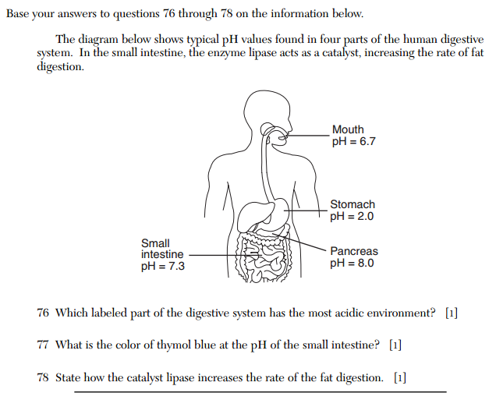
94
Old Regents problems.
Note: it looks like Biology, they love to “mix” things up like this.
It’s all easy chem, go slowly.

Slide 131
94
Stomach
A pH 7.3 makes
it yellow
Catalysts decrease the activation energy or offer an alternate pathway forward. Do not say it speeds up the reaction!
(of course it does, answer the question!)

Slide 132
fin
That’s French!

