Slide 1
Atomic Theory Class #1
OBJECTIVE: Examining the basic structure of the ATOM, and to learn what the numbers on the Periodic table show us.

Slide 2
1. All atoms are made up of three sub-atomic
(smaller than atoms) parts. They are the…
Parts of the atom | Particle Charge | Symbol | Mass | Location
proton
neutron
electron

Slide 3
1. All atoms are made up of three sub-atomic
(smaller than atoms) parts. They are the…
Parts of the atom | Particle Charge | Symbol | Mass | Location
proton | Positive + | p⁺ | 1 amu | nucleus
neutron | Neutral Ø | n° | 1 amu | nucleus
electron | Negative – | e⁻ | zero in high school | flying around the nucleus

Slide 4
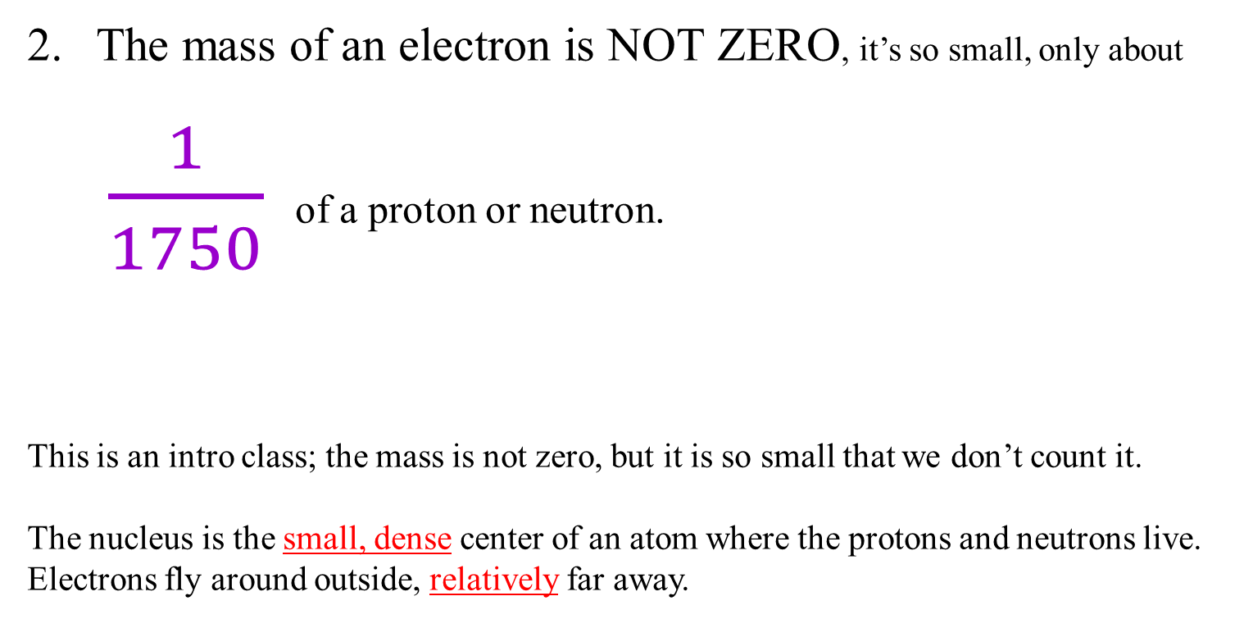
The mass of an electron is NOT ZERO, it’s so small, only about
$\frac{1}{1750}$ of a proton or neutron.
This is an intro class; the mass is not zero, but it is so small that we don’t count it.
The nucleus is the small, dense center of an atom where the protons and neutrons live.
Electrons fly around outside, relatively far away.

Slide 5
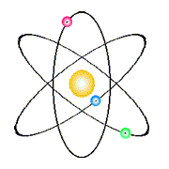
3. The nucleus is the small, dense, positive center of an atom where the protons live (and so do the neutrons).
4. Electrons fly around outside, relatively far away.
In this model, the nucleus is the yellow ball in the middle.
This is a model of atom #3,
which is LITHIUM.
It does not show the three protons and four neutrons.
It’s a cartoon, it’s not even what we think atoms look like, but it’s cute.

Slide 6
5. AMU is atomic mass unit.
abbreviated as just “u”
It’s a super small mass, and there is a lot of math to make it equivalent to 1.67377 x 10⁻²⁴ gram, but we’ll NEVER DO MATH with this number.
6. In high school a proton has mass of 1 amu. (1 u)
A neutron has mass of = 1 amu. (1 u)
7. In high school, because the mass of the electron is
so much smaller, we discount it in our calculations,
but it is NOT REALLY ZERO.

Slide 7
8.
Atomic
Mass
12.011
Missing numbers, we will discuss them soon, not today.
C
Atomic
Number
Electron
Configuration
6
2-4

Slide 8
9. Atomic Mass Numbers will be rounded to the
nearest whole number in our class. We will learn why the
decimals exist and why they are important too, have patience.
10. Mass Number = mass of protons + neutrons
Atomic Mass = p⁺ plus n°

Slide 9

11. The mass of sodium is 23 AMU.
It has a total of
11 protons + ___ neutrons.
11p⁺
?n°
= 23 AMU

Slide 10
11. copy
Sodium mass | 23 AMU | protons + neutrons
Minus atomic number | -11 | - protons
Equal | 12 | neutrons

Slide 11
12. How many protons, neutrons and electrons
are in TIN (element number 50)?
Mass of Sn = 119 = p⁺ + n°
– atomic #

Slide 12
12. How many protons, neutrons and electrons
are in TIN (element number 50)?
Mass of Sn = 119 = p⁺ + n°
– atomic # – 50 – # p⁺
69 = # n°
Tin has 50 protons, 50 electrons, and 69 neutrons.

Slide 13
13
This slide left intentionally blank; you know why.

Slide 14
14. All atoms are electrically neutral,
the number of p⁺ = the number of e⁻
the positives = the negatives.
Atom | Number of protons | Number of electrons
helium | 2 | 2
copper | 29 | 29
tungsten | 74 | 74
BISMUTH | 83 | 83
Protons = electrons ALWAYS

Slide 15
15. How many p⁺, n° and e⁻ are in INDIUM?
Indium mass | # protons PLUS # neutrons =
 | minus protons
 | equals neutrons
The protons = electrons, so indium has 49 electrons also.

Slide 16
15. How many p⁺, n° and e⁻ are in INDIUM?
Indium mass | # protons PLUS # neutrons = | 115
 | minus protons | – 49
 | equals neutrons | 66
The protons = electrons, so indium has 49 electrons also.

Slide 17
16. How many p⁺, n° and e⁻ are in NIOBIUM (#41)?
Niobium mass | # protons PLUS # neutrons =
 | minus protons | –
 | equals neutrons
The protons = electrons, so niobium has electrons also.

Slide 18
16. How many p⁺, n° and e⁻ are in NIOBIUM (#41)?
Niobium mass | # protons PLUS # neutrons = | 93
 | minus protons | – 41
 | equals neutrons | 52
The protons = electrons, so niobium has 41electrons also.

Slide 19
17. How many p⁺, n° and e⁻ are in IRON (#26)?
Iron mass | # protons PLUS # neutrons =
 | minus protons | –
 | equals neutrons
The protons = electrons, so iron has electrons also.

Slide 20
17. How many p⁺, n° and e⁻ are in IRON (#26)?
Iron mass | # protons PLUS # neutrons = | 56
 | minus protons | – 26
 | equals neutrons | 30
The protons = electrons, so iron has 26 electrons also.

Slide 21
A more formal symbol for Calcium can also be written as:
40
20
Ca
Atomic mass
Atomic number
18. Write the Formal Symbols for:
Mercury | Chlorine | Copper

Slide 22
A more formal symbol for Calcium can also be written as:
40
20
Ca
Atomic mass
Atomic number
18. Write the Formal Symbols for:
Mercury | Chlorine | Copper
Hg
35
17
Cl
64
29
Cu
201
80

Slide 23
Electrons don’t just fly around randomly
19. Electrons stay in SHELLS,
which are also energy levels.
20. Shells closer to the nucleus have
LOWER energy electrons.
Electrons in shells further away from the
nucleus, have higher energy.

Slide 24
21. The shells are sized to hold a maximum
number of electrons.
You don’t memorize how many can fit into each shell, you just look at group 18 on the Periodic Table.
These are the NOBLE GASES.
They have only full shells.

Slide 25
 | Noble gases | Electron Configuration in the shells
22 | Helium He | 2
23 | Neon Ne
24 | Argon Ar
25 | Krypton Kr
26 | Xenon Xe
27 | Radon Rn
Fill in all
of the appropriate boxes

Slide 26
 | Noble gases | Electron Configuration in the shells
22 | Helium He | 2
23 | Neon Ne | 2 | 8
24 | Argon Ar | 2 | 8 | 8
25 | Krypton Kr | 2 | 8 | 18 | 8
26 | Xenon Xe | 2 | 8 | 18 | 18 | 8
27 | Radon Rn | 2 | 8 | 18 | 32 | 18 | 8

Slide 27
28. Orbital | Maximum electrons that fit in this orbital
First | 2
Second | 8
Third | 8, or 18 (it can stretch)
Fourth | 8, or 18, or 32 (wow)
Fifth | 8 or 18
Sixth | 8
“Full” is relative. It is better understood as perfectly stable arrangement. These electron shells, can be stable in different ways. The first two never adjust. The bigger shells are fancy, and Group 18 tells us this, just put your finger in the right box and think.

Slide 28
Let’s practice a little bit.
29. How many electrons does silver have in total?
30. How many electrons are in the 3rd shell of silver?
31. How many protons are in hafnium?
How many electrons are in the 2nd shell of hafnium?
32. What element has 18 neutrons and 17 electrons?

Slide 29
Let’s practice a little bit.
29. How many electrons does silver have in total? 47e⁻
30. How many electrons are in the 3rd shell of silver? 18e⁻
31. How many protons are in hafnium? 72p⁺
How many electrons are in the 2nd shell of hafnium? 8e⁻
32. What element has 18 neutrons and 17 electrons? Chlorine

Slide 30

Atomic Theory Class #2
Objective: students will review the models of the atom through scientific history, learning how ideas progressed and were dismissed as new information was developed.
Most famous chemists had remarkable mustaches.
That’s the easiest way to keep track
of who’s who in science!

Slide 31
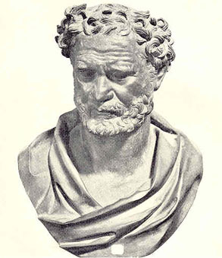
33.
2400 years ago, the philosopher Democritus said:
If you took anything and cut it in half, and in half,
and in half, over and over, sooner or later,
you would get to a piece so small that
it could not be cut in half again.
That indivisible particle he named
ATOMOS
(in Greek)
In English we say atom.
The first of many mustaches in our course!

Slide 32
In the early 1800’s John Dalton developed the Atomic Theory.
On the next page is a 4-part theory, that
you will have to recognize and understand.
You do not have to memorize it.

Slide 33
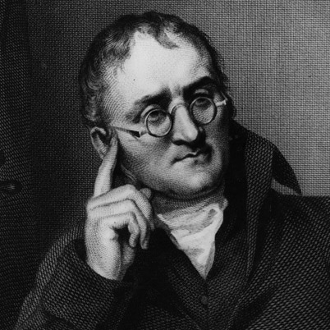
34. Dalton’s Atomic Theory
(This is so important)
1. All elements are composed of individual kinds of atoms.
2. Atoms of one element are identical.
Atoms of different elements have different masses.
3. Atoms can chemically combine with other atoms
IN SIMPLE WHOLE NUMBER RATIOS, to form new substances.
4. Chemical reactions change the arrangement of atoms, but when they
are bonded they do not become different kinds of atoms.

Slide 34
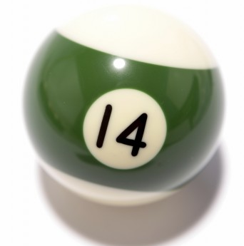
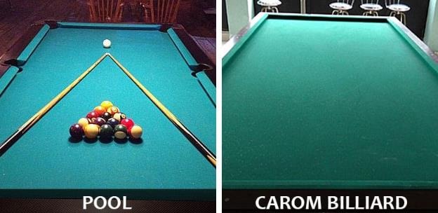
35. Dalton imagined his atom to look sort of like a billiard ball.
Billiards is a game like pool. The balls are hard spheres, and you can tell them apart by colors. His atoms had different masses. His atomic model was called the
BILLIARD BALL MODEL

Slide 35
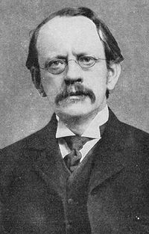
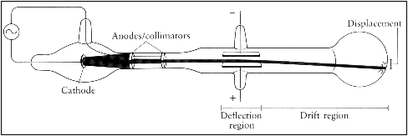
36. J. J. Thomson discovers
the electron in 1897!
(and later gets a Nobel Prize)
37. Thomson did a variety of experiments, some using what’s called the cathode ray tube, to detect and measure electrons. He found the first subatomic particle, the electron, which was negatively charged.

Slide 36
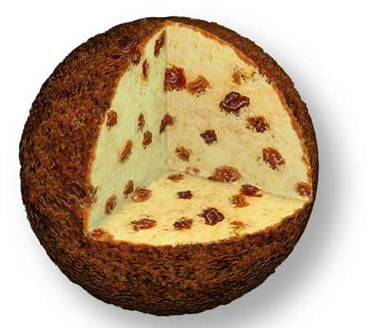
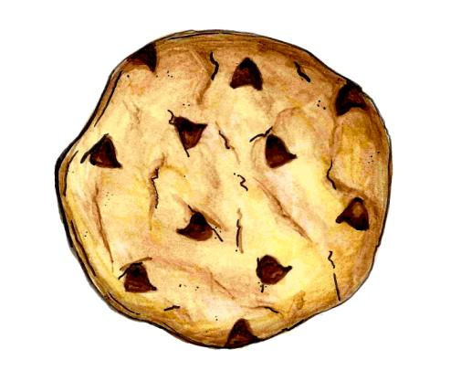
38. He describes the atom as PLUM PUDDING, after what his
wife’s dessert looked like! He put his newly discovered
negative electrons into the positive “mush” of the atom.
Thomson’s electrons
The “Positive Mush” of the atom.
Plum Pudding
The model that coulda been!

Slide 37
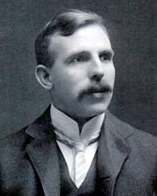
In 1908, my chemical hero, Ernest J. Rutherford discovers
the nucleus! - and much more about the atom!
Later, he wins a Nobel Prize.
39. Rutherford’s
Gold Foil Experiment
helps him discover the
nucleus, and figure out
the basic structure
of the atom.
(he knew it wasn’t cake!)

Slide 38
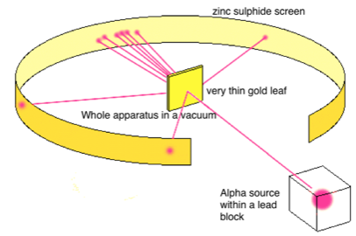





40. Details of the GOLD FOIL experiment to memorize and
share with your friends.

Slide 39
41. What does this gold foil experiment prove?
Atoms are mostly empty space
Since most of the alpha particles pass though the foil like it’s
not really there.
He knew atoms are neutral, so the nucleus must be dense and positively charged
The positive charged alpha particles never stuck to atoms, they dinged off atoms, the central atomic core of gold was bigger and positively charged.
Neutral atoms must therefore have the negatively charged electrons outside the nucleus
Flying around like planets made sense.

Slide 40
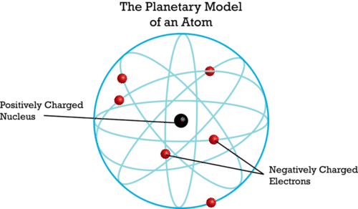
42. The Rutherford Model is named the
planetary model.
He perceives the electrons to be flying around the atom’s
nucleus like the planets orbiting the Sun.

Slide 41
43. Problems with Rutherford’s theory…
He could not explain how atoms could be mostly empty space? How can everything be mostly “not” there?
He could not explain how can these negative electrons fly around a positive center, but never get pulled into the positive nucleus? Or, how they just keep flying without ever running out of energy? Or, why they don’t fly off from the nucleus?
He could not explain if electrons flew around willy-nilly,
or if they were organized in some way.

Slide 42
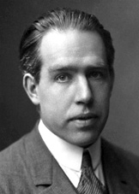
Rutherford was right, but he needed some help. In 1913, one of his students, a man with a plural first name, comes to his rescue.
Niels Bohr
44. Niels Bohr is able to do some
very funky math, and he proves
the Rutherford model of the atom
is correct.
He too wins a Nobel Prize.

Slide 43
45. The Bohr Model - the Planetary model with detail
He expands on the simple planetary model of Rutherford,
and put the electrons into specific shells, or energy levels.

Slide 44
45. The Bohr Model - the Planetary model with detail
He expands on the simple planetary model of Rutherford,
and put the electrons into specific shells, or energy levels.
46. He proves that for hydrogen, if the electron flies at the
right speed, and the right distance, it will mathematically
never run out of energy. They could fly in orbit around
the nucleus forever.

Slide 45
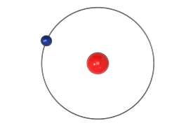
47. The math that proves electrons never run out of energy
only works for hydrogen with a single electron.
More electrons make this math too hard. But since the atoms exist, and the electrons do not seem not to fly off, or collapse into the nucleus, he postulated that this must work for all other atoms too.
Bohr model of hydrogen atom.

Slide 46
48. Draw a simple Bohr Model for Nitrogen
7 electrons, 2 in first orbit, 5 in second orbit.
7 p⁺
7 n°
7 p⁺
7 n°
2e⁻ 5e⁻

Slide 47
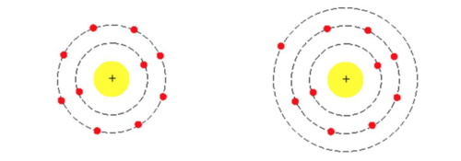
49. Niels Bohr further determines that electrons could gain a
specific amount of energy, an amount he called a quantum
of energy. This enables an electron to “jump” up to a
higher than normal energy level called the excited state.
Neon with a 2-8
Ground state electron configuration.
Neon with a 2-7-1
Excited state electron configuration.

Slide 48
50. The excited state is unstable, so the electron will soon
move back to the lower energy, more stable, ground state.
To do that it must release that exact amount of energy, the
same quantum of energy it absorbed to get excited.
51. This quantum of energy is released as visible light.
We can see it with our eyes!
52. The light we call SPECTRA. An example is an
electric neon light that emits that characteristic
orange light.
The orange light is its spectra, unique to neon.

Slide 49
53. The modern model of the atom has been
developed by many scientists over a long
period of time.

Slide 50
The modern model of the atom…
54. It’s called the Wave-Mechanical Model
The electrons sometimes act like waves of
energy, and sometimes like little bits of
mechanical matter with negative charge.
55. This model is about the
STATISTICAL PROBABILITY
of finding an electron’s location
MOST OF THE TIME, but not always.

Slide 51
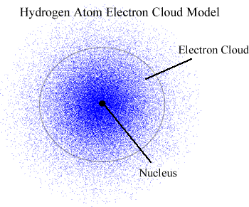
Electron shells are still energy levels, but inside each simple shell are suborbitals that aren’t so neat.
In this model/diagram, imagine that this is a photograph of a Hydrogen atom (impossible really) taken about 1000 times
on to the same piece of film, then printed overlapping.
Dots represents where the electrons were at some point.
56. Electrons are like
teenagers, they are
where they should
be most of the time,
but not always.

Slide 52
Atomic Theory Class #3
OB: The Patterns of the Electron Orbitals,
Ground State vs. Excited State, and SPECTRA
Take out your periodic tables.

Slide 53
Fill in Names & Ground State Electron Configurations
 | Symbol | Name | Ground State | Possible Excited States
57 | Li
58 | Na
59 | Mg
60 | Ca
61 | He
62 | Ne
63 | Ar

Slide 54
Fill in Excited State Configurations
 | Symbol | Name | Ground State | Possible Excited States
57 | Li | Lithium | 2-1
58 | Na | Sodium | 2-8-1
59 | Mg | Magnesium | 2-8-2
60 | Ca | Calcium | 2-8-8-2
61 | He | Helium | 2
62 | Ne | Neon | 2-8
63 | Ar | Argon | 2-8-8

Slide 55
Possible Excited States means that there are many other possibilities.
 | Symbol | Name | Ground State | Possible Excited States
57 | Li | Lithium | 2-1 | 1-2 or 1-1-1
58 | Na | Sodium | 2-8-1 | 2-7-2 or 2-7-1-1
59 | Mg | Magnesium | 2-8-2 | 2-8-1-1 or 2-7-3
60 | Ca | Calcium | 2-8-8-2 | 2-8-8-1-1 or 2-8-7-3
61 | He | Helium | 2 | 1-1 (only possibility)
62 | Ne | Neon | 2-8 | 2-7-1 or 2-6-2
63 | Ar | Argon | 2-8-8 | 2-8-7-1 or 2-7-9

Slide 56
64. Ground + Excited State electron configurations
have the SAME number of electrons,
the electrons are just in DIFFERENT places.
65. How do electrons get excited?
They absorb UNIQUE amounts of ENERGY,
called a QUANTUM of ENERGY.
A quantum means a specific amount.
66. Spectra is produced when this unique quantum of
energy is RELEASED as VISIBLE LIGHT.

Slide 57
67. The color of light, or the SPECTRA that we see, is a
MIXTURE of many colors of light that our eyes blur together.

Slide 58
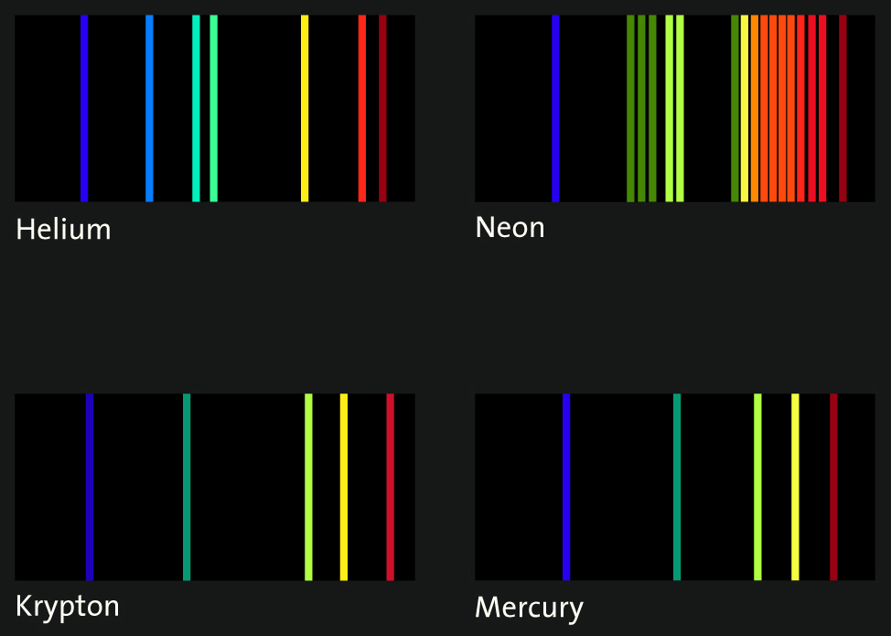

67. The color of light, or the SPECTRA that we see, is a
MIXTURE of many colors of light that our eyes blur together.
68. A refractive lens can break up this mixture of colors into a unique
SPECTROGRAPH. This can be measured (even by you, in lab)
The neon lamp
emits an orange light,
this is the spectra.
It’s a mixture of colors we see as one orange color.
That orange light is many colors, which we can separate with refractive lenses into this spectrograph (it’s like a fingerprint for neon)

Slide 59
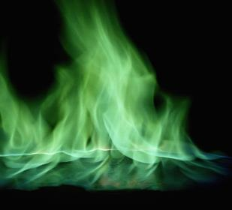
69. We’ll do flame tests too. Fire can change color too. Heat can excite the atom’s electrons, and each element or compound will gain a quantum of energy to become excited. Then emit that same quantum of energy when the electrons return to the ground state. Each quantum of energy produces a unique color of spectra, that we can see.
Green flames we see when we heat up copper salts is spectra.
The spectrograph is much harder to see because the flame is jumping around like mad.
We can’t see on the spectrograph lines in moving fire, but they are there.

Slide 60
Atomic Theory Class #4
Ob: What are isotopes and why are they so important?
You need a calculator + Periodic Table.

Slide 61
70. John Dalton once said that all atoms of an
element are identical.

Slide 62
71. He should have said:
All atoms of an element are chemically identical.
All atoms of an element react alike, and they have the same chemical properties,
but they are NOT physically identical.

Slide 63
72. All atoms of an element are chemically identical. They can have different masses because the
number of neutrons in any element can be different.
All iron atoms have 26 protons, and 26 electrons.
Most iron atoms have the “normal” 30 neutrons.
Some iron atoms have less neutrons.
Some iron atoms have more neutrons.

Slide 64
73. These different iron atoms are called
ISOTOPES of iron.
There are 118 elements,
but there are about
1500 different isotopes.

Slide 65
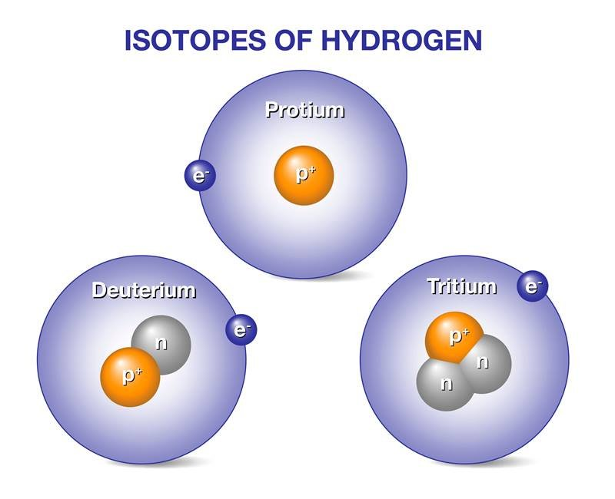
74. Each kind of atom comes in a variety of masses, every one of them is an ISOTOPE of that element.
75.
H-1 has 1 p⁺ + 0 n°
H-2 has 1 p⁺ + 1 n°
H-3 has 1 p⁺ + 2 n°
All are hydrogen atoms,
all bond in the same way.
They have different numbers of neutrons (how cool is that?)

Slide 66
FILL IN THIS CHART of the common Isotopes of Potassium
 | ISOTOPE | K-39 | K-40 | K-41
 | MASS in amu | 38.9637 | 39.963 | 40.9618
76 | # protons
77 | # electrons
78 | # neutrons

Slide 67
FILL IN THIS CHART of the common Isotopes of Potassium
 | ISOTOPE | K-39 | K-40 | K-41
 | MASS in amu | 38.9637 | 39.963 | 40.9618
76 | # protons | 19 | 19 | 19
77 | # electrons | 19 | 19 | 19
78 | # neutrons | 39 – 19 = 20 | 40 – 19 = 21 | 41 – 19 = 22

Slide 68
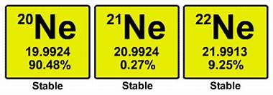
79. There are 3 ISOTOPES of neon
that are CHEMICALLY IDENTICAL.
The difference is the number of NEUTRONS.
80. Isotopes have a different mass but the same
chemical properties.

Slide 69
81. The average atomic mass (on the periodic table) is
calculated with the REAL MASSES of the all the
naturally occurring isotopes isotopes, multiped by
the proportions found in nature.
82. Adding 20 + 21 + 22 = 63 then divide by 3 for an
average gives us an average mass of 21 amu.
83. That’s not how we do average weighted atomic mass.
The Periodic Table says 20.180 AMU
Let’s copy the proper math (to learn) from the next slide.

Slide 70
84. Average weighted atomic mass math.
(mass in AMU)(decimal proportion) =
(19.9924 amu)(.9048) = 18.089 amu
(20.9924 amu)(.0027) = 0.057 amu
(21.9913 amu)(0.0925) = + 2.034 amu
20.18 amu

Slide 71
85. Average Weighted Atomic Mass
is the mass listed on our periodic tables. These use the mass of each isotope & the proportions that those isotopes make up of all that element.
86. Scientists measure these proportions regularly, sometimes the proportions of an isotope are measured better (and change) which causes a slight adjustment to the mass numbers on the Periodic Table (wow).

Slide 72
87. A new element named Arbuiso is discovered (A). It has
two isotopes, A-58 and A-59. 82.08% of all this
Arbuiso metal has mass of 57.96 amu, while the rest
has mass of 58.98 amu.
What is the weighted average atomic mass of this
cool new metallic element?

Slide 73
87. What is the weighted average atomic mass of this
cool new metallic element?
(57.96 amu)(.8208) = 47.573568 amu
(58.98 amu)(.1792) = +10.569216 amu
58.142784 amu
58.14 amu with 4 SF
NOTE: Use the exact atomic mass in the math.
Do not use the isotope “names” like A-58 and A-59!
It’s a small difference but you’re a scientist.

Slide 74
88. A new element X has 3 isotopes. Details are in this data table.
Calculate the average weighted atomic mass of element X.
Isotope Symbol | Isotope mass (amu) | Proportion of element X
X-23 | 22.8995 | 84.25%
X-24 | 23.9105 | 8.82%
X-26 | 25.9068 | ? %

Slide 75
88. A new element X has 3 isotopes. Details are in this data table.
Calculate the average weighted atomic mass of element X.
Isotope Symbol | Isotope mass (amu) | Proportion of element X
X-23 | 22.8995 | 84.25%
X-24 | 23.9105 | 8.82%
X-26 | 25.9068 | 6.93%
 |  | 100% (check)
(22.8995 amu)(.8425) = 19.2928288 amu
(23.9105 amu)(.0882) = 2.1089061 amu
(25.9068 amu)(.0693) = + 1.79534124 amu
23.19707614 amu = 23.2 amu 3 SF
Decimal Sum must be 1.000 !!

Slide 76
Stop here
Atomic Theory HW#2 and #3
due Wednesday.
Use your BASICS, your NOTES
and your BRAINS.

Slide 77
89. Who can finish this sentence?
The modern model of the atom has evolved

Slide 78
89. Who can finish this sentence?
The modern model of the atom has evolved over a long period of time through the work of many scientists.

Slide 79
 | Scientist Name | Model Name | Details
90 | Democritus (not a scientist)
91 | John Dalton
92 | J. J. Thomson
93 | Ernest J. Rutherford
94 | Niels Bohr
95 | Many others

Slide 80
 | Scientist Name | Model Name | Details
90 | Democritus (not a scientist) | x | The smallest part of anything was called “atomos”
91 | John Dalton | Billiard Ball | Atoms were like small hard spheres with different masses. Atomic Theory.
92 | J. J. Thomson | Plum Pudding | Discovered the electron, put it “into” a positive mush, so atoms stay neutral.
93 | Ernest J. Rutherford | Planetary | Gold foil experiment, electrons fly around the outside of a positive nucleus.
94 | Niels Bohr | Planetary with details | Electrons into energy levels called SHELLS or ORBITS. Discovers and explains spectra
95 | Many others | Modern, or Wave-Mechanical | Electrons are not in orbits, rather in energy levels called orbitals. Fuzzier and more in tune with complex quantum math.

Slide 81
96. The 4 main points of Dalton’s Atomic Theory
1. All elements are composed of individual kinds of atoms.
2. Atoms of one element are identical. Atoms of different
elements have different masses.
3. Atoms can chemically combine with other atoms
IN SIMPLE WHOLE NUMBER RATIOS, to form
new substances.
4. Chemical reactions change the arrangement of atoms,
but the atoms do not become different kinds of atoms.

Slide 82
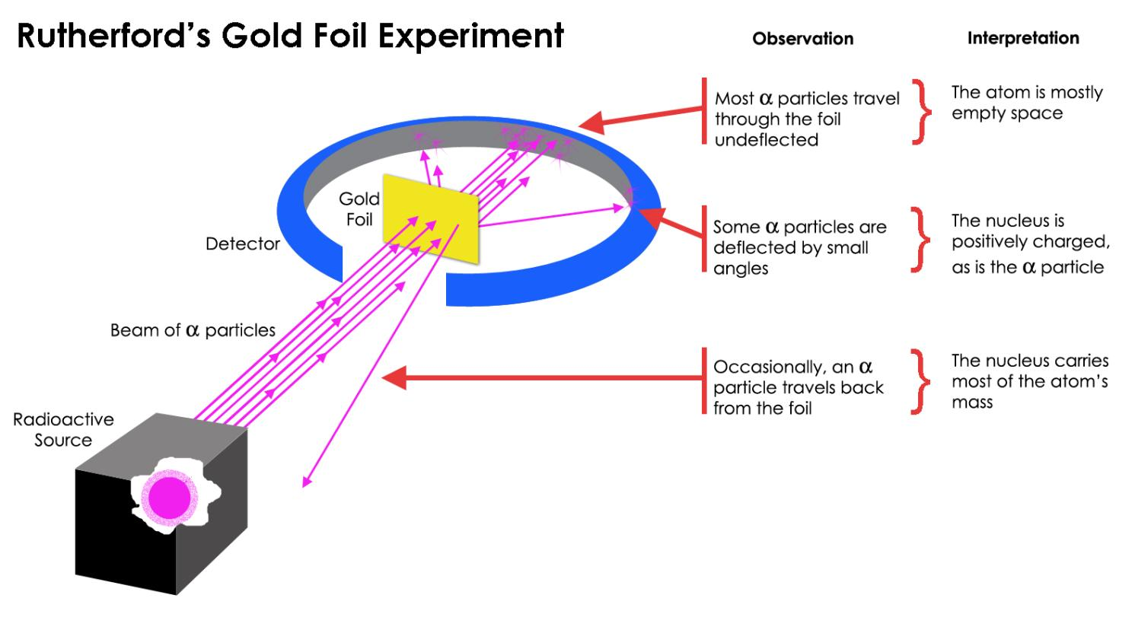
97.

Slide 83
98. What Rutherford discovered in his Gold Foil Experiment
An atom consists of a positively charged nucleus and is surrounded by negatively charged electrons that spin around it.
The size of the nucleus is extremely small as compared to the size of the whole atom.
The atom's entire mass is concentrated in the nucleus while the volume is taken up by the electrons in orbit around the nucleus.
Atoms are mostly empty space.

Slide 84
99. Rutherford could not explain…
Atomic stability. Why didn’t the electrons collapse into
the positive nucleus? Why didn’t fly away?
Why didn’t the orbiting electrons lose energy?
If they did, they’d slow down and make them collapse
into the nucleus.
If the atom was 99% empty space, that meant everything was mostly nothing. How could that be possible?

Slide 85
Describe the Bohr Model (planetary) and spectra.
1 Bohr proved that if the electron of the hydrogen atom was
at a set distance from the nucleus, and a set speed, it would
(using fancy math) never lose energy and get sucked into
the nucleus or fly away.
2 The math was too hard to prove for any other atom, but he
concluded, since atoms existed, and just because he couldn’t
do the math, the same circumstances held true for all atoms.

Slide 86
Bohr put the electrons into what he called ORBITS or SHELLS.
Each electron orbit was also an energy level.
Electrons in the orbits closer to the nucleus had
lower relative energy than electrons in the higher
shells or orbits.
102. He showed that the electrons were normally in
the ground state, or lowest energy level possible.
103. This low energy, or ground state was NORMAL.

Slide 87
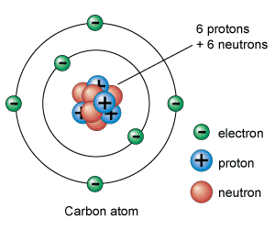
104. What’s the difference between orbit & orbital?
Bohr said orbit for energy level. Now we have electrons in energy levels called SHELLS.
Orbit implies radius and a “neat” simple spinning around the nucleus. Orbital means “zone”, which is fuzzier in shape.
NEAT ORBITS FUZZY SUB ORBITALS

Slide 88

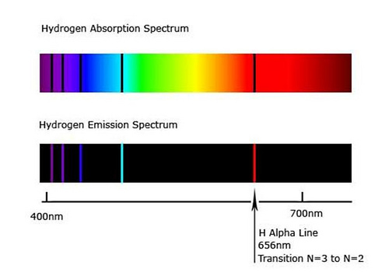
105. What’s the difference between SPECTRA + SPECTROGRAPH?
The word “open” has neon gas that
is excited by electricity.
The spectra given off we see as ORANGE light with our eyes.
It’s the mixture of color we
see as orange. The blue lamp is hydrogen gas, which has a different spectra we see as blue.
Through a refractive lens, we can see the blue is broken apart by the prism of the lens to this unique pattern of colors we see as blue.
For a few dollars more the device used to see this, with numerals to measure the wavelengths in nanometers (quantitative measuring)
Spectrograph for Hydrogen

Slide 89
Fill in the chart, using magnesium as an example of what to do.
 | Atom | Ground state electron configuration | Possible excited state configuration | # of electrons is always
106 | Mg #12 | 2-8-2 | 2-7-3 | 12
107 | Al #13
108 | C #6
109 | Ca #20
110 | Fe #26

Slide 90
Fill in the chart, using magnesium as an example of what to do.
 | Atom | Ground state electron configuration | Possible excited state configuration | # of electrons is always
106 | Mg #12 | 2-8-2 | 2-7-3 | 12
107 | Al #13 | 2-8-3 | 2-7-4 | 13
108 | C #6 | 2-4 | 2-3-1 | 6
109 | Ca #20 | 2-8-8-2 | 2-8-8-1-1 | 20
110 | Fe #26 | 2-8-14-2 | 2-8-13-3 | 26

Slide 91
August 2025 Chemistry Regents Exam, questions 66-69 Compounds of gallium are used in lasers and light-emitting diodes, also known as LEDs. The atomic mass and natural abundance of the two naturally occurring isotopes of gallium are given in the table. | Naturally Occurring Isotopes of Gallium
 | Isotope | Ga-69 | Ga-71
 | Atomic Mass (u) | 68.926 | 70.925
 | Natural Abundance (%) | 60.11 | 39.89
66 Compare the energy of an electron in the 4th shell of a gallium atom to the energy
of an electron in the 1st shell of the same atom.
67 State how a bright-line spectrum from a sample of an element viewed through
a spectroscope can be used to identify the element as gallium.
68 Explain, in terms of both protons and neutrons, why an atom of Ga-69 and an
atom of Ga-71 are classified as different isotopes of the same element.
69 Show the numerical set up for calculating the average weighted atomic mass of Ga.

Slide 92
August 2025 Chemistry Regents Exam, questions 66-69 Compounds of gallium are used in lasers and light-emitting diodes, also known as LEDs. The atomic mass and natural abundance of the two naturally occurring isotopes of gallium are given in the table. | Naturally Occurring Isotopes of Gallium
 | Isotope | Ga-69 | Ga-71
 | Atomic Mass (u) | 68.926 | 70.925
 | Natural Abundance (%) | 60.11 | 39.89
66 Compare the energy of an electron in the 4th shell of a gallium atom to the energy
of an electron in the 1st shell of the same atom. Electrons in the 4th shell have
higher energy than electrons in the 1st shell (of all atoms).
67 State how a bright-line spectrum from a sample of an element viewed through
a spectroscope can be used to identify the element as gallium. Every spectra and
every spectrograph is unique, so by comparing the known spectrograph of gallium
to what you see in lab, you can determine if it is gallium, or it is not.
68 Explain, in terms of both protons and neutrons, why an atom of Ga-69 and an
atom of Ga-71 are classified as different isotopes of the same element.
Both atoms have 31 protons (and 31 electrons). Their difference is that they
have 38 or 40 neutrons, which makes them isotopes (by definition). They are
chemically identical, but have different number of neutrons, with different masses.

Slide 93
August 2025 Chemistry Regents Exam, questions 66-69 Compounds of gallium are used in lasers and light-emitting diodes, also known as LEDs. The atomic mass and natural abundance of the two naturally occurring isotopes of gallium are given in the table. | Naturally Occurring Isotopes of Gallium
 | Isotope | Ga-69 | Ga-71
 | Atomic Mass (u) | 68.926 | 70.925
 | Natural Abundance (%) | 60.11 | 39.89
69 Show a numerical setup for calculating the atomic mass of gallium.
(68.926 u)(0.6011) = 41.4314186 u
(70.925 u)(0.3989) = 28.2919825 u
= 69.7234011 u
rounds to 69.72 u with 4 SF
In table D,
atomic mass units can be abbreviated “u”
for no good reason. AMU is a nice unit,
u is just tricky!
The decimals MUST round
to 1.000 or 1 WHOLE

Slide 94
Which are correct? If they are wrong, why are they wrong?
111. Mg ground state electron config. is 2-8-2
112. F ground state electron config. is 2-7
114. He ground state electron config. is 2
115. Ne ground state electron config. is 2-8-8
116. Mg excited state electron config. is 1-9-2
117. He excited state electron config. is 1-1
118. P excited state electron config. is 1-9-5
119. F excited state electron config. is 2-8
120. P ground state electron config. is 2-9-4

Slide 95
Which are correct? If they are wrong, why are they wrong?
111. Mg ground state electron config. is 2-8-2 correct
112. F ground state electron config. is 2-7 correct
114. He ground state electron config. is 2 correct
115. Ne ground state electron config. is 2-8-8 X Ar!
116. Mg excited state electron config. is 1-9-2 X 9
117. He excited state electron config. is 1-1 correct
118. P excited state electron config. is 1-9-5 X 9
119. F excited state electron config. is 2-8 X 10 e⁻
120. P ground state electron config. is 2-7-5 X not 15

