Slide 1
Welcome to Bonding
OBJECTIVE: introduction to what
Chemical Bonding is,
and learning how to draw
Lewis Dot Diagrams

Slide 2
Types of bonds we will see in high school are
1 | Ionic Bonds | Form between metal cations and nonmetal anions. Electrons are TRANSFERRED All ions end up with FULL electron shells (isoelectric to noble gases)
2 | Covalent bonds | Form between 2 or more NONMETALS - no metals make covalent bonds. Electrons are SHARED. There are NO IONS ever. Bonding atoms usually get FULL outer shells. (they follow the octet rule)
3 | Metallic Bonds | Form between atoms of metals. These hold metals together as a solid, but no new compounds form. These give rise to the 3 most important properties metals have. Metal element atoms can bond together; two or more kinds of metal atoms can be melted together to form alloys (solid mixtures, like brass)
4 | Intermolecular bonds | These are relatively weak attractions between molecules (not inside of them). There are 3 different kinds of IMF, and I like these a lot.

Slide 3
Bonding is all about the electrons
5 | The outermost electrons are the VALENCE electrons
6 | The outermost electron shell is the VALENCE SHELL
7 | To bond, atoms or ions always* end up ISOELECTRIC to a noble gas; they get a full valence shell full of electrons * there are some exceptions.

Slide 4
Lewis Dot Diagrams
Provide a simple way to learn to “see” the electrons for bonding. Before we learn bonding, we need to learn to draw atoms that can bond. Only the outer most electrons are involved in bonding, not the inner electrons.
8 | The DOTS represent the outermost electrons, the VALENCE ELECTRONS.
9 | The dots represent only valence electrons. We do not draw the INNER electrons that don’t bond.

Slide 5
Electron Shells
Electrons do not just fly around the nucleus, they are in specific zones, that are of a certain size and shape. They can “hold” only a certain number of electrons each, if there are “too many electrons”, another shell opens to accommodate these extra electrons.
10 | The first shell is tiny; it only holds up to 2 electrons.
11 | The 2nd shell is bigger; it holds up to 8 electrons.
12 | The 3rd shell is a bit trickier. It can be “full” when it has 8 electrons (like Ar), but it can also stretch to hold up to 18 electrons (like Kr).

Slide 6
Electron Shells
The larger shells (4th, 5th, 6th and 7th) are fancier.
14 | The 4th, 5th, and 6th shells can also be full, or stretch to fill up with a higher number of electrons.
15 | Rule: Noble gases always and only have full shells. If you need to know how many electrons fit into any shell, look at the group 18 atoms, they have only full, stable, perfectly full shells.

Slide 7
16
Atom number | Atom symbol | Lewis Dot (atom) | Ion Symbol | Lewis Dot (ion)
1 | H
Electron configuration | 1
2 | He
Electron configuration | 2
3 | Li
Electron configuration | 2-1

Slide 8
16
Atom number | Atom symbol | Lewis Dot (atom) | Ion Symbol | Lewis Dot (ion)
1 | H | H | H⁺¹ | [H]⁺¹
Electron configuration | 1 | 1 | “0” | “0”
2 | He | He | Helium does not make ions | Helium does not make ions
Electron configuration | 2 | 2 | X | X
3 | Li | Li | Li⁺¹ | [Li]⁺¹
Electron configuration | 2-1 | 2-1 | “2-0” | “2-0”

Slide 9
Atom number | Atom symbol | Lewis Dot (atom) | Ion Symbol | Lewis Dot (ion)
4 | Be
Electron configuration | 2-2
5 | B
Electron configuration | 2-3
6 | C
Electron configuration | 2-4
7 | N
Electron configuration | 2-5
16

Slide 10
Atom number | Atom symbol | Lewis Dot (atom) | Ion Symbol | Lewis Dot (ion)
4 | Be | Be | Be⁺² | [Be]⁺²
Electron configuration | 2-2 | 2-2 | “2-0” | “2-0”
5 | B | B | Boron does not make ions in high school chemistry | Boron does not make ions in high school chemistry
Electron configuration | 2-3 | 2-3 | X | X
6 | C | C | Carbon does not make ions in high school chemistry | Carbon does not make ions in high school chemistry
Electron configuration | 2-4 | 2-4 | X | X
7 | N | N | N⁻³ | [ N ]⁻³
Electron configuration | 2-5 | 2-5 | 2-8 | 2-8
16

Slide 11
Atom number | Atom symbol | Lewis Dot (atom) | Ion Symbol | Lewis Dot (ion)
8 | O
Electron configuration | 2-6
9 | F
Electron configuration | 2-7
10 | Ne
Electron configuration | 2-8
11 | Na
Electron configuration | 2-8-1
16

Slide 12
Atom number | Atom symbol | Lewis Dot (atom) | Ion Symbol | Lewis Dot (ion)
8 | O | O | O⁻² | [ O ]⁻²
Electron configuration | 2-6 | 2-6 | 2-8 | 2-8
9 | F | F | F⁻¹ | [ F ]⁻¹
Electron configuration | 2-7 | 2-7 | 2-8 | 2-8
10 | Ne | Ne | Neon does not make ions | Neon does not make ions
Electron configuration | 2-8 | 2-8 | X | X
11 | Na | Na | Na⁺¹ | [Na]⁺¹
Electron configuration | 2-8-1 | 2-8-1 | “2-8-0” | “2-8-0”
16

Slide 13
Atom number | Atom symbol | Lewis Dot (atom) | Ion Symbol | Lewis Dot (ion)
12 | Mg
Electron configuration | 2-8-2
13 | Al
Electron configuration | 2-8-3
14 | Si
Electron configuration | 2-8-4
15 | P
Electron configuration | 2-8-5
16

Slide 14
Atom number | Atom symbol | Lewis Dot (atom) | Ion Symbol | Lewis Dot (ion)
12 | Mg | Mg | Mg⁺² | [Mg]⁺²
Electron configuration | 2-8-2 | 2-8-2 | “2-8-0” | “2-8-0”
13 | Al | Al | Al⁺³ | [Al]⁺³
Electron configuration | 2-8-3 | 2-8-3 | “2-8-0” | “2-8-0”
14 | Si | Si | Silicon does not make ions in high school chemistry | Silicon does not make ions in high school chemistry
Electron configuration | 2-8-4 | 2-8-4 | X | X
15 | P | P | P⁻³ | [ P ]⁻³
Electron configuration | 2-8-5 | 2-8-5 | 2-8-8 | 2-8-8
16

Slide 15
Atom number | Atom symbol | Lewis Dot (atom) | Ion Symbol | Lewis Dot (ion)
16 | S
Electron configuration | 2-8-6
17 | Cl
Electron configuration | 2-8-7
18 | Ar
Electron configuration | 2-8-8
19 | K
Electron configuration | 2-8-8-1
16

Slide 16
Atom number | Atom symbol | Lewis Dot (atom) | Ion Symbol | Lewis Dot (ion)
16 | S | S | S⁻² | [ S ]⁻²
Electron configuration | 2-8-6 | 2-8-6 | 2-8-8 | 2-8-8
17 | Cl | Cl | Cl⁻¹ | [ Cl ]⁻¹
Electron configuration | 2-8-7 | 2-8-7 | 2-8-8 | 2-8-8
18 | Ar | Ar | Argon does not make ions | Argon does not make ions
Electron configuration | 2-8-8 | 2-8-8 | X | X
19 | K | K | K⁺¹ | [K]⁺¹
Electron configuration | 2-8-8-1 | 2-8-8-1 | “2-8-8-0” | “2-8-8-0”
16

Slide 17
Atom number | Atom symbol | Lewis Dot (atom) | Ion Symbol | Lewis Dot (ion)
20 | Ca | Ca | Ca⁺² | [Ca]⁺²
Electron configuration | 2-8-8-2 | 2-8-8-2 | 2-8-8-0 | 2-8-8-0
16
Remember…
17. Metals lose electrons to become isoelectric to a noble gas,
Metal Cations have EMPTY valence shells.
18. Nonmetals gain electrons to become isoelectric to a noble gas,
Nonmetal Anions have FULL outer shells.

Slide 18
Bonding class #2
OB: Metallic Bonds,
More Lewis Dots,
and the Octet Rule.
Get your periodic tables
open on your desk now please
(not later)

Slide 19
19. To bond ionically,
a metal atom forms into a cation
a nonmetal atom form into an anion
by transferring electrons (1,2,3, or more)
The Na° atom → Na⁺¹ cation, with a +1 charge
The Cl° atom → Cl⁻¹ anion, with a -1 charge

Slide 20
20. Let’s draw the Lewis dot diagrams for the atoms, the ions, and
then the compound. (Na, Cl, Na⁺¹, Cl⁻¹, and NaCl)
2 Individual atoms 2 Individual ions 1 Ionic compound

Slide 21


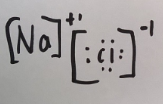


18. Let’s draw the Lewis dot diagrams for the atoms, the ions, and
then the compound.
2 Individual atoms 2 Individual ions 1 Ionic compound
The electron transfers
Always slightly askew.

Slide 22
21. Na atom loses one electron, changing
the electron configuration from
2-8-1 to “2-8-0”, really - just 2-8
Na loses, or transfers, 1 electron, it becomes isoelectric to Ne
2-8-1 → 2-8 + 1e⁻
22. Cl atom gains one electron, changing
the electron configuration from 2-8-7 to 2-8-8
Cl gains 1 electron, it becomes isoelectric to Ar
2-8-7 + 1e⁻ → 2-8-8
Noble gases have the most stable electron shells of all atoms.
They have only FULL, and PERFECT electron configurations.

Slide 23
23. Ions tend to follow the octet rule.
The octet rule means most ions end up
with 8 valence electrons (full outer shells)
There are a few exceptions to the
octet rule.
24. The exceptions include smaller ions with
only ONE SHELL. They are too small for
more than 2 electrons, like Li⁺¹ and Be⁺²

Slide 24
25. Fill in this chart
Compound name | Cation | Anion | Compound Formula | Lewis Dot Diagram (with electron configurations)
Magnesium oxide
Lithium fluoride
Calcium chloride

Slide 25

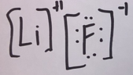
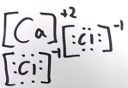
VOILA! You are now an ionic bonder!
Compound name | Cation | Anion | Compound Formula | Lewis Dot Diagram (with electron configurations)
Magnesium oxide | Mg⁺² | O⁻² | MgO | (Mg⁺² is 2-8 O⁻² is 2-8)
Lithium fluoride | Li⁺¹ | F⁻¹ | LiF | (Li⁺¹ is 2 F⁻¹ is 2-8)
Calcium chloride | Ca⁺² | Cl⁻¹ | CaCl₂ | (Ca⁺² is 2-8-8 both Cl⁻¹ are 2-8-8)

Slide 26
24. Fill in this chart
Compound name | Cation | Anion | Compound Formula | Lewis Dot Diagram (with electron configurations)
Sodium Sulfide
Cesium oxide
LAST TWO OF THESE

Slide 27
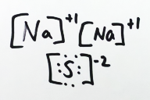
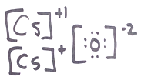
25. Ta Da! (take a bow if you got these all right)
Compound name | Cation | Anion | Compound Formula | Lewis Dot Diagram (with electron configurations)
Sodium Sulfide | Na⁺¹ | S⁻² | Na₂S | (Both Na⁺¹ are 2-8, S⁻² is 2-8-8)
Cesium oxide | Cs⁺¹ | O⁻² | Cs₂O | (Both Cs⁺¹ are 2-8-18-18-8, O⁻² is 2-8)
LAST TWO OF THESE

Slide 28
25. Draw the UGLY Lewis dot diagrams for
Magnesium Nitride Aluminum Oxide

Slide 29
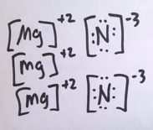
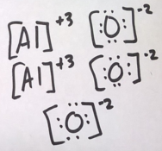
25. Draw the UGLY Lewis dot diagrams for
Magnesium Nitride Aluminum Oxide

Slide 30
Metallic Bonding
How do hunks of metal, things like pipes,
or wedding rings,
“flex” when you smash them with hammer,
or pull into a wire without out breaking?
How do wires conduct electricity?

Slide 31
26. Metallic Properties include
Malleable Ductile Conduct electricity
Form into cations Conduct heat Lustrous
Have higher densities + boiling points than nonmetals
Have lower Specific Heat Capacities than nonmetals

Slide 32
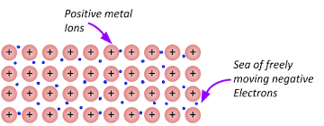
27. Metals are understood to be:
“PACKED CATIONS AWASH IN A
SEA OF LOOSE VALENCE ELECTRONS”.
Draw a bunch of dots between the cations in your notes now.

Slide 33
28. Metals are neutral, they have the same number of protons + electrons, but they seem to exist at packed cations, with shared valence electrons, not as packed atoms.
When the electrons become “loose” the metal remains neutral, but the mobile electrons can move around to offset excess positive charge formed if the cations move close together.

Slide 34
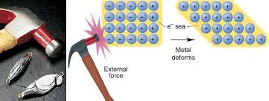
29. Imagine smashing the metal with a hammer to make the metal
exhibit its malleable nature. The cations will be crushed closer
together – they should repel from each other, causing a crack.
The loose valence electrons flow to offset this excess positive charge.
This also occurs when you squish metals into wires.

Slide 35
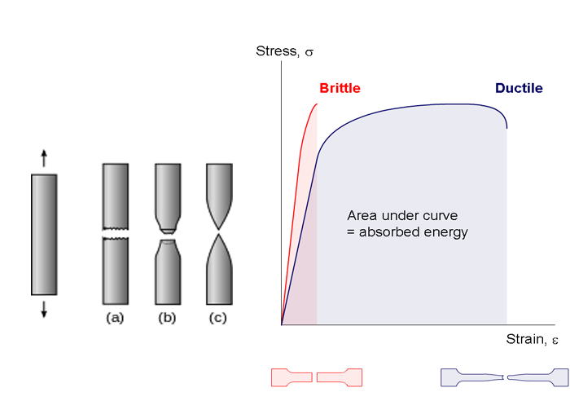
30. Ductile means can be drawn into a wire.
Pulling creates a “stretch” not a snap.
The metal is pulled upwards and downwards, creating stress. | This first metal snaps, it is not ductile. | The second metal stretches a bit, then in snaps. It can deform because when the cations get closer together, the loose valence electrons squeeze in too, keeping the neutrality. | This last metal is the most ductile, it changes shape the most (before breaking). As it deforms, the cations get closer, but the loose, mobile electrons offset that positive stress.

Slide 36
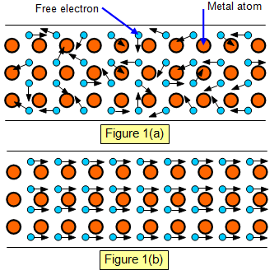
31. Imagine a flow of electrons (electricity) in from the left.
As electrons flow into the metal, there are too many
electrons for the cations, so the excess electrons flow out
the other side (the flow of electrons is electricity!).
Metal with loose valence electrons, moving RANDOMLY.
Electricity flowing into metal wire from the left, electrons flow to the right.

Slide 37
Bonding Class #3
Objective: introduction to covalent bonding
32. Covalent bonding occurs…
when 2 or more nonmetals share their
valence electrons to make a bond.
33. Atoms do not
transfer electrons like ions do.

Slide 38
34. Review… with ionic bonding, there is a TRANSFER of ELECTRONS from the METAL cation → NONMETAL anion
They follow the octet rule. The Metal comes first in the formula.
Ionic compounds come in formula units (FU’s), not molecules.
35. In Covalent Bonding, there is a
SHARING OF VALENCE ELECTRONS
THE ATOMS FOLLOW THE OCTET RULE.
36. There are NO METALS in covalent bonds
37. Atoms bond covalently to form molecules

Slide 39
38. Molecules form using covalent bonds (sharing electrons)
and follow the octet rule almost every time.
39. Let’s draw some molecules that share electrons covalently.
F₂
Cl₂

Slide 40
39. Let’s draw some molecules that share electrons covalently.
F₂ F F
Cl₂ Cl Cl
F₂ follows the octet rule.
Cl₂ follows the octet rule also.

Slide 41
40. Let’s draw two more. Hydrogen breaks the octet rule,
it’s too small to have 8 electrons, it has just one baby sized shell.
H₂
Br₂

Slide 42
40. Let’s draw two more. Hydrogen breaks the octet rule,
it’s too small to have 8 electrons, it has just one baby sized shell.
H₂ H:H
Br₂ Br Br
H₂ is too small
to follow the octet rule. It fills up the baby sized first shell.
Br₂ follows the octet rule.

Slide 43
41. In covalent bonds, all atoms get to share enough electrons so
that they get full valence shells at least some of the time.
42. All these bonds, F₂ - Cl₂ – H₂ - Br₂
are called SINGLE NONPOLAR COVALENT bonds
because they share one pair of electrons - 1 electron from each atom
AND
because there is no difference between their electronegativity values
43 | Electronegativity | Electronegativity | Electronegativity Difference | That means the bond is
F₂ | F 4.0 | F 4.0
Cl₂ | Cl 3.2 | Cl 3.2
H₂ | H 2.2 | H 2.2
Br₂ | Br 3.0 | Br 3.0

Slide 44
40. In covalent bonds, all atoms get to share enough electrons so
that they get full valence shells at least some of the time.
41. All these bonds, F₂ - Cl₂ – H₂ - Br₂
are called SINGLE NONPOLAR COVALENT bonds
because they share one pair of electrons - 1 electron from each atom
AND
because there is no difference between their electronegativity values
42 | Electronegativity | Electronegativity | Electronegativity Difference | That means the bond is
F₂ | F 4.0 | F 4.0 | zero | NONPOLAR
Cl₂ | Cl 3.2 | Cl 3.2 | zero | NONPOLAR
H₂ | H 2.2 | H 2.2 | zero | NONPOLAR
Br₂ | Br 3.0 | Br 3.0 | zero | NONPOLAR

Slide 45
43. Draw the Lewis Dot Diagram for HCl
and name the bond present.

Slide 46
43. Draw the Lewis Dot Diagram for HCl
and name the bond present.
Cl 3.2
H 2.2 Electronegativity difference is 1.0
The H and Cl share ONE PAIR of electrons,
This is a single polar covalent bond.
H Cl
Cl has 7 valence electrons, it needs to “borrow” one to get full.
H has ONE valence electron, it needs to “borrow” one to get full.

Slide 47
44. Draw the Lewis Dot Diagram for H₂O
and name the bond present.

Slide 48
44. Draw the Lewis Dot Diagram for H₂O
and name the bond present.
Oxygen borrows one electron from each of the hydrogen atoms, to fill up its larger shell
(oxygen follows the octet rule).
Hydrogen atoms borrow the one electron each
to fill up their baby sized shells too.
(hydrogen breaks the octet rule).
Electronegativity difference is 1.2!
H O
H
3.4
2.2
2.2
Water has 2 bonds, both are
SINGLE POLAR COVALENT

Slide 49
H Cl
Another way to draw this, without dots is called a structural diagram.
With a structural diagram, we only show the bonds, a short line indicates the sharing of one pair of electrons.
A single dash represents a single covalent bond.
H O
H

Slide 50
45. Structural Diagrams
H Cl H―Cl
H O
H
H―O
H
WATER has turned in space.
Molecules can move and orient in “any direction”.
Each “dash” represents 1 pair of shared electrons.

Slide 51
46. Draw the Lewis Dot and the Structural Diagram
for ammonia NH₃. Name each bond.
First, AMMONIA is not AMMONIUM
Ammonia, NH₃ is molecule.
Ammonium, NH₄⁺¹ is a cation. NOT THE SAME THING!
N
Nitrogen has 5 valence electrons, and they will be paired up in a Lewis dot diagram because this is more stable.
H
Hydrogen has 1 valence electron.
There are going to be three of these in one ammonia molecule.

Slide 52
46. Draw the Lewis Dot and the Structural Diagram
for ammonia NH₃. Name each bond.
Ammonia Lewis Dot Diagram | Ammonia Structural Diagram | Bond Names There are three separate N-H bonds, they share 1 pair of electrons. N 3.0 Electronegativity H 2.2 Electronegativity 0.8 difference These are 3 single polar covalent bonds.

Slide 53
46. Draw the Lewis Dot and the Structural Diagram
for ammonia NH₃. Name each bond.
Ammonia Lewis Dot Diagram | Ammonia Structural Diagram | Bond Names There are three separate N-H bonds, they share 1 pair of electrons. N 3.0 Electronegativity H 2.2 Electronegativity 0.8 difference These are 3 single polar covalent bonds.
H
H―N―H
N
H
H
H
Nitrogen follows the octet rule, hydrogen is too small, it only has a baby sized shell.

Slide 54
47. Draw the Lewis Dot and the Structural Diagram
for methane CH₄. Name each bond.
Methane Lewis Dot Diagram | Methane Structural Diagram | Bond Names There are four separate C-H bonds, they each share 1 pair of electrons. C 2.6 Electronegativity H 2.2 Electronegativity 0.4 difference These are 4 single polar covalent bonds.
Carbon follows the octet rule, hydrogen is too small, it only has a baby sized shell.

Slide 55
47. Draw the Lewis Dot and the Structural Diagram
for methane CH₄. Name each bond.
Methane Lewis Dot Diagram | Methane Structural Diagram | Bond Names There are four separate C-H bonds, they each share 1 pair of electrons. C 2.6 Electronegativity H 2.2 Electronegativity 0.4 difference These are 4 single polar covalent bonds.
H
H
H
C
H
H―C―H
H
H
Carbon follows the octet rule, hydrogen is too small, it only has a baby sized shell.

Slide 56
The greater the difference in electronegativity values between two atoms, the greater the polarity of the bond.
Greater EN difference means MORE POLAR bond
Smaller EN difference means LESS POLAR bond
48. Which bonds are more polar,
the C-H bonds in methane or
the N-H bonds in ammonia?

Slide 57
48. Which bonds are more polar,
the C-H bonds in methane or
the N-H bonds in ammonia?
Bond | Electro- negativity of 1st atom | Electro- negativity of H | Electronegativity difference | Both bonds exhibit polarity
C-H | 2.6 | 2.2 | 0.4 | Less Polar Bond
N-H | 3.0 | 2.2 | 0.8 | More Polar Bond

Slide 58
49. Draw the Lewis Dot and the Structural Diagram
for oxygen O₂. Name each bond.
Oxygen Lewis Dot Diagram | Oxygen Structural Diagram | Bond Names The two oxygen atoms share 2 pairs of electrons. This is a double bond. Both atoms have the same Electronegativity. NO DIFFERENCE in electronegativity equals a NONPOLAR bond This is a double polar covalent bond.
Both oxygen atoms follow the octet rule.

Slide 59
49. Draw the Lewis Dot and the Structural Diagram
for oxygen O₂. Name each bond.
Oxygen Lewis Dot Diagram | Oxygen Structural Diagram | Bond Names The two oxygen atoms share 2 pairs of electrons. This is a double bond. Both atoms have the same Electronegativity. NO DIFFERENCE in electronegativity equals a NONPOLAR bond This is a double nonpolar covalent bond
O O
O=O
O 3.4
O 3.4
Diff = zero
Both oxygen atoms follow the octet rule.

Slide 60
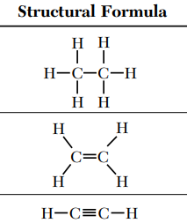
Bonding Class #4
Your objective today
is to become masterful with the Double covalent bonds, and Triple Covalent Bonds.
you will practice drawing structural diagrams for larger molecules

Slide 61
50. The HONClBrIF Twins bonding
Twin | Dot diagram | Structural diagrams | Name the bond
H₂
O₂
Cl₂
Br₂
I₂
F₂

Slide 62

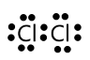
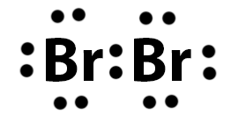

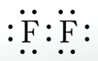
50. The HONClBrIF Twins bonding
Twin | Dot diagram | Structural diagrams | Name the bond
H₂ | H:H | H ̶̶ H | Single polar covalent
O₂ |  | O=O | Double polar covalent
Cl₂ |  | Cl ̶̶ Cl | Single polar covalent
Br₂ |  | Br ̶̶ Br | Single polar covalent
I₂ |  | I ̶̶ I | Single polar covalent
F₂ |  | F ̶̶ F | Single polar covalent

Slide 63
51. What about Nitrogen, N₂ ?
N atom | 2-5 electron configuration | Needs to make 3 bonds, to get an octet | Each N atom needs to borrow 3 electrons from the other N atom
To make this happen, you must become master of the Universe, move the electrons around to put them where they belong.
N₂ | Dot diagram | Structural diagram | Name the bond

Slide 64
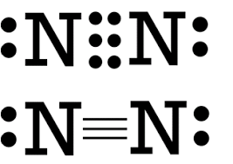
51. What about Nitrogen, N₂?
N atom | 2-5 electron configuration | Needs to make 3 bonds, to get an octet | Each N atom needs to borrow 3 electrons from the other N atom
To make this happen, you must become master of the Universe, move the electrons around to put them where they belong.
Twin | Dot diagram | Structural diagram | Name the bond
Triple
Nonpolar
covalent

Slide 65
52. C₂H₆ Draw the Lewis dot diagram, the structural diagram, then REDRAW the structural diagram to determine if this molecule has radial symmetry and is nonpolar, or if it’s “unbalanced” and polar.

Slide 66
52. C₂H₆ Draw the Lewis dot diagram, the structural diagram, then REDRAW the structural diagram to determine if this molecule has radial symmetry and is nonpolar, or if it’s “unbalanced” and polar.
Carbon makes an octet by borrowing 4 electrons, 3 from the H atoms, one from the “other” carbon atom. H get a “full” baby sized shell. | C–C bond is single nonpolar covalent C–H bonds are single polar covalent 7 total bonds in molecule | Every cut through the center point results in 2 equal halves, this molecule has radial symmetry, it is NONPOLAR
H H
H H
H H
H
C C
H
H―C―C―H
H―C―C―H
H H
H H
H H

Slide 67
53. C₂H₄ Draw the Lewis dot diagram, the structural diagram, then REDRAW the structural diagram to determine if this molecule has radial symmetry and is nonpolar, or if it’s “unbalanced” and polar.

Slide 68
53. C₂H₄ Draw the Lewis dot diagram, the structural diagram, then REDRAW the structural diagram to determine if this molecule has radial symmetry and is nonpolar, or if it’s “unbalanced” and polar.
Carbon makes an octet by borrowing 4 electrons, 2 from the H atoms, 2 from the “other” carbon atom. H get a “full” baby sized shell. | C=C bond is double nonpolar covalent C–H bonds are single polar covalent 5 total bonds in molecule | Every cut through the center point results in 2 equal halves, this molecule has radial symmetry, it is NONPOLAR
H H
H H
H H
C C
C C
C C
H H
H H
H H

Slide 69
54. C₂H₂ Draw the Lewis dot diagram, the structural diagram, then REDRAW the structural diagram to determine if this molecule has radial symmetry and is nonpolar, or if it’s “unbalanced” and polar.

Slide 70
54. C₂H₂ Draw the Lewis dot diagram, the structural diagram, then REDRAW the structural diagram to determine if this molecule has radial symmetry and is nonpolar, or if it’s “unbalanced” and polar.
Carbon makes an octet by borrowing 4 electrons, 1 from the H atom, 3 from the “other” carbon atom. H get a “full” baby sized shell. | C≡C bond is triple nonpolar covalent C–H bonds are single polar covalent 3 total bonds in molecule | Every cut through the center point results in 2 equal halves, this molecule has radial symmetry, it is NONPOLAR
H
C C
H
H―C C―H
H―C C―H

Slide 71
55. C₃H₈ Draw the Lewis dot diagram, the structural diagram, then REDRAW the structural diagram to determine if this molecule has radial symmetry and is nonpolar, or if it’s “unbalanced” and polar.

Slide 72
55. C₃H₈ Draw the Lewis dot diagram, the structural diagram, then REDRAW the structural diagram to determine if this molecule has radial symmetry and is nonpolar, or if it’s “unbalanced” and polar.
Carbons make octets by borrowing electrons, from the H atoms, and from the “other” carbon atoms. H get a “full” baby sized shell. | C–C bonds are single nonpolar covalent C–H bonds are single polar covalent 10 total bonds in molecule | Every cut through the center point results in 2 equal halves, this molecule has radial symmetry, it is NONPOLAR
H H H
H H
H
H H H
H―C―C―C―H
H
C C C
H
H―C―C―C―H
H H H
H H
H
H H H

Slide 73
56. CO₂ Draw the Lewis dot diagram, the structural diagram, then REDRAW the structural diagram to determine if this molecule has radial symmetry and is nonpolar, or if it’s “unbalanced” and polar.

Slide 74
56. CO₂ Draw the Lewis dot diagram, the structural diagram, then REDRAW the structural diagram to determine if this molecule has radial symmetry and is nonpolar, or if it’s “unbalanced” and polar.
Carbon make an octet by borrowing 2 electrons from each oxygen atom. Both “O” atoms borrow 2 electrons from the carbon atom. | O=C bonds are double polar covalent THIS IS A STRAIGHT LINE 2 total bonds in molecule | Every cut through the center point results in 2 equal halves, this molecule has radial symmetry, it is NONPOLAR
O
O
O=C=O
O=C=O
C

Slide 75
57. AsCl₃ Draw the Lewis dot diagram, the structural diagram, then REDRAW the structural diagram to determine if this molecule has radial symmetry and is nonpolar, or if it’s “unbalanced” and polar.

Slide 76
57. AsCl₃ Draw the Lewis dot diagram, the structural diagram, then REDRAW the structural diagram to determine if this molecule has radial symmetry and is nonpolar, or if it’s “unbalanced” and polar.
Arsenic make an octet by borrowing 1 electrons from each chlorine atom. The Cl atoms borrow 1 electron each from the arsenic atom. | As–Cl bond is single polar covalent 3 total bonds in molecule | Just one cut shows that this molecule does not have radial symmetry. One side is a “double Cl”, the other is a single Cl plus a pair of electrons. This is a POLAR molecule.
Cl
As
Cl
Cl―As―Cl
Cl―As―Cl
Cl
Cl
Cl

Slide 77
58. C₄H₁₀ Draw structural diagram, then REDRAW the structural diagram to determine if this molecule has radial symmetry and is nonpolar, or if it’s “unbalanced” and polar.
At some point you either can count electrons or you can’t. If you want, you can draw as many dots as you like, or you can just “know” the dots (the electrons) are there or not there. You know and can know because you’re smart. I am not drawing dots anymore. I think you are smart enough to know this.

Slide 78
58. C₄H₁₀ Draw structural diagram, then REDRAW the structural diagram to determine if this molecule has radial symmetry and is nonpolar, or if it’s “unbalanced” and polar.
At some point you either can count electrons or you can’t. If you want, you can draw as many dots as you like, or you can just “know” the dots (the electrons) are there or not there. You know and can know because you’re smart. I am not drawing dots anymore. I think you are smart enough to know this.
 | C–C bonds are single nonpolar covalent C–H bonds are single polar covalent 13 total bonds in molecule | Every cut through the center point results in 2 equal halves, this molecule has radial symmetry, it is NONPOLAR
H H H H
H H H H
H―C―C―C―C―H
H―C―C―C―C―H
H H H H
H H H H

Slide 79
59. OF₂ Draw the Lewis dot diagram, the structural diagram, then REDRAW the structural diagram to determine if this molecule has radial symmetry and is nonpolar, or if it’s “unbalanced” and polar.

Slide 80
59. OF₂ Draw the Lewis dot diagram, the structural diagram, then REDRAW the structural diagram to determine if this molecule has radial symmetry and is nonpolar, or if it’s “unbalanced” and polar.
All three atoms make octets. Oxygen borrows 2 electrons, one from each bromine. Each bromine borrows 1 electron from the oxygen. | O–Br bonds are single polar covalent 2 total bonds in molecule | The red line cuts this molecule into 2 equal halves, but The black line shows a double Br side vs. no Br side This molecule does not have radial symmetry, it’s POLAR.
O
Br
O
Br
O
Br
Br
Br
Br

Slide 81
58. What about all of those “other electrons” that are not involved in the bonding?
Oxygen has 2 pairs of electrons that are not bonding. Each bromine has 3 pairs of electrons that are not bonding. | These electron are not even draw in structural diagrams, but they are there, and they’re important, and they have a name. They are the “Unshared Pairs of Electrons”
O
Br
O
Br
Br
Br

Slide 82
60. CCl₄ Draw the Lewis dot diagram, the structural diagram, then REDRAW the structural diagram to determine if this molecule has radial symmetry and is nonpolar, or if it’s “unbalanced” and polar.

Slide 83
60. CCl₄ Draw the Lewis dot diagram, the structural diagram, then REDRAW the structural diagram to determine if this molecule has radial symmetry and is nonpolar, or if it’s “unbalanced” and polar.
All four atoms make octets. Carbon borrows 4 electrons, one from each chlorine, while each chlorine borrows 1 electron from the carbon. | C–Cl bonds are single polar covalent 4 total bonds in molecule | Every cut through the center point results in 2 equal halves, this molecule has radial symmetry, it is NONPOLAR
Cl
Cl
Cl
Cl
C
Cl
Cl―C―Cl
Cl―C―Cl
Cl
Cl
Cl

Slide 84
61. Draw Calcium oxide (last one today). Try to get this one correct, it’s trickier than you think. Calcium is atom #20, oxygen is #8.

Slide 85
61. Draw Calcium oxide (last one today). Try to get this one correct, it’s trickier than you think. Calcium is atom #20, oxygen is #8.
This is an ionic compound, there is no sharing of electrons! This is “polar” because it contains positive cations and negative anions, but it is not a molecule. It exists as a crystal, a lattice of millions of ions. Cations end up with “empty” valence shells, anions end up with FULL shells.
+2
[Ca]
[ O ]
-2

Slide 86
Bonding Class #5
Today will be reviewing some random bonding vocabulary, look at more Lewis Dot diagrams and Structural diagrams, and meet the weird hybrid bonds of…
O₃ CO PCl₅

Slide 87
62. ALLOYS
Alloys are MIXTURES of 2 or more metals, or a metal and a nonmetal. They are not chemically bonded.
The metals get mixed together by melting. When cooled, the mixed metals are not bonded, but mixed, they have different physical properties. They can be melted apart (reverse physical change).

Slide 88
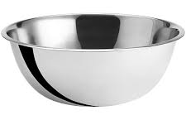
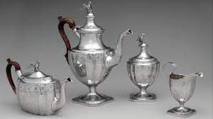
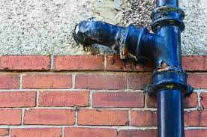
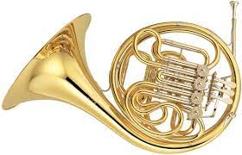
63. Examples of ALLOYS:
Sterling Silver | Ag + Cu | for strength
Cast Iron | Fe + C | for strength & non-corrosiveness
Stainless steel | Fe + Cr | for strength & non-corrosiveness
Brass | Zn + Cu | for durability, beauty, & French horns J

Slide 89
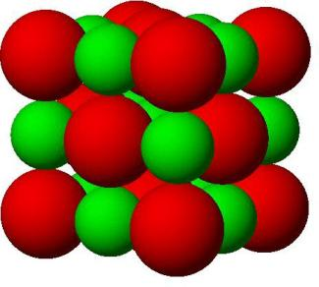
64. Coordination numbers is the
NUMBER OF IONS
EACH ION IS
SURROUNDED BY
IN THE SOLID LATTICE.
Each Na⁺¹ cation is surrounded by 6 Cl⁻¹ ions.
The reverse is also true,
Each Cl⁻¹ ion is surrounded by 6 Na⁺¹ cations

Slide 90
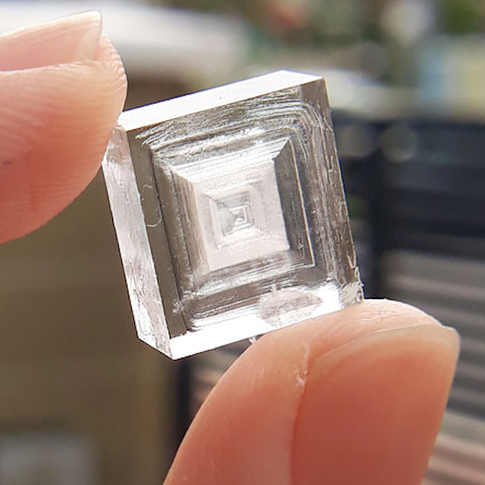
65. Since both coordination numbers are 6,
NaCl has a nice boxy shape.

Slide 91
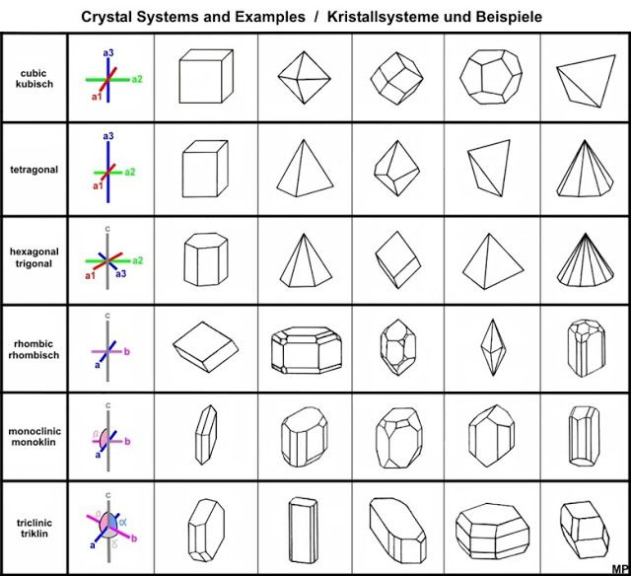
66.
Different Coordination Numbers
form into different shaped crystals.

Slide 92
67. Carbon Monoxide gas, CO First draw both ATOM Lewis Dot diagrams, then we discuss.
Carbon atom | Oxygen atom

Slide 93
67. Carbon Monoxide gas, CO First draw both ATOM Lewis Dot diagrams, then we discuss.
 |  | Carbon needs to make 4 bonds to form an octet. Oxygen needs to make 2 bonds for an octet. The math does not work. Nothing normal will allow for this, but CO exists.
 |  | Let’s try making a normal double polar covalent bond. This gives oxygen an octet, but not carbon, it’s better, but not correct.
C
O
C
O

Slide 94
67. Carbon Monoxide gas, CO First draw both ATOM Lewis Dot diagrams, then we discuss.
 | CO makes an EXCEPTIONAL BOND.
If oxygen “lends” 2 of its unshared pairs of electrons into the middle; allowing both atoms have an octet. This is STRANGE. It’s a normal double polar covalent bond, PLUS A COORDINATE COVALENT BOND | Oxygen “coordinates” the carbon octet, but those red electrons up top are not being shared in a “normal” way. Both are from one atom. CO exists. This is how it works.
C
O

Slide 95
A shorthand for this bond, a double polar
covalent plus a coordinate covalent bond
looks like this:
C
~
O

Slide 96
68. Phosphorus pentachloride is up next, another
real weirdo molecule…
It’s used to produce fertilizer and in other chemical reactions. It is common in chemistry – just new to you!
P has 5 valence electrons,
Chlorine has 7 valence electrons,
that does not work into an octet.

Slide 97
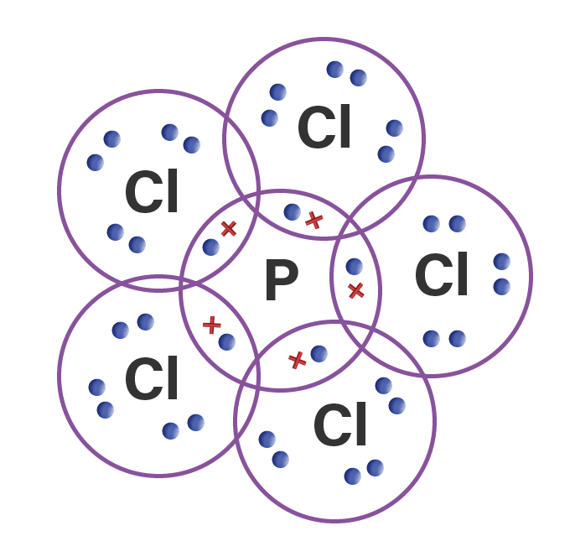
68. Phosphorus Pentachloride PCl₅
P
Cl
Cl
Cl
Cl
Cl
This breaks the octet rule -- phosphorous ends up with
10 valence electrons, two too many! It’s an exception.

Slide 98
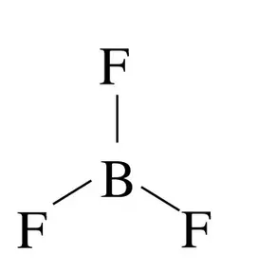
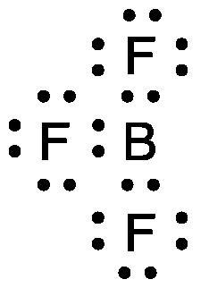
69. Boron has an electron configuration of 2-3
BF₃ strangely only make 3 bonds, which gives it just
6 total valence electrons, not an octet. Boron breaks the octet rule with TOO FEW ELECTRONS.
That’s okay, it’s another exception!
(boron rhymes with …)

Slide 99

John Adams High School, in Ozone Park, in New York City.
I graduated in 1978 on that sidewalk in front of the school.
We had 2 graduations that day; 975 graduates and their families were too many for one ceremony!

Slide 100

My sister and my brother both worked here, and they had the best crumbcake in the world. The cookies were fab too.
Those stairs go up to the A train to Manhattan. In Queens this train runs on elevated tracks (called the EL). In Brooklyn and Manhattan this train runs underground (the subway)

Slide 101
70 Ozone and Oxygen, both elemental oxygen.
One you breathe in to live, the other you can breathe in,
but you die (sorry).
O₃ vs. O₂
Ozone is an allotrope of oxygen.
Same element with different bonding,
and different properties.

Slide 102
71. Ozone with resonating bonds.
O
O
O
O
O
O
Scientists originally described ozone this way:
ozone had a stable and unstable side, and the stable bond would “RESONATE” back and forth.
Somehow this kept the molecule together, and it is a molecule that holds together. This was not the whole story.

Slide 103
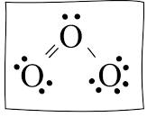
72. Ozone with its hybrid bonding:
Ozone has unusual bonding, a sort of
“1½ bonds” all the time, rather than any
sort of resonating structures.
The old name stuck.
Scientists know this because they can measure the bond lengths.
Single bonds are longer than double bonds.
“Resonating” bonds are hybrid bonds, here they are 1½ size all the time.
The valence electrons in ozone are shared between all 3 atoms, which is hard to draw, hard to describe, and breaks lots of rules.
O
O O

Slide 104
Bonding Class #6 Intro to the
Simple Intermolecular Attractions (IMF)
(not LMAO) (not LOL) (not DULL)
73. Intermolecular Bonds are the weak attractions between molecules or atoms. They are much weaker than ionic or covalent bonds, or metallic bonds.
They do impact a substance’s melting and boiling points (etc.), They help you determine if a substance
is likely a gas or liquid at room temperature.

Slide 105
There are 3 kinds of
INTERMOLECULAR BONDS,
electron dispersion force
dipole interaction
hydrogen bonding

Slide 106
The weakest is electron dispersion force. It’s caused by the constant movement of electrons, which creates “moments”
of negative or positive in the electron clouds.
75. Electron Dispersion Attraction is clearly displayed by
the halogens of group 17.
F₂, Cl₂ Br₂, and I₂, are all diatomic,
they all have single nonpolar bonds,
and
they are all nonpolar molecules.
They are in different phases at room temperature, due to electron dispersion attraction

Slide 107
76. Fluorine F₂
Each F₂ molecules has two 2-7 electron configurations, a total of 18 electrons.
When these 18 electrons all “move” to one side, for a nanosecond, a temporary dipole is created, positive and negative,
creating weak temporary attractions.
So few electrons make very weak dipoles.
F₂ is a gas at STP,
The kinetic energy exceeds the attractive
force of the electron dispersion attraction.

Slide 108
76. Chlorine Cl₂
Each Cl atom has a 2-8-7 electron configuration
Cl₂ Molecules have 34 electrons.
When these electrons all “move” to one side, for a nanosecond, they make stronger temporary dipoles.
Stronger temporary dipoles form with Cl₂ compared to F₂
but not enough to make a difference,
Cl₂ is a gas at STP,
because the kinetic energy exceeds the attractive forces.

Slide 109
76. Bromine Br₂
Each Br atom has a 2-8-18-7 electron config.
Br₂ molecules have 70 total electrons!
These electrons all shift about so much that when a dipole is temporarily created,
it’s much stronger.
The electron dispersion force is
strong enough to make Br₂ a liquid!
The weak but constant intermolecular attractions accumulate. This impacts the phase.
The kelvin kinetic energy cannot overcome the intermolecular attraction at STP
Br₂ is a liquid at STP

Slide 110
Each of these I₂ molecules has 106 electrons.
The electrons shift around so much, that a stronger temporary dipole forms so often that these I₂ molecules have the most moments of attraction of the halogens.
Although it is still weak,
so much electron dispersion attraction exists in iodine molecules,
I₂ is a solid at STP.
Electron Dispersion forces.
Example 4: Iodine I₂

Slide 111
77. At STP: The halogens, of group 17 can be
The difference in phase is only due to the amount of
ELECTRON DISPERSION FORCE
Caused by the number of moving electrons.
More electrons = stronger IMF
Gases | F₂ & Cl₂
Liquid | Br₂
Solid | I₂

Slide 112
dipole attraction
78. A dipole occurs when a molecule has polar bonds and does not
have radial symmetry. These form a near permanent dipole.
Draw that molecule below.
This molecule has polar bonds,
Cl has a higher electronegativity than S
The molecule DOES NOT have radial symmetry, it is a polar molecule.
The + and – are nearly permanently polar.
This creates a DIPOLE
(2 poles of opposite charge).
S
Cl Cl

Slide 113
79. A bunch of SCl₂ molecules exhibit dipole attraction, caused by near
permanent dipoles created by polar bonds in polar molecules.
+
+
S
Cl Cl
S
Cl Cl
+
S
Cl Cl
̶
̶
̶
̶
+
S
Cl Cl
̶
̶
Positive sides of molecules are attracted to the negative sides
of nearby molecules.
+
S
Cl Cl
̶
̶
̶
̶

Slide 114
80. Draw the Dipole Arrows for CH₄
Does this molecule have radial symmetry?
H
H C H
H
This molecule has polar bonds, C has a higher electronegativity than the H.
The molecule HAS radial symmetry,
it is a NONPOLAR molecule.
The whole outside of the molecule
is balanced, not polar.
This molecule DOES NOT HAVE
a DIPOLE

Slide 115
81. Compare and contrast SCl₂ and CH₄
 | Boiling point in Kelvin | Phase at room temp
SCl₂ | 333 K | Liquid
CH₄ | 111 K | Gas
Why would this be, Liquid + Gas?

Slide 116
81. Compare and contrast SCl₂ and CH₄
 | Boiling point in Kelvin | Phase at room temp
SCl₂ | 333 K | Liquid
CH₄ | 111 K | Gas
SCl₂ is a dipole, its molecules stick together well. It takes a lot more energy to separate them into a gas. CH₄ is a nonpolar molecule with little attraction to itself. It can’t hold together at this temperature, it shakes apart.

Slide 117
82. Hydrogen bonding is exactly the same
as dipole attraction, but hydrogen atoms
must be present in the molecule.
Let us compare H₂O and SCl₂, hydrogen bonding to dipole attraction. It’s the same thing, just a different level of strength due to a much greater electronegativity difference.
compound | atom 1 electronegativity | atom 1 electronegativity | Electronegativity difference | How polar are these molecules?
H₂O | H 2.2 | O 3.4 | 1.2 | More polar
SCl₂ | S 2.6 | Cl 3.2 | 0.6 | Less polar

Slide 118
83. Draw these two dipoles
S
Cl Cl
O
H H
SCl₂ has H₂O has
dipole attraction super duper dipole
called
HYDROGEN BONDING

Slide 119
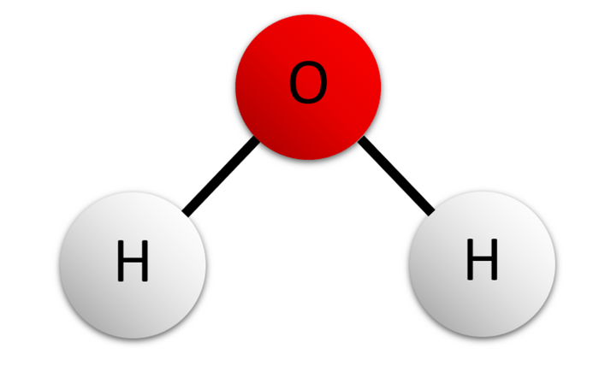
84. Draw SIX molecules of water like this one (randomly)
then put in the hydrogen bonding between them…
–
+
+

Slide 120
84. Positive Hydrogen atoms attract to negative Oxygen atoms.
–
–
+
+
+
+
–
–
+
+
There are billions of hydrogen bonds in a glass of water.
They hold the water molecules together.
+
+
–
–
+
+
+
+

Slide 121
85. bond type | example formulas
Ionic
Single nonpolar covalent
Single polar covalent
Double nonpolar covalent
Double polar covalent
Triple non polar covalent
Triple polar covalent
Coordinate covalent
Resonant
Ionic + Covalent at the same time
Breaks the octet rule (more than 8e⁻)
Breaks the octet rule (less than 8e⁻)

Slide 122
85. bond type | example formulas
Ionic | NaCl, CaO, KBr, MgO
Single nonpolar covalent | H_{2 ,} F₂, Cl₂, Br₂ H-H, F-F, Cl-Cl, and Br-Br
Single polar covalent | HCl, HF, HBr, HI
Double nonpolar covalent | O₂ O=O
Double polar covalent | CO₂ O=C=O
Triple nonpolar covalent | N₂ N≡N
Triple polar covalent | HCN (N to C is triple) H-C≡N
Coordinate covalent | CO (double polar covalent, PLUS the coordinate covalent)
Resonant | O₃ (Ozone Park!)
Ionic + Covalent at the same time | CuSO₄·5H₂O (also has hydrogen bonding!)
Breaks the octet rule (more than 8e⁻) | PCl₅
Breaks the octet rule (less than 8e⁻) | H₂ or LiF (the lithium) or BF₃

Slide 123

Bonding Class #7
OB: master relative oxidation numbers, review all bonding
A long, long time ago,
in a galaxy,
far, far away…
86. Relative Oxidation Numbers are those positive and negative numbers in the corners of the NONMETALS on the periodic table.
They help us decide what ratios of atoms to atoms that molecular compounds make.

Slide 124
87.
Hydrogen has a +1 and a –1 oxidation number.
Oxygen has only a – 2 oxidation number.
To “make” molecules, you combine atoms to atoms, so that the sum of the oxidation number
is zero. These are numbers, not ion charges!

Slide 125
87.
Hydrogen has a +1 and a –1 oxidation number.
Oxygen has only a – 2 oxidation number.
To “make” molecules, you combine atoms to atoms, so that the sum of the oxidation number
is zero. These are numbers, not ion charges!
H
+1
-1
O
-2
Since oxygen is -2, it will take two +1 hydrogen atoms
to sum to zero.
That is why
the formula is H₂O is good.
That’s why H₃O or
HO cannot form.
2:1 = H₂O
2 negative oxidation numbers cannot sum to zero.
The –1 oxidation number is not used here.

Slide 126
88. Determine the relative oxidation numbers in these molecules…
H⁺¹ Cl⁻¹ (+1) + (-1) = 0
C⁺⁴ O⁻² (+4) + 2x(-2) = 0
As⁺³ Cl⁻¹ (+3) + 3x(-1) = 0
BF₃
SiO₂
CO₂
PCl₅

Slide 127
88. Determine the relative oxidation numbers in these molecules…
H⁺¹ Cl⁻¹ (+1) + (-1) = 0
C⁺⁴ O⁻² (+4) + 2x(-2) = 0
As⁺³ Cl⁻¹ (+3) + 3x(-1) = 0
BF₃ | B⁺³ F⁻¹ F⁻¹ F^{-1 = zero}
SiO₂ | Si ⁺⁴ O⁻² O⁻² ^{= zero}
CO₂ | C⁺⁴ O⁻² O⁻² ^{= zero}
PCl₅ | P⁺⁵ Cl⁻¹ Cl⁻¹ Cl⁻¹ Cl⁻¹ Cl^{-1 = zero}

Slide 128
89 | Permanganate ion | MnO₄⁻¹ | Mn⁺¹ O⁻² O⁻² O⁻² O⁻² ⁼ ⁻¹
 | ammonia | NH₃ | N⁻³ H⁺¹ H⁺¹ H⁺¹ ⁼ ⁰
 | Sodium hydroxide | NaOH
 | Potassium chlorate | KClO₃
 | Carbon monoxide | CO
 | Carbon dioxide | CO₂
 | Dihydrogen sulfate | H₂SO₄
 | Nitrate ion | NO₃⁻¹
 | Nitrogen dioxide | NO₂
 | Phosphorus trichloride | PCl₃

Slide 129
89 | Permanganate ion | MnO₄⁻¹ | Mn⁺¹ O⁻² O⁻² O⁻² O⁻² ⁼ ⁻¹
 | ammonia | NH₃ | N⁻³ H⁺¹ H⁺¹ H⁺¹ ⁼ ⁰
 | Sodium hydroxide | NaOH | Na⁺¹ O⁻² H⁺¹ ⁼ ⁰
 | Potassium chlorate | KClO₃ | K⁺¹ Cl⁺⁵ O⁻² O⁻² O⁻² ⁼ ⁰
 | Carbon monoxide | CO | C⁺² O⁻² ⁼ ⁰
 | Carbon dioxide | CO₂ | C+4 O⁻² O⁻² ⁼ ⁰
 | Dihydrogen sulfate | H₂SO₄ | H⁺¹ H⁺¹ S⁺⁶ O⁻² O⁻² O⁻² O⁻² ⁼ ⁰
 | Nitrate ion | NO₃⁻¹ | N⁺⁵ O⁻² O⁻² O⁻² ⁼ ⁻¹
 | Nitrogen dioxide | NO₂ | N⁺⁴ O⁻² O⁻² ⁼ ⁰
 | Phosphorus trichloride | PCl₃ | P⁺³ Cl⁻¹ Cl⁻¹ Cl⁻¹ ⁼ ⁰

Slide 130
90. What is the difference between
bond polarity and molecular polarity?
Who has the guts to stand and tell us?

Slide 131
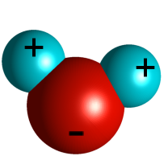
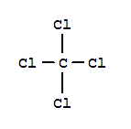
90. Bond polarity is due to a difference in electronegativity
between two bonding atoms. We check table S.
Molecular polarity has to do with molecular shape.
If a molecule has radial symmetry, it is a nonpolar molecule.
A molecule that doesn’t exhibit radial symmetry is polar.
A polar molecule water A nonpolar molecule CCl₄

Slide 132
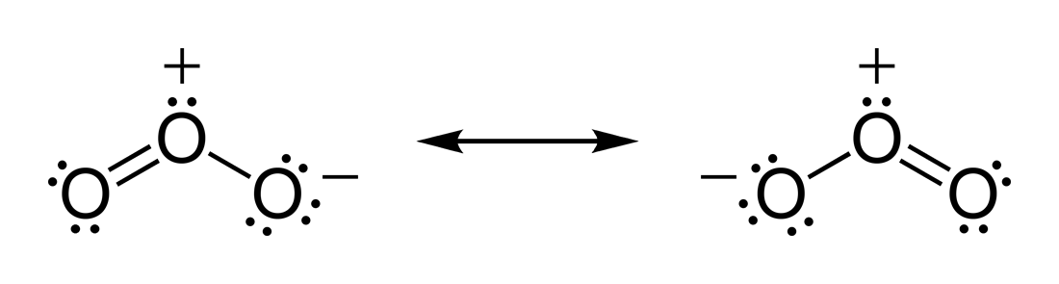
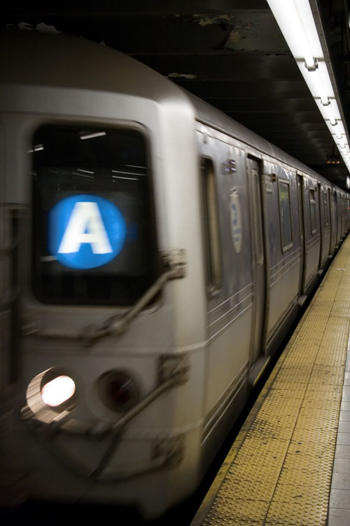
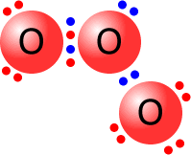
91. Explain the resonating bonds in ozone O₃
These hybrid bonds are “both” 1½ sized
and don’t really resonate!
O
O O

Slide 133
92. Draw the Lewis dot diagram, and explain how carbon monoxide bonds together.
C O

Slide 134
92.
C O
Carbon monoxide has one double polar covalent bond
(the bottom 2 pairs of electrons)
and one coordinate covalent bond.
(the two blue electrons on top)
which means oxygen just “lends” 2 electrons “into the mix”
so carbon “gets” an octet too.
~
C
O

Slide 135
93 | Question | True or False?
A | Ionic bonds can be single, double or triple bonds.
B | Covalent bonds are always polar bonds.
C | Oxygen molecules have double polar covalent bonds.
D | Nitrogen molecules have double nonpolar covalent bonds.
E | Hydrogen atoms can make single or double bonds.
F | Nonpolar molecules can’t have polar bonding.
G | Water can sometimes form into a straight–line shape.
H | Oxygen atoms must make double bonds.
I | Molecules with only nonpolar bonds can’t form polar molecules
J | The weakest intermolecular bond is called dipole attraction.

Slide 136
93 | Question | True or False?
A | Ionic bonds can be single, double or triple bonds. | False, just ionic
B | Covalent bonds are always polar bonds. | False, H₂, Cl₂, etc.
C | Oxygen molecules have double polar covalent bonds. | False, nonpolar
D | Nitrogen molecules have double nonpolar covalent bonds. | False, triple
E | Hydrogen atoms can make single or double bonds. | False, just single
F | Nonpolar molecules can’t have polar bonding. | False, CH₄ or CCl₄
G | Water can sometimes form into a straight–line shape. | False, NEVER
H | Oxygen atoms must make double bonds. | False, any 2 bonds
I | Molecules with only nonpolar bonds can’t form polar molecules | False, NBr₃
J | The weakest intermolecular bond is called dipole attraction. | False, electron dispersion

Slide 137
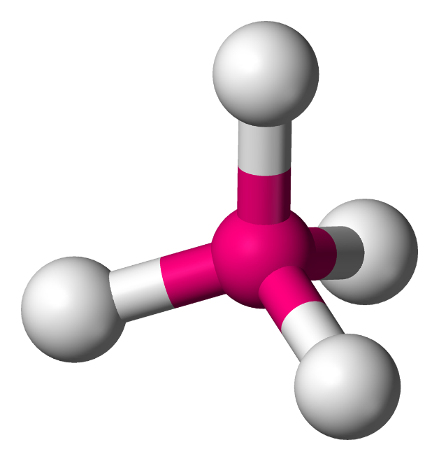
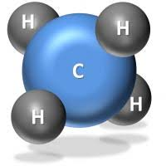
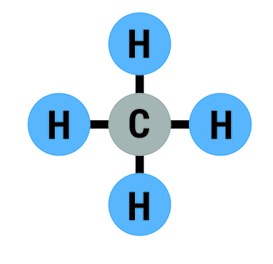
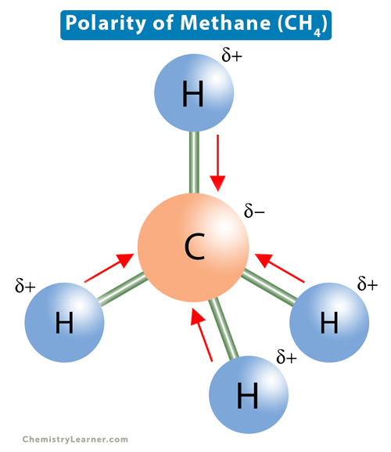
Models of Methane
CH₄

Slide 138
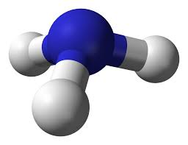
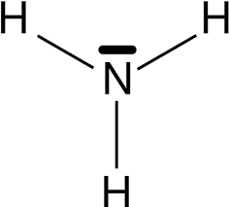
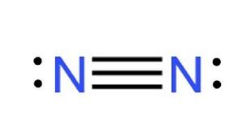
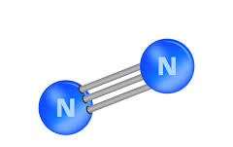
Models of nitrogen and ammonia
N₂ NH₃

Slide 139
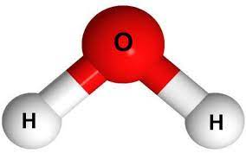
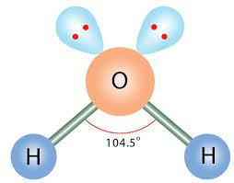
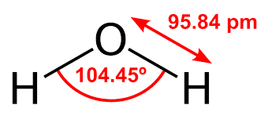
Models of Water
H₂O

Slide 140
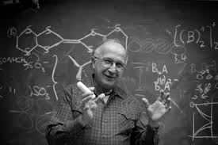
The end (sort of).
I once shook hands with this man, in Vestal High School. It’s a true highlight of my life. He’s Roald Hoffmann, Nobel Prize winner in Chemistry.
He studied bonding. All of it way over my head!

Slide 141
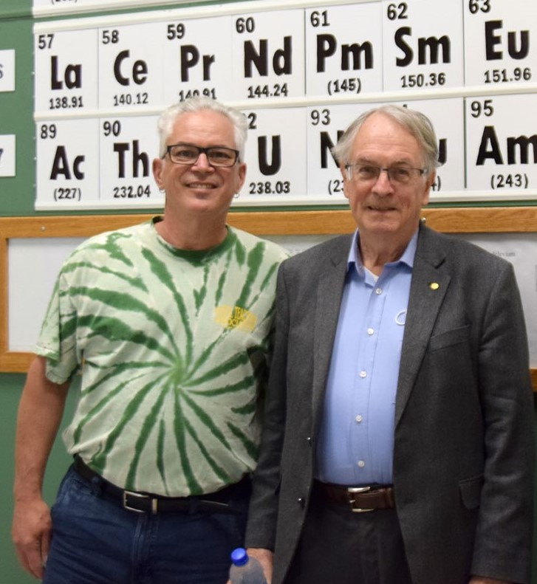
That is me with
Stanley Whittingham
He earned his Nobel Prize for his work on the lithium-ion battery.
I understood his work a bit more.
I got to shake his hand too.
That’s 2 Chemistry Nobel Prize winners, but who’s counting? (I am!)
So far there have been only
115 Chemistry Prizes awarded
(shared by 192 scientists).

