Slide 1
GAS CHEMISTRY
Take out your reference tables
(back page)
FIND THE
Combined Gas Law

Slide 2
1
P1V1
T₁
P2V2
T₂
=
2. Read this this way:
P₁V₁ over T₁ = P₂V₂ over T₂

Slide 3
P1V1
T₁
P2V2
T₂
=
3. What this means is that if you know the original
conditions of pressure, volume, + temperature
You can determine the new conditions
of pressure, volume, and temperature

Slide 4
4. Pressure can be – kPa, psi, mm of Hg, or atm
BUT THE SAME UNITS get used
ON BOTH SIDES of the equal sign

Slide 5
4. Pressure can be – kPa, psi, mm of Hg, or atm
BUT THE SAME UNITS get used
ON BOTH SIDES of the equal sign
5. Volume can be – usually Liters, mL, or cm³
BUT THE SAME UNITS get used
ON BOTH SIDES of the equal sign

Slide 6
4. Pressure can be – kPa, psi, mm of Hg, or atm
BUT THE SAME UNITS get used
ON BOTH SIDES of the equal sign
5. Volume can be – usually Liters, mL, or cm³
BUT THE SAME UNITS get used
ON BOTH SIDES of the equal sign
6. Temperature MUST BE KELVIN, OR ELSE

Slide 7
7. Your balloon is filled on the ground. It’s 45.6 liters in size, the helium
is at a pressure of 1.20 atm, at 293 K. The balloon rises and the
temperature drops to 278 K; the pressure drops to 1.05 atm.
What’s the new volume of the balloon? (lots of words, but easy!)
P1V1
T₁
P2V2
T₂
=

Slide 8
7. Your balloon is filled on the ground. It’s 45.6 liters in size, the helium
is at a pressure of 1.20 atm, at 293 K. The balloon rises and the
temperature drops to 278 K; the pressure drops to 1.05 atm.
What’s the new volume of the balloon?
P1V1
T₁
P2V2
T₂
=
(1.20 atm)(45.6 L) (1.05 atm)(V₂)
(293 K) (278 K)
(1.20 atm)(45.6 L)(278 K) = (1.05 atm)(293 K)(V₂)
=

Slide 9
7. Your balloon is filled on the ground. It’s 45.6 liters in size, the helium
is at a pressure of 1.20 atm, at 293 K. The balloon rises and the
temperature drops to 278 K; the pressure drops to 1.05 atm.
What’s the new volume of the balloon?
(1.20 atm)(45.6 L)(278 K)
(1.05 atm)(293 K)
= V₂
15,212.16
307.65
L = 49.4 liters 3SF

Slide 10
8. A weather balloon has been filled with helium to a volume of 65.5 liters, at 1.50 atm, temperature is 295 K. The balloon cools to 265 K, and the volume changes to 62.0 Liters. What is the pressure in this balloon under these new conditions?

Slide 11
8. A weather balloon has been filled with helium to a volume of 65.5 liters, at 1.50 atm, temperature is 295 K. The balloon cools to 265 K, and the volume changes to 72.0 Liters. What is the pressure in this balloon under these new conditions?
P1V1
T1
P2V2
T2
=
(1.50 atm)(65.5 L)
295 K
(P2)(62.0 L)
265 K
=
(1.50 atm)(65.5 L)(265 K) = (P₂)(62.0 L)(295 K)
1.42 atm = P₂

Slide 12
9. At constant temperature, a sample of CO₂ at 50.0 cm³ and 125 kPa is
put into a much larger container and it expands to 595 cm³.
What’s the new pressure of the gas?
P1V1
T₁
P2V2
T₂
=
P₁V₁ = P₂V₂
_{temp cancels out}

Slide 13
9. At constant temperature, a sample of CO₂ at 50.0 cm³ and 125 kPa is
put into a much larger container and it expands to 595 cm³.
What’s the new pressure of the gas?
P1V1 = P2V2
(125 kPa)(50.0 cm³) = (P₂)(595cm³)
(125 kPa)(50.0 cm³) = P₂
(595 cm³)
10.5 kPa = P₂

Slide 14
10. At constant pressure, 12.0 liters of CH₄ gas at 24.0°C is cooled down
to -15.0°C. What does the gas volume change to?

Slide 15
10. At constant pressure, 12.0 liters of CH₄ gas at 24.0°C is cooled down
to -15.0°C. What does the gas volume change to?
P₁V₁
T₁
P₂V₂
T₂
V₁
T₁
V₂
T₂
=
=
K = C + 273
K = 24.0 + 273 = 297K
K = C + 273
K = (-15.0) + 273 = 258K
We cannot use the centigrade temps, conversions first…

Slide 16
10. At constant pressure, 12.0 liters of CH₄ gas at 24.0°C is cooled down
to -15.0°C. What does the gas volume change to?
V₁
T₁
V₂
T₂
=
12.0 L
297 K
V₂
258 K
=
(12.0 L)(258 K) = (V₂)(297 K)
10.4 L = V₂

Slide 17
11. At a constant volume of 450.0 mL, a sample of oxygen gas is
at 165 kPa, and standard temperature. If it is heated up to 349 K,
what is the new pressure on this gas?
P₁V₁
T₁
P₂V₂
T₂
P1
T₁
P2
T₂
=
=

Slide 18
11. At a constant volume of 450.0 mL, a sample of oxygen gas is
at 165 kPa, and standard temperature. If it is heated up to 349 K,
what is the new pressure on this gas?
P1
T₁
P2
T₂
=
165 kPa
273 K
P₂
349 K
=
(P₂)(273 K) = (165 kPa)(349 K)
P₂ = 211 kPa

Slide 19
12. Fill in this chart to help you guide your way through ALL gas math problems
For Review | formula | Show a simple graph of this relationship | Name this relationship as inversely or directly proportional. Or both.
The combined gas law: |  |  | both inversely and directly
The combined gas law with constant temp: |  |  | inversely
The combined gas law with constant pressure: |  |  | directly
The combined gas law with constant volume: |  |  | directly
P1V1
T₁
P2V2
T₂
=
P₁V₁ = P₂V₂
V1
T₁
V2
T₂
=
P1
T₁
P2
T₂
=

Slide 20

The temperature of your gas must always be done in KELVIN. WHY???
You can never have a zero
or a negative number in
your denominator.
Centigrade has zero and
negative temperatures and
that wrecks the math.

Slide 21
Start gas class #2

Slide 22
Constant Temperature yields
P₁V₁ = P₂V₂
This is called BOYLE’S LAW,
which is part of the combined gas law.

Slide 23

15. Draw a picture of this balloon, which we will call the Charlie CO₂ Gas Balloon of Today, so that we can talk just about this unique sample of gas. We could talk about other samples, but for now, let’s ONLY talk about this sample, Ok?
Charlie’s CO₂
Gas Balloon
of Today
It is at pressure of 1.30 atm and has a volume of 350 mL.

Slide 24
16. What happens to pressure and volume of the balloon if
I squish it with my strong man arms?
squished!
Charlie’s CO₂
Gas Balloon
of Today

Slide 25

16. As the VOLUME decreased, the PRESSURE increased.
Pressure + Volume act opposite of each other
(you knew that would happen)
17. Pressure and volume are
INVERSELY PROPORTIONAL

Slide 26
18. What would happen to the pressure inside the Charlie
Balloon if I glued my hands to the balloon, and used my
manly arms to stretch out to a larger volume?
Original
Charlie balloon
EXPANDED
Charlie balloon

Slide 27
18. What would happen to the pressure inside the Charlie
Balloon if I glued my hands to the balloon, and used my
manly arms to stretch out to a larger volume?
Original
Charlie balloon
EXPANDED
Charlie balloon
Volume ↑ increased
Pressure ↓ decreased
Because pressure and volume are
inversely proportional, you probably
already knew what would happen!

Slide 28
20. Title your graph pressure as a function of volume of gas.
Pressure as a function of volume of a gas…
Pressure
Starting pressure, starting volume
1.30 atm + 350 mL
volume

Slide 29
When pressure increases, volume decreases.
Pressure as a function of volume of a gas…
Pressure
Starting pressure, starting volume
1.30 atm + 350 mL
High Pressure Low Volume
volume

Slide 30
As pressure decreases, volume increases.
Pressure as a function of volume of a gas…
High Volume
Low Pressure
Pressure
Starting pressure, starting volume
1.30 atm + 350 mL
volume

Slide 31
Because P and V change proportionally,
any P x V = any other P x V
21. P₁V₁ = P₂V₂ = P₃V₃ etc.
Pressure as a function of volume of a gas…
P₂V₂
Pressure
P₁V₁
volume

Slide 32
22. P x V = THE gas constant for this gas.
Pressure as a function of volume of a gas…
Pressure
atm
Original conditions
1.30 atm x 350 mL =
455 atm·mL
Volume mL
P x V = C = (1.30 atm)(350 mL) = 455 atm·mL (cool weirdo units)

Slide 33
Pressure as a function of volume of a gas…
P₂V₂ = 455 atm·mL
Pressure
atm
P₁V₁ = 455 atm·mL
P₃V₃ = 455 atm·mL
Volume mL
23. For every point on this graph,
P x V = the constant = 455 atm·mL

Slide 34
24. Same idea, new gas. Your nitrogen sample has
volume of 3.75 Liters at pressure of 125 kPa.
What is the gas constant for your gas?

Slide 35
24. Same idea, new gas. Your nitrogen sample has
volume of 3.75 Liters at pressure of 125 kPa.
What is the gas constant for your gas?
P x V = constant
(125 kPa)(3.75 L) = 469 kPa·L
more weirdo units!

Slide 36
25. Your N_{2(G)} sample expands to 9.75 Liters.
Calculate the new pressure? (your constant = 469 kPa·L)

Slide 37
25. Your N_{2(G)} sample expands to 9.75 Liters.
Calculate the new pressure? (your constant = 469 kPa·L)
For your gas sample the gas constant it 469 kPa·L
So,
P x V = constant
P x 9.75 L = 469 kPa·L
P = 48.1 kPa

Slide 38
Boyle's Law
26. For any sample of gas, pressure & volume are inversely proportional
and equal to a constant, so…
P₁V₁ = P₂V₂
27. Boyle’s Law is part of THE COMBINED GAS LAW.

Slide 39
28. At constant temperature, a sample of neon gas is at standard pressure
and 45.8 liters volume. If pressure doubles, what is the new volume?
Do the math in kPa here Do the math in atm here

Slide 40
28. At constant temperature, a sample of neon gas is at standard pressure
and 45.8 liters volume. If pressure doubles, what is the new volume?
Do the math in kPa here Do the math in atm here
P₁V₁ = P₂V₂
(101.3 kPa)(45.8 L) = (202.6 kPa)(V₂)
(101.3 kPa)(45.8 L)
202.6 kPa
= V₂
22.9 Liters = V₂

Slide 41
28. At constant temperature, a sample of neon gas is at standard pressure
and 45.8 liters volume. If pressure doubles, what is the new volume?
Do the math in kPa here Do the math in atm here
P₁V₁ = P₂V₂
(101.3 kPa)(45.8 L) = (202.6 kPa)(V₂)
P₁V₁ = P₂V₂
(1 atm)(45.8 L) = (2 atm)(V₂)
(101.3 kPa)(45.8 L)
202.6 kPa
(1 atm)(45.8 L)
2 atm
= V₂
= V₂
22.9 Liters = V₂
22.9 Liters = V₂
Of course, it’s the same answer.

Slide 42
29. A thick rubber balloon has 16.3 L of SO_{2(G)} at 1.25 atm.
The balloon is squished when you sit on it, to 12.8 L.
What’s the new balloon pressure?

Slide 43
29. A thick rubber balloon has 16.3 L of SO_{2(G)} at 1.25 atm.
The balloon is squished when you sit on it, to 12.8 L.
What’s the new balloon pressure?
P₁V₁ = P₂V₂
(1.25 atm)(16.3 L) = (P₂)(12.8 L)
(1.25 atm)(16.3 L)
12.8 L
= P₂
1.59 atm = P₂

Slide 44
30. Variables to measure gases…
pressure you can use any units you know such as:
kilo-Pascals kPa atmospheres atm
millimeters of mercury mm Hg pounds per square inch psi

Slide 45
30. Variables to measure gases…
pressure you can use any units you know such as:
kilo-Pascals kPa atmospheres atm
millimeters of mercury mm Hg pounds per square inch psi
volume you can use any units you know, such as:
Liters, milliliters, or centimeters cubed (L, mL, or cm³)

Slide 46
30. Variables to measure gases…
pressure you can use any units you know such as:
kilo-Pascals kPa atmospheres atm
millimeters of mercury mm Hg pounds per square inch psi
volume you can use any units you know, such as:
Liters, milliliters, or centimeters cubed (L, mL, or cm³)
temperature of a gas, in KELVIN
gases can have centigrade temps of zero or negative numbers, but WE CAN’T put zeros or negative numbers into our math denominators or the math crashes.

Slide 47
30. Variables to measure gases… |  | Units
1 | Pressure | kPa kilo-Pascals atm atmospheres mm Hg millimeters of mercury psi pounds per square inch | Other units are okay, so long as they are the same on both sides of your equal sign.
2 | Volume | L Liters mL milliliters cm³ centimeters cubed
3 | Temperature | K Kelvin | No choice, Kelvin only.
4 | Number of Moles | Moles are back! | Yay!

Slide 48
31. IMAGINE we put balloons into hot water, and into cold
water. What happens to the balloon sizes?
Into HOT water
Into COLD water

Slide 49
31. IMAGINE we put balloons into hot water, and into cold
water. What happens to the balloon sizes?
Into HOT water
Hotter
Gets
BIGGER
Into COLD water
colder
gets
smaller

Slide 50
32. When BOTH variables move in the same direction, at the
same time, It’s called DIRECTLY PROPORTIONAL.
Temperature and Volume Are Directly Proportional, any straight line will be directly proportional, the two variables do not have to change in a 1:1 ratio
Temp as a
function of Vol
Temp as a
function of Vol
Temp as a
function of Vol
Temp.
Temp.
Temp.
Volume
Volume
Volume

Slide 51

Let go before this happens.

Slide 52
33. Volume + Temperature of a gas are
DIRECTLY PROPORTIONAL

Slide 53
34. DRAW these two graphs carefully*
Temp as a Function of Volume Volume as a Function of Temp
temp
volume
volume
temp
*Note graph title difference, and the placement of the Y and X
axis labels. This is important.

Slide 54
35. All of these are directly proportional.
As one variable increases, so does the other.
T
T
T
Vol
Vol
Vol

Slide 55
Gas Class #3 starts next

Slide 56

Real vs. Ideal Gases
Chemists use the idea of “ideal gases”
to help you grasp how real gases work. Ideal gases are not real. They are perfect.
There are NO examples of ideal gases,
any more than there is a Superman or Wonder Woman. We understand them,
but we know they are fake.
Ideal gases are used to
help kids learn about real gases.
There are many examples of real gases: oxygen, nitrogen, carbon dioxide, helium, and methane (etc.).

Slide 57
35. Ideal Gases vs. Real Gases
A. Ideal gases do not exist. Except as the idea of a “perfect”
gas. Like Wonder Woman; she’s not real, but she’s perfect.
B. Real gases are real. They are the ones you know, like N₂,
CO₂, O₂, NH₃, He, etc.
C. Gases remain gases because they follow the kinetic
molecular theory of gases. (the KMT)
D. Ideal gases can never become liquid, no matter how cold
they get, or how much you squish them, they’re FAKE.
E. Real gases can become liquid or solid.

Slide 58
36. Real gases act more ideally with these conditions
High temperature and low pressure.
High temperature means higher kinetic energy and stronger collisions between particles. The harder they collide, the less likely it is that they will tangle up into a liquid.
Low pressure means that the particles have less collisions, which gives less chance to tangle up into
a liquid.

Slide 59
37. Fill in this chart about these gases.
Gas | Symbol | # of atoms per particle | “ideal” ranking
neon | Ne
carbon dioxide | CO₂
propane | C₃H₈

Slide 60
37. Fill in this chart about these gases.
Gas | Symbol | # of atoms per particle | “ideal” ranking
Neon | Ne | 1 | Most ideal
Carbon Dioxide | CO₂ | 3 | Medium
Propane | C₃H₈ | 11 | Least ideal

Slide 61
38. If you had 2.45 liters of CH_{4(G)}, NH_{3(G)} and Ar_{(G)} at the
same temp + pressure, which would be MOST IDEAL?

Slide 62
38. If you had 2.45 liters of CH_{4(G)}, NH_{3(G)} and Ar_{(G)} at the
same temp + pressure, which would be MOST IDEAL?
Argon would be the most ideal gas of these.
Ar particles are atoms, the smallest ones here. CH₄ is least ideal – it has the largest molecules.
Smaller particles are less likely
to get
“tangled up” into a liquid.

Slide 63
A quick reminder of pressure unit conversions..
39. Convert 1.06 atm into millimeters of mercury
40. Change 844 mm of Hg into kilopascals

Slide 64
A quick reminder of pressure unit conversions..
39. Convert 1.06 atm into millimeters of mercury
40. Change 844 mm of Hg into kilopascals
1.06 atm
1
X
760 mm Hg
1.0 atm
= 806 mm Hg (3SF)
844 mm Hg
1
X
101.3 kPa
760 mm Hg
= 112 kPa (3SF)
In the BASICS there are 7 conversion factors + 7 practice problems to make sure
you can switch from one unit to ANY OTHER pressure unit.

Slide 65
41. A gas in a rigid cylinder contains methane gas at
273 K and 125 kPa is warmed to 295 K.
What is the new pressure of this gas?
What does a rigid cylinder imply?

Slide 66
41. A gas in a rigid cylinder contains methane gas at
273 K and 125 kPa is warmed to 295 K.
What is the new pressure of this gas?
What does a rigid cylinder imply?
P1
T₁
P2
T₂
P1V1
T₁
P2V2
T₂
=
=
125 kPa
273 K
P₂
295 K
(125 kPa)(22.4 L)
273 K
P₂(22.4 L)
295 K
=
=
135 kPa = P₂
135 kPa = P₂

Slide 67
42. Avogadro’s Hypothesis
This is so important, consider putting this statement in a frame and hanging it in your bathroom, forever.
“Equal volumes of DIFFERENT gases, at THE SAME temperature & pressure
have the SAME number of moles, and
the SAME number of particles.”

Slide 68
Avogadro’s Hypothesis
“Equal volumes of DIFFERENT gases, at THE SAME temperature and pressure have the SAME number of moles, and the SAME number of particles.”
43 | He | CO₂ | NH₃ | ANY GAS
volume
Temp
Pressure
moles
particles

Slide 69
Avogadro’s Hypothesis
“Equal volumes of DIFFERENT gases, at THE SAME temperature and pressure have the SAME number of moles, and the SAME number of particles.”
43 | He | CO₂ | NH₃ | ANY GAS
volume | 22.4 L | 22.4 L | 22.4 L | 22.4 L
Temp | 273 K | 273 K | 273 K | 273 K
Pressure | 101.3 kPa | 101.3 kPa | 101.3 kPa | 101.3 kPa
moles | 1.0 mole | 1.0 mole | 1.0 mole | 1.0 mole
particles | 6.02 x 10²³ atoms | 6.02 x 10²³ molecules | 6.02 x 10²³ molecules | 6.02 x 10²³ particles

Slide 70
44. If you have 5.48 liters of He_{(G)} and CO_{2(G)} and NH_{3(G)}
all at STP, how many moles of each gas, and how many
particles of each gas are present?

Slide 71
44. If you have 5.48 liters of He_{(G),} CO_{2(G)} and NH_{3(G)} – all at
STP, how many moles and how many particles of each
gas are present?
5.48 L He
1
1 mole He
22.4 L He
X
= 0.245 moles He (3 SF)
0.245 moles He
1
6.02 x 10²³ atoms He
1 mole He
=
X
1.47 x 10²³ molecules He (3 SF)

Slide 72
44. If you have 5.48 liters of He_{(G),} CO_{2(G)} and NH_{3(G)} – all at
STP, how many moles and how many particles of each
gas are present?
5.48 L X
1
1 mole X
22.4 L X
X
= 0.245 moles X (3 SF)
0.245 moles X
1
6.02 x 10²³ atoms X
1 mole X
=
X
1.47 x 10²³ molecules X (3 SF)
X is ANY GAS

Slide 73
Gas Class #4 is next
Mostly review already!

Slide 74
Old Regents Exam questions…
47 Under which conditions of temperature and pressure does
carbon dioxide gas behave most like an ideal gas?
(1) low temperature + low pressure
(2) low temperature + high pressure
(3) high temperature + low pressure
(4) high temperature + high pressure

Slide 75
Old Regents Exam questions…
47 Under which conditions of temperature and pressure does
carbon dioxide gas behave most like an ideal gas?
(1) low temperature + low pressure
(2) low temperature + high pressure
(3) high temperature + low pressure
(4) high temperature + high pressure
Least likely to get stuck together and turn into
a liquid.

Slide 76
Old Regents Exam questions…
48 Which gas sample at STP has the same total number of molecules
as 2.0 liters of CO_{2(G)} at STP?
(1) 5.0 L of CO_{2(G)}
(2) 2.0 L of Cl_{2(G)}
(3) 3.0 L of H₂S_{(G)}
(4) 6.0 L of He_{(G)}

Slide 77
Old Regents Exam questions…
48 Which gas sample at STP has the same total number of molecules
as 2.0 liters of CO_{2(G)} at STP?
(1) 5.0 L of CO_{2(G)}
(2) 2.0 L of Cl_{2(G)}
(3) 3.0 L of H₂S_{(G)}
(4) 6.0 L of He_{(G)}
Avodagro’s Hypothesis
equal volumes of different gases have the same number of particles and the same number of moles.

Slide 78
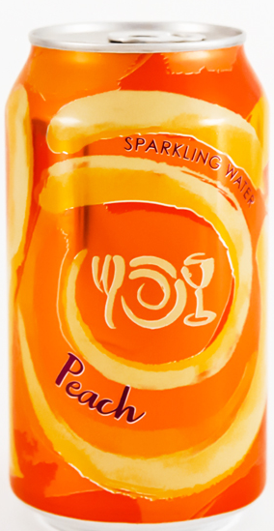

The Can Crush Demo
Heat up a can with some water in it on a hot plate

Slide 79
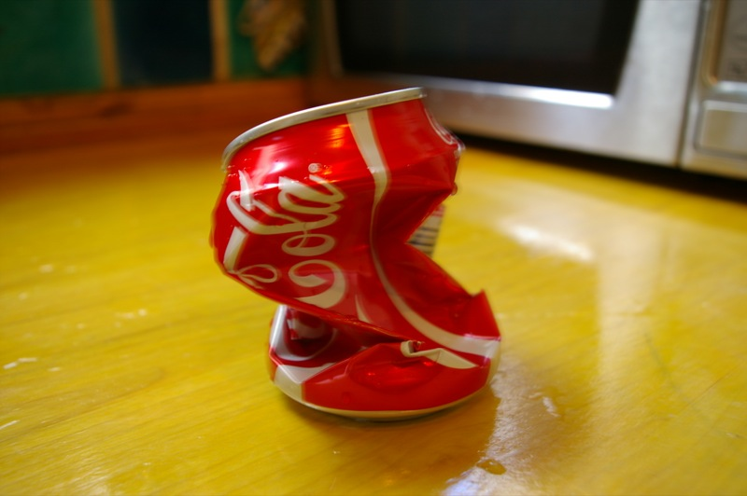
Temperature drops, steam condenses, pressure in the can decreases dramatically. Now the air pressure is easily able to crush the can.
The can does NOT SUCK in, chem never sucks.
49. Let’s draw a graph to show this relationship
Temperature as a function of Pressure
T
P

Slide 80
49. Temperature decreases, pressure decreases too.
Temperature + pressure are DIRECTLY PROPORTIONAL.
49. Let’s draw a graph to show this relationship, Temperature as a function of Pressure
T
P

Slide 81
50. Write the combined gas law

Slide 82
50. Write the combined gas law
P1V1
T₁
P2V2
T₂
=
51. State the relationship between pressure and volume?
(1) directly proportional
(2) indirectly proportional
(3) reversely proportional
(4) inversely proportional

Slide 83

50. Write the combined gas law
P1V1
T₁
P2V2
T₂
=
51. State the relationship between pressure and volume?
(1) directly proportional
(2) indirectly proportional
(3) reversely proportional
(4) inversely proportional
These variables move in opposite directions.

Slide 84
52. State the relationship between pressure and temperature.
P1V1
T₁
P2V2
T₂
=

Slide 85
52. State the relationship between pressure and temperature.
P1V1
T₁
P2V2
T₂
=
Pressure and Temp
are directly proportional
P₁
T₁
P₂
T₂
=

Slide 86
53. State the relationship between volume and temperature.
P1V1
T₁
P2V2
T₂
=

Slide 87
53. State the relationship between volume and temperature.
P1V1
T₁
P2V2
T₂
=
Volume and Temp
are directly proportional
V₁
T₁
V₂
T₂
=

Slide 88
Skip the two boxes on the bottom left side of this page.
54 – 56 and 57 – 59.

Slide 89
60. Kinetic Molecular Theory of Gases. Be familiar
with these 7 points. Make flashcards and learn
them well, the truth and the “fibs”.

Slide 90
A. All gas particles are in random, constant,
straight-line motion.
This is TRUE, particles (atoms or molecules) only move in straight lines.
No curves or loops allowed. If gases slowed down, they’d clump up into liquids, which is not allowed if you want to be a gas.
Both ideal and real gases follow this exactly.

Slide 91
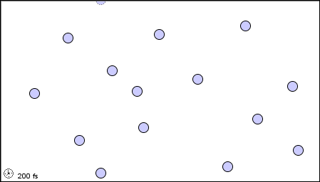
B. The volume of the gas particles is considered negligible.
The particles are separated by great distances relative to their size. Particles take up MUCH LESS space of a gas compared to the “empty” volume the particles move in. Real gases and ideal gases follow this exactly.

Slide 92
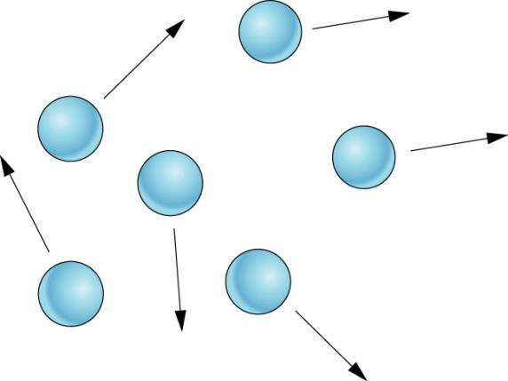
C. Gas particles have no attractive forces between them
The particles of gas act like small hard spheres.
They are not hard spheres. The nuclei are just surrounded by electrons, which are “mostly not there”. In fact, particles do have shapes, and there are attractive and, repulsive forces between particles
(which is overcome by heat from the Sun or Earth, or the heat!)

Slide 93
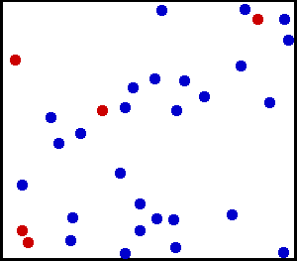
D. Gas particles have collisions that may result in a transfer
of energy between gas particles, but the total energy of the
system remains constant.
That means the collisions are ELASTIC.
This is not quite true, but it seems like it is. Gas particles do transfer their energy from particle to particle when they collide, but they also LOSE some energy too. This small loss of energy (heat loss) is offset by the energy provided by the Sun or Earth each day.
All the gases I know stay gases.
If there was a loss of energy
due to the collisions creating heat,
then the gas particles would slow down
and ultimately liquify.
Gases don’t turn into liquids
unless super chilled..
They do give off some heat when colliding
but it is a slight loss of energy made up
easily by our environment.

Slide 94
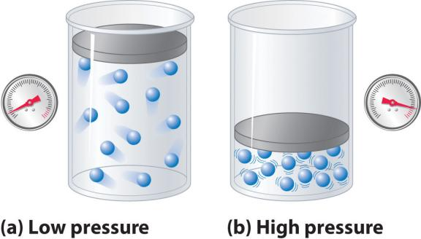
E. Gas particles are separated by great distances
relative to their size
Ideal gases can be compressed indefinitely but they remain gases. Real gases can be compressed a lot, but NOT indefinitely. Compressed gases liquify or even solidify.

Slide 95


F. The average kinetic energy is directly proportional
to the Kelvin temperature of a gas.
Kinetic energy and temperature always move together.
If the KE increases, Temperature increases too.
If KE decreases, then temperature decreases too.
Cold balloons, with low Kinetic Energy, have weaker and less collisions.
Hot balloons, with high Kinetic Energy, have greater and more frequent collisions.

Slide 96
Review

Slide 97
61. Draw these three graphs, casually, but correctly. Use P, V, and T for axis labels.
Draw proper lines. Indicate if each graph is directly or inversely proportional.
Volume as a function
of Temperature.
Pressure as a function
of Volume.
Pressure as a function
of Temperature.

Slide 98
61. Draw these three graphs, casually, but correctly. Use P, V, and T for axis labels.
Draw proper lines. Indicate if each graph is directly or inversely proportional.
Volume as a function
of Temperature.
Pressure as a function
of Volume.
Pressure as a function
of Temperature.
V
P
P
T
V
T
DIRECTLY Proportional INVERSELY Proportional DIRECTLY Proportional
This middle graph is hard to draw,
but it’s a smooth curve-alicious curve

Slide 99
62. According to the kinetic molecular theory,
the particles of an ideal gas
1. have no potential energy
2. are separated by great distances, compared to their size
3. have strong intermolecular forces
4. are arranged in a regular, repeated geometric pattern

Slide 100
62. According to the kinetic molecular theory,
the particles of an ideal gas
1. have no potential energy
2. are separated by great distances, compared to their size
3. have strong intermolecular forces
4. are arranged in a regular, repeated geometric pattern

Slide 101
63. Which temperature change would cause a sample of an
ideal gas to double in volume while the pressure is held
constant?
(1) from 400. K to 200. K
(2) from 200. K to 400. K
(3) from 400.°C to 200.°C
(4) from 200.°C to 400.°C

Slide 102
63. Which temperature change would cause a sample of an
ideal gas to double in volume while the pressure is held
constant?
(1) from 400. K to 200. K
(2) from 200. K to 400. K
(3) from 400.°C to 200.°C
(4) from 200.°C to 400.°C

Slide 103
64. A sample of gas confined in a cylinder with a movable
piston is kept at constant pressure. The volume of the gas
doubles when the temperature of the gas is changed from
400. K to 200. K
200. K to 400. K
200.°C to 400.°C
400.°C to 200.°C

Slide 104
64. A sample of gas confined in a cylinder with a movable
piston is kept at constant pressure. The volume of the gas
doubles when the temperature of the gas is changed from
400. K to 200. K
200. K to 400. K
200.°C to 400.°C
400.°C to 200.°C

Slide 105
65. Under which conditions of temperature and pressure
would a 1-liter sample of a real gas behave most like an
ideal gas?
(1) 100 K and 0.1 atm
(2) 100 K and 10 atm
(3) 500 K and 0.1 atm
(4) 500 K and 10 atm

Slide 106
65. Under which conditions of temperature and pressure
would a 1-liter sample of a real gas behave most like an
ideal gas?
(1) 100 K and 0.1 atm
(2) 100 K and 10 atm
(3) 500 K and 0.1 atm
(4) 500 K and 10 atm

Slide 107
66. What relationship from
gas chemistry does this
graph best represent?
A
B
(1) Pressure as a function of Volume
(2) Pressure as a function of Temperature
(3) Volume as a function of Temperature
(4) Temperature as a function of Kinetic Energy

Slide 108
66. What relationship from
gas chemistry does this
graph best represent?
A
B
(1) Pressure as a function of Volume
(2) Pressure as a function of Temperature
(3) Volume as a function of Temperature
(4) Temperature as a function of Kinetic Energy

Slide 109
67. What is the volume of a gas at 2.00 atm and 360. K, if it’s
original volume was 307 Liters at 385 K and 0.250 atm?

Slide 110
67. What is the volume of a gas at 2.00 atm and 360. K, if it’s
original volume was 307 Liters at 385 K and 0.250 atm?
P1V1
T₁
P2V2
T₂
=
(0.250 atm)(307 L)
385 K
(2.00 atm)(V₂)
360 K
=
27630
770
= V₂ = 35.9 Liters

Slide 111
68. Under which conditions of temperature and pressure
would a 1-liter sample of a real gas behave LEAST like an
ideal gas?
(1) 356 K and 1.2 atm
(2) 356 K and 4.0 atm
(3) 459 K and 1.2 atm
(4) 500 K and 4.0 atm

Slide 112
68. Under which conditions of temperature and pressure
would a 1-liter sample of a real gas behave LEAST like an
ideal gas?
(1) 356 K and 1.2 atm
(2) 356 K and 4.0 atm
(3) 459 K and 1.2 atm
(4) 500 K and 4.0 atm
COLDEST &
HIGHEST PRESSURE
is the least ideal.
(most likely
to turn into a liquid)

Slide 113
When we celebrate gases. Here’s how to do well:
1 You will be able to write out the KMT and explain each of the parts.
2 You will be able to draw 3 graphs, showing the relationships between:
Pressure + Volume, pressure + temperature, volume + temperature.
3 You will be able to state and explain Avogadro’s Hypothesis
4 You will be able to calculate any pressure conversions
5 You will be able to calculate any type of combined gas law problems
6 You will describe the difference between real and ideal gases
7 You will have read the BASICS twice.
The celebration will be short, sweet, and hopefully
for you, a fairly low-pressure event (haha)

