Slide 1
Kinetics Class #1
Objective: Introduction to kinetics and equilibrium chemistry. Four factors that affect the rate of chemical reactions.
Take out reference tables please.

Slide 2
Some reactions are fast, like the very first one you saw on the first day.
Some are really fast, remember the synthesis of water?
hydrogen gas + oxygen gas → water + energy

Slide 3
Some reactions are fast, like the very first one you saw on the first day.
Some are really fast, remember the synthesis of water?
hydrogen gas + oxygen gas → water + energy
Some are slow, remember the decomposition of H₂O₂?
2. hydrogen peroxide → water + oxygen gas + energy

Slide 4
That second one was SO SLOW that it took
a catalyst so we could watch it!
3. The catalyst was potassium iodide.
Write it in the equation where it belongs…
Hydrogen peroxide water + oxygen gas + E!
4. The CATALYST is not a reactant or product.
KI

Slide 5
5. Kinetics is the part of chemistry that studies the
RATES of REACTION

Slide 6
5. Kinetics is the part of chemistry that studies the
RATES of REACTION
6. We will again examine reactions that absorb energy
when they occur, called:
ENDOTHERMIC REACTIONS

Slide 7
5. Kinetics is the part of chemistry that studies the
RATES of REACTION
6. We will again examine reactions that absorb energy
when they occur, the
ENDOTHERMIC REACTIONS
7. And their opposites, reactions that emit
energy as a product, called
EXOTHERMIC REACTIONS

Slide 8
One of the simplest reactions we know is the combustion of methane.
CH_{4(G)} + 2O_{2(G)} → 2H₂O_{(G)} + CO_{2(G)} + energy
We know a lot about this reaction, let’s start naming things:
This reaction is COMBUSTION
It’s EXOTHERMIC, because heat is a PRODUCT

Slide 9
One of the simplest reactions we know is the combustion of methane.
CH_{4(G)} + 2O_{2(G)} → 2H₂O_{(G)} + CO_{2(G)} + energy
We know a lot about this reaction, let’s start naming things:
This reaction is COMBUSTION
It’s EXOTHERMIC, heat is a PRODUCT.

Slide 10
One of the simplest reactions we know is the combustion of methane.
CH_{4(G)} + 2O_{2(G)} → 2H₂O_{(G)} + CO_{2(G)} + energy
We know a lot about this reaction, let’s start naming things:
This reaction is COMBUSTION
It’s EXOTHERMIC, heat is a PRODUCT
The heat of reaction (ΔH table I) = –890.4 kJ/mole

Slide 11
One of the simplest reactions we know is the combustion of methane.
CH_{4(G)} + 2O_{2(G)} → 2H₂O_{(G)} + CO_{2(G)} + energy
We know a lot about this reaction, let’s start naming things:
This reaction is COMBUSTION
It’s EXOTHERMIC, heat is a PRODUCT
The heat of reaction (ΔH table I) = –890.4 kJ/mole
The forward reaction is EXOTHERMIC
because energy is a PRODUCT.

Slide 12
10. At the bottom of Table I it says that
“A minus sign (for ΔH) indicates an exothermic reaction.”

Slide 13
CH_{4(G)} + 2O_{2(G)} → 2H₂O_{(G)} + CO_{2(G)} + energy
11. The mole ratio of this equation would be: 1 : 2 : 2 : 1

Slide 14
CH_{4(G)} + 2O_{2(G)} → 2H₂O_{(G)} + CO_{2(G)} + 890.4 kJ
11. The mole ratio of this equation would be: 1 : 2 : 2 : 1
The thermochemical mole ratio would be
1 : 2 : 2 : 1 : 890.4 kJ

Slide 15
CH_{4(G)} + 2O_{2(G)} → 2H₂O_{(G)} + CO_{2(G)} + energy
12. Indicators of a chemical reaction, TOPIC-B,
the I stands for Irreversible?
Is this reaction reversible or not?

Slide 16
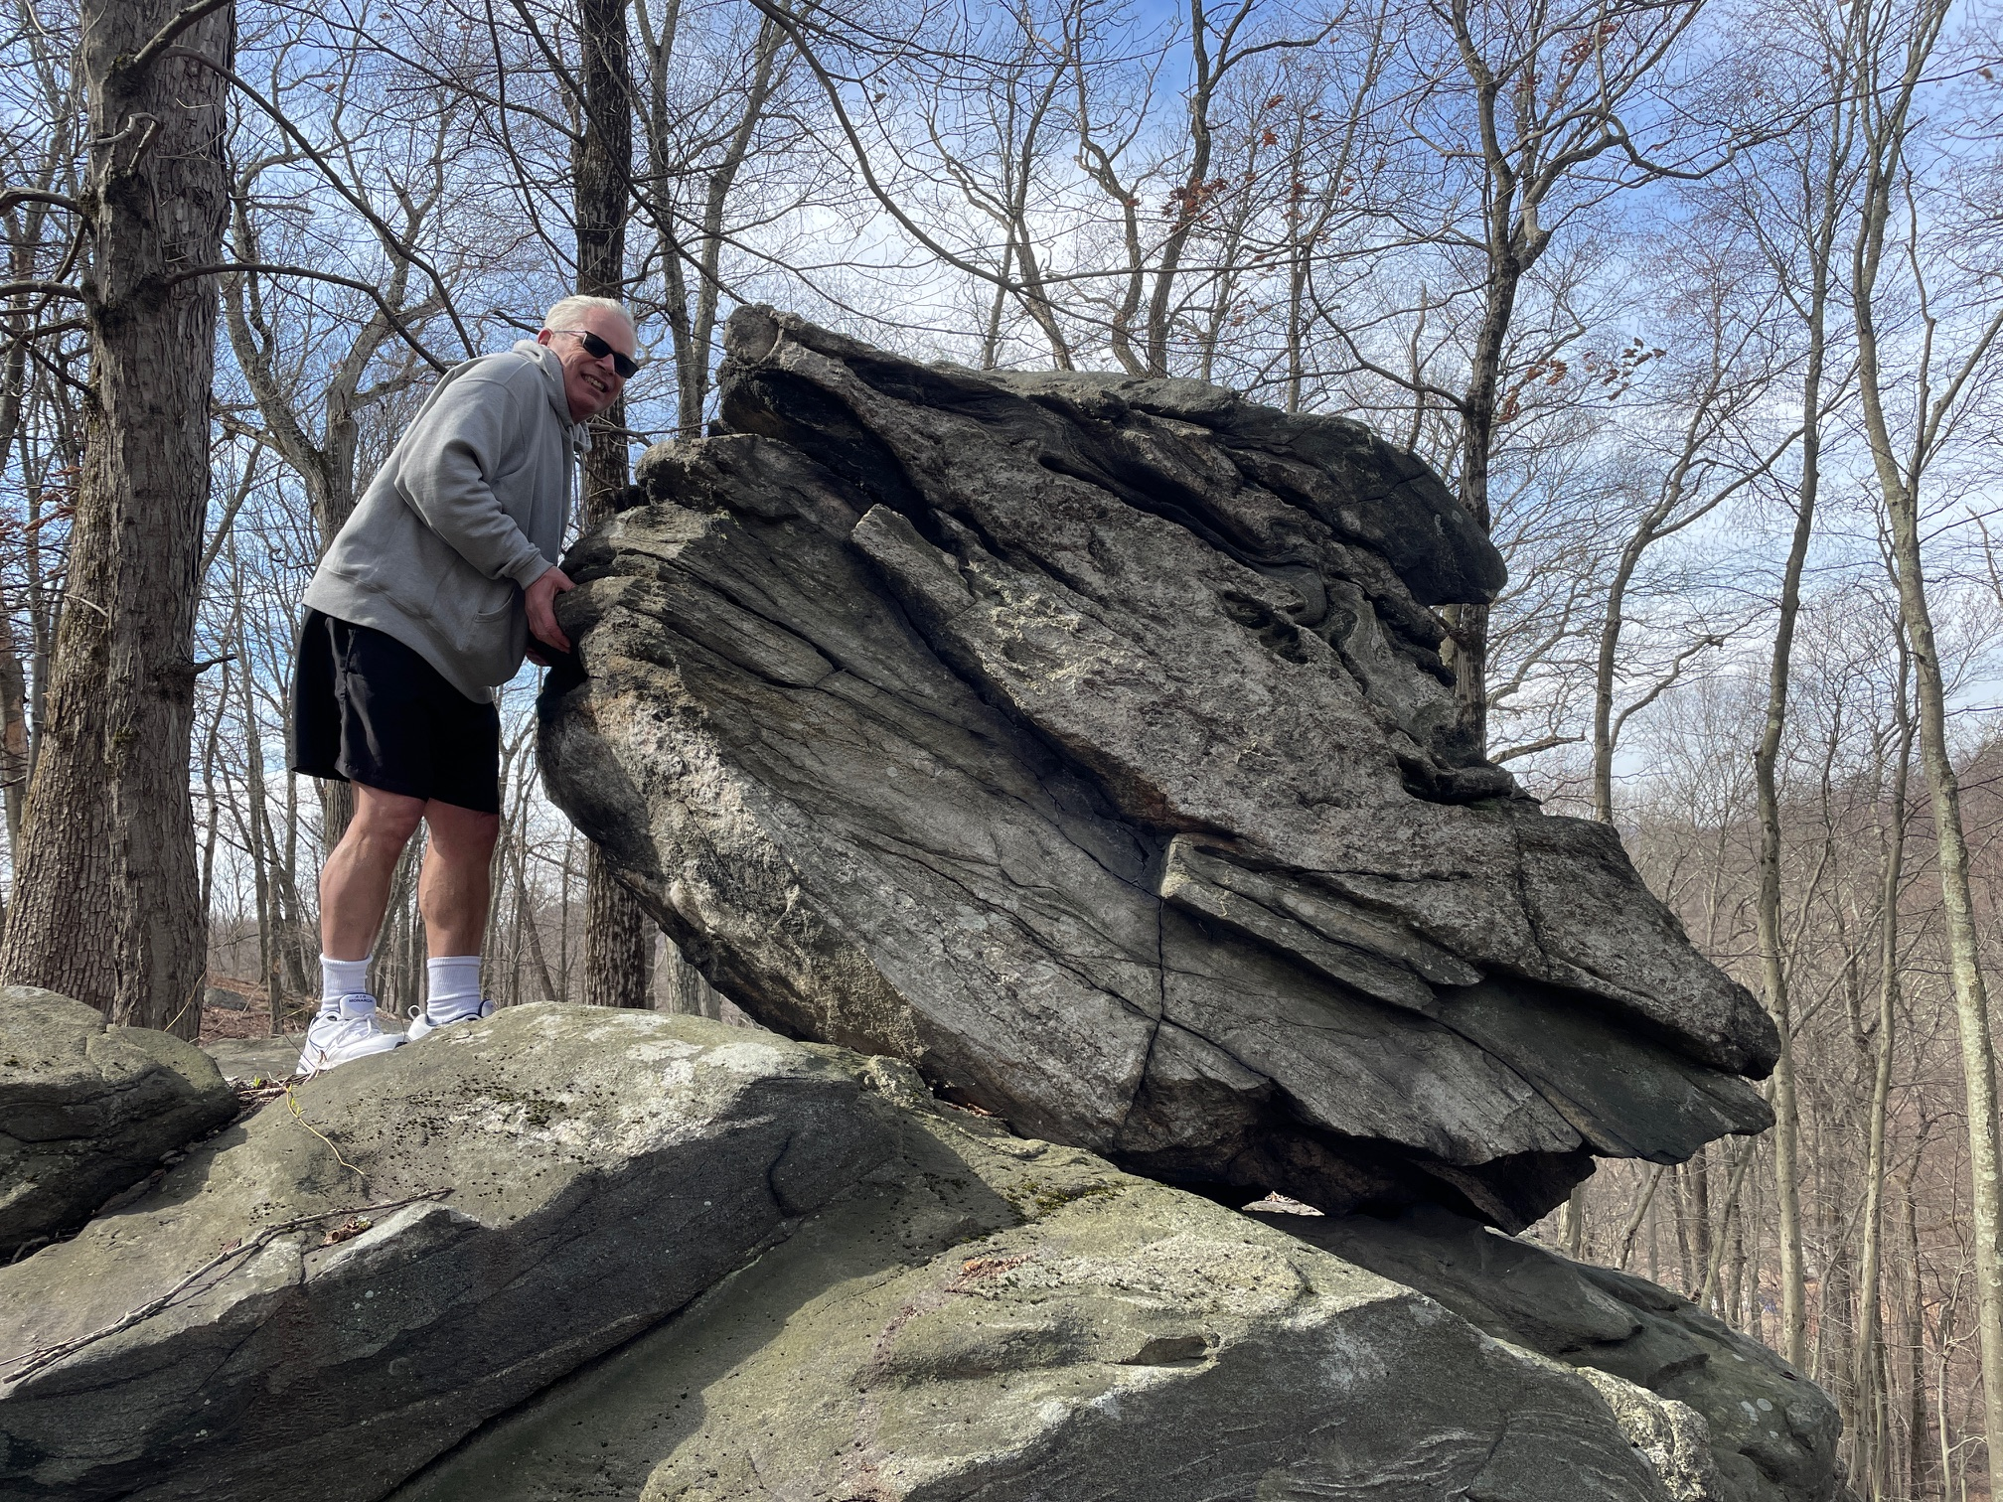
CH_{4(G)} + 2O_{2(G)} → 2H₂O_{(G)} + CO_{2(G)} + energy
It is reversible, but it’s not SPONTANEOUSLY reversible.

Slide 17
What is different here compared to the combustion of methane?
2H₂O_{(L)} + energy → O_{2(G)} + 2H_{2(G)}

Slide 18
What is different here compared to the combustion of methane?
2H₂O_{(L)} + energy → O_{2(G)} + 2H_{2(G)}
14. Here, energy is a reactant,

Slide 19
What is different here compared to the combustion of methane?
2H₂O_{(L)} + energy → O_{2(G)} + 2H_{2(G)}
14. Here, energy is a reactant,
the reaction is endothermic +ΔH
find it on table I now…

Slide 20
Wait… is it on table I?
What is happening here???

Slide 21
Table I shows this…
2H_{2(G)} + O_{2(G)} → 2H₂O_{(L)} + 571.6 kJ
This is EXOTHERMIC SYNTHESIS!
2H₂O_{(L)} + 571.6 kJ → O_{2(G)} + 2H_{2(G)}
This is ENDOTHERMIC Decomposition!

Slide 22
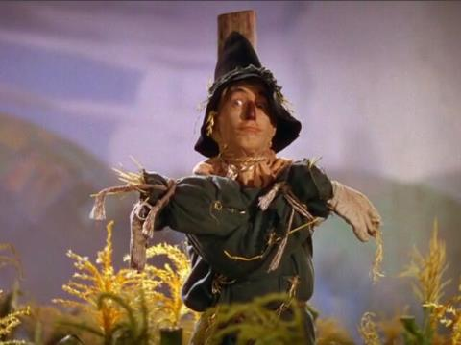
This decomposition reaction is OPPOSITE, of what’s shown on table I.
You are allowed to reverse a reaction, but if you do, you must reverse the sign for ΔH.

Slide 23
17. Reaction | ΔH | Exo or endo
Example 2C₈H_{18(L)} + 25O_{2(G)} → 16CO_{2(G)} + 18H₂O_{(G)} | -10943 kJ/mole | exo
N_{2(G)} + O_{2(G)} → 2NO_{(G)}
C₂H_{2(G)} → 2C_{(S)} + H_{2(G)}
4Al_{(S)} + 3O_{2(G)} → 2Al₂O_{3(S)}
From table I, exo, written here
exactly as on table I

Slide 24
17. Reaction | ΔH | Exo or endo
Example 2C₈H_{18(L)} + 25O_{2(G)} → 16CO_{2(G)} + 18H₂O_{(G)} | -10943 kJ/mole | exo
N_{2(G)} + O_{2(G)} → 2NO_{(G)}
C₂H_{2(G)} → 2C_{(S)} + H_{2(G)}
4Al_{(S)} + 3O_{2(G)} → 2Al₂O_{3(S)}

Slide 25
17. Reaction | ΔH | Exo or endo
Example 2C₈H_{18(L)} + 25O_{2(G)} → 16CO_{2(G)} + 18H₂O_{(G)} | -10943 kJ/mole | exo
N_{2(G)} + O_{2(G)} → 2NO_{(G)} | +182.6 kJ/mole | endo
C₂H_{2(G)} → 2C_{(S)} + H_{2(G)}
4Al_{(S)} + 3O_{2(G)} → 2Al₂O_{3(S)}

Slide 26
17. Reaction | ΔH | Exo or endo
Example 2C₈H_{18(L)} + 25O_{2(G)} → 16CO_{2(G)} + 18H₂O_{(G)} | -10943 kJ/mole | exo
N_{2(G)} + O_{2(G)} → 2NO_{(G)} | +182.6 kJ/mole | endo
C₂H_{2(G)} → 2C_{(S)} + H_{2(G)} | - 227.4 kJ | exo
4Al_{(S)} + 3O_{2(G)} → 2Al₂O_{3(S)}
Table I shows the synthesis as endothermic.
This is OPPOSITE

Slide 27
17. Reaction | ΔH | Exo or endo
Example 2C₈H_{18(L)} + 25O_{2(G)} → 16CO_{2(G)} + 18H₂O_{(G)} | -10943 kJ/mole | exo
N_{2(G)} + O_{2(G)} → 2NO_{(G)} | +182.6 kJ/mole | endo
C₂H_{2(G)} → 2C_{(S)} + H_{2(G)} | - 227.4 kJ | exo
4Al_{(S)} + 3O_{2(G)} → 2Al₂O_{3(S)} | -3351 kJ/mole | exo

Slide 28
18. Reaction | ΔH | Exo or endo
C₃H_{8(G)} + 5O_{2(G)} → 3CO_{2(G)} + 4H₂O_{(G)}
CO_{2(G)} → C_{(S)} + O_{2(G)}
NaOH_{(S)} Na⁺¹_{(AQ)} + OH^{–1}_{(AQ)}
2NH_{3(G)} → N_{2(G)} + 3H_{2(G)}
H₂O

Slide 29
18. Reaction | ΔH | Exo or endo
C₃H_{8(G)} + 5O_{2(G)} → 3CO_{2(G)} + 4H₂O_{(G)} | -2219.2 kJ/mole | exo
CO_{2(G)} → C_{(S)} + O_{2(G)}
NaOH_{(S)} Na⁺¹_{(AQ)} + OH^{–1}_{(AQ)}
2NH_{3(G)} → N_{2(G)} + 3H_{2(G)}
H₂O

Slide 30
18. Reaction | ΔH | Exo or endo
C₃H_{8(G)} + 5O_{2(G)} → 3CO_{2(G)} + 4H₂O_{(G)} | -2219.2 kJ/mole | exo
CO_{2(G)} → C_{(S)} + O_{2(G)} | +393.5 kJ/mole | endo
NaOH_{(S)} Na⁺¹_{(AQ)} + OH^{–1}_{(AQ)}
2NH_{3(G)} → N_{2(G)} + 3H_{2(G)}
Table I shows the synthesis as exothermic.
This is OPPOSITE
H₂O

Slide 31
18. Reaction | ΔH | Exo or endo
C₃H_{8(G)} + 5O_{2(G)} → 3CO_{2(G)} + 4H₂O_{(G)} | -2219.2 kJ/mole | exo
CO_{2(G)} → C_{(S)} + O_{2(G)} | +393.5 kJ/mole | endo
NaOH_{(S)} Na⁺¹_{(AQ)} + OH^{–1}_{(AQ)} | -44.51 kJ/mole | Exo
2NH_{3(G)} → N_{2(G)} + 3H_{2(G)}
H₂O

Slide 32
18. Reaction | ΔH | Exo or endo
C₃H_{8(G)} + 5O_{2(G)} → 3CO_{2(G)} + 4H₂O_{(G)} | -2219.2 kJ/mole | exo
CO_{2(G)} → C_{(S)} + O_{2(G)} | +393.5 kJ/mole | endo
NaOH_{(S)} Na⁺¹_{(AQ)} + OH^{–1}_{(AQ)} | -44.51 kJ/mole | Exo
2NH_{3(G)} → N_{2(G)} + 3H_{2(G)} | +91.8 kJ/mole | Endo
Table I shows the synthesis of ammonia as exothermic, this is the opposite.
H₂O

Slide 33

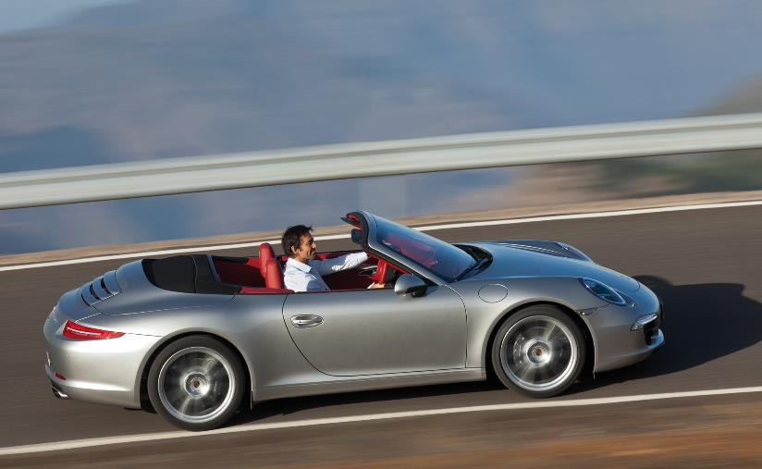
Let’s change gears. Do you know how to drive a car?
Slowly, safely?
Or is this
more your style?

Slide 34


To drive from Vestal to Johnson City High School it’s about 8 miles. That should take about 20 minutes.
8 miles 0.33 hours | = ~ 24 mph

Slide 35
It you drive fast, getting there in just 10 minutes…
8 miles 0.17 hours | = ~ 47 mph

Slide 36
It you drive fast, getting there in just 5 minutes…
8 miles .083 hours | = ~ 96 mph!
27. Time and rate are connected, but they are NOT THE SAME THING.

Slide 37
TIME IS HOW LONG IT TAKES
to complete a chemical reaction,
usually measured in seconds.
Rate is different.
We will need this formula in the kinetics Clock Lab soon. Don’t forget this!
30. Time ≠ rate. Not in driving, not in chem.
Rate = | 1 time in seconds

Slide 38
Rate has a weird unit of | sec⁻¹

Slide 39
These factors affect the rate of a reaction
32. Increase in Temperature
hotter usually means the reaction will happen faster
33. Increase reactant surface area
which allows the reactants to react faster
34. Increase the concentration of the reactants
more stuff, more chance for a reaction to happen
35. Adding a catalyst

Slide 40
These factors affect the rate of a reaction
36. Increase in Temperature
causes MORE COLLISIONS between the particles.
37. Increase reactant surface area
causes MORE COLLISIONS between the particles.
38. Increase the concentration of the reactants
causes MORE COLLISIONS between the particles.

Slide 41
39. Adding a catalyst
Catalysts have no affect
on the collisions of particles,
but they still speed up
chemical reactions.
How they work will have
to wait for a few days.

Slide 42
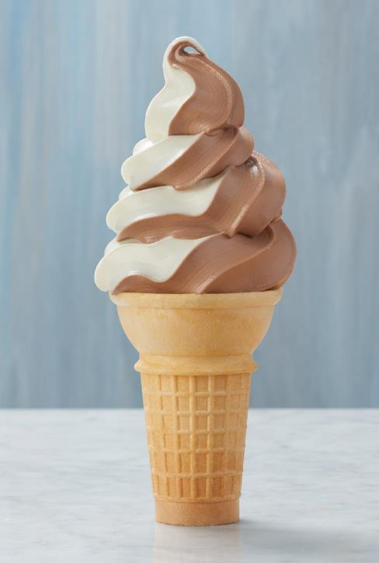
Kinetics Class #2
Objective: Potential Energy Diagrams
are the graphs that show the flow of energy through chemical reactions.
They come in 2 flavors,
exothermic and endothermic.

Slide 43
40. The Law of Conservation of Energy
Energy cannot be created
or destroyed in
a chemical reaction or
a physical change,
but it can be transferred.

Slide 44
41. Potential energy diagrams
show the flow of energy in a chemical reaction,
from start to finish.

Slide 45
42. Draw the potential energy diagram showing the combustion of CH₄
Potential energy diagram for combustion of methane
Potential Energy
kJ/mole
0 kJ
Time
zero
The time of the reaction
End of reaction

Slide 46
The reactants, in this case methane and oxygen, have some potential to explode.
This “energy” is known, but we don’t know it in high school chem.
Potential energy diagram for combustion of methane
Potential Energy
kJ/mole
0 kJ
Time
zero
The time of the reaction
End of reaction

Slide 47
You can carry around your methane and oxygen all day relatively safely. As long as you don’t add some heat, the explosion won’t happen. To react, the particles need to collide with sufficient energy and proper orientation. They don’t have that yet.
Potential energy diagram for combustion of methane
Potential Energy
kJ/mole
0 kJ
Time
zero
The time of the reaction
End of reaction

Slide 48
If we begin to warm the reactants up (with some heat) this is what happens…
Dangerous, but no kaboom yet…
Potential energy diagram for combustion of methane
Potential Energy
kJ/mole
0 kJ
Time
zero
The time of the reaction
End of reaction

Slide 49
Here we are literally at the “point of no return” – the TOP. Here the reaction can’t help but to go forward. It’s like being at the very top of the roller coaster as it crests the top of the first big hill!
Potential energy diagram for combustion of methane
Potential Energy
kJ/mole
0 kJ
Time
zero
The time of the reaction
End of reaction

Slide 50
At this point the kaboom has started, we’ve ADDED the activation energy to START the reaction, and the reaction has “paid back” this start up energy.
We’re back to where we started from an energy point of view, but, we’re not able to stop yet.
Potential energy diagram for combustion of methane
Potential Energy
kJ/mole
AE
0 kJ
Time
zero
The time of the reaction
End of reaction

Slide 51
The kaboom keeps happening, the reaction releases all the heat it has to.
The products form and they are dull, dull, dull (from an energy point of view).
Potential energy diagram for combustion of methane
Potential Energy
kJ/mole
AE
0 kJ
Time
zero
The time of the reaction
End of reaction

Slide 52
The products, water & CO₂ are mostly unreactive. They have low potential energy. The reactants had a much greater potential energy.
The difference between the PE reactants and PE products = ΔH.
The ΔH is NEGATIVE because this is EXOTHERMIC.
Potential energy diagram for combustion of methane
Potential Energy
kJ/mole
AE
reactants
-ΔH
products
0 kJ
Time
zero
The time of the reaction
End of reaction

Slide 53
Potential energy diagram for combustion of methane
Potential Energy
kJ/mole
AE
reactants
-ΔH
products
0 kJ
Time zero
End of reaction
The time of the reaction

Slide 54
43. Potential energy diagram vocabulary
Potential Energy of Reactants | the kJ/mole of energy that the reactants start with
Potential Energy of Products | the kJ/mole of energy that the products end up with
ΔH | the difference in PE between reactants and products this PE diagram has a –ΔH
Activation Energy (AE) | the energy required start the reaction (to get to the top of the hill)

Slide 55
44. Draw the potential energy diagram for
the synthesis of C₂H_{2(G)} (look for that on table I now)
Potential energy diagram for formation of C₂H_{2(G)}
PE
kJ/mole
Time of reaction

Slide 56
44. Draw the potential energy diagram for
the synthesis of C₂H_{2(G)} (this is endothermic)
Potential energy diagram for formation of C₂H_{2(G)}
PE Products
AE activation energy
PE
kJ/mole
ΔH = +227.4 kJ/mole
PE Reactants
Time of reaction
48. The green dot on the top of the hill is the ACTIVATED COMPLEX.
The reactants have come apart but haven’t formed into products yet.

Slide 57
45. Draw the potential energy diagram for the solvation of sodium hydroxide
NaOH_{(S)} Na⁺¹_{(AQ)} + OH⁻¹_{(AQ)} + 44.51 kJ
sodium hydroxide dissolving into water
water
Potential energy
kJ/mole
Time of the reaction…

Slide 58
45. Draw the potential energy diagram for the solvation of sodium hydroxide
NaOH_{(S)} Na⁺¹_{(AQ)} + OH⁻¹_{(AQ)} + 44.51 kJ
sodium hydroxide dissolving into water
water
Represents the activation complex
The transition between R & P
Potential energy
kJ/mole
reactants
AE
Time of the reaction…

Slide 59
45. Draw the potential energy diagram for the solvation of sodium hydroxide
NaOH_{(S)} Na⁺¹_{(AQ)} + OH⁻¹_{(AQ)} + 44.51 kJ
sodium hydroxide dissolving into water
water
46. This energy is the HEAT of SOLUTION, not heat of reaction.
activation
complex
Potential energy
kJ/mole
reactants
AE
-ΔH
We don’t know the actual levels, but we know that this difference is 44.51 kJ/mole
products
Time of the reaction…

Slide 60
47. More Kinetics Vocabulary
Potential energy | The energy stored in the bonds of the reactants or the products
Activation complex | A transitional state; the reactants come apart – but have not yet turned into the products
Activation energy | The minimum amount of energy it takes to start a reaction.
ΔH or ΔS (Heat of Solution) | The difference between the potential energy of the reactants and products. Heat of Reaction or Heat of Solution
Potential energy diagram | A graph showing the flow of energy in a chemical reaction. These can be exothermic or endothermic

Slide 61
48. Draw the potential energy diagram for the synthesis of aluminum oxide.
Label the reactants, products, AE, AC, ΔH. Graph needs axis labels, and a title.
4Al_{(S)} + 3O_{2(G)} → 2Al₂O_{3(S)} + 3351 kJ
PE
kJ/mole
Time of the reaction

Slide 62
48. Draw the potential energy diagram for the synthesis of aluminum oxide.
Label the reactants, products, AE, AC, ΔH. Graph needs axis labels, and a title.
4Al_{(S)} + 3O_{2(G)} → 2Al₂O_{3(S)} + 3351 kJ
AC
Al + O₂
AE
PE
kJ/mole
-ΔH
Al₂O₃
Time of the reaction

Slide 63
49. Draw the PE diagram for the solvation of sodium chloride.
NaCl + energy Na⁺¹ + Cl⁻¹
ΔH = +3.88 kJ/mole
Go!
water

Slide 64
49. Draw the PE diagram for the solvation of sodium chloride.
NaCl + energy Na⁺¹ + Cl⁻¹
water
Table salt dissolves in water, ΔH = +3.88 kJ/mole
PE
kJ/mole
Time of reaction

Slide 65
49. Draw the PE diagram for the solvation of sodium chloride.
NaCl + energy Na⁺¹ + Cl⁻¹
water
Table salt dissolves in water, ΔH = +3.88 kJ/mole
Ions in solution
PE
kJ/mole
+ΔH
salt
AE
Time of reaction

Slide 66
50. Draw the PE diagram for the combustion of propane.
Indicate the PE of reactants, products, AE, AC, ΔH, and a title.
PE diagram for the combustion of propane ΔH = -2219.2 kJ/mole
P E
kJ/mole
Reaction time

Slide 67
50. Draw the PE diagram for the combustion of propane.
Indicate the PE of reactants, products, AE, AC, ΔH, and a title.
PE diagram for the combustion of propane ΔH = -2219.2 kJ/mole
Activated complex
loose atoms of
C + H + O
P E
kJ/mole
AE
C₃H₈ + O₂
-ΔH
CO₂ + H₂O
Reaction time

Slide 68
Kinetics Class #3
The affect of catalysts on chemical reactions

Slide 69
Draw the PE diagram for
51. The combustion of glucose
and for The synthesis of HI gas.
Make 2 graphs, label PE of reactants and products, AE, AC, and ΔH (+ or -), and a title, with labels for the X and Y axis.
This should only take 2 minutes! Click ahead now

Slide 70
51.
Exothermic on left Endothermic on right
Combustion of glucose
ΔH = -2804 kJ/mole
Synthesis of HI gas
ΔH = +53.0 kJ/mole
PE
kJ/mole
PE
kJ/mole
time
time

Slide 71
51.
Exothermic on left Endothermic on right
Combustion of glucose
ΔH = -2804 kJ/mole
Synthesis of HI gas
ΔH = +53.0 kJ/mole
AC
PE
kJ/mole
PE
kJ/mole
R
AE
-ΔH
P
time
time

Slide 72
51.
Exothermic on left Endothermic on right
Combustion of glucose
ΔH = -2804 kJ/mole
Synthesis of HI gas
ΔH = +53.0 kJ/mole
AC
AC
PE
kJ/mole
PE
kJ/mole
P
R
AE
R
AE
+ΔH
-ΔH
P
time
time

Slide 73
52. What is a Catalyst?
A substance that speeds up a
chemical reaction without changing the reaction in any other way.
It doesn’t get used up, it doesn’t alter the amount of energy absorbed or released.

Slide 74
53. Catalysts
lower the activation energy
or they
provide an alternate chemical pathway
for the reaction to proceed more quickly.

Slide 75
54. Indicate WHAT HAPPENS IF YOU ADD A CATALYST
TO THESE REACTIONS?
Exothermic on left Endothermic on right
Combustion of glucose
ΔH = -2804 kJ/mole
Synthesis of HI gas
ΔH = +53.0 kJ/mole
AC
AC
PE
kJ/mole
PE
kJ/mole
P
R
AE
R
AE
+ΔH
-ΔH
P
time
time

Slide 76
54. Indicate WHAT HAPPENS IF YOU ADD A CATALYST
TO THESE REACTIONS?
Exothermic on left Endothermic on right
Combustion of glucose
ΔH = -2804 kJ/mole
Synthesis of HI gas
ΔH = +53.0 kJ/mole
AC
AC
PE
kJ/mole
PE
kJ/mole
P
R
AE
R
AE
+ΔH
-ΔH
P
time
time

Slide 77
55. Catalysts DO NOT change the number of collisions.
Catalysts are said to work in 2 different ways….

Slide 78
55. Catalysts DO NOT change the number of collisions.
Catalysts are said to work in 2 different ways…
56. Catalysts
lower the activation energy
of a reaction.
This lets the reaction start in a less energetic way, so it can happen quicker than normal. Once it starts, it moves right along.
57. Catalysts provide
“an alternate pathway”
for the reaction to proceed.
This lets this reaction happen quicker. (Like a shortcut).

Slide 79
58. Draw this demo titled: “Catalysts speed up the rate of a chemical reaction.”
2H₂O2 2H2O + O2 + ENERGY (exothermic)
KI
H₂O₂ solution
+ KI
Catalyst
The same reaction will happen at left, just MUCH SLOWER!

Slide 80
58. Draw this demo titled: “Catalysts speed up the rate of a chemical reaction.”
2H₂O2 2H2O + O2 + ENERGY (exothermic)
KI
Meh
LIKE WOW!
H₂O₂ solution
+ KI
Catalyst
Both reactions are exactly the same, except for speed.

Slide 81
Kinetics Class #4
Objective: Describing chemical reactions that are in dynamic equilibrium; learning how to “push” them forward, or in reverse, using
LeChatelier's Principle.

Slide 82
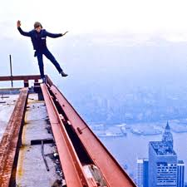
August 7, 1974
Phillipe Petit decides it’s his day.
He chooses to set up a high wire between the Twin Towers in NYC, and then to walk across this wire
for about an hour.
Here he is, warming up.

Slide 83
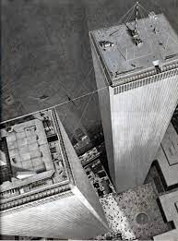
That little black smudge is him on the wire, between the two buildings.
I’ve been on the one to the left a bunch of times.
It was an amazing view.
The black specks on the ground are small clumps
of people walking to work.

Slide 84
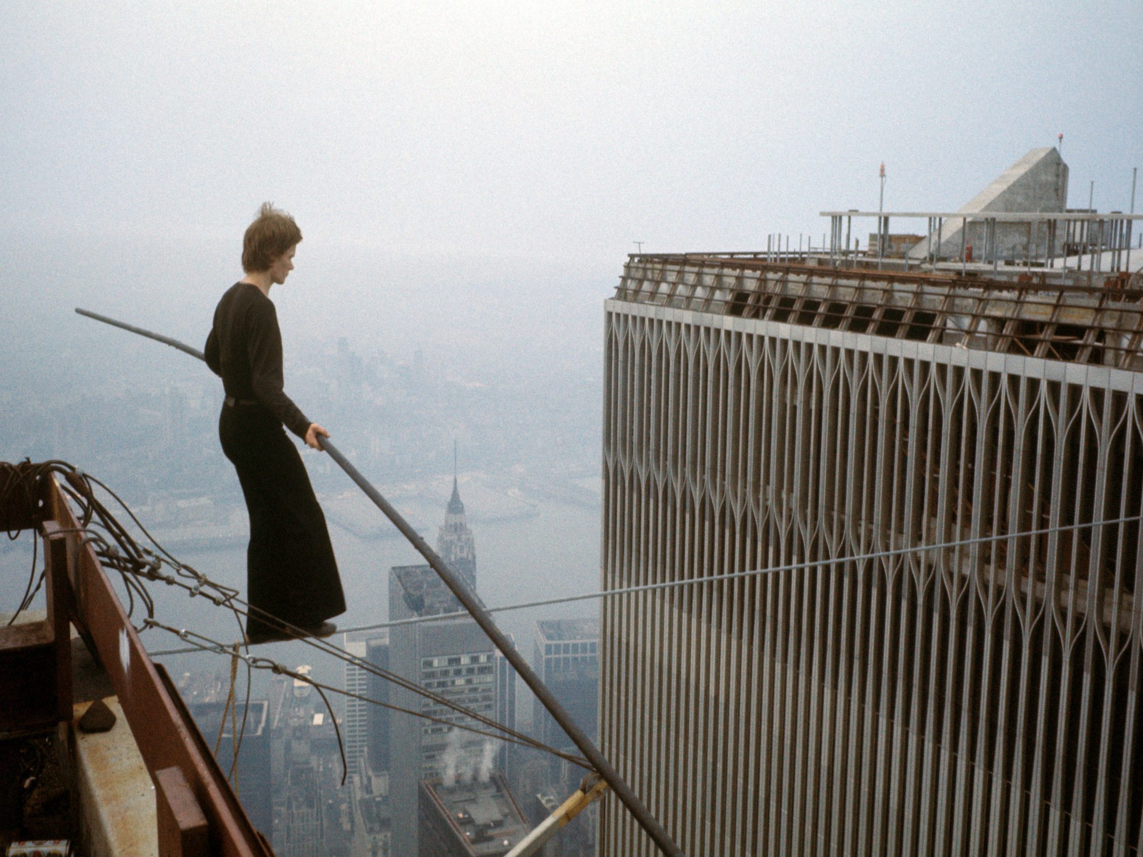

Slide 85
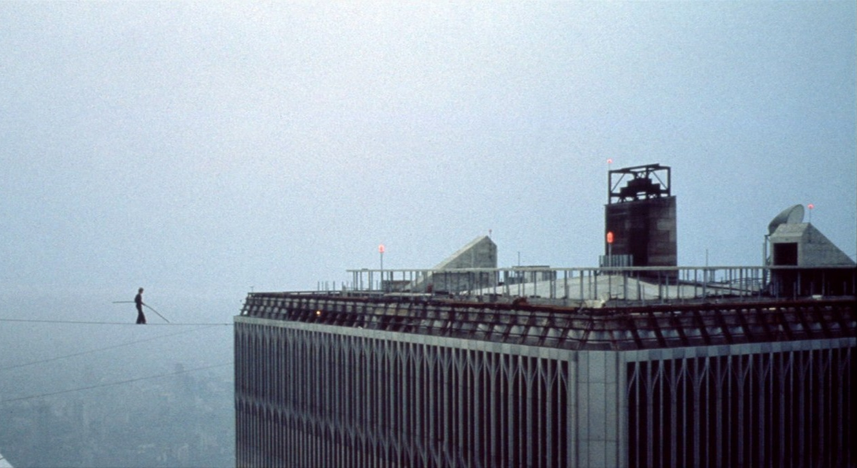
Phillipe sat and then laid down on the wire during his show.
Note, there is no net.
He once said: “I see three oranges, and I have to juggle.
I see two towers, and I have to walk.”

Slide 86
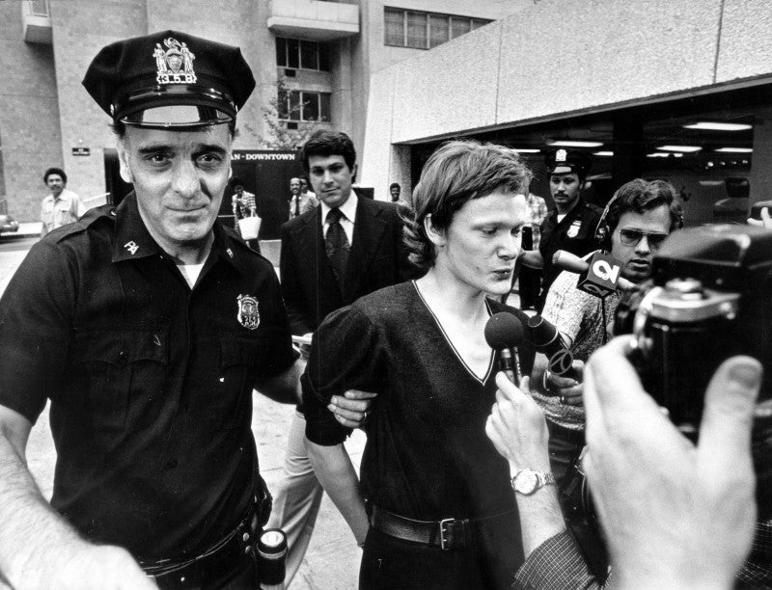
Monsieur Petit, is arrested for trespassing and disorderly conduct.
Charges were dropped after he promised a judge that he’d teach kids to walk a wire in Central Park.

Slide 87
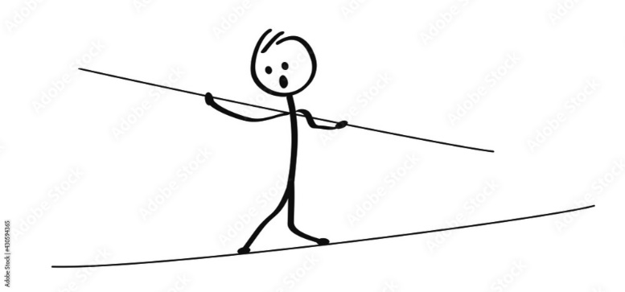
In some ways, a dynamic equilibrium is what Phillipe Petit was in while on that wire. No matter the stresses, he could not FALL OFF that wire.
Winds from the helicopters blew against him, so he twisted and adjusted his long pole, to keep his balance.
No matter the stress, wind from the left, less wind from the right, whatever, he bent and did what ever was needed to stay alive.
He had to accommodate all stress and change is stance, and get into a new balance, he kept his equilibrium.

Slide 88
59. Most chemical reactions are “one way”, meaning that once they happen, they are done. Spontaneous reversals in chemistry are not common, because most reactions are without enough energy to go the other way.
60. Some reactions are REVERSIBLE because their energy requirements, their
∆H is very low in BOTH directions, forward and reverse.
61. One of the most important chemical reactions that is reversible, is the simultaneous
synthesis and decomposition of ammonia shown below…
N_{2(G)} + 3H_{2(G)} ⇌ 2NH_{3(G)} + energy

Slide 89
62. Dynamic equilibrium is when the rate of
the forward reaction is equal to the rate
of the reverse reaction.
63. In this reaction…
N_{2(G)} + 3H_{2(G)} ⇌ 2NH_{3(G)} + energy
The rate that synthesis occurs is the
same as the rate of the reverse decomp.
64. A dynamic equilibrium is…
constantly changing, and constantly
staying the same.

Slide 90
65. In a dynamic equilibrium situation,
you DO NOT necessarily have equal masses,
or equal moles, on opposite sides of the ⇌
66. The rate of the forward reaction = the rate of the reverse reaction.
67. It is possible to have equal masses or
equal moles on both sides, but that is
NOT a condition, it’s only a possibility.
dynamic equilibrim

Slide 91
68. LeChatelier's Principle
A chemical system in
dynamic equilibrium will stay at equilibrium, and if a chemical stress is applied, the system will shift to counter act this stress,
until a new equilibrium is reached.

Slide 92
69. You can disrupt a chemical
equilibrium by
increasing or decreasing temperature
increasing or decreasing pressure
adding or removing stuff
70. The chemical system must
accommodate this stress, and
a NEW, different dynamic
equilibrium will form.

Slide 93
71. What happens if we pump in extra NH_{3(G)}
to this closed system?
nitrogen + hydrogen ⇌ ammonia + energy
Add Ammonia

Slide 94
71. What happens if we pump in extra NH_{3(G)}
to this closed system?
nitrogen + hydrogen ⇌ ammonia + energy
Add Ammonia
If you imagine the forward reaction happens 100x per minute,
the reverse reaction also happens 100x per minute,
this stays in balance, it’s in dynamic equilibrium
Always changing, always staying the same.

Slide 95
71. What happens if we pump in extra NH_{3(G)}
to this closed system?
nitrogen + hydrogen ⇌ ammonia + energy
← Add Ammonia
Adding ammonia would make no difference to the synthesis reaction. That would happen 100x per minute.
The reverse reaction happen more often (maybe 125x per minute) for a while – until a new balance is found.
This stress causes a “reverse shift” for a bit.

Slide 96
N₂ + 3H₂ ⇌ 2NH₃ + energy
72. This closed system is in dynamic equilibrium. Let’s apply different stresses,
and see which way the system will “push” to create a new dynamic equilibrium.
Add nitrogen
Add hydrogen
Add ammonia
Add energy (heat)
Add pressure

Slide 97
N₂ + 3H₂ ⇌ 2NH₃ + energy
72. This closed system is in dynamic equilibrium. Let’s apply different stresses,
and see which way the system will “push” to create a new dynamic equilibrium.
Add nitrogen
Add hydrogen
Add ammonia
Add energy (heat)
Add pressure
More nitrogen
makes for
more collisions
between hydrogen and nitrogen,
pushing this reaction FORWARD

Slide 98
N₂ + 3H₂ ⇌ 2NH₃ + energy
72. This closed system is in dynamic equilibrium. Let’s apply different stresses,
and see which way the system will “push” to create a new dynamic equilibrium.
Add nitrogen
Add hydrogen
Add ammonia
Add energy (heat)
Add pressure
More hydrogen
makes for
more collisions
between hydrogen and nitrogen,
pushing this reaction FORWARD also

Slide 99
N₂ + 3H₂ ⇌ 2NH₃ + energy
72. This closed system is in dynamic equilibrium. Let’s apply different stresses,
and see which way the system will “push” to create a new dynamic equilibrium.
Add nitrogen
Add hydrogen
Add ammonia
Add energy (heat)
Add pressure
More ammonia can only decompose, so this shifts to the REVERSE,
until a new dynamic equilibrium forms.

Slide 100
N₂ + 3H₂ ⇌ 2NH₃ + energy
72. This closed system is in dynamic equilibrium. Let’s apply different stresses,
and see which way the system will “push” to create a new dynamic equilibrium.
Add nitrogen
Add hydrogen
Add ammonia
Add energy (heat)
Add pressure
More heat only favors more decomposition,
this shifts to the REVERSE also,
until a new dynamic equilibrium forms.

Slide 101
N₂ + 3H₂ ⇌ 2NH₃ + energy
72. This closed system is in dynamic equilibrium. Let’s apply different stresses,
and see which way the system will “push” to create a new dynamic equilibrium.
Add nitrogen
Add hydrogen
Add ammonia
Add energy (heat)
Add pressure
MORE PRESSURE
favors less moles of gas. There are 4 moles of gas at left, only 2 moles of gas at right.

Slide 102
N₂ + 3H₂ ⇌ 2NH₃ + energy
73. Remove nitrogen
Remove hydrogen
Remove ammonia
Remove energy (cool system)
Lower pressure

Slide 103
N₂ + 3H₂ ⇌ 2NH₃ + energy
73. Remove nitrogen
Remove hydrogen
Remove ammonia
Remove energy (cool system)
Lower pressure
Less N₂ means
less collisions
and less synthesis.
This favors the REVERSE
reaction.

Slide 104
N₂ + 3H₂ ⇌ 2NH₃ + energy
73. Remove nitrogen
Remove hydrogen
Remove ammonia
Remove energy (cool system)
Lower pressure
Less H₂ means
less collisions
and less synthesis.
This favors the REVERSE
reaction also.

Slide 105
N₂ + 3H₂ ⇌ 2NH₃ + energy
73. Remove nitrogen
Remove hydrogen
Remove ammonia
Remove energy (cool system)
Lower pressure
Less NH₃ means
less decomposition but the forward synthesis keeps going.
This favors the FOWARD
reaction.

Slide 106
N₂ + 3H₂ ⇌ 2NH₃ + energy
73. Remove nitrogen
Remove hydrogen
Remove ammonia
Remove energy (cool system)
Lower pressure
Less heat means
less decomposition but the forward synthesis keeps going.
This favors the FOWARD reaction.

Slide 107
N₂ + 3H₂ ⇌ 2NH₃ + energy
73. Remove nitrogen
Remove hydrogen
Remove ammonia
Remove energy (cool system)
Lower pressure
Less pressure favors MORE MOLES of GAS, so this goes in REVERSE for a while.

Slide 108
Objective
Students will see a dynamic equilibrium reaction undergo a forward shift and a reverse shift.
Then we’ll practice with dynamic equilibrium equations to drill the LeChatelier's Principle.
Take out notes ̶ start with #74

Slide 109

This compound is called Bromthymol Blue. It’s big, it’s ionic, and in water is will ionize into an acid H⁺¹ cation, and a big C₂₇H₂₉O₅S⁻¹ anion.
The molecule is yellow, and the anion is blue.
Depending upon how this dynamic equilibrium shifts the color will change.
The more reverse shift will make the solution get yellow.
The more forward shift turns it blue.
If you get lucky and “balance it half and half, the solution will turn green.
It’s not easy being green.
water
HC₂₇H₂₉O₅S_{(S)} H⁺¹_{(AQ)} + C₂₇H₂₉O₅S⁻¹_{(AQ)}
molecule YELLOW Anion BLUE

Slide 110
Bromthymol Blue is in dynamic equilibrium.
water
HC₂₇H₂₉O₅S_{(S)} H⁺¹_{(AQ)} + C₂₇H₂₉O₅S⁻¹_{(AQ)}
molecule YELLOW Anion BLUE
74. The molecule will dissociate into ions
at the same rate as the ions re-form into
molecules.

Slide 111
Bromthymol Blue is in dynamic equilibrium.
water
HC₂₇H₂₉O₅S_{(S)} H⁺¹_{(AQ)} + C₂₇H₂₉O₅S⁻¹_{(AQ)}
molecule YELLOW Anion BLUE
74. The molecule will dissociate into ions
at the same rate as the ions reform into
molecules.
75. This will always change but always be the same.
DYNAMIC EQUILIBRIUM

Slide 112
76.
water
HC₂₇H₂₉O₅S_{(S)} H⁺¹_{(AQ)} + C₂₇H₂₉O₅S⁻¹_{(AQ)}
molecule YELLOW Anion BLUE
H⁺¹
Add H⁺¹
Adding acid to the beaker will shift the dynamic equilibrium… REVERSE

Slide 113
76.
water
HC₂₇H₂₉O₅S_{(S)} H⁺¹_{(AQ)} + C₂₇H₂₉O₅S⁻¹_{(AQ)}
molecule YELLOW Anion BLUE
H⁺¹
Add H⁺¹
Adding acid to the beaker will shift the dynamic equilibrium… REVERSE
Making the solution YELLOW

Slide 114
76.
water
HC₂₇H₂₉O₅S_{(S)} H⁺¹_{(AQ)} + C₂₇H₂₉O₅S⁻¹_{(AQ)}
molecule YELLOW Anion BLUE
OH⁻¹
Add H⁺¹
Adding acid to the beaker will shift the dynamic equilibrium… REVERSE
Making the solution YELLOW
Add OH⁻¹
Add OH⁻¹ ions (base) will shift it… FORWARD

Slide 115
76.
water
HC₂₇H₂₉O₅S_{(S)} H⁺¹_{(AQ)} + C₂₇H₂₉O₅S⁻¹_{(AQ)}
molecule YELLOW Anion BLUE
OH⁻¹
Add H⁺¹
Adding acid to the beaker will shift the dynamic equilibrium… REVERSE
Making the solution YELLOW
Add OH⁻¹
Add OH⁻¹ ions (base) will shift it… FORWARD
Making the solution BLUE

Slide 116
76.
Without talking too much chemistry,
let’s watch how dynamic equilibrium works…
It can get yellow, it can get blue, and maybe…
it can get GREEN (the half-way point).
water
HC₂₇H₂₉O₅S_{(S)} H⁺¹_{(AQ)} + C₂₇H₂₉O₅S⁻¹_{(AQ)}
molecule YELLOW Anion BLUE

Slide 117
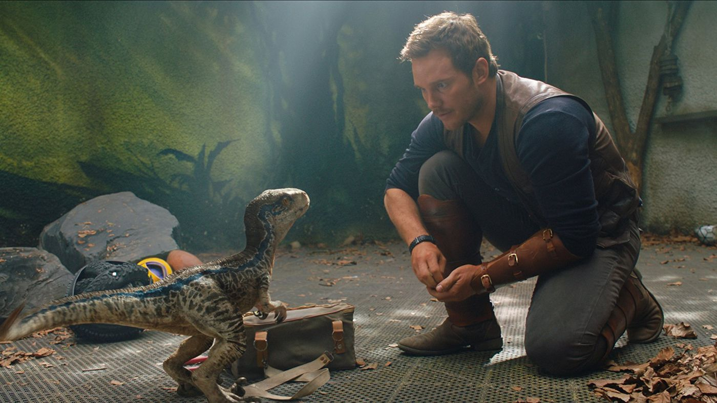
4Al_{(S)} + 3O_{2(G)} ⇌ 2Al₂O_{3(S)} + Energy
This is NOT really a dynamic equilibrium. We will believe in ghosts, or dinosaurs now. If the reaction has the double arrows, we will use the concepts of dynamic equilibrium and LeChatelier’s Principle to “play” with the theory. This will NOT reverse with just heat, but here it can.

Slide 118
4Al_{(S)} + 3O_{2(G)} ⇌ 2Al₂O_{3(S)} + Energy
77. The forward reaction is exothermic; the reverse reaction is endothermic.
The forward reaction is synthesis; the reverse is decomposition.
We cannot know how many grams of aluminum, oxygen, or aluminum oxide are on either side of the double arrows, but we KNOW that the rate of synthesis (forward) is equal to the rate of the decomposition (reverse). Both reactions continue, but the mass on either side remain constant.
Let’s stress this out now…

Slide 119
78. 4Al_{(S)} + 3O_{2(G)} ⇌ 2Al₂O_{3(S)} + Energy
Add aluminum oxide
Remove oxygen
Remove heat (cool system)
Add aluminum
Add Heat
Increase pressure

Slide 120
78. 4Al_{(S)} + 3O_{2(G)} ⇌ 2Al₂O_{3(S)} + Energy
← Add aluminum oxide
← Remove oxygen
Remove heat (cool system) →
Add aluminum →
← Add Heat
Increase pressure →

Slide 121
79. Pressure only effects gases.
Pressure does not effect
solids, liquids, or aqueous.
80. If a stress “stops” or slows down a forward reaction,
the reverse keeps happening.
81. If a stress “stops” or slows down a reverse reaction,
the forward keeps happening.
82. A new balance, or equilibrium will always be reached.

Slide 122
83. This is NOT a real dynamic equilibrium, but we will “make believe” because of the double arrows.
CH_{4(G)} + 2O_{2(G)} ⇌ CO_{2(G)} + 2H₂O_{(G)} + energy
Add methane
Add water
Add heat
Remove carbon dioxide
Remove heat
Remove methane
Add carbon dioxide

Slide 123
83. This is NOT a real dynamic equilibrium, but we will “make believe” because of the double arrows.
CH_{4(G)} + 2O_{2(G)} ⇌ CO_{2(G)} + 2H₂O_{(G)} + energy
Add methane →
← Add water
← Add heat
Remove carbon dioxide →
Remove heat →
← Remove methane
← Add carbon dioxide

Slide 124
83. This is NOT a real dynamic equilibrium, but we will “make believe” because of the double arrows.
CH_{4(G)} + 2O_{2(G)} ⇌ CO_{2(G)} + 2H₂O_{(G)} + energy
Increase pressure
Decrease pressure

Slide 125
83. This is NOT a real dynamic equilibrium, but we will “make believe” because of the double arrows.
CH_{4(G)} + 2O_{2(G)} ⇌ CO_{2(G)} + 2H₂O_{(G)} + energy
X Increase pressure X
X Decrease pressure X
There are equal numbers of moles of gas on both sides, increasing pressure does not FAVOR either forward or reverse here.
There are equal numbers of moles of gas on both sides, increasing pressure does not FAVOR either forward or reverse here.

Slide 126
Review for Kinetics
Time to think.
#84 in notes.

Slide 127
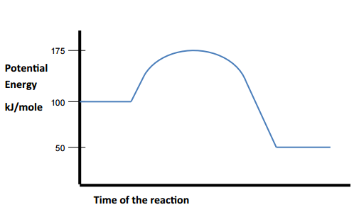
Questions
84. Is this an exo or endothermic reaction?
85. What is the potential energy of the
activated complex?
86. What is the PE of the products?
87. What is the ΔH?
88. What would be a possible activation energy
with a catalyst?

Slide 128
Questions
84. Is this an exo or endothermic reaction? exo
85. What is the potential energy of the
activated complex? 175 kJ/mole
86. What is the PE of the products? 50 kJ/mole
87. What is the ΔH? -50 kJ/mole
88. What would be a possible activation energy
with a catalyst? Less than 75 kJ/mole

Slide 129
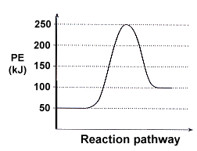
89. What is the PE of the reactants?
90. What is the activation energy for
this reaction?
91. Is this reaction exo or endothermic?
92. What are possible AE values for this reaction
with a catalyst?
93. What is the ΔH for this reaction?
94. Would the ΔH for this reaction change with a catalyst?

Slide 130
89. What is the PE of the reactants?
50 kJ/mole
90. What is the activation energy for
this reaction? 200 kJ/mole
91. Is this reaction exo or endothermic?
endothermic
92. What are possible AE values for this reaction
with a catalyst? Less than 200, more than 50 kJ/mole
93. What is the ΔH for this reaction? +50 kJ/mole
94. Would the ΔH for this reaction change with a catalyst?
No, only the AE changes.

Slide 131
95. In this dynamic equilibrium…
Which way does each stress push the
reaction with all of these stresses?
3A_{(G)} + B_{(S)} ⇌ 3C_{(G)} + D_{(G)} + energy
Add heat
Add B
Inc. pressure
Remove D
Add C

Slide 132
95. In this dynamic equilibrium…
Which way does each stress push the
reaction with all of these stresses?
3A_{(G)} + B_{(S)} ⇌ 3C_{(G)} + D_{(G)} + energy
Add heat
Add B
Inc. pressure
Remove D
Add C

Slide 133
95. In this dynamic equilibrium…
Which way does each stress push the
reaction with all of these stresses?
3A_{(G)} + B_{(S)} ⇌ 3C_{(G)} + D_{(G)} + energy
Add heat
Add B
Inc. pressure
Remove D
Add C

Slide 134
96. State in plain language, and in
complete sentences,
LeChatelier’s Principle
97. State the 4 stresses that can be
applied to a dynamic equilibrium.

Slide 135
96. LeChatelier’s Principle
Chemical systems at equilibrium tend to stay at equilibrium. When a chemical stress is put upon a chemical system in equilibrium, it will shift to relieve that stress, and a new dynamic equilibrium forms.
97. Stresses include changes in
pressure, temperature, and
adding/removing reactants.

Slide 136
98. Of the 4 factors that would that speed up a chemical
reaction, three of them work one way, but the 4th
factor works a different way.

Slide 137
98. Of the 4 factors that would that speed up a chemical
reaction, three of them work one way, but the 4th
factor works a different way.
1. Increase temp = more collisions
2. Increase surface area of reactants = more collisions
3. Increase concentration of reactants = more collisions
4. Using a catalyst lowers the Activation Energy required, or provides
an alternate pathway. THIS DOES NOT make more collisions.
All 4 make reaction rate increase. All 4 make reaction time decrease. | You get that these are NOT the same, right? Ask now if you don’t (please).

Slide 138
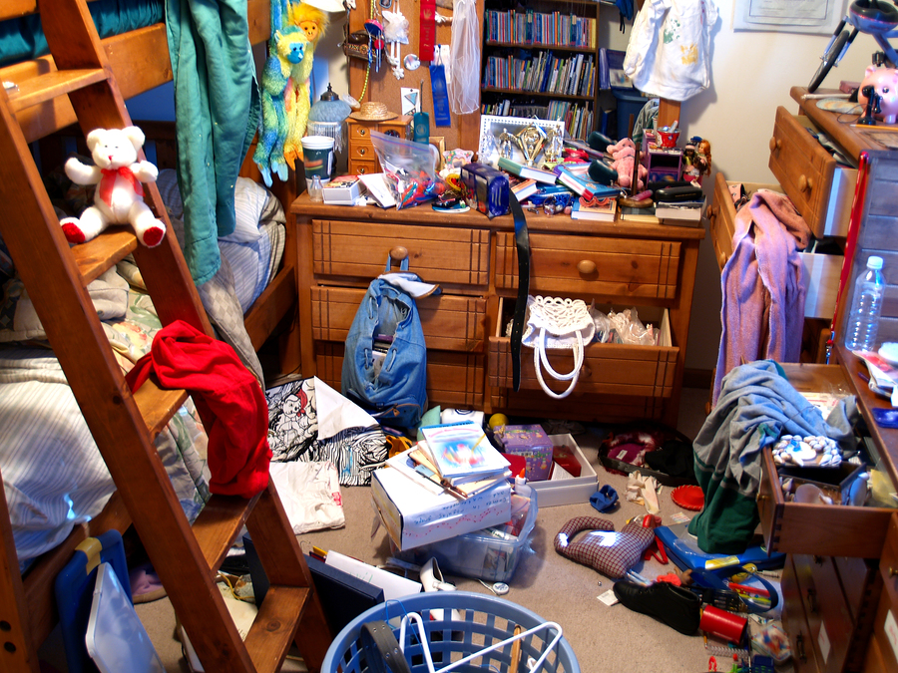
99. Entropy is the measure of disorder in a chemical system.
Much disorder = HIGH ENTROPY
In AP Chem it has units and numbers,
in our course it is just a definition.

Slide 139

121. Entropy is the measure of disorder in a chemical system.
Much disorder = HIGH ENTROPY
No disorder = LOW ENTROPY

Slide 140
100. Compare the phases of matter for entropy
Solid
Liquid
Gas

Slide 141
100. Compare the phases of matter for entropy
Solid | Lowest entropy (most order)
Liquid | Medium entropy
Gas | Highest entropy (most disorder)

Slide 142
101. Three solid compounds are at the same temperature and pressure, which has the most entropy, which has the least entropy, and why?
C₄H₁₀ butane
CH₄ methane | ← Change your notes here to methane!
C₁₂H₂₂O₁₁ Sucrose (sugar)

Slide 143
101. Three solid compounds are at the same temperature and pressure, which has the most entropy, which has the least entropy, and why?
C₄H₁₀ butane | Medium Entropy. They hold 14 atoms together in total.
CH₄ methane | Most Entropy, these are the smallest particles. They are the least organized because they only hold two atoms together.
C₁₂H₂₂O₁₁ Sucrose (sugar) | Least Entropy, these are the largest particles. They are the MOST organized because they hold 45 atoms together.

Slide 144
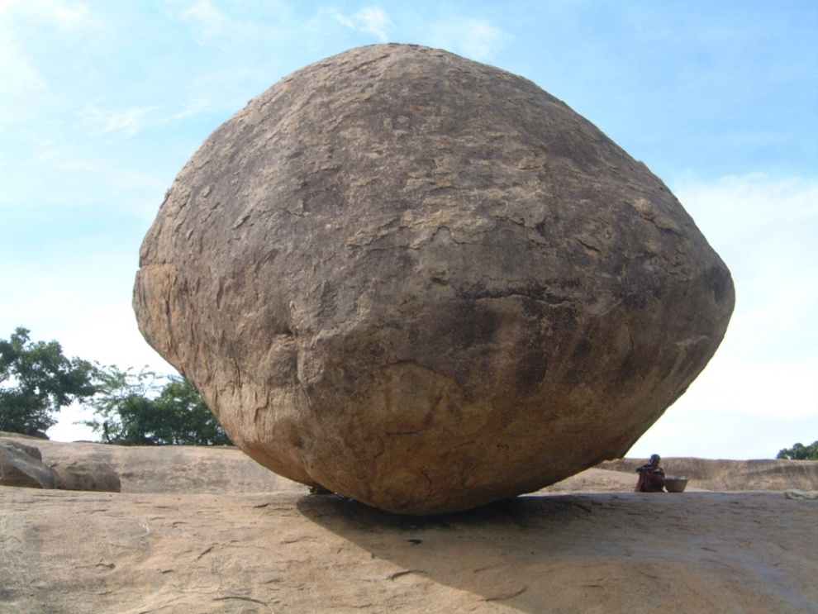
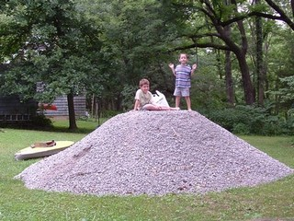
Which is more likely –
boulders crumbling, or
pebbles reforming big rocks?

Slide 145
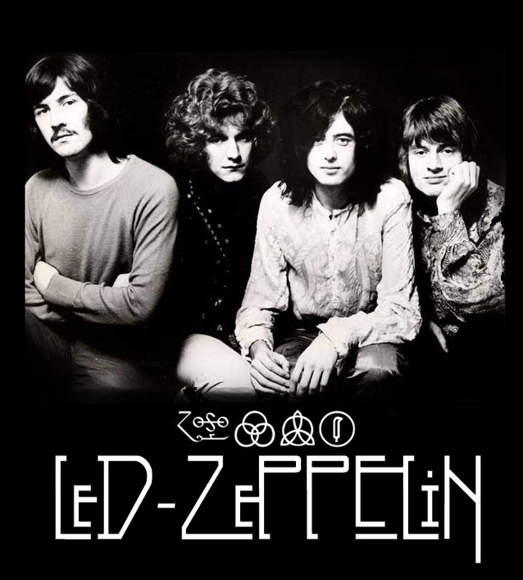
102. If mountains crumble to
the sea, there will still be
you & me.
(from Thank You, by Led Zeppelin)
103. From the NYS Curriculum:
Systems in nature tend to undergo changes
toward lower energy and higher entropy.

Slide 146
104. 2H_{2(G)} + C_{(S)} ⇌ CH_{4(G)}
What’s equal in a dynamic equilibrium?
(Mass, liters, density, what?)

Slide 147
104. 2H_{2(G)} + C_{(S)} ⇌ CH_{4(G)}
The rate of the
forward reaction is equal to
the rate of the reverse reaction.
That’s it.

Slide 148
105. Draw and completely label an
ENDOthermic
potential energy diagram
and an
EXOthermic
potential energy diagram

Slide 149
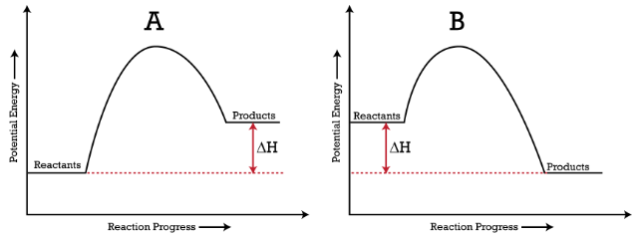
104
Endo on the left, products have MORE energy than they started with, they had to ABSORB energy.
Exo on the right, products have LESS energy than they started with , they had to RELEASE energy.

Slide 150
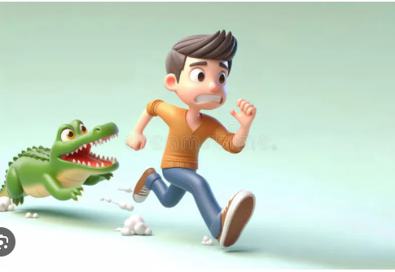
The notes are done, but there are 16 more slides for review.
If you look them over and think a bit, you will likely score
3-4 points higher on the Kinetics Celebration
than some of your less motivated friends.
If an alligator chases you and your friends,
how fast do you have to run?

Slide 151
Which way do these stresses cause this equilibrium
to shift, forward or reverse?
CO_{(G)} + 2H_{2(G)} ⇌ CH₃OH_{(G)} + energy
Increase pressure
Increase temperature
Add CO
Remove Hydrogen
Add a catalyst
Decrease pressure
Decrease temperature
Remove methanol

Slide 152
Which way do these stresses cause this equilibrium
to shift, forward or reverse?
CO_{(G)} + 2H_{2(G)} ⇌ CH₃OH_{(G)} + energy
Increase pressure
Increase temperature
Add CO
Remove Hydrogen
X Add a catalyst X
Decrease pressure
Decrease temperature
Remove methanol

Slide 153
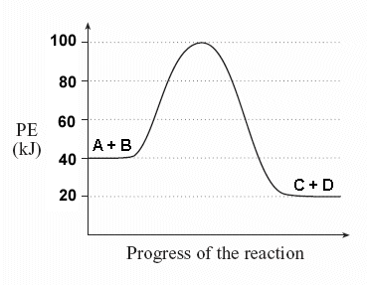
This is a potential energy diagram.
Answer me this…
What is the ∆H?
What is the AE?
What is energy of the activated complex?

Slide 154
This is a potential energy diagram.
Answer me this…
∆H = – 20 kJ/mole
AE = 60 kJ/mole
activated complex has 100 kJ/mole

Slide 155
Which of these solids have the lowest entropy and the highest entropy - at STP?
CO₂
C₃H₈
Na₃Al(SO₄)₃∙12H₂O

Slide 156
Which of these solids have the lowest entropy and the highest entropy - at STP?
CO₂ (most entropy, fewest bonds)
C₃H₈
Na₃Al(SO₄)₃∙12H₂O (lowest entropy, most bonds)

Slide 157
If a reaction takes 25.0 seconds to occur,
what is the rate of reaction?
25.0 seconds
0.0400 seconds
0.0400 seconds⁻¹
400. seconds ⁻¹

Slide 158
If a reaction takes 25.0 seconds to occur,
what is the rate of reaction?
25.0 seconds
0.0400 seconds
0.0400 seconds⁻¹
400. seconds ⁻¹
rate =
1
seconds
1
25.0 sec
=
=
Do the math!

Slide 159
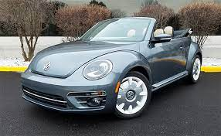
Gasoline burns in my punch-buggy engine, which statement is true?
Energy is a reactant, ∆H is negative
Energy is a product, ∆H is negative
Energy is a reactant, ∆H is positive
Energy is a product, ∆H is positive

Slide 160
Gasoline burns in my punch-buggy engine, which statement is true?
Energy is a reactant, ∆H is negative
Energy is a product, ∆H is negative
Energy is a reactant, ∆H is positive
Energy is a product, ∆H is positive

Slide 161
What are the 3 ways to stress a dynamic equilibrium? Add or remove energy, add or remove reactants, increase or decrease the pressure of gases.
What are the 4 ways to increase the rate of a chemical reaction?

Slide 162
What are the 3 ways to stress a dynamic equilibrium? Add or remove energy, add or remove reactants, increase or decrease the pressure of gases.
What are the 4 ways to increase the rate of a chemical reaction? Increase collisions by using hotter stuff, by using smaller sized particles, or by using more concentrated solutions, or by adding a catalyst.

Slide 163
State
LeChatelier’s Principle

Slide 164
A chemical system at equilibrium stays at equilibrium. If a chemical stress is added
to a system at dynamic equilibrium, the system shifts
to accommodate that stress,
and a new
dynamic equilibrium will form.

Slide 165
Kinetics Quiz
Get white sheet of paper.
Name and class period on top, draw a line.
In a moment, copy the
chemical reaction onto that line.
Under that, write in the 5 chemical stresses shown on the next slide.
ADD ARROWS for each of the 5 stresses, Showing a forward shift or reverse shift.
(5 points)
Name class period Kinetics Quiz
________________________________

Slide 166
Kinetics Quiz
Then on the other side, you will draw TWO Potential Energy diagrams, label all that is asked. (10 points each)
25 total points possible.

Slide 167
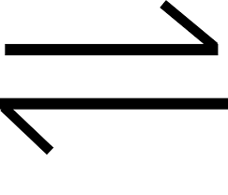
Copy reaction, copy five “stresses”, put in symbols to show each LeChatelier Shift. Period 7
Add oxygen
Add water
Increase pressure
Decrease heat
Add a catalyst
Draw 2 potential energy diagrams, one for the synthesis of liquid water, and one for the decomposition of NH_{3(G)}. Use table I.
FOR BOTH: Title each graph, label X and Y axis, label reactants, products, activated complex, the ∆H with proper sign, show the affect
of a catalyst on the reaction pathway, label activation energy.
2CH_{3(G)} + 3O_{2(G)} |  | 2CO_{2(G)} + 4H₂O_{(G)} + energy

