Slide 1
Matter Class #1
OB: We will define what matter is, learn the three (plus one) phases of matter are, what the phase change names are, and learn several physical properties of matter. We’ll also cover lots of vocabulary that you MUST MASTER ASAP.
There is NOTHING the matter with you,
one silly joke per day is all you get.

Slide 2
1. Define Matter – ANYTHING THAT
TAKES UP SPACE
AND HAS MASS.
2. All matter exists in one of these
“states” or phases:
A. SOLIDS B. LIQUIDS
C. GASES D. AQUEOUS

Slide 3
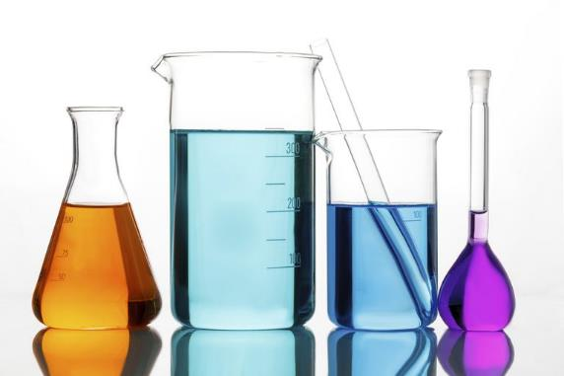
The word AQUEOUS means…
DISSOLVED into WATER
(not other liquids, just water)
Example of aqueous include solutions, like salt water, or tea, or acids.

Slide 4
4. Matter can be PURE or MIXED.
Pure matter includes the 118 ELEMENTS
from the PERIODIC TABLE
and all the millions of COMPOUNDS
5. Mixed Matter is just a
PHYSICAL BLEND
OF PURE SUBSTANCES

Slide 5
6. What is a physical property
of matter?
Qualities that are…
CONSTANT and MEASURABLE

Slide 6
7. Some examples of physical properties include…
Density
Boiling Point (same as condensing point)
Freezing point (same as melting point)
Hardness
Magnetic attraction (or not)
Solubility in water (aqueous)
Solubility in other solvents (oils, ethers, etc.)
and many more.

Slide 7
8. Physical Changes are also
called PHASE changes.

Slide 8
9. The six phase changes are…
Solid → Liquid is called
Liquid → Solid is called
Gas → Liquid is called
Liquid → Gas is called
Solid → Gas is called
Gas → Solid is called

Slide 9
9. The six phase changes are…
Solid → Liquid is called | MELTING
Liquid → Solid is called | FREEZING
Gas → Liquid is called | CONDENSING
Liquid → Gas is called | VAPORIZATION
Solid → Gas is called | SUMLIMATION
Gas → Solid is called | DEPOSITION

Slide 10
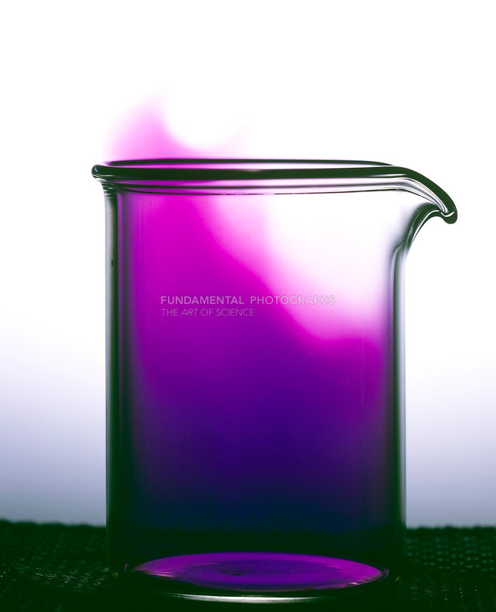
Get up, it’s time for a neat demo
Iodine, the element, which is a
solid at normal temperature,
will be made to sublimate
into iodine gas, without
becoming a liquid first.
It will sublimate into a gas.
Then it will undergo
deposition, gas to solid.

Slide 11
10. Chemical & Physical Changes in matter
No new matter forms.
No new properties form.
Same formulas.
Physical
Changes
Chemical
Changes
A rearrangement of the atoms or particles of the substance
New matter forms.
New properties form.
New formulas.
11. Physical changes are just phase changes.
Chemical changes are reactions, which make new stuff.

Slide 12
12. What are MIXTURES?
Mixtures are… PHYSICAL BLENDS OF PURE MATTER
The properties of matter in a mixture are CONSTANT.
No new properties form, no new substances form.
When making a mixture….
NO NEW COMPOUNDS ARE FORMED

Slide 13
14. Mixtures can be the same throughout or
are randomly mixed together.
15. Mixtures that are mixed the
SAME THROUGHOUT are called…
16. Mixtures that are mixed
DIFFERENTLY THROUGHOUT
are called…

Slide 14
15. Mixtures that are the
SAME THROUGHOUT are called…
HOMOGENEOUS
16. Mixtures that are
DIFFERENT THROUGHOUT
are called…
HETEROGENOUS

Slide 15
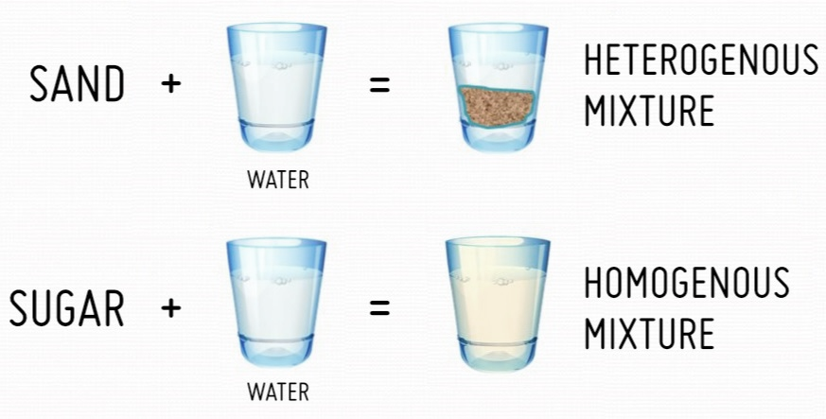
Examples
17
18

Slide 16
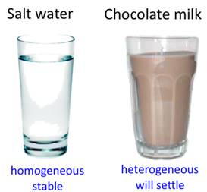
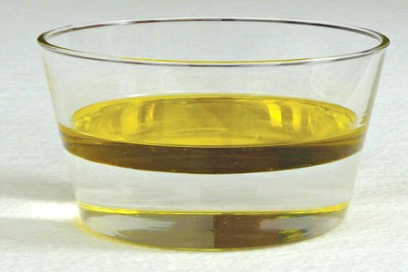
Salty Water Chocolate milk Oil & white vinegar
Homogeneous
stays mixed perfectly
Heterogenous, will settle apart soon
Heterogeneous, will not mix at all
19. Salt water is homogeneous – it’s the same throughout.
20. Chocolate milk is heterogeneous, because
the chocolate will settle to the bottom. (It starts mostly homogeneous)
21. Oil and vinegar are heterogeneous; they will not mix.

Slide 17
22. Mixtures can come in ALL PHASES. Examples of mixtures
Solution phase | examples | Contains this | Mixed with this
Solids | Cast Iron | Carbon | Iron
 | Brass | Zinc | Copper
Liquids | Wine | Ethanol | Fruit juice
 | Vinegar | Acetic acid | Water
Gas | Air | Oxygen | Nitrogen, etc.
Aqueous | Ocean water | Salt | Water
 | Gatorade | Sugar + Food color | Water

Slide 18
Matter Class #2
OB: Matter Vocabulary,
Compounds, Elements, etc., and the Law of Conservation of Matter

Slide 19
23
MATTER
Mixtures
(two flavors ☺)
Pure substances
all homogeneous

Slide 20
23
MATTER
Mixtures
(two flavors ☺)
Pure substances
all homogeneous
118 Elements
examples: Mg, Ca, Fe
Compounds
examples: H₂O, CO₂, NaCl

Slide 21
23
MATTER
Mixtures
(two flavors ☺)
Pure substances
all homogeneous
Homogeneous
includes all solutions, even gas or solid ones
118 Elements
examples: Mg, Ca, Fe
Heterogeneous
sugar + salt,
sand + water,
concrete, chicken soup
Compounds
examples: H₂O, CO₂, NaCl

Slide 22
The Law of Conservation of Matter
Matter cannot be created
or destroyed
in a chemical reaction,
or in a physical change.
What is a physical change again?
24

Slide 23
A physical change is a
phase change
24

Slide 24
Sodium and Chlorine yields Sodium Chloride
25. Sodium + chlorine are the ____________
26. Sodium Chloride is the __________________

Slide 25
Sodium and Chlorine yields Sodium Chloride
25. Sodium + chlorine are the reactants
26. Sodium Chloride is the product
Reactants become products.
You can have one reactant, or many reactants,
and you can have one product or many

Slide 26
27. The mass of the The mass of the
REACTANTS PRODUCTS
because all chemical reactions follows the…
Law of Conservation of Matter
=

Slide 27
If you completely react 46 grams of sodium and 70 grams of chlorine, how many grams of sodium chloride form?

Slide 28
If you completely react 46 grams of sodium and 70 grams of chlorine, how many grams of sodium chloride form?
46 g Na + 70 g Cl → 116 grams of NaCl

Slide 29
29. When 8 grams of hydrogen reacts with
64 grams of oxygen,
how many grams of water form?

Slide 30
29. When 8 grams of hydrogen reacts with
64 grams of oxygen,
how many grams of water form?
8 g hydrogen + 64 g oxygen → 72 g water

Slide 31
30. When 4 g hydrogen reacts with sufficient
oxygen and forms 36 grams water,
how many grams of oxygen was used in
this reaction?

Slide 32
30. When 4 g hydrogen reacts with sufficient
oxygen and forms 36 grams water,
how many grams of oxygen was used in
this reaction?
4 g hydrogen + 32 g oxygen → 36 grams H₂O

Slide 33
31. How many grams of hydrogen
reacts here to form ammonia?
6 g H₂ + 28 g N₂ → 34 g NH₃

Slide 34
31. How many grams of hydrogen
reacts here to form ammonia?
6 g H₂ + 28 g N₂ → 34 g NH₃

Slide 35
32. How much Iron (III) oxide
forms here? (that’s rust)
223 g Fe + 96 grams O₂ → 319 g Fe₂O₃
(rust)

Slide 36
32. How much Iron (III) oxide
forms here? (that’s rust)
223 g Fe + 96 grams O₂ → 319 g Fe₂O₃
(rust)

Slide 37
How to counting atoms in chemical formulas (write formulas and number of atoms)
 | Compound | Formula | Number of atoms
33 | carbon dioxide | CO₂
34 | lithium carbonate | Li₂CO₃
35 | aluminum phosphate | AlPO₄

Slide 38
How to counting atoms in chemical formulas
 | Compound | Formula | Number of atoms
33 | carbon dioxide | CO₂ | 1 + 2 = 3
34 | lithium carbonate | Li₂CO₃ | 2 + 1 + 3 = 6
35 | aluminum phosphate | AlPO₄ | 1 + 1 + 4 = 6

Slide 39
 | Compound | Formula | Number of atoms
36 | water | H₂O
37 | glucose | C₆H₁₂O₆
38 | hydrogen sulfate | H₂SO₄
39 | hydrogen phosphate | H₃PO₄
40 | silicon dioxide | SiO₂

Slide 40
 | Compound | Formula | Number of atoms
36 | water | H₂O | 2 + 1 =3
37 | glucose | C₆H₁₂O₆ | 6 + 12 + 6 = 24
38 | hydrogen sulfate | H₂SO₄ | 2 + 1 + 4 = 7
39 | hydrogen phosphate | H₃PO₄ | 3 + 1 + 4 = 8
40 | silicon dioxide | SiO₂ | 1 + 2 = 3

Slide 41
 | Compound | Formula | Number of atoms
41 | magnesium hydroxide | Mg(OH)₂
42 | ammonium sulfite | (NH₄)₂SO₃
43 | cobalt (II) dichromate | Co₂(Cr₂O₇)₃
44 | manganese (VII) carbonate | Mn₂(CO₃)₇
45 | aluminum hydroxide | Al(OH)₃

Slide 42
 | Compound | Formula | Number of atoms
41 | magnesium hydroxide | Mg(OH)₂ | 1 + (2)2 = 5
42 | ammonium sulfite | (NH₄)₂SO₃ | (5)2 + 1 + 3 = 14
43 | cobalt (II) dichromate | Co₂(Cr₂O₇)₃ | 2 + (9)3 = 29
44 | manganese (VII) carbonate | Mn₂(CO₃)₇ | 2 + (4)7 = 30
45 | aluminun hydroxide | Al(OH)₃ | 1 + (2)3 = 7

Slide 43
Matter Class #3
Objectives: How can we separate mixtures
apart into pure substances?
Also, how can we tell if a
chemical reaction has occurred?

Slide 44
46. A mixture is a physical blend
of 2 or more pure substances.
They could be Elements + Elements
Elements + Compounds
Compounds + Compounds

Slide 45
When 2 or more pure substances are mixed together, the mixture retains the properties of its parts.
Example: breakfast might be sliced bananas, vanilla yogurt and cheerios. They’re mixed together, but they
don’t “bond” into a new substance.
Each part keeps its properties.

Slide 46
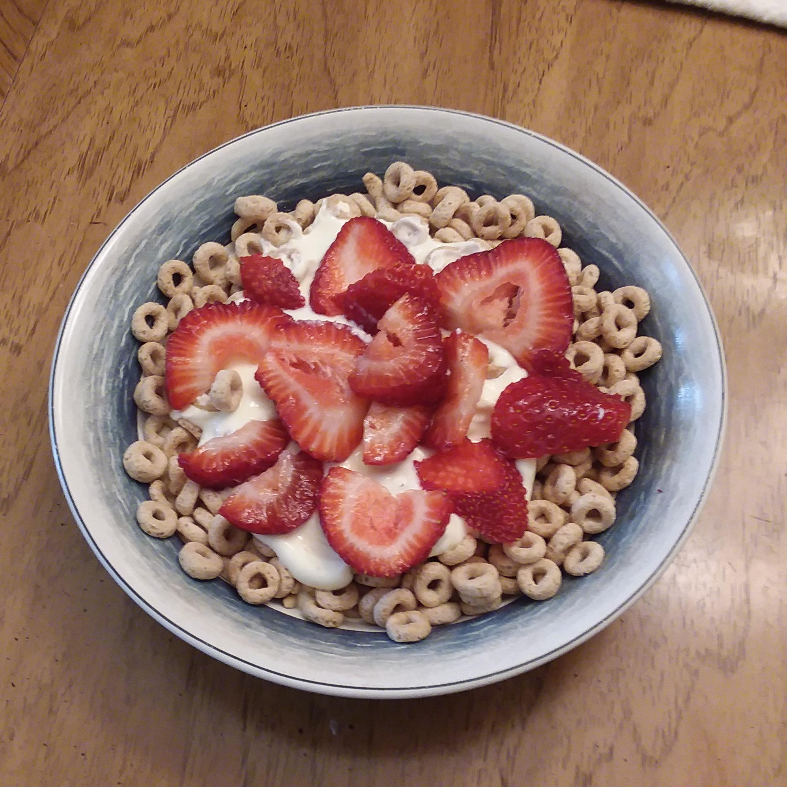
Yogurt, fruit and cheerios are mixed, but do not form a new substance.
48. Each part of a mixture retains
their properties.
Each bite is
different because they are not mixed perfectly with the other parts.

Slide 47
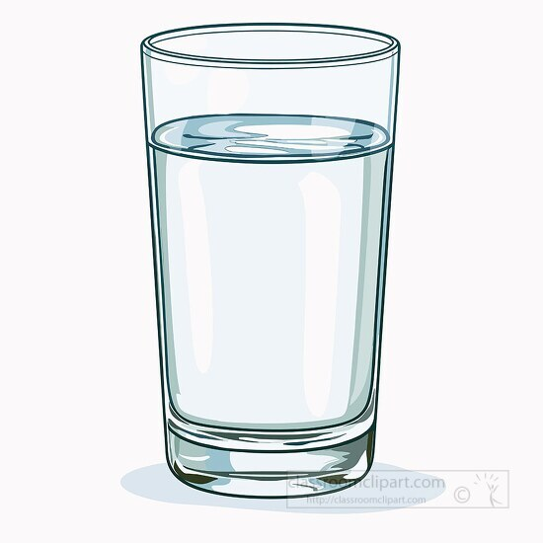
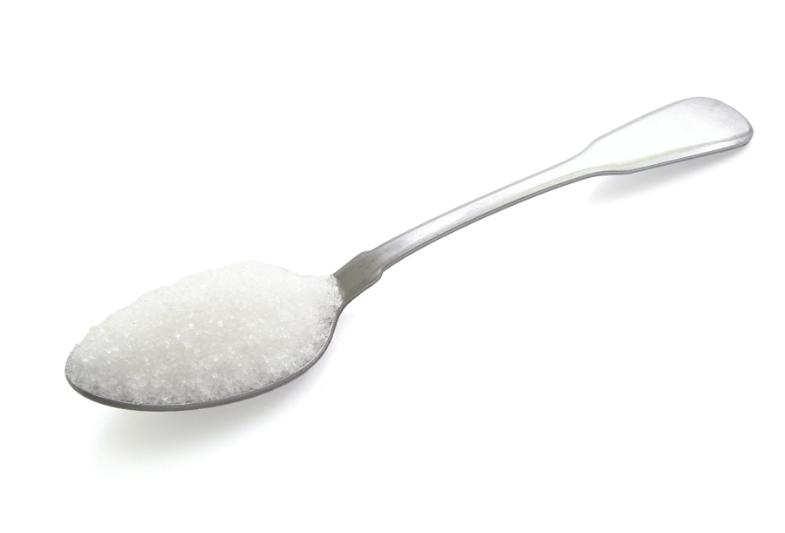
49. When you put some table salt into
water, you get salty water.
The parts mix perfectly together.
50. Mixtures don’t make a new substance.
+
=

Slide 48
51. You can separate a mixture
apart physically because
it’s not chemically bonded
together.
Separating mixtures are
not chemical reactions.

Slide 49
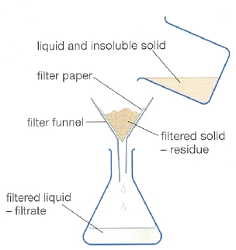
53. You can separate mixtures by
physical means (not chemical).
To separate the mixture of sand and water, you could filter them apart.
54. The “process” that allows us to separate a mixture is to
TAKE ADVANTAGE
OF A DIFFERENCE
IN THEIR
PHYSICAL PROPERTIES.
Here, that is particle sizes.
Sand is bigger than water, sand gets caught in the filter paper.
Sand and water mixed
trapped
sand
Water without sand

Slide 50
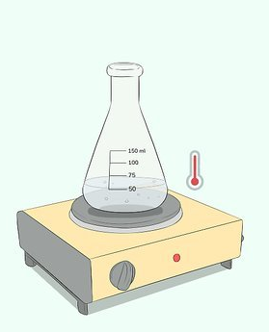
55. To separate ethanol and water (both liquid) you
can’t filter them apart. You can take advantage of
the difference in their boiling points,
~100°C for water, ~81°C for the alcohol.
81-85°C
Using a thermometer, you could heat up the mixture over 81°C but lower than 100°C.
The alcohol boils off; the water just gets hot.
When the mixture stops boiling, all the alcohol has been boiled away,
leaving only hot water in the flask.
Over heating boils away both liquids,
which is unhelpful.

Slide 51
56. Using a distillation apparatus, you separate the mixture and “catch” the ethanol as well. Hot water is in the flask at left, ethanol is in the beaker at right.
You separate the mixture by taking advantage
of the physical property of boiling point
between water and ethanol.
Thermometer
81°C
Vaporized
ethanol
Condensing tube
Water + ethanol
Controlled Heat
Ethanol collects in beaker

Slide 52
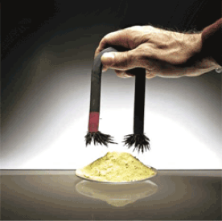
Solid sulfur and solid iron cannot be filtered apart, nor can they be distilled apart. THINK…
57. Here, the iron is
separated from sulfur, by taking advantage
of the magnetic attraction that iron has to the magnet, and sulfur doesn’t.

Slide 53
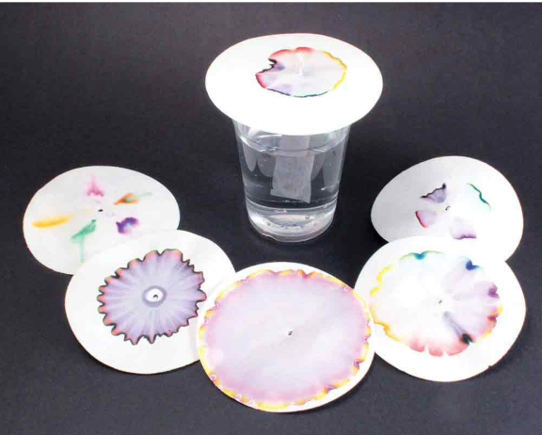
58. PAPER CHROMATOGRAPHY
allows you to separate the
colors of markers by taking
advantage of the ink solubility
in water, as well as the
density of color particles.
Sharpies are permanent
(insoluble in water) and
don’t move as the water flows
in the paper.
Inks that can dissolve into
water are lifted off the paper
and travel based upon their density.

Slide 54
59. You could also separate mixtures by taking advantage of differences in
Freezing Points, Density, Melting Points, Etc.

Slide 55
Take a deep breath, we have to switch gears.

Slide 56
60. A chemical reaction is when 2 or more
substances are bonded together in a
chemical reaction, forming…
NEW PURE SUBSTANCES
that have DIFFERENT properties than
the reactants had.

Slide 57
How can you tell if a chemical reaction has occurred or not?
There are 6 indicators we look for, and if one or more happens it is VERY LIKELY that a reaction did happen.
These indicators are not PROOF. Thinking is still required.
61. We’ll use the acronym
TOPIC-B
to remember what to look for.

Slide 58
62. Indicators that a chemical reaction has probably occurred:
T
O
P
I
C
B

Slide 59
62. Indicators that a chemical reaction has probably occurred:
T | If TEMPERATURE CHANGE occurs (hotter or colder) energy is released or absorbed.
O | ODOR CHANGE means new stuff that smells different has been made.
P | PRECIPITATES are solids that form when some solution are mixed, solids that were not present before and are not soluble in the water.
I | All chemical reactions are reversible, but that requires chemical smarts. Most chemical reactions are spontaneously IRREVERSIBLE, once they happen they stay done.
C | COLOR CHANGES mean new substances with different colors have formed.
B | BUBBLES of a new gas means a gas formed from the reactants.

Slide 60

Matter Class #4
Objective:
Particle Diagrams for solids, liquids, gases, atoms, molecules, compounds, and mixtures.
Put on your thinking hats.

Slide 61
63. A particle diagram shows the idea of
chemical substances in a cartoon sort of way
The diagrams are not realistic in shape, but with some imagination and thinking, you can understand what they are going to show.
7 vocabulary words to start…
solid | particles are stuck together, they’re organized, holds its shape.
liquid | particles are “sticky but not stuck”, they fill bottom of a container.
gas | particles don’t touch, they bounce around in straight lines.

Slide 62
atom | smallest bit of any element
diatomic elements | one of 7 kinds of atoms that are always paired when pure. (H₂ + O₂)
compound | 2 or more different atoms bonded together, making a compound
mixture | combo of elements or compounds with no specific formulas

Slide 63
64. Particle diagrams for a SOLID
Solid particles are stuck together, organized, orderly, and hold their shape in the container.

Slide 64
64. Particle diagrams for a SOLID, LIQUID
Solid particles are stuck together, organized, orderly, and hold their shape in the container. | Liquid particles are sticky but not stuck, they conform to the shape of the bottom of the container.

Slide 65
64. Particle diagrams for a SOLID, LIQUID, GAS
Solid particles are stuck together, organized, orderly, and hold their shape in the container. | Liquid particles are sticky but not stuck, they conform to the shape of the bottom of the container. | Gas particles are floating, never “touch” each other, and fill the whole container, and don’t touch the bottom.

Slide 66
Atoms, diatomic elements, and molecules… which are which?

Slide 67
ATOMS
DIATOMIC ELEMENTS
1:4 or 4:1 ratios
1:3 or 3:1 ratios
1:2 or 2:1 ratios
SOLIDS
No LIQUIDS here
Atoms, diatomic elements, and molecules… which are which?

Slide 68

65. How will you remember the
7 elements that are diatomic?
They are the HONClBrIF Twins!

Slide 69
66

Slide 70
Gas molecules,
like CO₃ or H₂O
The
7 HONClBrIF
twins
Gas molecules,
like NH₃ or SO₃
Liquid
molecules,
like H₂O
Atomic gas
Solid
Gas
66

Slide 71
REVIEW OF MATTER
Know this. Be one with the matter.
You can do it.
Let’s finish the notes in a big way.
J
Or do this at home!

Slide 72
67. A physical change is
a chemical change
a phase change
a chemical reaction
a change in density

Slide 73
67. A physical change is
a chemical change
a phase change
a chemical reaction
a change in density

Slide 74
68. Write in a phase symbol
 | Indefinite shape, indefinite volume
 | Definite shape, definite volume
 | Indefinite shape, definite volume

Slide 75
68. Write in a phase symbol
G | Indefinite shape, indefinite volume
S | Definite shape, definite volume
L | Indefinite shape, definite volume

Slide 76
69. Define heterogeneous
NOT the same throughout, like chocolate chip cookies, or bits of copper and iron in one beaker.
70. Define heterogenous
The same throughout, like Gatorade. or any solution in chemistry lab.

Slide 77
71. Which CAN be decomposed by a chemical change?
Co | B. CO
C. Hg | D. Fe

Slide 78
71. Which CAN be decomposed by a chemical change?
Co X element | B. CO J compound
C. Hg X element | D. Fe X element
Elements cannot be broken down into simpler substances, compounds can.

Slide 79
72. How can we separate a mixture of
table salt and water?
A. a chemical reaction
B. with filter paper
C. with a strong magnet
D. with a distillation apparatus

Slide 80
72. How can we separate a mixture of
table salt and water?
A. a chemical reaction
B. with filter paper
C. with a strong magnet
D. with a distillation apparatus
By taking advantage of difference in their boiling points.

Slide 81
73. Convert the melting point
of copper into centigrade
degrees. Use a formula.

Slide 82
73. Convert the melting point
of copper into centigrade
degrees. Use a formula.
K = C + 273
1358 = C + 273
1085°C = C

Slide 83
74. If 502 grams of iron completely
combines with 216 grams of
oxygen to form rust, how many
grams of rust form?

Slide 84
74. If 502 grams of iron completely
combines with 216 grams of
oxygen to form rust, how many
grams of rust form?
502 g + 216 g = 718 grams rust

Slide 85
75. When 2 elements chemically combine into a
product, the product…
A. has the same properties as the reactants
B. has a blend of properties of the reactants
C. has new, unique properties, unlike the reactants
D. may or may not be similar, it depends on
which elements combine

Slide 86
75. When 2 elements chemically combine into a
product, the product…
A. has the same properties as the reactants
B. has a blend of properties of the reactants
C. has new, unique properties, unlike the reactants
D. may or may not be similar, it depends on
which elements combine

Slide 87
76. Count the number of atoms in these formulas
A | aluminum permanganate | Al(MnO₄)₃
B | ammonium carbonate | (NH₄)₂CO₃
C | nickel (III) acetate | Ni(C₂H₃O₂)₃
D | ammonium phosphate | (NH₄)₃PO₄
E | yttrium oxalate | Y(C₂O₄)₃

Slide 88
76. Count the number of atoms in these formulas
A | aluminum permanganate | Al(MnO₄)₃ | 1 + (5)3 = 16
B | ammonium carbonate | (NH₄)₂CO₃ | (5)2 + 1 + 3 = 14
C | nickel (III) acetate | Ni(C₂H₃O₂)₃ | 1 + (7)3 = 22
D | ammonium phosphate | (NH₄)₃PO₄ | (5)3 + 1 + 4 = 20
E | yttrium oxalate | Y(C₂O₄)₃ | 1 + (6)3 = 19

Slide 89
77. Name all the phase changes
Solid → Gas
Liquid → Gas
Solid → Liquid
Gas → Solid
Liquid → Solid
Gas → Liquid

Slide 90
77. Name all the phase changes
Solid → Gas | sublimation
Liquid → Gas | vaporization
Solid → Liquid | melting
Gas → Solid | deposition
Liquid → Solid | freezing
Gas → Liquid | condensation

Slide 91
78. State standard temperature in both
Kelvin and in Centigrade.

Slide 92
78. State standard temperature in both
Kelvin and in Centigrade.
Table A shows...
273 Kelvin, or 0°C

Slide 93
79. Calculate (with a formula) the volume
of 375 grams of sodium metal.

Slide 94
79. Calculate (with a formula) the volume
of 375 grams of sodium metal.
D =
Mass
Volume
375 grams
Volume
0.97 g/cm³ =
0.97 g/cm³ (V) = 375 grams
V = 387 cm³
(3 sf)
0.97 g/cm³ = 0.97 g/cm³

Slide 95
This is a balanced equation for the combustion of heptane.
C₇H_{16(L)} + 11O_{2(G)} → 7CO_{2(G)} + 8H₂O_{(G)}
80 | Which of the 4 subsances are reactants?
81 | Which are the products?
82 | How many atoms in one heptane?
83 | How many molecules of water formed?

Slide 96
This is a balanced equation for the combustion of heptane.
C₇H_{16(L)} + 11O_{2(G)} → 7CO_{2(G)} + 8H₂O_{(G)}
80 | Which of the 4 subsances are reactants? | C₇H₁₆ + O₂
81 | Which are the products? | CO_{2(G)} + H₂O
82 | How many atoms in one heptane? | 7 + 16 = 23
83 | How many molecules of water formed? | 8

Slide 97
84. What is the underlying principle
of separating mixtures?
(what do we “have to do”?)

Slide 98
84. What is the underlying principle
of separating mixtures?
(what do we “have to do”?)
We need to take advantage of a difference in their physical properties. Mixtures are not chemically combined or bonded, so we use physical means, like differences in boiling points, density, freezing points, hardness, color, solubility, or any other physical properties we can determine.

Slide 99
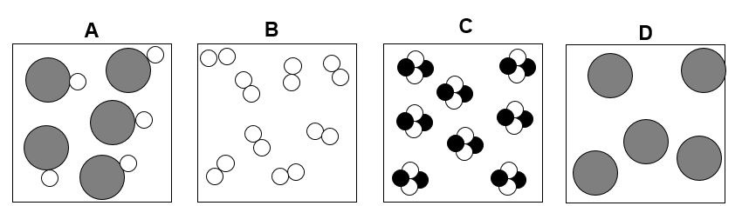
85. Which box or boxes contain
a diatomic element?
a mixture?
a monoatomic element?
a compound?

Slide 100
85. Which box or boxes contain
a diatomic element? B
a mixture? none
a monoatomic element? D
a compound? A + C

