Slide 1

Objective: Intro to the Mole
You gotta have a reference table and
a calculator of your own now.
No exceptions.

Slide 2

One way to measure how much someone loves you is to see if they know that a dozen roses means twelve.*
(*a dozen does not really mean love,
but you get it, right?)

Slide 3
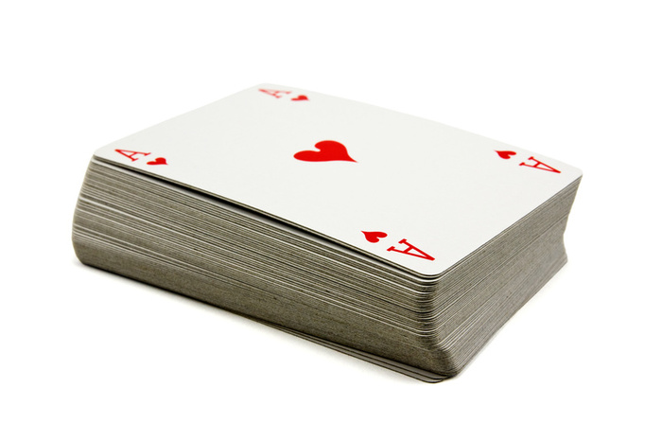
One way to measure how much someone loves you is to see if they know that a dozen roses means twelve.
A deck of cards = 52 cards. 51 is not a deck.

Slide 4
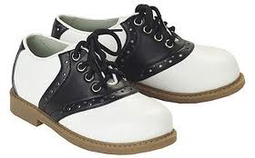
One way to measure how much someone loves you is to see if they know that a dozen roses means twelve.
A deck of cards = 52 cards. 51 is not a deck.
And we know that ONE PAIR of shoes = 2 shoes

Slide 5
You could have a pair of atoms, or a dozen, or even 52, but you wouldn’t know it because atoms are so small. We need a bigger unit, and that’s what a mole is.
1. A mole is a certain number of particles.
You could have a mole of atoms OR molecules
OR cations or anions
OR EVEN a mole of formula units (!)
the smallest theoretical bit of an ionic compound
2. A mole is number of things. Exactly: 6.02 x 10²³ of things.
That’s: 602,000,000,000,000,000,000,000 things.
A mole of hard-boiled eggs is BIGGER than the Earth!

Slide 6
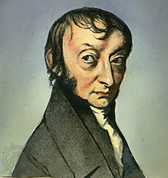
No one ever counted that many,
but it’s been worked
out mathematically.
3. 6.02 x 10²³ is called
Avogadro’s Number
in honor of Amadeo Avogadro,
an Italian chemist who studied gases.

Slide 7
4. How many atoms are in one mole of
mercury? 6.02 x 10²³ atoms of mercury
5. How many atoms are in 0.50 mole of carbon?
whole mole
Half as many, 3.01 x 10²³ atoms.
half mole

Slide 8
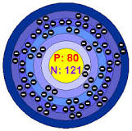
What is the mass of one mole of mercury?
6. One atom of mercury has a
weighted average mass of 200.59 amu
7. In our class we round that to the
nearest whole number: 201 amu
Element #80 has
80 electrons flying around in the shells
or energy levels.

Slide 9
What is the mass of 1 mole of mercury?
8. One MOLE of mercury has
mass of 201 grams.
One atom has 201 amu
One mole has 201 grams

Slide 10
6.02 x 10²³ atoms of Hg
One mole means a certain number of things, exactly 6.02 x 10²³ of them.
One mole means a certain mass of stuff, called the MOLAR MASS.
1.0 mole Hg
201 grams of Hg

Slide 11
9 | Molar mass (this column first) | If you had this much… | The total mass would be…
Carbon |  | 1.0 mole
Aluminum |  | 2.0 moles
Helium |  | 3.0 moles
Magnesium |  | 0.5 moles
Iron |  | 2.50 moles
Oxygen |  | 1.0 moles
Fluorine |  | 2.0 moles

Slide 12
9 | Molar mass (this column first) | If you had this much… | The total mass would be… (this column second)
Carbon | 12 grams/mole | 1.0 mole
Aluminum | 27 grams/mole | 2.0 moles
Helium | 4 grams/mole | 3.0 moles
Magnesium | 24 grams/mole | 0.5 moles
Iron | 56 grams/mole | 2.50 moles
Oxygen | 32 grams/mole | 1.0 moles
Fluorine | 38 grams/mole | 2.0 moles

Slide 13
9 | Molar mass (this column first) | If you had this much… | The total mass would be… (this column second)
Carbon | 12 grams/mole | 1.0 mole | 1 x 12 = 12 g
Aluminum | 27 grams/mole | 2.0 moles | 2 x 27 = 54 g
Helium | 4 grams/mole | 3.0 moles | 3 x 4 = 12 g
Magnesium | 24 grams/mole | 0.5 moles | 0.5 x 24 = 12 g
Iron | 56 grams/mole | 2.50 moles | 2.5 x 56 = 140 g
Oxygen | 32 grams/mole | 1.0 moles | 1 x 32 = 32 g
Fluorine | 38 grams/mole | 2.0 moles | 2 x 38 = 76 g

Slide 14
10. The HONClBrIF Twins need special attention.
They exist in nature, when PURE, as diatomic molecules, not individual atoms.
So, their MOLAR MASS, the mass of one mole of a substance is as follows…
H₂ 2 x 1g = 2 g/mole
O₂ 2 x 16 g = 32 g/mole
N₂ 2 x 14g = 28 g/mole
Cl₂ 2 x 35g = 70 g/mole
Br₂ 2 x 80g = 160 g/mole
I₂ 2 x 127g = 254 g/mole
F₂ 2 x 19g = 38 g/mole
Always round atomic mass to nearest WHOLE NUMBER!

Slide 15
Molar mass can be calculated for compounds as well, as long as you can write a proper formula.
11. One mole of a substance = its molar mass
12. Calculate the molar mass of carbon dioxide
CO₂
C
O
! Save this space
Molar mass on the left side.

Slide 16
Molar mass can be calculated for compounds as well, as long as you can write a proper formula.
11. One mole of a substance = its molar mass
12. Calculate the molar mass of carbon dioxide
CO₂
C 1 x 12 g = 12 g
O 2 x 16 g = 32 g
44 g/mole
! Save this space
Molar mass on the left side.

Slide 17
14. You can say 44 g/mole this way:
Carbon dioxide has a molar mass of
44 grams/mole
Or
44 grams of CO₂ = one mole of CO₂

Slide 18
15. Determine the molar mass of Iron (III) nitrate
Fe(NO₃)₃
Fe
N
O
! Save this space
Molar mass on the left side.

Slide 19
15. Determine the molar mass of Iron (III) nitrate
Fe(NO₃)₃
Fe 1 x 56 g = 56 g
N 3 x 14 g = 42 g
O 9 x 16 g = 144 g
242 g/mole
! Save this space
Molar mass on the left side.
16. COPY THIS:
Iron (II) nitrate has a molar mass of 242 grams 1 mole Fe(NO₃)₃ = 242 g Fe(NO₃)₃

Slide 20
17. What is the mass of 2.70 moles of sulfur?
to do this we need to get a grip on what this is asking.
It means convert 2.70 moles of sulfur to grams of sulfur.
You will need the molar mass of sulfur to do this math problem.
What is the molar mass of sulfur?
We can say 1 mole of sulfur = ___ grams of sulfur

Slide 21
17. What is the mass of 2.70 moles of sulfur?
to do this we need to get a grip on what this is asking.
It means convert 2.70 moles of sulfur to grams of sulfur.
You will need the molar mass of sulfur to do this math problem.
18. What is the molar mass of sulfur? 32 g/mole
19. We can say 1 mole of sulfur = 32 grams of sulfur
From this equality we can make a conversion factor, and easily switch these units from moles into grams.

Slide 22

20. What is the mass of 2.70 moles of sulfur?
1 mole of sulfur = 32 grams of sulfur
Start “over 1”, then use the equality to make a conversion
factor that cancels out the units, do the math, arms up!
2.70 moles S 1 | X | 32 g S 1 mole S | = | 86.4 grams of Sulfur

Slide 23
21. What is the mass of 0.356 moles of lead?
(start over 1, get the molar mass of lead, make a conversion factor that cancels out the moles, do the math)

Slide 24
21. What is the mass of 0.356 moles of lead?
(start over 1, get the molar mass of lead, make a conversion factor that cancels out the moles, do the math)
0.356 moles lead
1
207 g lead
1 mole Pb
x
=
73.692 grams
73.7 g Pb (3SF)

Slide 25
22. What is the mass of 6.15 moles of boron?
(start over 1, get the molar mass of lead, make a conversion factor that cancels out the moles, do the math)

Slide 26
22. What is the mass of 6.15 moles of boron?
(start over 1, get the molar mass of lead, make a conversion factor that cancels out the moles, do the math)
6.15 mole B
1
11 g B
1 mole B
67.65 g boron
67.7 g boron
(3 SF)
X
=

Slide 27
Objective of Mole class #2
Calculating Molar Masses, and how many atoms or molecules are in any mass of a compound or element.
Periodic tables and calculators mandatory

Slide 28
23. What is the molar mass of aluminum permanganate?
write the ion charges, then figure the formula, underline it, list the atoms, figure the molar mass.

Slide 29
23. What is the molar mass for aluminum permanganate?
write the ion charges, then figure the formula, underline it, list the atoms, figure the molar mass.
Al(MnO₄)₃ Al⁺³ MnO₄⁻¹
Al
Mn
O
! Save this space
Molar mass on the left side.

Slide 30
23. What is the molar mass for aluminum permanganate?
write the ion charges, then figure the formula, underline it, list the atoms, figure the molar mass.
Al(MnO₄)₃ Al⁺³ MnO₄⁻¹
Al 1 x 27 g = 27 g
Mn 3 x 55 g = 165 g
O 12 x 16 = 192 g
384 g/mole
! Save this space
Molar mass on the left side.

Slide 31

24. Stupid, extra NYS Regents likes vocabulary.
A. Gram Molecular Mass
means molar mass for a molecular compound
Gram Formula Mass
means molar mass for an ionic compound
Both mean molar mass.
It’s just extra vocabulary, don’t be like them →

Slide 32
25. What’s the gram molecular mass of 1-OCTANOL?
C₈H₁₆OH

Slide 33
26. What’s the gram molecular mass of 1- OCTANOL?
C₈H₁₆OH
_{C 8 X 12g = 96 g}
H 16 X 1g = 16 g1 g = 16 g
_{O 1 X 16 g = 16 g}
_{H 1 X 1 g = 1 g}
_{129 g/mole}
1 mole of this stuff = 129 grams or
1 mole of this stuff = 6.02 x 10²³ molecules
! Save this space
Molar mass on the left side.

Slide 34
26. What is the molar mass of sodium sulfate.
Na₂SO₄
! Save this space
Molar mass on the left side.
Na
S
O

Slide 35
26. What is the molar mass of sodium sulfate.
Na₂SO₄
! Save this space
Molar mass on the left side.
Na 2 moles x 23 g = 46 g
S 1 mole x 32 g = 32 g
O 4 moles x 16 g = 64 g
142 g/mole

Slide 36
27. If you have 183.2 g of sodium sulfate,
how many moles do you have?

Slide 37
27. If you have 183.2 g of sodium sulfate,
how many moles do you have?
183.2 g Na₂SO₄
1
1 mole Na₂SO₄
142 g Na₂SO₄
x
= 1.290 moles of Na₂SO₄
4 SF
Unlimited SF
Needs 4 SF too

Slide 38
28. How many moles of gold is 551 grams of gold?

Slide 39
28. How many moles of gold is 551 grams of gold?
551 g Au
1
1 mole Au
197 g Au
= 2.80 moles Au
X

Slide 40
29. How many moles of silicon
is 37.33 grams of silicon?

Slide 41
29. How many moles of silicon
is 37.33 grams of silicon?
37.33 g Si
1
4 SF
1 mole Si
28 g Si
1.333 moles Si
must have
(4 SF)
=
x
Unlimited SF in this equality
All molar masses have unlimited SF

Slide 42
Remember
6.02 x 10²³ particles = 1 mole of anything
30. How many moles of zinc are in 1.25 x 10²³ atoms?

Slide 43
30. How many moles of Zn are in 1.25 x 10²³ atoms?
1.25 x 10²³ atoms Zn
1
1 mole Zn
6.02 x 10²³ atoms Zn
x
=
1.25
6.02
10²³
10²³
x
=

Slide 44
30. How many moles of Zn are in 1.25 x 10²³ atoms?
1.25 x 10²³ atoms Zn
1
1 mole Zn
6.02 x 10²³ atoms Zn
x
=
1.25
6.02
10²³
10²³
0.208 moles zinc
x
=
(3 SF)
This expression = 1

Slide 45

31. How many moles of xenon gas
are in 8.75 x 10²⁴ atoms of Xe?

Slide 46
31. How many moles of Xe gas are in 5.75 x 10²⁴ atoms of Xe?
8.75 x 10²⁴ atoms of Xe
1
x
1 mole Xe
6.02 x 10²³ atoms of Xe
=
8.75
6.02
10²⁴
10²³
x
moles Xe = 1.45 x 10¹ moles Xe
1.45 x 10¹ moles Xe = 14.5 moles Xe

Slide 47
32. If you find 50.0 grams of pure silver,
how many atoms of silver did you find?
Hint - this is a 2-step problem, 1st convert grams → moles, convert moles → atoms

Slide 48
32. If you find 50.0 grams of pure silver,
how many atoms of silver did you find?
Hint - this is a 2-step problem, 1st convert grams → moles, convert moles → atoms
50.0 g Ag
1
1 mole Ag
108 g Ag
X
= 0.463 moles Ag

Slide 49
32. If you find 50.0 grams of pure silver,
how many atoms of silver did you find?
Hint - this is a 2-step problem, 1st convert grams → moles, convert moles → atoms
50.0 g Ag
1
1 mole Ag
108 g Ag
X
= 0.463 moles Ag
0.463 mole Ag
1
6.02 x 10²³ atoms Ag
1 mole Ag
X
=
0.463 x 6.02 x 10²³ atoms Ag = 2.79 x 10²³ atoms of silver
3SF

Slide 50
OBJECTIVE: Moles Class #3
Students will grasp how MOLES are central to connecting to mass, to numbers of particles, and to volumes of gases.
Periodic tables + calculators now.
Get lots of paper please.
Get ready to draw a shark J
We will practice 2-step math conversion problems.

Slide 51
33.
One mole = 6.02 x 10²³ particles
particles can be atoms, molecules, or even FU’s!
One mole = the molar mass of an
element or a compound

Slide 52
34.
1 mole of any gas = 22.4 liters of gas at STP
*the gas must be at standard temperature + standard pressure
which is on Table A.
273 Kelvin or 0°C - and - one atmosphere of pressure
That means “normal conditions”. All gases will be at STP, or normal conditions, until January.
We’ll get into pressure changes later in the year.

Slide 53
Moles are Central
to chemistry
Moles connect
mass, volume, and numbers of particles. It’s a universal math tool that you can
use to make amazing connections.
On the next page you will draw a cool map, connected to a silly story. Please use a lot of space and be neat.
Copy everything especially the mole shark.

Slide 54
35. Chemistry Vacationland
Mole
Island

Slide 55
35. Chemistry Vacationland
Volume Island
1 mole = 22.4 L of gas
Mole Shark!
Mole
Island
1 mole = molar mass
1 mole = 6.02 x 10²³ particles
Mass
Island
Particle
Island

Slide 56
It begins, here is our first Mole Math Problem
36. How many liters of neon gas are in 65.3 g of Ne?
(hint: start at the beginning)
Where is the beginning? What island do we start on?
Let’s look at the map, figure out our starting point and where we are going, and use our conversion hints to get this done.

Slide 57
36. How many liters of neon gas are in 65.3 grams of neon?
Always start at the beginning, OVER ONE, to put your units in the numerator.
65.3 g Ne
1

Slide 58
36. How many liters of neon gas are in 65.3 grams of neon?
65.3 g Ne
1
1 mole Ne
20 g Ne
x
= 3.27 moles Ne

Slide 59
36. How many liters of neon gas are in 65.3 grams of neon?
65.3 g Ne
1
1 mole Ne
20 g Ne
x
= 3.27 moles Ne
3.27 moles Ne
1
22.4 L Ne
1 mole Ne
= 73.2 liters Ne
x

Slide 60
37: If you win a door prize of
3.58 x 10²⁴ atoms of aluminum,
how many grams do you have?
This is another 2-step problem.
Start at particle island, to moles, then a trip to mass island. Look at map now.

Slide 61
37: If you win a door prize of 3.58 x 10²⁴ atoms of
aluminum, how many grams do you have?
3.58 x 10²⁴ atoms Al
1
ALWAYS START
over one

Slide 62
37: If you win a door prize of 3.58 x 10²⁴ atoms of
aluminum, how many grams do you have?
3.58 x 10²⁴ atoms Al
1
1 mole Al
6.02 x 10²³ atoms Al
x
=
3.58
6.02
10²⁴
10²³
x
= 0.595 x 10¹ moles Al
5.95 moles Al

Slide 63
37: If you win a door prize of 3.58 x 10²⁴ atoms of
aluminum, how many grams do you have?
3.58 x 10²⁴ atoms Al
1
1 mole Al
6.02 x 10²³ atoms Al
x
=
3.58
6.02
10²⁴
10²³
x
= 0.595 x 10¹ moles Al
5.95 moles Al
27 g Al
1 mole Al
5.95 moles Al
1
x
= 161 g Al
(3 SF)
BANG!

Slide 64
38. What is the mass of 7.99 x 10²⁵ molecules of CO₂?
Mole Shark!
There are
no short cuts!
This is a 2-step problem!

Slide 65
38. What is the mass of 7.99 x 10²⁵ molecules of CO₂?
7.99 x 10²⁵ molecules CO₂
1
1 mole CO₂
6.02 x 10²³ molecules CO₂
x
=
7.99
6.02
10²⁵
10²³
x
= 1.33 x 10² moles CO₂
Simplify!

Slide 66
38. What is the mass of 7.99 x 10²⁵ molecules of CO₂?
7.99 x 10²⁵ molecules CO₂
1
1 mole CO₂
6.02 x 10²³ molecules CO₂
x
=
7.99
6.02
10²⁵
10²³
x
= 1.33 x 10² moles CO₂
Simplify!
1.33 x 10² moles CO₂ = 133 moles CO₂
_{FINISH UP!}

Slide 67
38. What is the mass of 7.99 x 10²⁵ molecules of CO₂?
7.99 x 10²⁵ molecules CO₂
1
1 mole CO₂
6.02 x 10²³ molecules CO₂
x
=
7.99
6.02
10²⁵
10²³
x
= 1.33 x 10² moles CO₂
Simplify!
1.33 x 10² moles CO₂ = 133 moles CO₂
_{FINISH UP!}
What’s the molar mass of CO₂?

Slide 68
38. What is the mass of 7.99 x 10²⁵ molecules of CO₂?
7.99 x 10²⁵ molecules CO₂
1
1 mole CO₂
6.02 x 10²³ molecules CO₂
x
=
7.99
6.02
10²⁵
10²³
x
= 1.33 x 10² moles CO₂ = 133 moles
133 moles CO₂
1
44 g CO₂
1 mole CO₂
x
= 5852 g CO₂ gas
5850 grams CO₂
3 SF
BANG

Slide 69
Objective: introduction to the idea of percent composition by mass
You will need a calculator and periodic table.

Slide 70
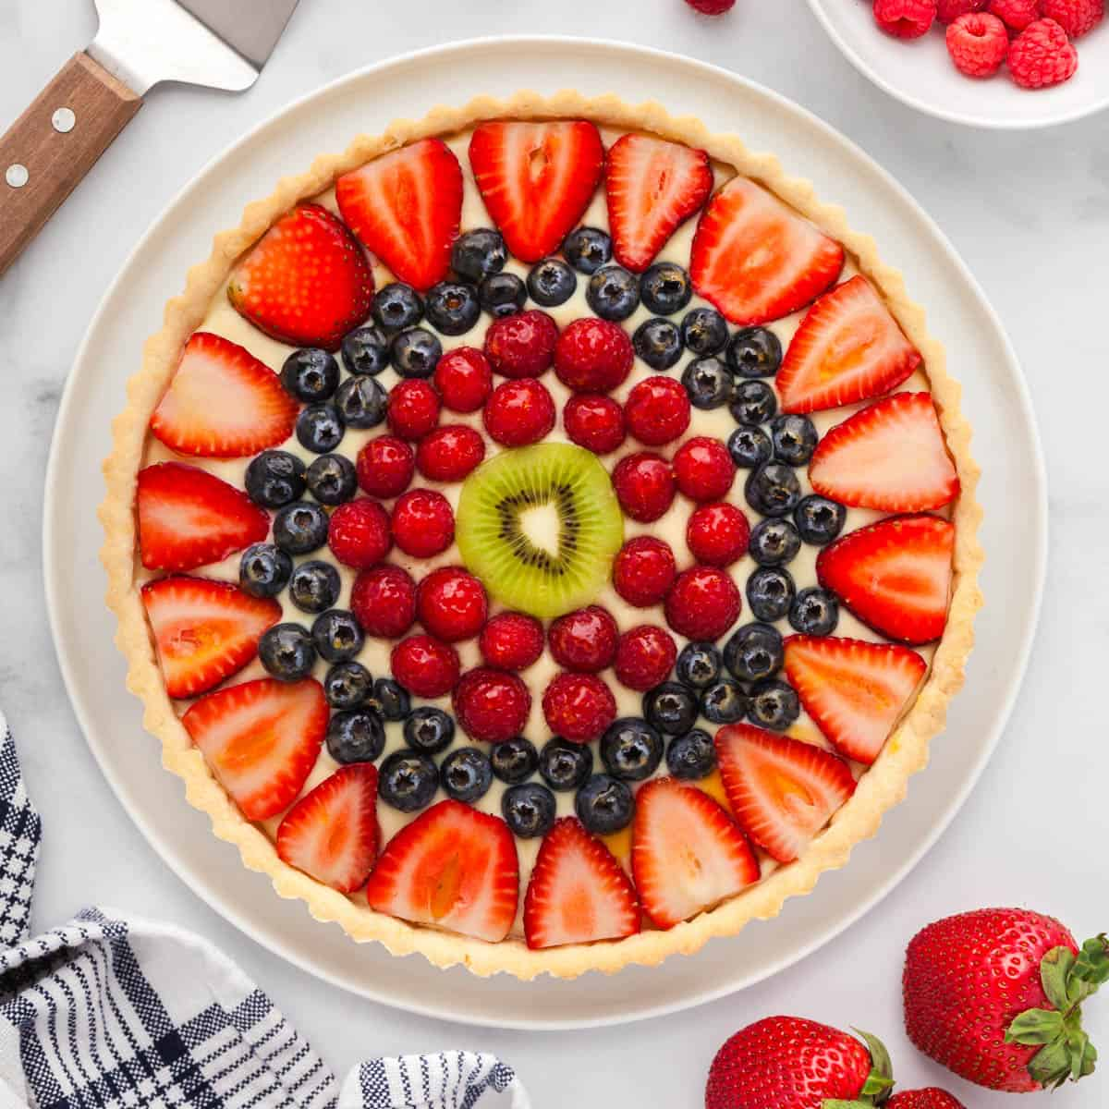
Fancy Tart Recipe
12 oz. strawberries
6 oz blueberries
4 oz of raspberries
2 oz kiwi
_______________
24 ounces total

Slide 71
Fancy Tart Recipe
12 oz. strawberries
6 oz blueberries
4 oz of raspberries
2 oz kiwi
_______________
24 ounces total
Strawberries are 12/24 of the whole amount of fruit,
Strawberries make up 50% of the fruit by mass.

Slide 72
Fancy Tart Recipe
12 oz. strawberries
6 oz blueberries
4 oz of raspberries
2 oz kiwi
_______________
24 ounces total
Blueberries are 6/24 of the whole amount of fruit,
Blueberries make up 25% of the fruit by mass.

Slide 73
Fancy Tart Recipe
12 oz. strawberries
6 oz blueberries
4 oz of raspberries
2 oz kiwi
_______________
24 ounces total
Raspberries are 4/24 of the whole amount of fruit,
Raspberries make up 17% of the fruit by mass.

Slide 74
Fancy Tart Recipe
12 oz. strawberries
6 oz blueberries
4 oz of raspberries
2 oz kiwi
_______________
24 ounces total
Kiwi are 2/24 of the whole amount of fruit,
Kiwi make up 8% of the fruit by mass.

Slide 75
Fancy Tart Recipe
12 oz. strawberries
6 oz blueberries
4 oz of raspberries
2 oz kiwi
_______________
24 ounces total
Strawberries make up 50% of the fruit by mass.
Blueberries make up 25% of the fruit by mass.
Raspberries make up 17% of the fruit by mass.
Kiwi make up 8% of the fruit by mass.
That’s a total of 100% of the fruit (duh!)

Slide 76
39. How do we determine the percent composition by mass
of silicon and oxygen in silicon dioxide?
First, we must determine the molar mass (on the left), then…

Slide 77
39. How do we determine the percent composition by mass
of silicon and oxygen in silicon dioxide?
First, we must determine the molar mass (on the left), then…
SiO₂
Si 1 x 28 = 28 g
O 2 x 16 = 32 g
60 g/mole

Slide 78
39. How do we determine the percent composition by mass
of silicon and oxygen in silicon dioxide?
First, we must determine the molar mass (on the left), then…
SiO₂ % comp by mass
Si 1 x 28 = 28 g Si 28/60 x 100% = 47%
O 2 x 16 = 32 g O 32/60 x 100% = 53%
60 g/mole 100%
Check!

Slide 79
What does this mean???
40. Silicon Dioxide (SiO₂) is 47% silicon by mass
and is 53% oxygen by mass.
So, if you had 100 grams of SiO₂ in your hand, you’d have 47 grams of silicon and 53 grams of oxygen in total.

Slide 80
41. What’s the percent composition by mass
of calcium and chlorine in calcium chloride?
First do the molar mass on the left, then the % comp by mass on the right.

Slide 81
41. What’s the percent composition by mass
of calcium and chlorine in calcium chloride?
First do the molar mass on the left, then the % comp by mass on the right.
CaCl₂
Ca 1 x 40 = 40 g
Cl 2 x 35 = 70 g
110 g/mole

Slide 82
41. What’s the percent composition by mass
of calcium and chlorine in calcium chloride?
First do the molar mass on the left, then the % comp by mass on the right.
CaCl₂ % Comp by Mass
Ca 1 x 40 = 40 g Ca 40/110 x 100% = 36%
Cl 2 x 35 = 70 g Cl 70/110 x 100% = 64%
110 g/mole 100%
Check!

Slide 83
42. What’s the percent composition by mass
for Cobalt (III) nitrate?
First, molar mass on the left side of the page…

Slide 84
42. What’s the percent composition by mass
for Cobalt (III) nitrate?
Co(NO₃)₃
Co 1 x 59 = 59 g
N 3 x 14 = 42 g
O 9 x 16 = 144 g
245 g/mole

Slide 85
42. What’s the percent composition by mass
for Cobalt (III) nitrate?
Co(NO₃)₃ % Comp by Mass
Co 1 x 59 = 59 g Co 59/245 x 100% = 24%
N 3 x 14 = 42 g N 42/245 x 100% = 17%
O 9 x 16 = 144 g O 144/245 x 100% = 59%
245 g/mole 100%
Check!

Slide 86
This means that the compound Co(NO₃)₃
by mass is proportionally:
24% cobalt, also 17% nitrogen, and 59% oxygen.
43. So, imagine that you have a hunk of this cobalt (III) nitrate, say 186 grams, in your pocket. That’s less than a half pound.
How many of those 185 grams are cobalt?
How many are nitrogen?
And how many are oxygen?

Slide 87
This means that the compound Co(NO₃)₃ by mass is proportionally:
24% cobalt, also 17% nitrogen, and 59% oxygen.
So, imagine that you have a hunk of this cobalt (III) nitrate, say 186.5 grams, in your pocket. That’s less than a half pound.
186 x 0.24 = 44.6 g is cobalt
24% = 0.24 as a decimal

Slide 88
This means that the compound Co(NO₃)₃ by mass is proportionally:
24% cobalt, also 17% nitrogen, and 59% oxygen.
So, imagine that you have a hunk of this cobalt (III) nitrate, say 186.5 grams, in your pocket. That’s less than a half pound.
186 x 0.24 = 44.6 g is cobalt
186 x 0.17 = 31.6 g is nitrogen
186 x 0.59 = 110. g is oxygen
186 g total (3 SF)
24% = 0.24 as a decimal
17% = 0.17 as a decimal
59% = 0.59 as a decimal

Slide 89
44. You blow up a balloon until its mass is 64.0 grams.
How many of those grams are just carbon? Just oxygen?

Slide 90
44. You blow up a balloon until its mass is 64.0 grams.
How many of those grams are just carbon? Just oxygen?
CO₂
C 1 x 12 = 12 g
O 2 x 16 = 32 g
44 g/mole

Slide 91
44. You blow up a balloon until its mass is 64.0 grams.
How many of those grams are just carbon? Just oxygen?
CO₂ % comp by mass
C 1 x 12 = 12 g C 12/44 x 100% = 32%
O 2 x 16 = 32 g O 32/44 x 100% = 67%
44 g/mole 100%
Now finish strong!

Slide 92
44. You blow up a balloon until its mass is 64.0 grams.
How many of those grams are just carbon? Just oxygen?
CO₂ % comp by mass
C 1 x 12 = 12 g C 12/44 x 100% = 32%
O 2 x 16 = 32 g O 32/44 x 100% = 67%
44 g/mole 100%
45. 64.0 g x .32 = 20.5 g carbon
64.0 g x .68 = 43.5 g oxygen
20.5 g + 43.5 g = 64.0 g total……..perfect!

Slide 93
46 What is the percent composition by mass of aluminum in
aluminum hydroxide monohydrate? Round answer to 3 SF

Slide 94
46 What is the percent composition by mass of aluminum in
aluminum hydroxide monohydrate? Round answer to 3 SF
Al(OH)₃•H₂O
Al 1 x 27 = 27 Al
O 3 x 16 = 48 O
H 3 x 1 = 3 H
H₂O 1 x 18 = 18 H₂O
96 g/mole

Slide 95
46 What is the percent composition by mass of aluminum in
aluminum hydroxide monohydrate? Round answer to 3 SF
Al(OH)₃•H₂O
Al 1 x 27 = 27 Al
O 3 x 16 = 48 O
H 3 x 1 = 3 H
H₂O 1 x 18 = 18 H₂O
27g
96g
X 100% = 28.1%
48g
96g
X 100% = 50.0%
3g
96g
X 100% = 3.13%
18g
96g
X 100% = 18.8%
96 g/mole

Slide 96
46 What is the percent composition by mass of aluminum in
aluminum hydroxide monohydrate? Round answer to 3 SF
Al(OH)₃•H₂O
Al 1 x 27 = 27 Al
O 3 x 16 = 48 O
H 3 x 1 = 3 H
H₂O 1 x 18 = 18 H₂O
27g
96g
X 100% = 28.1%
48g
96g
X 100% = 50.0%
3g
96g
X 100% = 3.13%
18g
96g
X 100% = 18.8%
96 g/mole
100.% 3 SF

Slide 97
OB: Percent composition by mass and mole problems combined.

Slide 98
47.
You find a box with a bar of metal that is stamped PURE GOLD.
The bar weighs 324.8 grams EXACTLY.
How many atoms of gold do you have?
Step one, convert grams to moles

Slide 99
47. How many atoms of gold are in 324.8 grams of gold?
324.8 g Au
1
x
1 mole Au
197 g Au
=
1.649 moles Au

Slide 100
47. How many atoms of gold are in 324.8 grams of gold?
324.8 g Au
1
x
1 mole Au
197 g Au
=
1.649 moles Au
1.649 moles Au
1
x
6.02 x 10²³ atoms Au
1 mole Au
=
Simplify!
(1.649 x 6.02) x 10²³ atoms Au = 9.927 x 10²³ = atoms Au

Slide 101
48. If you have 64.35 g of sodium hydroxide,
how many grams of those are oxygen?
Step one, molar mass of this compound

Slide 102
48. If you have 64.35 g of sodium hydroxide,
how many grams of those are oxygen?
NaOH
Na 1x23= 23
O 1x16= 16
H 1x1 = 1
40g/mole
Next step: percent comp by mass of all three parts of this compound

Slide 103
48. If you have 64.35 g of sodium hydroxide,
how many grams of those are oxygen?
NaOH % Comp by Mass
Na 1x23= 23 Na
O 1x16= 16 O
H 1x1 = 1 H
40g/mole
23g
40g
X 100% = 57.5%
16g
40g
X 100% = 40%
1g
40g
X 100% = 2.5%

Slide 104
48. If you have 64.35 g of sodium hydroxide,
how many grams of those are oxygen?
NaOH % Comp by Mass
Na 1x23= 23 Na
O 1x16= 16 O
H 1x1 = 1 H
40g/mole
23g
40g
X 100% = 57.5%
16g
40g
X 100% = 40%
1g
40g
X 100% = 2.5%
64.35 g x .40 = 25.74 grams oxygen
4 SF

Slide 105
Assume
STP
49. Calculate the mass of the
helium in the balloon.
346 L
Helium
Gas

Slide 106
Assume
STP
49. Calculate the mass of the
helium in the balloon.
346 L
Helium
Gas
346 L He
1
1 mole He
22.4 L He
= 15.4 moles
He
x

Slide 107
Assume
STP
49. Calculate the mass of the
helium in the balloon.
346 L
Helium
Gas
346 L He
1
1 mole He
22.4 L He
= 15.4 moles
He
x
15.4 moles He
1
4 g He
1 mole He
= 61.6 g He
x

Slide 108
Empirical Formulas are stupid.
They are not “real” chemistry, they are
mathematical ratios of atoms that look like a formula.
They are written this way to confuse you.
The State of New York does not want you to get a 100% on the Regents Exam; don’t get mad, just learn this simple technique, and roll with it.

Slide 109
For example…
Octane’s formula is C₈H₁₈
which has an 8:18 ratio
John Dalton said “simple, whole number ratios” for compounds,
He didn’t know that many
organic molecules break that rule.
C₈H₁₈ ratio can be mathematically reduced to 4:9

Slide 110
51
The molecular or chemical formula for octane is… | C₈H₁₈
The empirical formula for octane is… | C₄H₉

Slide 111
EMPIRICAL FORMULAS
are math, they are not real chemistry.
Most empirical formulas are not real compounds.
If an empirical formula happens to be a compound,
it’s not the one you started with.
52. C₄H₉ can not exist as a compound

Slide 112
53. CHEMICAL (or molecular) FORMULA | Ratio → reduced ratio | EMPIRICAL FORMULA
C₆H₁₄ (hexane) | 6:14 → 3:7 | C₃H₇
C₆H₁₂H₆ (glucose)
C₂₄H₄₈ (candle wax)
C₂H₂ (acetylene gas)
H₂O₂ (hydrogen peroxide)
C₆H₆ (cyclohexene)
C₁₀H₂₂ (decane)
C₅H₁₀ (pentene)
C₅H₁₀O₅ (pentose)
You fill
these
boxes in
We’ll check
them
in a
few
minutes.

Slide 113
53. CHEMICAL (or molecular) FORMULA | Ratio → reduced ratio | EMPIRICAL FORMULA
C₆H₁₄ (hexane) | 6:14 → 3:7 | C₃H₇
C₆H₁₂H₆ (glucose) | 6:12:6 → 1:2:1 | CH₂O
C₂₄H₄₈ (candle wax) | 24:48 → 1:2 | CH₂
C₂H₂ (acetylene gas) | 2:2 → 1:1 | CH
H₂O₂ (hydrogen peroxide) | 2:2 → 1:1 | HO
C₆H₆ (cyclohexene) | 6:6 → 1:1 | CH
C₁₀H₂₂ (decane) | 10:22 → 5:11 | C₅H₁₁
C₅H₁₀ (pentene) | 5:10 → 1:2 | CH₂
C₅H₁₀O₅ (pentose) | 5:10:5 → 1:2:1 | CH₂O

Slide 114
The true stupidity of Empirical Formulas comes next.
These things might matter somewhere, but in
high school, they’re just dumb.

Slide 115
In compounds like these, the ratios are
already completely reduced.
They can’t be reduced any more.
Compound | Formula | Empirical formula
Water | H₂O
Methane | CH₄
Carbon dioxide | CO₂

Slide 116
In compounds like these, the ratios are
already completely reduced.
They can’t be reduced any more.
Compound | Formula | Empirical formula
Water | H₂O | H₂O
Methane | CH₄ | CH₄
Carbon dioxide | CO₂ | CO₂

Slide 117
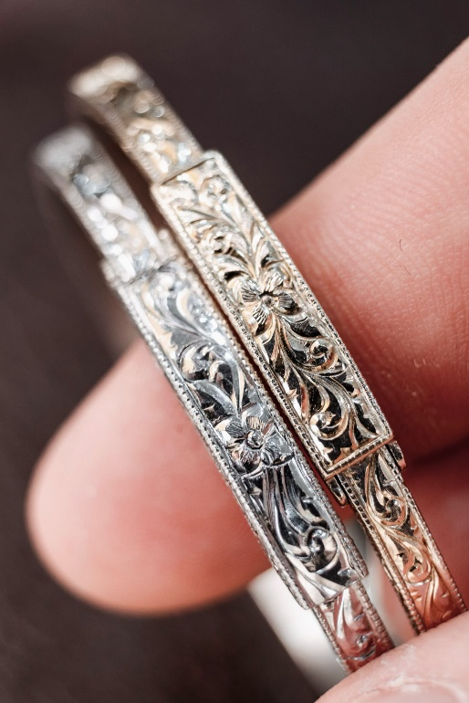
54. If you find 8.251 moles of platinum, which is selling for
$32.67*/gram. Are you rich or just happy?

Slide 118
54. If you find 8.251 moles of platinum, which is selling for
$32.67*/gram. Are you rich or just happy?
8.251 moles Pt
1
195 g Pt
1 mole Pt
x
= 1609 grams Pt

Slide 119
54. If you find 8.251 moles of platinum, which is selling for
$32.67*/gram. Are you rich or just happy?
8.251 moles Pt
1
195 g Pt
1 mole Pt
x
= 1609 grams Pt
1609 g Pt
1
x
$32.67
1 g Pt
= $52,566 !! wow

Slide 120
54. If you find 8.251 moles of platinum, which is selling for
$32.67*/gram. Are you rich or just happy?

Slide 121
54. If you find 8.251 moles of platinum, which is selling for
$32.67*/gram. Are you rich or just happy?
8.251 moles Pt
1
195 g Pt
1 mole Pt
x
= 1609 grams Pt

Slide 122
REVIEW: mole problems and percent composition by mass problems.
Get a calculator and reference table, mole island maps will help.
In 35 minutes you will own mole problems, molar mass, and percent comp by mass, or else you will come in to see me for extra help. There is no in between on this. Own it today.

Slide 123
55. Convert 4.87 x 10²⁴ formula units of
sodium chloride to grams. Get your map

Slide 124
55. Convert 4.87 x 10²⁴ formula units of
sodium chloride to grams. Get your map
4.87 x 10²⁴ FU NaCl
1
1 mole NaCl
6.02 x 10²³ FU NaCl
x
=

Slide 125
55. Convert 4.87 x 10²⁴ formula units of
sodium chloride to grams. Get your map
4.87 x 10²⁴ FU NaCl
1
1 mole NaCl
6.02 x 10²³ FU NaCl
x
=
4.87
6.02
10²⁴
10²³
x
= 0.809 x 10¹ = 8.09 moles NaCl

Slide 126
55. Convert 4.87 x 10²⁴ formula units of
sodium chloride to grams. Get your map
4.87 x 10²⁴ FU NaCl
1
1 mole NaCl
6.02 x 10²³ FU NaCl
x
=
4.87
6.02
10²⁴
10²³
x
= 0.809 x 10¹ = 8.09 moles NaCl
8.09 moles NaCl
1
58 g NaCl
1 mole NaCl
= 469 grams NaCl
x

Slide 127
56. You have 125 g of CO_{2(G)} at STP.
What’s the volume of the ballon in liters?

Slide 128
56. You have 125 g of CO_{2(G)} at STP.
What’s the volume of the ballon in liters?
125 g CO₂
1
1 mole CO₂
44 g CO₂
x
= 2.84 moles CO₂

Slide 129
56. You have 125 g of CO_{2(G)} at STP.
What’s the volume of the ballon in liters?
125 g CO₂
1
1 mole CO₂
44 g CO₂
x
= 2.84 moles CO₂
2.84 moles CO₂
1
22.4 L CO₂
1 mole CO₂
x
= 63.6 Liters CO₂

Slide 130
57. If you happen to have 325 g
of titanium (II) sulfate,
how many FU’s are present?
We’ll need this
TiSO₄
Ti 1 x 48 = 48 g
S 1 x 32 = 32 g
O 4 x 16 = 64 g
144 g/mole

Slide 131
57. If you happen to have 325 g
of titanium (II) sulfate,
how many FU’s are present?
325 g TiSO₄
1
1 mole TiSO₄
144 g TiSO₄
x
= 2.26 moles TiSO₄

Slide 132
57. If you happen to have 325 g
of titanium (II) sulfate,
how many FU’s are present?
325 g TiSO₄
1
1 mole TiSO₄
144 g TiSO₄
x
= 2.26 moles TiSO₄
2.26 moles TiSO₄
1
6.02 x 10²³ FU TiSO₄
1 mole TiSO₄
x
=

Slide 133
57. If you happen to have 325 g
of titanium (II) sulfate,
how many FU’s are present?
325 g TiSO₄
1
1 mole TiSO₄
144 g TiSO₄
x
= 2.26 moles TiSO₄
2.26 moles TiSO₄
1
6.02 x 10²³ FU TiSO₄
1 mole TiSO₄
x
=
(2.26 x 6.02) x 10²³ = 13.6 x 10²³ = 1.36 x 10²⁴ FU’s TiSO₄

Slide 134
58. You have 67.2 g of water, how many
of those grams are just hydrogen? Just oxygen?
(Round the percentages to whole numbers)

Slide 135
58. You have 67.2 g of water, how many
of those grams are just hydrogen? Just oxygen?
(Round the percentages to whole numbers)
H₂O % Comp by Mass
H 2 x 1 = 2 H
O 1 x 16 = 16 O
18 g/mole
2g
18g
X 100 % = 11%
16g
18g
X 100 % = 89%
67.2 g x .11 = 7.39 grams are hydrogen
67.2 g x .89 = 59.8 grams are oxygen
7.39 + 59.8 = 67.2 grams in total (3 SF)

Slide 136
59. What is the percent comp by mass of nickel in the
compound nickel (II) carbonate? How many grams
of nickel are present in 235. g of NiCO₃?

Slide 137
59. What is the percent comp by mass of nickel in the
compound nickel (II) carbonate? How many grams
of nickel are present in 235. g of NiCO₃?
NiCO₃
Ni 1x59= 59
C 1x12= 12
O 3x16= 48
119 g/mole

Slide 138
59. What is the percent comp by mass of nickel in the
compound nickel (II) carbonate? How many grams
of nickel are present in 235. g of NiCO₃?
NiCO₃ % comp by mass
Ni 1x59= 59 Ni
C 1x12= 12 C
O 3x16= 48 O
119 g/mole
59g
119g
X 100% = 49.6%
12g
119g
X 100% = 10.1%
48g
119g
X 100% = 40.3%
100%
235 g X 0.496 = 117 g is just nickel

Slide 139
60. What are the empirical formulas for the following compounds? example
Paraffin wax | C₂₆H₅₂ | CH₂
Ethene | C₂H₄
Decene | C₁₀H₂₀
Sucrose | C₁₂H₂₂O₁₁
Heptane | C₇H₁₆
Hydrogen monochloride | HCl
Potassium sulfite | K₂SO₃
Butane | C₄H₈
Glucose | C₆H₁₂O₆

Slide 140
60. What are the empirical formulas for the following compounds? example
Paraffin wax | C₂₆H₅₂ | CH₂
Ethene | C₂H₄ | CH₂
Decene | C₁₀H₂₀ | CH₂
Sucrose | C₁₂H₂₂O₁₁ | C₁₂H₂₂O₁₁
Heptane | C₇H₁₆ | C₇H₁₆
Hydrogen monochloride | HCl | HCl
Potassium sulfite | K₂SO₃ | K₂SO₃
Butane | C₄H₈ | CH₂
Glucose | C₆H₁₂O₆ | CH₂O

Slide 141
61. How many electrons in a Mg⁺² cation?
Many students will choose 12 e―
Mg atom has 12 e― the Mg+2 cation has 10 e―
62. How many electrons in each of these species?
Al⁺³ | Al | Co⁺³ | Co⁺²
Pb⁺² | Pb⁺⁴ | F⁻¹ | S⁻²
N⁻³ | Au⁺¹ | Au⁺³ | Cu
Cl⁻¹ | Fe | Na⁺¹ | Mn⁺⁷

Slide 142
61. How many electrons in a Mg⁺² cation?
Many students will choose 12 e―
Mg atom has 12 e― the Mg+2 cation has 10 e―
62. How many electrons in each of these species?
Al⁺³ | Al | Co⁺³ | Co⁺²
Pb⁺² | Pb⁺⁴ | F⁻¹ | S⁻²
N⁻³ | Au⁺¹ | Au⁺³ | Cu
Cl⁻¹ | Fe | Na⁺¹ | Mn⁺⁷
10 e⁻
13 e⁻
24 e⁻
25 e⁻
80 e⁻
10 e⁻
18 e⁻
78 e⁻
10 e⁻
78 e⁻
76 e⁻
29 e⁻
18 e⁻
26 e⁻
10 e⁻
18 e⁻

