Slide 1
Welcome to Nuclear Chemistry
Previously we have been focusing on how the electrons of atoms and ions do their thing. Electrons are shared, transferred, and allow for bonding.
1. Nuclear Chem is about the
NUCLEUS, not the electrons,
and nuclear chem is weird.

Slide 2
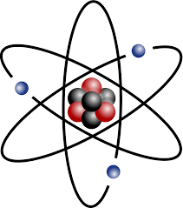
Atoms have protons and neutrons in the nucleus, the electrons fly around outside.
2. In every atom the number or protons = the number of electrons (the positives = the negatives).
3. The ATOMIC NUMBER = the number of protons.
4. Atomic MASS in high school = # protons PLUS # neutrons, measured in AMU’s.
Each proton = 1 AMU
Each neutron = 1 AMU
5. Atomic Mass = # protons PLUS # neutrons (in AMU)
Element | Atomic Mass | Molar Mass
He | 4 amu (2 p + 2 n) | 4 g/mole
Hg | 201 amu (80 p = 121 n) | 201 g/mole
Cu | 64 amu (29 p + 35 n) | 64 g/mole

Slide 3
6. Example…
Uranium (element 92) has mass = 238 (protons + neutrons)
- 92 (minus 92 protons)
126 (uranium has 126 neutrons)
Since there are 92 positive protons, there are also 92 negative electrons, all atoms, even uranium, are neutral.
You should be able to determine the number of protons, neutrons and electrons for any atom on the periodic table.

Slide 4
Every atom has a unique number of protons (& electrons too).
Take out your periodic table, put your finger in the right box!
7. If you are an atom with 12 protons: you MUST be Mg.
8. If you have 29 protons: you’re COPPER.
9. Atoms with 90 protons: can only be THORIUM.
---------------------------------
10. Every atom has a certain number of neutrons,
but there are many isotopes.
11. Isotopes are atoms of an element with a different number
of neutrons, but the SAME number of protons + electrons.

Slide 5
12. How many protons, neutrons and electrons are in the
most common isotope of radium on the Periodic table?
+2 Ra 88 -18-32-18-8-2

Slide 6
12. How many protons, neutrons and electrons are in the
most common isotope of radium on the Periodic table?
Atomic mass
226 AMU
+2 Ra 88 -18-32-18-8-2
Atomic Number is 88
that means 88 protons
(and 88 electrons too)

Slide 7
12. How many protons, neutrons and electrons are in the
most common isotope of radium on the Periodic table?
+2 Ra 88 -18-32-18-8-2
226 AMU
- 88 protons
138 neutrons
88 protons means
88 electrons too

Slide 8
14. Determine protons, neutrons and electron count for C-12

Slide 9
14. Determine protons, neutrons and electron count for C-12
Carbon-12 (p plus n) mass: 12 AMU
minus the protons: - 6 protons
6 neutrons
The ratio of neutrons to protons (6:6 or 1:1)
is stable, this isotope of carbon is not radioactive.

Slide 10
15. Determine protons, neutrons and electron count for C-14

Slide 11
15. Determine protons, neutrons and electron count for C-14
Carbon-14 (p plus n) mass: 14 AMU
minus the protons: - 6 protons
8 neutrons
The ratio of neutrons to protons
(8:6 or 1.33:1) is not stable,
this isotope of carbon is radioactive.

Slide 12
16. Determine protons, neutrons and electron count for
P-31 (stable P) and then P-32 (radioactive P)

Slide 13
16. Determine protons, neutrons and electron counts for
P-31 (stable P) and then P-32 (radioactive P)
Phosphorous-31 (p plus n) mass: 31 AMU
minus the protons: - 15 protons
16 neutrons
neutron : proton ratio is 16:15, which is stable.
Phosphorous-32 (p plus n) mass: 32 AMU
minus the protons: - 15 protons
17 neutrons
neutron : proton ratio is 17:15, which is unstable.

Slide 14
17. Of the 118 known elements, there are about 1500 known
ISOTOPES. There are 3 different isotopes of even tiny
HYDROGEN. Every atom has several or more isotopes.
18. Of these 1500 isotopes, most are stable and not
radioactive. Only about 150 of them are unstable.
19. Stable means that the neutron to proton ratio falls into
a “zone of stability”.
20. About 150 isotopes are UNSTABLE.
Their neutron to proton ratio is funky,
and they need to FIX this ratio to
become stable.

Slide 15
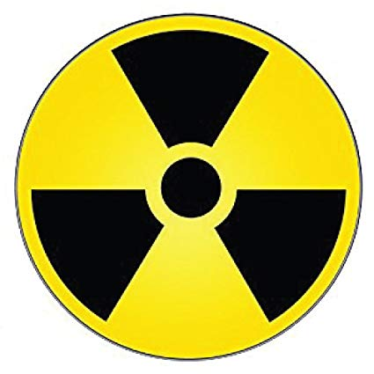
21. FIXING this neutron to proton ratio means they will
EMIT RADIATION, or parts of their nucleus.
22. Emitting radiation means emitting a variety of
nuclear particles and/or energy, which will change
the neutron to proton ratio.
The
International Symbol for Radiation
(danger)

Slide 16
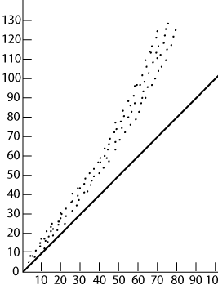
23. The neutron to proton ratio for STABLE ISOTOPES (atoms) is close to…
Smaller atoms | up to Ca | 1 n°/ proton
Medium atoms | up to Zr | 1.25 n°/ proton
Larger atoms | all the rest | 1.5 n°/ proton
All nuclei with ratios outside this band are unstable, and that’s what we will study during this unit of chem.
Band of Stable
neutron : proton ratios
#n°
1:1
line
#p⁺

Slide 17
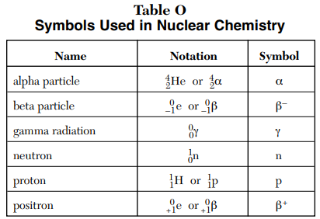
Table O Table O lists the radioactive particles.
Radioactive emission is mostly particles but can be energy as well. The radiation that we need to familiarize ourselves with is in Table O.

Slide 18
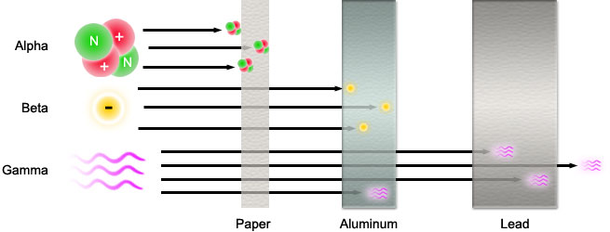
24. Can you be protected from RADIATION?
What stops different kinds of radiation?

Slide 19
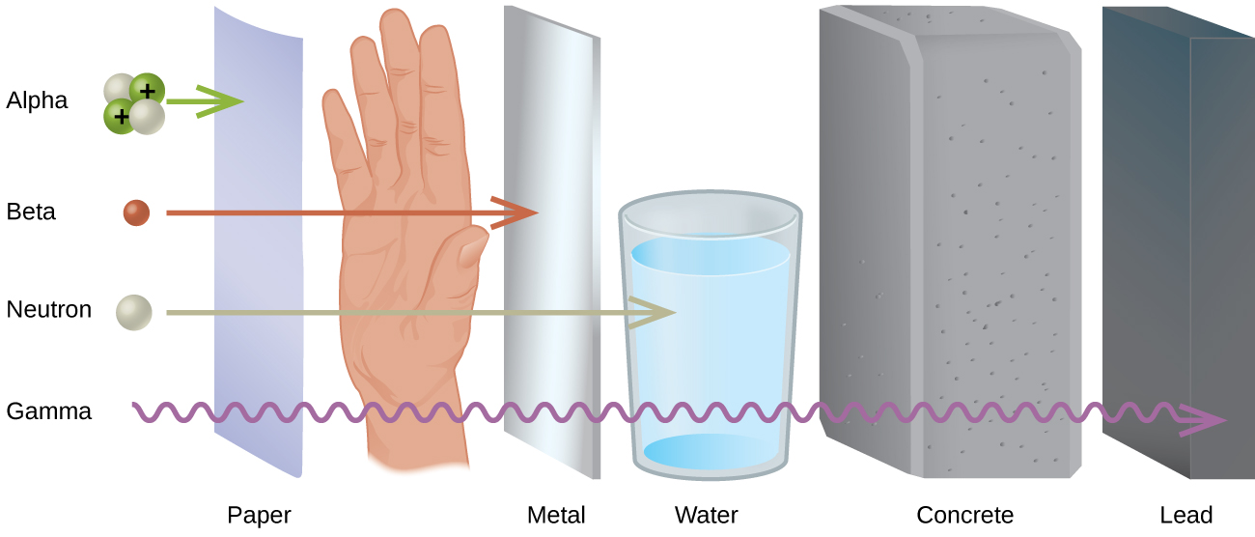
25. What can stop neutrons?
What stops gamma radiation? Nothing.

Slide 20
26. FILL IN THIS CHART about RADIOACTIVE PARTICLES and energy.
Table O | Mass | Charge | Symbols | Penetrating power
ALPHA
BETA
GAMMA
NEUTRON
PROTON
POSITRON

Slide 21






26. FILL IN THIS CHART about RADIOACTIVE PARTICLES and energy.
Table O | Mass | Charge | Symbols | Penetrating power
ALPHA | 4 AMU | +2 |  | WEAKEST
BETA | ZERO in HS | -1 |  | STRONG
GAMMA | ZERO | NEUTRAL |  | STRONGEST
NEUTRON | 1 AMU | NEUTRAL |  | MEDIUM
PROTON | 1 AMU | +1 |  | Does not apply
POSITRON | ZERO in HS | +1 |  | SIMILAR TO BETA

Slide 22
27. Radiation is emitted by unstable
isotopes to obtain a more stable
neutron to proton ratio in the nucleus.
28. Emitting different types of radiation
changes that ratio in different ways.

Slide 23
29. Some isotopes make one change, or emit
radiation once, and they become stable.
30. Some isotopes undergo multiple changes,
or transmutations before they get stable.
31. The types of emissions, and the amount of
time it takes to emit this radiation,
is very well known to scientists.

Slide 24
32 | A nucleus emits radiation to change its nucleus, to change its neutron to proton ratio. It changes into a different kind of atom. It TRANSMUTES into a new kind of atom.
33 | This process is called NATURAL TRANSMUTATION or RADIOACTIVE DECAY
34 | Nothing can speed up this process or slow it down. It happens on its own, naturally.

Slide 25
Nuclear Class 2
Natural Transmutation or
Radioactive decay,
Table N, and
HALF LIFE problems

Slide 26
Radiation, comes in 6 forms, all listed in table O.
35. Unstable radioisotope nuclei literally spit out parts of themselves, to change the ratio of neutrons to protons to get stable.
36. Doing this changes them from one kind
of an atom to another, which is called
transmutation.

Slide 27
Let’s start doing some stuff, let’s look at table N.
37. The last radioisotope is Uranium-238
atomic mass of this isotope
238 = protons plus neutrons
238 - 92 = 146 neutrons
It has 146 neutrons and 92 protons
That is a ratio of 1.58 neutrons/proton
U-238 is on Table N because that ratio is unstable
238
92
U

Slide 28
38.
238
U
238
92
U
This is really… this
Table N does not include the atomic number (number or protons)
for any of the isotopes because they like to torture high school students.
All uranium atoms have 92 protons, so you can just check your
Periodic Tables for any radioisotope they throw at you,
and you can fill in the atomic number.

Slide 29
Table N says that this stuff will undergo ALPHA decay.
That means it emits an alpha particle as radiation to adjust the neutron to proton ratio, to get stable.
Table O shows us the symbols. It’s a chemical equation but with simple math to figure everything out.
238
92
U
An alpha particle of radiation + ??
Radiation emission causes transmutation
238
92
U
4
2
+
39.
He

Slide 30
Table N says that this stuff will undergo ALPHA decay.
That means it emits an alpha particle as radiation to adjust the neutron to proton ratio, to get stable.
Table O shows us the symbols. It’s a chemical equation but with simple math to figure everything out.
238
92
U
An alpha particle of radiation + ??
Radiation emission causes transmutation
234
90
Th
238
92
U
4
2
+
39.
He

Slide 31
238
92
U
4
2
+
Th
He
234
90
40. A lot just happened. Let’s examine this.
Radioactive U-238 emits an alpha particle to get stable.
With 2 less protons, and 2 less neutrons, the uranium has
TRANSMUTED into thorium-234
The numbers on the top make sense: 238 = 4 + 234
The numbers on the bottom make sense too: 92 = 2 + 90
This is called natural transmutation, or alpha decay,
or just radioactive decay.
Weirdly, this uranium atom just became an atom of thorium.

Slide 32
41. Determine the decay mode and write the
complete decay reaction for carbon-14.
14 | C | →

Slide 33
41. Determine the decay mode and write the
complete decay reaction for carbon-14.
14 6 | C | → | 0 -1 | e + | 14 7 | N
42. C-14 emits beta radiation. It undergoes beta decay.
The carbon-14 transmutes into nitrogen-14.
(A neutron has become a proton)

Slide 34
43. Determine the decay mode and write the
complete decay reaction for Calcium-37.
37 | Ca | →

Slide 35
43. Determine the decay mode and write the
complete decay reaction for Calcium-37.
37 20 | Ca | → | 0 +1 | e + | 37 19 | K
44. Radioactive Ca-37 emits a positron from it’s
nucleus, it transmutes into K-37.
It undergoes positron decay.
This JUST HAPPENS, with no help required.

Slide 36
45. Determine the decay mode and write the
complete decay reaction for Radium-226.
226 | Ra | →

Slide 37
45. Determine the decay mode and write the
complete decay reaction for Radium-226.
226 88 | Ra | → | 4 2 | He + | 222 86 | Rn
46. Radioactive Ra-226 emits an alpha particle,
which (changes it) transmutes it into Radon-222.
Radium-226 undergoes alpha decay.
This is natural transmutation, it JUST HAPPENS all by itself.

Slide 38
47. Determine the decay mode and write the
complete decay reaction for Cs-137.
137 | Cs | →

Slide 39
47. Determine the decay mode and write the
complete decay reaction for Cs-137.
137 55 | Cs | → | 0 -1 | e + | 137 56 | Ba
48. Cesium-137 emits a beta particle, it transmutes
into Barium-137. Cs-137 undergoes beta decay.

Slide 40
49. Determine the decay mode and write the
complete decay reaction for Iron-53.
53 | Fe | →

Slide 41
49. Determine the decay mode and write the
complete decay reaction for Iron-53.
53 26 | Fe | → | 0 +1 | e + | 53 25 | Mn
50. Fe-53 transmutes into manganese-53
by undergoing positron decay

Slide 42
49. Determine the decay mode and write the
complete decay reaction for gold-198.
198 | Au | →

Slide 43
51. Determine the decay mode and write the
complete decay reaction for gold-198.
198 79 | Au | → | 0 -1 | e + | 198 80 | Hg
52. Radioactive gold-198 transmutes into
mercury-198 by emitting a beta particle…
when it undergoes radioactive decay.

Slide 44
53. Determine the decay mode and write the
complete decay reaction for Neon-19.
19 | Ne | →

Slide 45
53. Determine the decay mode and write the
complete decay reaction for Neon-19.
19 10 | Ne | → | 0 +1 | e + | 19 9 | F
54. Unstable neon-19 transmutes into fluorine-19
after it emits a positron particle… to change the
neutron - proton ratio of its nucleus.

Slide 46
55. Determine the decay mode and write the
complete decay reaction for Fr-220.
220 | Fr | →

Slide 47
55. Determine the decay mode and write the
complete decay reaction for Fr-220.
220 87 | Fr | → | 4 2 | He + | 216 85 | At
56. Francium-220 undergoes alpha decay,
it transmutes into astatine-216.

Slide 48

Beta Decay. A beta particle is essentially an electron, but it comes from inside the nucleus. Somehow, a neutron emits the negative charge without mass, it turns itself into a proton!
57. A neutron emits a negative charge of “no mass”,
(beta particle) and… a neutron becomes a proton.
DRAW THESE CIRCLES
Beta⁻¹
The positive and the negative SUM to neutral.
neutronº
1 amu
proton⁺¹
1 amu

Slide 49
A positron particle is essentially an electron with a positive charge,
it comes from inside the nucleus. Somehow, a proton emits the positive charge without mass, it turns itself into a neutron!
58. A proton emits a positive charge of “no mass”,
(positron particle)... a proton becomes a neutron
DRAW THESE CIRCLES
The positive and the neutral SUM to positive.
Positron
+1
Positron
+1
proton⁺¹
1 amu
proton⁺¹
neutronº
1 amu

Slide 50
59. A half life is the amount of time
it takes for one half of a given
radioisotope to transmute.

Slide 51
How long is the half life of each isotope? (table N)
J | Nuclide | Half Life | Units mean
69 | Au-198
61 | C-14
62 | Ca-37
63 | U-238
64 | Pu-239

Slide 52
How long is the half life of each isotope? (table N)
J | Nuclide | Half Life | Units mean
69 | Au-198 | 2.695 d | Days
61 | C-14 | 5715 y | Years
62 | Ca-37 | 182 ms | Milli-seconds
63 | U-238 | 4.47 x 10⁹ y | Years (4,470,000,000)
64 | Pu-239 | 2.410 x 10⁴ y | Years (24,200)

Slide 53
65. The half life of radioactive gold-198 is 2.695 days.
That means…
100 g
Au-198
start

Slide 54
After one ⅟₂ life, half of the gold transmuted (into Hg-198).
50 g
Au-198 & 50 g
Hg-198
100 g
Au-198
start
After 1 HL
2.695 days
Only ½ of the gold is left

Slide 55
After 4-half-lives, only half of a half of a half of a half (⅟₁₆ )
is left over. The math is EASY in high school chem.
50 g
Au-198 & 50 g
Hg-198
25 g
Au-198 & 75 g
Hg-198
12.5 g
Au-198 & 87.5 g
Hg-198
6.25 g
Au-198 & 93.75 g
Hg-198
100 g
Au-198
start
After 1 HL
2.695 days
After 2 HL
5.390 days
After 3 HL
8.085 days
After 4 HL
10.78 days
100%
50%
Or
¹/₂
unchanged
25%
Or
¹/₄
unchanged
12.5%
Or
¹/₈
unchanged
6.25%
Or
¹/₁₆
unchanged

Slide 56
In half-life problems
Always make the T-chart.
You can solve for the % transmuted, or % left untransmuted
You can solve for grams transmuted or grams unchanged
You can solve for fraction transmuted or fraction unchanged
You could solve for how long (seconds to years) that’s passed
You could solve for how long until something happens
It’s all math, it’s in the T-chart

Slide 57
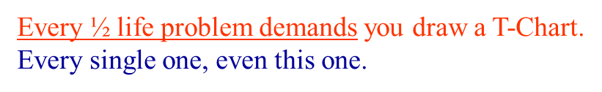
66. You accumulate 22.0 grams of the radioisotope carbon-14
How long before only 2.75 grams of the C-14 remains
unchanged?

Slide 58
66. You accumulate 22.0 grams of the radioisotope carbon-14
How long before only 2.75 grams of the C-14 remains
unchanged?
22.0 g
NOW

Slide 59
66. You accumulate 22.0 grams of the radioisotope carbon-14
How long before only 2.75 grams of the C-14 remains
unchanged?
22.0 g
11.0 g
5.50 g
2.75 g
NOW
1 half life
3 half lives
2 half lives
One half-life of this C-14 is 5715 years
5715 years X 3 = 17,145 years
This will take 17,145 years.

Slide 60
67. The doctor injects you with 2.00 g radioactive I-131 to measure your
thyroid uptake. How long until you have just 0.125 g left in you?
(that is an enormous dose, but we are doing math problems)
2.00 g
START

Slide 61
67. The doctor injects you with 2.00 g radioactive I-131 to measure your
thyroid uptake. How long until you have just 0.125 g left in you?
(that is an enormous dose, but we are doing math problems)
2.00 g
1.00 g
0.500 g
0.250 g
0.125 g
START
1
2
3
4
It takes 4 half lives for this 2.00 g radioactive iodine to transmute away so that only 0.125 g remains. Each half life is 8.07 days, so…
4 X 8.021 days = about 32.084 days,
about 1 month.

Slide 62
68. You put 400.0 g of Fe-53 in your pocket.
How long until you have 12.5 grams of this iron left?
What has the other 387.5 grams become?
400.0 g
NOW

Slide 63
68. You put 400.0 g of Fe-53 in your pocket.
How long until you have 12.5 grams of this iron left?
What has the other 387.5 grams become?
400.0 g
400.0 g
200.0 g
100.0 g
50.0 g
25.0 g
12.5 g
NOW
1 2 3 4 5
5 HL X 8.51 minutes =
This is called positron decay.
53
26
Fe
0
+1
53
25
Mn
e
+

Slide 64
69. If a scientist purifies 1.0 gram of radium-226, how many
years must pass before only 0.50 gram of the original
radium-226 sample remains unchanged?

Slide 65
69. If a scientist purifies 1.0 gram of radium-226, how many
years must pass before only 0.50 gram of the original
radium-226 sample remains unchanged?
Only one half-life must pass to transmute 1.0 grams into 0.5 grams,
LOOK at table N:
Ra-226 has a half-life of 1599 years.

Slide 66
70. Based on Reference Table N, what fraction of a
radioactive Sr-90 sample would remain unchanged
after 58.2 years?
A. ½ B. ¼ C. 1/8 D. 1/16

Slide 67
70. Based on Reference Table N, what fraction of a
radioactive Sr-90 sample would remain unchanged
after 58.2 years?
A. ½ B. ¼ C. 1/8 D. 1/16
Whole Half Quarter
¹/₁ ¹/₂ ¹/₄
START 29.1yr 58.2 years

Slide 68
71. What is the half-life & decay mode of Rn-222?
A. 1.910 days and alpha decay
B. 1.910 days and beta decay
C. 3.823days and alpha decay
D. 3.823 days and beta decay

Slide 69
71. What is the half-life & decay mode of Rn-222?
A. 1.910 days and alpha decay
B. 1.910 days and beta decay
C. 3.823days and alpha decay
D. 3.823 days and beta decay
LOOK at table N:
3.823 days, Alpha Radiation emitted, choice C

Slide 70
72. What is the half-life of sodium-25 if 1.00 gram of a 16.00-gram
sample of sodium-25 remains unchanged after 237 seconds?
A. 47.4 s B. 59.3 s C. 79.0 s D. 118 s

Slide 71
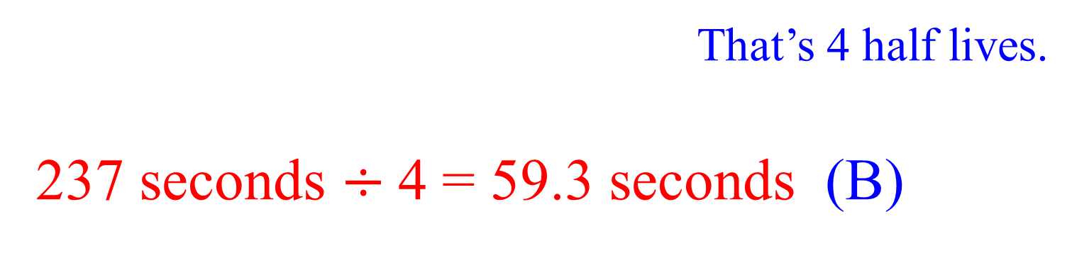
72. What is the half-life of sodium-25 if 1.00 gram of a 16.00-gram
sample of sodium-25 remains unchanged after 237 seconds?
A. 47.4 s B. 59.3 s C. 79.0 s D. 118 s
16 g
8 g
4 g
2 g
1 g
START
1
2
3
4
That’s 4 half lives.
237 seconds $÷$4 = 59.3 seconds (B)

Slide 72
Nuclear chem class #3
Artificial Transmutations
What is FISSION?
What is FUSION?
How does the Sun work?
How do nuclear power plants make energy?
How do Nuclear Bombs Work?

Slide 73
These three are all decay reactions… all are natural transmutations.
73.
233
92
U
4
2
He
+
231
90
Th
The U-238 undergoes alpha decay, transmuting into thorium-231.
3
1
H
0
-1
e
+
3
2
He
74.
The H-3 undergoes beta decay, transmuting into helium-3.
75.
37
19
K
0
+1
e
+
37
18
Ar
The K-37 undergoes positron decay, transmuting Argon-37.

Slide 74
76. Artificial transmutation is caused by humans.
It is done by scientists; it cannot occur on its own. With sufficient radioactive material it can release massive amounts of energy inside a nuclear reactor
or a nuclear bomb. Small reactions are less powerful
The first artificial transmutation reactions were carried out by some of the “regular” characters in our class. In 1919 Ernest (“Gold Foil”) Rutherford “bombs” some nitrogen atoms with alpha particles.

Slide 75
77. Ernest Rutherford (my hero) artificially transmutes
nitrogen into oxygen! Nitrogen is bombarded with
alpha particles… (also used in his Gold Foil experiment)
14 7 | N | + | 4 2 | He → | 17 8 | O + | 1 1 | p
N-14 artificially transmutes into O-17 & a proton
The thing to see here is that the Radioisotope IS NOT ALONE in the front of the arrow. It doesn’t JUST HAPPEN; the N-14 had to zapped with an alpha particle. Stuff like this can’t just happen, it’s artificial!

Slide 76
78. Beryllium is artificially transmuted with alpha particles
by James Chadwick in 1932 (discovered the neutron!)
9 4 | Be | + | 4 2 | He → | 12 6 | C + | 1 0 | n
Be-9 artificially transmutes into C-12 & a neutron
Count the “TOP numbers”, 9 = 4 = 12 = 1
Count the “BOTTOM numbers”, 4 + 2 = 6 + 0
That always works in nuclear chemistry.

Slide 77
79. In1934 Marie Curie artificially transmutes aluminum into
radioactive phosphorous (1st artificially created radioisotope)
27 13 | Al | + | 4 2 | He → | 30 15 | P + | 1 0 | n
The P-30 formed will undergo
natural transmutation into silicon-30
Count the “TOP numbers” and the “BOTTOM numbers”

Slide 78
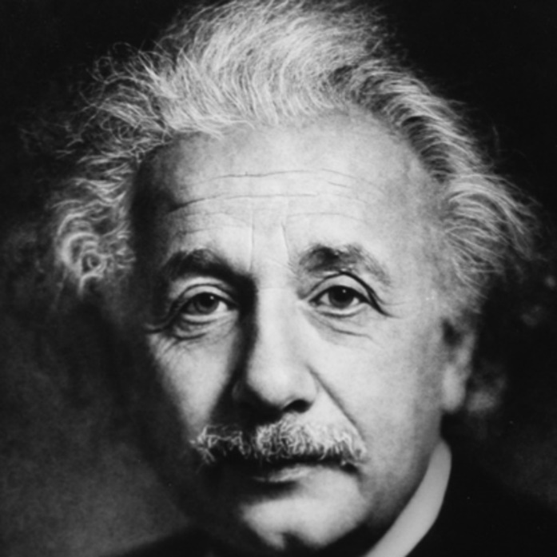
These examples of artificial transmutation release little energy. Some artificial transmutations are nuclear bombs, or reactions that power a nuclear power plant. They release LOTS of energy.
According to Albert Einstein, energy and matter are the same thing, just in different forms. His famous equation,
E = mc²
Which means energy equals mass times
the speed of light, squared.
80.
Copy that.

Slide 79
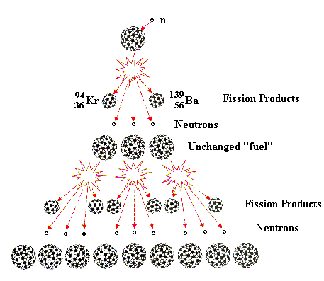
81. A chain reaction starts out and then increases in size through every cycle, until at
some point so much energy is released, a giant amount of energy is released.
Here, U-235 is artificially transmuted into U-236 by neutron bombardment.
The U-236 instantly splits into Kr + Ba + 3 more n° + energy.
82. In the next cycle, this happens three times, releasing triple energy and 9 (3x3) neutrons.
In the third cycle it increases again, nine U-236 split, releasing more energy than before and 27 neutrons.
83. Each cycle releases more
and more energy and neutrons.

Slide 80
84. The splitting of atoms by artificial
transmutation is called
FISSION.
85. Einstein proposed E = mc²
and he proved that energy = mass
(times a really big number).
In Fission, some mass is converted
into energy.
The Law of Conservation of Mass
does not apply in nuclear chemistry!

Slide 81
86. This missing mass from a
nuclear reaction is called the
MASS DEFECT,
The mass is no longer present,
but it is accounted for by E = mc²
It gets converted into energy

Slide 82
87. There are MANY different fission reactions. Below are
2 different artificial transmutations that SPLIT the ATOM.
Check that the TOP and BOTTOM numbers work.
235 92 | U + | 1 0 | n → | 140 56 | Ba + | 93 36 | Kr + | 3 | 1 0 | n + energy
235 + 1 = 140 + 93 +3 236 = 236 J
235 92 | U + | 1 0 | n → | 144 54 | Xe + | 90 38 | Sr + | 2 | 1 0 | n + energy
235 + 1 = 144 + 90 +2 236 = 236 J

Slide 83
88. The daughter nuclei that form are usually
radioactive as well. They will undergo
natural transmutation. By chance all 4 of
these fission products undergo beta decay.
140 56 | Ba | → | 0 -1 | e + | 140 57 | La
85 36 | Kr | → | 0 -1 | e + | 93 37 | Rb
144 54 | Xe | → | 0 -1 | e + | 144 55 | Cs
90 38 | Sr | → | 0 -1 | e + | 90 39 | Y

Slide 84
89. In a nuclear bomb, the chain reaction is designed to release an “out of control” amount of energy, causing a giant explosion in seconds.
The same reaction, controlled inside of a nuclear power plant, releases the same amount of energy over a much longer time, usually many months.

Slide 85
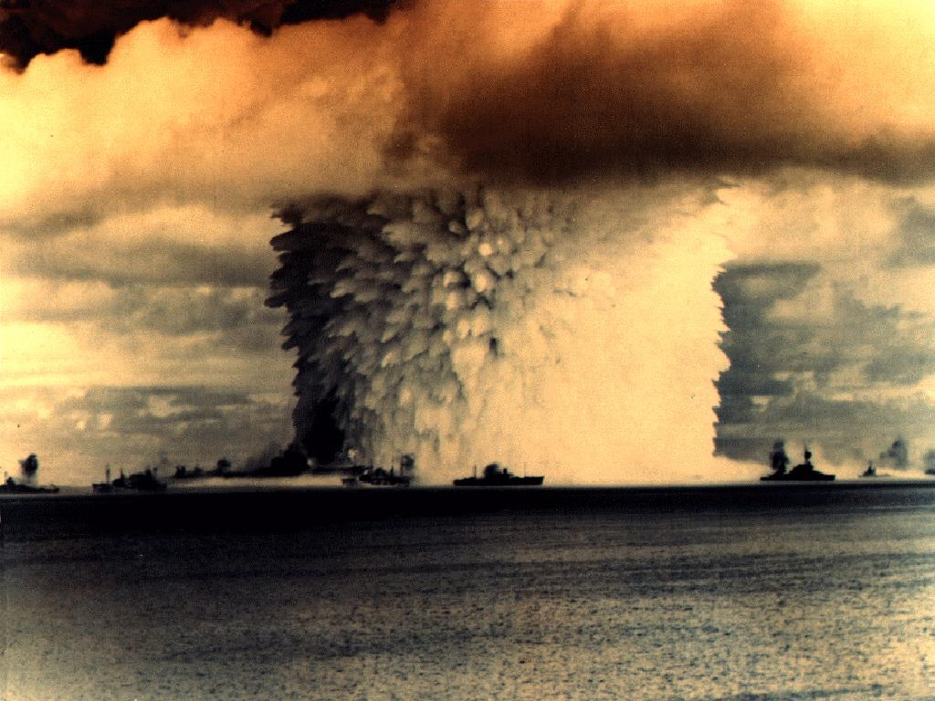
This photo is of a nuclear bomb test in the Pacific Ocean, probably in the mid-1940’s. This is a small bomb compared to what is available now.
Those are giant sized ships from a navy, watching a nuclear test explosion from a “safe” distance.

Slide 86
90. Another type of artificial transmutation reaction is
FUSION
91. It’s the squishing together of smaller atoms
and making larger ones.
There is a loss of mass during (mass defect)
in fusion reactions.
Fusion is much more powerful than fission.

Slide 87
92. The Sun is powered by fusion.
The fusion reaction on the Sun is a different fusion reaction than scientists can make happen.
We can’t get temperature and pressure high enough to squish normal hydrogen atoms into helium atoms.
There are many different types of fusion reactions.

Slide 88
93. The Sun squashes 4 hydrogen atoms into helium this way:
4 H
1
1
4
2
He + 2 e + energy!!!!
0
-1

Slide 89
94. Scientists cannot make atoms of H-1 fuse together;
it takes TOO MUCH heat and pressure
95. Scientists can bond 2 isotopes of hydrogen atoms
into helium like this…
Both types of FUSION release gigantic amounts of energy.
2 | H | + | 3 | H → | 4 2 | He + | 1 0 | n + energy

Slide 90
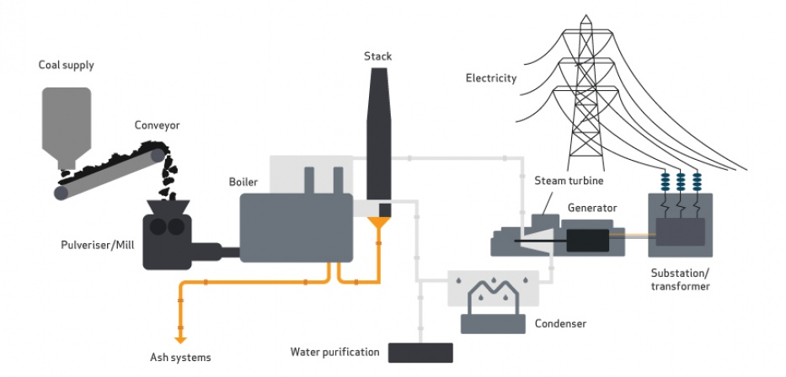
How does a nuclear power plant make electricity?
96. Heat produced by burning turns water into steam.
Steam is shot at the turbine blades, which spin like crazy.
The spinning rotates magnets in the generator
around copper wire; this creates electricity.

Slide 91
How does a nuclear power plant work?
It’s simple (not really).
97. The nuclear fission reaction creates heat,
which makes water turn into steam, to turn turbine blades, to spin the generator, to make electricity.
Somewhat the same way as the coal plant does, but without making any greenhouse gases, or acid rain, or ash (not too shabby).

Slide 92
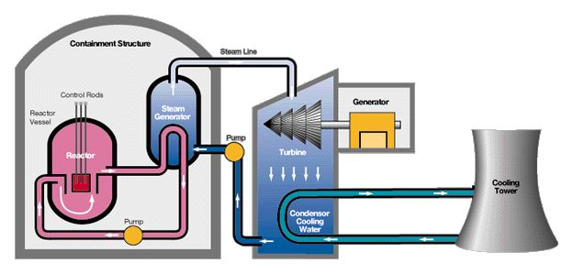
There is the “inside” the containment dome part.
And the outside the containment dome part. Don’t mix these up.

Slide 93
The containment dome is (hopefully) strong enough to keep the radiation in, and everything else out.
Inside the reactor vessel is where the fission reaction happens. Uranium 235 is bombed with neutrons and the chain reaction starts.

Slide 94
This reaction should start a nuclear explosion, a chain reaction leads quickly to a massive energy release because of the small but measurable mass defect. Because of E=mc², this mass loss should cause a huge explosion, but it doesn’t.
Inside the vessel are control rods, that control the reaction. They are able to be pushed in or out of the reactor. They absorb neutrons, which slows down or moderates the reaction. It keeps it hot, but not too hot. Often they are cadmium or silver or indium metals.

Slide 95
The water in the pink pipes gets super heated, and the heat transfers to the water in the blue steam generator.
The steam it makes is pumped to the turbines which spin and make a current.

Slide 96
Hopefully this water in red stays in the pipes and never escapes. It’s touching the nuclear material and gets rather radioactive itself. All the radiation is supposed to stay inside the containment dome.
The water in the turbine area cools down from steam back into water, to be reheated into steam again by more heat from the reactor. This water should stay un-radioactive if all goes well.

Slide 97
STEAM
Cool water, from the really big lake, or from an ocean comes in here to help cool the water down. This water absorbs the excess heat from the turbine steam so it can be recycled.
The environmental water is heated and then run through the cooling tower to disperse the heat as steam to the air. Lots more heat is pumped back to the ocean/lake nearby.

Slide 98
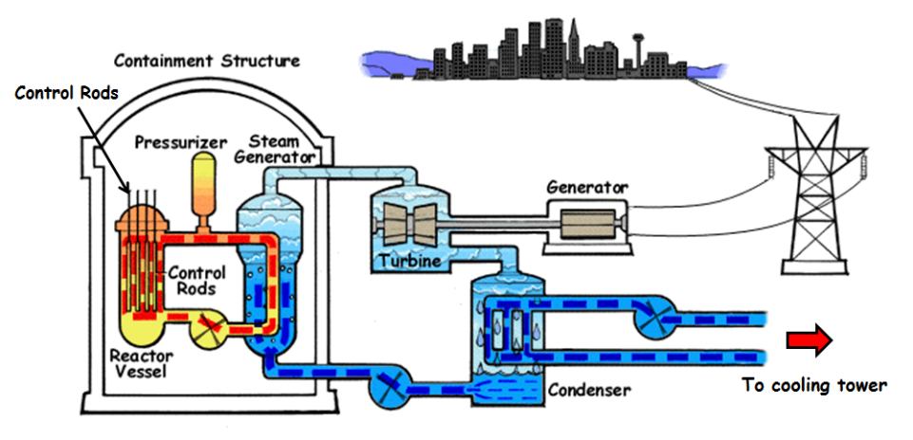

Slide 99
98. Nuclear Power Plants
A fission reaction is started in the reactor core. It’s controlled with cadmium rods that can absorb excess neutrons. Once the reaction starts, the cadmium “eats” neutrons, so that the reaction goes, but doesn’t really expand (like a bomb does).
Lots of heat is created, steam reaches 450°C. The water that touches this material is highly radioactive and remains sealed in the “inner” water loop. The steam pulls heat from the core.
The steam transfers it’s heat to a middle loop of water, making that boil as well, although not quite as hot. That steam spins the turbine blades. Once past the blades, this steam is condensed back to water, so it can absorb maximum heat when it approaches that inner water pipe.
The blades spin the magnets in the generator, which induces an electric current.
Water from outside (ocean or large lake) cools the middle loop steam back to water before it picks up heat from the inner core steam. This cooling loop produces the only constant “waste”, which is hot water, which is real pollution, but is not a terrible problem.
The radioactive waste is a terrible problem. It’s radioactive, for 20,000 or more years, so it must be put out of our environment, and guarded from terrorists forever. If it gets into the environment, it can kill or cause cancer.
The spent fuel is cooled for several years, then put into long term concrete storage on site at nuclear power plants.

Slide 100

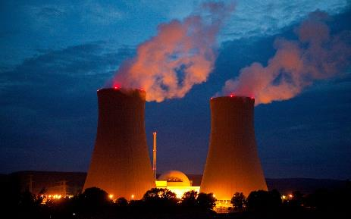
99. Nuclear Energy Pros:
Does not emit large amounts of CO₂ or other greenhouse gases
A consistent and reliable energy source
Allows countries to become energy independent
Low operating costs once setup
100. Nuclear Energy Cons:
Environmental impact of radioactive waste
Requires mining & refining uranium & transporting it to plant
Radioactive waste disposal
Potential for deadly and costly nuclear disasters
High initial cost to develop a nuclear plant
Limited by the availability of uranium
Can be a precursor to nuclear weapons

Slide 101
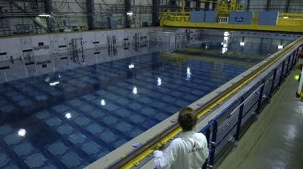
101. Right now, the general plan is to store in underwater at nuclear plants, while we figure out what else to do with it.
In Japan this did not work well, as the water boils away if it is not kept very cool. That leads to LEAKS.

Slide 102
102. How does radioactive carbon dating work?
On Earth there is a certain amount of radioactive carbon by percent. It’s measurable if you’re college level smart and you have some fancy tools. There is a “normal” level of radioactive carbon in our environment, and it’s been stable a long time.
The ratio of radioactive carbon to stable carbon is a constant. Although some is always transmuting, there is always more being made, by a variety of means, all involving the bombardment of carbon with high energy particles from the Sun.
The ratio is known and measurable
(~ one atom per trillion carbon atoms are radioactive). If this ratio changed, it could be measured.
High energy neutrons + N_{2(G)} → C-14 + protons
This is a type of naturally occurring artificial transmutation.

Slide 103
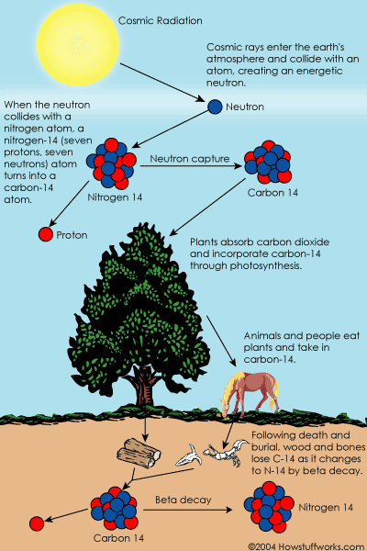
This radioactive carbon
is everywhere in small quantities.
In plants and in the animals that eat the plants, and in animals that eat both plants and animals.
Even though it’s always decaying back into nitrogen, it’s also being replaced constantly too.
There is a constant amount of C-14 in the world.

Slide 104

If an animal eats regularly, and all animals do (except for one kind),
they all have a constant ratio of radioactive to stable carbon.
103. Which kind of animal DOES NOT EAT regularly?

Slide 105

103. Dead animals don’t eat, once they die, the ratio of C-14 to C-12 begins to change. Since it is measurable (if you’re a scientist) you can calculate how long it must have taken to change that ratio by the amount it changed. Since you also know the half life of C-14, you can calculate when the last time that bird was still eating (when it died).

Slide 106
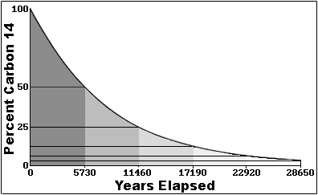
Since all living things have a constant amount of C-14, that is measurable, in them, once they die (and stop eating) the radioactive decay begins without replacing the C-14.
104. The longer that animal is dead, the lower
the C-14 to C-12 ratio becomes
If a scientist measures the bones
of a dead animal to have just
half of the expected C-14, that
means the animal stopped eating
one half life of C-14 ago,
or 5715 years ago.
½ life: 1 2 3 4 5

Slide 107
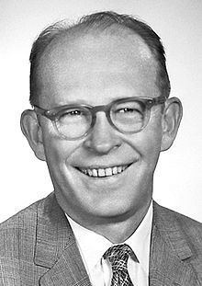
Willard F. Libbey wins the Nobel Prize in Chemistry in 1960
for work he did in the 1940’s with Radioactive C-14 to date previously
living organisms.
It is very accurate to at least 50,000 years. Older materials can still be measured, but there is some error possible due to the fact that very little C14 will be measurable.
Some larger samples have been scientifically measured to longer, but not much older than that. Dinosaurs cannot
be measured using the C-14 method.

Slide 108

105. The La Brea Tar Pits, near Los Angeles, California

Slide 109
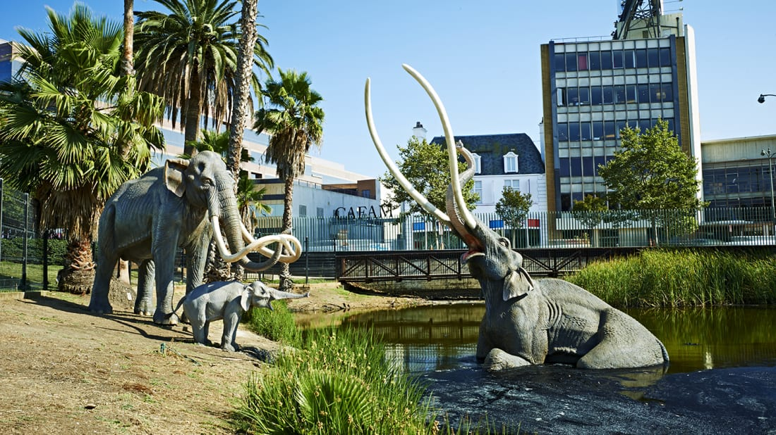
Museum Models, sunk in the tar, near LA, California. This shows a mastodon stuck and about to sink into the tar, where it will NOT ROT. Once in a while these animals pop back out and scientists can wash them off and examine perfectly preserved specimens. The ratio of C-14 to C-12 tell how long ago they stopped eating.

Slide 110
Nuclear Medicine
There are only 2 uses for nuclear radiation that are discussed in high school.
106. Iodine-131 is for the diagnosis and treatment
of thyroid disorders.
This radioactive isotope is injected into a person, then after 24 or 48 hours a special “picture” is taken, called a radiograph, which measures the amount of radiation in someone’s throat (where the thyroid gland is).
Radioactive iodine is chemically identical, just radioactive, the thyroid gland picks it up, or doesn’t, doctors can diagnose glandular activity. Radioactive iodine “gets stuck” in thyroid and emits beta radiation that can “kill” cancer, to treat patients medically.

Slide 111
Nuclear Medicine
107. Cobalt-60 to treat some cancers.
This isotope produces beta radiation, which can be aimed like a beam of invisible killer rays, which gets pointed at tumors inside people.
The beta particles kill most cells they pass though, including cancers. Their plan is to zap the tumors precisely while killing as few of the healthy cells at possible.
Radiation treatment causes the patient pain and nausea, and some cell death, which can mostly self repair, hopefully making you cancer free.
108. Most other radioactive isotopes are not used in medicine.

