Slide 1
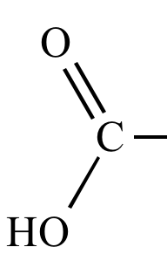
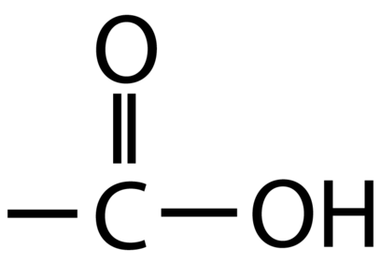
ORGANIC ACIDS
107. An organic acid will release H⁺¹ cations in solution,
just like Arrhenius acids.
108. Organic acids contain the functional group called the
– COOH group
109. Draw the functional group going to the left and to the right side.
“R” stands for the rest of the molecule, not the functional group.
R
R

Slide 2
110A. draw methanoic acid | B. draw ethanoic acid
C. draw propanoic acid | D. draw hexanoic acid

Slide 3
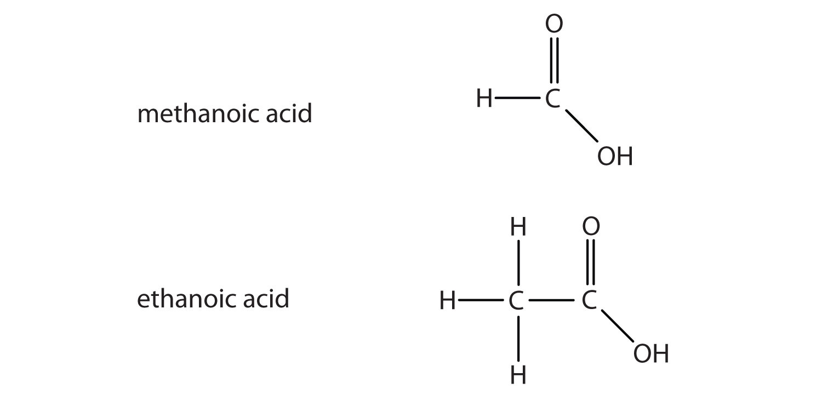
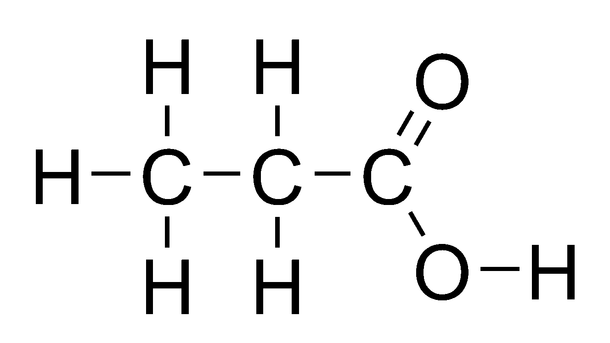

110A. draw methanoic acid | B. draw ethanoic acid
C. draw propanoic acid | D. draw hexanoic acid

Slide 4
110E. draw nonanoic acid

Slide 5
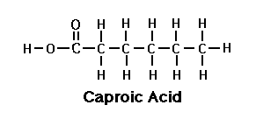
110E. draw nonanoic acid

Slide 6
111. The whole list of acids in high school includes
# carbon atoms | Name | Condensed Structural formula
1 | Methanoic acid | HCOOH
2 | Ethanoic acid | CH₃COOH
3 | Propanoic acid | CH₃CH₂COOH
4 | Butanoic acid | CH₃(CH₂)₂COOH
5 | Pentanoic acid | CH₃(CH₂)₃COOH
6 | Hexanoic acid | CH₃(CH₂)₄COOH
7 | Heptanoic acid | CH₃(CH₂)₅COOH
8 | Octanoic acid | CH₃(CH₂)₆COOH
9 | Nonanoic acid | CH₃(CH₂)₇COOH
10 | Decaonic acid | CH₃(CH₂)₈COOH

Slide 7
112. Copy this chart… these are the same
molecules with different names.
Acetic | Ethanoic
HC₂H₃O₂ | CH₃COOH
2C + 4H + 2O | 2C + 4H + 2O
These molecules are identical but have different names. Acetic is “inorganic” style. Ethanoic is “organic” style. But they are identical molecules. Both are weak acids, both are weak electrolytes, both are vinegar, both are the same thing with different names.

Slide 8
114. Draw propanoic acid “to the left” and “to the right”.
Make sure you can see this in both directions.

Slide 9
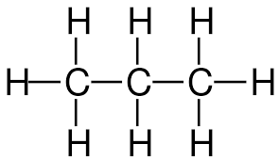
114. Draw propanoic acid “to the left” and “to the right”.
Make sure you can see this in both directions.
O
O
OH
HO
– COOH group

Slide 10
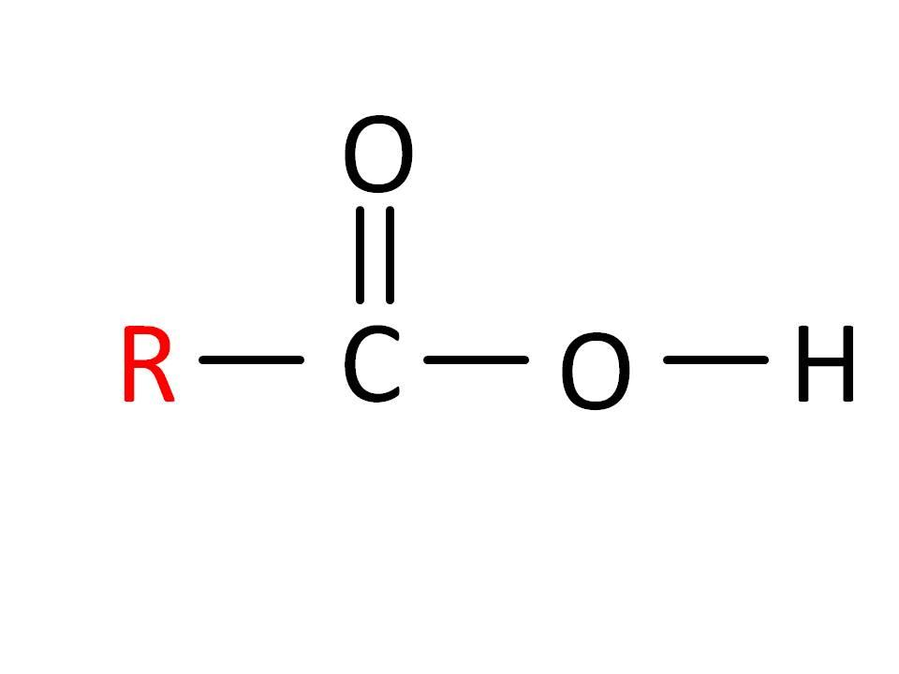
ESTERS
115. The next functional group are the ESTERS. They tend to smell really good.
They form from a reaction between an __________ and
an _________.
116. This reaction is called ________________.
117. The ester functional group
looks like this:
Make an “L” with your left hand.
The “thumb” side is different than
the hand side, right???
Hand side thumb side

Slide 11
ESTERS
115. The next functional group are the ESTERS. They tend to smell really good.
They form from a reaction between an organic acid and
an alcohol.
116. This reaction is called esterfication.
117. The ester functional group
looks like this: →→ →→ →→
copy the box into your notes now…
Make an “L” with your left hand.
The “thumb” side is different than
the hand side, right???
Hand side thumb side

Slide 12
LAST NAME
hand side
FIRST NAME
thumb side
The ESTER group makes an “L” shape, like your hand.
118. The THUMB side, is the FIRST NAME side.
119. The other side is the hand side, or LAST NAME side.
120. We ALWAYS name ESTERS the THUMB SIDE first.

Slide 13
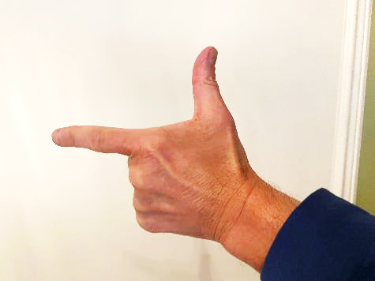
121
Thumb to the RIGHT
Ester Functional Group
LAST NAME
hand side
FIRST NAME
thumb side
O
LAST NAME
hand side
–– C – O ––
FIRST NAME
thumb side

Slide 14
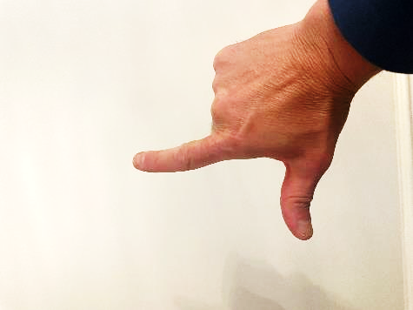
122
Thumb to the LEFT
Ester Functional Group
–– O
FIRST NAME
thumb side
LAST NAME
hand side
O
FIRST NAME
thumb side
–– O – C –––
LAST NAME
hand side

Slide 15
123. Draw methyl propanoate (to the left + right)
Start with the functional group in the middle of the box.
Functional group towards the right side | – C – O –
Functional group towards the left side | – O – C –
O
O

Slide 16
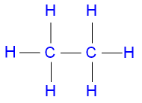
123. Draw methyl propanoate (to the left + right)
Start with the functional group in the middle of the box.
Functional group towards the right side CH₃CH₂COOCH₃ | – C – O – Esters have a “COO” group
Functional group towards the left side CH₃OOCCH₂CH₃ | – O – C Esters have a “COO” group
O
O

Slide 17
124. Draw butyl pentanoate
Butyl is the first name, the THUMB SIDE
Pentanoate is the last name, the HAND SIDE
O
―C―O―

Slide 18
124. Draw butyl pentanoate
O
―C―C―C―C―C―O―C―C―C―C―
Five carbons to the hand side
Four carbons to the thumb side
The carbon in the functional group COUNTS as part of the last name.
Pentanoate has 5 carbons, including the functional group -COO.

Slide 19
125. Draw these now…
Methyl hexanoate Ethyl methanoate

Slide 20


Methyl Hexanoate
125.
Ethyl methanoate

Slide 21
126. Now draw Ethyl propanoate and its
isomer, Propyl ethanoate.
These are NOT the same molecule.

Slide 22
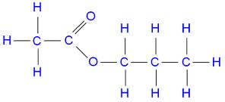
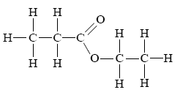
Propyl ethanoate
3—2
Ethyl propanoate
2—3

Slide 23
127. Final note, ALWAYS put in the “H” in the methanoate molecules. That “H” is mandatory. Otherwise, it looks like you either forgot to finish, or don’t know what to do at all.
The “H” in the methanoate says YOU KNOW you’re done on that side.
Draw Propyl Methanoate

Slide 24
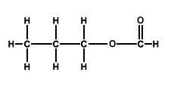

127. Draw Propyl Methanoate (shown “left and right”)

Slide 25
Amines and Amides are similar
(in the same way aldehydes + ketones were).
128. The Amines + Amides both
contain NITROGEN.
129. Count to 3 for nitrogen, N must
always make 3 bonds.

Slide 26
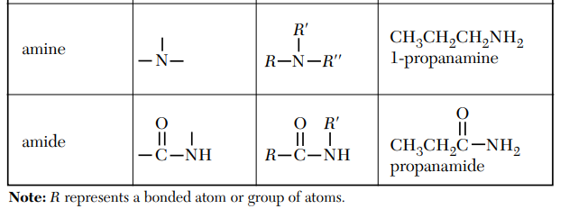
130. Amine groups can be on the end or in the middle of a hydrocarbon chain
131. Amide groups are always
on the end of a chain.
Change the table as shown now. In high school we only have simple with -NH₂
H
H
Middle or End
H
End only

Slide 27
132. Nitrogen atoms can form bonds
of 3 chains, in our class they will
always bond simply with one carbon,
and two hydrogen atoms only.
R––N–H
H
This is the AMINE
functional group
R––NH₂
“R” means one carbon, or up to 10 carbons, just ALKANES.

Slide 28
133. Nitrogen atoms always make 3 bonds
In amides, the “NH₂” part bonds to
a carbon double bonded to oxygen.
Fancier.
R––C–N–H
H
O
This is the AMIDE
functional group
O
R––C–NH₂

Slide 29
134. draw methanamine | 135. draw methanimide
136. draw ethanamine | 137. draw ethanamide
138. draw 3-pentanamine | 139. draw pentanamide (no number?)

Slide 30
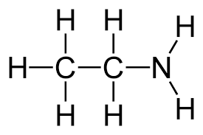
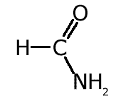
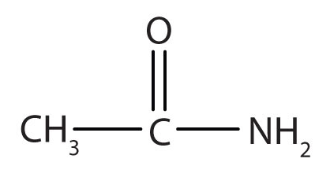
136. draw methanamine | 137. draw methanamide
138. draw ethanamine | 139. draw ethanamide
140. draw 3-pentanamine NH₂ CH₃CH₂CHCH₂CH₃ | 141. draw pentanamide (no number?) O CH₃CH₂CH₂CH₂C ̶ NH₂

Slide 31
Organic Chem Class 6
Objective: Examining and Mastering all of the Organic Chemical Reactions:
Substitution, Addition, Fermentation, Esterfication, Polymerization and Saponification

Slide 32
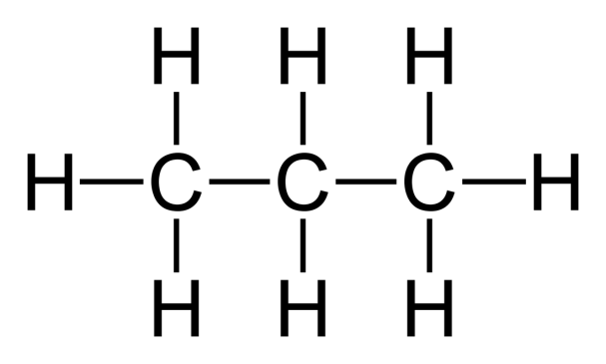
140. Substitution reactions:
Saturated + Halogen → Halocarbon + HX
Hydrocarbon
(alkane) + (F, Cl, Br, or I) → Halocarbon + HX
Propane + F₂ 1-fluoropropane + HF
+ F₂

Slide 33
140.
Propane + F₂ 1-fluoropropane + HF
+ F₂
F + HF

Slide 34
Draw these 2 substitution reactions with structural diagrams and NAME the products properly.
141. Ethane + chlorine yields…
142. Butane + iodine yields 2-iodobutane + HI

Slide 35
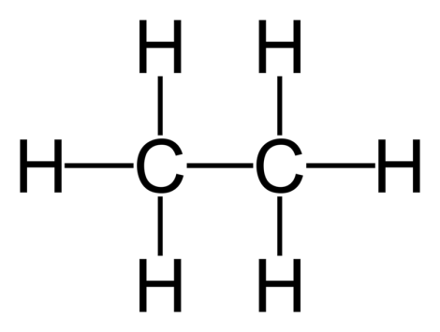
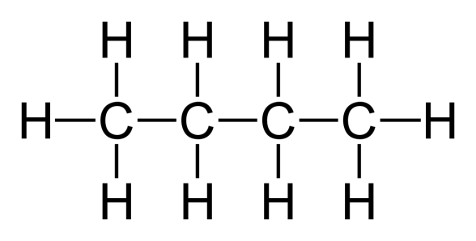
141.
Ethane + chlorine yields chloroethane + HCl
142. Butane + iodine yields 2-iodobutane + HI
+ Cl₂
Cl + HCl
+ I₂
+ HI
I

Slide 36
ADDITION reactions start with a halogen and a UNSATURATED hydrocarbon (an alkene or alkyne). We ADD the halogen into it, FORM ONE PRODUCT.
143. Draw and write the structural diagrams for:
Ethene + Bromine yields 1,2 dibromoethane

Slide 37
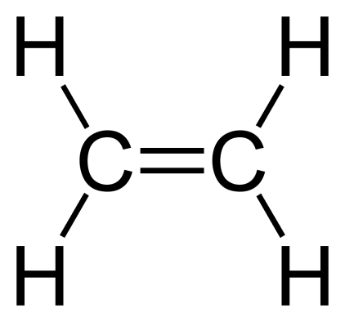
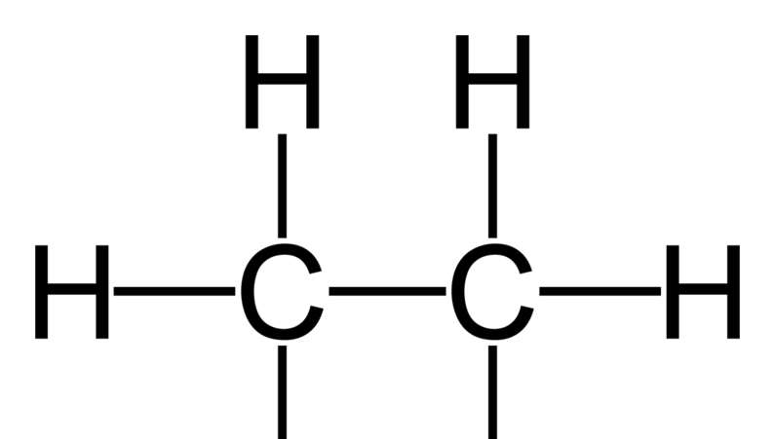
143. Ethene + Bromine yields 1,2 dibromoethane
+ Br₂
Br Br
Here, the double bond opens, making room to add both atoms of bromine, simultaneously.
The Br’s get added one to each of the carbon atoms.

Slide 38
144. Draw Propene + chlorine → 1,2dichloropropane
145. Ethyne and fluorine → 1,2 difluoroethene

Slide 39
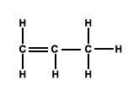
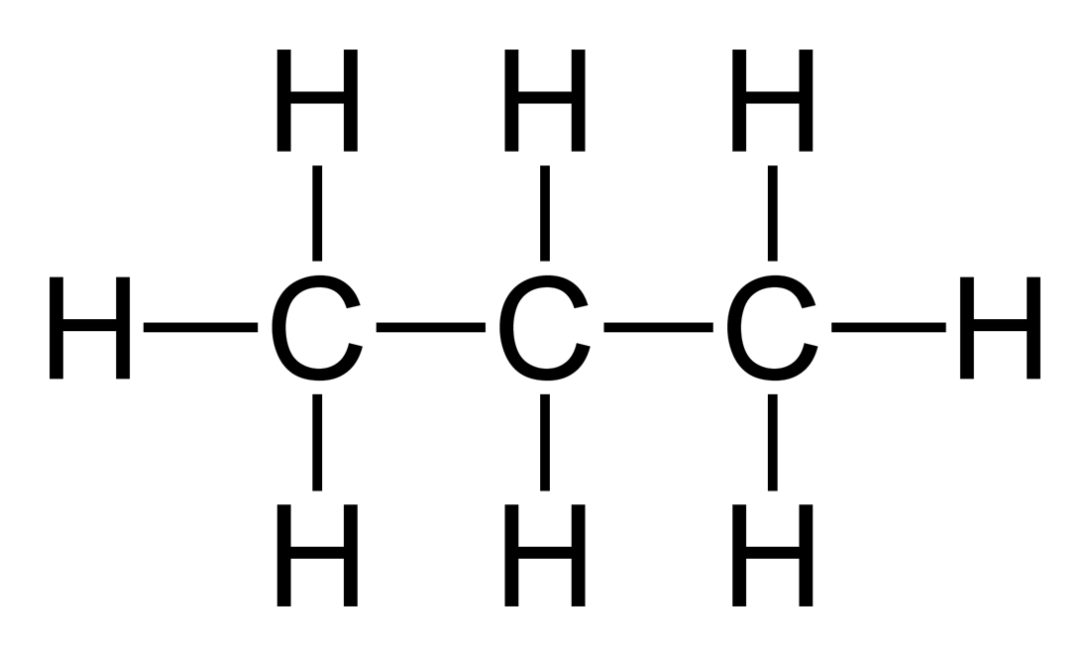
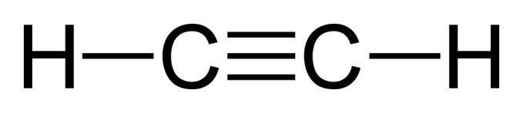
144. Propene and chlorine yields 1,2 dichloropropane
145. Ethyne and fluorine yields 1,2 difluoroethene
Cl
+ Cl₂
Cl
F F
+ F₂
H—C=C—H

Slide 40
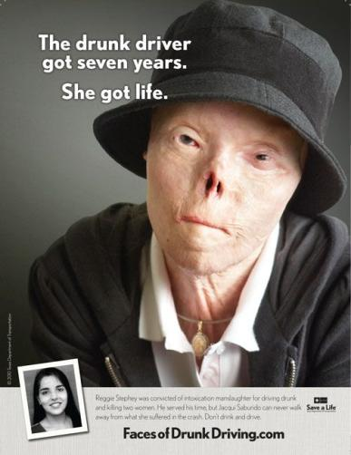
Fermentation is an organic chemical process known to humans for 1000’s of years. It turns juices into ethanol and carbon dioxide. That’s how to make champagne, or wine, or beer, or stronger liquors.
It’s a billions of dollars a year industry around the world, it’s wonderful in small amounts - when you’re over 21.
It can be terrible too.
It makes you think weirdly. It can make you angry, it certainly makes you stupider in the moment.
It makes you unsafe.
Jacqueline Saburido was in a car accident at age 20 on 9-19-1999
She died of cancer in April 2019 at age 30.
Don’t drink alcohol until you’re 21.
Never, ever drive drunk.
Never, ever get in a car if the driver has been drinking.
Never ever, not with anyone, no matter what.

Slide 41
146. Fermentation is the organic chemical reaction that YEAST turn
sugar into ethanol and carbon dioxide.
147. Yeast excrete waste products called
ethanol + CO₂ during anerobic respiration.
148.
yeast enzymes
in water
Sugars CH₃CH₂OH + CO₂
Ethanol alcohol and carbon dioxide

Slide 42
There are many kinds of sugars, but we will use GLUCOSE to show fermentation.
149. Balance this reaction:
glucose forms ethanol and carbon dioxide gas.
C₆H₁₂O₆ ^{in yeast with water} __________ + ___________

Slide 43
There are many kinds of sugars, but we will use GLUCOSE to show fermentation.
149. Balance this reaction:
glucose forms ethanol and carbon dioxide gas.
C₆H₁₂O₆ ^{in yeast with water} 2CH₃CH₂OH_{(AQ)} + 2CO_{2(G)}

Slide 44
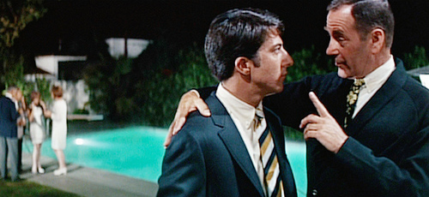
150. Polymerization the process of making plastics.
Here is a shot from the movie
“The Graduate” with Dustin Hoffmann
(he’s the guy on the left).
At Ben’s college graduation party
he talks to one of his dad’s friends.
He offers some sage advice to the
young Ben, and the line…
“I have just one word of advice for you. Are you listening to me Ben?”
“Yes, sir.“ Ben replies. The man says:
“Plastics.”

Slide 45
151.
Polymerization
mer
means
unit
or body
poly
means many
-ization
means the
process of
the organic chemical reaction of making plastics or polymers.

Slide 46
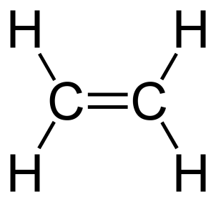
A “mer” is a molecule or “unit”
A “mer”
ethene molecule

Slide 47
153. A lot of “mers” (a lot of ethene molecules)
ethene molecules
catalyst
n
Catalysts break open those double bonds, allowing the “mers” to unite into chains that go on and on, and are indefinite in length. There is not a “real” formula for the polymer formed.

Slide 48
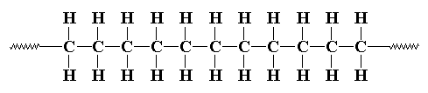
153. A lot of “mers” (a lot of ethene molecules)
can form long chains of a polymer called Polyethylene
catalyst
n
the polyethylene formula is
(–CH₂CH₂–)_{n}

Slide 49
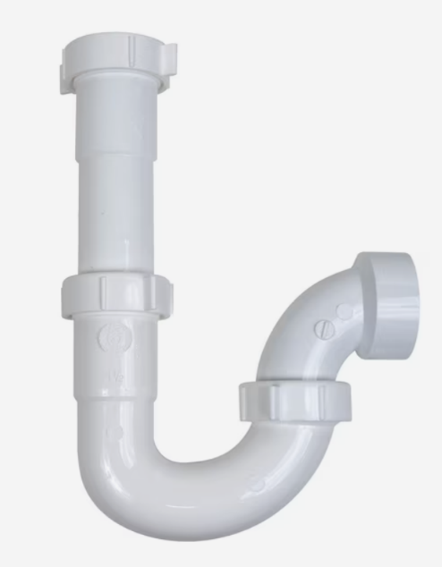
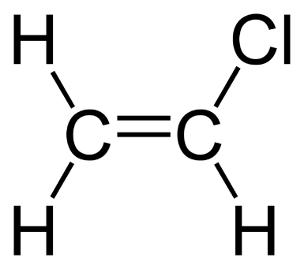
154. Other plastics that you probably know of already are
PVC, or polyvinyl chloride is the OLD-FASHIONED name for the plastic white pipes which are used for plumbing in your home.
It starts out with CHLOROETHENE as the “mer”.
It forms POLYCHLORETHENE
PVC is the old name for it.
( )_{n} →

Slide 50
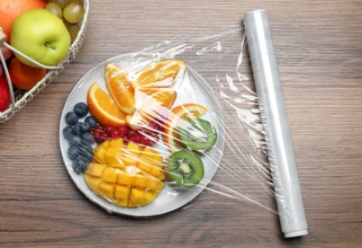
154. Other plastics that you probably know of already are
Polyethylene is what thin, soft clear plastic food bags are made of ethene molecules (sandwich wrap plastic).

Slide 51
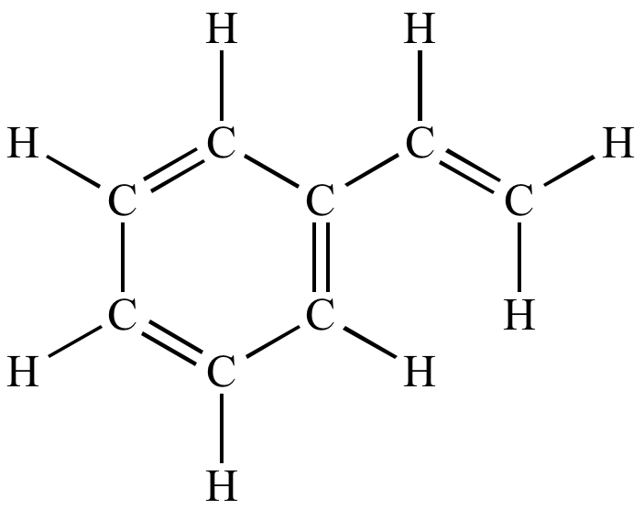
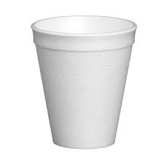
154. Other plastics that you probably know of already are
Polystyrene (Styrofoam) is another plastic you have used. This one is white + opaque.
This molecule (mer) is styrene
The “H” atoms come off and more styrene molecules link together,
like a chain link fence,
to make Styrofoam.

Slide 52
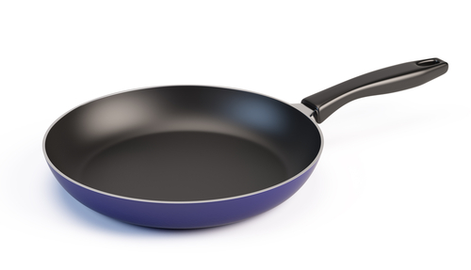
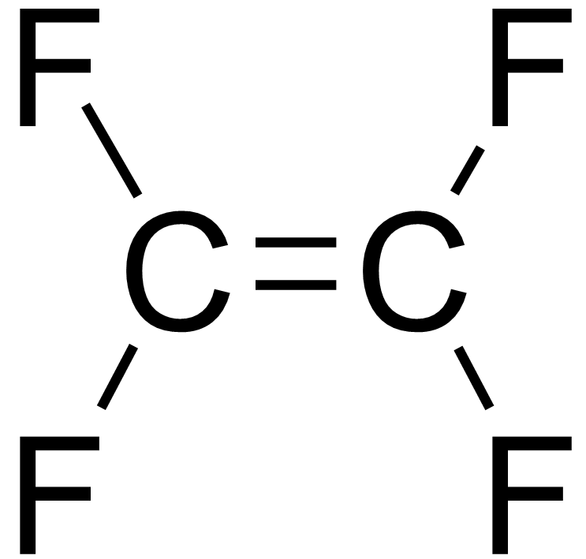
154. Other plastics that you probably know of already are
Teflon (used in frying pans) is Polytetrafluoroethylene.
The “mer” is CF₂=CF₂ which you’d call tetrafluroethene
This is the “mer”

Slide 53
ESTERIFICATION
The molecules “face” each other, functional groups close, and we take out HOH (water). The rest of the molecules then bond together making an ester with that famous COO group in the middle making an “L” shape.
155. organic acid + alcohol → ester + HOH
156. Combine propanoic acid + ethanol
(use structural diagrams, not formulas – draw)

Slide 54
156. we will combine propanoic acid + ethanol
+
OH

Slide 55
156. we will combine propanoic acid + ethanol
H H
+
HO
C
C
H
OH
H H
Acids will ionize the hydrogen in the –COOH group. Alcohols do not ionize at all. To form water, something a bit odd happens.

Slide 56
156. we will combine propanoic acid + ethanol
H H
+
HO
C
C
H
OH
H H
HOH (water) +
The acid provides the –OH, while the alcohol provides the H, to make HOH.
Odd since acids usually provide H+1 ions, and alcohols are NOT ionic at all. Odd.

Slide 57
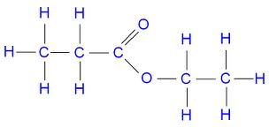
156. we will combine propanoic acid + ethanol
H H
+
HO
C
C
H
OH
H H
HOH (water) +
Ethyl Propanoate

Slide 58
157. Draw the reactant molecules and product molecules
(and product names)
butanoic acid + 1-propanol form an ester + water

Slide 59
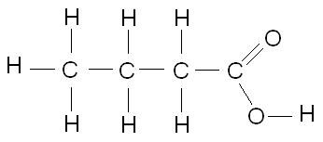
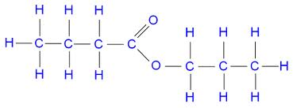
157. Draw the reactant molecules and product molecules
(and product names)
butanoic acid + 1-propanol form an ester + water
H H H
+
HO
C
C
C
HOH +
H
OH
H H H
Propyl Butanoate

Slide 60
Organic Acids and Esters, that have the same total number of carbons, are isomers too.
Ethanoic acid (CH₃CH₂COOH) is an isomer to
methyl methanoate (CH₃COOCH₃)
Propanoic acid (CH₃CH₂CH₂COOH) is an isomer to
methyl ethanoate (CH₃CH₂COOCH₃)
and ethyl methanoate (CH₃COOCH₂CH₃)
Butanonic acid is an isomer to methyl propanoate, and
ethyl ethanoate and
propyl methanoate.
Etc.

Slide 61
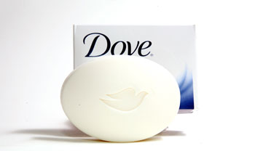
I use that stuff
158. SAPONIFICATION is the most complex reaction but the easiest to recognize and remember. If you misspell this reaction the first four letters might spell out SOAP.
In fact, this organic reaction is the reaction that makes SOAP. (the take a bath kind) Did I say SOAP?

Slide 62
159. The word equation for making soap is always...
A triple ester* molecule combines with 3 strong bases, forming a triple alcohol and 3 soap molecules.
THREE is our lucky number.
*A triple ester is a FAT
Soap molecules are not really molecules, they contain a metal cation. Soaps are “charged particles” that are mostly nonpolar on one side, and very polar and AQ on the other.

Slide 63
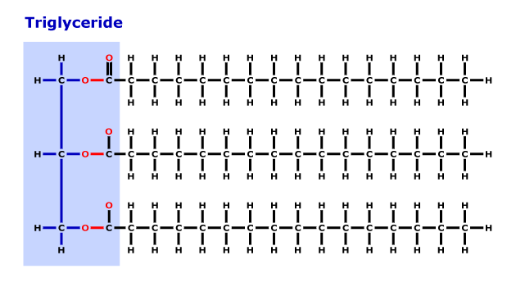
160. Reactants for saponification…
+ 3 NaOH →
You can use any 3 bases, different bases will result in different kinds of soap, softer, harder, liquid or solid, different colors, etc.
Circle the ester groups

Slide 64
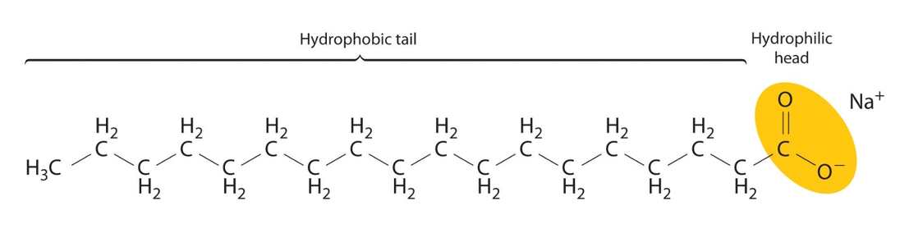
161. (products)
The products of saponification are SOAP and a triple alcohol.
Note, the soap has a “triple” molecular shape, and contains an ION as well.
H
H – C – OH
H – C – OH
H – C – OH
+
H
3CH₃(CH₂)₁₆COONa⁺
Only one is shown in the diagram
Triple
Alcohol
We don’t have to name these molecules,
just “recognize” them at the end of this equation.

Slide 65
Organic Chem Class #7
Objective:
ISOMERS, and Branched Hydrocarbons
Drawing them, naming them,
and condensed structural formulas.

Slide 66
ISOTOPES are chemically identical atoms with different atomic masses (different # neutrons) which are the reason for average atomic masses being decimals.
ALLOTROPES, such as graphite and diamonds, both pure carbon They are bonded differently and have different properties. If you don’t believe that, try to take the regents with a diamond, or get engaged with a pencil!
167.
ISOMERS are organic compounds with the same chemical
formulas, but different structures. They have
the same molar mass, but different properties.

Slide 67
168. Examples include ethanol and dimethyl ether Draw the structural + chemical formulas for these.
 | Structural diagrams | Condensed structural formulas
Ethanol
Dimethyl ether

Slide 68
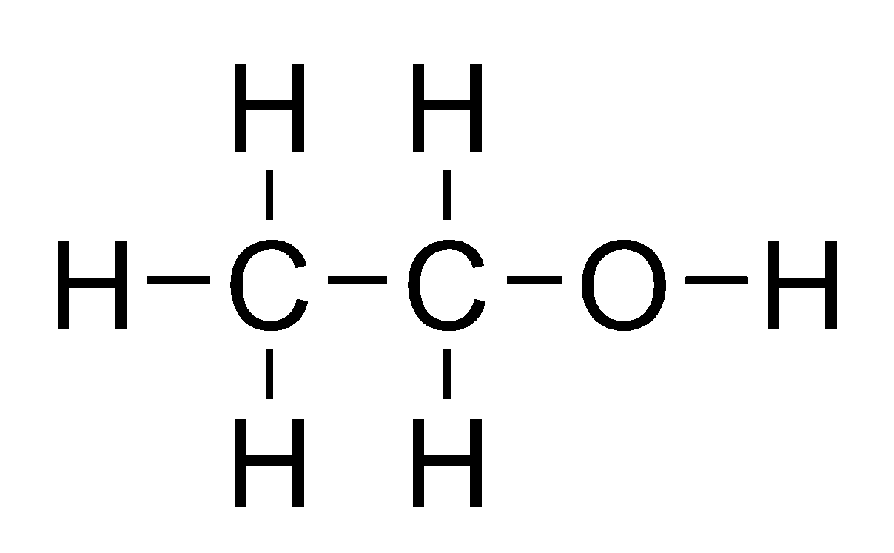
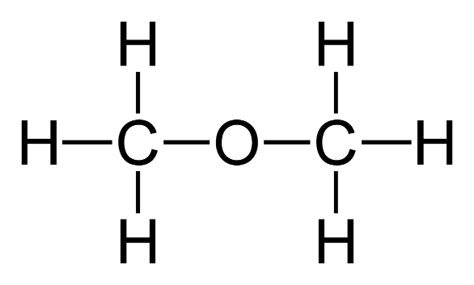
168. Examples are ethanol and dimethyl ether Draw the structural + chemical formulas for these.
 | Structural diagrams | Condensed structural formulas
Ethanol |  | CH₃CH₂OH (C₂H₆O)
Dimethyl ether |  | CH₃OCH₃ (C₂H₆O)

Slide 69
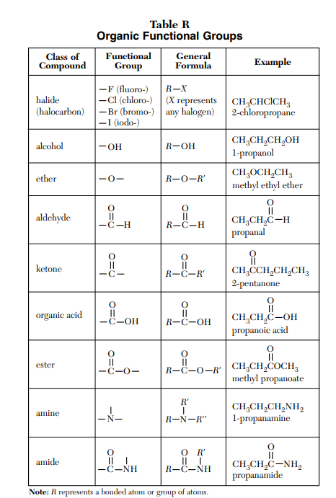
All alcohols with the same number of carbon atoms as an ether are isomers…
Ex: Hexanol (6) is isomer
to
methyl pentyl ether, and
ethyl butyl ether, and
Dipropyl ether
All aldehydes with the same number of carbon atoms as a ketone are isomers…
Ex: Pentanal (5) is isomer
to
2-pentanone or 3-pentanone
All organic acids with the same number of carbon atoms as esters are isomers…
Ex: propanoic acid (3) is isomer
to
methyl ethanoate or ethyl methanoate
1+2 carbons or 2+ carbons

Slide 70
Branched Hydrocarbons can also be isomers of each other.
169. Draw hexane
Then pentane with a “methyl” group on the #2 carbon.

Slide 71
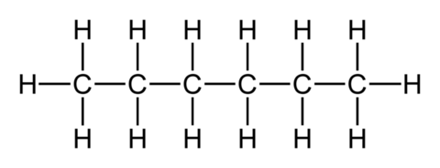
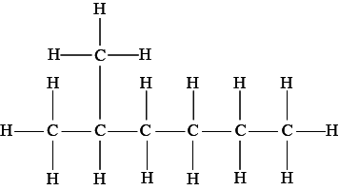
Branched Hydrocarbon Isomers.
169. This is hexane.
C₆H₁₄
Draw pentane with a “methyl” group on the #2 carbon.
This is methyl pentane,
also C₆H₁₄

Slide 72
170. Draw this, name this,
then draw an isomer of it.
H
H
C
H
H
H
H
C
C
C
H
H
H
H
C
H
H

Slide 73
170. Draw this, name this,
then draw an isomer of it.
DIMETHYL
PROPANE
H
H
C
H
H
H
H
C
C
C
H
H
H
H
C
H
H

Slide 74

170. Dimethyl
propane
C₅H₁₂
H
H
C
H
H
H
H
C
C
C
H
H
H
H
C
H
H
Is an isomer to pentane
C₅H₁₂

Slide 75
171. Draw 4-methyl, 5-ethyl nonane

Slide 76
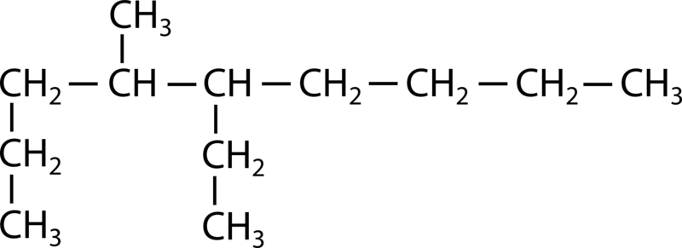
171. Draw 4-methyl, 5-ethyl nonane
Name the longest chain, then find the branches.

Slide 77
172. Draw 7ethyl, 8-fluoro, 2-nonyne

Slide 78
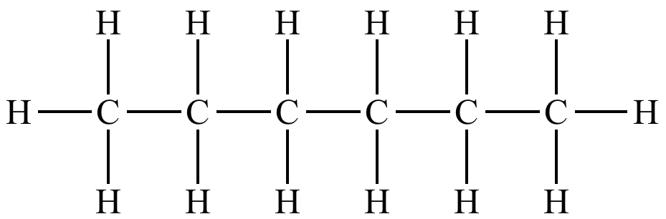
172. Draw 7ethyl, 8-fluoro, 2-nonyne
CH₃
CH₂
C ≡ C
F

