Slide 1
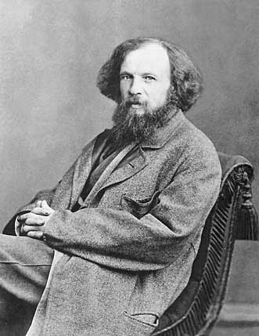
OB: Trends of the Periodic Table
1. Dimitri Mendeleev created the first modern periodic table in March 1869.
The Periodic Table in your NYS Reference Tables packet is modeled on it. Take yours out right now.

Slide 2
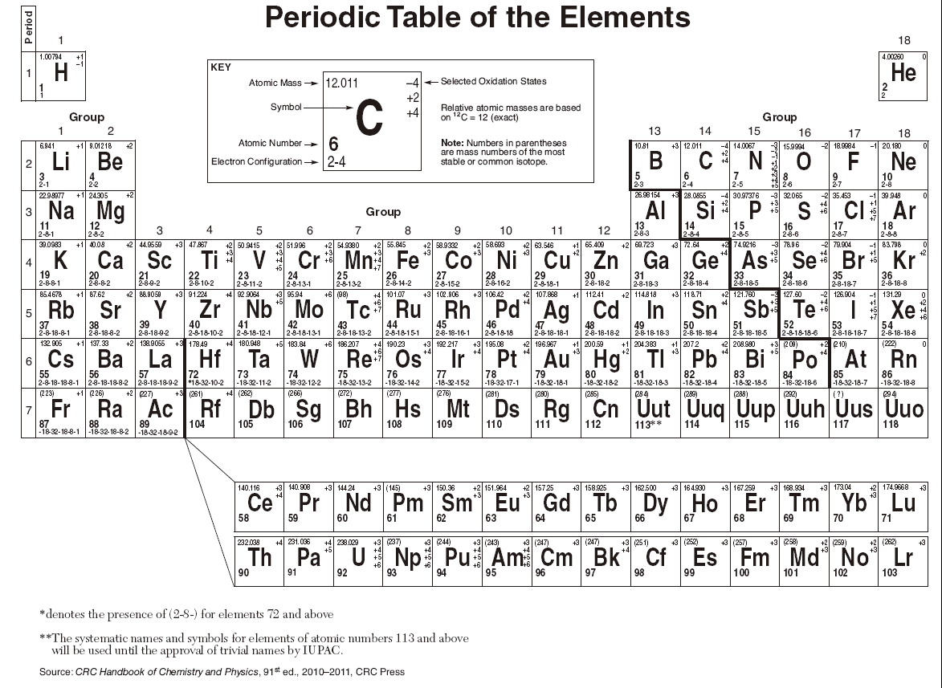
2 There are 18 COLUMNS on the table, they are called GROUPS.
3 There are 7 ROWS that go across
the table to the right are called
PERIODS.
Indicate on the periodic table
to the left side of your notes
The groups and the periods.

Slide 3
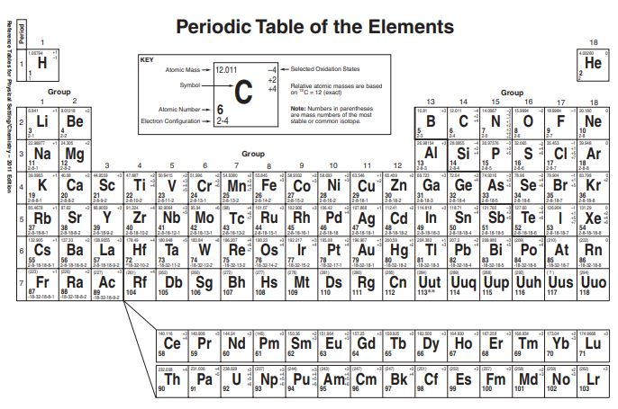
Sections of the table
have names.
You must learn these names.
4. Group 1 (Li to Fr)
are the
ALKALI
metals

Slide 4
5. Group 2 (Be to Ra)
are the
ALKALINE
EARTH
metals

Slide 5
6. Group 3-12
plus the metals
under the staircase
are the
TRANSITIONAL
metals

Slide 6
7. All the elements
to the top right
of the stairs
are the
NONMETALS
So is
HYDROGEN

Slide 7
8. Group 17
are the
HALOGENS
(they are all nonmetals)

Slide 8
9. Group 18
are the
Noble Gases
(they are all nonmetals)

Slide 9
10. Seven atoms
that touch the
staircase are
the
METALLOIDS
Al and Po also touch
but they are metals,
not metalloids.

Slide 10
11. The bottom
rows of the
table are the
INNER TRANSITIONAL
metals.
They all fit
inside group 3

Slide 11
12. Atoms in the same group share many chemical properties,
because the have the same number of valence (or outermost)
electrons.
Atoms in a group will bond the same way.
Group 1 metals +1 cations | Group 17 nonmetals -1 anions | Form into 1:1 ratio compounds |  | Group 2 metals +2 cations | Group 17 nonmetals -1 anions | Form into 1:2 ratio compounds
Li | Cl | LiCl |  | Be | Br | BeBr₂
Na | Cl | NaCl |  | Mg | Br | MgBr₂
K | Cl | KCl |  | Ca | Br | CaBr₂

Slide 12
It is the Periodic Table of the Elements.
14. What does PERIODIC mean?

Slide 13
It is the Periodic Table of the Elements.
What does PERIODIC mean?
Periodic refers to a pattern or normal repetition of things.
Things that happen periodically have a predictable pattern, like
YOUR BIRTHDAY (only once per year)
PAYDAYS (not often enough, every other Thursday for me)
The New Yorker Magazine (every Friday in the mail)
The New York Times (every single day!)

Slide 14
15. The elements on the Periodic Table
are arranged in order of increasing
atomic number.
That means by increasing number of PROTONS.

Slide 15
16. The Periodic Law (memorize)
When the elements are arranged in order of
increasing atomic number, there is a
periodic repetition of similar chemical properties
- in the groups.
This works because of the weird shape of the table.

Slide 16
17. Similar properties “show up” periodically, IN THE GROUPS.
18. At the top of the table, the properties repeat every 8 atoms,
but in the middle of the table it’s every 18 atoms.
Let’s count from Lithium → Sodium (group 1 metals that make +1 cations)
Now count from Sodium → Potassium.
Next, count from Fluorine → Chlorine (group 17 nonmetals that make -1 anions)
Next count from Potassium → Rubidium.
And Chlorine → Bromine. Top and middle different, but predictable!

Slide 17
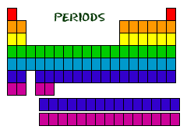
19. The periods of the table
go left to right.
20. The periods contain many
elements that have
very different properties.
21. Period numbers 1 to 7
correspond to the number of
electron shells that all atoms
in a period have.
1
Periods ↔
2
3
4
5
6
7
6
7

Slide 18
22. Period number (1-7) indicates of how many electron shells all atoms in the period has.
period | example element | electron configuration on periodic table | number of electron shells
 | H | 1
 | Be | 2-2
 | S | 2-8-6
 | Mn | 2-8-13-2
 | Xe | 2-8-18-18-8
 | Ba | 2-8-18-18-8-2
 | Ra | 2-8-18-32-18-8-2

Slide 19
22. Period number (1-7) indicates of how many electron shells all atoms in the period has.
period | example element | electron configuration on periodic table | number of electron shells
1 | H | 1 | one
2 | Be | 2-2 | two
3 | S | 2-8-6 | three
4 | Mn | 2-8-13-2 | four
5 | Xe | 2-8-18-18-8 | five
6 | Ba | 2-8-18-18-8-2 | six
7 | Ra | 2-8-18-32-18-8-2 | seven

Slide 20
The numbers in the element boxes on periodic table help us know many things.
Find | The box shows | Think
Atomic Mass | 12.011 amu | We round this to 12 amu = 12 protons plus neutrons total
Atomic Number | 6 | The number of protons (also equals the number of electrons)
Electron Configuration | 2-4 | Electrons are in 2 shells. (2 + 4 = 6)
Selected Oxidation States | -4 +2 +4 | These are used to determine formulas of molecular compounds, these ARE NOT ion charges

Slide 21
23. Each of these subatomic particles fits into this table, you should memorize this.
Particle | Location | Charge | Mass | Symbol
Proton
Neutron
Electron

Slide 22
23. Each of these subatomic particles fits into this table, you should memorize this.
Particle | Location | Charge | Mass | Symbol
Proton | Nucleus | +1 | 1 amu | p⁺
Neutron | Nucleus | none | 1 amu | n°
Electron | Outside the nucleus | ̶ 1 | zero in H.S. chem | e ̶

Slide 23
Another way to write this information (for cobalt) would be this:
This shows the average mass of cobalt to be 59 amu, and that it has
an atomic number of 27.
24. Calculate the number of protons, neutrons & electrons for COBALT
Co
59
27

Slide 24
Mass = total number of p⁺ plus n° = 59
minus atomic number = p⁺ -27
equals the number of neutrons = 32
The atomic number is the number of protons, which is the same as the number of electrons (the positives = the negatives).
24. Cobalt-59 has 27 protons, 27 electrons, and 32 neutrons.
Co
59
27

Slide 25
25. List ALL of the nonmetals (by symbol, in numeric order)

Slide 26
25. List ALL of the nonmetals (by symbol, in numeric order)
H |  |  |  |  |  |  |  |  | He
 |  |  |  | B | C | N | O | F | Ne
 |  |  |  |  | Si | P | S | Cl | Ar
 |  |  |  |  |  | As | Se | Br | Kr
 |  |  |  |  |  |  | Te | I | Xe
 |  |  |  |  |  |  |  |  | Rn
Count them, there are
22
Nonmetals

Slide 27









26. list symbols of all the metalloids. Each number corresponds to an atomic number.
5 | 14 | 32 | 33 | 51 | 52 | 85

Slide 28
26. list symbols of all the metalloids. Each number corresponds to an atomic number.
5 | 14 | 32 | 33 | 51 | 52 | 85
boron | silicon | germanium | arsenic | antimony | tellurium | astatine
nonmetal | nonmetal | metal | nonmetal | metal | nonmetal | nonmetal
B
Si
Ge
As
Sb
Te
At
There are 7 Metalloids
2 other METALS touch the staircase, Al and Po (they are dog food exception to this trend)
Uus and Uuo are not touching the stairs, they are not metalloids. .

Slide 29
27. How many elements are METALS?
We won’t list them all.
All elements are metals except the nonmetals.
There are
118 elements – 22 nonmetals = 96 metals

Slide 30
Start Class #2 here
#28 - #42

Slide 31
28. There are seven trends that we examine as
group trends (patterns going down a group)
and
period trends (patterns going across the table)

Slide 32
29. These trends are…
 | The trends on the periodic table | have these units | find details in
1 | atomic mass | amu | Table S
2 | atomic radius | pm or picometers | Table S
3 | net nuclear charge | no units | Periodic table
4 | 1st Ionization energy | kJ/mole | Table S
5 | metallic vs. nonmetallic properties | no units | Periodic table
6 | cation sizes and anion sizes | no units | Periodic table
7 | electronegativity values | no units | Table S

Slide 33
30. What is the group trend for atomic mass?
We will use group 2 but all groups follow the same
pattern, you can believe me, but you should check too.
Try always to use 4 atoms in a group.
Atom | Mass in amu
Be
Mg
Ca
Sr

Slide 34
30. What is the group trend for atomic mass?
The group trend
for atomic mass
is increasing.
WHY?
Atom | Mass in amu
Be | 9
Mg | 24
Ca | 40
Sr | 88

Slide 35
30. What is the group trend for atomic mass?
The group trend
for atomic mass
is increasing.
WHY? Each box below has
more protons + more neutrons,
each has mass of 1 amu.
Atom | Mass in amu
Be | 9
Mg | 24
Ca | 40
Sr | 88

Slide 36
31. What is period trend for atomic mass?
Atom | Na | Mg | Al | Si
Mass in amu

Slide 37
31. What is period trend for atomic mass?
Atom | Na | Mg | Al | Si
Mass in amu | 23 | 24 | 27 | 28
The period trend for atomic mass is increasing. WHY?

Slide 38
31. What is period trend for atomic mass?
Atom | Na | Mg | Al | Si
Mass in amu | 23 | 24 | 27 | 28
The period trend for atomic mass is increasing. Because each atom adds AT LEAST one proton, usually some neutrons as ell, they all have mass of 1 amu each.

Slide 39
32. What is the group trend for atomic radius?
Group 1 | Radius in pm
Li
Na
K
Rb
WHY?

Slide 40
32. What is the group trend for atomic radius?
Group 1 | Radius in pm | The group trend for atomic radius is increasing.
Li | 130.
Na | 160.
K | 200.
Rb | 215
WHY?

Slide 41
32. What is the group trend for atomic radius?
Group 1 | Radius in pm | The group trend for atomic radius is increasing.
Li | 130.
Na | 160.
K | 200.
Rb | 215
WHY? Because each atom below has another electron shell. More shells = bigger atoms.

Slide 42
33. What is the period trend for atomic radius?
Atom | Li | Be | B | C
Mass in amu
WHY?

Slide 43
33. What is the period trend for atomic radius?
Atom | Li | Be | B | C
Mass in amu | 130. | 99 | 84 | 75
The period trend for atomic radius is decreasing.
WHY?

Slide 44
33. What is the period trend for atomic radius?
Atom | Li | Be | B | C
Mass in amu | 130. | 99 | 84 | 75
The period trend for atomic radius is decreasing.
WHY? All atoms of a period have the SAME NUMBER of SHELLS. Each atom has MORE PROTONS, pulling on the same number of shells a bit harder, pulling the electrons closer to the nucleus.

Slide 45
33. What is the period trend for atomic radius?
Atom | Li | Be | B | C
Mass in amu | 130. | 99 | 84 | 75
With more and more protons pulling on the same number of shells, the atoms shrink with this great positive pull from the center of the atom.
lithium | beryllium | boron | carbon
3 p⁺
4 p⁺
5 p⁺
6 p⁺

Slide 46
Net Nuclear Charge Trend
34. Net Nuclear Charge is the
SUM TOTAL of charges inside the NUCLEUS.
Since inside the nucleus are only protons (positive charges) and neutrons (no charges), the net nuclear charge is always positive.
In fact, if you FORGET the positive sign, it’s wrong.

Slide 47
34. What is the group trend for net nuclear charge? | Atom | Atomic Number (number of protons) | Net Nuclear Charge
 | Be
 | Mg
 | Ca
 | Sr
 | Ba
The group trend
for net nuclear charge is increasing.
WHY?
Each box below has more protons, all protons are positive.

Slide 48
34. What is the group trend for net nuclear charge? | Atom | Atomic Number (number of protons) | Net Nuclear Charge
 | Be | 4 | +4
 | Mg | 12 | +12
 | Ca | 20 | +20
 | Sr | 38 | +38
 | Ba | 56 | +56
The group trend
for net nuclear charge is increasing.
WHY?
Each box below has more protons, all protons are positive.

Slide 49
34. What is the group trend for net nuclear charge? | Atom | Atomic Number (number of protons) | Net Nuclear Charge
 | Be | 4 | +4
 | Mg | 12 | +12
 | Ca | 20 | +20
 | Sr | 38 | +38
 | Ba | 56 | +56
The group trend
for net nuclear charge is increasing.
WHY?
Each box below has more protons, all protons are positive.

Slide 50
35. What is the Period Trend for Net Nuclear Charge?
atom | K | Ca | Sc | Ti
atomic number
net nuclear charge
The period trend for net nuclear charge is increasing. WHY? Because each successive box has one more proton, each proton has a +1 charge.

Slide 51
35. What is the Period Trend for Net Nuclear Charge?
atom | K | Ca | Sc | Ti
atomic number | 19 | 20 | 21 | 22
net nuclear charge | +19 | +20 | +21 | +22
The period trend for net nuclear charge is increasing. WHY? Because each successive box has one more proton, each proton has a +1 charge.

Slide 52
35. What is the Period Trend for Net Nuclear Charge?
atom | K | Ca | Sc | Ti
atomic number | 19 | 20 | 21 | 22
net nuclear charge | +19 | +20 | +21 | +22
The period trend for net nuclear charge is increasing. WHY? Because each successive box has one more proton, each proton has a +1 charge.

Slide 53
First Ionization Energy
This trend requires some vocabulary, and then a
“reality check” since NYS only wants you to be able to deal with the trend, but they don’t include a real explanation for what this means.
It’s all good.

Slide 54
36. First Ionization Energy is the
amount of energy required to
make a mole of atoms into
a mole of +1 cations.
It’s the amount of energy needed to pull off a mole of
electrons from a mole of atoms. They’re listed in Table S.

Slide 55
What is the 1st Ionization Energy for Lithium?
Changing a mole of Li atoms → a mole of Li⁺¹ cations
requires 520. kJ/mole (520 kilo-joules per mole)
1 mole Li⁰ → (1 mole Li⁺¹ + 1 mole of e⁻)
Lithium electrons don’t fall off, energy is required to pull them off.
For lithium it takes 520 kJ per mole

Slide 56
No writing, keep thinking:
What about a mole of Magnesium?
To change 1 mole of Mg° →1 mole of Mg⁺¹ it takes 738 kJ/mole.
But WHAT are Mg⁺¹ cations? They don’t even exist.

Slide 57
To make a mole of Mg⁺² cations:
Step one: the 1st Ionization energy is required to do this:
1 mole Mg⁰ → 1 mol Mg⁺¹ + 1 mole of electrons
Step two: the 2nd Ionization Energy is needed to do this:
1 mol Mg⁺¹ → 1 mol Mg⁺² + 1 mole of electrons
For Mg The 1st Ionization energy is 738 kJ/mole
The 2nd Ionization energy is 2371 kJ/mole
It’s “harder” to take the second electrons off, the positive/negative tug of war is being won by the protons (12 vs. 11 now). Mg⁺¹ never forms, this is JUST a data chart you need to use.
NYS does not think you smart enough to handle that, but they think it’s okay to let you think
it’s possible to have a Mg⁺¹ cation. They stink.

Slide 58
No writing, think:
For Aluminum, there’s a 1st Ionization energy,
a 2nd Ionization Energy, and a 3rd Ionization energy too.
Fluorine, a nonmetal does not usually become a cation,
but it can be forced temporarily. It takes A LOT of energy.
First Ionization Energy is just a trend, and some very loose chemistry. Don’t worry about it. This is about you reading the data chart only, and it’s not hard.

Slide 59
37. What is the group trend for 1st Ionization Energy?
Group 1 | 1st ionization energy kJ/mole | Electron configuration
Li
Na
K
Rb
The group trend for 1st ionization energy is decreasing. Why? There are more protons in each atom going down a group, the extra electron shells put them at a greater distance from the nucleus. The distance weakens the pull of the protons.

Slide 60
37. What is the group trend for 1st Ionization Energy?
Group 1 | 1st ionization energy kJ/mole | Electron configuration
Li | 520. | 2-1
Na | 496 | 2-8-1
K | 419 | 2-8-8-1
Rb | 403 | 2-8-18-8-1
The group trend for 1st ionization energy is decreasing. Why? There are more protons in each atom going down a group, the extra electron shells put them at a greater distance from the nucleus. The distance weakens the pull of the protons.

Slide 61
37. What is the group trend for 1st Ionization Energy?
Group 1 | 1st ionization energy kJ/mole | Electron configuration
Li | 520. | 2-1
Na | 496 | 2-8-1
K | 419 | 2-8-8-1
Rb | 403 | 2-8-18-8-1
The group trend for 1st ionization energy is decreasing. Why? There are more protons in each atom going down a group, the extra electron shells put them at a greater distance from the nucleus. The distance weakens the pull of the protons.

Slide 62
It “gets easier” to turn a mole of atoms into
a mole of +1 cations as we move down a group,
because the electrons that get removed are further from the nucleus.
The electrons at this distance are being attracted inward with less pull.
The distance from the nucleus “hurts” more than the increase of protons “helps” hold onto the electrons.
The ATOMIC SIZE increases, and
the valence electrons that get liberated
are further from the positive nucleus.
Lithium 130. pm
Sodium 160. pm
Potassium 200. pm
Rubidium 215 pm

Slide 63
38. What is the period trend for 1st Ionization Energy?
Atom | Rb | Sr | Y | Zr
1st Ionization Energy in kJ/mole
The period trend for 1st Ionization energy is increasing. Why? Because with the SAME number of shells, but more and more protons in the nucleus, the atoms are smaller, and the electrons are being more tightly held by the protons. The atoms are smaller, and the electrons are being held more tightly.

Slide 64
38. What is the period trend for 1st Ionization Energy?
Atom | Rb | Sr | Y | Zr
1st Ionization Energy in kJ/mole | 403 | 549 | 600. | 640.
The period trend for 1st Ionization energy is increasing. Why? Because with the SAME number of shells, but more and more protons in the nucleus, the atoms are smaller, and the electrons are being more tightly held by the protons. The atoms are smaller, and the electrons are being held more tightly.

Slide 65
38. What is the period trend for 1st Ionization Energy?
Atom | Rb | Sr | Y | Zr
1st Ionization Energy in kJ/mole | 403 | 549 | 600. | 640.
The period trend for 1st Ionization energy is increasing. Why? Because with the SAME number of shells, but more and more protons in the nucleus, the atoms are smaller, and the electrons are being more tightly held by the protons. The atoms are smaller, and the electrons are being held more tightly.

Slide 66
Metallic vs. Nonmetallic Properties
The whole Periodic Table is made up of nonmetals and metals. 22 nonmetals and 96 metals. (7 are metalloids too).
45. Metallic properties include…..
46. Nonmetallic properties include….
You need to know lots of them.

Slide 67
45. Metals are… malleable and ductile conduct heat + electricity shiny (they’re lustrous) dense Metals have lower specific heat capacity constants, and they form cations, | 46. Nonmetals are not malleable or ductile (they’re brittle or not even solids) do not conduct heat or electricity not lustrous (most are gases!) less dense Metals have higher specific heat capacity constants, and they form anions.

Slide 68
47. If you could rank all of the metals in all properties, and score out who wins the most times, the most metallic element is francium.
48. If you measured all the nonmetals on
all the nonmetallic property list, the most
non-metallic element is helium.

Slide 69
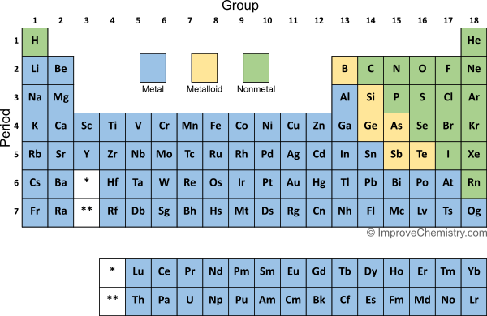
Which element is the most metallic, strontium, copper or lead?
At

Slide 70
Which element is the most metallic, strontium, copper or lead?
Sr is the
MOST METALLIC, it’s closest to francium!
At

Slide 71
50. Which element is
the most nonmetallic.
Sulfur,
Neon, or
Bromine?
At

Slide 72
50. Which element is
the most nonmetallic.
Sulfur,
Neon, or
Bromine?
Neon, it’s closest to He!
At

Slide 73
Cation Sizes and Anion Sizes
We have no charts to look over to determine the actual sizes of any ions, but we can still
figure out the trends of cation sizes and of anion sizes by thinking about the size of the ATOMS.
51. How big is a PICOMETER (pm)???
Table C says a “pico” is 1 x 10⁻¹² of a whole
Or 10¹² picometers = one meter.
10⁻¹² m = one trillionth of a meter

Slide 74
52 group 1 CATIONS | Electron configurations of cations | 53. group 17 ANIONS | Electron configurations of anions
Li⁺¹
Na⁺¹
K⁺¹
Rb⁺¹
The group trend for cation size is increasing. The group trend for anion size is increasing. …………..The group trend for all ions is increasing…………..

Slide 75
52 group 1 CATIONS | Electron configurations of cations | 53. group 17 ANIONS | Electron configurations of anions
Li⁺¹ | 2 | F⁻¹ | 2-8
Na⁺¹ | 2-8 | Cl⁻¹ | 2-8-8
K⁺¹ | 2-8-8 | Br⁻¹ | 2-8-18-8
Rb⁺¹ | 2-8-18-8 | I⁻¹ | 2-8-18-18-8
The group trend for cation size is increasing. The group trend for anion size is increasing. …………..The group trend for all ions is increasing…………..

Slide 76
52 group 1 CATIONS | Electron configurations of cations | 53. group 17 ANIONS | Electron configurations of anions
Li⁺¹ | 2 | F⁻¹ | 2-8
Na⁺¹ | 2-8 | Cl⁻¹ | 2-8-8
K⁺¹ | 2-8-8 | Br⁻¹ | 2-8-18-8
Rb⁺¹ | 2-8-18-8 | I⁻¹ | 2-8-18-18-8
a. The group trend for cation size is increasing. b. The group trend for anion size is increasing. c. The group trend for all ions is increasing…………..

Slide 77
55. Cations are smaller than their atoms by a whole shell.
Going down any group, you still ADD shells.
Anions are larger than their atoms, they stretch out
their valence shells.
Going down any group, you still ADD shells.

Slide 78
56. What the period trend for cations?
CATIONS Period 3 | Na⁺¹ | Mg⁺² | Al⁺³
Electron configurations

Slide 79
56. What the period trend for cation size?
CATIONS Period 3 | Na⁺¹ | Mg⁺² | Al⁺³
Electron configurations | 2-8 11 protons + 10 electrons | 2-8 12 protons + 10 electrons | 2-8 13 protons + 10 electrons
The period trend for cation size is decreasing.
WHY? Each cation has the exact same electron configuration, but each successive cation has more protons. More protons pull the same electrons in tighter (smaller)

Slide 80
56. What the period trend for cations?
CATIONS Period 3 | Na⁺¹ | Mg⁺² | Al⁺³
Electron configurations | 2-8 11 protons + 10 electrons | 2-8 12 protons + 10 electrons | 2-8 13 protons + 10 electrons
The period trend for cation size is decreasing.
WHY? Each cation has the exact same electron configuration, but each successive cation has more protons. More protons pull the same electrons in tighter (smaller)

Slide 81
56. What the period trend for anion size?
ANIONS Period 2 | N⁻³ | O⁻² | F⁻¹
Electron configurations
The period trend for anion size is decreasing.
Why? Each anion has the exact same electron configuration, but each successive cation has more protons. More protons pull the same electrons in tighter (smaller)

Slide 82
56. What the period trend for anion size?
ANIONS Period 2 | N⁻³ | O⁻² | F⁻¹
Electron configurations | 2-8 7 protons + 10 electrons | 2-8 9 protons + 10 electrons | 2-8 9 protons + 10 electrons
The period trend for anion size is decreasing.
Why? Each anion has the exact same electron configuration, but each successive cation has more protons. More protons pull the same electrons in tighter (smaller)

Slide 83
56. What the period trend for anion size?
ANIONS Period 2 | N⁻³ | O⁻² | F⁻¹
Electron configurations | 2-8 7 protons + 10 electrons | 2-8 9 protons + 10 electrons | 2-8 9 protons + 10 electrons
The period trend for anion size is decreasing.
Why? Each anion has the exact same electron configuration, but each successive cation has more protons. More protons pull the same electrons in tighter (smaller)

Slide 84
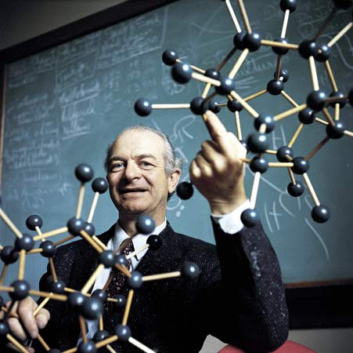
Electronegativity
the idea that generated a Nobel Prize for Dr. Linus Pauling
This guy is the ONLY person ever
to win 2 Nobel Prizes by himself.
Some others shared two prizes.
he’s really the man.

Slide 85
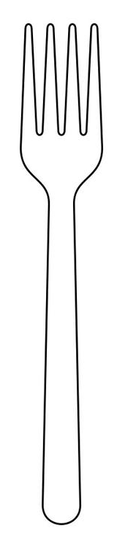
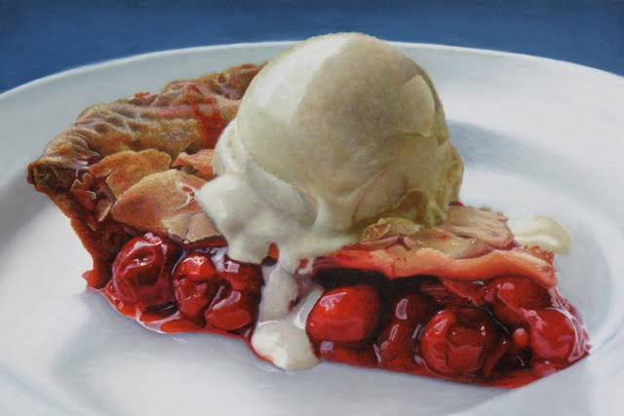
61. Electronegativity is defined as
the tendency for an atom to gain an electron when bonding.
Bonding is a complicated matter that we haven’t learned much about yet. Atoms bond by sharing electrons, or by transferring electrons in ionic bonding. Not all atoms or ions share the electrons fairly which makes one side of a bond more negative or more positive. These bonds are POLAR BONDS. Electronegativity is a measure of how well these electrons are shared, or how polar the bonds are. We’ll spend LOTS of time on this soon, but for now, it’s the trend, which is easy.
YOU
ME

Slide 86
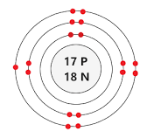
62. Let’s imagine the bond between H + Cl in HCl
Cl “pulls” a 3.2 amount, H pulls a 2.2 amount.
Chlorine gets the H electron MOST of the time.
This is a polar bond.
Cl EN Value: 3.2
H EN Value: ̶ 2.2
Difference in EN Values: 1.0
H
Cl

Slide 87
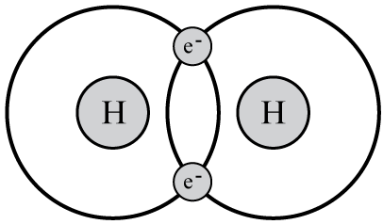
63. Let’s imagine 2 bonded hydrogen atoms.
Both atoms “pull” to get the other atoms electron a “2.2” amount.
Since they are the same, they share the two electrons equally.
This is a nonpolar bond.
H EN Value: 2.2
The Other H EN Value: ̶ 2.2
Difference in EN Values: ZERO

Slide 88
64. The greater the difference in electronegativity makes a
more polar bond.
65. No difference in electronegativity makes a
nonpolar bond.
66. By comparing a bond’s electronegativity difference
you can rank bonds from most polar to least polar.

Slide 89
67. Draw this diagram | H ̶ Cl Electronegativity values: 2.2 and 3.2 | The arrow itself is called a dipole arrow. It shows the polarity of the bond. The arrowhead points to where the electron “goes” (more negative). The arrow tail is a “positive” sign, it shows H lost an electron and is more positive

Slide 90
What is the group trend for electronegativity values? (do both groups, as a test)
Group 1 Atoms | Group 1 electronegativity values
Li
Na
K
Rb
Group 17 Atoms | Group 17 electronegativity values
F
Cl
Br
I
68. The group trend for electronegativity value is decreasing.
WHY? Smaller atoms have less protons, but the distance that they act upon is much smaller. Fluorine has the highest electronegativity value
of all, it is the perfect storm of “size and numbers of protons”.

Slide 91
What is the group trend for electronegativity values? (do both groups, as a test)
Group 1 Atoms | Group 1 electronegativity values
Li | 1.0
Na | 0.9
K | 0.8
Rb | 0.8
Group 17 Atoms | Group 17 electronegativity values
F | 4.0
Cl | 3.2
Br | 3.0
I | 2.7
68. The group trend for electronegativity value is decreasing.
WHY? Smaller atoms have less protons, but the distance that they act upon is much smaller. Fluorine has the highest electronegativity value
of all, it is the perfect storm of “size and numbers of protons”.

Slide 92
What is the group trend for electronegativity values? (do both groups, as a test)
Group 1 Atoms | Group 1 electronegativity values
Li | 1.0
Na | 0.9
K | 0.8
Rb | 0.8
Group 17 Atoms | Group 17 electronegativity values
F | 4.0
Cl | 3.2
Br | 3.0
I | 2.7
68. The group trend for electronegativity value is decreasing.
WHY? Smaller atoms have less protons, but the distance that they act upon is much smaller. Fluorine has the highest electronegativity value
of all, it is the perfect storm of “size and numbers of protons”.

Slide 93
69. What is the period trend for electronegativity value?
Period 2 | Li | Be | B | C | N | O | F | Ne
Electro Negativity Values
The period trend for electronegativity value is increasing.
WHY? Moving across a period there are the same number of electron shells, but more protons, which pull the electrons in tighter. Atoms are smaller, ions are smaller, and electrons are pulled in when bonding stronger. But what about NEON?

Slide 94
69. What is the period trend for electronegativity value?
Period 2 | Li | Be | B | C | N | O | F | Ne
Electro Negativity Values | 1.0 | 1.6 | 2.0 | 2.6 | 3.0 | 3.4 | 4.0 | ---
The period trend for electronegativity value is increasing.
WHY? Moving across a period there are the same number of electron shells, but more protons, which pull the electrons in tighter. Atoms are smaller, ions are smaller, and electrons are pulled in when bonding stronger. But what about NEON?

Slide 95
69. What is the period trend for electronegativity value?
Period 2 | Li | Be | B | C | N | O | F | Ne
Electro Negativity Values | 1.0 | 1.6 | 2.0 | 2.6 | 3.0 | 3.4 | 4.0 | ---
The period trend for electronegativity value is increasing.
WHY? Moving across a period there are the same number of electron shells, but more protons, which pull the electrons in tighter. Atoms are smaller, ions are smaller, and electrons are pulled in when bonding stronger. But what about NEON?

Slide 96
69. What is the period trend for electronegativity value?
Period 2 | Li | Be | B | C | N | O | F | Ne
Electro Negativity Values | 1.0 | 1.6 | 2.0 | 2.6 | 3.0 | 3.4 | 4.0 | ---
70. Neon has NO electronegativity value. It’s a noble gas and it has NO TENDENCY to gain electrons in a bond, it has no tendency to make bonds. Neon has only full shells, it’s fully stable and it is “disinterested” in helping other atoms get more stable.

Slide 97
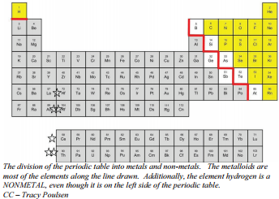
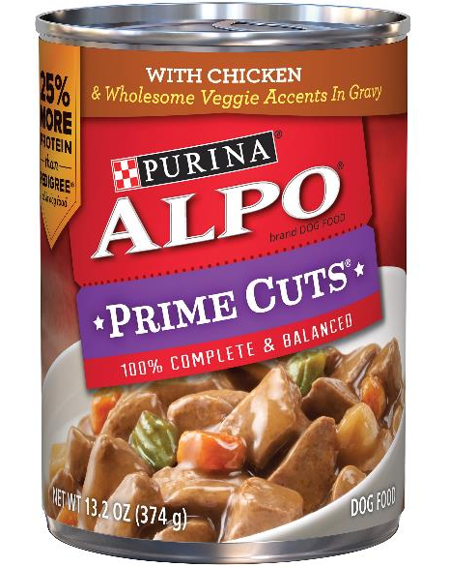
Exceptions to the trends.
The first trend you learned about wasn’t even called a trend back then. We learned that
nine atoms touch the staircase on the periodic table, but only 7 atoms are metalloids.
71. These atoms:
Al & Po are the
“dog food exception”.
That’s why I have a can
of AlPo dog food.

Slide 98

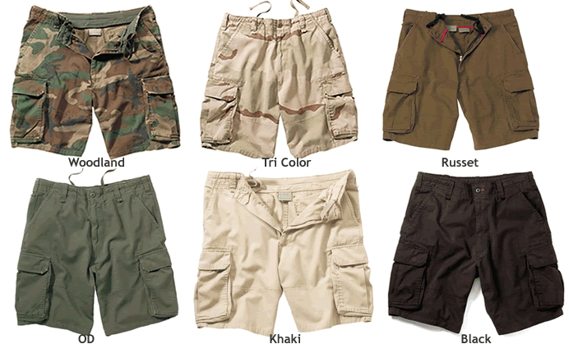
Most trends have exceptions. On the Periodic table, and off.
September
October
November
December
TODAY

Slide 99
Wearing pants is not the end of the trend, it’s an exception to the trend.
A trend is a pattern that is predictable and repetitive, but it can go oops.
72. What are the atomic masses of these elements in period 4?
atoms | Mn | Fe | Co | Ni | Cu
amu | 54.9380 | 55.845 | 58.9332 | 58.693 | 64.456
trend | ↑ | ↑ | ↑ | ↓ | ↑
73. Nickel does NOT DESTROY the trend, it’s an exception.

Slide 100
Atoms | Li | Be | B | C | N | O | F | Ne
Radius in pm | 130. | 99 | 84 | 75 | 71 | 64 | 60 | 62
 | start | ↓ | ↓ | ↓ | ↓ | ↓ | ↓ | ↑
74. The period trend for atomic radius is
decreasing. Neon is an exception to this trend.
No big deal.

Slide 101
75. Fill in this chart. Noble gases have no tendency to make bonds ever, they don’t have electronegativity
values either, right? Look them up now.
Atomic Number | Symbol | Name | Electronegativity value
2
10
18
36
54
86

Slide 102
76. Xenon is an exception to this trend. The trend stands, but xenon has formed into some
compounds when “forced” with super high pressure and lots of energy. Whoa!
Atomic Number | Symbol | Name | Electronegativity value
2 | He | helium | ----
10 | Ne | neon | ----
18 | Ar | argon | ----
36 | Kr | krypton | ----
54 | Xe | xenon | 2.6
86 | Rn | radon | ----
EXCEPTION

Slide 103
76. Xenon is an exception to this trend. The trend stands, but xenon has formed into some
compounds when “forced” with super high pressure and lots of energy. Whoa!
Xenon is an exception.
Noble gases are inert; they do not normally react with other elements.
By rule they make no bonds of any kind. But under extreme conditions of pressure scientists have been able to “force” xenon into some bonds.
You can’t do it, but it’s possible.
Atomic Number | Symbol | Name | Electronegativity value
2 | He | helium | ----
10 | Ne | neon | ----
18 | Ar | argon | ----
36 | Kr | krypton | ----
54 | Xe | xenon | 2.6
86 | Rn | radon | ----
EXCEPTION

Slide 104
77. Are there exceptions to Net Nuclear Charge?
Think hard.

Slide 105
77. Are there exceptions to Net Nuclear Charge?
No, the table adds ONE PROTON per box in every period, and lots of protons going down in the groups. This trend is perfect.

Slide 106
78. Predict the actual sizes of these cations first
Atom | Electron configuration | Radius | Ion | Electron configuration | Radius
Lithium
Magnesium
Scandium
Oxygen
Phosphorous

Slide 107
78. Predict the actual sizes of these anions next
Atom | Electron configuration | Radius | Ion | Electron configuration | Radius
Lithium | 2-1 | 32 pm | Li⁺¹ | 2 | 24 pm
Magnesium | 2-8-2 | 140. pm | Mg⁺² | 2-8 | 125 pm
Scandium | 2-8-9-2 | 159 pm | Sc⁺³ | 2-8-8 | 138 pm
Oxygen
Phosphorous

Slide 108
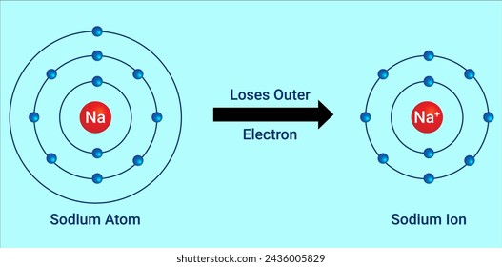
78. Cations are smaller than their atoms.
When a sodium atom becomes
a sodium cation, the atoms loses
1 electron and a whole shell. Atoms are BIGGER than cations.
78. Anions are bigger than their atoms.
When a fluorine atom becomes
a fluoride anion, the atoms gains
1 electron and the valence shell stretches out a bit,
to accommodate the extra electron.
Anions are BIGGER than atoms.
F
F

Slide 109
79. Cations are always much smaller than their
atoms WHY?
Cations LOSE a whole shell when they
“lose” electrons.
Anions are always slightly bigger than the
atoms they formed from, WHY?
Gaining electrons “fills” that valence shell,
stretching it out to full size.

Slide 110
Relative scales & arbitrary scales… Electronegativity (Dr. Linus was a fun guy, but not a fungi)
80. A relative scale compares all members of the group to one set standard.

Slide 111
Relative scales & arbitrary scales… Electronegativity (Dr. Linus was a fun guy, but not a fungi)
80. A relative scale compares all members of the group to one set standard.
81. Electronegativity is a relative scale; all atoms are relative to fluorine.
Pauling determined that fluorine has the greatest tendency to gain electrons
when making a bond, he ranked all other atoms to it.

Slide 112
Relative scales & arbitrary scales… Electronegativity (Dr. Linus was a fun guy, but not a fungi)
80. A relative scale compares all members of the group to one set standard.
81. Electronegativity is a relative scale; all atoms are relative to fluorine.
Pauling determined that fluorine has the greatest tendency to gain electrons
when making a bond, he ranked all other atoms to it.
82. An arbitrary scale is one that uses numbers that don’t really matter.
Pauling choose 4.0 for the highest EN value, given to fluorine.
All other atoms were given values ranked down to zero.
He could have use 100 as his top value, or eleven, or anything. He just picked 4.0 for his
own reason. There are not 4.0 somethings, in fact there isn’t even a unit.

Slide 113
Relative scales & arbitrary scales… Electronegativity (Dr. Linus was a fun guy, but not a fungi)
80. A relative scale compares all members of the group to one set standard.
81. Electronegativity is a relative scale; all atoms are relative to fluorine.
Pauling determined that fluorine has the greatest tendency to gain electrons
when making a bond, he ranked all other atoms to it.
82. An arbitrary scale is one that uses numbers that don’t really matter.
Pauling choose 4.0 for the highest EN value, given to fluorine.
All other atoms were given values ranked down to zero.
He could have use 100 as his top value, or eleven, or anything. He just picked 4.0 for his
own reason. There are not 4.0 somethings, in fact there isn’t even a unit.
83. Electronegativity is BOTH a RELATIVE SCALE & an ARBITRARY SCALE.

Slide 114
Last Point, not really related to Periodic Table, but stuck in here to keep in mind…
84. ALLOTROPES
Allotropes are pure forms of an element that have different bonding patterns which leads to different physical properties and
different chemical properties too.

Slide 115
85. ALLOTROPE examples
An allotrope is a chemically pure form of an atom that is structurally bonded together differently and therefore has different chemical and physical properties.
Carbon | Oxygen
1. Carbon atoms C | 1. Diatomic oxygen O₂
2. Graphite – layered sheets of C | 2. Triatomic oxygen ozone O₃
3. Buckminster fullerenes – balls of C atoms | 3. Oxygen atoms – unstable O
Allotropes are physically different from each other and have different properties.

