Slide 1
Objective:
Introduction to phases chemistry, how substances change phase from solid, to liquid to gas.
Today: # 1 through 27

Slide 2
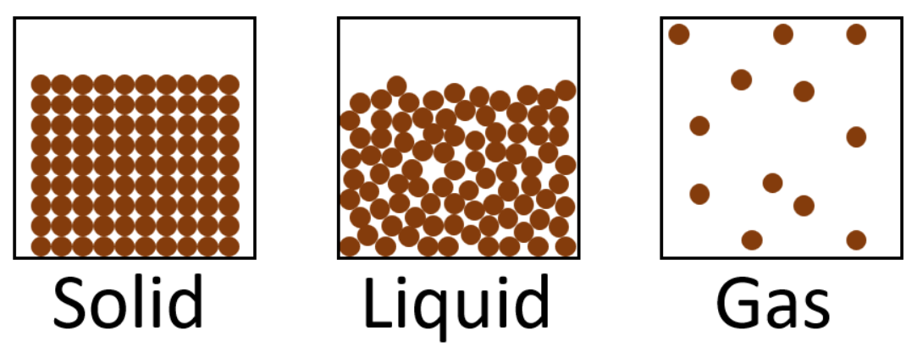
1. There are three phases of matter…

Slide 3
2. Six Phase
Changes
melting
vaporizing
condensing
freezing
sublimation
deposition

Slide 4
3. Six Phase Changes
Endothermic energy absorbed | Exothermic energy released
Melting solid → liquid | Freezing liquid → solid
Vaporizing liquid → gas | Condensing gas → liquid
Sublimation solid → gas | Deposition gas → solid

Slide 5
4. Indicate the “important” phase change temperatures
for water (at standard pressure)
solid
liquid
gas
273 K 0°C 373 K 100°C

Slide 6
5. Now, add some details.
solid
liquid
gas
273 K 0°C 373 K 100°C
This is the
MELTING POINT
and the
FREEZING POINT
It’s the cold phase change
This is the
BOILING POINT
and the
CONDENSING POINT
It’s the hot phase change

Slide 7
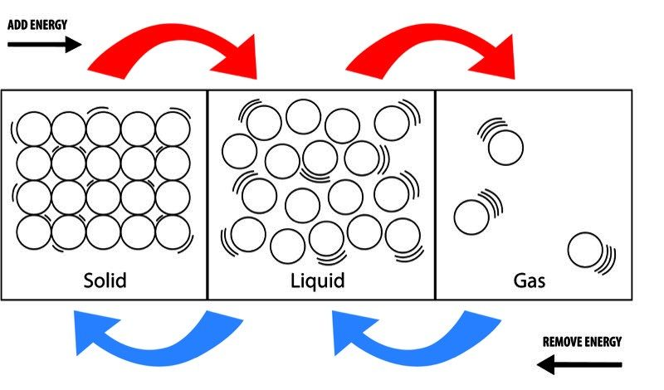
6. The melting point = the freezing point.
melting is endothermic
freezing is exothermic
This is the PHASE CHANGE temperature
between solid and liquid.
melting is endothermic
Both phase changes
occur at 0°C or 273 K
It’s only a matter of
the direction of energy
flow, in or out of the
water molecules.
freezing is exothermic

Slide 8
7. The boiling point = the condensing point.
Vaporization is endothermic.
Condensation is endothermic.
This is the PHASE CHANGE temperature
between liquid and gas.
vaporizing is endothermic
Both phase changes
occur at 100°C or 373 K
It’s only a matter of
the direction of energy
flow, in or out of the
water molecules.
condensing is exothermic

Slide 9
8. We will draw the heating curve for water. The graph can’t start at zero Kelvin.
The Heating Curve for WATER
Temp
In
Kelvin
Heat added at a constant rate →

Slide 10
9. Put the important temperatures on the Y axis
The Heating Curve for WATER
373
Temp
In
Kelvin
273
Heat added at a constant rate →

Slide 11
10. Done. Note: BC is much shorter than DE.
The Heating Curve for WATER
F
D
373
E
Temp
In
Kelvin
B
273
C
A
Heat added at a constant rate →

Slide 12
10. Let’s see what is happening at each segment now.
The Heating Curve for WATER
F
D
373
E
Temp
In
Kelvin
B
SEGMENT | TEMP CHANGE | KINETIC ENERGY CHANGE | POTENTIAL ENERGY CHANGE | PHASE OR PHASES PRESENT
AB
BC
CD
DE
EF
273
C
A

Slide 13
10. Let’s see what is happening at each segment now.
The Heating Curve for WATER
F
D
373
E
Temp
In
Kelvin
B
SEGMENT | TEMP CHANGE | KINETIC ENERGY CHANGE | POTENTIAL ENERGY CHANGE | PHASE OR PHASES PRESENT
AB | INC | INC | STEADY | solid
BC | STEADY | STEADY | INC | S→L
CD | INC | INC | STEADY | liquid
DE | STEADY | STEADY | INC | L→G
EF | INC | INC | STEADY | gas
273
C
A

Slide 14

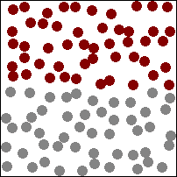
11. Temperature is hotter when the particles move FASTER
12. Cold temperatures means the particles move SLOWER
14. The “energy of motion” is called KINETIC energy.
← cooler
slower
hotter→
faster

Slide 15
15. When temperature increases, particles move faster.
That means temp + kinetic energy change together.
If temperature decreases, kinetic energy decreases
(particles slow).
If temperature increases, kinetic energy increases.
(particles speed up).
If temperature is steady, kinetic energy is steady too.

Slide 16
During a phase change on the heating curve, segment BC, heat energy is being
added at a constant rate, but the temperature, and kinetic energy, stay steady.
20. The Law of Conservation of Energy states:
Energy cannot be created or destroyed in a
chemical reaction, or during a physical change,
but it can be transferred.
How do we explain heat energy being added
while the Kinetic Energy remains steady?

Slide 17
Kinetic energy is the
energy of motion.
Potential energy is the
energy of phase.
21.

Slide 18
22. Potential energy of each phase
 | Gas highest PE
 | Liquid medium PE
 | Solid lowest PE
Condensation
decrease in PE
Vaporizing
increase in PE
Freezing
decrease in PE
Melting
increase in PE

Slide 19
23
 | Gas highest PE
 | Liquid medium PE
 | Solid lowest PE
Potential Energy
Increases
as phase changes
in this direction
Potential Energy
Decreases
as phase changes
in this direction

Slide 20
24. Which phase has the highest potential energy?
Solid Liquid Gas
25. Which phase has the lowest potential energy?
Solid Liquid Gas

Slide 21
24. Which phase has the highest potential energy?
Solid Liquid Gas
25. Which phase has the lowest potential energy?
Solid Liquid Gas

Slide 22
26. The cold phase change for H₂O, ice → water,
is endothermic. Energy is added, but
the temperature remains steady at 273 K.
If the law of conservation of energy holds (it does)
what energy increases during this phase change?

Slide 23
26. The cold phase change for H₂O, ice → water,
is endothermic. Energy is added, but
the temperature remains steady at 273 K.
If the law of conservation of energy holds (it does)
what energy increases during this phase change?
POTENTIAL ENERGY INCREASES.
The liquid phase is a higher potential than the solid phase.

Slide 24
27. Can both kinetic & potential
energy change at the same time?

Slide 25
27. Can both kinetic & potential
energy change at the same time?
No!

Slide 26
Last slide today. Using just your arms to dance
Let’s do the low kinetic energy dance first.
Next, do the high kinetic energy dance.
Something to make you smile…
Why does your teacher think he has
LOW KINETIC ENERGY,
but also, HIGH KINETIC ENERGY?
Read the PHASES BASICS tonight…

Slide 27
Phases Class 2 objective…
heating and cooling curves, changes of phase, changes in kinetic and potential energy.
Notes # 28 - 36

Slide 28
28. Draw the cooling curve for rubidium. Put in the 2 temperatures (from table S)
The COOLING Curve for RUBIDIUM
Temp
In
Kelvin
Heat is removed at a constant rate →

Slide 29
28. Draw the entire curve, put in dots and label each point A, B, C, D, E, F left to right.
The COOLING Curve for RUBIDIUM
961
Temp
In
Kelvin
312
Heat is removed at a constant rate →

Slide 30
29. Fill in the boxes under your graph.
The COOLING Curve for RUBIDIUM
A
C
961
B
Temp
In
Kelvin
E
312
D
F
Heat is removed at a constant rate →

Slide 31
29. Fill in the boxes under your graph.
The COOLING Curve for RUBIDIUM
A
C
961
B
Temp
In
Kelvin
SEGMENT | TEMP CHANGE | KINETIC ENERGY CHANGE | POTENTIAL ENERGY CHANGE | PHASE OR PHASES PRESENT
AB
BC
CD
DE
EF
E
312
D
F

Slide 32
29. Fill in the boxes under your graph.
The COOLING Curve for RUBIDIUM
A
C
961
B
Temp
In
Kelvin
SEGMENT | TEMP CHANGE | KINETIC ENERGY CHANGE | POTENTIAL ENERGY CHANGE | PHASE OR PHASES PRESENT
AB | DEC | DEC | steady | Gas
BC | steady | steady | DEC | Gas → Liquid
CD | DEC | DEC | steady | Liquid
DE | steady | steady | DEC | Liquid → Solid
EF | DEC | DEC | steady | Solid
E
312
D
F

Slide 33
30. On one graph, draw the heating curve for lead and the cooling curve for bismuth (!)

Slide 34
30. Get your data on table S before you draw the graphs…
LEAD red
BISMUTH blue
2022
1837
600
544

Slide 35
The HOT phase change (the higher one) is ALWAYS LONGER than the COLD phase change. ALWAYS.
F
D
2022
1837
A
E
C
B
Bismuth
cooling curve
Lead
heating curve
B
600
544
C
E
D
F
A
Heat added (or removed) at a constant rate →

Slide 36
The characteristics of solids, liquids and gases?
31. True or False, nearly every substance can be a solid, liquid or a gas?

Slide 37
The characteristics of solids, liquids and gases?
31. True or False, nearly every substance can be a solid, liquid or a gas?
32. An exceptions is wood, which is a mixed solid, but combusts before
it melts. All elements and nearly all compounds can be at any phase
with proper temperature and pressure.

Slide 38
The characteristics of solids, liquids and gases?
31. True or False, nearly every substance can be a solid, liquid or a gas?
32. An exceptions is wood, which is a mixed solid, but combusts before
it melts. All elements and nearly all compounds can be at any phase
with proper temperature and pressure.
33. Where do we find the element melting and boiling points? _______

Slide 39
The characteristics of solids, liquids and gases?
31. True or False, nearly every substance can be a solid, liquid or a gas?
32. An exceptions is wood, which is a mixed solid, but combusts before
it melts. All elements and nearly all compounds can be at any phase
with proper temperature and pressure.
33. Where do we find the element melting and boiling points? TABLE S
34. Where do we find the element freezing and condensing points? ____

Slide 40
The characteristics of solids, liquids and gases?
31. True or False, nearly every substance can be a solid, liquid or a gas?
32. An exceptions is wood, which is a mixed solid, but combusts before
it melts. All elements and nearly all compounds can be at any phase
with proper temperature and pressure.
33. Where do we find the element melting and boiling points? TABLE S
Where do we find the element freezing and condensing points?
Table S!
Melting point = Freezing point.
Boiling point = Condensation point.

Slide 41
35 | Particle Attraction | Particle Movement | Particles are... | Relative Density | Compressibility
Solid
Liquid
Gas

Slide 42
35 | Particle Attraction | Particle Movement | Particles are... | Relative Density | Compressibility
Solid | strong | almost none just a slight vibration | stuck together | usually highest | almost zero
Liquid | pretty strong | particles flow all over each other | sticky but not stuck | usually medium | almost zero
Gas | weak, almost nonexistent | rapid, in straight lines, with many collisions | hardly ever touch except to collide off of each other | always lowest | gases compress a lot!

Slide 43
36. Draw the particle diagrams of a solid, liquid and a gas in the boxes below.
SOLID | LIQUID | GAS

Slide 44
36. Draw the particle diagrams of a solid, liquid and a gas in the boxes below.
SOLID | LIQUID | GAS

Slide 45
36. Draw the particle diagrams of a solid, liquid and a gas in the boxes below.
SOLID Particles are rigidly arranged, orderly, repetitively spaced. They have a definite shape. They DO NOT take shape of container. | LIQUID Particles in constant motion and touch each other. They do not have definite shape. They TAKE the shape of the container. | GAS Particles are in fast motion, only touching when colliding. They have no shape, they FILL any container they’re in.

Slide 46
Phases Class #3 objective: Describing gas pressure
(or air pressure), what causes it and how does it change?
#37 to #73
We’ll start after a good story.
Pens down…

Slide 47


Slide 48
Gas Pressure
37. Gas Pressure is caused by the COLLISIONS of particles
with each other and the container walls that hold it.
38. More collisions = higher pressure
Stronger collisions = higher pressure
Hotter = higher kinetic energy = more and stronger collisions
Colder = lower kinetic energy = less and weaker collisions.
Hot ballons = happy kids Cold balloons = sad kids

Slide 49

Gas pressure is measured in four different units in chemistry. Most are weirdo, but you will learn them all. Take out table A.
41. Normal Pressure is
1 atm or 1 atmosphere
The WHOLE ATMOSPHERE
is pushing down on you →
1 atm = 101.3 kPa or 101.3 kiloPascals
These are metric units, good for our math!

Slide 50
1 atm = 101.3 kPa
42. In the USA &England we use crazy English units. For pressure they are pounds per square inch!
1 atm = 101.3 kPa = 14.7 psi

Slide 51
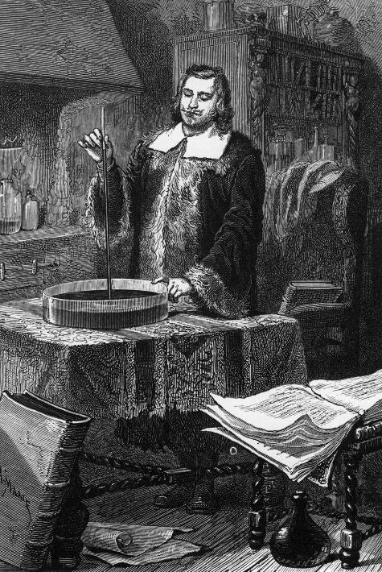
43. Measuring pressure was originally figured out by
a guy named EVANGLISTA TORRICELLI
44. He invented a device called the BAROMETER.
It used mercury and a metric ruler.
He decided that “normal pressure”
was when the air pressure could
push mercury up a tube 760 mm.

Slide 52
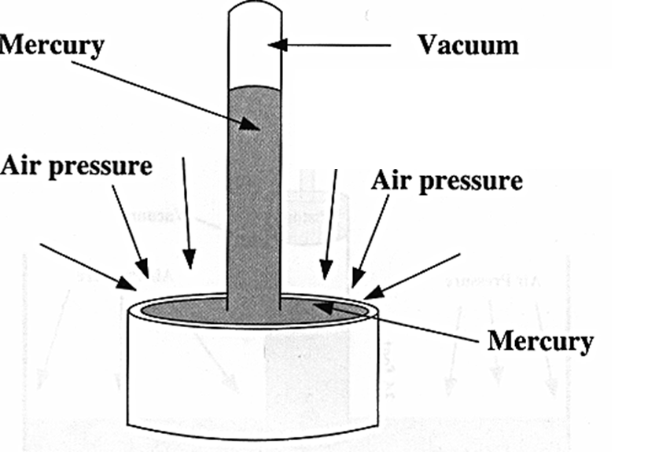
45. Torricelli’s Barometer
The higher the air pressure, the taller
the mercury rises.
Torricelli decided
that when the mercury reached exactly 760 mm,
it was a normal amount of pressure that was causing
this to happen.

Slide 53
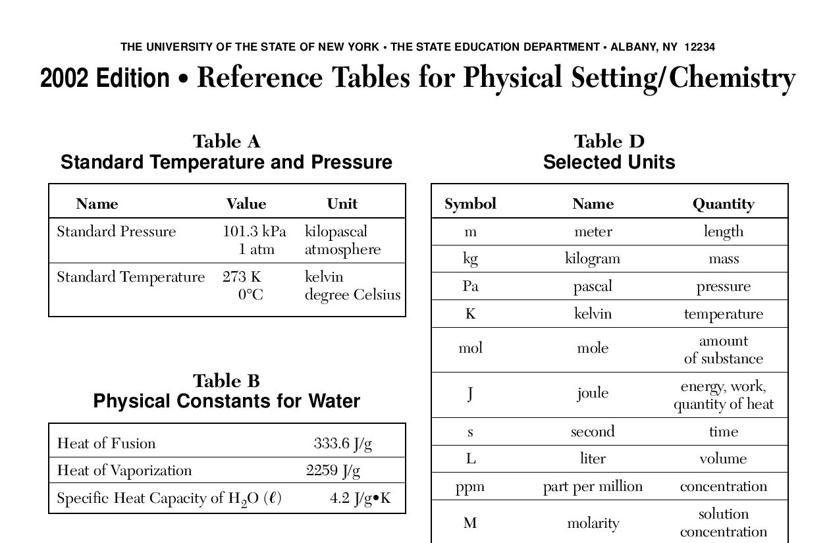
Right now, take out your reference tables to page 1.
Under Table A, write this into your table for safekeeping:
1 atm = 101.3 kPa = 760 mm Hg = 14.7 psi

Slide 54
Air and Gas Pressure Conversion Math
On cold days the air pressure is slightly higher than
normal (cold air is a little more dense than warm air). Today the air pressure registers 1.08 atm.
46. Convert 1.08 atm into kilopascals.

Slide 55
Air and Gas Pressure Conversion Math
On cold days the air pressure is slightly higher than
normal (cold air is a little more dense than warm air). Today the air pressure registers 1.08 atm.
46. Convert 1.08 atm into kilopascals.
1 atm = 101.3 kPa = 760 mm Hg = 14.7 psi
1.08 atm
1
X = 109 kPa
101.3 kPa
1 atm

Slide 56


Time out.
It’s time for 2 demos to PROVE that gases are REAL and that gases exert pressure. Proof came from a UE 4th grade student.
You should do both demos at home, tonight, for your family.

Slide 57
Time back in!
47. Convert 145 kPa into atmospheres.

Slide 58
Time back in!
47. Convert 145 kPa into atmospheres.
1 atm = 101.3 kPa = 760 mm Hg = 14.7 psi
145 kPa
1
X = 1.43 atm
1 atm
101.3 kPa

Slide 59
48. Convert 905 mm Hg into kPa.

Slide 60
48. Convert 905 mm Hg into kPa.
1 atm = 101.3 kPa = 760 mm Hg = 14.7 psi
905 mm Hg
1
X = 121 kPa
101.3 kPa
760 mm Hg

Slide 61
49. Convert 31.0 kPa (pressure on Mr. Everest)
into atmospheres.

Slide 62
49. Convert 31.0 kPa (pressure on Mr. Everest)
into atmospheres.
1 atm = 101.3 kPa = 760 mm Hg = 14.7 psi
31.0 kPa
1
X
1 atm
101.3 kPa
=
0.306 atm
3 SF

Slide 63
50. Convert the high pressure of 2.68 atm
into pounds per square inch.

Slide 64
50. Convert the high pressure of 2.68 atm
into pounds per square inch.
1 atm = 101.3 kPa = 760 mm Hg = 14.7 psi
2.68 atm
1
X
14.7 psi
1 atm
=
39.4 psi

Slide 65

51. The maximum pressure in
an NBA basketball is
8.50 psi. Convert 8.50 psi
into mm of Hg.
Giannis Antetokounmpo

Slide 66
51. The maximum pressure in
an NBA basketball is
8.50 psi. Convert 8.50 psi
into mm of Hg.
Giannis Antetokounmpo
1 atm = 101.3 kPa = 760 mm Hg = 14.7 psi
8.50 psi
1
760 mm Hg
14.7 psi
=
= 439 mm Hg
X
6460
14.7

Slide 67
52. A PHASE diagram shows the phases
of a substance at a variety of
temperatures and pressures.
Every substance has one, let’s look at the
PHASE DIAGRAM OF WATER

Slide 68
phase diagram for water
4
53
The dotted line is NORMAL PRESSURE
You live your whole life very close to that line.
That’s normal and good for
your health.
P
R
E
S
S
U
R
E
1
101.3
kPa
2
3
0°C
Temperature
100°C

Slide 69
phase diagram for water
4
54. #1 is the NORMAL FREEZING POINT FOR WATER
55. #2 is the NORMAL BOILING POINT FOR WATER
Normal pressure makes it “normal”
P
R
E
S
S
U
R
E
1
101.3
kPa
2
3
0°C
Temperature
100°C

Slide 70
phase diagram for water
4
56. # 3 is the
TRIPLE POINT.
All 3 phases and all 6 phase changes occur at the same time at this point.
57. # 4 is the
CRITICAL POINT
At this point you can’t tell the difference between gas or liquid.
P
R
E
S
S
U
R
E
1
101.3
kPa
2
3
0°C
Temperature
100°C

Slide 71
phase diagram for water
4
P
R
E
S
S
U
R
E
1
101.3
kPa
2
3
0°C
Temperature
100°C
58. Triple point for water is at 273.16 K or 0.01°C, and about 4.58 kPa
Critical point (VERY out of scale) is at 374°C (!) and about 22,080 kPa (!)

Slide 72
phase diagram for water
4
P
R
E
S
S
U
R
E
1
101.3
kPa
2
3
0°C
Temperature
100°C
59. The slanted line is ALL the melting & freezing points for H₂O at
many different pressures. Water normally freezes/melts at 0°C,
but at other pressures, this temperature changes.

Slide 73
phase diagram for water
4
P
R
E
S
S
U
R
E
1
101.3
kPa
2
3
0°C
Temperature
100°C
60. From point 3 → 4 are ALL the boiling/condensing points for H₂O.
Normally water boils at 100°C, but if you change the pressure
from “normal”, that changes this phase change temperature.

Slide 74
phase diagram for water
4
P
R
E
S
S
U
R
E
freezing
condensing
101.3
kPa
melting
vaporizing
deposition
sublimation
0°C
Temperature
100°C
61. Copy in the 6 phase changes onto your phase diagram.
Water can sublime & deposit, but only in the bottom left
corner of this graph.

Slide 75
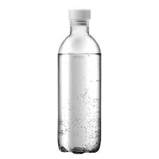
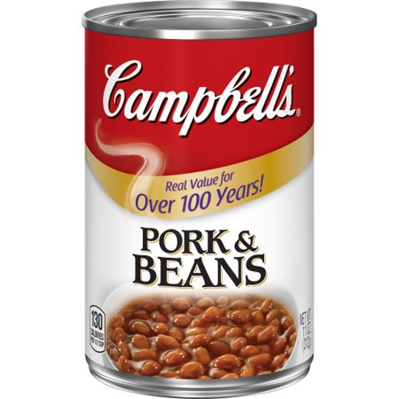

63. These 3 containers are examples of CLOSED systems.
Heating them up could cause an EXPLOSION due to the increasing VAPOR pressure.
Time for a story
from 1972 J
Vapor pressure is the extra pressure caused by the evaporating liquid inside of a closed system like a can or bottle, or a corked flask!

Slide 76
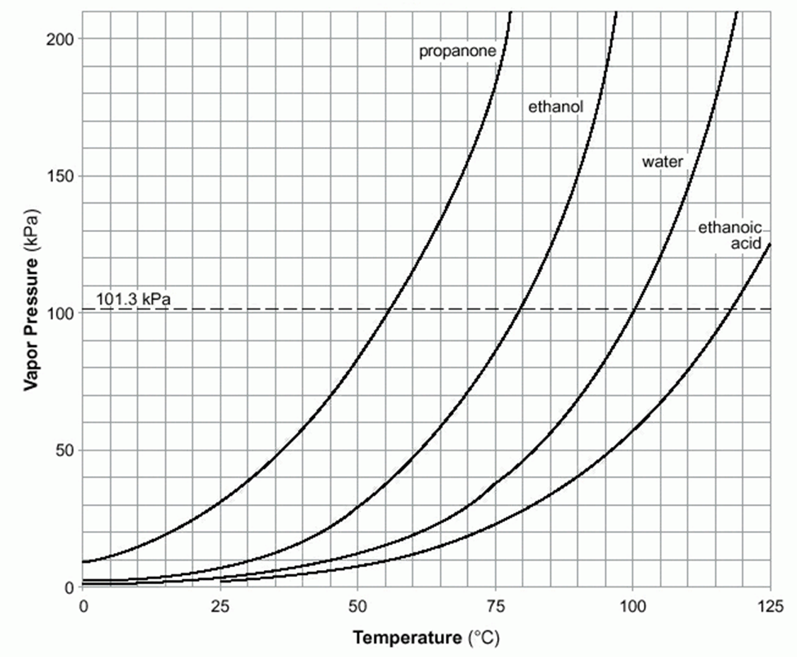
64
If you warm up a sealed can of beans
to 25°C, how much vapor pressure is added to the inside
of this can by the water inside it?
Only about 4 kPa, hardly enough to make any difference!
Table H

Slide 77
65
If you warm up a sealed can of beans
to 80°C, how much vapor pressure is added to the inside
of this can by the water inside it?
About 43 kPa, it’s starting to push hard from the inside out.
Table H

Slide 78
66
If you warm up a sealed can of beans
to 95°C, how much vapor pressure is added to the inside
of this can by the water inside it?
About 82 kPa.
It might explode!
Table H

Slide 79
67
What is the vapor pressure of….
Propanone at 45°C?
Ethanoic acid at 90°C?
Water at 105°C?
Ethanol at 90°C?
Table H

Slide 80
67
What is the vapor pressure of….
Propanone at 45°C?
70 kPa
Ethanoic acid at 90°C?
40 kPa
Water at 105°C?
120 kPa
Ethanol at 90°C?
70 kPa
Table H

Slide 81
If you close up a bottle of water and let it sit in the room, which is at 25°C, the water warms up and evaporates a bit.
68. How much pressure is in the top
of the bottle when you start?
69. How much is in it after
the water warms up to 25°C?

Slide 82
If you close up a bottle of water and let it sit in the room, which is at 25°C, the water warms up and evaporates a bit.
68. How much pressure is in the top
of the bottle when you start?
69. How much is in it after
the water warms up to 25°C?
This makes almost no difference.
Vapor pressure is the extra pressure caused by
evaporating liquid in a close system (like a bottle).
101.3 kPa
101.3 kPa + 3 kPa
~ 104 kPa

Slide 83
70. What if the bottle is heated up to 90°C?
Pressure changes from 101.3 kPa
To 101.3 kPa + 70 kPa = 171 kPa !!
(think: Boom!)

Slide 84
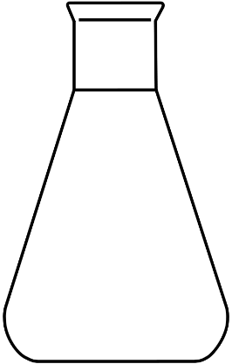
3 corked bottles
with equal volumes
of different liquids.
What happens as we
heat them slowly.
# | Temp | Ethanol VP in kPa | Ethanoic Acid VP in kPa | Propanone VP in kPa
71 | 25°C
72 | 45°C
73 | 75°C

Slide 85
3 corked bottles
with equal volumes
of different liquids.
What happens as we
heat them slowly.
# | Temp | Ethanol VP in kPa | Ethanoic Acid VP in kPa | Propanone VP in kPa
71 | 25°C | 8 kPa | 3 kPa | 31 kPa
72 | 45°C | 22 kPa | 6 kPa | 70 kPa
73 | 75°C | 88 kPa | 23 kPa | 180 kPa
The propanone bottle will EXPLODE first.

Slide 86
Phases class #4

Slide 87
Table H tells us 3 different things…
74. Tells us the vapor pressure of 4 liquids, at many pressures.
Vapor pressure is the extra pressure inside of a closed system,
caused by the evaporation of a liquid.
Some liquids evaporate easier (higher VP, weaker IMF)
Some liquids evaporate worse (lower VP, stronger IMF).
75. Tells us the boiling points of 4 liquids, at many pressures.
76. Tells us what phase (liquid or gas) these substances are,
at any pressure/temperature point on the graph.

Slide 88
Let’s look at table H again
77. Point 1 is called
78. Point 2 is called the
79. Point 3 is called the
80. Point 4 is called the
81. Point 5 is called
82. Point 6 is called the
5
2
1
3
4
6

Slide 89
Let’s look at table H again
77. Point 1 is called
normal boiling point of water
78. Point 2 is called the
normal boiling point of propanone
(water is in the liquid phase here)
79. Point 3 is called the
normal boiling point of ethanoic acid
80. Point 4 is called the
a lower boiling point of water
at a lower pressure than normal
81. Point 5 is called a higher boiling point of water where there is high pressure.
82. Point 6 is called the a boiling point of water when air pressure is very low.
5
2
1
3
4
6

Slide 90
83. What is the boiling point of
ethanol at 60 kPa?
84. What is the boiling point of
propanone at 70 kPa?
85. What is the boiling point of
ethanol at 150 kPa?
86. What is the boiling point of
water at 180 kPa?
87. What is the boiling point of
ethanol at 30 kPa?

Slide 91
83. What is the boiling point of
ethanol at 60 kPa? 65°C
84. What is the boiling point of
propanone at 70 kPa? 45°C
85. What is the boiling point of
ethanol at 150 kPa? 90°C
86. What is the boiling point of
water at 180 kPa? 115°C
87. What is the boiling point of
ethanol at 30 kPa? 50°C

Slide 92
Fill in this chart…
88
Pressure | Temperature | This | is a…
80 kPa | 50°C | Ethanol | Liquid
110 kPa | 95°C | Ethanol
110 kPa | 95°C | Water
110 kPa | 95°C | Ethanoic acid
120 kPa | 60°C | Propanone

Slide 93
Fill in this chart…
88
Pressure | Temperature | This | is a…
80 kPa | 50°C | Ethanol | Liquid
110 kPa | 95°C | Ethanol | Gas
110 kPa | 95°C | Water | Liquid
110 kPa | 95°C | Ethanoic acid | Liquid
120 kPa | 60°C | Propanone | Liquid

Slide 94
Fill in this chart…
89
Pressure | Temperature | This | is a…
130 kPa | 65°C | Propanone
40 kPa | 90°C | Ethanoic acid
190 kPa | 115°C | Water
101.3 kPa | 56°C | Ethanol
20 kPa | 10°C | ALL FOUR

Slide 95
Fill in this chart…
89
Pressure | Temperature | This | is a…
130 kPa | 65°C | Propanone | Gas
40 kPa | 90°C | Ethanoic acid | Liquid + Gas !
190 kPa | 115°C | Water | Liquid
101.3 kPa | 56°C | Ethanol | Liquid
20 kPa | 10°C | ALL FOUR | Liquid

Slide 96
At point | What phase is…
1 | propanone | liquid
2 | propanone
2 | ethanol
3 | water
3 | ethanoic acid
4 | ethanoic acid
4 | ethanol
5 | ethanol
5 | water
6 | all 4 compounds
2
5
4
1
3
6
Gas or
Liquid
or both ?
90

Slide 97

At point | What phase is…
1 | propanone | liquid
2 | propanone | gas
2 | ethanol | liquid
3 | water | gas
3 | ethanoic acid | liquid
4 | ethanoic acid | liquid
4 | ethanol | gas
5 | ethanol | gas
5 | water | gas and liquid!
6 | all 4 compounds | all gas
2
5
4
1
3
6

Slide 98
Kinetic Molecular Theory
This theory explains how gases “work”.
How do gases exist as gases?
How they stay gases?
How the particles of gas act (atoms or molecules)?
How should we understand gases in our minds?

Slide 99
97. The KMT states
A. Gases are in random, constant, straight-line motion
This means the particles do not hover, stop, or do loop de loops.

Slide 100
97. The KMT states
B. Gases are separated by great distances relative to their size
This means that the particles are super far apart. This causes very low density compared to liquids or solids.

Slide 101
C. The volume of the gas
particles is considered
negligible.
Compared to the space the whole gas takes up the space that the particles would take up is less than 1% of that.

Slide 102
D. Gases have no attractive
forces between them.
(nor repulsive)
They seem to act this way,
but there is attraction and repulsion between gas particles.

Slide 103
E. Gases have collisions that may result in a transfer of energy between gas particles, but the total energy of the system remains constant.
That means these collisions are elastic (but they are not)

Slide 104
What does this mean?
Gases are real and made up of atoms and molecules.
When these particles collide with each other and the sides of containers, pressure is exerted. More collisions = higher pressure.
Collisions of course result in the loss of energy. Not a lot, but this loss should cause gases to turn to liquids over time as they run out of energy. They don’t because (really) the Sun comes out and rewarms the Earth every day. And we turn on the heat in our buildings too.
Gases are mostly empty space; particle size is insignificant.
Gases usually stay gases, but the theory talks about perfection and real gases are not perfect.

