Slide 1
Intro to the first of 5 chemical reactions
In a chemical reaction, sometimes bonds are broken and sometimes new bonds form, and sometimes both happen. Every time a reaction occurs new substances form. These new substances have their own properties that are not like the properties of the reactants. There are 5 of kinds of reactions that we learn about.
The first kind of reaction is called the SYNTHESIS REACTION.
It may be called a combination reaction

Slide 2
2. In a synthesis reaction, smaller reactants
combine to form larger products.
3. The “ABSTRACT” is X + Y → XY
4. The Reactants form into Products.

Slide 3
Vocabulary
Reactants are the substances that we start with, they react
together and form the products.
Products are what we end up with at the end.
Synthesis reaction has 2 or more reactants that form into one larger product.
Energy is required to start all chemical reactions.
EXOTHERMIC reactions emit more energy than was provided to start the reaction. ENDOTHREMIC reactions absorb more energy than they emit.

Slide 4


Demo of Synthesis… coming in a few minutes.
Remember on the first day
we blew up
a balloon filled with hydrogen
and it created a
fireball?
We are going to
do it again,
with more chemistry
-- but we still need to
protect our ears!

Slide 5
Before we do this reaction again, we can first describe it several ways.
10. A word equation describes the reaction with words, no symbols, no numbers, as simply as possible. Name each substance properly, reactants forming into products.
11. The word equation for this reaction will be:
__________________________________________________________________

Slide 6
11. The word equation for this reaction will be:
Hydrogen and oxygen gases form into water
Or
Hydrogen and oxygen gases form dihydrogen monoxide
Or
Hydrogen and oxygen gases synthesize into water
Etc. Simple, clear, fewer words, in a non-confusing way.
Don’t say it backwards:
Water forms from hydrogen and oxygen gases combining.

Slide 7
To balance a chemical reaction, you must start with the correct chemical symbols. We call this the SKELETON.
This shows all the substances written in proper form.
The word equation gives us the skeleton:
12. Hydrogen and oxygen gases make water
__________________________________________________

Slide 8
The + sign means these reactants react.
The arrow sign → means react into
YOU DO NOT WRITE IN THE DASHES, those are for thinking, and teaching, not for balancing.
12. Hydrogen and oxygen gases make water…
__H_{2(G)} + __O_{2(G)} → __H₂O_{(G)}
This is not balanced. Note the phase symbols.

Slide 9
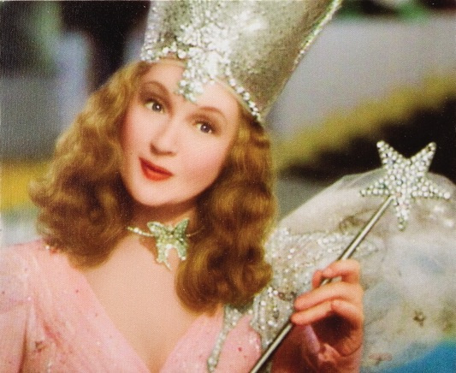
14. Glinda says…
“It’s always best to start
at the beginning.”
15. Rewrite the skeleton reaction from above again.
Then we’ll balance it.
__H_{2(G)} + __O_{2(G)} → __H₂O_{(G)}

Slide 10
15. Balanced….
Hydrogen and oxygen gases make water…
2H_{2(G)} + O_{2(G)} → 2H₂O_{(G)}

Slide 11
15. Balanced….
Hydrogen and oxygen gases make water…
2H_{2(G)} + O_{2(G)} → 2H₂O_{(G)}
16. There are the same number of atoms on the reactant side as the product side.
Matter can’t be created or destroyed
in a chemical reaction (or physical change).

Slide 12
Just do it.
Stop torturing the students Charlie, blow up the balloon already.

Slide 13
17. Balanced Thermochemical equation….
This is an EXOTHERMIC REACTION
2H_{2(G)} + O_{2(G)} → 2H₂O_{(G)} + Energy
Although energy was required to start this
reaction, the energy given off was much greater;
the “NET ENERGY” is a product.
Energy is written with the products.

Slide 14
18. An important chemical adage is
“When bonds form, energy is released.”
In this case, it took energy to break the bonds between the hydrogen atoms, and between the oxygen atoms, but MORE energy was released when the bonds inside the water formed.
19. To break bonds, energy must be absorbed.

Slide 15
2H_{2(G)} + O_{2(G)} → 2H₂O_{(G)} + Energy
Energy is required to
break the bonds holding the H₂ together, and to break the bonds holding the O₂ together.
“To break bonds,
energy is absorbed.”
21. When the water forms, these bonds are so stable, that a lot of energy is released.
“When bonds form energy is released.”

Slide 16
Copy the word equation, (22) write the skeleton equation, then (23) balance the chemical reaction.
Add phase symbols where you can.
copy: Sodium + chlorine yields sodium chloride
22. ___________________________________
23. ___________________________________

Slide 17
Copy the word equation, (22) write the skeleton equation, then (23) balance the chemical reaction.
Add phase symbols where you can.
copy: Sodium + chlorine yields sodium chloride
22. Na + Cl₂ → NaCl
23. 2Na_{(S)} + Cl_{2(G)} → 2NaCl_{(S)}

Slide 18
Copy the word equation, (24) write the skeleton equation, then (25) balance the chemical reaction. Add phase symbols where you can.
copy: Iron + Oxygen synthesizes to iron III oxide
Unless you’re a genius, write out the ions.
24. ___________________________________
25. ___________________________________

Slide 19
Copy the word equation, (24) write the skeleton equation, then (25) balance the chemical reaction. Add phase symbols where you can.
copy: Iron + Oxygen synthesizes to iron III oxide
Unless you’re a genius, write out the ions.
24. Fe_{(S)} + O_{2(G)} → Fe₂O_{3(S)}
25. 4Fe_{(S)} + 3O_{2(G)} → 2Fe₂O_{3(S)}

Slide 20
Copy the word equation, (26) write the skeleton equation, then (27) balance the chemical reaction. Add phase symbols where you can.
copy: Aluminum + Sulfur synthesize into aluminum sulfide
Al⁺³ S⁻²
26. ___________________________________
27. ___________________________________

Slide 21
Copy the word equation, (26) write the skeleton equation, then (27) balance the chemical reaction. Add phase symbols where you can.
copy: Aluminum + Sulfur synthesize into aluminum sulfide
Al⁺³ S⁻²
26. Al_{(S)} + S_{(S)} → Al₂S_{3(S)}
27. 2Al_{(S)} + 3S_{(S)} → Al₂S_{3(S)}

Slide 22
Copy the word equation, (28) write the skeleton equation, then (29) balance the chemical reaction. Add phase symbols where you can.
copy: Potassium and bromine make potassium bromide K⁺¹ Br ⁻¹
28. ___________________________________
29. ___________________________________

Slide 23
Copy the word equation, (28) write the skeleton equation, then (29) balance the chemical reaction. Add phase symbols where you can.
copy: Potassium and bromine make potassium bromide K⁺¹ Br ⁻¹
28. K_{(S)} + Br_{2(L)} → KBr_{(S)}
29. 2K_{(S)} + Br_{2(L)} → 2KBr_{(S)}

Slide 24
30. Four skeleton equations… Balance them now.
_C + _O₂ → _CO
_Cu + _O₂ → _Cu₂O
_Zn + _O₂ → _ZnO
_N₂ + _H₂ → _NH₃

Slide 25
30. Four skeleton equations… Balance them now.
2C + O₂ → 2CO
4Cu + O₂ → 2Cu₂O
2Zn + O₂ → 2ZnO
N₂ + 3H₂ → 2NH₃

Slide 26
Decomposition reactions
31. Decomposition reactions are the opposite of synthesis, here
one larger reactant is broken down into 2 or more smaller products
In a decomposition reaction there is always
ONE REACTANT, and 2 or more products
Example: Lead II oxide decomposes into lead and oxygen
Copy: 2PbO_{(S)} → 2Pb_{(S)} + O_{2(G)}
(balanced)

Slide 27
32. Abstract: AB → A + B
33. Word Equation for Decomp demo reaction…
hydrogen peroxide decomposes into water & oxygen gas
34. Skeleton __H₂O_{2(L)} → __H₂O_{(L)} + __O_{2(G)}
Do the demo now!

Slide 28
34. Balanced Chemical Reaction
2H₂O_{2(AQ)} → 2H₂O_{(L)} + O_{2(G)}
Count… 4 H’s & 4 O’s in reactants. 4 H’s and 4 O’s in the products
35. This reaction is SO SLOW, that
you need to add a CATALYST

Slide 29
Add the CATALYST where it belongs.
KI
2H₂O_{2(AQ)} → 2H₂O_{(L)} + O_{2(G)} + energy

Slide 30
36.
The exact same reaction occurs with a catalyst as without one, but when things happen fast, they appear different.
Slow or fast, without or with a catalyst,
it’s the SAME REACTION,
just the speed changes.
Because it happens so fast,
it seems like something else happened.

Slide 31
37.
The catalyst is
NOT A REACTANT

Slide 32
Copy the word equation (39) write the skeleton equation
then (40) balance the chemical reaction.
Add phase symbols where you can.
38. copy: magnesium nitride decomposes
Mg⁺² N⁻³ into magnesium & nitrogen
39. ___________________________________
40. ___________________________________

Slide 33
Copy the word equation, (38) write the skeleton equation
then (39) balance the chemical reaction.
Add phase symbols where you can.
38. copy: magnesium nitride decomposes
Mg⁺² N⁻³ into magnesium & nitrogen
39. _Mg₃N_{2(S)} → _Mg_{(S)} + _N_{2(G)}
40. Mg₃N_{2(S)} → 3Mg_{(S)} + N_{2(G)}

Slide 34
41. Copy the word equation, (42) write the skeleton,
then (43) balance the chemical reaction.
Add phase symbols.
copy: Magnesium carbonate decomposes
into carbon dioxide & magnesium oxide
Mg⁺² CO₃⁻² Mg⁺² O⁻²
42. ___________________________________
43. ___________________________________

Slide 35
41. Copy the word equation, (42) write the skeleton,
then (43) balance the chemical reaction.
Add phase symbols.
copy: Magnesium carbonate decomposes
into carbon dioxide & magnesium oxide
Mg⁺² CO₃⁻² Mg⁺² O⁻²
42. MgCO_{3(S)} → CO_{2(G)} + MgO_{(S)}
43. It’s perfect just like that!

Slide 36
44. Copy the word equation, (45) write the skeleton,
then (46) balance the chemical reaction.
Add phase symbols.
44. Iron (II) oxide decomposes Fe⁺² O⁻²
45. ___________________________________
46. ___________________________________

Slide 37
44. Copy the word equation, (45) write the skeleton,
then (46) balance the chemical reaction.
Add phase symbols.
44. Iron (II) oxide decomposes Fe⁺² O⁻²
45. _FeO_{(S)} → _Fe_{(S)} + _O_{2(G)}
46. 2FeO_{(S)} → 2Fe_{(S)} + O_{2(G)}

Slide 38
47. Copy the word equation, (48) write the skeleton,
then (49) balance the chemical reaction.
Add phase symbols.
47. Ammonia gas decomposes.
48. ___________________________________
49. ___________________________________

Slide 39
47. Copy the word equation, (48) write the skeleton,
then (49) balance the chemical reaction.
Add phase symbols.
47. Ammonia gas decomposes.
48. _NH_{3(G)} → _N_{2(G)} + _H_{2(G)}
49. 2NH_{3(G)} → N_{2(G)} + 3H_{2(G)}

Slide 40
50. Copy the word equation, (51) write the skeleton,
then (52) balance the chemical reaction.
Add phase symbols.
50. Dinitrogen Pentoxide gas decomposes
into nitrogen + oxygen gas.
51. ___________________________________
52. ___________________________________

Slide 41
50. Copy the word equation, (51) write the skeleton,
then (52) balance the chemical reaction.
Add phase symbols.
50. Dinitrogen Pentoxide gas decomposes
into nitrogen + oxygen gas.
51. _N₂O_{5(G)} → _N_{2(G)} + _O_{2(G)}
52. 2N₂O_{5(G)} → 2N_{2(G)} + 5O_{2(G)}

Slide 42
Single Replacement Reactions
(I Love Janet so I Love Table J too.)
52. Single Replacement reactions (SR) start with you adding atoms of an element into one aqueous solution.

Slide 43
53. When IONIC COMPOUNDS dissolve into water they are
AQUEOUS
54. Ionic compounds form LOOSE MOBILE IONS
in water if they are soluble. If they are insoluble the
compounds just fall to the bottom of the beaker like rocks.
55. A simple ionic compound, NaCl does this:
NaCl_{(S)} |  | Na⁺¹_{(AQ)} | + | Cl⁻¹_{(AQ)}
water

Slide 44
56. First the salt disappears, it dissolves.
At the particle level, the NaCl separates into positive and negative ions, which are now loose in the water, creating a SOLUTION of loose mobile ions.
57. This is not a chemical reaction.
It’s a PHYSICAL CHANGE S → AQ

Slide 45
58. When salts dissolve into water, there are
no reactants or products because it is
not a chemical reaction.
This is a MIXTURE.
Because the salt dissolves into water, and it is homogenous, it forms an aqueous solution
We have lots of aqueous solutions in chem.
Examples include (look at table I)

Slide 46
SALT | goes into water | forms this | + | that
SOLID | goes into water | forms LOOSE MOBILE IONS
KNO_{3(S)} | ^{water} | K⁺¹_{(AQ)} | + | NO₃⁻¹_{(AQ)}
NaOH_{(S)} | ^{water} | Na⁺¹_{(AQ)} | + | OH⁻¹_{(AQ)}
NH₄Cl_{(S)} | ^{water} |  | +

Slide 47
59. Another ionic compound that dissolves and ionizes in water is SILVER NITRATE.
We’ll put some atoms of COPPER into it,
which is a single replacement reaction set up.
Cu_{(S)} + AgNO_{3(AQ)} →

Slide 48
60. In a single replacement reaction, there are always
3 parts, the atoms, cations and the anions. (label)
Cu_{(S)} + AgNO_{3(AQ)} →
COPPER is
the atom
Nitrate is
the anion
Silver is
the cation
61. 2 of these 3 are ALWAYS on one side of table J or
on the other side of table J. LOOK NOW.

Slide 49
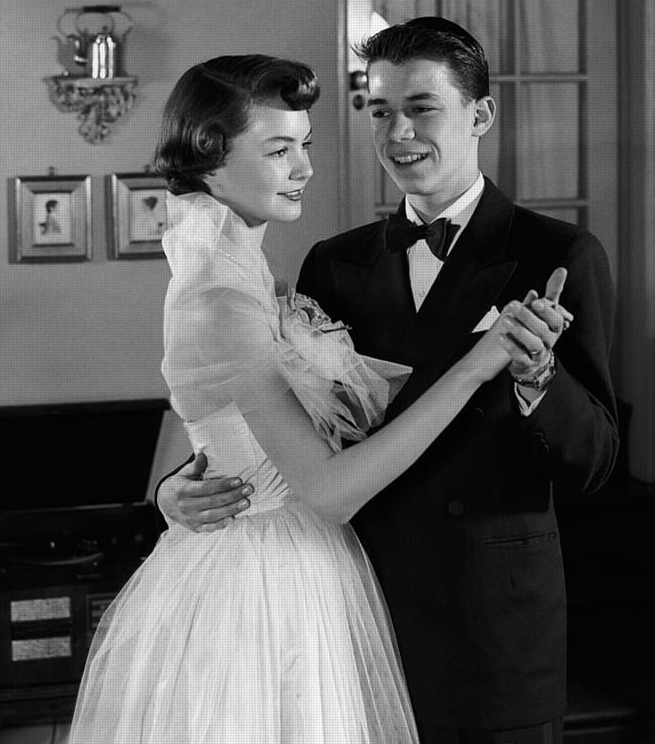
Time for a story…
Cu_{(S)} + AgNO_{3(AQ)} →
Nitrate is the anion part
COPPER is the
ATOMS part
Silver is the cation part

Slide 50
63. COPPER is “higher” than silver on table J. See top left and bottom left of the table. It says MOST ACTIVE at top, which means more reactive. Or less reactive.
The copper has the chemical strength to REPLACE the silver in the solution, the
silver gets bumped out of solution.

Slide 51
64. The copper TAKES the silver’s place in the solution,
the silver falls out as a solid in the new copper solution.
Cu_{(S)} + AgNO_{3(AQ)} → CuNO_{3(AQ)} + Ag_{(S)}
65. The nitrate anion basically hangs out in solution, unchanged. The nitrate ion is called the…
“SPECTATOR ION”
Table J reminds me of my wife Janet.

Slide 52
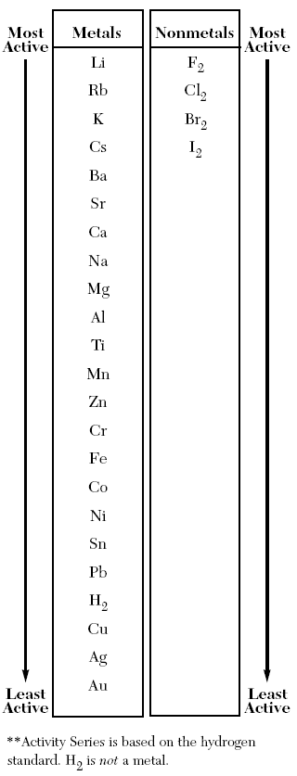
66. A single replacement reaction always has 3 parts, the ATOMS,
the CATION and the ANION.
67. Two of the 3 are ALWAYS on one side of table J. The other is on the other side, or not even on the table (who cares!)
COPPER
and SILVER
are on the LEFT SIDE.
68. Copper is MORE REACTIVE
than silver, so it bumps the silver out and takes its place in the solution.

Slide 53
69. Copy word equation
Magnesium metal and hydrochloric acid form…
First, look at table K. That’s a list of acid names and formulas. Don’t forget it. Which one is the first one?
70. Acids are weird compounds. They are molecular, they
do not form ions to bond, but in water they “unbond” like
cations do, forming loose mobile ions.
The more H⁺¹ ions in solution, the stronger the acid.
The chlorides sort of are just there.

Slide 54
70. Remember when ionic compounds go into water, they dissolve, and IONIZE, like this:
Compound | Goes into water | Forms cations | And | anions
NaCl_{(S)} |  | Na⁺¹_{(AQ)} | + | Cl⁻¹_{(AQ)}
HCl_{(G)} |  | H⁺¹_{(AQ)} | + | Cl⁻¹_{(AQ)}
water
water
Acids are common aqueous solutions
in many kinds of chemical reactions.

Slide 55
Mg_{(S)} + HCl_{(AQ)} →
Atoms Cation /Anion
71. The 3 parts, the perfect set up for
a single replacement reaction.
Watch the demo!

Slide 56
Mg_{(S)} + HCl_{(AQ)} →
Mg is more reactive (higher on table J)
so… Mg will replace the H⁺¹ in solution,
bumping the hydrogen out as a gas.
The chloride is our spectator ion.

Slide 57
Skeleton (now balance it)
_Mg_{(S)} + _HCl_{(AQ)} → _MgCl_{2(AQ)} + _H_{2(G)}

Slide 58
Skeleton (now balance it)
_Mg_{(S)} + _HCl_{(AQ)} → _MgCl_{2(AQ)} + _H_{2(G)}
Balanced!
Mg_{(S)} + 2HCl_{(AQ)} → MgCl_{2(AQ)} + H_{2(G)}
74. The Mg replaces the H⁺¹ in solution, the
hydrogen precipitates as a gas, and
the chloride Cl⁻¹ anions are the spectators.

Slide 59
Mg_{(S)} + 2HCl_{(AQ)} → MgCl_{2(AQ)} + H_{2(G)}
All this talk of table J…

Slide 60
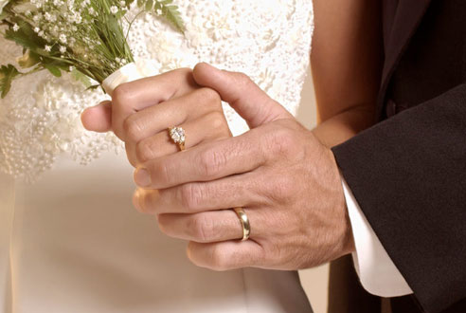
Love + Table J
Charlie gets married with a Band of Gold (Au) from Janet…

Slide 61
Charlie’s Wedding Band is Made of
Solid gold!
?
HCl_{(AQ)}

Slide 62
Table J tells us when reactions will happen, or not.
75. Au_{(S)} + HCl _{(AQ)} → X no reaction
76. Because Au is lower than H on table J,
gold is not active enough to bump out
the hydrogen from solution!
Nothing happens!

Slide 63
Balance these SR reactions or write an X for no reaction
77.
Mg_{(S)}+ Zn(NO₃)_{2(AQ)} → __________________

Slide 64
Balance these SR reactions or write an X for no reaction
77.
Mg_{(S)}+ Zn(NO₃)_{2(AQ)} → Mg(NO₃)_{2(AQ)} + Zn_{(S)}
Mg is higher on J than Zn, so
Mg replaces the Zn in solution. Nitrate anions are the spectators.

Slide 65
Balance these SR reactions or write an X for no reaction
78.
Na_{(S)} + Sn(NO₃)_{2(AQ)} → __________________

Slide 66
Balance these SR reactions or write an X for no reaction
78.
2Na_{(S)} + Sn(NO₃)_{2(AQ)} → 2NaNO_{3(AQ)} + Sn_{(S)}
Na is higher on J than Sn, so
Na replaces the Sn in solution. Nitrate anions are the spectators.

Slide 67
Balance these SR reactions or write an X for no reaction
79.
Cl_{2(G)} + KBr_{(AQ)} → ____________________

Slide 68
Balance these SR reactions or write an X for no reaction
79.
Cl_{2(G)} + KBr_{(AQ)} → ____________________
Cl_{2(G)} + 2KBr_{(AQ)} → 2KCl_{(AQ)} + Br_{2(L)}
SPECIAL: Cl is higher on J than Br, so
Cl replaces the Br in solution. Potassium cations are the spectators.
79. This is special
It’s called an ANION REPLACEMENT kind of SR.

Slide 69
Balance this…
80. Zinc and sulfuric acid… (copy the blue)
Zn_{(S)}+ H₂SO_{4(AQ)} →

Slide 70
Balance this…
80. Zinc and sulfuric acid… (copy the blue)
Zn_{(S)}+ H₂SO_{4(AQ)} → ZnSO_{4(AQ)} + H_{2(G)}
81. Zn is higher than H is on table J, so
Zn replaces the H⁺¹ in solution, H₂ gas escapes,
the SO₄⁻² sulfate anion is our spectator here.
Switch ‘em, fix ‘em, balance ‘em!

Slide 71
Balance this… copy the blue…
82. Lithium and
cobalt (III) hydrogen carbonate solution…
Li_{(S)} + Co(HCO₃)_{3(AQ)} →

Slide 72
Balance this… copy the blue…
82. Lithium and
cobalt (III) hydrogen carbonate solution…
3Li_{(S)} + Co(HCO₃)_{3(AQ)} → 3LiHCO_{3(AQ)} + Co_{(S)}
Lithium replaces the cobalt in solution,
hydrogen carbonate is our spectator ion.

Slide 73
Balance these… copy the blue
83. silver metal and potassium chloride solution…
Ag_{(S)}+ KCl_{(AQ)} →
Switch ‘em. Fix em’. Balance ‘em.

Slide 74
Balance these… copy the blue
83. silver metal and potassium chloride solution…
Ag_{(S)}+ KCl_{(AQ)} → X no reaction
copy this:
Silver is BELOW potassium on table J, it cannot push the K⁺¹ ion out of solution. Nothing happens.
(the silver does get wet in the beaker)

Slide 75
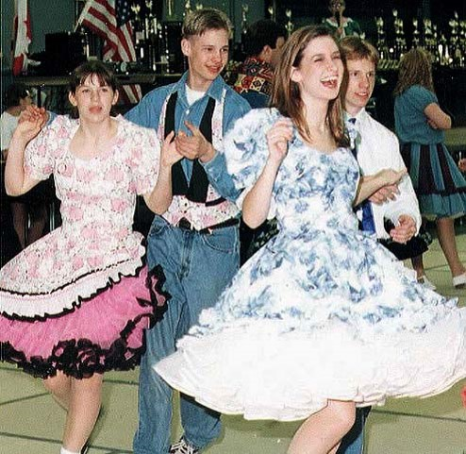
Double Replacement Reactions
The Vestal KB, 2006…

Slide 76
Double Replacement Reactions
84. Two AQ solutions starts a double replacement
reaction.
AQ + AQ →
85. You end up with a
DIFFERENT AQ and a SOLID (precipitate)
86. AQ + AQ → diff AQ + S

Slide 77
Double Replacement Reactions
87. In the abstract:
AB_{(AQ)} + XY_{(AQ)} → AY_{(AQ)} + XB_{(S)}
The cations come first, and they stay first.
Copy red box and arrows into your notes.

Slide 78
88. Let’s watch a DR reaction…
copper (II) sulfate + lithium carbonate
solutions combine…

Slide 79
Copper (II) sulfate + lithium carbonate solutions combine…
write the ions first, you must get the skeleton perfect!
Cu⁺² SO₄⁻² Li⁺¹ CO₃⁻²
CuSO_{4(AQ)} + Li₂CO_{3(AQ)} →
Switch ‘em, and fixe ‘em!

Slide 80
Copper (II) sulfate + lithium carbonate solutions combine…
write the ions first, you must get the skeleton perfect!
Cu⁺² SO₄⁻² Li⁺¹ CO₃⁻² Fe⁺³ CO₃⁻² Li⁺¹ SO₄⁻²
CuSO_{4(AQ)} + Li₂CO_{3(AQ)} → CuCO₃₍ ₎ + Li₂SO₄₍ ₎
It’s already balanced! So, now we F’em!

Slide 81
Copper (II) sulfate + lithium carbonate solutions combine…
write the ions first, you must get the skeleton perfect!
Cu⁺² SO₄⁻² Li⁺¹ CO₃⁻² Fe⁺³ CO₃⁻² Li⁺¹ SO₄⁻²
CuSO_{4(AQ)} + Li₂CO_{3(AQ)} → CuCO_{3(S)} + Li₂SO_{4(AQ)}
DR = AQ + AQ → diff AQ + S

Slide 82
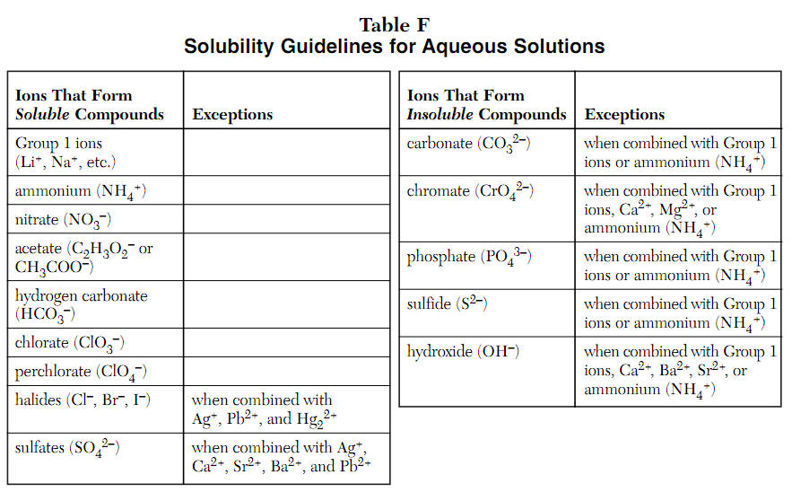
Label the tops of each of the 4 columns, AQ or S, like this now.
AQ
S
AQ
S

Slide 83
Copper (II) nitrate + lithium chromate solutions combine…
write the ions first, you must get the skeleton perfect!
Cu⁺² NO₃⁻¹ Li⁺¹ CrO₄⁻² Cu⁺² CrO₄⁻² Li⁺¹ NO₃⁻¹
Cu(NO₃)_{2(AQ)} + Li₂CrO_{4(AQ)} → CuCrO_{4(S)} + 2LiNO_{3(AQ)}
Table F show us this is solid
and this is aqueous in water
This is the precipitate that “proves” a reaction happened.

Slide 84
89. Sodium chloride + lead (II) acetate solutions
combine…
write out all ions to get formulas correct. Then do it again for the products.

Slide 85
89. Sodium chloride + lead (II) acetate solutions
combine…
write out all ions to get formulas correct. Then do it again for the products.
Na⁺¹ Cl⁻¹ Pb⁺² C₂H₃O₂⁻¹
__NaCl_{(AQ)} + __Pb(C₂H₃O₂)_{2(AQ)} →

Slide 86
89. Sodium chloride + lead (II) acetate solutions
combine…
write out all ions to get formulas correct. Then do it again for the products.
Na⁺¹ Cl⁻¹ Pb⁺² C₂H₃O₂⁻¹
__NaCl_{(AQ)} + __Pb(C₂H₃O₂)_{2(AQ)} →

Slide 87
89. Sodium chloride + lead (II) acetate solutions
combine into sodium acetate and lead (II) chloride
Na⁺¹ Cl⁻¹ Pb⁺² C₂H₃O₂⁻¹ Na⁺¹ C₂H₃O₂⁻¹ Pb⁺² Cl⁻¹
__NaCl_{(AQ)} + __Pb(C₂H₃O₂)_{2(AQ)} →

Slide 88
89. Sodium chloride + lead (II) acetate solutions
combine into sodium acetate and lead (II) chloride
Na⁺¹ Cl⁻¹ Pb⁺² C₂H₃O₂⁻¹ Na⁺¹ C₂H₃O₂⁻¹ Pb⁺² Cl⁻¹
_NaCl_{(AQ)} + _Pb(C₂H₃O₂)_{2(AQ)} → _NaC₂H₃O₂₍ ₎ + _PbCl₂₍ ₎
Switched, fixed, now balance this.

Slide 89
89. Sodium chloride + lead (II) acetate solutions
combine into sodium acetate and lead (II) chloride
Na⁺¹ Cl⁻¹ Pb⁺² C₂H₃O₂⁻¹ Na⁺¹ C₂H₃O₂⁻¹ Pb⁺² Cl⁻¹
2NaCl_{(AQ)} + _Pb(C₂H₃O₂)_{2(AQ)} → 2NaC₂H₃O₂₍ ₎ + _PbCl₂₍ ₎
Now, table F this.

Slide 90
89. Sodium chloride + lead (II) acetate solutions
combine into sodium acetate and lead (II) chloride
Na⁺¹ Cl⁻¹ Pb⁺² C₂H₃O₂⁻¹ Na⁺¹ C₂H₃O₂⁻¹ Pb⁺² Cl⁻¹
2NaCl_{(AQ)} + _Pb(C₂H₃O₂)_{2(AQ)} → 2NaC₂H₃O_{2(AQ)} + _PbCl_{2(S)}
Table F if your name is chloride, you are probably insoluble (S) but there are exceptions.
For instance, Na is an exception (NaCl is AQ).
Lead IS an exception, PbCl₂ is (S)

Slide 91
90. Write the IONS and FORMULAS. Are these AQ or S in water?
Compound | IONS | FORMULA | AQ or S ?
Silver chloride | Ag⁺¹ Cl⁻¹ | AgCl | S
Magnesium nitrate
Sodium hydroxide
Strontium sulfate
Calcium nitrate
Barium acetate
Aluminum chlorate
Lead (II) bromide
Lithium sulfide
Ammonium chromate
Barium sulfate

Slide 92
90. Now do the rest…
Compound | IONS | FORMULA | AQ or S ?
Silver chloride | Ag⁺¹ Cl⁻¹ | AgCl | S
Magnesium nitrate | Mg⁺² NO₃⁻¹ | Mg(NO₃)₂ | AQ
Sodium hydroxide
Strontium sulfate
Calcium nitrate
Barium acetate
Aluminum chlorate
Lead (II) bromide
Lithium sulfide
Ammonium chromate
Barium sulfate

Slide 93
90. DONE!
Compound | IONS | FORMULA | AQ or S ?
Silver chloride | Ag⁺¹ Cl⁻¹ | AgCl | S
Magnesium nitrate | Mg⁺² NO₃⁻¹ | Mg(NO₃)₂ | AQ
Sodium hydroxide | Na⁺¹ OH⁻¹ | NaOH | AQ
Strontium sulfate | Sr⁺² SO₄⁻² | SrSO₄ | S
Calcium nitrate | Ca⁺² NO₃⁻¹ | Ca(NO₃)₂ | AQ
Barium acetate | Ba⁺² C₂H₃O₂⁻¹ | Ba(C₂H₃O₂)₂ | AQ
Aluminum chlorate | Al⁺³ ClO₃⁻¹ | Al(ClO₃)₃ | AQ
Lead (II) bromide | Pb⁺² Br⁻¹ | PbBr₂ | S
Lithium sulfide | Li⁺¹ S⁻² | Li₂S | AQ
Ammonium chromate | NH₄⁺¹ CrO₄⁻² | (NH₄)₂CrO₄ | AQ
Barium sulfate | Ba⁺² SO₄⁻² | BaSO₄ | S

Slide 94
Turn these equation openings into balanced
Double Replacement reactions now. Complete one slide
91. Potassium phosphate + calcium chloride
solutions combine into…

Slide 95
91. Potassium phosphate + calcium chloride
solutions combine into…
Potassium phosphate + calcium chloride solutions
combine into potassium chloride and calcium phosphate
K⁺¹ PO₄⁻³ Ca⁺² Cl⁻¹ K⁺¹ Cl⁻¹ Ca⁺² PO₄⁻³
2K₃PO_{4(AQ)} + 3CaCl_{2(AQ)} → 6KCl_{(AQ)} + _Ca₃(PO₄)_{2(S)}

Slide 96
92. Copy the reactants, finish the equation, balance and complete the phase symbols for both products. Write ions first!
Ba⁺² Cl⁻¹ Rb⁺¹ OH⁻¹
_BaCl_{2(AQ)} + _RbOH_{(AQ)} →

Slide 97
92. Copy the reactants, finish the equation, balance and complete the phase symbols for both products. Write ions first!
Ba⁺² Cl⁻¹ Rb⁺¹ OH⁻¹ Ba⁺² OH⁻¹ Rb⁺¹ Cl⁻¹
_BaCl_{2(AQ)} + 2RbOH_{(AQ)} → _Ba(OH)_{2(AQ)} + 2RbCl_{(AQ)}
What happened here?
2 AQ solutions as a product?? WHAT??

Slide 98
92. Copy the reactants, finish the equation, balance and complete the phase symbols for both products. Write ions first!
Ba⁺² Cl⁻¹ Rb⁺¹ OH⁻¹ Ba⁺² OH⁻¹ Rb⁺¹ Cl⁻¹
_BaCl_{2(AQ)} + 2RbOH_{(AQ)} → _Ba(OH)_{2(AQ)} + 2RbCl_{(AQ)}
When both products are AQ,
a chemical reaction
did not happen.
All we did was mix the
2 solutions together,
but they didn’t form a solid product.

Slide 99
Second period today we will practice. Reference tables and pens only.
Clear your desks.
Yellow handout is just Synthesis and Decomp Reactions,
but LOTS of practice writing formulas and balancing.
You can do this, or you give up, but there is no in between.
I will help you, with practice you will improve,
but with giving up you throw away your entire future
and surrender to failure and weakness. Be strong.

Slide 100
Combustion Reactions
93. Combustion reactions require a
hydrocarbon + oxygen → carbon dioxide + water
(+ energy)
94. Hydrocarbon is a compound made
of carbon and hydrogen only.
95. There are 1000’s of different hydrocarbons,
methane (CH₄) is the smallest

Slide 101
96. In the abstract…
“HC”₍ ₎ + O_{2(G)} → CO_{2(G)} + H₂O_{(G)}
Gases, liquids, or solids possible.
Hydrocarbons | Examples
gas | methane, propane
liquid | butane, octane
solid | waxes

Slide 102
Word Equation: Methane combusts.
Copy this skeleton reaction, then balance it…
(you don’t have to write the dashes, they are for thinking)
.
_CH_{4(G)} + _O_{2(G)} → _CO_{2(G)} + _H₂O_{(G)}
Balance this here

Slide 103
Word Equation: Methane combusts.
Copy this skeleton reaction, then balance it…
(you don’t have to write the dashes, they are for thinking)
.
_CH_{4(G)} + 2O_{2(G)} → _CO_{2(G)} + 2H₂O_{(G)}
1:2:1:2 John Dalton is happy. Heat released makes the water a gas too.

Slide 104
98. Propane combusts.
_C₃H_{8(G)} + _O_{2(G)} →
Balance this here

Slide 105
98. Propane combusts.
_C₃H_{8(G)} + 5O_{2(G)} → 3CO_{2(G)} + 4H₂O_{(G)}
1:5:3:4 John Dalton is happy. Heat released makes the water a gas too.

Slide 106
Ethane combusts
_C₂H_{6(G)} + _O_{2(G)} →
Balance this here

Slide 107

Ethane combusts
2C₂H_{6(G)} + 7O_{2(G)} → 4CO_{2(G)} + 6H₂O_{(G)}
I’m Happy.
John Dalton is happy.
2:7:4:6 cannot be reduced.
Pharrell is Happy.

Slide 108
100. Oxygenated hydrocarbon:
a hydrocarbon that also has oxygen.
These include sugars, acids, alcohols, and many other compounds. They combust too, but the balancing is a little trickier. There’s oxygen in all reactants and all products.

Slide 109
Demo for Combustion of Methanol
101. Word Equation: Methanol combusts
You will not always “know” the formulas for these, they will be provided.
Methanol formula is CH₃OH
That’s weird looking but we write alcohol formulas in the “organic chem style”.
_CH₃OH_{(G)}+ _O_{2(G)} →
Balance this here

Slide 110

Demo for Combustion of Methanol
101. Word Equation: Methanol combusts
You will not always “know” the formulas for these, they will be provided.
Methanol formula is CH₃OH
That’s weird looking but we write alcohol formulas in the “organic chem style”.
2CH₃OH_{(G)}+ 3O_{2(G)} → 2CO_{2(G)} + 4H₂O_{(G)}
What says John Dalton?
Uncle John says 2:3:2:4 can’t be reduced – great! Everyone’s happy now.

Slide 111
102. Glucose (C₆H₁₂O₆) combusts.
_C₆H₁₂O_{6(S)} + _O_{2(G)} → _CO_{2(G)} + _H₂O_{(G)}
Balance this here

Slide 112
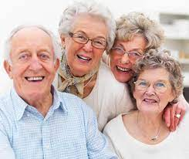
102. Glucose (C₆H₁₂O₆) combusts.
_C₆H₁₂O_{6(S)} + 6O_{2(G)} → 6CO_{2(G)} + 6H₂O_{(G)}
And John Dalton says?
Perfect 1:6:6:6 can’t be reduced ratio.
Even us oldies are happy.

Slide 113
103. Octane (C₈H₁₈) combusts.
_C₈H_{18(L)} + __O_{2(G)} → _CO_{2(G)} + __H₂O_{(G)}
Balance this here

Slide 114
103. Octane (C₈H₁₈) combusts.
2C₈H_{18(L)} + 25O_{2(G)} → 16CO_{2(G)} + 18H₂O_{(G)}
Boom!

Slide 115
OB: recognizing chemical reactions, balancing practice.
REVIEW
Get your reference tables and
white paper too.
Studying means writing, not looking. Studying is ACTIVE, not passive.

Slide 116
104. Phosphorous + chlorine gas form into
phosphorous pentachloride gas.
Balance this here

Slide 117
104. Phosphorous + chlorine gas form into
phosphorous pentachloride gas.
2P_{(S)} + 5Cl_{2(G)} → 2PCl_{5(G)}

Slide 118
105. Manganese VII oxide forms into
manganese and oxygen gas
Balance this here

Slide 119
Manganese VII oxide forms into
manganese and oxygen gas
2Mn₂O_{7(S)} → 4Mn_{(S)} + 7O_{2(G)}
decomposition

Slide 120
106. Sodium goes into aluminum acetate solution
Balance this here

Slide 121
106. Sodium goes into aluminum acetate solution
3Na_{(S)} + _Al(C₂H₃O₂)_{3(AQ)} → 3NaC₂H₃O_{2( AQ)} + _Al_{(S)}
This is a cation replacement; the sodium bounces out the
Al⁺³ cation. The acetate anion is the spectator ion here.

Slide 122
107. Bromine is added to lithium iodide solution
Balance this here

Slide 123
107. Bromine is added to lithium iodide solution
_Br_{2(L)} + 2LiI_{(AQ)} → 2LiBr_{(AQ)} + _I_{2(S)}
Here bromine bumps out the IODIDE anion, Li⁺¹ is the spectator ion.
This is an anion replacement single replacement reaction.
HONCIBrIF twins

Slide 124
108. Tin is added to barium chlorate solution
Balance this here

Slide 125
108. Tin is added to barium chlorate solution
_Sn_{(S)} + _Ba(ClO₃)_{2 (AQ)} → X no reaction
Because Ba is “higher” or more reactive than Sn on table J, the tin cannot replace the barium. Nothing happens (the tin gets wet in the beaker)
Sn below Ba on table J

Slide 126
109. Lithium nitrate and potassium chloride
solutions are poured together
Balance this here

Slide 127
109. Lithium nitrate and potassium chloride
solutions are poured together
Li⁺¹ NO₃⁻¹ K⁺¹ Cl⁻¹ K⁺¹ NO₃⁻¹ Li⁺¹ Cl⁻¹
_LiNO_{3(AQ)} + _KCl_{(AQ)} → _KNO_{3(AQ)} + LiCl_{(AQ)}
Balanced in a 1:1:1:1 ratio
What happened? 2 AQ products = NO REACTION
This is just a mixture.
NOT a chemical reaction

Slide 128
110. Lead (II) hydrogen carbonate and
Cobalt (III) sulfate solutions are poured together
Balance this here

Slide 129
110. Lead (II) hydrogen carbonate and
Cobalt (III) sulfate solutions are poured together
Pb⁺² HCO₃⁻¹ Co⁺³ SO₄⁻² Co⁺³ HCO₃⁻¹ Pb⁺² SO₄⁻²
Pb(HCO₃)_{2(AQ)} + Co₂(SO₄)_{3(AQ)} → Co(HCO₃)_{3(AQ)} + PbSO_{4(S)}
Forming cobalt (III) hydrogen carbonate solution and lead (II) sulfate solid.
Double Replacement

Slide 130
111. Sodium hydroxide and ammonium chromate
solutions mix together…
Balance this here

Slide 131
111. Calcium hydroxide and ammonium chromate
solutions mix together…
Ca⁺² OH⁻¹ NH₄⁺¹ CrO₄⁻² NH₄⁺¹ OH⁻¹ Ca⁺² CrO₄⁻²
2Ca(OH)_{2(AQ)} + (NH₄)₂CrO_{4(AQ)} → 2NH₄OH _{(AQ)} + Ca₂CrO_{4(S)}
Double Replacement

Slide 132
112. Hexane combusts C₆H_{14(L)}
Balance this here

Slide 133
112. Hexane combusts C₆H_{14(L)}
2C₆H_{14(L)} + 19O_{2(G)} → 12CO_{2(G)} + 14H₂O_{(G)}
Simple whole number ratios.

Slide 134
114. Propanol combusts (C₃H₅OH) this is a type of alcohol.
Balance this here

Slide 135
114. Propanol combusts (C₃H₅OH) this is a type of alcohol.
C₃H₅OH_{(L)} + 4O_{2(G)} → 3CO_{2(G)} + 3H₂O_{(G)}
You did it!

Slide 136
In combustion, only carbon dioxide (+ water) form, like this…
CH_{4(G)} + 2O_{2(G)} → CO_{2(G)} + 2H₂O_{(G)}
That is COMPLETE COMBUSTION.
115. But if there is not enough oxygen for this to
happen, sometimes burning still happens,
but it is not combustion that occurs,
INCOMPLETE COMBUSTION
can happen instead.
There are MANY kinds of incomplete combustion reactions, you can’t know them all, but you can balance any of them, if given the products.

Slide 137
116. Incomplete combustion examples
3CH_{4(G)} + 2O_{2(G)} → C_{(S)} + 2CO_{(G)} + 2H₂O_{(G)}
_{Or}
2CH_{4(G)} + 3O_{2(G)} → 2CO_{(G)} + 4H₂O_{(G)}
_{Or}
3CH_{4(G)} + 5O_{2(G)} → CO_{(G)} + 2CO_{2(G)} + 6H₂O_{(G)}
Solid carbon is soot, carbon monoxide is poison.
There are many other incomplete combustion equations.

