Slide 1
Redox Class #1: oxidation + reduction reactions made fun (kidding)
Redox is the chemistry of
1. batteries
2. electroplating precious metals onto physically stronger metals
3. decomposing water with electricity

Slide 2
4. The two ⅟₂ reactions of Redox are always paired and balanced.
Red (reduction)
Ox (oxidation)

Slide 3
5. In the old days...
Oxidation meant combining or bonding with oxygen atoms
Reduction meant un-bonding from oxygen atoms

Slide 4
6. Now scientists understand this as
Oxidation: “LOSING ELECTRONS” (or becoming a cation)
Reduction: “GAINING ELECTRONS” (or becoming an anion)

Slide 5
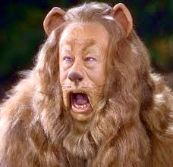
To remember this, we’ll say…
LEO the lion goes GER!

Slide 6
To remember, we’ll say LEO the lion goes GER!
LEO = LOSS of Electrons is Oxidation
LEO
GER = GAIN of Electrons is Reduction
GER
OiL RiG = Oxidization is Losing electrons, Reduction is Gaining Electrons

Slide 7
8 | word eq | magnesium and oxygen form magnesium oxide
9 | skeleton | Mg + O₂ → MgO
10 | balanced | 2Mg + O₂ → 2MgO
11 | with oxidation numbers | 2Mg⁰ + 2O₂⁰ → 2Mg⁺²O⁻²
12 | What’s happening here? | Magnesium atoms lose 2 electrons each, they become two magnesium +2 cations Oxygen atoms gain 2 electrons each, they become oxide -2 anions. The oxidation numbers (ionic charges) change through the arrow, this is redox.
13 | Skip this one | Ha!

Slide 8
14 | Specifically, Mg atoms oxidize into Mg⁺² cations
15 | The oxygen atoms are reduced into oxide O⁻² anions
16 | By rule, all atoms are neutral, even HONClBrIF twins
17 | Atoms are neutral, ions have their specific charges
18 | Ionic compounds are neutral, but they are made up of charged ions which sum to zero.
19 | If the reactants have different charges, or different oxidation numbers than the products, Redox occurred.

Slide 9
 | 2Mg⁰ + O₂⁰ → 2Mg⁺²O⁻²
20 | In this synthesis/redox reaction, which species is oxidized?
 | Mg atoms are oxidized (into Mg⁺² cations)
21 | In this synthesis/redox reaction, which species is reduced?
 | O atoms are reduced (into O⁻² anions)
22 | What’s up with saying “species” in chemistry?
 | There are 2 “species” of magnesium (Mg° and Mg⁺²) There are also 2 species of oxygen (O° and O⁻²) NYS likes dumb wording, sorry.

Slide 10
23 | Redox is the pair of reactions that allows for the balanced transfer of electrons.
24 | Redox in this case is synthesis. Redox can be single replacement, it can be decomposition, it can be combustion
25 | In Double replacement + acid base neutralization ions switch partners but DO NOT CHANGE ION CHARGES. These are not redox.
26 | Ionic compounds are always neutral, but they contain charged ions.

Slide 11
A while back we did a single replacement reaction with silver nitrate (poison) and copper metal. We precipitated out silver metal, which
I joked that I could melt into a belly button ring, or a silver bullet, to shoot a werewolf.
The word equation is…
silver nitrate solution + copper yields…
copper (I) nitrate + silver metal
27. Write the balanced chemical equation.

Slide 12
silver nitrate solution + copper yields… copper (I) nitrate + silver metal
27 | AgNO_{3(AQ)} + Cu_{(S)} → CuNO_{3(AQ)} + Ag_{(S)}
Write in the ion charges for all species.
28 | Ag⁺¹NO₃⁻¹_{(AQ)} + Cu⁰_{(S)} → Cu⁺¹NO₃⁻¹ _{(AQ)} + Ag_{(S)}⁰

Slide 13
28 | Ag⁺¹NO₃⁻¹_{(AQ)} + Cu⁰_{(S)} → Cu⁺¹NO₃⁻¹ _{(AQ)} + Ag_{(S)}⁰
29 | So, what is happening here? What species is oxidized and what species is reduced? What species is the spectator ion?
29 | NO₃⁻¹ anion stays the same, it’s the spectator ion Ag⁺¹ → Ag⁰ For this to happen, Ag⁺¹ gains one e⁻ Ag⁺¹ are reduced into Ag° Cu⁰ → Cu⁺¹ For this to happen, Cu° loses one e⁻ Cu° are oxidized into Cu⁺¹

Slide 14
30 | Add the oxidation numbers, or ionic charges to this single replacement reaction It is already balanced
Li_{(S)} + NaCl_{(AQ)} → LiCl_{(AQ)} + Na_{(S)}
Li⁰ + Na⁺¹Cl⁻¹ → Li⁺¹Cl⁻¹ + Na⁰
31 32 | Write out the half reactions Write out the net ionic equation
31 32 | ¹/₂ ox Li⁰ → Li⁺¹ + 1e⁻¹ ¹/₂ red Na⁺¹ + 1e⁻¹ → Na⁰ Net Li⁰ + Na⁺¹ → Li⁺¹ + Na⁰

Slide 15
33 | Add the oxidation numbers, or ionic charges to this single replacement reaction It is already balanced
 | Mg + 2HCl → MgCl₂ + H₂
33 | Mg⁰ + 2H⁺¹Cl⁻¹ → Mg⁺²Cl⁻¹₂ + H₂⁰
34 | Write out the half reactions and the net ionic equation
34 | ¹/₂ ox Mg° → Mg⁺² + 2e⁻¹ ¹/₂ red 2H⁺¹ + 2e⁻¹ → H₂° Net Mg° + 2H⁺¹ → Mg⁺² + H₂°

Slide 16
35 | Balance this equation with oxidation numbers (not ionic charges)
 | carbon monoxide & oxygen make carbon dioxide
35 | 2C⁺²O⁻²_{(G)} + 2O₂⁰_{(G)}→ 2C⁺⁴O₂⁻²_{(G)}
36 | Write out the half reactions and the net equation
36 | ¹/₂ ox 2C⁺² → 2C⁺⁴ + 4e⁻¹ ¹/₂ red O₂⁰ + 4e⁻¹ → 2O₂⁻² Net 2C⁺² + O₂⁰ → 2C⁺⁴ + 2O₂⁻² This is tricky: C changes through arrow. Only some oxygen atoms change from 0 → -2

Slide 17
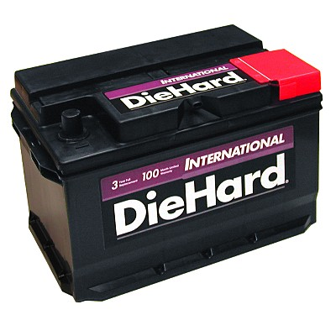
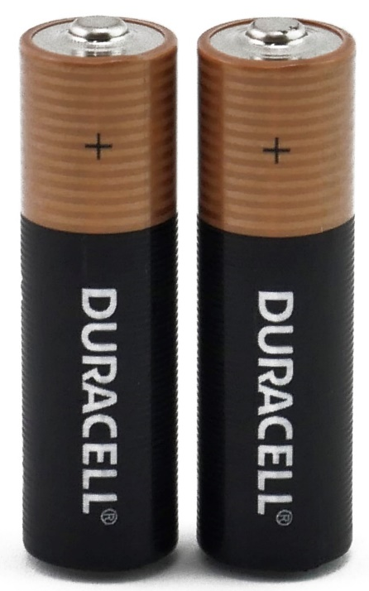
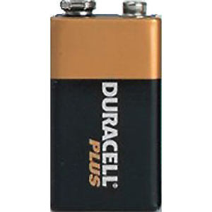
Redox Class #2 assigning oxidation numbers plus how voltaic cells work.
If you didn’t read the BASICS yet, ask yourself why?

Slide 18
To see if any chemical reaction is ALSO redox, you have to determine if the oxidation numbers, or ion charges change going though the reaction arrow.
Put the oxidation numbers into each equation, then state the type of chemical reaction/reactions have occurred. The first on is an example.
 | Reactants | Products | Reaction types
ex | Ni_{(S)} + CuSO_{4(AQ)} → Ni⁰ + Cu⁺²SO₄⁻² → | NiSO_{4(AQ)} + Cu_{(S)} Ni⁺²SO₄⁻² + Cu⁰ | Single replacement and REDOX
ex | HCl_{(AQ)} + NaOH_{(AQ)} → H⁺¹Cl⁻¹ + Na⁺¹OH⁻¹ → | NaCl_{(AQ)} + HOH_{(L)} Na⁺¹Cl⁻¹ + H⁺¹OH⁻¹ | Acid Base Neutralization NOT Redox

Slide 19
Fill in these reactions with oxidation numbers,
fill in last column.
Reactants |  | Products |  | Reaction types
37 | Li_{(S)} + Zn(NO₃)_{2(AQ)} → → | _______{(AQ)} + ______{(S)}
38 | CaCl_{2(AQ)} + 2NH₄OH_{(AQ)} → → |  | _____________+ __________

Slide 20
Fill in these reactions with oxidation numbers,
fill in last column.
Reactants |  | Products |  | Reaction types
37 | Li_{(S)} + Zn(NO₃)_{2(AQ)} → Li⁰ + Zn⁺²(NO₃)₂⁻¹⁻¹ → | 2LiNO_{3(AQ)} + Zn_{(S)} 2Li⁺¹⁺¹ 2NO₃⁻¹⁻¹ + Zn⁰ |  | Single replacement REDOX
38 | CaCl_{2(AQ)} + 2NH₄OH_{(AQ)} → Ca⁺²Cl⁻¹⁻¹ + 2NH₄⁺¹ 2OH⁻¹ → |  | Ca(OH)_{2(S)} + 2NH₄Cl_{(AQ)} Ca⁺² 2OH⁻¹⁻¹ + 2NH₄⁺¹ 2Cl⁻¹⁻¹ |  | Double replacement NOT REDOX

Slide 21
What are the individual oxidation numbers for all these species? (they sum to zero*)
39 | Cr₂O₇⁻² | CO₂
40 | CaCl₂ | CO
41 | N₂O₅ | NO
42 | H₂SO₄ | NO₂
43 | H₂O | NH₃

Slide 22
What are the individual oxidation numbers for all these species? (NOT THIS ONE*)
39 | Cr₂O₇⁻² 2Cr⁺⁶ and 7O^{-2*} | CO₂ C⁺⁴ O⁻² O⁻²
40 | CaCl₂ Ca⁺² Cl⁻¹Cl⁻¹ | CO C⁺² O⁻²
41 | N₂O₅ N⁺⁵ N⁺⁵ and 5O⁻² | NO N⁺² O⁻²
42 | H₂SO₄ H⁺¹H⁺¹S⁺⁶ + 4O⁻² | NO₂ N⁺⁴ O⁻² O⁻²
43 | H₂O H⁺¹H⁺¹ O⁻² | NH₃ N⁻³ and 3H⁺¹

Slide 23
Copper (I) nitrate solution + potassium forms potassium nitrate solution + copper
44 | Write the balanced equation for the word equation above. Add the ion charges. (no phases)
45 | Write the half reactions and the net ionic equation.
½ OX
½ RED
NET

Slide 24
Copper (I) nitrate solution + potassium forms potassium nitrate solution + copper
44 | Write the balanced equation for this word equation. Add the ion charges. (no phases)
Cu⁺¹NO₃⁻¹ + K⁰ → K⁺¹NO₃⁻¹ + Cu⁰
45 | Write the half reactions and the net ionic equation.
½ OX K⁰ → K⁺¹ + 1e⁻
½ RED Cu⁺¹ + 1e⁻ → Cu⁰
NET K⁰ + Cu⁺¹ → K⁺¹ + Cu⁰

Slide 25
45 | Write the half reactions and the net ionic equation.
½ OX K⁰ → K⁺¹ + 1e⁻
½ RED Cu⁺¹ + 1e⁻ → Cu⁰
NET K⁰ + Cu⁺¹ → K⁺¹ + Cu⁰
46 | What species is oxidized?
47 | What species is reduced?
48 | What is the spectator ion?

Slide 26
45 | Write the half reactions and the net ionic equation.
½ OX K⁰ → K⁺¹ + 1e⁻
½ RED Cu⁺¹ + 1e⁻ → Cu⁰
NET K⁰ + Cu⁺¹ → K⁺¹ + Cu⁰
46 | What species is oxidized? K⁰
47 | What species is reduced? Cu⁺¹
48 | What is the spectator ion? None here

Slide 27
silver nitrate solution + copper forms copper (II) nitrate solution + silver
49 | Write the balanced equation for this word equation. Add the ion charges. (no phases)
50 | Write the half reactions and the net ionic equation.
½ OX
½ RED
NET

Slide 28
2Ag⁺¹⁺¹NO₃⁻¹⁻¹ + Cu⁰ → Cu⁺² 2NO₃⁻¹⁻¹ + 2Ag⁰
50 | Write the half reactions and the net ionic equation.
½ OX Cu⁰ → Cu⁺² + 2e⁻
½ RED 2Ag⁺¹ + 2e⁻ → 2Ag⁰
NET Cu⁰ + 2Ag⁺¹ → Cu⁺² + 2Ag⁰
51 | What species is oxidized?
52 | What species is reduced?
53 | What is the spectator ion?

Slide 29
2Ag⁺¹⁺¹NO₃⁻¹⁻¹ + Cu⁰ → Cu⁺² 2NO₃⁻¹⁻¹ + 2Ag⁰
50 | Write the half reactions and the net ionic equation.
½ OX Cu⁰ → Cu⁺² + 2e⁻
½ RED 2Ag⁺¹ + 2e⁻ → 2Ag⁰
NET Cu⁰ + 2Ag⁺¹ → Cu⁺² + 2Ag⁰
51 | What species is oxidized? Cu⁰
52 | What species is reduced? 2Ag⁺¹
53 | What is the spectator ion? NO₃⁻¹

Slide 30
54 | A battery is a voltaic cell.
55 | Batteries spontaneously produce electricity Electricity is the flow of electrons, which can do work – like light up your bulb, or start your car, or what ever.
56 | Batteries are cute, and neatly packaged, but to learn how they work we need to see the details.

Slide 31
bulb
2 beakers with solutions in them. Each solution has a metal bar in it as well. These bars are the electrodes, are are connected by a wire, to carry electricity.
There is a “U” shaped tube with salt water, stuffed with cotton balls so the solution doesn’t just dump out.

Slide 32
bulb
KCl_{(AQ)}
(Salt bridge)
Zn⁰
Cu⁰
OX ZnSO_{4(AQ)}
CuBr_{2(AQ)} RED
57. First battery is a zinc-copper voltaic cell. Zinc goes into any zinc solution. Copper goes into any copper solution.
In the middle is the “salt bridge” (any salt). I picked zinc sulfate, copper (II) bromide, and potassium chloride salt.

Slide 33
bulb
KCl_{(AQ)}
Zn⁰
Cu⁰
Zn⁺²
Cu⁺²
OX ZnSO_{4(AQ)}
CuBr_{2(AQ)} RED
53. Look at table J to decide which metal, zinc or copper, will oxidize, and which will be reduced. Zinc is more reactive. Label the beakers OX and RED. Put metal ions into solution.

Slide 34
bulb
KCl_{(AQ)}
2e⁻
2e⁻
Zn⁰
OX
Cu⁰
RED
Zn⁺²
Cu⁺²
OX ZnSO_{4(AQ)}
CuBr_{2(AQ)} RED
Show the oxidation and the reduction half reactions in the beaker. Zinc metal oxidizes at left, copper cations are reduced at right. Electricity is produced by the OXIDATION.

Slide 35
bulb
Cl⁻¹
KCl_{(AQ)}
K⁺¹
2e⁻
2e⁻
Zn⁰
OX
Cu⁰
RED
Zn⁺²
Cu⁺²
OX ZnSO_{4(AQ)}
CuBr_{2(AQ)} RED
As soon as ions move into or out of the beakers, the solutions get charged, which STOPS the electricity. That is why we have the salt bridge. The salt ions migrate to neutralize these charges, which keeps the battery running.

Slide 36
bulb
KCl_{(AQ)}
2e⁻
2e⁻
Zn⁰
OX
Cu⁰
RED
Zn⁺²
Cu⁺²
OX ZnSO_{4(AQ)}
CuBr_{2(AQ)} RED

Slide 37
ANODE
bulb
CATHODE
Cl⁻¹
KCl_{(AQ)}
K⁺¹
2e⁻
2e⁻
Zn⁰
OX
Cu⁰
RED
Zn⁺²
Cu⁺²
OX ZnSO_{4(AQ)}
CuBr_{2(AQ)} RED
We label the 2 electrodes next. Leo the Lion is a
RED-CAT, which reminds us that REDUCTION happens
on the CATHODE. Oxidation is on the ANODE.

Slide 38
ANODE
bulb
CATHODE
Cl⁻¹
KCl_{(AQ)}
K⁺¹
2e⁻
2e⁻
Zn⁰
OX
Cu⁰
RED
Zn⁺²
Cu⁺²
OX ZnSO_{4(AQ)}
CuBr_{2(AQ)} RED
Half-reactions and Net Ionic Equation…
½ OX Zn⁰ → Zn⁺² + 2e⁻
½ RED Cu ⁺² + 2e⁻ → Cu⁰
NET Zn⁰ + Cu ⁺² → Zn⁺² + Cu⁰

Slide 39
ANODE
bulb
CATHODE
Cl⁻¹
KCl_{(AQ)}
K⁺¹
2e⁻
2e⁻
Zn⁰
Cu⁰
OX
RED
Zn⁺²
Cu⁺²
OX ZnSO_{4(AQ)}
CuBr_{2(AQ)} RED
All batteries die for the same three reasons…
They run out of: ANODE (zinc metal), SALT IONS,
or CATHODE SIDE CATIONS (not copper!)
Remember: one word, 2 words, and 3 words.

Slide 40
58. Completely label this voltaic cell, including…
bulb
NaCl_{(AQ)}
Salt bridge
Pb°
Mg°
Pb⁺²
Mg⁺²
PbCl_{2(AQ)}
Mg(NO₃)_{2(AQ)}
Labels for OX, RED, anode, cathode, flow of electrons, solution charges, flow of ions, half reactions and NET ionic equation. State the 3 reasons that this battery will die.

Slide 41
CATHODE
bulb
ANODE
Na⁺¹
NaCl_{(AQ)}
Cl⁻¹
Salt bridge
2e⁻
-
2e⁻
+
Pb°
Mg°
Pb⁺²
Mg⁺²
REDPbCl_{2(AQ)}
OX Mg(NO₃)_{2(AQ)}
½ OX Mg⁰ → Mg⁺² + 2e ̵
½ RED Pb⁺² + 2e ̵ → Pb⁰
NET Mg⁰ + Pb⁺² → Mg⁺² + Pb⁰
Battery dies when you run out of…
ANODE, SALT IONS, CATHODE SIDE CATIONS

Slide 42
OB: Redox Class #3 Lots more practice with voltaic cells

Slide 43
59. Completely label this voltaic cell, including…
bulb
NaI_{(AQ)}
Rb
Cs
RbF_{(AQ)}
CsCl_{(AQ)}
Labels for OX, RED, anode, cathode, flow of electrons, solution charges, flow of ions, half reactions and NET ionic equation.
Name the 3 solutions. State the 3 reasons that this battery will die.

Slide 44
anode
bulb
cathode
NaI_{(AQ)}
Na⁺¹
I⁻¹
e⁻¹
e⁻¹
Rb⁰
Cs⁰
Rb⁺¹
Cs⁺¹
RbF_{(AQ)}
OX
CsCl_{(AQ)}
RED
½ ox: Rb° → Rb⁺¹ + 1e⁻¹
½ red: Cs⁺¹ + 1e⁻¹ → Cs°
NET IONIC EQ: Rb° + Cs⁺¹ → Rb⁺¹ + Cs°
Rubidium fluoride, cesium chloride solutions, with sodium iodide salt solution.
This cell will die when it runs out of anode (Rb), salt ions (NaI_{(AQ)}), or runs out of
cathode side cations (Cs⁺¹).

Slide 45
60. Completely label this voltaic cell, including…
bulb
(NH₄)₂CO_{3(AQ)}
Ba
Sr
Ba(NO₃)_{2(AQ)}
Sr(C₂H₃O₂)_{2(AQ)}
Labels for OX, RED, anode, cathode, flow of electrons, solution charges, flow of ions, half reactions and NET ionic equation.
Name the 3 solutions. State the 3 reasons that this battery will die.

Slide 46
bulb
anode
bulb
cathode
CO₃⁻²
(NH₄)₂CO_{3(AQ)}
NH₄⁺¹
e⁻¹
e⁻¹
Ba⁰
Sr⁰
Ba⁺²
Sr⁺²
Ba(NO₃)_{2(AQ)}
OX
Sr(C₂H₃O₂)_{2(AQ)}
RED
½ ox: Ba° → Ba⁺² + 2e⁻¹
½ red: Sr⁺² + 2e⁻¹ → Sr°
NET ionic eq: Ba° + Sr⁺² → Ba⁺² + Sr°
Barium nitrate and strontium acetate solutions,
ammonium carbonate salt solution.

Slide 47
61. Completely label this voltaic cell, including…
bulb
Li₃(PO₄)_{(AQ)}
Ag
Mg
AgHCO_{3(AQ)}
MgCrO_{4(AQ)}
Labels for OX, RED, anode, cathode, flow of electrons, solution charges, flow of ions, half reactions and NET ionic equation.
Name the 3 solutions. State the 3 reasons that this battery will die.

Slide 48
bulb
cathode
anode
Li⁺¹
Li₃(PO₄)_{(AQ)}
PO₄⁻³
e⁻¹
e⁻¹
Ag⁰
Mg⁰
Ag⁺¹
Mg⁺²
RED
OX
AgHCO_{3(AQ)}
MgCrO_{4(AQ)}
½ ox: Mg ° → Mg⁺² + 2e⁻¹
½ red: 2Ag⁺¹ + 2e⁻¹ → 2Ag°
NET IONIC EQ: Mg ° + 2Ag⁺¹ → Mg⁺² + 2Ag⁺¹
Silver hydrogen carbonate and magnesium chromate solutions, with lithium phosphate salt solution.
BATTERY DIES RUN OUT OF ANODE, SALT IONS, OR CATHODE SIDE CATIONS.

Slide 49
OB: Redox Class #4
Voltaic vs. Electrolytic cells
Voltaic cells and electrolytic cell are the two kinds of electrochemical cells.
Voltaic cells are batteries. Electrolytic cells are next…

Slide 50
62
Electrochemical Cells
combine electricity and chemistry
Voltaic Cells
Chemistry spontaneously
creates electricity.
Electrolytic Cells
Electricity is needed
to force a redox reaction
to occur.

Slide 51
63. When you put copper into silver nitrate solution (which we have done more than once this year) the copper replaces silver in solution, the silver precipitate can be used for a belly button ring, or a bullet for a werewolf. You know this reaction, balance it now. This reaction happens spontaneously because it can happen.
Cu_{(S)} + 2AgNO_{3(AQ)} → Cu(NO₃)_{2(AQ)} + 2Ag_{(S)}
This reaction is SPONTANEOUS.
It’s redox and it is single replacement too.

Slide 52
64. We can stop that from happening and
make a different redox reaction happen,
if we use a battery, an outside energy
source (a battery).
Cu_{(S)} + 2AgNO_{3(AQ)} → Cu(NO₃)_{2(AQ)} + 2Ag_{(S)}

Slide 53
65. Fully label this electrolytic cell that will
plate silver metal onto a copper ring.
battery
AgNO_{3(AQ)}
Agº
Cu_{(S)}

Slide 54
The battery is a voltaic cell, the whole set up is the ELECTROLYTIC cell.
66. Write out half reactions and net equation.
e⁻¹
RED
OX
e⁻¹
battery
ANODE
AgNO_{3(AQ)}
Ag°
Agº
Ag°
Cu_{(S)}
Ag⁺¹
CATHODE

Slide 55
66.
½OX: Ag⁰ → Ag⁺¹ + 1e⁻
½RED: Ag⁺¹ + 1e⁻ → Ag⁰
NET: Ag⁰ + Ag⁺¹ → Ag ⁰ + Ag⁺¹
e⁻¹
RED
OX
e⁻¹
battery
ANODE
Ag°
AgNO_{3(AQ)}
Ag°
Ag°
Ag°
Agº
Ag°
Ag°
Ag°
Cu_{(S)}
Ag⁺¹
CATHODE

Slide 56
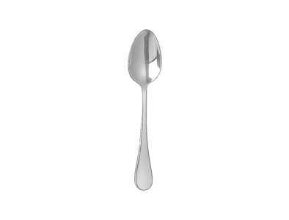
67 Label this ELECTROLTIC CELL
68 Write out ¹/₂ reactions and net equation.
battery
Aluminum
spoon
AuCl _{(AQ)}
Au_{(S)}

Slide 57
Electrons from the battery land on the spoon, which causes the reduction of the Au⁺¹ cations, plating the spoon gold. The gold bar oxidizes gold atoms into cations, and the free electrons from this oxidation replace the electrons from the battery.
e⁻¹
e⁻¹
RED
OX
battery
battery
Aluminum spoon
AuCl _{(AQ)}
64
½ ox: Au°_{(S)} → Au⁺¹_{(AQ)} + 1e⁻¹
½ red: Au⁺¹_{(AQ)} + 1e⁻¹ → Au°
NET: Au°+ Au⁺¹ → Au° + Au⁺¹
Au°
Au°
Au⁺¹

Slide 58
Electrons from the battery land on the spoon, which causes the reduction of the Au⁺¹ cations, plating the spoon gold. The gold bar oxidizes gold atoms into cations, and the free electrons from this oxidation replace the electrons from the battery.
e⁻¹
e⁻¹
RED
OX
battery
battery
anode
Aluminum spoon
CATHODE
AuCl _{(AQ)}
68
½ ox: Au°_{(S)} → Au⁺¹_{(AQ)} + 1e⁻¹
½ red: Au⁺¹_{(AQ)} + 1e⁻¹ → Au°
NET: Au°+ Au⁺¹ → Au° + Au⁺¹
Au°
Au°
Au°
Au°
Au⁺¹
Au°
Au°

Slide 59
69. Electrolysis is the decomposition
of a compound with electricity.
(vague)
Hydrolysis is the decomposition
of water with electricity.
(specifically, water)

Slide 60
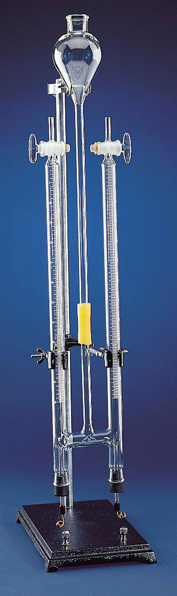
Pure water plus a little H₂SO_{4(AQ)}
(which provides ions) to allow
water to conduct electricity.
2 tubes filled with water, each with a spigot on top.
The electrodes must be connected to a Direct Current power supply
(like a strong battery).
70. The electricity forces a
nonspontaneous redox reaction.
2 platinum electrodes which do not corrode, and they conduct electricity well. Attach the power supply here.

Slide 61
H₂O_{(L)} decomposes into H_{2(G)} + O_{2(G)}
71. The decomposition of water:
2H₂O_{(L)} 2H_{2(G)} + O_{2(G)}
Rewrite with oxidation numbers showing

Slide 62
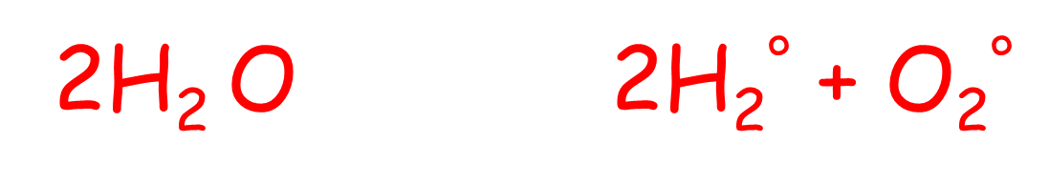
H₂O_{(L)} decomposes into H_{2(G)} + O_{2(G)}
71. The decomposition of water:
2H₂O_{(L)} 2H_{2(G)} + O_{2(G)}
Rewrite with oxidation numbers showing
+1
-2

Slide 63
+1
-2
72. Write out the half reactions and the NET ionic equation..
½Ox
½Red
NET

Slide 64
+1
-2
72. Write out the half reactions and the NET ionic equation..
½Ox 2O⁻² → O₂° + 4e⁻
½Red 2H₂⁺¹ + 4e⁻ → 2H₂°
NET 2H₂⁺¹ + 2O⁻² → 2H₂° + O₂°

Slide 65
73. Which electrochemical cell spontaneously
produces electricity from a chemical reaction?
74. Name the type of cell where electricity forces a
redox reaction that would not be spontaneous.
75. What always happens at the anode?
76. What always happens at the cathode?
77. Is Leo ALWAYS a RED-CAT?

Slide 66
73. Which electrochemical cell spontaneously
produces electricity from a chemical reaction?
VOLTAIC CELL
74. Name the type of cell where electricity forces a
redox reaction that would not be spontaneous.
ELECTROLYTIC CELL
75. What happens at the anode? OXIDATION
76. What happens at the cathode? REDUCTION
77. Is Leo ALWAYS a RED-CAT? Yes, don’t forget!

