Slide 1
SOLUTIONS Class #1
Objective: Describing what solutions are,
how they form, and how we can measure
their strength – or concentration.
Get a calculator and reference tables out.

Slide 2
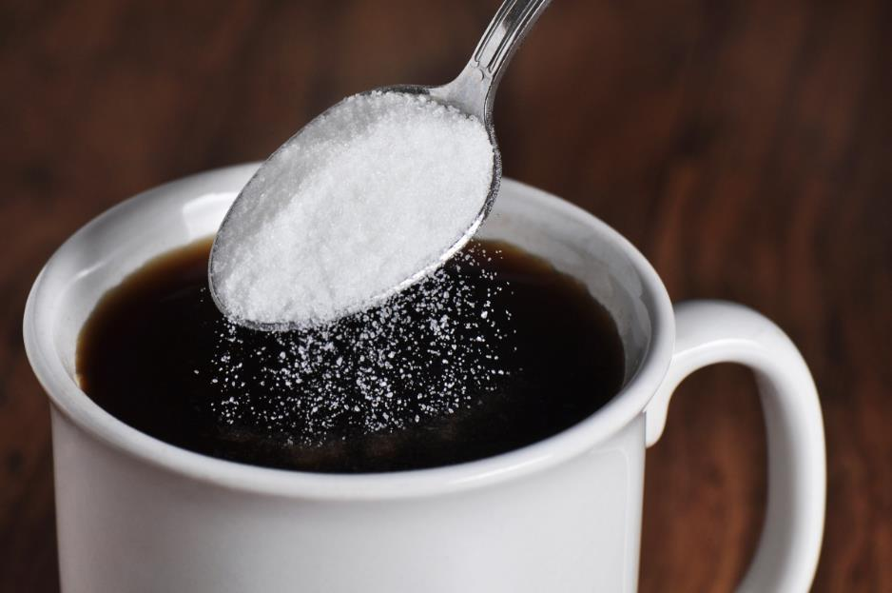
1. A solution is a homogeneous mixture.
2. A solution forms when a solute is dissolved into a solvent.
If you make this solution
Sugar is the SOLUTE Coffee is the SOLVENT

Slide 3
4. When a solution holds the maximum amount
of solute it is a SATURATED solution.
5. If there is less than the maximum amount of
solute in the solution it is UNSATURATED

Slide 4
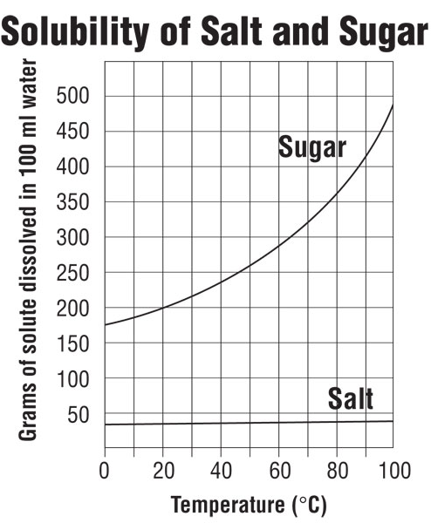
Hot solvents usually hold more solute than cold.
This graph shows data for 100 mL solutions
6. Compare a 10°C sugar
solution to
a 90°C sugar solution…
At 10°C you can fit ___ g sugar into solution.
At 90°C you can fit ___ g sugar into solution.

Slide 5
Hot solvents usually hold more solute than cold.
This graph shows data for 100 mL solutions
6. Compare a 10°C sugar solution to
a 90°C sugar solution…
At 10°C you can fit 175 g sugar into solution.
At 90°C you can fit 425 g sugar into solution.
Hotter solutions “juggle” molecules or ions faster. The hotter solutions can hold more
solute than colder solutions.
7. It’s hard to see here, but the NaCl solubility
increases just a tiny bit (38 g → 40 g)
in a100 mL solution, a small increase.

Slide 6
8. Most solutions you think about will be aqueous
which means dissolved in _______
9. But solutions can also be gases like ____
or even solids _________
such as BRASS or CAST IRON.

Slide 7
8. Most solutions you think about will be aqueous
which means dissolved in WATER
9. But solutions can also be gases like AIR
or even solids ALLOYS
such as BRASS or CAST IRON ).

Slide 8
When you try to dissolve stuff into solution, there are 3 factors that will affect this rate
(either making it faster or slower.
DEMONSTRATION one
Let’s watch 2 forms of the same compound Copper (II) sulfate
First, CHUNKS of CuSO₄ into room temperature water
Next, POWDERED CuSO₄ into room temperature water
150 mL of water - and stir them.

Slide 9
When you try to dissolve stuff into solution, there are 3 factors that will affect this rate
(either making it faster or slower.
DEMONSTRATION one
Let’s watch 2 forms of the same compound Copper (II) sulfate
First, CHUNKS of CuSO₄ into room temperature water
Next, POWDERED CuSO₄ into room temperature water
150 mL of water - and stir them.
Powdered dissolves faster: greater surface area means more water touches more solute, MORE COLLISIONS BETWEEN particles, so faster dissolving.

Slide 10
When you try to dissolve stuff into solution, there are 3 factors that will affect this rate
(either making it faster or slower.
DEMONSTRATION 2
Watch Alka-seltzer dissolve into water.
One tablet into 150 mL HOT water
One tablet into 150 mL COLD water
Which dissolves faster?

Slide 11
When you try to dissolve stuff into solution, there are 3 factors that will affect this rate
(either making it faster or slower.
DEMONSTRATION 2
Watch Alka-seltzer dissolve into water.
One tablet into 150 mL HOT water
One tablet into 150 mL COLD water
Which dissolves faster?
The hotter water dissolved the alka-seltzer faster.
Hotter molecules with MORE KINETIC ENERGY, produce
MORE COLLISIONS between the two, increasing the rate of solvation.

Slide 12
When you try to dissolve stuff into solution, there are 3 factors that will affect this rate
(either making it faster or slower.
DEMONSTRATION 3
Let’s watch a cube of SUGAR go into into 150 mL water
One cube into water no stirring
One cube into same amount of water, with stirring
Which dissolves faster?

Slide 13
When you try to dissolve stuff into solution, there are 3 factors that will affect this rate
(either making it faster or slower.
DEMONSTRATION 3
Let’s watch a cube of SUGAR go into into 150 mL water
One cube into water no stirring
One cube into same amount of water, with stirring
Which dissolves faster?
The stirred sugar dissolved faster. Faster moving water created MORE COLLISIONS between the sugar cube and water, resulting in faster dissolving. This higher kinetic energy was caused by the agitation.

Slide 14
10. SMALLER PARTICLES = MORE SURFACE AREA
More collisions gives FASTER DISSOLVING
11. HOTTER TEMP = HIGHER KE = MORE MOTION
More collisions gives FASTER DISSOLVING
12. AGITATION = HIGHER KE = MORE MOTION
More collisions gives FASTER DISSOLVING
14. The rate of solvation increases with more
surface area (smaller particles), higher
temperatures and with more agitation.

Slide 15
How much solute will dissolve into a solution?
It depends first on
15. The actual solubility –
does this stuff dissolve into water?
(ionic compounds are on table F)
16. The Temperature of the solvent
(usually, hotter solvents fit more solute in solution)
17. Pressure
(higher pressure = higher solubility, only for gases)

Slide 16
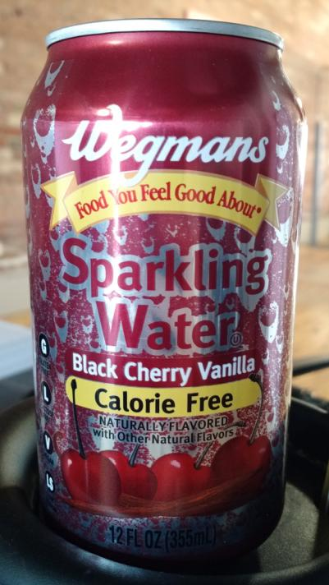
Draw the H₂O molecule + CO₂ molecule.
(structural diagrams)

Slide 17
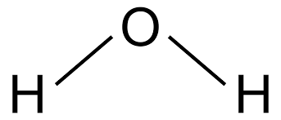
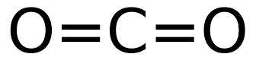
Draw the H₂O molecule + CO₂ molecule.
(structural diagrams)
19. What sort of molecules are these? (polar or nonpolar?)
water is polar, carbon dioxide is nonpolar.
Like dissolves like (???)

Slide 18
Draw the H₂O molecule + CO₂ molecule.
(structural diagrams)
19. What sort of molecules are these? (polar or nonpolar?)
water is polar, carbon dioxide is nonpolar.
Like dissolves like (???)

Slide 19
20. How does Wegman’s even get CO₂ into water to make
seltzer? What about Like dissolves like?
H₂O is “bent” and polar.
CO₂ has radial symmetry and is nonpolar.
These molecules should not be able to form a solution.
The ONLY way to mix them is under HIGH PRESSURE
(and then they quickly seal the can).

Slide 20
21. There are several ways to measure
how strong a solution is in chemistry.
Qualitatively we can say things like
strong or weak
Or we could use “better” words like
concentrated or dilute
With numbers and units, in a quantitative measure,
we will use
MOLARITY

Slide 21
22. Molarity is the expression of concentration of a
solution as measured by the number of moles of
solute in a liter of solution.
M =
# moles solute
Liters of solution

Slide 22
23. What is the concentration of a NaNO₃ solution
containing 4.50 moles of solute in 1220 mL volume?

Slide 23
23. What is the concentration of a NaNO₃ solution
containing 4.50 moles of solute in 1220 mL volume?
Molarity = | # moles solute Liters of solution
Molarity = | 4.50 moles 1.22 Liters
Molarity = | 3.69 M

Slide 24
23. What is the concentration of a NaNO₃ solution
containing 4.50 moles of solute in 1220 mL volume?
Molarity = | # moles solute Liters of solution
Molarity = | 4.50 moles 1.22 Liters
Molarity = | 3.69 M
24. Say: this solution has a 3.69 Molarity
Write: 3.69 M NaNO_{3(AQ)}
Think: this solution is the same as a 1-liter AQ solution
containing 3.69 mole NaNO₃ solute per liter.

Slide 25
25. What is the concentration of a 1650 mL salty
water solution containing 125 g NaCl?

Slide 26
25. What is the concentration of a 1650 mL salty
water solution containing 125 g NaCl?
Molarity = | # moles solute Liters of solution
Convert grams of NaCl to moles first. Then convert mL into liters. Use moles & liters.

Slide 27
25. What is the concentration of a 1650 mL salty
water solution containing 125 g NaCl?
Molarity = | # moles solute Liters of solution
Convert grams of NaCl to moles first. Then convert mL into liters. Use moles & liters.
125 g NaCl
1
X
1 mole NaCl
58 g NaCl
= 2.16 moles NaCl
MOLAR MASS
NaCl
Na 1 x 23g = 23 g
Cl 1 x 36 g = 35 g
58 g/mole
1650 mL solution
1
1 Liter
1000 mL
= 1.65 Liters
X

Slide 28
25. What is the concentration of a 1650 mL salty
water solution containing 125 g NaCl?
Molarity = | # moles solute Liters of solution
Molarity = | 2.16 moles 1.65 Liters
Molarity = | 1.31 M
Say: this sodium chloride solution has a 1.31 molarity
Write: 1.31 M NaCl(AQ)
Think: this solution contains the equivalent of
1.31 moles NaCl per liter of solution

Slide 29
26. If you add 43.5 g NaCl to enough water to form
a 648 mL solution, what is its concentration?
(figure out moles, and liters first, then write the formula, or else)
CONVERT MOLES FIRST
M =
# moles NaCl
Liters of solution

Slide 30
26. If you add 43.5 g NaCl to enough water to form
a 648 mL solution, what is its concentration?
(figure out moles, and liters first, then write the formula, or else)
CONVERT MOLES FIRST
THEN CONVERT LITERS
43.5 g NaCl
1
1 mole NaCl
58 g NaCl
X
= 0.750 mole
M =
# moles NaCl
Liters of solution

Slide 31
26. If you add 43.5 g NaCl to enough water to form
a 648 mL solution, what is its concentration?
(figure out moles, and liters first, then write the formula, or else)
CONVERT MOLES FIRST
THEN CONVERT LITERS
Now fill in the formula
and do the math
43.5 g NaCl
1
1 mole NaCl
58 g NaCl
X
= 0.750 mole
M =
# moles NaCl
Liters of solution
648 mL
1
1 Liter
1000 mL
= 0.648 Liters
X

Slide 32
26. If you add 43.5 g NaCl to enough water to form
a 648 mL solution, what is its concentration?
(figure out moles, and liters first, then write the formula, or else)
CONVERT MOLES FIRST
THEN CONVERT LITERS
0.750 moles
0.648 Liters
M =
M = 1.16 M
SAY: This has a 1.16 molarity
WRITE: 1.16 M NaCl_{(AQ)}
THINK:
This is equivalent to a solution with 1.16 moles of salt per liter
43.5 g NaCl
1
1 mole NaCl
58 g NaCl
X
= 0.750 mole
648 mL
1
1 Liter
1000 mL
= 0.648 Liters
X

Slide 33
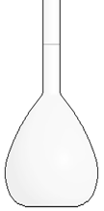
27. You put 111 g KCl solid into a volumetric flask.
You fill the flask to 250. mL, what is the
molarity of this solution?
Start with the formula, or you know what might happen!

Slide 34
27. You put 111 g KCl solid into a volumetric flask.
You fill the flask to 250. mL, what is the
molarity of this solution?
Molarity = | # moles solute Liters of solution

Slide 35
27. You put 111 g KCl solid into a volumetric flask.
You fill the flask to 250. mL, what is the
molarity of this solution?
Molarity = | # moles solute Liters of solution
111 g KCl
1
1 mole KCl
74 g KCl
X
= 1.50 moles KCl
250. mL solution
1
1 Liter
1000 mL
X
= 0.250 Liters
Molarity = | 1.50 moles 0.250 Liters | = 6.00 M
Fill with
water to 250 mL
111 grams KCl first

Slide 36
28. You put 74.0 g KCl solid into a flask.
You fill the flask to 1600. mL, what is the
molarity of this solution?

Slide 37
28. You put 74.0 g KCl solid into a flask.
You fill the flask to 1600. mL, what is the
molarity of this solution?
74.0 g KCl = 1.00 moles KCl 1600. mL = 1.600 Liters
M =
# moles KCl
Liters of solution
=
MOLAR MASS
KCl
K 1 x 39g = 39 g
Cl 1 x 36 g = 35 g
74 g/mole

Slide 38
28. You put 74.0 g KCl solid into a flask.
You fill the flask to 1600. mL, what is the
molarity of this solution?
74.0 g KCl = 1.00 moles KCl 1600. mL = 1.600 Liters
M =
# moles KCl
Liters of solution
=
1.00 moles KCl
1.600 Liters solution
=
SAY: This is a 0.625 Molar KCl_{(AQ)}
WRITE 0.625 M KCl_{(AQ)}
THINK: The solution contains 0.625 moles KCl/Liter

Slide 39
29. Calculate the molarity of 750. mL LiBr_{(AQ)} that has
215 g LiBr solute.

Slide 40
29. Calculate the molarity of 750. mL LiBr_{(AQ)} that has
215 g LiBr solute.
MOLAR MASS | Convert gram to moles
LiBr Li 1 x 7g = 7 g Br 1 x 80 g = 80 g 87 g/mole
Then Liters
215 grams 1 | X | 1 mole LiBr 87 grams LiBr | = | 2.47 moles LiBr
750. mL solution
1
1 Liter
1000 mL
X
= 0.750 Liters

Slide 41
29. Calculate the molarity of 750. mL LiBr_{(AQ)} that has
215 g LiBr solute.
MOLAR MASS | Convert gram to moles
LiBr Li 1 x 7g = 7 g Br 1 x 80 g = 80 g 87 g/mole
Then Liters
Now molarity…
215 grams 1 | X | 1 mole LiBr 87 grams LiBr | = | 2.47 moles LiBr
750. mL solution
1
1 Liter
1000 mL
X
= 0.750 Liters
M = | 2.47 moles 0.750 Liters | = 3.29 M

Slide 42
Let’s totally change gears now. Take out Table G
SOLUBILITY CURVES at Standard Pressure

Slide 43
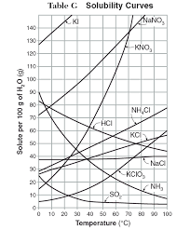
30. How many grams of sodium nitrate are in a 100 mL
aqueous solution that is saturated at 10°C?
Find NaNO₃ curve.
Find 10°C.
Slide Upwards until you
find their meeting point.
(80 grams)

Slide 44
31. How many grams of NaNO₃ fit into
325 mL of water at 10°C? 80 g in 100 mL

Slide 45
31. How many grams of NaNO₃ fit into
325 mL of water at 10°C? 80 g in 100 mL
NaNO₃
water
80 g
100 mL
X g
325 mL
10°C
=
100 X = 26,000
X = 260.
X = 260. grams NaNO₃

Slide 46
32. What is the MOLARITY
of this solution of 260. g NaNO₃
in 325 mL? Start with a formula
M =
# moles NaNO₃
Liters of solution

Slide 47
32. What is the MOLARITY
of this solution of 260. g NaNO₃
in 325 mL? Start with a formula
M =
# moles NaNO₃
Liters of solution
260. g NaNO₃
1
1 mole NaNO₃
85 g NaNO₃
x
= 3.06 moles
325 mL
1
x
1 Liter
1000 mL
= 0.325 Liters

Slide 48
32. What is the MOLARITY
of this solution of 260. g NaNO₃
in 325 mL? Start with a formula
M =
# moles NaNO₃
Liters of solution
= 9.42 M
M =
3.06 moles KCl
0.325 Liters

Slide 49
33. Solutions Vocabulary to Memorize by Tomorrow
Solute – the stuff dissolved into the solvent of a solution (the salt of salty water)
Solvent – the part of the solution that the solute is dissolved into, the water of salty water.
Saturated – when a solution is holding the maximum solute at a particular temperature.
Unsaturated – when a solution is holding LESS THAN the maximum solute
at a particular temperature
.
Table G – the solubility guidelines for 10 compounds over all liquid water temps.
Molarity – the measured concentration of a solution in moles/Liter units.
Molarity Formula: M =
Molarity Units – MOLES of solute per LITER - not grams or mL!
moles of solute
Liters of solution

Slide 50
Solutions Class #3
Objective: More practice with molarity problems, and
how to make a solution properly (and wrong!),
and then –
how to make a new solution from a solution
that you have in the stock room on a shelf.

Slide 51
34. Calculate the molarity of a solution containing
259 g KBr_{(AQ)} with total volume of 750. mL
(the molar mass KBr = 119 g/mole)

Slide 52
34. Calculate the molarity of a solution containing
259 g KBr_{(AQ)} with total volume of 750. mL
(the molar mass KBr = 119 g/mole)
M =
# moles KBr
Liters of solution
=
2.18 Moles KBr
0.750 Liters solution
This is a 2.91 M KBr_{(AQ)} solution
It has a Molarity of 2.91

Slide 53
35. How many grams of sodium chloride are in a 100 mL
aqueous solution that is saturated at 90°C?

Slide 54
35. How many grams of sodium chloride are in a 100 mL
aqueous solution that is saturated at 90°C?
Exactly 40 grams fits into 100 mL.

Slide 55
38. How many grams of sodium chloride are in a 100 mL
aqueous solution that is saturated at 90°C?

Slide 56
36. How many grams of sodium chloride are in an
885 mL aqueous solution that is saturated at 90°C?
Do this as shown, no variations allowed.

Slide 57
36. How many grams of sodium chloride are in an
885 mL aqueous solution that is saturated at 90°C?
Do this as shown, no variations allowed.
NaCl
water
40 g
100 mL
X g
885 mL
90°C
=
100 x = 35,400
X = 354 grams NaCl

Slide 58
37. What’s the molarity of this saturated solution of NaCl_{(AQ)}?
(First convert these 354 grams of NaCl into moles)

Slide 59
37. What’s the molarity of this saturated solution of NaCl_{(AQ)}?
(First convert these 354 grams of NaCl into moles)
354 g NaCl
1
X
= 6.10 moles NaCl
1 mole NaCl
58 g NaCl
6.10 moles
0.885 Liters
= 6.89 M NaCl_{(AQ)}
M =

Slide 60
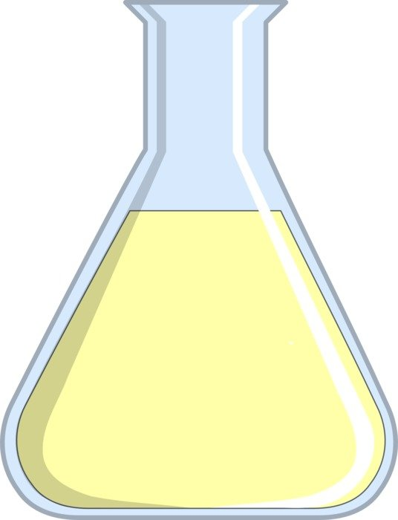
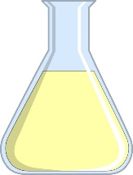
38. If you had two SATURATED NaCl_{(AQ)}
100 mL
saturated NaCl
Saturated
NaCl_{(AQ)}
Would they
- have the same molarity?
- be able to conduct electricity?
885 mL
saturated NaCl

Slide 61
38. If you had two SATURATED NaCl_{(AQ)}
100 mL
saturated NaCl
IDENTICAL
Except for size
Would they
- have the same molarity? YES
- be able to conduct electricity? YES
885 mL
saturated NaCl

Slide 62
39. How many grams of NaCl are required to form a
2.50 L of 0.900 M NaCl_{(AQ)}? (a formula will guide you)

Slide 63
39. How many grams of NaCl are required to form a
2.50 L of 0.900 M NaCl_{(AQ)}? (a formula will guide you)
M =
X moles NaCl
Liters of solution
0.900M =
1
X moles NaCl
2.50 Liters
X moles = 2.25 moles NaCl is 58 g/mole, so…
2.25 moles x 58 g = 131 g NaCl (3 SF)
1 1 mole

Slide 64
40. How many grams of KOH required to make a
1.20 M solution of KOH_{(AQ)} of 2.00 Liters?
(always write a formula)

Slide 65
40. How many grams of KOH required to make a
1.20 M solution of KOH_{(AQ)} of 2.00 Liters?
(always write a formula)
M =
# moles KOH
Liters of solution
1.20 M =
1
# moles KOH
2.00 Liters
# moles = 2.40 moles KOH
2.40 moles KOH
1
x
56 g KOH
1 mole KOH
= 134 g KOH

Slide 66

How can we prepare a
1.20 M solution of KOH_{(AQ)} of 2.00 Liters?
The wrong way is the way
will seem right, at first!

Slide 67
How can we prepare a
1.20 M solution of KOH_{(AQ)} of 3.20 Liters?
The wrong way is to get 2.00 Liters of water, then add 134 g of KOH into it.
If you do that, the KOH
SLIGHTLY increase the
volume over 2.00 liters.

Slide 68
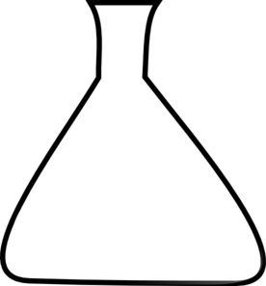
41. How can we prepare a
1.20 M solution of KOH_{(AQ)} of 2.00 Liters?
SECOND
Fill with water,
UP TO the
measured mark
2.00 Liter mark
← FIRST
Add 134 grams of KOH_{(S)} first

Slide 69
42. How would you mix up 2.65 liters of
2.50 M KNO_{3(AQ)} from scratch?

Slide 70
42. How would you mix up 2.65 liters of
2.50 M KNO_{3(AQ)} from scratch? Scratch means use the M formula
M =
# moles KNO₃
Liters of solution
2.50M =
1
# moles KNO₃
2.65 Liters
moles KNO₃ = 6.63 moles KNO₃ needed.
6.63 moles KNO₃
1
101 grams KNO₃
1 mole KNO₃
X
= 670. grams KNO₃

Slide 71
42. How would you mix up 2.65 liters of
2.50 M KNO_{3(AQ)} from scratch? Scratch means use the M formula
First…
670. grams of KNO_{3(S)}
into the beaker,
Then, fill with the water,
UP TO THE 2.65 LITER MARK.
NOTE: no flasks like this exist.
This is math. Real labs have
only “normal sized flasks.
2.65 Liters exactly
2
670. grams of KNO_{3(S)} first

Slide 72
If you have some strong 2.50M KNO_{3(AQ)} solution in the stock room, how would you use it make 1.00 Liter of 1.15 M KNO_{3(AQ)} ?
To do this kind of a problem we’ll need a new formula, that’s not
on our reference tables.
Let’s add it to the reference tables and come back to this question in a few minutes.

Slide 73
Take out your reference table, back page, and add this dilution formula to the concentration box, with red notes.
Concentration
For mixing solutions from scratch, or measuring
solution concentration.
For mixing up a new solution from
a stock solution you have on-hand
M₁V₁ = M₂V₂
_{- dilution formula -}
Molarity =
Moles of solute
Liters of solution

Slide 74
This requires the dilution formula + what do all those letters & numbers mean.
43. The DILUTION FORMULA is: M₁V₁ = M₂V₂
The symbols mean:
M₁ is Molarity of the original stock solution
V₁ is Volume of the original stock solution (unknown)
M₂ is Molarity of the new solution you want to make
V₂ is Volume of new solution that you want to make

Slide 75
44. Using a 2.50M KNO_{3(AQ)} how would you make
1.00 Liters of 1.15 M KNO_{3(AQ)} ? Write: M₁V₁ = M₂V₂

Slide 76
44. Using a 2.50M KNO_{3(AQ)} how would you make
1.00 Liters of 1.15 M KNO_{3(AQ)} ? Write: M₁V₁ = M₂V₂
M₁V₁ = M₂V₂
(2.50 M)(V₁) = (1.15 M)(1.00 L)
(1.15 M)(1.00 L)
2.50 M
V₁ =
V₁ =0.460 Liters of stock

Slide 77
44. You need 0.460 L (46.0 mL) of stock, but that’s NOT how to make this solution.
FIRST: put in the
46.0 mL stock
SECOND: fill up with pure water to the
1.00 L mark
(1000.0 mL)
because that is the TOTAL VOLUME
of solution you want.

Slide 78
45. How do you prepare a 200. mL NaCl_{(AQ)} solution
of 1.00 molarity from a stock solution of 5.50 M?
M₁V₁ = M₂V₂

Slide 79
45. How do you prepare a 200. mL NaCl_{(AQ)} solution
of 1.00 molarity from a stock solution of 5.50 M?
M₁V₁ = M₂V₂
(5.50 M)(X mL) = (1.00 M)(200 mL)
x mL =
x mL = 36.4 mL stock (is that it?)
(1.00 M)(200. mL)
5.50 M

Slide 80
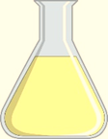
45. How do you prepare a 200. mL NaCl_{(AQ)} solution
of 1.00 molarity from a stock solution of 5.50 M?
We want a 200. mL solution, the math tells us
HOW MUCH STOCK solution to start with. So…
2. Fill with
water to the
200.mL mark
200. mark
1. Add
36.4 mL STOCK
into a new beaker.
WATER
STOCK

Slide 81
46. Hydrochloric acid solution comes to the school very concentrated – at 12.0 M! Using this stock, how do you to make up 2.00 L of 2.25 M HCl solution? start with a formula

Slide 82
46. Hydrochloric acid solution comes to the school very concentrated – at 12.0 M! Using this stock, how do you to make up 2.00 L of 2.25 M HCl solution? start with a formula
(12.0 M)(x L) = (2.25 M)(2.00 L)
x L =
(2.25 M)(2.00 L)
12.0 M
X = 0.375 L = 375 mL

Slide 83
46. Hydrochloric acid solution comes to the school very concentrated – at 12.0 M! Using this stock, how do you to make up 2.00 L of 2.25 M HCl solution? start with a formula
(12.0 M)(x L) = (2.25 M)(2.00 L)
x L =
(2.25 M)(2.00 L)
12.0 M
X = 0.375 L = 375 mL
To mix this solution up, you would first pour 0.375 Liters of the stock HCl_{(AQ)} (375 mL),
into a flask, then you’d pour in enough water to dilute it to 2.00 liters (up to the 2000 mL mark).
375 mL stock + enough water = 2000 mL new solution

Slide 84


Slide 85
Solutions Class #4
Objective: Another way to measure low concentrations of
very weak solutions called
PARTS PER MILLION,
and then, the
colligative properties of water

Slide 86
No Writing, think about this, you put 1502 grams NaCl into a swimming pool of 312,000 liters of water. What is the molarity of this solution?
(the answer is stupidly small to make a point)
1502 g NaCl
1
X
1 mole NaCl
58 g NaCl
= 25.9 moles salt

Slide 87
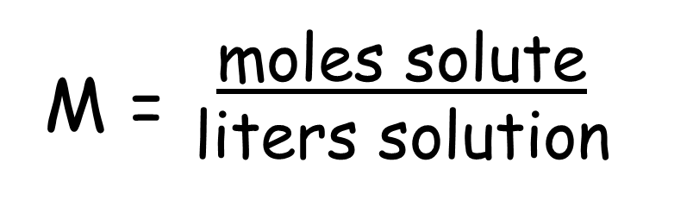
No Writing, think about this, you put 1502 grams NaCl into a swimming pool of 312,000 liters of water. What is the molarity of this solution?
(the answer is stupidly small to make a point)
1502 g NaCl
1
X
1 mole NaCl
58 g NaCl
= 25.9 moles salt
25.9 moles
312,000 Liters

Slide 88
No Writing, think about this, you put 1502 grams NaCl into a swimming pool of 312,000 liters of water. What is the molarity of this solution?
(the answer is stupidly small to make a point)
1502 g NaCl
1
X
1 mole NaCl
58 g NaCl
= 25.9 moles salt
25.9 moles
312,000 Liters
M = 0.0000830 Molar NaCl_{(AQ)}
830 ten millionths Molar!! Sort of a stupid number.
It’s true, but the number is way too small to “make any sense” to us.

Slide 89
We need a different way to measure strength of really weak solutions, called PPM
47. PPM stands for: PARTS PER MILLION
The formula is on the back of your reference table, look for it now, copy it into your notes here
48 ……… PPM = X 1,000,000
grams of solute
grams of solution

Slide 90
49. You put 1502 grams NaCl into a swimming pool
of 312,000 liters of water.
What is the molarity of this solution?
What’s the concentration of this in PPM?
use the formula

Slide 91
49. You put 1502 grams NaCl into a swimming pool
of 312,000 liters of water.
What is the molarity of this solution?
What’s the concentration of this in PPM?
use the formula
grams solute
grams solution
PPM = x 1,000,000 =
1502 g NaCl
312,000,000 g solution
PPM = x 1,000,000 =
PPM = 4.81 parts per million NaCl in solution
(3 SF)

Slide 92
Sometimes low concentration environmental poisons are measured this way.
MOLARITY AND PPM are mathematically interchangeable,
choose the measure with the
“normal” numbers.

Slide 93
50. There are 3 properties of called the colligative properties.
They are the properties that are changed
by dissolving solutes into the solvent.
All solutions will have colligative properties, but we will ONLY
discuss water in our class
51. The 3 colligative properties of water are:

Slide 94
51. The 3 colligative properties of water are:
BOILING POINT
FREEZING POINT
VAPOR PRESSURE

Slide 95
52. The reason for these properties is
HYDROGEN BONDING
Remember, if it’s a property of water,
there’s only one reason!

Slide 96
53. For water to boil, energy must break the _______ bonds.
54. If solute like NaCl ions are dissolved into water, the hydrogen bonds
still need to break, but now, the water must also overcome the polar
attractions to the ___ too.
55. Water has a BP of ____. Salty water will have a ______ BP.

Slide 97
53. For water to boil, energy must break the hydrogen bonds.
54. If solute like NaCl ions are dissolved into water, the hydrogen bonds
still need to break, but now, the water must also overcome the polar
attractions to the ions too.
55. Water has a BP of 373 K. Salty water will have a HIGHER BP.

Slide 98
56. For water to freeze, the molecules must make those neat
little 6-molecule rings to solidify. The molecules are
hydrogen bonded to each other.
When solute is dissolved into the water, these particles
literally get in the way of the hydrogen bonding.
Water can’t freeze at a normal 273 must it has to be colder
for the ions to be pushed aside as ice forms.
The more solute (polar molecules like sugar, or ions)
the colder the water must be to freeze.
Na⁺¹

Slide 99
Vapor pressure is a hard vocabulary word. Learn it now (finally).
Draw this diagram and labels…
57. Vapor pressure is the extra pressure caused by the
evaporation of a liquid in a closed system (like a bell jar).
58. Water has a very low vapor pressure.
59. What is the vapor pressure of water at 25 centigrade?
60. Why does water have LOW VAPOR PRESSURE?
61. What impact would polar molecules, or ions, (solute) have on vapor pressure?
Air Pressure
101.3 kPa
Air Pressure
101.3 kPa
Extra pressure
water

Slide 100
Vapor pressure is a hard vocabulary word. Learn it now (finally).
Draw this diagram and labels…
57. Vapor pressure is the extra pressure caused by the
evaporation of a liquid in a closed system (like a bell jar).
58. Water has a very low vapor pressure.
59. What is the vapor pressure of water at 25 centigrade?
60. Why does water have LOW VAPOR PRESSURE?
Hydrogen bonding (duh!)
61. What impact would polar molecules, or ions, (solute) have on vapor pressure?
The more polar molecules, or ions, the worse evaporation would be, so the lower the
vapor pressure would be.
Air Pressure
101.3 kPa
Air Pressure
101.3 kPa
Extra pressure
water

Slide 101
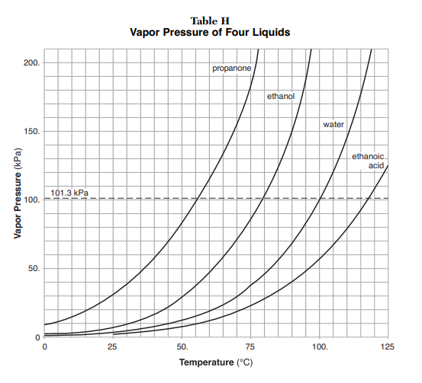
62. The higher vapor pressure means that the
molecules evaporate faster or easier because
there are less hydrogen bonds in the solution.
At 25 C, water has a vapor pressure of about 4 kPa (very low) because water has strong hydrogen bonding holding it snuggly and not wanting to let go.
Propanone is much less polar of a molecule, and at the same temperature, its vapor pressure is 30 kPa. It evaporates so easily compared to water at any temperature, because it is NOT being held snuggly by hydrogen bonding .

Slide 102
63 The boiling point ELEVATION for water is | 0.50 K/mole particles per liter
64 The freezing point DEPRESSION for water is | 1.86 K/mole particles per liter
Put these constants on the back page of your reference tables above and below the word “Concentration”. These constants must be provided, they are not on the reference tables, but it’s nice to have them handy.

Slide 103
The hardest thing for students to grasp is how many particles end up in solution based upon some important info like 2.0 M CaCl_{2(AQ)}
We will practice a lot. If you miss this part, the rest will always be wrong. Practice this table over and over until you “get it”. Particles can be moles of ions, or moles of molecules (if the compound is NOT ionic)
65 | Formula | When the ionic compounds go into water, this is what they turn into
ex | 1.0 M NaCl_{(AQ)} | 1 mole Na⁺¹ and 1 mole Cl⁻¹ = 2 moles ions
 | 2.0 M NaCl_{(AQ)} | __ moles Na⁺¹ and __ moles Cl⁻¹ = __ moles ions
 | 3.0 M NaCl_{(AQ)} | __ moles Na⁺¹ and __ moles Cl⁻¹ = __ moles ions
 | 2.0 M CaCl_{2(AQ)} | __ moles Ca⁺² and __ moles Cl⁻¹ = __ moles ions
 | 3.0 M CaCl_{2(AQ)} | __ moles Ca⁺² and __ moles Cl⁻¹ = __ moles ions

Slide 104
The hardest thing for students to grasp is how many particles end up in solution based upon some important info like 2.0 M CaCl_{2(AQ)}
We will practice a lot. If you miss this part, the rest will always be wrong. Practice this table over and over until you “get it”. Particles can be moles of ions, or moles of molecules (if the compound is NOT ionic)
65 | Formula | When the ionic compounds go into water, this is what they turn into
ex | 1.0 M NaCl_{(AQ)} | 1 mole Na⁺¹ and 1 mole Cl⁻¹ = 2 moles ions
 | 2.0 M NaCl_{(AQ)} | 2 moles Na⁺¹ and 2 moles Cl⁻¹ = 4 moles ions
 | 3.0 M NaCl_{(AQ)} | 3 moles Na⁺¹ and 3 moles Cl⁻¹ = 6 moles ions
 | 2.0 M CaCl_{2(AQ)} | 2 moles Ca⁺² and 4 moles Cl⁻¹ = 6 moles ions
 | 3.0 M CaCl_{2(AQ)} | 3 moles Ca⁺² and 6 moles Cl⁻¹ = 2 moles ions

Slide 105
66. Formula | Numbers of moles of particles*
2.50 M NaCl_{(AQ)} | __ mole Na⁺¹ & __ mole Cl⁻¹ = ___ moles ions
1.25 M NaCl_{(AQ)} | ___ moles Na⁺¹ & ___ moles Cl⁻¹ = ___ moles ions
1.75 M NaCl_{(AQ)} | ___ moles Na⁺¹ & ___ moles Cl⁻¹ = ___ moles ions
2.25 M CaCl_{2(AQ)} | ___ moles Ca⁺² & ___ moles Cl⁻¹ = ___ moles ions
3.0 M Al(OH)_{3(AQ)} | __ mole Al⁺³ & __ moles OH⁻¹ = ___ moles ions
1.0 M NH_{3(AQ)} | ___ mole of MOLEULES
2.50 M C₁₂H₂₂O_{11(AQ)} | ___ moles of MOLECULES
1.0 M AgCl | ***

Slide 106
66. Formula | Numbers of moles of particles*
2.50 M NaCl_{(AQ)} | 2.5 mole Na⁺¹ & 2.5 mole Cl⁻¹ = 5.00 moles ions
1.25 M NaCl_{(AQ)} | 1.25 moles Na⁺¹ & 1.25 moles Cl⁻¹ = 2.50 moles ions
1.75 M NaCl_{(AQ)} | 1.75 moles Na⁺¹ & 1.75 moles Cl⁻¹ = 3.50 moles ions
2.25 M CaCl_{2(AQ)} | 2.25 moles Ca⁺² & 4.5 moles Cl⁻¹ = 6.75 moles ions
3.0 M Al(OH)_{3(AQ)} | 3 moles Al⁺³ and 9 moles OH⁻¹ = 12.0 moles ions
1.0 M NH_{3(AQ)} | 1 mole of MOLEULES (it’s not ionic)
2.50 M C₁₂H₂₂O_{11(AQ)} | 2.50 moles of MOLECULES (it’s not ionic)
1.0 M AgCl | ZERO moles of ions – it’s NOT AQUEOUS!

Slide 107
67. Calculate the temperature that a 1.00 liter,
2.00 M NaCl_{(AQ)} solution will boil in Kelvin.
BP Elevation is 0.50 K/mole of particles per liter

Slide 108
67. Calculate the temperature that a 1.00 liter,
2.00 M NaCl_{(AQ)} solution will boil in Kelvin.
BP Elevation is 0.50 K/mole of particles per liter
Start BP + BP Elevation = New BP
373 K + (4 x 0.50 K) = 375 K
A 2.00 molar solution has 2 moles of solute, each NaCl formula unit makes 2 ions,
NaCl_{(S)} →→ →→ Na⁺¹_{(AQ)} + Cl⁻¹_{(AQ)}
2NaCl_{(S)} →→ →→ 2Na⁺¹_{(AQ)} + 2Cl⁻¹_{(AQ)}
THIS IS 2.00 M X 2 moles per formula unit = 4
water
water

Slide 109
68. Calculate the Kelvin BP of a 1.00 Liter,
3.00 M CaCl_{2(AQ)}.

Slide 110
68. Calculate the Kelvin BP of a 1.00 Liter,
3.00 M CaCl_{2(AQ)}.
Start BP + BP Elevation = New BP
373 K + (9 x 0.50 K) = 377.5 K
Each mole of calcium chloride yields 3 moles of ions,
3 moles of calcium chloride yields 9 moles of ions.
Each mole of ions elevates the BP by 0.50 K
The New BP will be equal to the original BP for water + the BP elevation
373 K + (9 x 0.50 K) = 373 K + 4.5 K = 377.5 K (the heck with SF)

Slide 111
69. Calculate the temperature that a 1.00 liter,
2.00 M NaCl_{(AQ)} solution will freeze in Kelvin.
FP Depression = 1.86 K/ mole of particles per liter

Slide 112
69. Calculate the temperature that a 1.00 liter,
2.00 M NaCl_{(AQ)} solution will freeze in Kelvin.
FP Depression = 1.86 K/ mole of particles per liter
Start FP - FP Depression = New FP
273 K - (4 x 1.86 K) = 266 K
Each mole of particles will depress the freezing point by 1.86 K, so
the FP changes to: 273 – (4 x 1.86 K) = 273 k – 7.44 K = 266 K
(with 3 SF)

Slide 113
70. Calculate the FP in Kelvin of a 1.00 Liter,
3.00 M CaCl_{2(AQ)}.

Slide 114
70. Calculate the FP in Kelvin of a 1.00 Liter,
3.00 M CaCl_{2(AQ)}.
Start FP - FP Depression = New FP
273 K - (9 x 1.86 K) = 256 K
Each mole of sodium sulfide yields 3 moles of ions,
3 moles of sodium sulfide yields 9 moles of ions.
Each mole of ions depresses the FP by 1.86 K
The New BP will be equal to the original FP for water - the FP depression
273 K + (9 x 1.86 K) = 273 K – 16.7 K = 256 K (3 SF)

Slide 115
71. What is the parts per million concentration of a solution containing 98.0 grams of lithium chromate (Li₂CrO₄) that is dissolved into a swimming pool of 57,800 liters?

Slide 116
71. What is the parts per million concentration of a solution containing 98.0 grams of lithium chromate (Li₂CrO₄) that is dissolved into a swimming pool of 57,800 liters?
98.0 g
57,800,000 g
PPM =
X 1,000,000 = 1.70 PPM

Slide 117
We can rank the vapor pressure of these solutions from lowest to highest by comparing the number of moles of particles per liter in each.
Rank these 1.0 liter aqueous solutions by vapor pressure.
72. Aqueous solution | Number of moles of particles per liter | VP Rank
1.00 M NaCl
1.00 M CaCl₂
1.00 M NBr₃
1.00 M Al(NO₃)₃

Slide 118
We can rank the vapor pressure of these solutions from lowest to highest by comparing the number of moles of particles per liter in each.
Rank these 1.0 liter aqueous solutions by vapor pressure.
72. Aqueous solution | Number of moles of particles per liter | VP Rank
1.00 M NaCl | 2 | 2nd highest
1.00 M CaCl₂ | 3 | 3rd highest
1.00 M NBr₃ | 1 (molecular!) | Highest VP evaporates best or easiest
1.00 M Al(NO₃)₃ | 4 | Lowest VP evaporates worst

Slide 119
The dissociation of ionic compounds into water. Count the ions!
73. Compound | Formula | When put into water, these ions form
Sodium carbonate
Ammonium sulfide
Aluminum nitrate
Lead (IV) acetate
Silver chloride

Slide 120
The dissociation of ionic compounds into water. Count the ions!
73. Compound | Formula | When put into water, these ions form
Sodium carbonate | Na₂CO₃ | TWO Na⁺¹ + CO₃⁻²
Ammonium sulfide | (NH₄)₂S | TWO NH₄⁺¹ + S⁻²
Aluminum nitrate | Al(NO₃) ₃ | Al⁺³ + THREE NO₃⁻¹
Lead (IV) acetate | Pb(C₂H₃O₂)₄ | Pb⁺⁴ + FOUR C₂H₃O₂NO₃⁻¹
Silver chloride | AgCl | none ! It’s not AQ!

Slide 121
74. What is the freezing point of a 1.00 liter solution
of 1.00 M Tin (IV) nitrate?
Round to nearest WHOLE KELVIN Temp

Slide 122
74. What is the freezing point of a 1.00 liter solution
of 1.00 M Tin (IV) nitrate?
Round to nearest WHOLE KELVIN Temp
1 mole of Sn(NO₃)_{4(AQ)} → 5 moles of ions in solution
273 Kelvin – (5 x 1.86 K) = new FP
273 K – (9.3 K) = 263.7 Kelvin = 264 K

Slide 123
75. In a solution labeled 2.46 M KCl_{(AQ)} that is exactly
2.00 Liters in volume, how many grams of KCl are in
this solution?

Slide 124
75. In a solution labeled 2.46 M KCl_{(AQ)} that is exactly
2.00 Liters in volume, how many grams of KCl are in
this solution?
This label “means” 2.46 moles of KCl per liter. You have
2 liters, so this means 2 x 2.46 moles = 4.92 moles of KCl
the molar mass of KCl is (39 + 35 = ) 74 g/mole so,
4.92 moles KCl
1
X
74 g KCl
1 mole KCl
= 364 g KCl
(3 SF)

Slide 125
According to an article in the New England Journal
of Medicine, mercury toxicity begins at 0.100 PPM.
76. If someone dropped 125 grams of Hg_{(L)} into the
school pool, that is 102,900 liters, would the mercury
level be safe or over the limit of safety?

Slide 126
According to an article in the New England Journal
of Medicine, mercury toxicity begins at 0.100 PPM.
76. If someone dropped 125 grams of Hg_{(L)} into the
school pool, that is 102,900 liters, would the mercury
level be safe or over the limit of safety?
Short answer: NO.
PPM = x 1,000,000
PPM = x 1,000,000
PPM = 1.21 PPM this is UNSAFE!

Slide 127
77. What is the molarity of a solution
if 278 g KCl is dissolved into a
solution of 5000. mL total volume?
(start with a formula if you know what’s good for you!)

Slide 128
77. What is the molarity of a solution
if 278 g KCl is dissolved into a
solution of 5000. mL total volume?
(start with a formula if you know what’s good for you!)
moles of solute
liters of solution
M =
M = = 0.752 molar (3sf)
3.76 moles KCl
5.000 liters

Slide 129
78. How do you prepare 25.5 mL 0.850 M NaOH_{(AQ)}
if you start with a stock solution of 6.40 M?
Do math, then draw a diagram to show how to “make” this.

Slide 130
78. How do you prepare 100.0 mL 0.850 M NaOH_{(AQ)}
if you start with a stock solution of 6.40 M?
Do math, then draw a diagram to show how to “make” this.
M₁V₁ = M₂V₂
(6.40 M)(V₁) = (O.850 M)(100.0 mL)
V₁ = 13.3 mL stock (3 sf)
_{now draw a picture.}

Slide 131
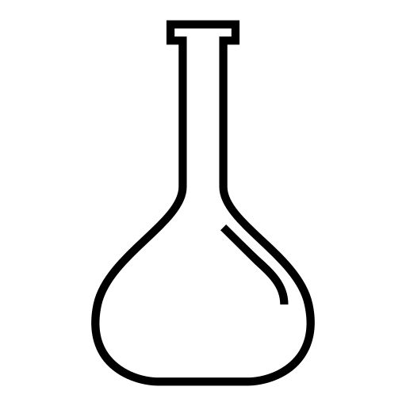








78. How do you prepare 100.0 mL 0.850 M NaOH_{(AQ)}
if you start with a stock solution of 6.40 M?
Do math, then draw a diagram to show how to “make” this.
M₁V₁ = M₂V₂
(6.40 M)(V₁) = (O.850 M)(100.0 mL)
V₁ = 13.3 mL stock (3 sf)
100.0 mL
mark
SECOND: fill to 100.0 mL total volume
(with water)
water
FIRST: put 13.3 mL stock solution into beaker.
stock

Slide 132
79. You dissolve 2.25 moles of KBr into water forming a
1.00 liter solution. What is this solution’s BP and FP?
(Round to nearest WHOLE Kelvin temperature)

Slide 133
79. You dissolve 2.25 moles of KBr into water forming a
1.00 liter solution. What is this solution’s BP and FP?
(Round to nearest WHOLE Kelvin temperature)
BP The original BP was 373 Kelvin, so the NEW BP is…
373 + (4.5 x 0.50K) = 373 + 2.25 = 375.25 K = 375 K
FP The original FP was 273 Kelvin, so the NEW FP is…
273 – (4.5 x 1.86K) = 273 – 8.37 = 264.63 K = 265 K

Slide 134
80. If you have a 2.40 M HCl stock solution, how do
you make a 50.0 mL of 3.00 M HCl solution from it?
A diagram might help you think through this math.

Slide 135
80. If you have a 2.40 M HCl stock solution, how do
you make a 50.0 mL of 3.00 M HCl solution from it?
A diagram might help you think through this math.
M₁V₁ = M₂V₂
(2.40 M)(V₁) = (3.00 M)(50.0 mL)
V₁ = 62.5 mL stock
? What ? Next slide please…
X
FIRST: put 62.5 mL stock HCl

Slide 136
81. Three ions are shown below.
Draw in 3 water molecules oriented to each of these ions.
Ca⁺²
Cl⁻¹
Cl⁻¹

Slide 137
81. Three ions are shown below.
Draw in 3 water molecules oriented to each of these ions.
H H
O
O
O
H H
Ca⁺²
H H
Cl⁻¹
O
H H
H H
H H
O
O
O
H H
Cl⁻¹
H H
H H
O
O

