Slide 1
You need a calculator now.
1st class, start Thermochem
1-31 in notes

Slide 2
Thermochemistry
Thermochemistry concerns itself with how energy
is RELEASED or ABSORBED in chemical reactions, or PHYSICAL CHANGES
Since we just learned about phases, we’ll start with them first, then move to chemical reactions.
Physical changes = Phase changes
They are exothermic or endothermic
Exothermic changes release or emit heat energy. Endothermic changes absorb heat energy

Slide 3
1. Exothermic means to EMIT heat energy.
2. Endothermic means to ABSORB heat energy.
3. To melt a solid into a liquid,
solids ABSORB heat energy.
4. To freeze liquids into solids, liquids
EMIT heat energy.

Slide 4
5. To vaporize a liquid into a gas,
liquids ABSORB heat energy.
6. To condense a gas into a liquid, gases
RELEASE heat energy.
7. For sublimation, when a solid turns directly
into a gas, solids ABSORB heat energy.
8. For deposition, when a gas turns directly into
a solid, gases RELEASE heat energy.

Slide 5
9. When substances are hotter, their particles
are moving FASTER
10. Hot substances have HIGHER
Kinetic Energy than colder ones.
11. When substances are colder, their particles
are moving SLOWER
12. Colder substances have LOWER
Kinetic Energy than hotter ones.

Slide 6
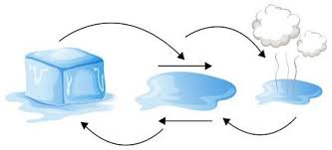


Kinetic energy is the energy of motion. Faster particles have higher kinetic energy. Kinetic energy and temperature change together, they are directly proportional.
Potential energy is the energy of phase.
Gases have the highest potential energy,
Liquids have medium potential energy
Solids have the lowest potential energy.
POTENTIAL ENERGY INCREASES
14
DRAW IN
THE ARROWS
POTENTIAL ENERGY DECREASES

Slide 7
The Heating Curve for Water
F
Boiling Point
Temperature
D
E
Melting Point
B
C
A
Heat is added at a constant rate →
15. Segment | Phase or Phases Present | Temperature & Kinetic Energy INC or DEC or STEADY? | Potential Energy INC or DEC or STEADY?
AB
BC
CD
DE
EF

Slide 8
The Heating Curve for Water
F
Boiling Point
Temperature
D
E
Melting Point
B
C
A
Heat is added at a constant rate →
15. Segment | Phase or Phases Present | Temperature & Kinetic Energy INC or DEC or STEADY? | Potential Energy INC or DEC or STEADY?
AB | AB | SOLID | INCREASING
BC | BC | Solid to Liquid | STEADY
CD | CD | Liquid | INCREASING
DE | DE | Liquid to Gas | STEADY
EF | EF | GAS | INCREASING

Slide 9
The Heating Curve for Water
F
Boiling Point
Temperature
D
E
Melting Point
B
C
A
Heat is added at a constant rate →
16. Why is BC shorter than DE? MELTING IS EASIER, LESS ENERGY IS
REQUIRED COMPARED TO VAPORIZING (BOILING)
17. To melt ONE GRAM of SOLID ICE into one gram of liquid water requires the
HEAT OF FUSION, FOR WATER IT’S ONLY 334 JOULES/GRAM ADDED IN
18. To freeze ONE GRAM of liquid water into SOLID ICE requires the
HEAT OF FUSION, FOR WATER IT’S ONLY 334 JOULES/GRAM REMOVED

Slide 10
The heating curve for water
F
Boiling Point
Temperature
D
E
Melting Point
B
C
A
Heat is added at a constant rate →
22. Why is BC shorter than DE? MELTING IS EASIER, LESS ENERGY IS
REQUIRED COMPARED TO VAPORIZING (BOILING)
23. To melt ONE GRAM of SOLID ICE into one gram of liquid water requires the
HEAT OF FUSION, FOR WATER IT’S ONLY 334 JOULES/GRAM ADDED IN
To freeze ONE GRAM of liquid water into SOLID ICE requires the
HEAT OF FUSION, FOR WATER IT’S ONLY 334 JOULES/GRAM REMOVED
24. To Boil Away (vaporize) one gram of hot liquid water into steam requires the
HEAT OF VAPORIZATION, for water that is 2260 JOULES/GRAM ADDED IN.

Slide 11
25. Table B has three important physical constants for water.
Fill in this chart now.
Constant | Value with units | Will make one gram of H₂O...
Heat of Fusion
Heat of Vaporization
Specific Heat Capacity

Slide 12
25. Table B has three important physical constants for water.
Fill in this chart now.
Constant | Value with units | Will make one gram of H₂O...
Heat of Fusion | 334 J/g | MELT or FREEZE one gram of H₂O, NO TEMP CHANGE
Heat of Vaporization | 2260 J/g | VAPORIZE or CONDENSE one gram of H₂O, NO TEMP CHANGE
Specific Heat Capacity | 4.18 J/g·K | Change temp of one gram of H₂O by 1 Kelvin (or 1°C) hotter or colder

Slide 13
The heating curve for water
F
Boiling
Point
D
E
Melting
Point
B
C
A
Heat is added at a constant rate →
If we consider just ONE GRAM OF WATER…
26. To move from B to C, we would need to ADD 334 Joules of energy.
27. To move from D to E, we would need to ADD 2260 Joules of energy.

Slide 14
The heating curve for water
F
Boiling
Point
D
E
Melting
Point
B
C
A
Heat is added at a constant rate →
If we consider just ONE GRAM OF WATER…
26. To move from B to C, we would need to ADD 334 Joules of energy.
27. To move from D to E, we would need to ADD 2260 Joules of energy.

Slide 15
The heating curve for water
F
Boiling Point
Temperature
D
E
Melting Point
B
C
A
Heat is added at a constant rate →
28. Moving from B to C is ENDOTHERMIC – ADDING IN HEAT.
29. Moving from D to E is ENDOTHERMIC – ADDING IN HEAT.

Slide 16
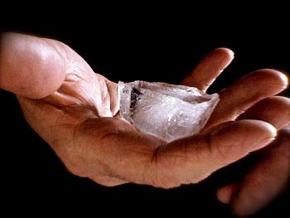
30. It takes 334 Joules to melt one gram of ice, at the
melting point. There is no temperature change,
this happens at 273 Kelvin or 0°C.
How much energy does it take to melt a real sized
ice cube of 73.5 grams?

Slide 17
30. It takes 334 Joules to melt one gram of ice, at the
melting point. There is no temperature change,
this happens at 273 Kelvin or 0°C.
How much energy does it take to melt a real sized
ice cube of 73.5 grams?
q = mH_{F}
q = (73.5g)(334 J/g)
q = 24549 J = 24,500 Joules with 3 SF

Slide 18
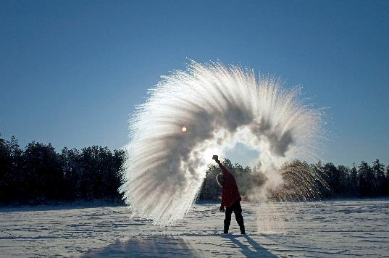
31. How much energy does it take
to freeze 125 grams of pure
water into ice if the water is at
0°C to start?

Slide 19
31. How much energy does it take
to freeze 125 grams of pure
water into ice if the water is at
0°C to start?
q = mH_{F}
q = (125g)(334 J/g)
q = 41750 J = 41,800 Joules with 3 SF
this is ENERGY REMOVED from the water.

Slide 20
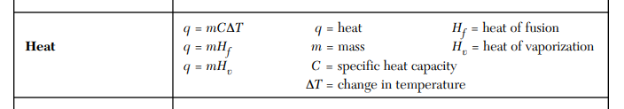
Open to the BACK PAGE of your reference tables.
Insert this RED ink into your table.
All ∆T
Cold: S ↔ L
Hot: L ↔ G
This will remind you to use the first formula for
ALL PROBLEMS with a ΔT
The 2nd formula is for melting or freezing (no ΔT)
The last formula is for boiling or condensing (no ΔT)

Slide 21
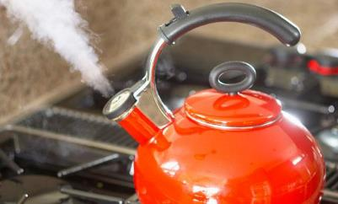
32. How much energy does it take to vaporize
73.5 grams of water into steam?

Slide 22
32. How much energy does it take to vaporize
73.5 grams of water into steam?
q = mH_{V}
q = (73.5g)(2260 J/g)
q = 166,110 J = 166,000 Joules with 3 SF

Slide 23

33. If 2.75 grams of steam condenses into water onto
your finger, how much energy do you absorb?

Slide 24
33. If 2.75 grams of steam condenses into water onto
your finger, how much energy do you absorb?
q = mH_{V}
q = (2.75g)(2260 J/g)
q = 6215 J = 6220 Joules
with 3 SF

Slide 25
34. Which phase change takes more energy,
the COLD one (BC) or the HOT one (DE)? vaporizing
35. If heat is added AT A CONSTANT RATE, why is BC shorter than
DE on a heating curve for water? Because it takes LONGER to
ADD more energy if it goes in at a CONSTANT RATE.
BC needs 334 J/g while DE needs 2260 J/g
The heating curve for water
F
Boiling Point
Temperature
D
E
Melting Point
B
C
A
Heat is added at a constant rate

Slide 26
34. Which phase change takes more energy,
the COLD one (BC) or the HOT one (DE)? vaporizing
35. If heat is added AT A CONSTANT RATE, why is BC shorter than
DE on a heating curve for water?
H_{F} < H_{V}
_{cold hot}
The heating curve for water
F
H_{V}
_{HOT}
Boiling Point
Temperature
D
E
H_{F}
_{cold}
Melting Point
B
C
A
Heat is added at a constant rate

Slide 27
1 gram ice |  | 1 gram water liquid
1 gram water liquid |  | 1 gram ice
1 gram water liquid |  | 1 gram steam gas
1 gram steam gas |  | 1 gram water liquid
To make 1 gram of cold water 1 Kelvin or 1°C hotter |  | 1 gram of warmer water
1 gram of cooler water |  | To make 1 gram of hot water 1 Kelvin or 1°C cooler
36
Add 334 Joules
Remove 334 Joules
Add 2260 Joules
Remove 2260 Joules
Add 4.18 Joules
Remove 4.18 Joules

Slide 28
37. To heat one gram of
pure water from
275 K → 276 K
you need to add
4.18 Joules
275 K 276 K

Slide 29
37. To heat one gram of
pure water from
275 K → 276 K
you need to add
4.18 Joules
275 K 276 K

Slide 30
38. To heat 1.0 gram of
H₂O from
365 K → 366 K
you need to add
4.18 Joules
365 K 366 K

Slide 31
38. To heat 1.0 gram of
H₂O from
365 K → 366 K
you need to add
4.18 Joules
365 K 366 K

Slide 32
39. If one gram of hot water,
at 368 K cools to 367 K
how much heat radiated
out of it?
4.18 Joules
368 K 367 K

Slide 33
39. If one gram of hot water,
at 368 K cools to 367 K
how much heat radiated
out of it?
4.18 Joules
368 K 367 K

Slide 34
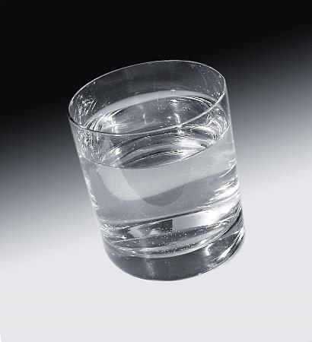
40. If you put 375 grams of tap water at 294 Kelvin into the fridge to cool it all down to 275 Kelvin, how much energy needed to be removed from this water?

Slide 35
40. If you put 375 grams of tap water at 294.0 K into the fridge to cool it all down to 275.0 K, how much energy needed to be removed from this water?
q = mCΔT
q = (375 g)(4.18 J/g·K)(19.0 K)
q = 29,782.5 J = 29,800 J (3 SF)

Slide 36
41. Convert both centigrade temps → Kelvin
24.0°C → Kelvin K = C + 273 K = 24.0 + 273 = 297 K
95.0°C → Kelvin K = C + 273 K = 95.0 + 273 = 368 K
C
K
100 Boiling point 373
95.0°C
K
42. The ∆T in °C = 95 – 24 = 71 C
The ∆T in K = 368 – 297 = 71 K
43. ∆T in °C = ∆T in K
24.0°C
K
0 Melting point 273

Slide 37
41. Convert both centigrade temps → Kelvin
24.0°C → Kelvin K = C + 273 K = 24.0 + 273 = 297 K
95.0°C → Kelvin K = C + 273 K = 95.0 + 273 = 368 K
C
K
100 Boiling point 373
95.0°C
368 K
42. The ∆T in °C = 95 – 24 = 71 C
The ∆T in K = 368 – 297 = 71 K
43. ∆T in °C = ∆T in K
24.0°C
297 K
0 Melting point 273

Slide 38
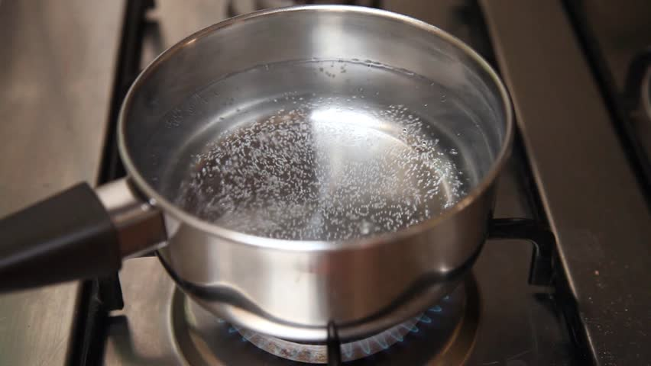
44. A pot has 650. grams of water at room temp, or 24.0°C. You think to make some mac & cheese and turn on the stove to heat the water. Your BFF shows up with pizza so you turn off the stove. The water is at 95.0°C. How much energy would your Dad say you wasted heating up this water for nothing?

Slide 39
44. A pot has 650. grams of water at room temp, or 24.0°C. You think to make some mac & cheese and turn on the stove to heat the water. Your BFF shows up with pizza so you turn off the stove. The water is at 95.0°C. How much energy would your Dad say you wasted heating up this water for nothing?
q = mCΔT
q = (650. g)(4.18 J/g·K)(71.0 K)
q = 192907 J = 193,000 J (3 SF)

Slide 40
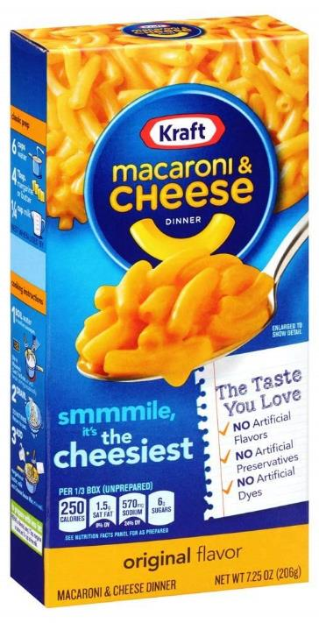
45. You want some mac & cheese so you put 650. grams of water at 24.0°C onto the stove top. You begin to text your BFF and “forget” about eating for a while. Your Mom yells “Who left this pot on the stove?!” You realize that you have vaporized 35.0 grams of your water while distracted. You turn off the stove and decide to eat out instead. How much energy did it take to all of this?

Slide 41
51. You want some mac & cheese so you put 650. grams of water at 24.0°C onto the stove top. You begin to text your BFF and “forget” about eating for a while. Your Mom yells “Who left this pot on the stove?!” You realize that you have vaporized 35.0 grams of your water while distracted. You turn off the stove and decide to eat out instead. How much energy did it take to all of this?
FIRST
Use q = mCΔT to WARM UP all the water
q = (650. g)(4.18 J/g·K)(76.0 K)
q = 206,492 J = 206,000 J (3 SF)
THEN
Use q = mH_{V} to VAPORIZE some of the water
q = (35.0 g)(2260 J/g)
q = 79,100 J (3 SF)
Then SUM UP THE TOTAL for one answer….
206,000 J
+ 79,100 J
285,100 J
285,000 J
(3SF)

Slide 42
Quick Class today - notes #52 - #60
You must have a calculator.
Get it out now.
Take out your reference tables
we will write on the back page now.

Slide 43
Copy this under the Temperature formula
Water Constants and Formulas
H_{F} = 334 J/g H_{V} = 2260 J/g
q = mH_{F} q = mH_{V}
C = 2.10 J/g∙K C = 4.18 J/g∙K C = 1.90 J/g∙K
q = mCΔT q = mCΔT q = mCΔT
MP/FP BP/CP
273 K/0⁰C 373 K/100⁰C
cold phase hot phase
change change
Then we should talk about it for one minute, okay?

Slide 44
46. How many joules of energy are required to
freeze 355 mL of water at 273K?

Slide 45
46. How many joules of energy are required to
freeze 355 mL of water at 273K?
FREEZING IS THE COLD PHASE CHANGE
one mL of water = one gram of water
q = mH_{F}
q = (355 g)(334 J/g)
q = 118570 J = 119,000 Joules with 3 SF

Slide 46
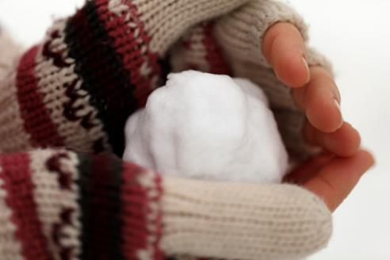
47. How many joules required to melt a snowball of 415 g?

Slide 47
47. How many joules required to melt a snowball of 415 g?
q = mH_{F}
q = (415 g)(334 J/g)
q = 138610 J = 139,000 Joules
with 3 SF

Slide 48
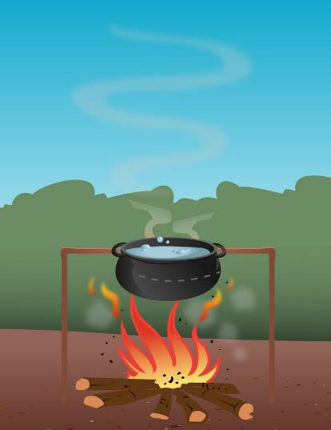
48. How many joules does it take to warm up
375 grams of water by 7.50 Kelvin?

Slide 49
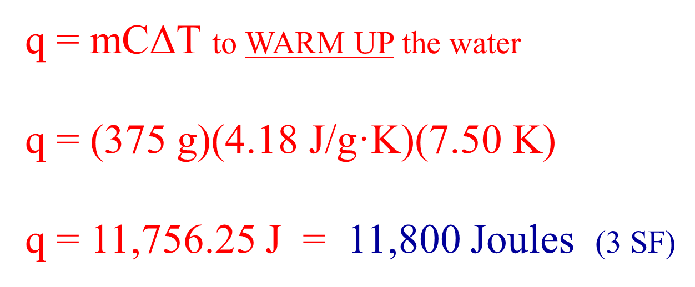
48. How many joules does it take to warm up
375 grams of water by 7.50 Kelvin?

Slide 50
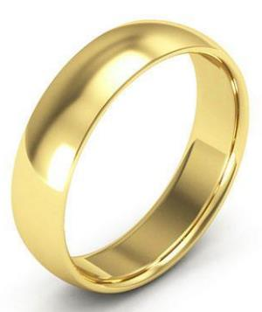
49. What is the specific heat capacity constant for GOLD if it
takes 271 joules to warm up a ring with mass of 34.2 g
from room temp of 294.0 K to a “too hot to wear”
temperature of 355.5 Kelvin?

Slide 51
49. What is the specific heat capacity constant for GOLD if it
takes 271 joules to warm up a ring with mass of 34.2 g
from room temp of 294.0 K to a “too hot to wear”
temperature of 355.5 Kelvin?
Use SOLVE FOR
q = mCΔT
271 J = (34.2 g)(C)(61.5 K)
= C → → → = 0.129 J/g·K
271 J
(34.2 g)(61.5 K)

Slide 52
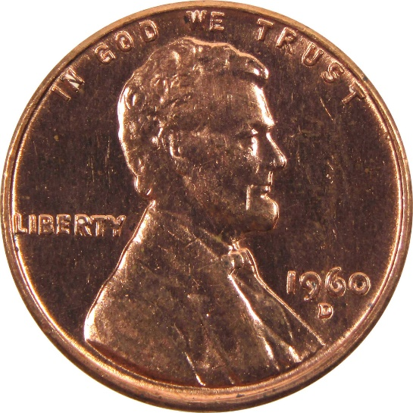
50. What is the specific heat capacity constant of copper, if it takes 951 joules to warm up 41.63 grams of copper from 294.5 K up to 352.9 Kelvin?

Slide 53
50. What is the specific heat capacity constant of copper, if it takes 951 joules to warm up 41.63 grams of copper from 294.5 K up to 352.9 Kelvin?
Use SOLVE FOR
q = mCΔT
951 J = (41.63 g)(C)(58.4 K)
= C → → → = 0.391 J/g·K
notice the units!
951 Joules
(41.63 g)(58.4 K)

Slide 54
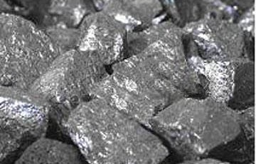
51. What is the heat of fusion constant for an
unknown if it takes 6750 Joules to melt
28.0 grams of it?

Slide 55
51. What is the heat of fusion constant for an
unknown if it takes 6750 Joules to melt
28.0 grams of it?
Use SOLVE FOR
q = mH_{F}
6750 J = (28.0 g)(H_{F})
= H_{F} → → → 241 J/g

Slide 56

52. How many grams of water can be frozen
when you remove 87,500 joules from it?

Slide 57
52. How many grams of water can be frozen
when you remove 87,500 joules from it?
Use SOLVE FOR
q = mH_{F}
87,500 J = (m)(334 J/g)
= m → → → 261.970 g = 262 g
with 3 SF
87,500 J
334 J/g

Slide 58
53. If 92.0 grams of a substance absorbs 27,496 Joules and the
temperature increased from 12.3°C to 83.8°C, what is the
specific heat capacity constant of this unknown?

Slide 59
53. If 92.0 grams of a substance absorbs 27,496 Joules and the
temperature increased from 12.3°C to 83.8°C, what is the
specific heat capacity constant of this unknown?
Use SOLVE FOR
q = mCΔT
27,496 J = (92.0 g)(C)(71.5 K)
= C → → → = 4.18 J/g·K 3 SF
27,496 J
(92.0 g)(71.5 K)
What is it, probably?

Slide 60
We will stop here, and begin the C of Cu Lab
In this lab we will experimentally measure the specific heat capacity constant for copper.
What is the C of H₂O?
Let’s go through the set up now, and get some goggles and a partner (2 partners, or solo)

Slide 61
Here come some “real life” thermochem problems, not do the math and pop out an answer, but real thermochemistry situations that are multi-step processes.
For example: If some very hot steam spurts into a very cold freezer and the water goes from very hot gas to very cold ice, it’s NOT one big problem.
Energy is removed in each separate step, with different formulas & different constants.
Hot steam cools down | q = mCΔT | 2.10 J/gˑK | = joules
Hot steam condenses | q = mH_{F} | 334 J/g | = joules
Hot water cools | q = mCΔT | 4.18 J/gˑK | = joules
Cool water freezes | q = mH_{V} | 2260 J/g | = joules
Ice cools | q = mCΔT | 1.90 J/gˑK | = joules
Five separate thermochem steps… |  |  | SUM up all jOULES

Slide 62
54. You put a 155 gram snowball at – 4.00°C into the back of
your friend’s jacket. It ultimately warms up to his body
temperature of 37.0°C. How much energy did that take?
step | called | formula | Do the math
1
2
3
Total Joules required →

Slide 63
54. You put a 155 gram snowball at – 4.00°C into the back of
your friend’s jacket. It ultimately warms up to his body
temperature of 37.0°C. How much energy did that take?
step | called | formula | Do the math
1 | warming ice* | q = mC∆T | q = (155 g)(2.10 J/g·K)(4.00 K) = 1302 J
2 | melting ice | q = mH_{F} | q = (155 g)(334 J/g) = 51770 J
3 | warming water | q = mC∆T | q = (155 g)(4.18 J/g·K)(37.0 K) = 23972 J
Total Joules required → |  |  | total = 76774 = 76,800 Joules with 3 SF

Slide 64

55. You allow 5.75 grams of steam to condense
at 373 K onto a piece of glass, then it cools
down to room temp of 23.5°C.
How much energy is emitted by this H₂O?
step | called | formula | Do the math
1
2
Total Joules required →

Slide 65
55. You allow 5.75 grams of steam to condense
at 373 K onto a piece of glass, then it cools
down to room temp of 23.5°C.
How much energy is emitted by this H₂O?
step | called | formula | Do the math
1 | Condensing | q = mH_{V} | q = (5.75 g)(2260 J/g) = 12995 J
2 | Cooling water | q = mC∆T | q = (5.75 g)(4.18 J/gK)(76.5 K) = 1839 J
Total Joules required → |  |  | 14834 J = 14,800 J with 3 SF

Slide 66
63. The title to table I is

Slide 67
63. The title to table I is
Heats of Reaction at 101.3 kPa and 298 K

Slide 68
63. The title to table I is
Heats of Reaction at 101.3 kPa and 298 K
64. There are 25 reactions and

Slide 69
56. Table I is titled
Heats of Reaction at 101.3 kPa and 298 K
57. There are
18 chemical reactions, and
6 PHYSICAL CHANGES (phase changes),
and
1 weirdo thing at the bottom that we can’t
talk about for about 7 weeks, but we will.

Slide 70
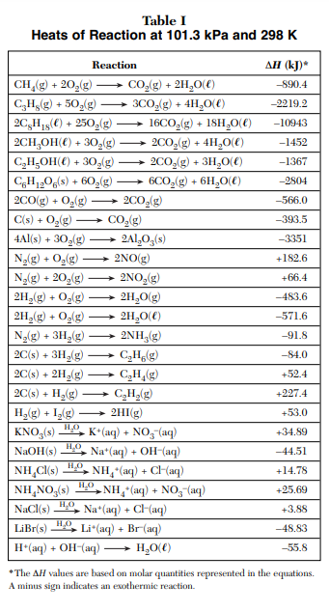
LABEL THE TABLE NOW…
COMBUSTION
SYNTHESIS
Solution
formation
(physical change)
Solid → Aqueous
Something weird

Slide 71
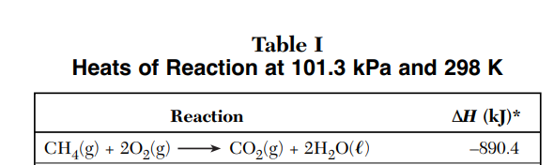
Look at the last column… ΔH (kJ/mole)*
Look at bottom of the table…
These balanced equations have mole ratios, and the energy they emit (or absorb) is ALSO IN RATIO.
The first reaction is the combustion of methane (Bunsen burner gas). COPY the first line…

Slide 72
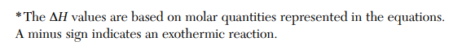
The ΔH (kJ/mole)
Is the change in HEAT, or the amount of energy in KILOJOULES that is emitted (or absorbed).
In this reaction heat is emitted, it is exothermic.

Slide 73
58. 1 mole of methane combusts with 2 moles of oxygen and forms
1 mole of carbon dioxide and 2 moles of water…
The Mole ratio is 1:2:1:2
AND
Since this is exothermic, it emits exactly 890.4 kilojoules of heat energy
The thermochemical mole ratio is 1:2:1:2:890.4 kJ

Slide 74

59. Looking at table I, what is the
first ENDOTHERMIC REACTION
The synthesis of NO_{(G)}
When one mole of this forms, 182.6 kJ are
ABSORBED, it feels COLDER if you are close by.

Slide 75
Time for the MOST endothermic reaction you will ever see.
I am going to mix 2 kinds of solid white crystals together.
Let’s write the formulas then we’ll do it…
ammonium thiocyanate and barium hydroxide octahydrate
form into barium thiocyanate and ammonia gas and water.

Slide 76
Time for the MOST endothermic reaction you will ever see.
I am going to mix 2 kinds of solid white crystals together.
Let’s write the formulas then we’ll do it…
ammonium thiocyanate and barium hydroxide octahydrate
form into barium thiocyanate and ammonia gas and water.
Ba(OH)₂·8H₂O_{(S)} + 2NH₄SCN_{(S)} →
Ba(SCN)_{2(S)} + 2NH_{3(G)} + 10H₂O_{(L)}

Slide 77
Copy this...
Ba(OH)₂·8H₂O_{(S)} + 2NH₄SCN_{(S)} → Ba(SCN)_{2(S)} + 2NH_{3(G)} + 10H₂O_{(L)}
The ΔH for this reaction is VERY +

Slide 78
61. Can energy be positive or negative? NO
It’s sort of like money.
You might have a $1 but you don’t have +$1
If you have no money but owe me a dollar,
you don’t have -$1 !
62. The +ΔH means that the reaction is ABSORBING energy,
it is endothermic
The –ΔH means that the reaction is EMITTING energy,
it is exothermic

Slide 79
63. The 6th reaction on table I | C₆H₁₂O_{6(S)} + 6O_{2(G)} → 6CO_{2(G)} + 6H₂O_{(G)}
The ΔH is | — 2804 kJ | Heat is emitted exothermically Heat is a PRODUCT
Rewrite this | C₆H₁₂O_{6(S)} + 6O_{2(G)} → 6CO_{2(G)} + 6H₂O_{(G)} + 2804 kJ
Heat is a product in an exothermic reaction, it can be written WITH the products. The ΔH is negative, but this is not changed to a + here. The negative sign MEANS exothermic, not negative!
Kilojoule | Is a big amount of energy | 1000 Joules = 1 kilojoule
Kilogram | Is a big amount of mass | 1000 grams = 1 kilogram
Kilometer | Is a big amount of length | 1000 meters = 1 kilometer

Slide 80
Start Class #4
Notes #64 through ___.
Calculators & reference tables necessary.
Phones & ear buds away,
or else.

Slide 81
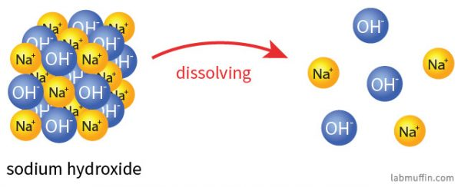
64. How many joules are released when one mole of
NaOH dissolves into water? ______________
78. How many joules are absorbed when one mole of
NaCl dissolves into water? _________________
DISSOLVES IN
WATER
LOOSE MOBILE IONS
in water
SOLID

Slide 82
64. How many joules are released when one mole of
NaOH dissolves into water? 44.51 kiloJoules
78. How many joules are absorbed when one mole of
NaCl dissolves into water? _________________
44.51 kJ
1
X
1000 J
1 kJ
= 44,510 Joules

Slide 83
65. How many joules are absorbed when one mole of
NaCl dissolves into water?

Slide 84
65. How many joules are absorbed when one mole of
NaCl dissolves into water?
3.88 kJ
1
X
1000 J
1 kJ
= 3,880 Joules

Slide 85
66. How many joules are absorbed when 9.75 moles of
NaCl dissolves into water?

Slide 86
66. How many joules are absorbed when 9.75 moles of
NaCl dissolves into water?
NaCl
energy
1
3.88 kJ
9.75
X kJ
MR
=
X = (3.88kJ/mole)(9.75 moles)
X = 37.8 kJ
37.8 kJ 1 | X | 1000 J 1 kJ | = | 37,800 joules

Slide 87
67. When you dissolve 11.9 moles
of LiBr into water, how many kJ
are released?

Slide 88
67. When you dissolve 11.9 moles
of LiBr into water, how many kJ
are released?
LiBr
energy
1
48.83 kJ
11.9
X kJ
MR
=
X = (48.83)(11.9)
X = 581.077 kJ
X = 581 kJ with 3 SF

Slide 89
68. How much energy is JOULES is absorbed when
52.61 moles of KNO₃ is dissolved into water?

Slide 90
68. How much energy is JOULES is absorbed when
52.61 moles of KNO₃ is dissolved into water?
KNO₃
energy
1
34.89 kJ
52.61
X kJ
MR
=
X = (34.89)(52.61) = 1835.5629 kJ
X = 1836 kJ with 4 SF
1836 kJ
1
X
1000 J
1 kJ
= 1,836,000 Joules

Slide 91
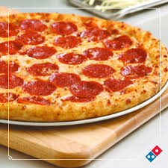

69. One slice of Domino's Pepperoni Pizza has
about 309 Calories of energy.
In the US, we used weird units sometimes (ounces, inches, quarts, etc.)
We have scientific calories (which are small and use a lower case “c”)
We also have Food Calories (which are big and use a CAPITAL “C”)
1000 calories = 1 Calorie (ugh!)
Another way to say this is 1000 cal = 1 kilocalorie (kcal)

Slide 92
69. Convert 309 Calories into the three
other units of energy.
1 cal = 4.18 Joules 1000 Joules = 1 kilo-Joule 1000 calories = 1 Calorie (kilocalorie)
309 C 1 | X | 1000 cal 1 C | = | 309,000 cal
309,000 cal 1 | X | 4.18 J 1 cal | = | 1,290.000 J
1,290.000 J 1 | X | 1 kJ 1000 J | = | 1290 kJ

Slide 93
70. Copy these conversion factors under table B now.
1 cal = 4.18 Joules
1000 Joules = 1 kilo-Joule
1000 calories = 1 Calorie (kilocalorie)

Slide 94
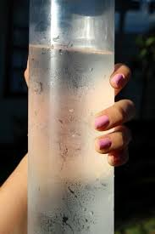
The specific heat capacity constant
for water is 4.18 J/gˑK
It takes 4.18 joules to
warm up 1 gram of water by 1 K
4.18 joules = 1 cal
It takes 1 cal to
warm up 1 gram of water by 1 K
It would take 354 cals to warm up
354 g H₂O at 7°C → 8°C
7°C 8°C

Slide 95
71. How many joules is 354 cal?
7°C 8°C

Slide 96
71. How many joules is 354 cal?
354 cal
1
4.18 J
1 cal
=
X
1479.72 J = 1480 joules
with 3 SF
7°C 8°C

Slide 97
72. Convert 3429 cal into kilojoules.

Slide 98
72. Convert 3429 cal into kilojoules.
3429 cal
1
4.18 J
1 cal
= 14333.22 J =
14330 joules with 4 SF
X
14330 J
1
1 kJ
1000 J
X
= 14.33 kJ with 4 SF

Slide 99
73. When two moles of water gas synthesize (like the first day of school)
the amount of energy released is 483.6 kJ.
Convert that amount of energy into joules, cals, and Calories.

Slide 100
73. When two moles of water gas synthesize (like the first day of school)
the amount of energy released is 483.6 kJ.
Convert that amount of energy into joules, cals, and Calories.
483.6 kJ 1 | X | 1000 joules 1 kJ | = | 483,600 joules
483,600 joules 1 | X | 1 cal 4.18 joules | = | 116,000 cal
116,000 cal 1 | X | 1 C 1000 cal | = | 116 C

Slide 101
74. Methane combusts, what is the ΔH?
Convert these kJ → joules, cals, and Calories.

Slide 102
74. Methane combusts, what is the ΔH?
Convert these kJ → joules, cals, and Calories.
890.4 kJ 1 | X | 1000 joules 1 kJ | = | 890,400 joules
890,400 joules 1 | X | 1 cal 4.18 joules | = | 213,000 cal
213,000 cal 1 | X | 1 C 1000 cal | = | 213 C

Slide 103
Walk around Practice
You have 12 questions out back (pick a color, all the same)
You can do these, or you can’t.
One or two might be difficult, think hard, or realize that you better pay attention tomorrow when you learn how to do the last sort of problems.
12 questions and we’re done. Don’t rush, get them done right.

Slide 104
Start Last thermochem class

Slide 105
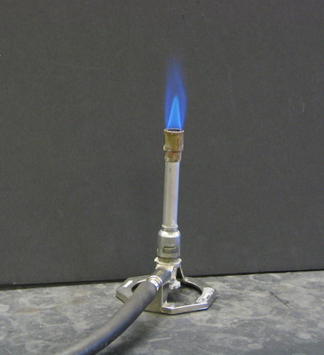
75. If you combust 8.44 moles
of methane, how many
kilojoules are released?

Slide 106
75. If you combust 8.44 moles
of methane, how many
kilojoules are released?
CH₄
energy
1
890.4 kJ
8.44
X kJ
MR
=
X = (890.4)(8.44) = 7514.976 kJ
X = 7510 kJ with 3 SF

Slide 107
76. If you combust 40.8 moles of glucose,
how many kJ are released? (look at table I)

Slide 108
76. If you combust 40.8 moles of glucose,
how many kJ are released? (look at table I)
glucose
energy
1
2804 kJ
40.8
X kJ
MR
=
X = (2804)(40.8) = 114403.2 kJ
X = 114,000 kJ with 3 SF

Slide 109
77. Liquid octane (reaction #3 on Table I) combusts in car
engines. If you burn up 12.890 moles of C₈H₁₈,
how many kilojoules are released?

Slide 110
77. Liquid octane (reaction #3 on Table I) combusts in car
engines. If you burn up 12.890 moles of C₈H₁₈,
how many kilojoules are released?
Special note here: Watch this Mole Ratio!
octane
energy
2
10943 kJ
=
12.890
X kJ
MR
2X = (10943)(12.890) = 141055.27 kJ
X = 70527.635 kJ
X = 70,528 kJ with 5 SF

Slide 111
78. Table I shows us this:
4Al + 3O₂ → 2Al₂O₃ ∆H = -3351 kJ
It can be rewritten as this…
4Al + 3O₂ → 2Al₂O₃ + 3351 kJ
In this reaction, heat energy is a product.
The H is negative, but we add this energy to the product side. No mix up on signs.

Slide 112
79. When 7.50 moles of aluminum oxide form,
how many kJ are released?

Slide 113
79. When 7.50 moles of aluminum oxide form,
how many kJ are released?
Al₂O₃
energy
2
3351 kJ
7.50
X kJ
MR
=
2X = (3351)(7.50) = 25132.5 kJ
X = 12,600 kJ with 3 SF

Slide 114
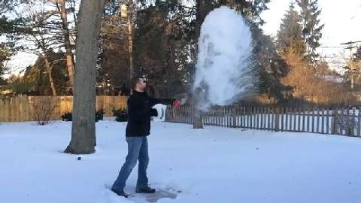
80. How many calories are removed when
45.8 grams of ice forms from water at 273K?

Slide 115
80. How many calories are removed when
45.8 grams of ice forms from water at 273K?
Use SOLVE FOR
q = mH_{F}
q = (45.8 g)(334 J/g)
q = 15297.2 Joules = 15,300 J with 3 SF
15,300 J
1
1 cal
4.18 J
X
= 3660 cal with 3 SF

Slide 116
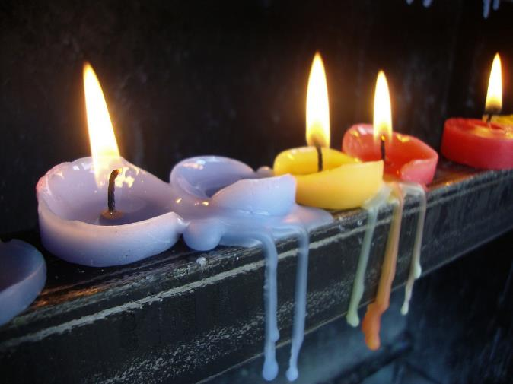
81. What is the HEAT OF FUSION for candle wax
if it takes 3388 Joules to melt a whole birthday
candle with mass of 23.04 grams?
These candles are burning (combustion) and they are melting.
This question is about the melting,
the physical change.

Slide 117
81. What is the HEAT OF FUSION for candle wax
if it takes 3388 Joules to melt a whole birthday
candle with mass of 23.04 grams?
Use SOLVE FOR
q = mH_{F}
3388 J = (23.04 g)(H_{F})
= H_{F}
H_{F} = 147 J/g
3388 J
23.04 g

Slide 118
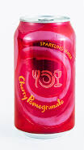
82. When a 355 mL can of seltzer, is warmed from a
temperature of 293 K by adding 64,000 Joules
of energy to it, what is the final temperature?
Assume the seltzer is just water.

Slide 119
82. When a 355 mL can of seltzer, is warmed from a
temperature of 293 K by adding 64,000 Joules
of energy to it, what is the final temperature?
Assume the seltzer is just water.
q = mCΔT
64,000 J = (355 g)(4.18 J/g·K)(ΔT)
64,000 J
(355 g)(4.18 J/g·K)
64,000 J
1483.9 J/K
= ΔT
= ΔT = 43 K
293 K
+ 43 K
336 K
SF L

Slide 120
83. How many grams of water can be heated
by 25.5 K when it absorbs 17,500 joules?

Slide 121
83. How many grams of water can be heated
by 25.5 K when it absorbs 17,500 joules?
Use q = mC∆T solve for
17,500 J = (m)(4.18 J/g·K)(25.5 K)
17,500 J
(4.18 J/g·K)(25.5 K)
= m = 164 grams
with 3 SF

Slide 122
84. When 51.1 g of copper cools, it emits 1788 Joules.
If it was at 381.5 Kelvin, what is its final temperature?
the C_{Cu} = 0.391 J/g·K ? (this is the hardest so far!) Think!

Slide 123
84. When 51.1 g of copper cools, it emits 1788 Joules.
If it was at 381.5 Kelvin, what is its final temperature?
the C_{Cu} = 0.391 J/g·K ? (this is the hardest so far!) Think!
q = mCΔT
1788 J = (51.1 g)(0.391 J/g·K)(ΔT)
1788 J
19.9801 J/K
= ΔT = 89.4 K
381.5 K
- 89.4 K
292 K

Slide 124

85. A 246.4 gram snowball at 273.0 K
first melts, then warms to 26.55°.
How many joules did it take to do that?
You can see in their eyes that this is LOVE. Snow down the back is a sure way to win the heart of someone that
you wish loved you. It always works.
step | called | formula | Do the math
1
2
Total Joules required →

Slide 125
85. A 246.4 gram snowball at 273.0 K
first melts, then warms to 26.55°.
How many joules did it take to do that?
step | called | formula | Do the math
1 | melting ice | q = mH_{F} | q = (246.4 g)(334 J/g) = 82297.6 J
2 | warming water | q = mC∆T | q = (246.4g)(4.18 J/g·K)(26.55 K) = 27345 J
Total Joules required → |  |  | total = 109642.8 109,600 Joules with 4 SF

Slide 126
There is no easy way to directly measure the energy that is in food. An indirect way has been figured out, using a machine called a BOMB CALORIMETER
86. Let’s draw it now…

Slide 127
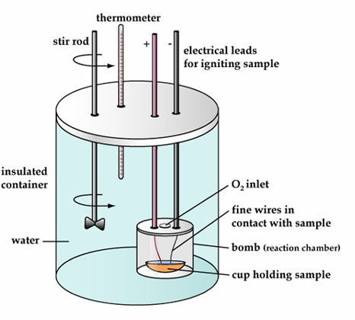
86
Food goes into the cup. It’s sealed in the “bomb” with oxygen. The electricity leads are attached. This is placed into a certain mass of pure water, at measured temperature. The stirrer moves the water around and makes sure it’s all at the same temperature. At some point you spark and burn the food. Heat is released into the water and the temperature rises.
Using q = mC∆T, calculate the number joules required to make that temperature change, convert to cal,
then Calories.

Slide 128
87. Let’s assume that there is exactly 2120. mL of water in our bomb
calorimeter and it’s at exactly 295.0 K. After burning up our food
sample, the temperature of the water rises to 354.5 K.
How many Calories of energy are in this food sample?

Slide 129
87. Let’s assume that there is exactly 2120. mL of water in our bomb
calorimeter and it’s at exactly 295.0 K. After burning up our food
sample, the temperature of the water rises to 354.5 K.
How many Calories of energy are in this food sample?
q = mCΔT
q = (2120. g)(4.18 J/g·K)(59.50 K)
q = 527,265.2 J
527,300 J
1
1 cal
4.18 J
X
= 126,148.32 cal
= 126,100 cal
126,100 cal
1
1 C
1000 cal
X
= 126.1 Calories

Slide 130
88.
Cooling curve for Chromium metal
A
C
B
K
E
L
V
I
N
117.
A. What temps are on the Y axis?
B. What’s PE doing BC?
C. What’s KE doing DE?
D. Why is BC longer than DE?
E. Which thermochem formula do you use for BC?
F. How about for EF?
E
D
F
Heat removed at a constant rate (time)

Slide 131
88.
A
Cooling curve for Chromium metal
KE
PE
C
2944
q = mH_{V}
B
K
E
L
V
I
N
PE
117.
A. What temps are on the Y axis?
B. What’s PE doing on BC and CD?
C. What’s KE doing on AB and DE?
D. Why is BC longer than DE?
E. Which thermochem formula do you use for BC?
F. How about for EF?
KE
E
2180
D
q = mCΔT
F
Heat removed at a constant rate (time)

Slide 132
89. Propane gas, C₃H₈ combusts according to Table I.
How much energy (in kJ) is released when 5.75 moles
C₃H₈ combusts? (find this - Table I, it’s the 2nd reaction)

Slide 133
89. Propane gas, C₃H₈ combusts according to Table I.
How much energy (in kJ) is released when 5.75 moles
C₃H₈ combusts? (find this - Table I, it’s the 2nd reaction)
C₃H₈ + 5 O₂ → 3CO₂ + 4 H₂O ΔH = -2219.2 kJ
Which is: C₃H₈ + 5 O₂ → 3CO₂ + 4 H₂O + 2219.2 kJ
exothermic, energy is a product
C₃H₈
energy
1
2219.2 kJ
5.75
X kJ
MR
=
X = 12760.4 kJ
X = 12,800 kJ with 3 SF

Slide 134
90. How much energy is absorbed by the
reaction of 9.20 moles of HI_{(G)} forming?
H_{2(G)} + I_{2(G)} → 2HI _{(G)} ΔH = +53.0 kJ
53.0 kJ + H_{2(G)} + I_{2(G)} → 2HI _{(G)} (energy is a reactant)

Slide 135
90. How much energy is absorbed by the
reaction of 9.20 moles of HI_{(G)} forming?
H_{2(G)} + I_{2(G)} → 2HI _{(G)} ΔH = +53.0 kJ
53.0 kJ + H_{2(G)} + I_{2(G)} → 2HI _{(G)} (energy is a reactant)
HI
energy
2
53.0 kJ
2X = 487.6 kJ
X = 243.8 kJ
X = 244 kJ 3 SF
MR
=
9.20
X kJ

Slide 136
91. When 45.0 g of an unknown metal absorbs 1.51 kJ of
heat. The temperature changes from 268 K to 345 K.
What is the specific heat capacity constant for this metal?
Note: KILOJOULES!

Slide 137
91. When 45.0 g of an unknown metal absorbs 1.51 kJ of
heat. The temperature changes from 268 K to 345 K.
What is the specific heat capacity constant for this metal?
Use q = mC∆T
1510 J = (45.0 g)(C)(77.0 K)
= C = 0.436 J/g·K
1510 J
(45.0 g)(77.0 K)

Slide 138
92. Copy these…
The Law of Conservation of Matter (or mass)
Matter cannot be created or destroyed in a chemical
reaction, or a physical change. (that’s a phase change)
The Law of Conservation of Energy
Energy cannot be created or destroyed in a chemical
reaction, or a physical change, but it can be transferred.
(that’s a phase change)

Slide 139
93. Which takes more energy? Melting 50.0 g of ice
or vaporizing 50.0 g of water into steam?

Slide 140
93. Which takes more energy? Melting 50.0 g of ice
or vaporizing 50.0 g of water into steam?
Melting a single gram takes 334 J/g.
Vaporizing a single gram takes 2260 J/g while
The hot phase change always takes
more energy – for any number of grams

Slide 141
94. Which takes more energy?
Heating 23.0 mL of water from 274 K to 299 K
This ∆T is 25°C
Or
Heating 23.0 mL of water from 299 K to 323 K?
This ∆T is 24°C
is 24°C = less energy
A greater ∆T would require more energy.

Slide 142
94. Which takes more energy?
Heating 23.0 mL of water from 274 K to 299 K
This ∆T is 25°C
Or
Heating 23.0 mL of water from 299 K to 323 K?
This ∆T is 24°C
is 24°C = less energy
A greater ∆T would require more energy.

Slide 143
95. Which takes more energy?
(no estimating, this requires math)
Vaporizing 21.0 g water from 373 K liquid to gas
q = mH_{V} = (21.0 g)(2260 J/g) = 47,460 J
(more energy)
or Changing the temp of 100.0 g H₂O by 97.0 K?
q = mC∆T = (100.0 g)(4.18 J/g·K)(97.0 K) = 40546 J
(less energy)

Slide 144
95. Which takes more energy?
(no estimating, this requires math)
Vaporizing 21.0 g water from 373 K liquid to gas
q = mH_{V} = (21.0 g)(2260 J/g) = 47,460 J
(more energy)
or Changing the temp of 100.0 g H₂O by 97.0 K?
q = mC∆T = (100.0 g)(4.18 J/g·K)(97.0 K) = 40546 J
(less energy)

Slide 145
96. Which has the LOWEST AVERAGE
KINETIC ENERGY?
A. 100 mL water at 51.0°C
B. 100 mL water at 50.0°C
C. 175 mL water at 49.0°C
D. 175 mL water at 23.0°C

Slide 146
Which has the LOWEST AVERAGE
KINETIC ENERGY?
A. 100 mL water at 51.0°C
B. 100 mL water at 50.0°C
C. 175 mL water at 49.0°C
D. 175 mL water at 23.0°C
this is KE/mL, not total energy
Lowest temp = Lowest kinetic energy

Slide 147
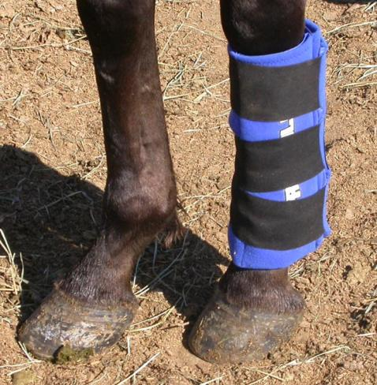
This horse has a boo boo.
That’s an ICE PACK on his leg.
97. Describe the flow of energy:
Heat flows from ice pack → leg
Cold flows from ice pack → leg
Heat flows from leg → ice pack
Cold flows from leg → ice pack

Slide 148
This horse has a boo boo.
That’s an ICE PACK on his leg.
97. Describe the flow of energy:
Heat flows from ice pack → leg
Cold flows from ice pack → leg
Heat flows from leg → ice pack
Cold flows from leg → ice pack

Slide 149
98. This is important and has not been covered yet. Thermochemistry is a 2 way street. The amount of energy is used to melt one gram of ice into water is 4.18 Joules. That same amount of energy REMOVED from a gram of cold water at the freezing point will freeze one gram of ice.
Table I shows us this: the synthesis of ammonia is exothermic N_{2(G)} + 3H_{2(G)} → 2NH_{3(G)} ΔH = - 91.8 kJ
That means that the decomposition of ammonia looks like this: 2NH_{3(G)} → N_{2(G)} + 3H_{2(G)} ΔH = + 91.8 kJ

Slide 150
Table I shows us this: the synthesis of aluminum oxide is exothermic 4Al_{(S)} + 3O_{2(G)} → 2Al₂O_{3(S)} ΔH = - 3351 kJ
99. How many kilojoules are absorbed when 4.58 moles of aluminum oxide decompose? 2Al₂O_{3(S)} → 4Al_{(S)} + 3O_{2(G)} ΔH = + 3351 kJ
Al₂O₃
energy
2
3351 kJ
4.58
x kJ
MR
=
2X = 15,347.58 kJ
X = 7670 kJ
3 SF

Slide 151
100. You must remember these…
The old chemistry adage goes like this… | When bonds form ENERGY IS RELEASED.
A good example of this is… | The synthesis of water. A balloon explodes as the water bonds together.
Never forget… | ∆T°C = ∆T K even though the temperatures are different numbers!

