Slide 1
WATER
This slide show covers everything that you have to know about water.
Power down your cell phones – batteries work by redox, which we won’t cover for at least 30 days.
Let’s start today with just pens/pencils, reference tables, and the water notes.

Slide 2
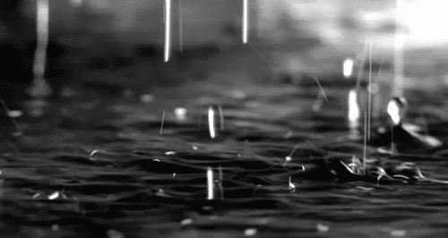
Objective: what are the important properties of water,
and what causes them?
What do you already know about water?
Formula? Shape? What atoms? What kind of bonds
are between atoms in the molecule?
What type of bonding between is between the water molecules? What is the density of water?
Or its freezing and boiling points?

Slide 3
1. A water molecule is BENT – they do not have radial symmetry.
The molecules are polar. Water has polar bonds – due to a great
difference in the electronegativity values of oxygen and hydrogen.
O H
H
These red dipole arrows indicate that the electrons move mostly towards
the oxygen atom, and
that leaves both of the
hydrogen atoms
more positive.

Slide 4
2. Draw 7 molecules of water (randomly, they are not soldiers!) and with
COLORED PENCIL LINES indicate the hydrogen bonding
BETWEEN MOLECULES.
O H
H
O H
H

Slide 5
1 + 2. Draw 7 molecules of water (randomly, they are not soldiers!) and with DOTTED LINES indicate the hydrogen bonding BETWEEN MOLECULES.
O H
H
O H
H
O H
H
O H
H
O H
H
O H
H
O H
H
BLUE
Hydrogen bonds
Between molecules

Slide 6
3. Hydrogen bonding:
is the intermolecular attraction between polar molecules containing polar bonds containing hydrogen atoms.
They help create super duper dipoles, or intermolecular magnetic attraction between molecules.

Slide 7
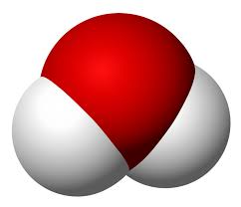
Get 6 magnetic water molecules.
4. Which atoms
are Red ?
White ?
Attach six
“water molecules” into a ring shape.

Slide 8
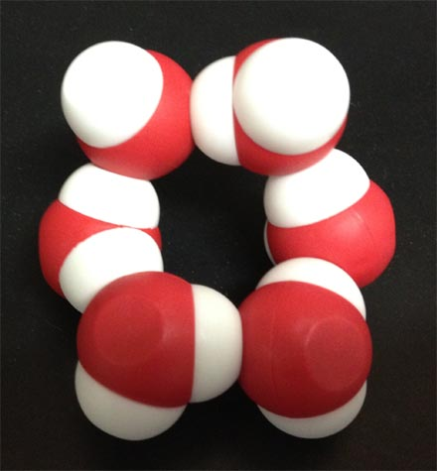
5. Water forms into a HEXAGON
See the hole there?
When the temp gets
so cold that ice forms,
it starts as a 6 molecule
ring, that grows in all
directions.

Slide 9
6. If you squish the magnets
(water molecules) in your hands and
move them slowly they take up less
space than when in the ring shape.
The density of pure water is _______
or you could say it this way _______

Slide 10
6. If you squish the magnets
(water molecules) in your hands and
move them slowly they take up less
space than when in the ring shape.
The density of pure water is 1 g/cm³
or you could say it this way 1 g/mL
1 mL = 1cm³ of volume

Slide 11
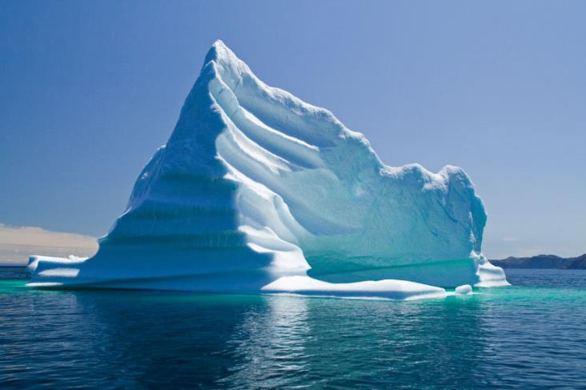
7. The density of ICE is
LESS THAN THE DENSITY OF WATER
since ice floats in liquid water.
8. The hole in the ring creates a slightly greater
VOLUME for the six molecules of water that
the liquid water just doesn’t have.

Slide 12
9. Liquid water freezes at what temp?
273 K or 0 °C
10. To melt
one gram of ice → one gram of water
it would take adding the
HEAT OF FUSION
11. For water, that constant is
334 Joules/gram

Slide 13
9. Liquid water freezes at what temp?
273 K o273 K or 0 °Cr 0 °C
10. To melt
one gram of ice → one gram of water
it would take adding the
HHEAT OF FUSION
11. For water, that constant is
334 Joules/gram

Slide 14
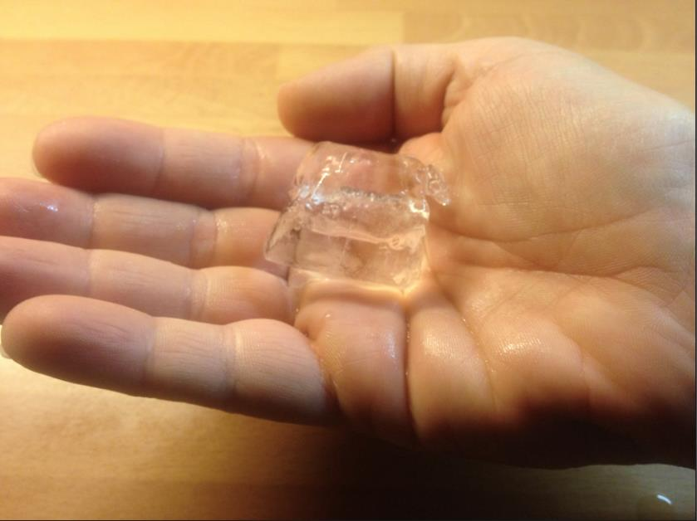
12. If you put an ice cube in your hand - does your hand get cold?
Or does the heat leave your hand?
Why does your hand get cold?

Slide 15
12. The HEAT ENERGY is transferred from
HAND TO ICE. The cold is the lack of
heat, or in effect,
cold is NOTHING.
Why does your hand get cold?
Your hand feels colder, but that’s just the
way we talk. The heat energy leaves your
hand, it has less kinetic energy as the heat
transfers to the ice cube.

Slide 16
14. How many water molecules does it take to
form a normal crystal of ice?
15. How many points does a normal
SNOWFLAKE have?
What’s the number ??????

Slide 17
14. How many water molecules does it take to
form a normal crystal of ice? SIX
15. How many points does a normal
SNOWFLAKE have? SIX
What’s the number ??????
How many question marks are right there??????

Slide 18
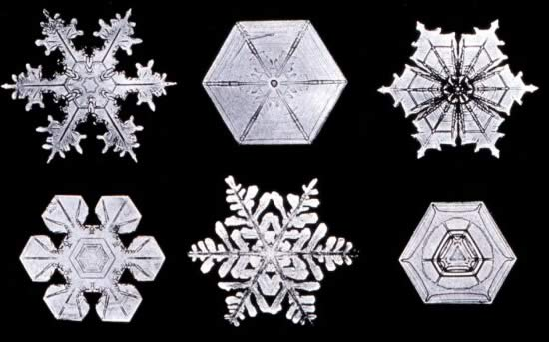
snowflakes

Slide 19
The Most Important Properties Of Water (and what causes them)
16. Water has a high BOILING POINT
This is due to _______________________

Slide 20
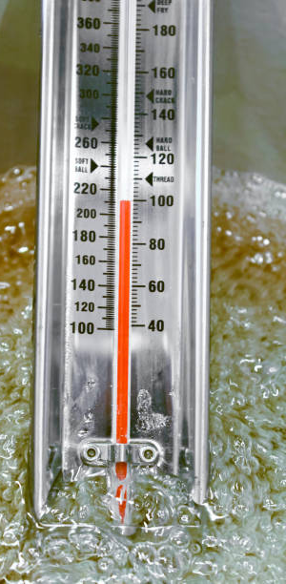
The Most Important Properties Of Water (and what causes them)
16. Water has a high BOILING POINT
This is due to HYDROGEN BONDING
The intermolecular attraction of the
hydrogen bonds hold the water molecules
loose enough for them to move, but tight
enough so that it’s hard to separate them
apart into a gas.
That takes lots of energy.

Slide 21
The Most Important Properties Of Water (and what causes them)
17. Water has a LOW VAPOR PRESSURE
This is due to __________________

Slide 22
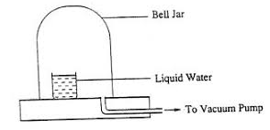
The Most Important Properties Of Water (and what causes them)
17. Water has a LOW VAPOR PRESSURE
This is due to HYDROGEN BONDING
The intermolecular hydrogen bonds hold the water molecules together which makes it
harder for water to evaporate
than molecules that have less
intermolecular attraction.

Slide 23
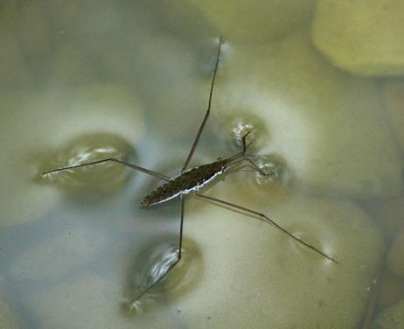
18. Water has SURFACE TENSION
This is due to ______________________

Slide 24
18. Water has SURFACE TENSION
This is due to HYDROGEN BONDING.
The intermolecular hydrogen bonds hold the water molecules tight to themselves and not at all to the air.
This creates a “skin” or what
is called surface tension.
I hate those bugs, don’t you?

Slide 25
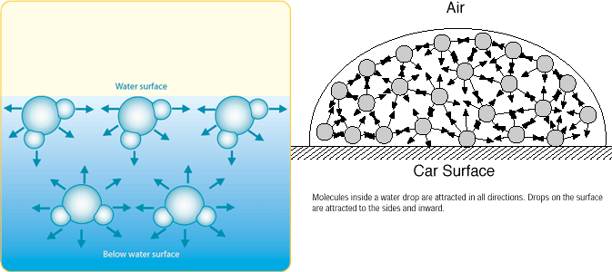
19. Surface tension… is created when the attractive forces between the water molecules are “unbalanced”. At the surface there is great side to side attraction but no attraction in the up direction where there is NO water.
Inside the bulk of the water the hydrogen bonding is the same in every direction, so no surface or edge forms.

Slide 26

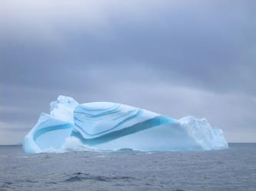
20. Solid water (ice) can FLOAT on liquid water.
This is due to ___________________

Slide 27
20. Solid water (ice) can FLOAT on liquid water.
This is due to HYDROGEN BONDING.
Water molecules form rings of six, which creates a small “hole” in the center of them. It makes frozen water slightly less dense than liquid water. Liquid water molecules fit together more tightly, so liquid water is denser than ice.
Many love stories are emotional disasters. This one made lots of $$. Love, thanks to hydrogen bonding.

Slide 28
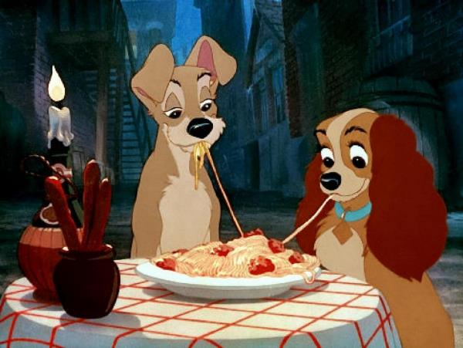
20. Solid water (ice) can FLOAT on liquid water.
This is due to HYDROGEN BONDING.
All love stories are great.
Sometimes they
make you cry.
That’s okay.
Lady and the Tramp.

Slide 29
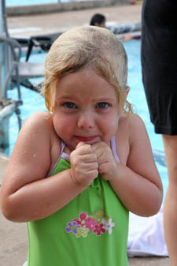
21. Water has a very high
SPECIFIC HEAT CAPACITY CONSTANT
This is due to _____________________
Without a pool heater this is what it looks like at the Vestal Public Pool most of the summer.
Even on sunny days.
Why? Because… it takes a lot of combustion to warm up the millions of grams of water by each degree in a pool.

Slide 30
21. Water has a very high
SPECIFIC HEAT CAPACITY CONSTANT
This is due to HYDROGEN BONDING
Without a pool heater this is what it looks like at the Vestal Public Pool most of the summer.
Even on sunny days.
Why? Because… it takes a lot of combustion to warm up the millions of grams of water by each degree in a pool.
22. The “C” of H₂O is 4.18 J/g·K

Slide 31
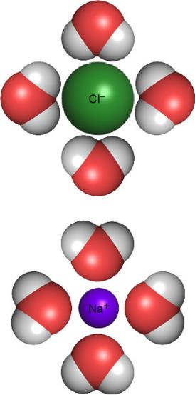
23. Water has THE ABILITY TO CREATE SOLUTIONS,
this is CALLED SOLVATION – NOT SALVATION!
This is due to ____________________

Slide 32
23. Water has THE ABILITY TO CREATE SOLUTIONS,
this is CALLED SOLVATION – NOT SALVATION!
This is due to HYDROGEN BONDING
24. This can be stated more casually as
Like Dissolves Like

Slide 33
Like dissolves like.
25. This means that POLAR water can only dissolve
POLAR MOLECULES
or (most) ionic compounds.
Or
26. Oils, and other nonpolar solvents,
can only dissolve other nonpolar solutes
(but not water which is polar)

Slide 34
27. Water has the ability to form
HYDRATED IONIC COMPOUNDS.
This is due to ____________________
28. Examples of these are:

Slide 35
27. Water has the ability to form
HYDRATED IONIC COMPOUNDS.
This is due to HYDROGEN BONDING
28. Examples of these are
CuSO₄·5H₂O and MgSO₄·7H₂O
What are those dots???
They indicate HYDROGEN BONDING
between ionic compounds and the water.

Slide 36
29. WATER VOCABULARY Words to Memorize by Tomorrow.
1 Solvation: the process of dissolving into a liquid
2 Solute: this dissolves into the solvent of a solution
Solvent: the solute dissolves into this part, usually the “bigger” part of a solution
4. Aqueous: a solution that is dissolved in water
5. Soluble: able to dissolve
6 Insoluble: unable to dissolve, or precipitates when formed in water in DR
7 Saturated: solution holding maximum solute in solution (Charlie chocolate milk)
8 Unsaturated: solution that can dissolve more solute in solution (Janet choc. milk)

Slide 37
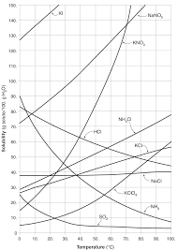
Water Class #2 Objective:
Mastering Table G –
the Solubility Curves for 10 Compounds
Take it out now please

Slide 38
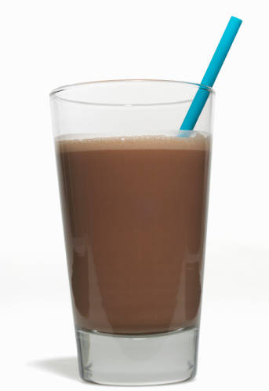
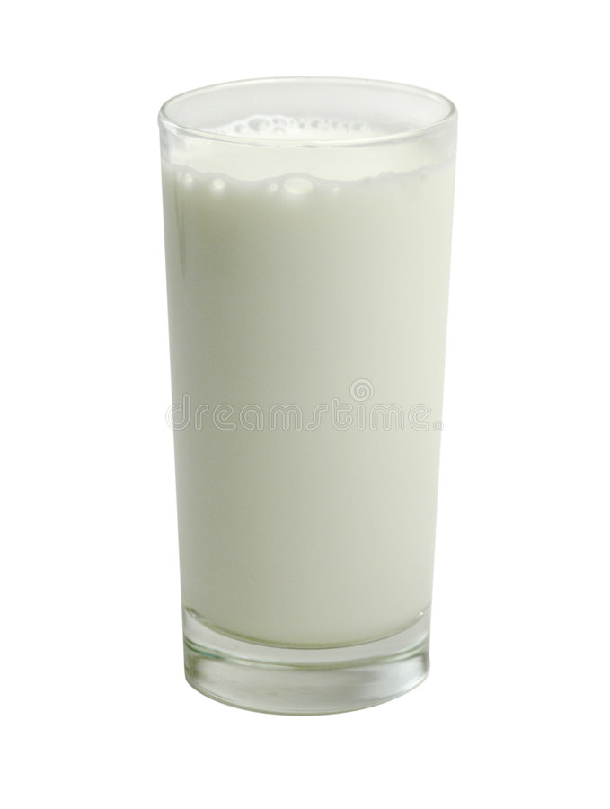
When you come to my house for chocolate milk and cookies, the cookies will be first rate chocolate chip cookies.
Depending upon who makes the chocolate milk, me, or my wife Janet, you will either want to come back, or maybe not.
MINE
Janet’s

Slide 39
How concentrated a solution is makes a difference in chemistry. That solution could be chocolate milk, or salty water. Or sugar in coffee.
All solutions contain solutes dissolved into solvents.
30. For salty water, which is the solute –
which is the solvent?
31. For chocolate milk, which is the solute –
which is the solvent?

Slide 40
How concentrated a solution is makes a difference in chemistry. That solution could be chocolate milk, or salty water. Or sugar in coffee.
All solutions contain solutes dissolved into solvents.
30. For salty water, SALT IS THE SOLUTE,
water is the solvent.
31. Chocolate milk, CHOCOLATE SAUCE is the SOLUTE,
milk is the solvent.
Each solvent can “HOLD” only a certain amount of solute at any temperature. That’s the solubility of the solution

Slide 41

The table shows how much of 10 different compounds can dissolve into 100 mL of AQ solution, at ANY temperature that water is still LIQUID.
We can only look at one curve at a time.
Table G
Solubility Curves at Standard Pressure

Slide 42
32. Table G is titled:
SOLUBILITY CURVES-
at standard pressure
which is: 101.3 kPa
33. The Y axis (up/down) is solubility
Grams of solute/100 grams of water
34. Which really means:
Grams of solute/100 mL of water
Gently cross it out and replace it now →
35. The X axis has these units
°C
Why doesn’t it go lower than zero or higher than 100? SOLUTIONS ARE AQUEOUS.
Below 0: the solution can freeze solid,
Over 100: the solution can boil off.
Table G
Solubility Curves at Standard Pressure

Slide 43
36. How many grams of
KCl fits into 100 mL
of water at 10°C?
____
37. How many grams of
KClO₃ fits into 100 mL of
water at 40°C? _______
38. How many grams of
potassium nitrate
fits into 100 mL of
AQ solution at 50°C?
____
Table G
Solubility Curves at Standard Pressure

Slide 44
36. How many grams of
KCl fits into 100 mL
of water at 10°C?
30 grams
37. How many grams of
KClO₃ fits into 100 mL of
water at 40°C? 15 grams
38. How many grams of
potassium nitrate
fits into 100 mL of
AQ solution at 50°C?
84 grams
Table G
Solubility Curves at Standard Pressure

Slide 45
39.
A. How many compounds are on
this graph? ____
B. How many lines go “up” as the
temperature rises? _____
C. How many lines go “down” as the
temperature rises? ________
D. How many of these compounds
are IONIC? ________
E. How many of these compounds are
MOLECULAR? ___________
Table G
Solubility Curves at Standard Pressure

Slide 46
39.
A. How many compounds are on
this graph? TEN
B. How many lines go “up” as the
temperature rises? SEVEN
C. How many lines go “down” as the
temperature rises? THREE
D. How many of these compounds
are IONIC? SEVEN
E. How many of these compounds are
MOLECULAR? THREE
40. How do we make sense of
these statements???
Table G
Solubility Curves at Standard Pressure

Slide 47
40. How do we make sense of these
statements???
Ionic compound solubility
in water increases with
higher temperature.
Molecular compound solubility in water decreases with higher temperature.
Table G
Solubility Curves at Standard Pressure

Slide 48
41. How many lines can you look at on this graph at any time? ____
42. When an ionic compound like KI or NaCl goes into water, what particles end up in the water? ________
43. When something like sugar C₁₂H₂₂O₁₁ go into water, what particles end up in the liquid water? ____________
Table G
Solubility Curves at Standard Pressure

Slide 49
41. How many lines can you look at on this graph at any time? ONE
42. When an ionic compound like KI or NaCl goes into water, what particles end up in the water? LOOSE MOBILE IONS
43. When something like sugar C₁₂H₂₂O₁₁ go into water, what particles end up in the liquid water? LOOSE MOBILE
MOLECULES
Table G
Solubility Curves at Standard Pressure

Slide 50
44. How many g of NH₃ fit into 100 mL of water at 90°C?
45. When water (or any solvent) holds the maximum amount
of solute at a given temperature, this solution is said to be:
____________________________

Slide 51
44. How many g of NH₃ fit into 100 mL of water at 90°C?
10 grams NH₃
45. When water (or any solvent) holds the maximum amount
of solute at a given temperature, this solution is said to be:
SATURATED
Like Charlie Chocolate Milk.

Slide 52
46. How many grams of ammonia fit
into 50 mL of water at 90°C

Slide 53
46. How many grams of ammonia fit
into 50 mL of water at 90°C
NH₃
water
10 g
100 mL
x g
50 mL
90°C
=

Slide 54
46. How many grams of ammonia fit
into 50 mL of water at 90°C
NH₃
water
10 g
100 mL
x g
50 mL
90°C
=
100 x = 500
x = 5 g NH₃
This was very easy, half the solution, half the solute, duh!
Same process of proportion works every other time too, but with a calculator.

Slide 55
47. How many grams of KCl fit into 100 mL of
water at 10°C?
48. How many grams of KCl fit into 350 mL of
water at 10°C?

Slide 56
47. How many grams of KCl fit into 100 mL of
water at 10°C? 30g
48. How many grams of KCl fit into 350 mL of
water at 10°C?
10°C
KCl
water
30 g
100 mL
=
x g
350 mL
100 x = 10500
x = 105 g KCl
(3 SF)

Slide 57
49. How many grams of NH₃ fit into 100 mL of water at
10°C?
50. How many grams of NH₃ fit into 12.0 mL of water
at 10°C? ____ (show work!)

Slide 58
49. How many grams of NH₃ fit into 100 mL of water at
10°C? 70 grams
50. How many grams of NH₃ fit into 12.0 mL of water
at 10°C? ____ (show work!)
10°C
NH₃
water
70 g
100 mL
=
x g
12.0mL
100 x = 840
x = 8.4 g NH₃

Slide 59
This question is the same type, but asked a bit differently:
51. How many grams of KClO₃ solute fits into
844 mL of water at 373 Kelvin? (show work)

Slide 60
This question is the same type, but asked a bit differently:
51. How many grams of KClO₃ solute fits into
844 mL of water at 373 Kelvin? (show work)
100°C
KClO₃
water
60 g
100 mL
=
x g
844 mL
100 x = 50640
x = 506 g KClO₃
(3 SF)

Slide 61
52. How many grams of sodium nitrate will it take
to saturate 64.0 mL of water at 283 Kelvin?

Slide 62
52. How many grams of sodium nitrate will it take
to saturate 64.0 mL of water at 283 Kelvin?
NaNO₃
water
80 g
100 mL
x g
64.0 mL
10°C
=
100 x = 5120
x = 51.2 g NaNO₃
(3 SF)

Slide 63
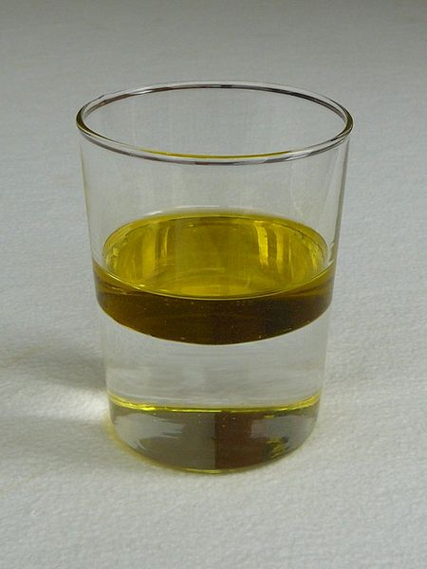
Water Class #3
Objective:
More table G practice,
more Water Vocabulary,
and oil in water!

Slide 64
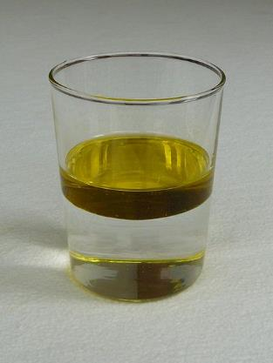
Shade in the 2 liquids in the tube. Label them OIL & Water
53 _________
54. _______________
55. They do not mix because
__________________

Slide 65
Shade in the 2 liquids in the tube. Label them OIL & Water
53 OIL on top
54. WATER on bottom
55. They do not mix because
LIKE DISSOLVES LIKE
56. In this case the OIL is NONPOLAR
and the WATER is POLAR.

Slide 66
Shade in the 2 liquids in the tube. Label them OIL & Water
53 OIL on top
54. WATER on bottom
55. They do not mix because
LIKE DISSOLVES LIKE
56. In this case the OIL is NONPOLAR
and the WATER is POLAR.
THEY ARE ____________
57. The reason that the oil is ON TOP and not on under the water is:
Oil has a lower density than water.

Slide 67
Shade in the 2 liquids in the tube. Label them OIL & Water
53 OIL on top
54. WATER on bottom
55. They do not mix because
LIKE DISSOLVES LIKE
56. In this case the OIL is NONPOLAR
and the WATER is POLAR.
THEY ARE IMMISCIBLE
57. The reason that the oil is ON TOP and not on under the water is:
Oil has a lower density than water.

Slide 68
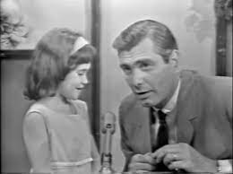
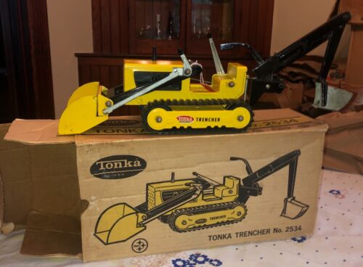
Immiscible and
Miscible Solutions
A box of biscuits
A box of mixed biscuits
and a biscuit mixer.

Slide 69
58 Immiscible two liquids that cannot mix due
to a polarity difference, like water and oil.
Water is polar, oil is nonpolar.
59 Miscible two liquids that can mix because
they have the same polarity, like vegetable
oil or olive oil (both nonpolar)
or water and ethyl alcohol (both polar)

Slide 70
60. When a solution holds the most solute possible in the solvent it
is said to be
SATURATED
61. If the solution holds LESS than that maximum amount of solute,
it’s called:
UNSATURATED
62. Charlie Chocolate milk would be SATURATED
while Janet’s is UNSATURATED

Slide 71
63. 100 mL HCl_{(AQ)}
at 80°C
contains 37 g
of HCl.
Is this saturated
or unsaturated?

Slide 72
63. 100 mL HCl_{(AQ)}
at 80°C
contains 37 g
of HCl.
It is unsaturated
48 g could fit.

Slide 73
64. Is a 100 mL
NaNO_{3(AQ)}
at 25°C
saturated if it
contains
93 g NaNO₃?

Slide 74
64. Is a 100 mL
NaNO_{3(AQ)}
at 25°C
saturated if it
contains
93 g NaNO₃?
UNSATURATED
This solution
could hold 95 g
of NaNO₃

Slide 75
65. How many grams of
NaCl will saturate
a 100 mL solution at
90°C?

Slide 76
65. How many grams of
NaCl will saturate
a 100 mL solution at
90°C? 40 grams

Slide 77
66. If you put 43 g
NaCl into
100 mL, what
would happen?

Slide 78
66. If you put 43 g
NaCl into
100 mL, what
would happen?
40 grams will
dissolve, the
other 3 grams
falls to the
bottom of the
beaker.

Slide 79
67. Will a 100 mL
NaCl_{(AQ)} at 90°C
be saturated if it
contains
43 g NaCl?

Slide 80
67. Will a 100 mL
NaCl_{(AQ)} at 90°C
be saturated if it
contains
43 g NaCl?
Yes - it will be a
saturated solution.
AND… the 3 grams
keeps dissolving,
and the water keeps
dropping more NaCl
out so that 40g is
always dissolved.

Slide 81
68
NaCl_{(S)} Na⁺¹_{(AQ)} + Cl⁻¹_{(AQ)}
3 grams remains solid
30 grams remains dissolved
Salt dissolves into solution, it become LOOSE MOBILE IONS.
Salt precipitates out of solution becoming solid.
This process will not stop, as long at there is liquid water and the temperature holds. It’s called… Dynamic Equilibrium
Always changing and always staying the same.
Always dissolving and always precipitating, at the same rate.

Slide 82
Are these solutions saturated or unsaturated?
If unsaturated, how many more grams of solute can fit?
 | Temp | Solute | If a solution contains this Mass in g | Is it Saturated or Unsaturated? | If unsaturated, how many more grams are needed to saturate this solution?
69 | 30°C | HCl | 60 g
70 | 60°C | KNO₃ | 100 g
71 | 10°C | NaNO₃ | 80 g
72 | 90°C | NH₄Cl | 73 g
73 | 20°C | KCl | 20 g
74 | 5°C | NaCl | 31 g
Temp | Mass of solute | Solute | Sat or Unsat? | # grams
30°C | 60 g | HCl | Un | ~7 g
60°C | 100 g | KNO₃ | Un | ~5 g
60°C | 125 g | NaNO₃ | Sat | X
90°C | 10 g | NH₃ | Sat | X
20°C | 30 g | KCl | Un | ~ 3 g
5°C | 36 g | NaCl | un | ~ 2 g

Slide 83
Are these solutions saturated or unsaturated?
If unsaturated, how many more grams of solute can fit?
 | Temp | Solute | If a solution contains this Mass in g | Is it Saturated or Unsaturated? | If unsaturated, how many more grams are needed to saturate this solution?
69 | 30°C | HCl | 60 g | UN | ~7 grams more
70 | 60°C | KNO₃ | 100 g | UN | ~5 grams more
71 | 10°C | NaNO₃ | 80 g | SAT | zero
72 | 90°C | NH₄Cl | 73 g | SAT | zero
73 | 20°C | KCl | 20 g | UN | ~13 grams more
74 | 5°C | NaCl | 31 g | UN | ~6 grams more
Temp | Mass of solute | Solute | Sat or Unsat? | # grams
30°C | 60 g | HCl | Un | ~7 g
60°C | 100 g | KNO₃ | Un | ~5 g
60°C | 125 g | NaNO₃ | Sat | X
90°C | 10 g | NH₃ | Sat | X
20°C | 30 g | KCl | Un | ~ 3 g
5°C | 36 g | NaCl | un | ~ 2 g

Slide 84
75. Below are 2 NaCl formula units that have ionized into water. Draw 3 water
molecules surrounding each ion showing proper orientation towards these ions.
Note their charges indicated in the little circles.
Cl⁻¹
Na⁺¹
Cl⁻¹
Na⁺¹

Slide 85
75.
H H
O
H H
O
H H
O
H H
O
Cl⁻¹
Na⁺¹
H H
O
H H
O
H H
O
H H
O
Cl⁻¹
Na⁺¹
H H
O
H H
O

Slide 86
76. Explain in one sentence why the water
molecules are going to orient themselves to the
ions in solution.

Slide 87
76. Explain in one sentence why the water
molecules are going to orient themselves to the
ions in solution.
The water molecules have a + side (hydrogen)
and a ̶ side (oxygen).
The ions have charges too, positive and negative.
It’s expected that the positives would be attracted to the negatives, and vice versa.

Slide 88
Surfactants
77. Soap is a surfactant. It can break
the surface tension of water.
78. Surfactant = surface acting agent.

Slide 89
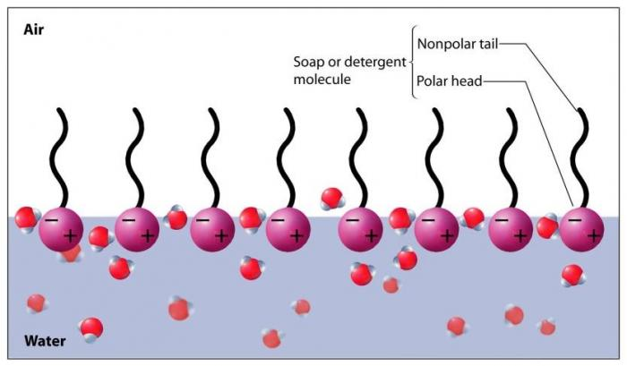
79. Soap is partially soluble (polar) + partially insoluble (nonpolar)
80. The polar “head” gets dissolved; the nonpolar “tail”
creates gaps in the surface hydrogen bonding.
This allows water to escape “out of” the surface, or stuff to “fall through” the surface of the water.
81. Surfactants
create
gaps in the
surface
hydrogen
bonding.

Slide 90
82. Oil molecules (vegetable oil, motor oil, mineral oil, etc.)
are all nonpolar. When oil is put into (polar) water,
why can’t the oil dissolve into the water like salts, or
polar sugar molecules?
LIKE DISSOLVES LIKE, the water is polar, the oil is nonpolar. The water “can’t catch” the oil droplets, they slip through the waters grasp.
The oil floats because it has lower density than the water.

Slide 91
82. Oil molecules (vegetable oil, motor oil, mineral oil, etc.)
are all nonpolar. When oil is put into (polar) water,
why can’t the oil dissolve into the water like salts, or
polar sugar molecules?
LIKE DISSOLVES LIKE, the water is polar, the oil is nonpolar. The water “can’t catch” the oil droplets, they slip through the water’s grasp.
The oil floats because oil
has lower density than the water.

Slide 92
83. How many grams of KClO₃ fits into 100 mL of water at 90°C?
84. How many grams of KClO₃ fits into 100 mL of water at 40°C?

Slide 93
83. How many grams of KClO₃ fits into 100 mL of water at 90°C? 52 g
84. How many grams of KClO₃ fits into 100 mL of water at 40°C? 35 g

Slide 94
THINK HARD NOW…
85. If you have a saturated KClO_{3(AQ)} at 90°C and put it
into a cooler and the temperature drops to just 40°C,
what could possibly happen to all that KClO₃ that
was in solution?

Slide 95
If you have a saturated KClO_{3(AQ)}
at 90°C and put it into a cooler and
the temperature drops to just 40°C,
what could possibly happen to all
that KClO₃ that was in solution?
About 52 grams of KClO₃would
be in solution when 90°C
but only about 15 grams fits in
solution at 40°C .
52 grams
- 15 grams
37 grams precipitates

Slide 96
86. A 100 mL saturated solution of KNO₃ is at 60°C.
It is cooled to 20°C. Describe what happens.
Do the math too

Slide 97
86. A 100 mL saturated solution of KNO₃ is at 60°C.
It is cooled to 20°C. Describe what happens.
Do the math too
At 60°C the solution holds 105 grams of this solute.
At 20°C the solution holds 35 grams of this solute.
The difference (105 – 35 = 70 grams)
70 grams precipitates out of solution because this cold solution can’t hold all of those grams.

Slide 98
86. A 100 mL saturated solution of KNO₃ is at 60°C.
It is cooled to 20°C. Describe what happens.
Do the math too
At 60°C the solution holds 105 grams of this solute.
At 20°C the solution holds 35 grams of this solute.
The difference (105 – 35 = 70 grams)
70 grams precipitates out of solution because this cold solution can’t hold all of those grams.
The rate of precipitation = the rate of solvation
This is dynamic equilibrium

Slide 99
The Last Water Class
Objective: a final review of water
including some vocabulary
and some symbolic
representations of
deep thinking.

Slide 100
87. What happens when you put 140 g KI into 100 mL water
at 10°C?
88. Does this “STOP”?
89. What does happen?
Draw a picture of this and label it all properly too.
90. SATURATED SOLUTION
KI_{(AQ)}
91. EXCESS SOLUTE KI_{(S)}

Slide 101
87. What happens when you put 140 g KI into 100 mL water
at 10°C? 135 grams dissolves into the water
5 grams falls to the bottom of the beaker.
88. Does this “STOP”? NO!
89. What does happen? It keeps dissolving into solution and
precipitating out of solution.
Draw a picture of this and label it all properly too.
90. SATURATED SOLUTION
KI_{(AQ) 135 g AQ}
91. EXCESS SOLUTE KI_{(S) 5 g S}

Slide 102
92. In a ________________
the rate of the ________ reaction is equal to the
rate of the _______ reaction.

Slide 103
92. In a dynamic equilibrium
the rate of the forward reaction is equal to the
rate of the reverse reaction.
93. In this case we could say that the

Slide 104
92. In a dynamic equilibrium
the rate of the forward reaction is equal to the
rate of the reverse reaction.
93. In this case we could say that the
rate of rate of
SOLVATION PRECIPITATION
=

Slide 105
94. When NaCl_{(S)} → Na⁺¹_{(AQ)} + Cl⁻¹_{(AQ)}
this is called _________________
or _______________
95. Does sugar, C₁₂H₂₂O₁₁ do this? _____ How does sugar dissolve into water?
H₂O

Slide 106
94. When NaCl_{(S)} → Na⁺¹_{(AQ)} + Cl⁻¹_{(AQ)}
this is called IONIZATION
or DISSOCIATION
95. Does sugar, C₁₂H₂₂O₁₁ do this? _____ How does sugar dissolve into water?
H₂O

Slide 107
94. When NaCl_{(S)} → Na⁺¹_{(AQ)} + Cl⁻¹_{(AQ)}
this is called IONIZATION
or DISSOCIATION
95. Does sugar, C₁₂H₂₂O₁₁ do this? NO!
How does sugar dissolve into water?
BY BREAKING INTO MOLECUES,
NOT INTO IONS. Sugar is not ionic.
H₂O

Slide 108
96. Electrolytes
The hardest vocab word of the year
To be an electrolyte, First, you must be IONIC
Second, you must become AQUEOUS in water
Which provides LOOSE MOBILE IONS in solution
Loose mobile ions conduct ELECTRICITY
IONIC but NOT AQ is not an electrolyte (AgCl or CuS say)
AQ but not IONIC is not an electrolyte (sugar water)

Slide 109
 | Substance | Is this an electrolyte? | Will this conduct electricity?
97 | NaCl_{(AQ)}
98 | NaCl_{(S)}
99 | NaOH_{(AQ)}
100 | NaOH_{(S)}
101 | AgCl_{(AQ)}
102 | AgCl_{(S)}
103 | C₁₂H₂₂O_{11(AQ)}

Slide 110
 | Substance | Is this an electrolyte? | Will this conduct electricity?
97 | NaCl_{(AQ)} | Yes | Yes
98 | NaCl_{(S)} | Yes | No, no loose ions
99 | NaOH_{(AQ)} | Yes | Yes
100 | NaOH_{(S)} | Yes | No, no loose ions
101 | AgCl_{(AQ)} | Does not exist check table F | No, no loose ions
102 | AgCl_{(S)} | No | No
103 | C₁₂H₂₂O_{11(AQ)} | No | No, no loose ions this is NOT IONIC

Slide 111
104. Is Be(OH)₂ an electrolyte?
Can it conduct electricity?
105. What about Be(OH)_{2(L)} (melted beryllium hydroxide)
Will that be able to conduct electricity?
106. How is that possible?
107. If liquid Be(OH)₂ can conduct electricity, is it an
electrolyte?

Slide 112
104. Is Be(OH)₂ an electrolyte? NO, it’ s not AQ in water
Can it conduct electricity?
No loose ions = no electrical conduction
105. What about Be(OH)_{2(L)} (melted beryllium hydroxide)
Will that be able to conduct electricity? YES!
106. How is that possible? MELTED = LOOSE IONS
107. If liquid Be(OH)₂ can conduct electricity, is it an
electrolyte?
NO, electrolytes must be aqueous.
This is NOT AQUEOUS - check table F.

Slide 113
108. When sodium chloride goes into water, we
would write the “equation” this way:
NaCl_{(S)} Na⁺¹_{(AQ)} + Cl⁻¹_{(AQ)}
109. This is called ________________ or _______________
110. Does sugar do this? _____
What does sugar do?
____________________________________
H₂O

Slide 114
108. When sodium chloride goes into water, we
would write the “equation” this way:
NaCl_{(S)} Na⁺¹_{(AQ)} + Cl⁻¹_{(AQ)}
109. This is called IONIZATION or DISSOCIATION
Does sugar do this? NO! What does sugar do?
IT DISSOLVES INTO MOLECULES.
Sugar is NOT IONIC, it dissolves because the
molecules are POLAR, but it dissolves into
LOOSE MOBILE MOLECULES
H₂O

Slide 115
111. Show the dissociation or the ionization
for sodium nitrate in water
with phase symbols:

Slide 116
111. Show the dissociation or the ionization
for sodium nitrate in water
with phase symbols:
water
NaNO_{3(S)} Na⁺¹_{(AQ)} + NO₃⁻¹_{(AQ)}

Slide 117
112. Show the dissociation or the ionization
for potassium phosphate in water with
phase symbols:

Slide 118
112. Show the dissociation or the ionization
for potassium phosphate in water with
phase symbols:
water
Na₃PO_{4(S)} 3Na⁺¹_{(AQ)} + PO₄⁻³_{(AQ)}
This is BALANCED…, one mole of Na₃PO₄
becomes THREE moles of Na⁺¹ cations and
ONE mole of PO₄⁻³ anions.
An ionic compound that is AQ in water
turns into LOOSE MOBILE IONS in solution.

