Slide 1
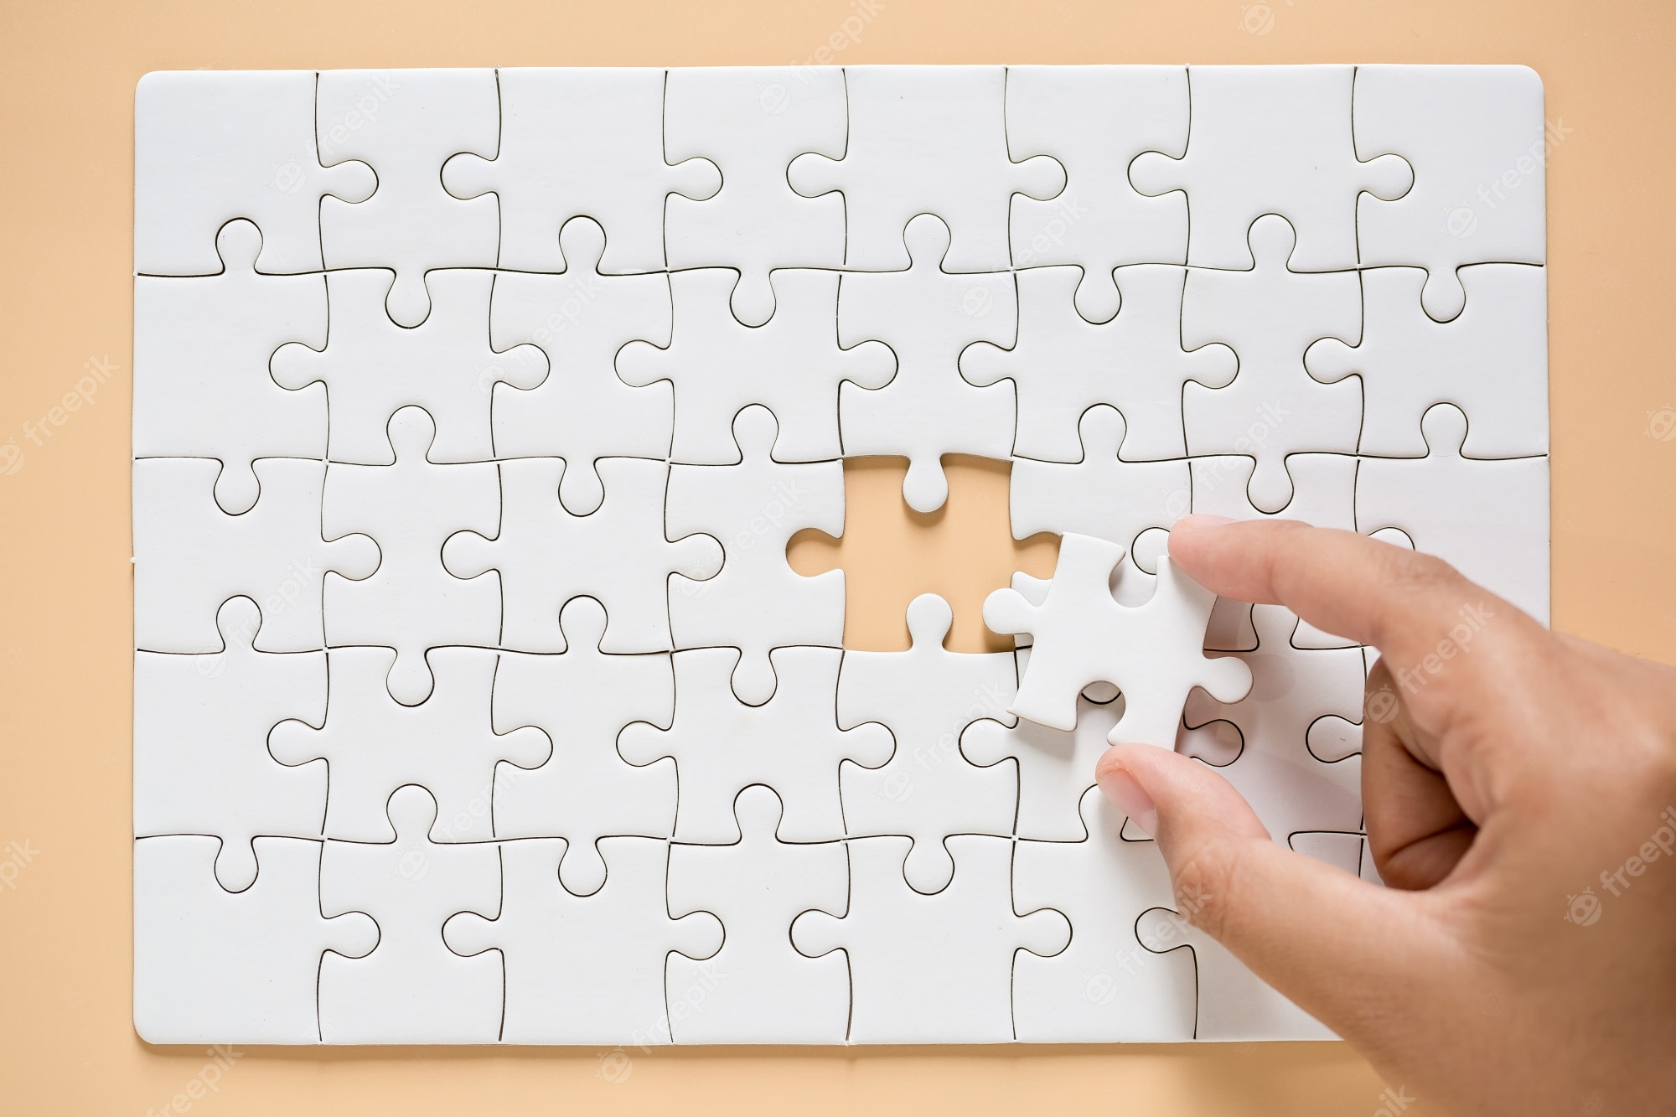
The Periodic Table Puzzle Adventure

Slide 2
The puzzle is only a puzzle.
The pieces represent the idea of elements, not particular elements.
In real life, each element has properties. Mendeleev had to consider these properties when he made his table, or he had to decide to overlook some of them, so that the table made sense going across a period, or down a group.
There were so many properties to use or skip. He had no one to ask for help either.
You can ask for help, but I won’t help you until later. Try not to get mad.

Slide 3
Your job is to put these 24 cards in a sensible table that makes sense of all 6 properties going across any “Period”, or down any “Group”.
I randomly took out 2 cards from your envelope, to help make it a little harder for you
This will be difficult.

Slide 4
Here, the 6 properties to consider are COLOR
WHOLE NUMBER
Number of STARS DECIMAL NUMBER
Number of NOTCHES Number of HOLES.

Slide 5
Here is your plan
Get a smart partner, or plan to work alone. No triples.
Find a space to work that is flat. Any table, any floor, any 2 desks together will work.
Know all puzzles look similar, but they are numbered on the back. Turn over all your cards, make sure that they all have the same number on the back, and that you have 22 cards total (24 minus the two I took)
Don’t look around for help, all puzzles are similar, but different enough that friends can’t really help you. (that’s why we number them to keep the individual puzzles in one baggie.
Turn the cards back over. Write the properties on your handout, look at the cards, make sure you see these properties on each card.
Make a table that is a “perfect” rectangle in shape (minus 2 cards). Look at the diagrams to get this.

Slide 6
Every set has numbers and colors and stars, etc. But each set is a little different, that is why they are all numbered on the back. Make sure you have 22 cards, with the same number on the back.
Your finished puzzle will be a perfect rectangle. The puzzle has 24 pieces, you have only 22, leave room for the last two pieces. Put them into a rectangle shape that will fit all 24 cards. The puzzle could be a lot of sizes, only one will work for you.
12 x 2
2 x 12
3 x 8
6 x 4
8 x 3
4 x 6

Slide 7
It’s not a race, but one team will “win”. It probably won’t be you. Enjoy this, you will not be the same afterwards, but you will never forget this either.

