Slide 1
Chemical Reactions Lab.
All of the experiments you would have done yourself, in photos.

Slide 2
There are five kinds of chemical reactions (so far)
Synthesis (sometimes called combination)
Decomposition (opposite of synthesis)
Single Replacement
Double Replacement
Combustion

Slide 3
TOPIC-B are the indicators that a chemical reaction PROBABLY happened. If you see these, look carefully to see what might have really happened.
T – temperature changes
O – odor changes
P – precipitate falls out of solution
I – these are SPONTANEOUSLY irreversible (all chemical reactions can be reversed)
C – color change
B – bubbles of a new gas form

Slide 4
Gas | Test | What happens?
Carbon dioxide | Flaming splint
Oxygen | Glowing splint
Hydrogen | Flaming splint
There is a link to click in experiment 2 that shows the three tests for these 3 gases. Patience, you’re nearly there!

Slide 5
Gas | Test | What happens?
Carbon dioxide | Flaming splint | Flame goes out
Oxygen | Glowing splint | Wood reignites
Hydrogen | Flaming splint | The famous toot

Slide 6
In this lab there are 20 chemical reactions (some of them are physical changes and not reactions, observe carefully).
For each one…
You must write a BALANCED CHEMICAL EQUATION;
You must write a WORD EQUATION; and
You can’t leave any BLANKS.

Slide 7
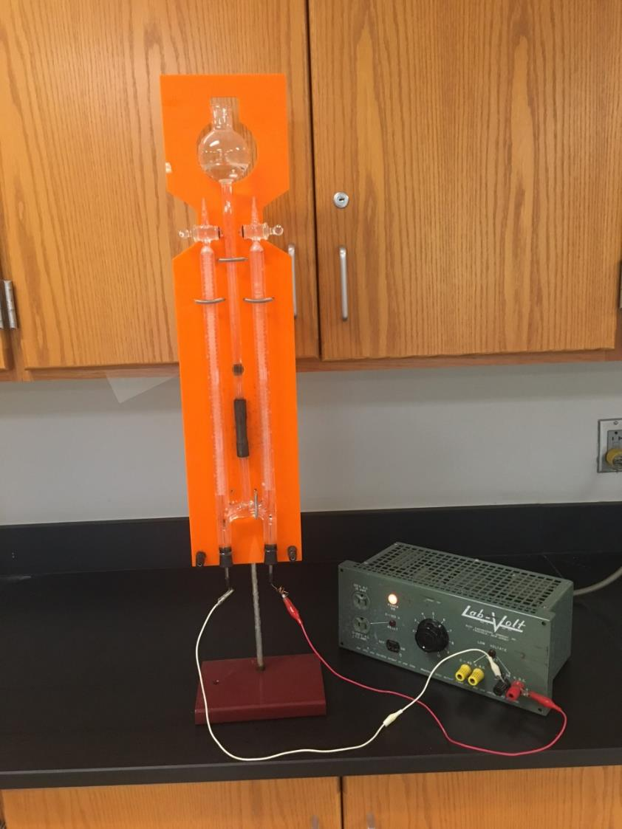
Reaction #1 The Decomposition of Water with a Hoffmann Apparatus
This cool machine breaks water into 2 gases: H₂ and O₂.
Electricity from the wall is ALTERNATING CURRENT, and the green box changes it to DIRECT CURRENT (like a battery).
Direct current runs through the water, which also has some acid in it (that allows the water to conduct electricity). Pure water cannot conduct electricity.

Slide 8
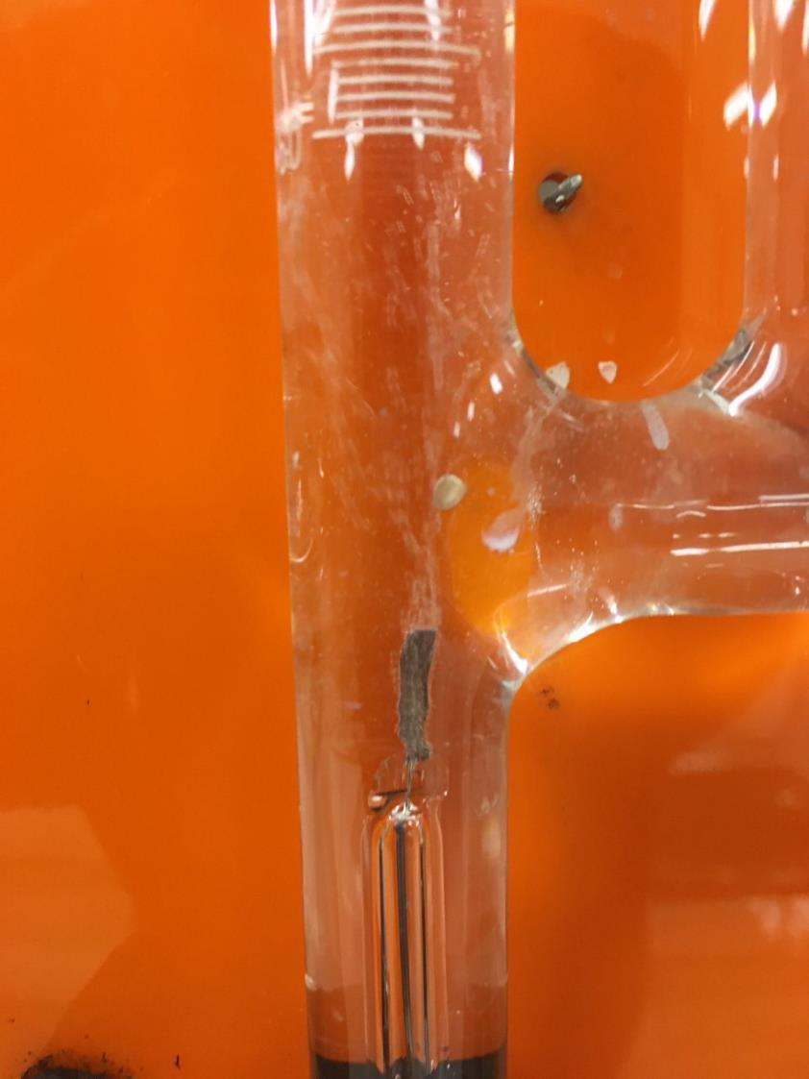
This is the electrode on the left, where the hydrogen gas forms. See the bubbles popping off the metal and going UP the tube?

Slide 9
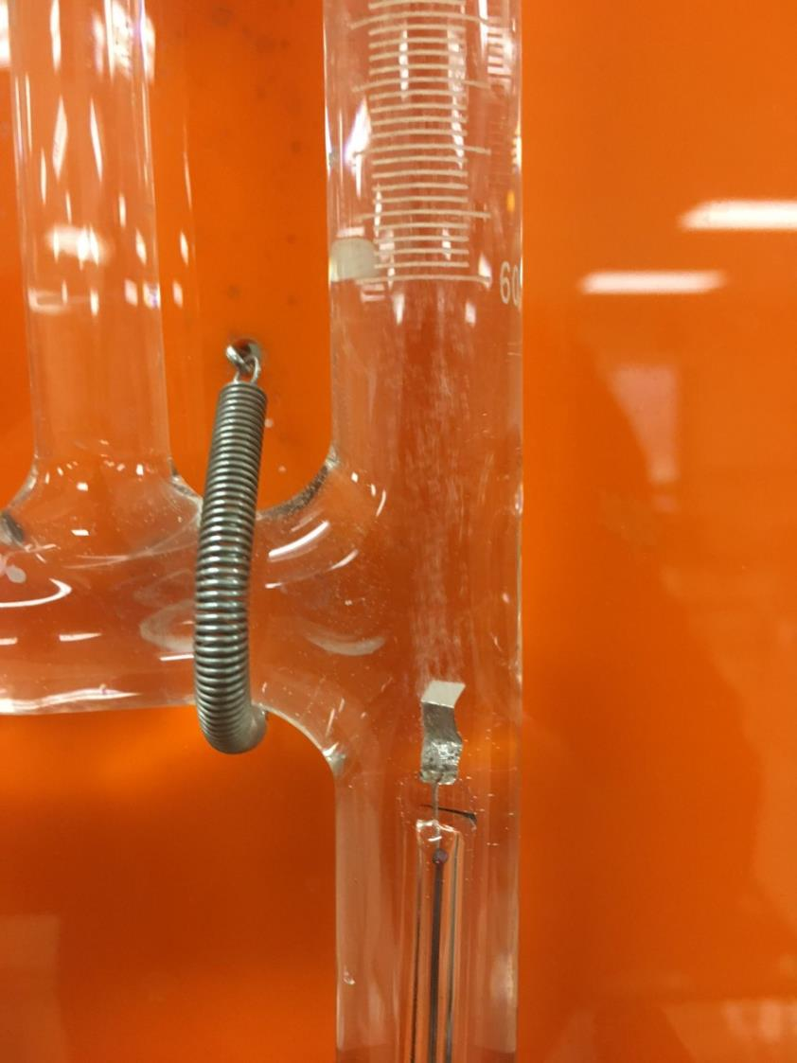
This is the electrode on the right, where the oxygen gas forms. See the bubbles popping off the metal and going UP the tube?

Slide 10
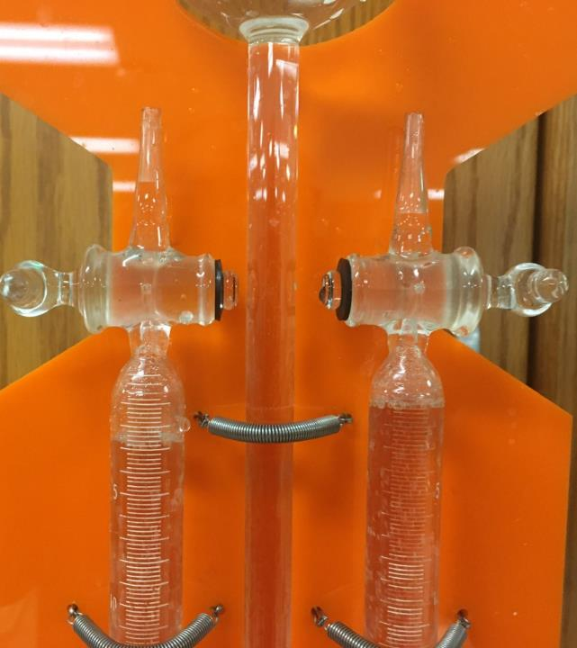
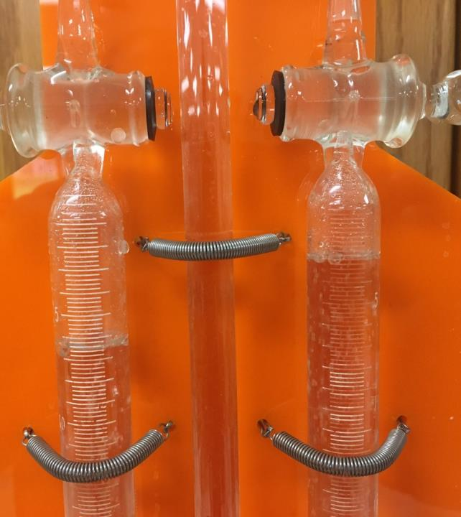
After 20 seconds, the difference of gas volumes is obvious, with hydrogen on the left, oxygen at right.
After 40 seconds, the difference of gas volumes is even more pronounced.

Slide 11
Reaction #2 The Synthesis of Water
Here, some H_{2(G)} combines with O_{2(G)} from the air to make water.
There is no way to photograph this, but I did make a video of how the Hoffmann Apparatus works, and I did the tests for all three gases.
Most fun is hydrogen, then the test for oxygen gas, and lastly the test for carbon dioxide gas. Click here for the video.

Slide 12
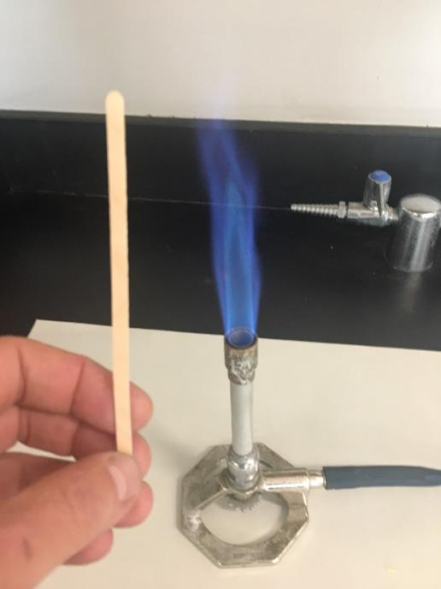
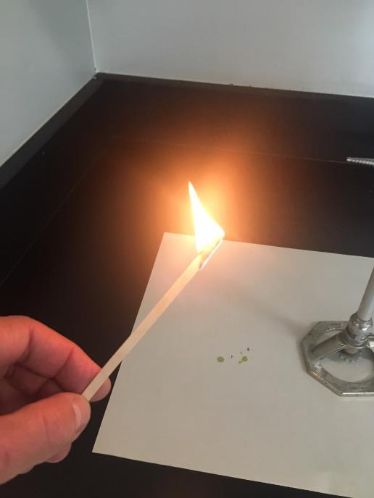
Reaction #3 The Combustion of Wood
A “splint” of wood near the Bunsen burner, then wood burning. You have seen wood burn; it is a real chemical reaction.
Wood is an “oxygenated hydrocarbon”.

Slide 13
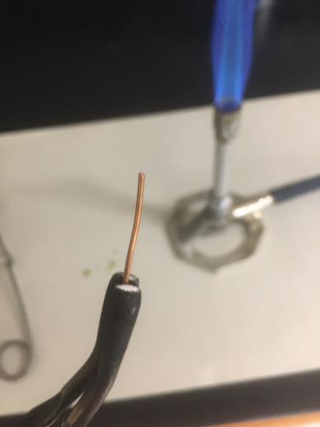
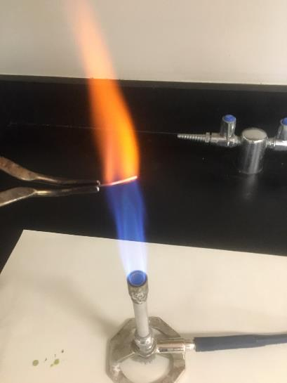
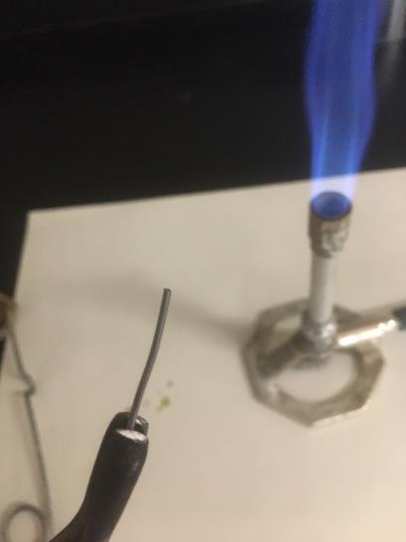
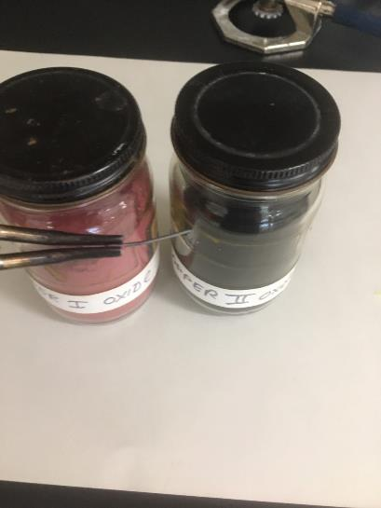
Reaction #4 Making some Copper Oxide (which one?)
Heat up the copper wire in the Bunsen burner, it gets so hot that it gets excited enough to combine with oxygen in the air. Your job is to determine which one forms, and which formula it is.
Copper turns “black”, which is the Copper (II) oxide.

Slide 14
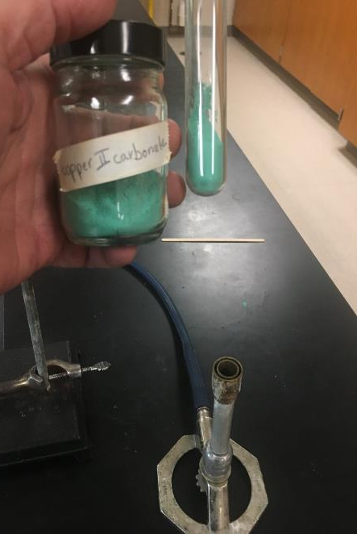
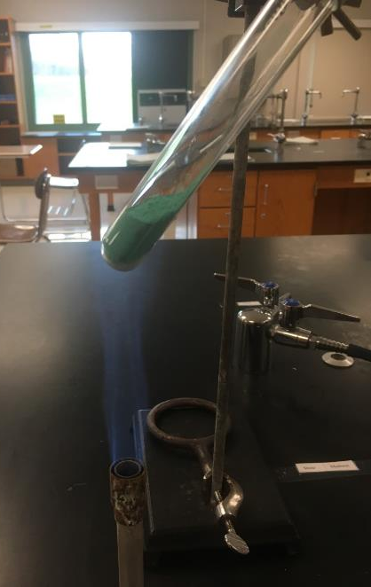
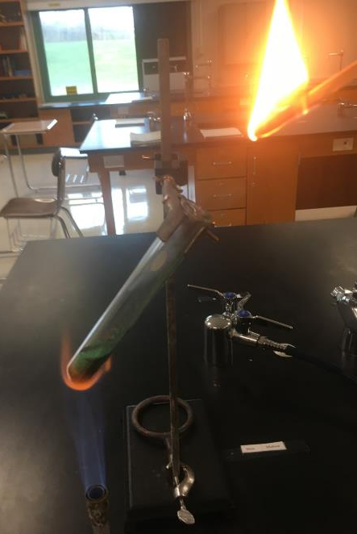
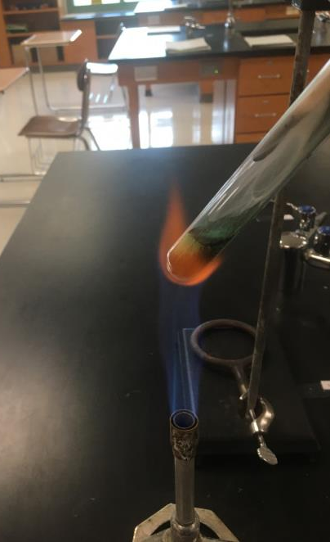
Reaction #5 Breaking down copper (II) carbonate with heat
The compound is in a test tube, held up by a test tube clamp to the ring stand. The heat is sufficient to decompose this compound.
The compound is green, but when it decomposes, the product is black. The other product is an invisible gas – which puts out the flame (what gas does that?)

Slide 15
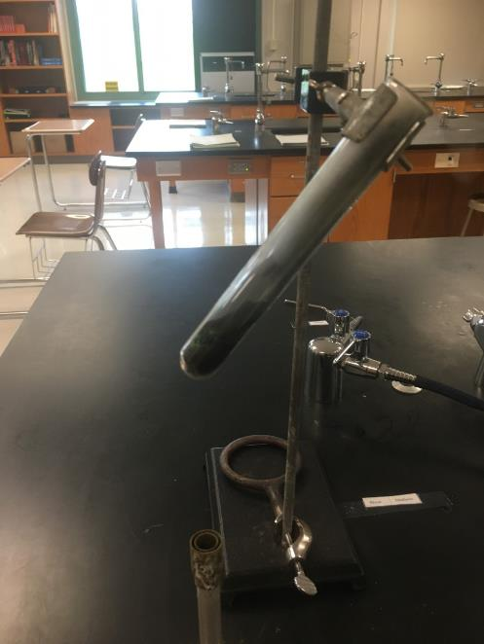
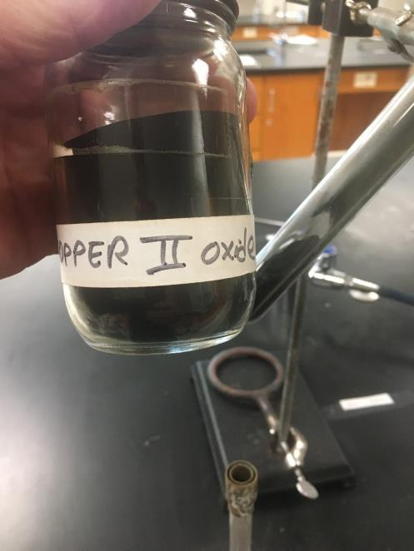
Reaction #5 Breaking down copper (II) carbonate with heat
The product in the tube is now all black. What do you think that solid product might be? (duh!)

Slide 16
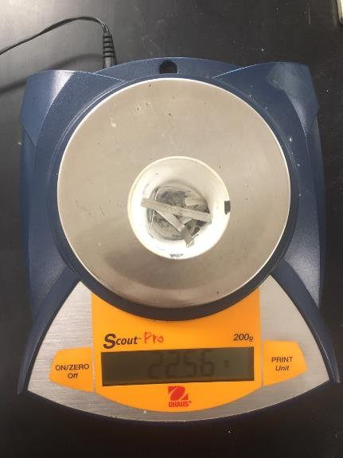
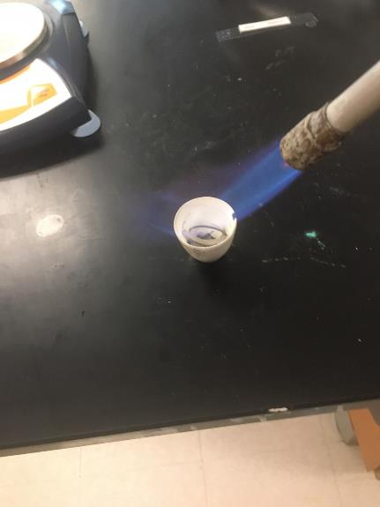
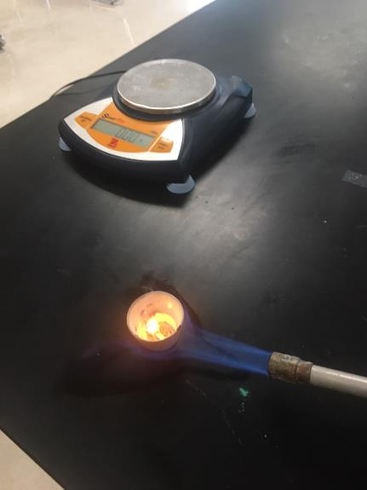
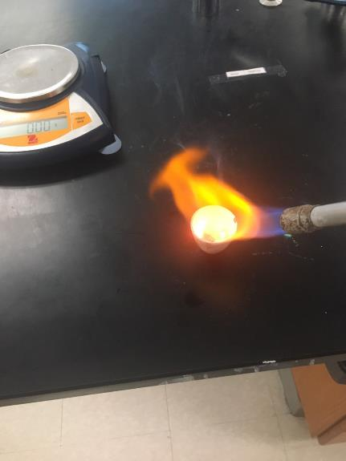
Reaction #6 Magnesium combines with oxygen (rapidly) to show clearly a big change from metal to dust.
22.56 g is the start mass (Mg and the cup). I heated it with a Bunsen burner in a big way. The metal oxidized.

Slide 17
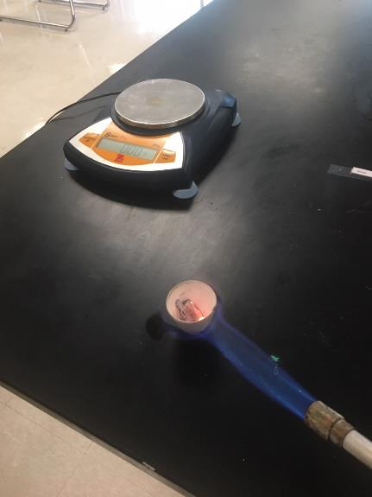
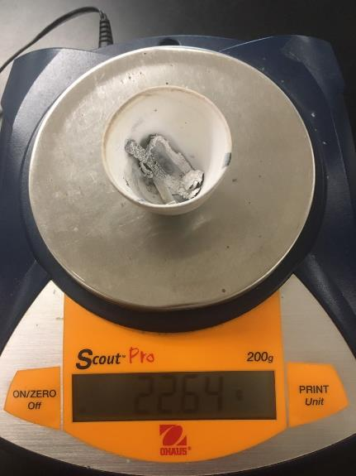
Reaction #6 Magnesium combines with oxygen (rapidly) to show clearly a big change from metal to dust.
22.56 g is the start mass – but the end mass is higher, 22.64 g!!!
What about the Law of Conservation of Mass? What’s up here?

Slide 18
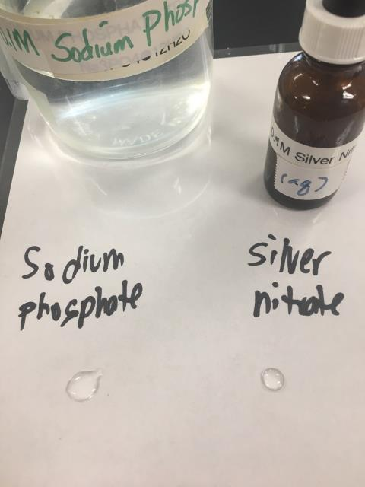
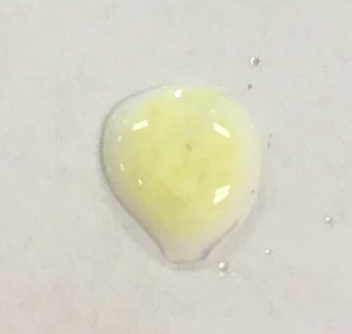
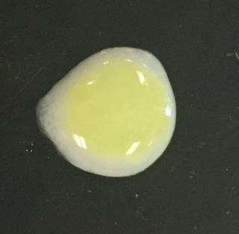
Reaction #7 Sodium Phosphate + Silver Nitrate Solutions
Two solutions, both clear to start, mixed together, and a chemical reaction happens. Notice the PRECIPTITATE that forms.
The precipitate shown on white, and black backgrounds.

Slide 19
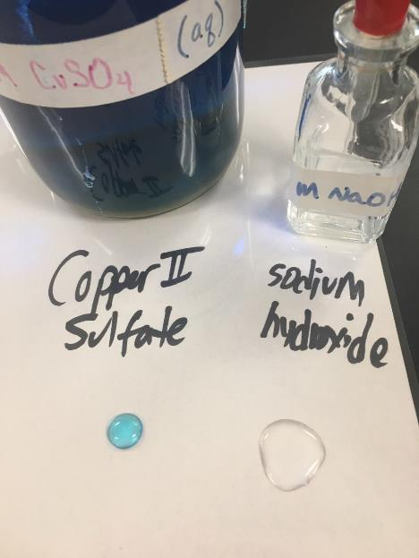
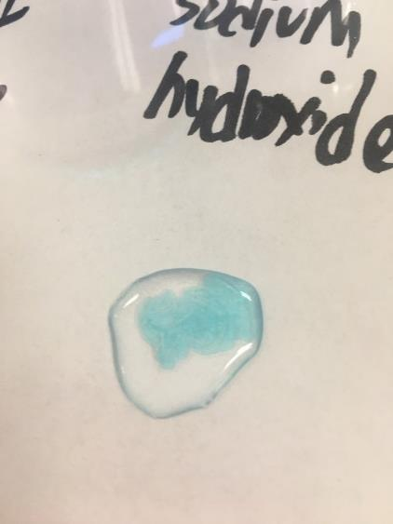
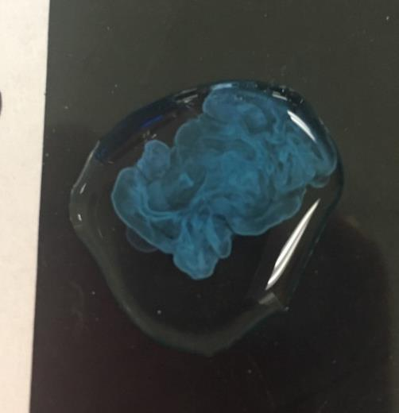
Reaction #8 Sodium Hydroxide + Copper (II) Sulfate Solutions
One clear, one blue solution to start, mixed together, and a chemical reaction happens. Notice the PRECIPTITATE that forms. Precipitate shown on white and black backgrounds.

Slide 20
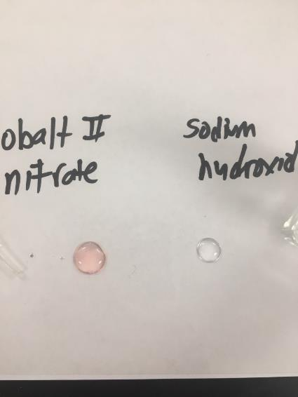
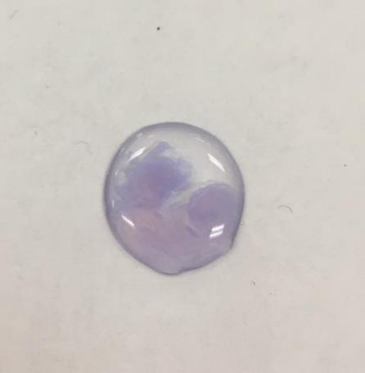
Reaction #9 Sodium Hydroxide + Cobalt (II) Nitrate Solutions
One red, and one clear solution to start.
When mixed together, a chemical reaction happens. Notice the purple colored PRECIPTITATE that forms.
See how it’s not just a purple solution, but there are “spots” of purple floating in the clear solution?

Slide 21
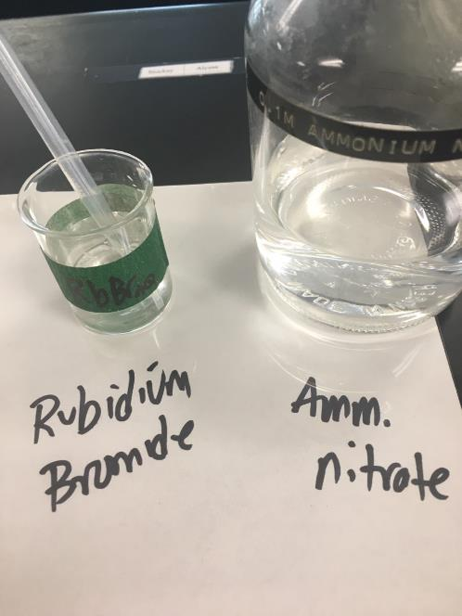
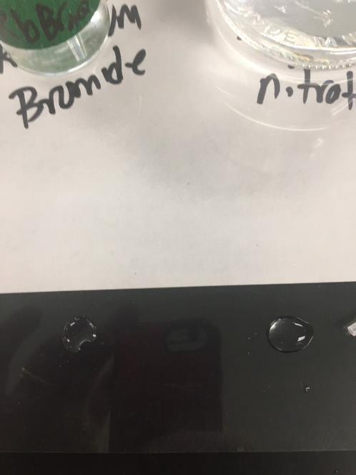
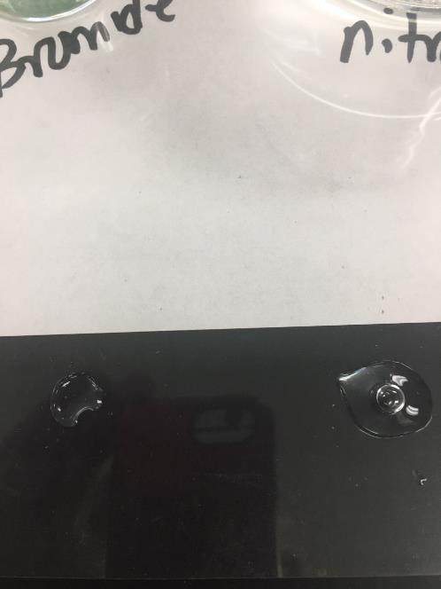
Reaction #10 Rubidium Chloride + Ammonium Nitrate Solutions
Two clear solutions to start, mixed together, and a chemical reaction happens. Notice – DID A PRECIPTITATE form?
I added more RbBr_{(AQ)} to the right side, no changes noticed

Slide 22
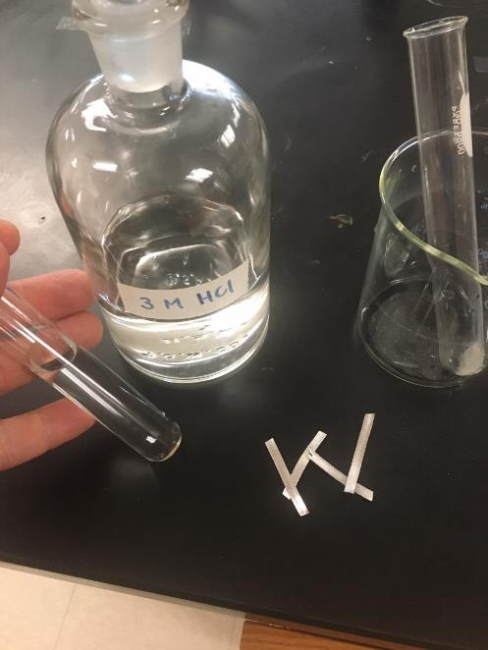
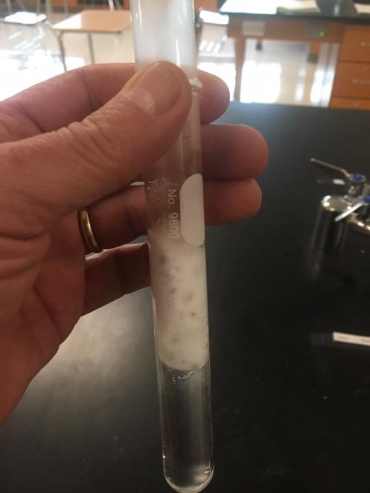
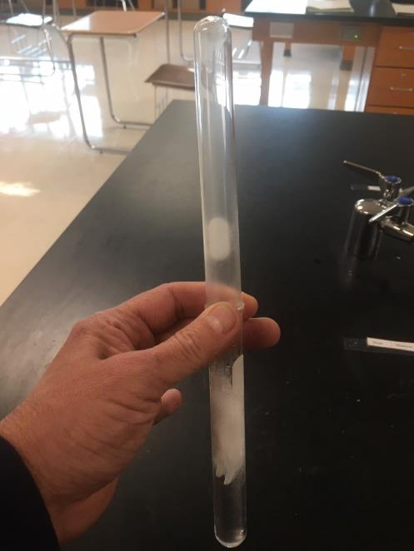
Reaction #11 Magnesium + Hydrochloric Acid Solution
Magnesium goes into clear solution (acid) has vigorous reaction.
Acid it test tube, magnesium metal on table, beaker to hold it all.
Reaction goes wild, I “catch” the gas in upper test tube. It’s getting hot!

Slide 23
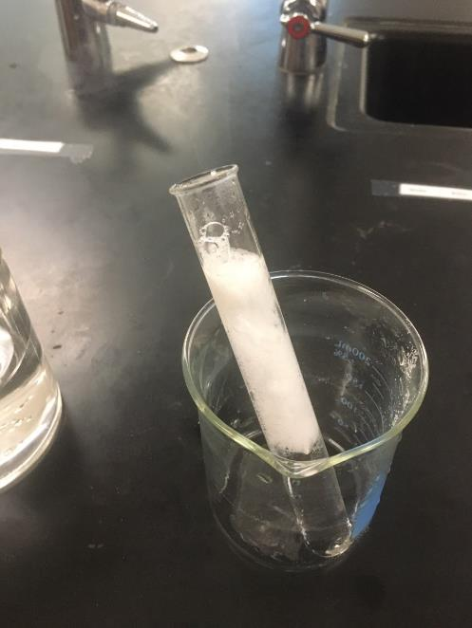
Reaction #11 Magnesium + Hydrochloric Acid Solution
Too hot!
The test for hydrogen gas worked, on a short video that I shot it was too quiet to catch the “toot”.
The toot is like the FIREBALL on the first day, but on a smaller scale. Toot, not boom!
The test requires you hold a lit stick of wood underneath the upside-down tube of hydrogen gas.
It is okay to keep it open, the low-density gas stays in the tube, it can’t pour out.
The toot is usually quite loud! The toot is the exothermic part of the synthesis of water from hydrogen gas and oxygen in the air.

Slide 24
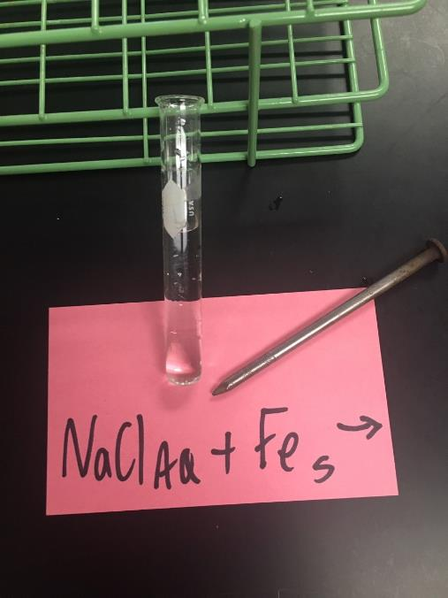
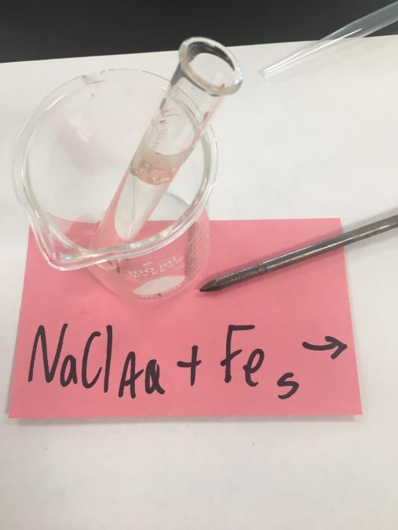
Reaction #12 Iron + Sodium Chloride Solution
Before and after, an iron nail goes into a clear solution. The solution stays clear, no changes noticed to the nail either.

Slide 25
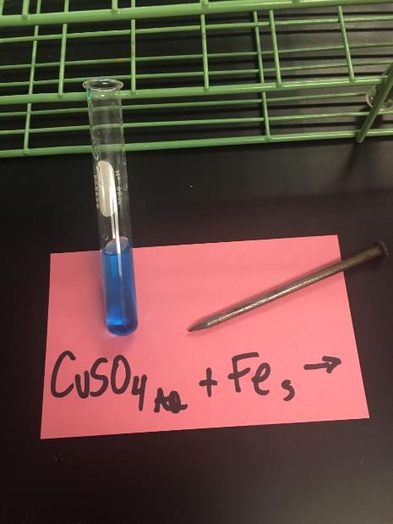
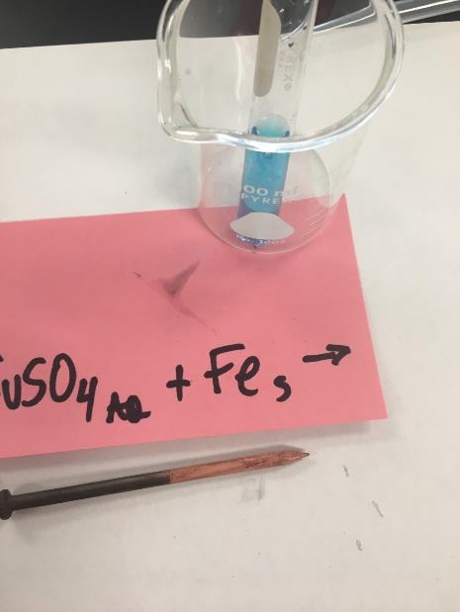
Reaction #14 Iron + Copper II Sulfate Solution
Before and after, an iron nail goes into the blue solution. The nail comes out “red” colored, which can be scraped off with a fingernail. The solution is noticeably less blue than it was (?)!
The nail is covered in reddish stuff, which of course is COPPER from the SR reaction that happened here.

Slide 26
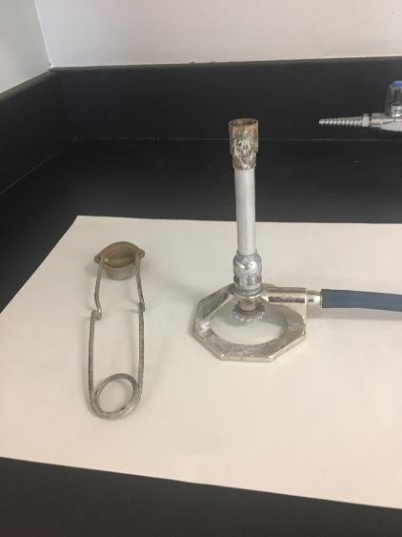
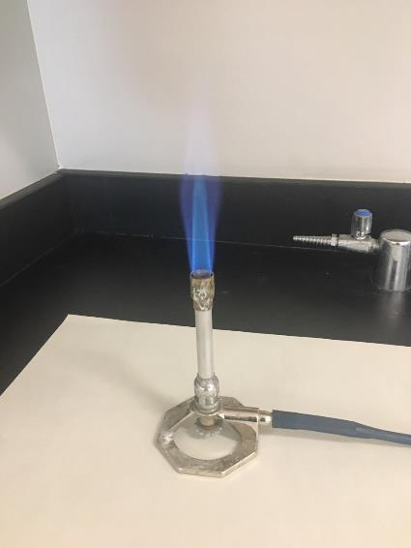
Reaction #15 Methane gas burns (combusts)
Before and after, a Bunsen burner with igniter, then, a lit Bunsen burner, methane gas burns in the oxygen in the air. Everything here is a gas: the reactants are gases, and products are gases too. These gases are all invisible to our eyes, but REAL.

Slide 27
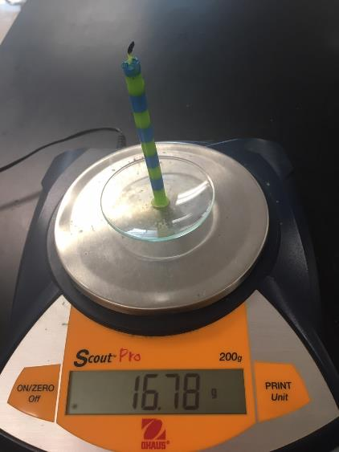
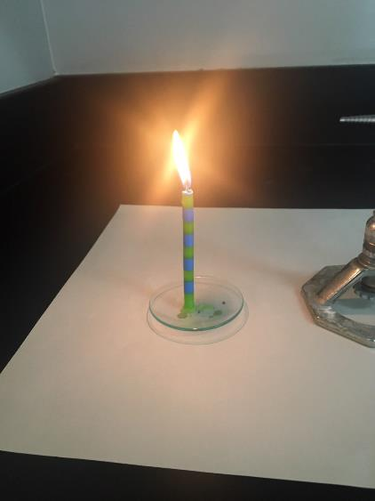
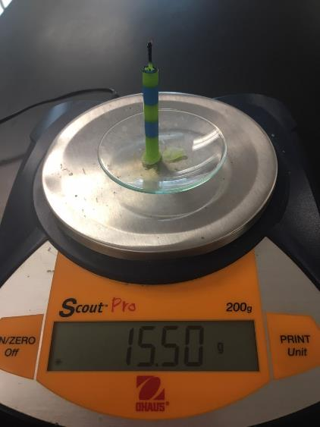
Reaction #16 Burning of a candle
Candle on a “watch glass” on the scale, the candle burning in oxygen in the air, the candle on scale after about 16 minutes.
Where did that 1.28 grams of the candle disappear to???

Slide 28
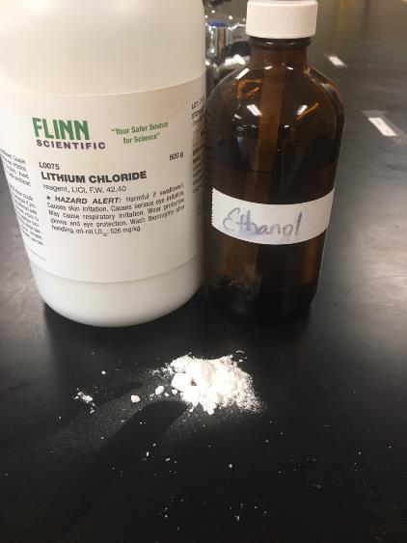
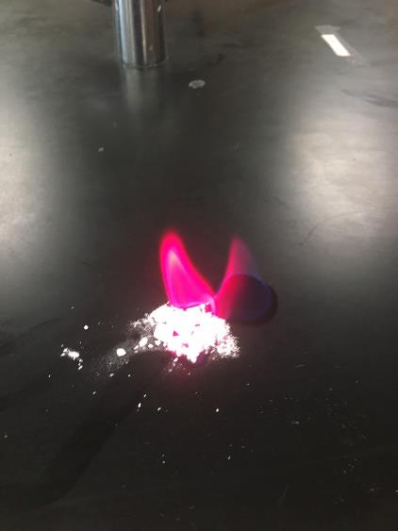
Reaction #17 Ethanol alcohol burns
The alcohol is burned ON a salt called lithium chloride. The salt only gets hot, the electrons in the salt get excited by this input of heat energy. The electrons move to the excited state. These electrons return to the ground state, emitting that lavender color in the flame. Using the lithium chloride is just for fun, and to remind you about spectra. The burning of ethanol is kind of “boring”, just a blue flame, like Bunsen burner gas.

Slide 29
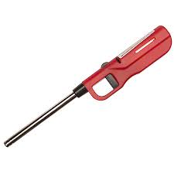
Reaction #18 Butane gas combusts
We have butane gas in the “clicker lighter”. It burns like methane does, but it has a different formula.

Slide 30
Reaction #19 putting potassium nitrate salt into water.
This is a white crystal solid ionic salt, which is added to water, forming a solution.
Water starts at 19.5⁰C. After adding the salt, the temperature changes to 16.8 ⁰ C.

Slide 31
Reaction #20 Aluminum added to potassium chloride solution
Before and after: an aluminum nail is put into a clear potassium chloride solution. The solution stayed clear, the nail got wet, no changes to either are visible.

