Slide 1
Atomic Theory Class #1
OBJECTIVE: Examining the basic structure of the ATOM, and to learn what the numbers on the Periodic table show us.

Slide 2
1. All atoms are made up of three sub-atomic (smaller than atoms) parts. They are the…
Parts of the atom | Particle Charge | Symbol | Mass | Location
proton
neutron
electron

Slide 3
1. All atoms are made up of three sub-atomic (smaller than atoms) parts. They are the…
Parts of the atom | Particle Charge | Symbol | Mass | Location
proton | Positive + | p⁺ | 1 amu | nucleus
neutron
electron

Slide 4
1. All atoms are made up of three sub-atomic (smaller than atoms) parts. They are the…
Parts of the atom | Particle Charge | Symbol | Mass | Location
proton | Positive + | p⁺ | 1 amu | nucleus
neutron | Neutral Ø | n° | 1 amu | nucleus
electron

Slide 5
1. All atoms are made up of three sub-atomic (smaller than atoms) parts. They are the…
Parts of the atom | Particle Charge | Symbol | Mass | Location
proton | Positive + | p⁺ | 1 amu | nucleus
neutron | Neutral Ø | n° | 1 amu | nucleus
electron | Negative – | e⁻ | zero in high school | flying around the nucleus

Slide 6
The mass of an electron is NOT ZERO, but it’s so small, only $\frac{1}{1750}$ of a proton or neutron, that we will disregard its mass.
This is an intro class; the mass is not zero, but it is so small that we don’t count it.
The nucleus is the small, dense center of an atom where the protons and neutrons live.
Electrons fly around outside, relatively far away.

Slide 7
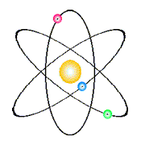
3. The nucleus is the small, dense, positive center of an atom where the protons live (and so do the neutrons).
4. Electrons fly around outside, relatively far away.
In this model, the nucleus is the yellow ball in the middle. It does not show it, but inside must be three protons and probably 4 neutrons.
This is a model of atom #3, which is LITHIUM.
It’s a cartoon, it’s not even what we think atoms look like, but it’s cute.

Slide 8
5. AMU is atomic mass unit.
It’s a super small mass, and there is a lot of math to make it equivalent to 1.67 x 10⁻²⁴ gram, but we WILL NEVER DO THIS MATH, okay? Never ever.
6. In high school a proton is = 1 amu. A neutron is = 1 amu too.
7. In high school, because the mass of the electron is so much smaller, we discount it in our calculations, but it is NOT REALLY ZERO.

Slide 9
8.
Atomic Mass
12.011
Missing numbers, we will discuss them soon, not today.
C
Atomic Number Electron Configuration
6
2-4

Slide 10
9. Atomic Mass Numbers will be rounded to the nearest whole number (they’re not whole numbers, patience)
10. Mass Number = mass of protons + neutrons
Atomic Mass = p⁺ plus n°

Slide 11
11. The mass of sodium is 23 AMU. It has a total of 11 protons + ___ neutrons.
11p⁺
?n°
= 23 AMU

Slide 12
11. copy
Sodium mass | 23 AMU | protons + neutrons
Minus atomic number | -11 | - protons
Equal | 12 | neutrons

Slide 13
12. How many protons, neutrons and electrons are in TIN (element number 50)?
Mass of Sn = 119 = p⁺ + n°
– atomic # – # p⁺

Slide 14
12. How many protons, neutrons and electrons are in TIN (element number 50)?
Mass of Sn = 119 = p⁺ + n°
– atomic # 50 – # p⁺
69 = # n° Tin has 50 protons, 50 electrons, and 69 neutrons.

Slide 15
13
This slide left intentionally blank; you know why.

Slide 16
14. All atoms are electrically neutral, the number of p⁺ = e⁻
The positives = the negatives.
# p⁺
# e⁻

Slide 17
15. How many p⁺, n° and e⁻ are in INDIUM?
Indium mass | # protons PLUS # neutrons =
 | minus protons | –
 | = neutrons

Slide 18
15. How many p⁺, n° and e⁻ are in INDIUM?
Indium mass | # protons PLUS # neutrons = | 115
 | minus protons | – 49
 | equals neutrons | 66
The protons = electrons, so indium has 49 electrons also.

Slide 19
16. How many p⁺, n° and e⁻ are in NIOBIUM (#41)?
Niobium mass | # protons PLUS # neutrons =
 | minus protons | –
 | equals neutrons
The protons = electrons, so niobium has electrons also.

Slide 20
16. How many p⁺, n° and e⁻ are in NIOBIUM (#41)?
Niobium mass | # protons PLUS # neutrons = | 93
 | minus protons | – 41
 | equals neutrons | 52
The protons = electrons, so niobium has 41electrons also.

Slide 21
17. How many p⁺, n° and e⁻ are in IRON (#26)?
Iron mass | # protons PLUS # neutrons =
 | minus protons | –
 | equals neutrons
The protons = electrons, so iron has electrons also.

Slide 22
17. How many p⁺, n° and e⁻ are in IRON (#26)?
Iron mass | # protons PLUS # neutrons = | 56
 | minus protons | – 26
 | equals neutrons | 30
The protons = electrons, so iron has 26 electrons also.

Slide 23
A more formal symbol for Calcium can also be written as:
40 20
Ca
Atomic mass
Atomic number
18. Write the Formal Symbols for:
Mercury | Chlorine | Copper

Slide 24
A more formal symbol for Calcium can also be written as:
40 20
Ca
Atomic mass
Atomic number
18. Write the Formal Symbols for:
Mercury | Chlorine | Copper
Hg
35 17
Cl
64 29
Cu
201 80

Slide 25
Electrons don’t just fly around randomly
19. Electrons stay in SHELLS or ORBITALS, which are also energy levels.
20. The closer to the nucleus, the LOWER the energy level. Electrons in shells further away from the nucleus, are in higher energy orbitals - or higher energy shells.

Slide 26
21. The orbitals are sized to hold a maximum number of electrons.
You don’t memorize how many can fit into each orbital, you just look at group 18 on the Periodic Table.
These are the NOBLE GASES. They have only full orbitals.

Slide 27
 | Noble gases | Electron Configuration
22 | Helium He
23 | Neon Ne
24 | Argon Ar
25 | Krypton Kr
26 | Xenon Xe
27 | Radon Rn

Slide 28
 | Noble gases | Electron Configuration
22 | Helium He | 2
23 | Neon Ne
24 | Argon Ar
25 | Krypton Kr
26 | Xenon Xe
27 | Radon Rn

Slide 29
 | Noble gases | Electron Configuration
22 | Helium He | 2
23 | Neon Ne | 2 - 8
24 | Argon Ar
25 | Krypton Kr
26 | Xenon Xe
27 | Radon Rn

Slide 30
 | Noble gases | Electron Configuration
22 | Helium He | 2
23 | Neon Ne | 2 – 8
24 | Argon Ar | 2 – 8 – 8
25 | Krypton Kr
26 | Xenon Xe
27 | Radon Rn

Slide 31
 | Noble gases | Electron Configuration
22 | Helium He | 2
23 | Neon Ne | 2 – 8
24 | Argon Ar | 2 – 8 – 8
25 | Krypton Kr | 2 – 8 – 18 – 8
26 | Xenon Xe
27 | Radon Rn

Slide 32
 | Noble gases | Electron Configuration
22 | Helium He | 2
23 | Neon Ne | 2 – 8
24 | Argon Ar | 2 – 8 – 8
25 | Krypton Kr | 2 – 8 – 18 – 8
26 | Xenon Xe | 2 – 8 – 18 – 18 – 8
27 | Radon Rn

Slide 33
 | Noble gases | Electron Configuration
22 | Helium He | 2
23 | Neon Ne | 2 – 8
24 | Argon Ar | 2 – 8 – 8
25 | Krypton Kr | 2 – 8 – 18 – 8
26 | Xenon Xe | 2 – 8 – 18 – 18 – 8
27 | Radon Rn | 2 – 8 – 18 – 32 –18 – 8

Slide 34
28. Orbital | Maximum electrons that fit in this orbital
First | 2
Second | 8
Third | 8, or 18 (it can stretch)
Fourth | 8, or 18, or 32 (wow)
Fifth | 8 or 18
Sixth | 8
“Full” is relative. It is better understood as perfectly stable arrangement. These electron shells, or orbitals, can be stable in different ways. The first two never adjust. The bigger orbitals are fancy, and Group 18 tells us this, just put your finger in the right box and think.

Slide 35
Let’s practice a little bit.
29. Find silver, how many electrons does it have?

Slide 36
Let’s practice a little bit.
29. Find silver, how many electrons does it have? 47e⁻
30. Find hafnium, how many protons, electrons and how many neutrons in this element?

Slide 37
Let’s practice a little bit.
29. Find silver, how many electrons does it have? 47e⁻
30. Find hafnium, how many protons, electrons and how many neutrons in this element? 72p⁺, 72e⁻, 106n°
31. What element has 16 protons and 16 electrons?

Slide 38
Let’s practice a little bit.
29. Find silver, how many electrons does it have? 47e⁻
30. Find hafnium, how many protons electrons and how many neutrons in this element? 72p⁺, 72e⁻, 106n°
31. What element has 16 protons and 16 electrons? SULFUR
32. What is the chemical symbol for tungsten? How many electrons are in this element?

Slide 39
Let’s practice a little bit.
29. Find silver, how many electrons does it have? 47e⁻
30. Find hafnium, how many protons electrons and how many neutrons in this element? 72p⁺, 72e⁻, 106n°
31. What element has 16 protons and 16 electrons? SULFUR
32. What is the chemical symbol for tungsten? W How many electrons are in this element? 74e⁻

Slide 40
Atomic Theory Class #2 Objective: students will review the models of the atom through scientific history, learning how ideas progressed and were dismissed as new information was developed.
Most famous chemists had remarkable mustaches. That’s the easiest way to keep track of who’s who in science!

Slide 41
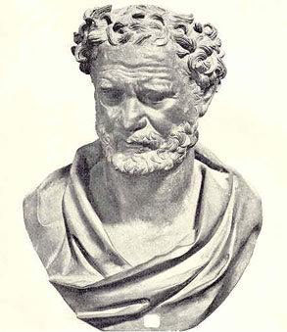
33. 2400 years ago, the philosopher Democritus said:
If you took anything and cut it in half, and in half, and in half, over and over, sooner or later, you would get to a piece so small that it could not be cut in half again.
That indivisible particle he named
ATOMOS (in Greek)
We say it as ATOM
The first of many mustaches in our course!

Slide 42
In the early 1800’s John Dalton thought he could invent chemistry, it had to be bigger than a single word.
He invented the Atomic Theory.
On the next page is a 4-part theory, that you will have to recognize and understand. You do not have to memorize it.

Slide 43
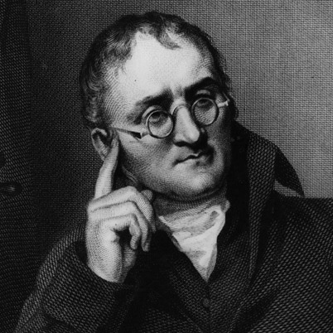
34. Dalton’s Atomic Theory
(This is so important)
1. All elements are composed of individual kinds of atoms.
2. Atoms of one element are identical. Atoms of different elements have different masses.
3. Atoms can chemically combine with other atoms IN SIMPLE WHOLE NUMBER RATIOS, to form new substances.
4. Chemical reactions change the arrangement of atoms, but when they are bonded they do not become different kinds of atoms.

Slide 44
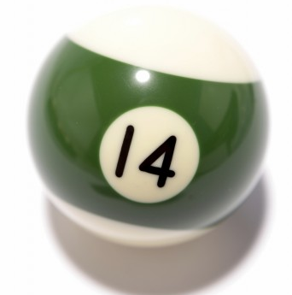
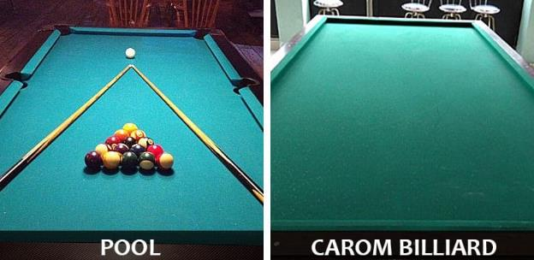
35. Dalton imagined his atom to look sort of like a billiard ball.
Billiards is a game like pool. The balls are hard spheres, and you can tell them apart by colors. His atoms had different masses. His atomic model was called the BILLIARD BALL MODEL

Slide 45
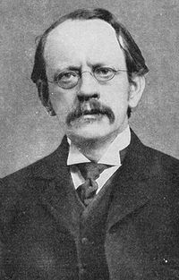
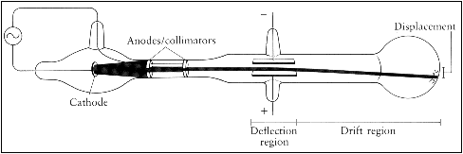
36. J. J. Thomson discovers the electron in 1897! (and later gets a Nobel Prize)
37. Thomson did a variety of experiments, some using what’s called the cathode ray tube, to detect and measure electrons. He found the first subatomic particle, the electron, which was negatively charged.

Slide 46
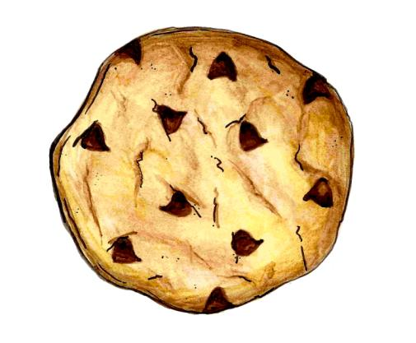
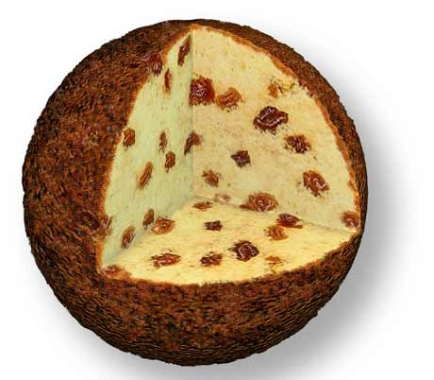
38. He describes the atom as PLUM PUDDING, after what his wife’s dessert looked like! He put his newly discovered negative electrons into the positive “mush” of the atom. If Mrs. Thomson made him chocolate chip cookies instead, his model would be the chocolate chip cookie model, with the cookie being positive, offset by the negative electrons or the chips!
Dalton’s electrons
The Model that coulda and shoulda been!
The “Positive Mush” of the atom.
Plum Pudding

Slide 47
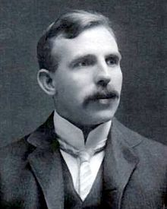
In 1908, my chemical hero, Ernest J. Rutherford discovers the nucleus! - and much more about the atom! Later, he wins a Nobel Prize.
39. Rutherford’s Gold Foil Experiment helps him discover the nucleus, and figure out the basic structure of the atom. (it wasn’t cake!)

Slide 48
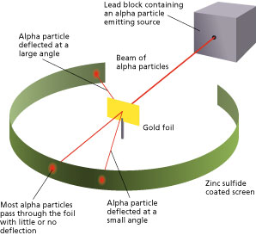
40. Details of the GOLD FOIL experiment to memorize and share with your friends.

Slide 49
41. What does this gold foil experiment prove?
Atoms are mostly empty space Since most of the alpha particles pass though the foil like it’s not really there.
He knew atoms are neutral, so the nucleus must be dense and positively charged Since the positively charged alpha particles never stuck to atoms, or they dinged off atoms, there must be a central atomic core that was bigger and positively charged.
Neutral atoms must therefore have the negatively charged electrons outside the nucleus Flying around like planets made sense.

Slide 50
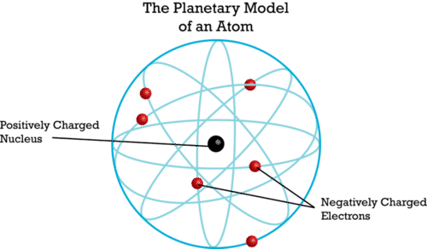
42. The Rutherford Model is named the planetary model. He perceives the electrons to be flying around the atom’s nucleus like the planets orbiting the Sun.

Slide 51
43. Problems with Rutherford’s theory…
How can atoms be mostly empty space? How can they be mostly “not” there?
How can these negative electrons fly around a positive center, but never get attracted into the positive nucleus? Why not? How do they just keep flying without ever running out of energy? Why don’t they fly off, away from the nucleus?
If they do fly around, do they just fly willy-nilly, or is there a system to them?
Rutherford could not provide solid answers to these questions.

Slide 52
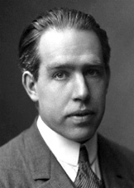
Rutherford was right, but he needed some help. In 1913, one of his students, a man with a plural first name, comes to his rescue.
Niels Bohr
44. Niels Bohr is able to do some very funky math, and he proves the Rutherford model of the atom is correct.
He too wins a Nobel Prize.

Slide 53
45. The Bohr Model - the Planetary model with detail
He expands on the simple planetary model of Rutherford, and put the electrons into specific orbits, or energy levels.

Slide 54
45. The Bohr Model - the Planetary model with detail
He expands on the simple planetary model of Rutherford, and put the electrons into specific orbits, or energy levels.
46. He proves that for hydrogen, if the electron flies at the right speed, and the right distance, it will mathematically never run out of energy, and stay in orbit forever around the nucleus.

Slide 55
HELLO??? Do I need this diagram??

Slide 56
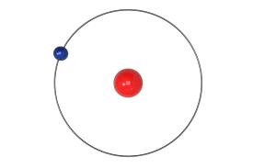
47. The math that proves electrons never run out of energy only works for hydrogen with a single electron.
More electrons make this math too hard. But since the atoms exist, and the electrons do not seem not to fly off, or collapse into the nucleus, he postulated that this must work for all other atoms too.
He did more math (we’ll get to soon).
Bohr model of hydrogen atom.

Slide 57
48. Draw a simple Bohr Model for Nitrogen

Slide 58
48. Draw a simple Bohr Model for Nitrogen 7 electrons, 2 in first orbit, 5 in second orbit.
7 p⁺ 7 n°

Slide 59
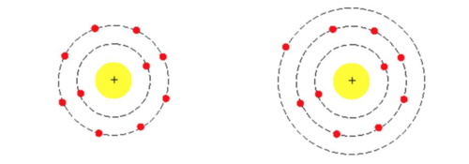
49. Niels Bohr further determines that electrons could gain a specific amount of energy, an amount he called a quantum of energy. This enables an electron to “jump” up to a higher than normal energy level called the excited state.
Neon with a 2-8
Ground state electron configuration.
Neon with a 2-7-1
Excited state electron configuration.

Slide 60
50. The excited state is unstable, and the electron will soon move back to the lower energy, more stable, ground state. To do that it must release that exact amount of energy, the same quantum of energy it absorbed to get excited. 51. This quantum of energy is released as visible light. We can see it with our eyes! 52. This light we call SPECTRA. An example is an electric neon light that emits that characteristic orange light. The orange light is its spectra, unique to neon.

Slide 61
53. The modern model of the atom has been developed by many scientists over a long period of time.
54. It’s called the Wave-Mechanical Model The electrons sometimes act like waves of energy, and sometimes like little bits of mechanical matter with negative charge.
55. This model is more about the STATISTICAL PROBABILITY of finding an electron’s location MOST OF THE TIME, not always.

Slide 62
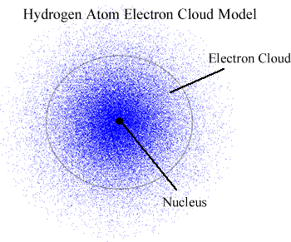
Electron orbitals are still energy levels, they just aren’t so neat.
In this model/diagram, imagine that this is a photograph of a Hydrogen atom (impossible really) taken about 1000 times on to the same piece of film, then printed overlapping. Dots represents where the electrons were at some point.
56. Electrons are like teenagers, they are where they should be most of the time, but not always.

Slide 63
Atomic Theory Class #3
OB: The Patterns of the Electron Orbitals, Ground State vs. Excited State, and SPECTRA
Take out your periodic tables.

Slide 64
Fill in chart
 | Symbol | Name | Ground State
57 | Li
58 | Na
59 | Mg
60 | Ca
61 | He
62 | Ne
63 | Ar

Slide 65
Names and ground state configurations
 | Symbol | Name | Ground State | Possible Excited States
57 | Li | Lithium | 2-1
58 | Na | Sodium | 2-8-1
59 | Mg | Magnesium | 2-8-2
60 | Ca | Calcium | 2-8-8-2
61 | He | Helium | 2
62 | Ne | Neon | 2-8
63 | Ar | Argon | 2-8-8

Slide 66
Possible Excited States
 | Symbol | Name | Ground State | Possible Excited States
57 | Li | Lithium | 2-1 | 1-2 or 1-1-1
58 | Na | Sodium | 2-8-1 | 2-7-2 or 2-7-1-1
59 | Mg | Magnesium | 2-8-2 | 2-8-1-1 or 2-7-3
60 | Ca | Calcium | 2-8-8-2 | 2-8-8-1-1 or 2-8-7-3
61 | He | Helium | 2 | 1-1 (only possibility)
62 | Ne | Neon | 2-8 | 2-7-1 or 2-6-2
63 | Ar | Argon | 2-8-8 | 2-8-7-1 or 2-7-9

Slide 67
64. Ground + Excited State electron configurations have the SAME number of electrons, the electrons are just in DIFFERENT places.
65. How do electrons get excited? They absorb UNIQUE amounts of ENERGY, called a QUANTUM of ENERGY. A quantum means a specific amount. 66. Spectra is produced when this unique quantum of energy is RELEASED as VISIBLE LIGHT.

Slide 68
67. The color of light, or the SPECTRA that we see, is a MIXTURE of many colors of light that our eyes blur together.

Slide 69
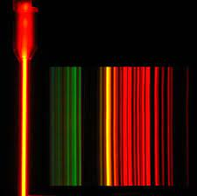
67. The color of light, or the SPECTRA that we see, is a MIXTURE of many colors of light that our eyes blur together.
68. A refractive lens can break up this mixture of colors into a unique SPECTROGRAPH. This can be measured (even by you, in lab)
In the Neon light tube orange light is the spectra
That orange light is many colors, which we can separate with refractive lenses into this spectrograph (like a fingerprint for neon.

Slide 70
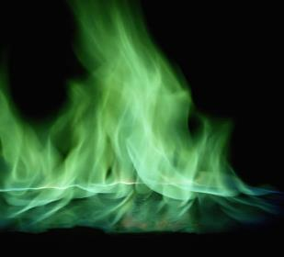
69. We can do flame tests too, where fire can change color, depending upon what elements or compounds we are heating up. Electrons gain a quantum of energy to become excited. Then emit that same amount of energy when the electrons return to the ground state. The energy emitted is spectra.
The green flame we see when we heat up copper salts is spectra. The spectrograph is much harder to see because the flame is jumping around like mad. We can’t see on the spectrograph lines. The spectrograph lines are present, we just can’t see them.

Slide 71
Atomic Theory Class #4 Ob: What are isotopes and why are they so important?
You will need a calculator and your Periodic tables out.

Slide 72
70. John Dalton once said that all atoms of an element are identical.

Slide 73
71. He should have said:
All atoms of an element are chemically identical. All atoms of an element react alike, and they have the same chemical properties, but they are NOT physically identical.

Slide 74
72. All atoms of an element are chemically identical. They can have different masses because the number of neutrons in any element is not set. All iron atoms have 26 protons, and 26 electrons.
Some iron atoms have the “normal” amount of 30 neutrons. Some iron atoms have less, or more.

Slide 75
72. All atoms of an element are chemically identical. They can have different masses because the number of neutrons in any element is not set. All iron atoms have 26 protons, and 26 electrons.
Some iron atoms have the “normal” amount of 30 neutrons. Some iron atoms have less, or more. 73. These different iron atoms are called ISOTOPES of iron.
There are 118 elements, but there are about 1500 different isotopes.

Slide 76
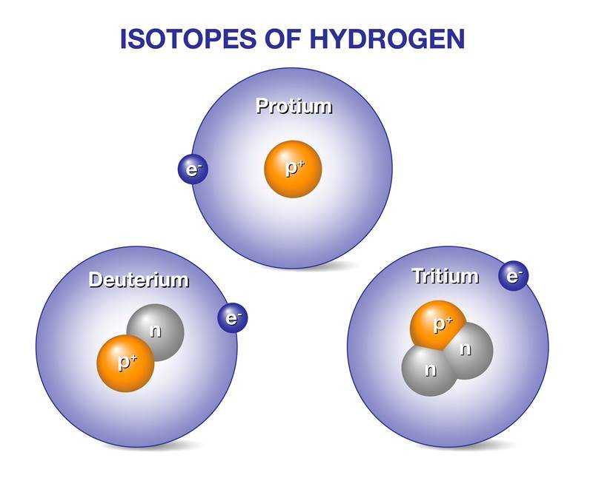
74. Each kind of atom comes in a variety of masses, every one of them is an ISOTOPE of that element.

Slide 77
75.
H-1 has 1 p⁺ + 0 n°
H-2 has 1 p⁺ + 1 n°
H-3 has 1 p⁺ + 2 n°
All are hydrogen atoms, all bond in the same way.
They have different numbers of neutrons (how cool is that?)

Slide 78
FILL IN THIS CHART of the common Isotopes of Potassium
 | ISOTOPE | K-39 | K-40 | K-41
 | MASS in amu | 38.9637 | 39.963 | 40.9618
76 | # protons
77 | # electrons
78 | # neutrons

Slide 79
FILL IN THIS CHART of the common Isotopes of Potassium
 | ISOTOPE | K-39 | K-40 | K-41
 | MASS in amu | 38.9637 | 39.963 | 40.9618
76 | # protons | 19 | 19 | 19
77 | # electrons
78 | # neutrons

Slide 80
FILL IN THIS CHART of the common Isotopes of Potassium
 | ISOTOPE | K-39 | K-40 | K-41
 | MASS in amu | 38.9637 | 39.963 | 40.9618
76 | # protons | 19 | 19 | 19
77 | # electrons | 19 | 19 | 19
78 | # neutrons

Slide 81
FILL IN THIS CHART of the common Isotopes of Potassium
 | ISOTOPE | K-39 | K-40 | K-41
 | MASS in amu | 38.9637 | 39.963 | 40.9618
76 | # protons | 19 | 19 | 19
77 | # electrons | 19 | 19 | 19
78 | # neutrons | 39 – 19 = 20 | 40 – 19 = 21 | 41 – 19 = 22

Slide 82
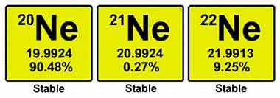
79. These 3 different ISOTOPES of neon are all CHEMICALLY identical. They have the same number of protons and the same number of electrons, but different numbers of NEUTRONS.
80. Isotopes have different mass but the same chemical properties.

Slide 83
81. The masses of all the naturally occurring isotopes make up 100% of all the average atomic mass of neon.
82. Adding 20 + 21 + 22 = 63 then divide by 3 for an average gives us an average mass of 21 amu.
83. That’s wrong! Periodic Table says 20.180 AMU What’s up?
Let’s copy the proper math (to learn) from the next slide.

Slide 84
84. Average weighted atomic mass has you multiply the exact mass X exact proportion of this isotope, then do that for all isotopes, then add up the totals to get your correct answer.
(mass in AMU)(decimal proportion) =
(19.9924 amu)(.9048) = 18.089 amu (20.9924 amu)(.0027) = 0.057 amu (21.9913 amu)(0.0925) = + 2.034 amu 20.18 amu

Slide 85
85. Average Weighted Atomic Mass is the mass listed on our periodic tables. These use the mass of each isotope & the proportions that those isotopes make up of all that element. 86. Scientists measure these naturally occurring proportions regularly, sometimes the proportions of an isotope are measured better (and change) which causes a slight adjustment to the mass numbers on the Periodic Table (wow).

Slide 86
87. A new element named Arbuiso is discovered (A). It has two isotopes, A-58 and A-59. 82.08% of all this Arbuiso metal has mass of 57.96 amu, while the rest has mass of 58.98 amu.
What is the weighted average atomic mass of this cool new metallic element?

Slide 87
87. A new element named Arbuiso is discovered (A). It has two isotopes, A-58 and A-59. 82.08% of all this Arbuiso metal has mass of 57.96 amu, while the rest has mass of 58.98 amu.
What is the weighted average atomic mass of this cool new metallic element?
(57.96 amu)(.8208) = 47.573568 amu
(58.98 amu)(.1792) = +10.569216 amu
58.142784 amu 58.14 amu with 4 SF
NOTE: when given a choice between using the casual mass of A-58 & A-59, and at the exact measurements 57.96 amu & 58.98 amu, use the exact mass in the math. Small difference but you’re a scientist.

Slide 88
88. A new element X has 3 isotopes, the details are in this data table. Calculate the average weighted atomic mass of element X.
Isotope Symbol | Isotope mass (amu) | Proportion of element X
X-23 | 22.8995 | 84.25%
X-24 | 23.9105 | 8.82%
X-26 | 25.9068 | ??? %

Slide 89
88. A new element X has 3 isotopes, the details are in this data table. Calculate the average weighted atomic mass of element X.
Isotope Symbol | Isotope mass (amu) | Proportion of element X
X-23 | 22.8995 | 84.25%
X-24 | 23.9105 | 8.82%
X-26 | 25.9068 | 6.93%
 |  | 100% (check)
(22.8995 amu)(.8425) = 19.2928288 amu (23.9105 amu)(.0882) = 2.1089061 amu (25.9068 amu)(.0693) = + 1.79534124 amu 23.19707614 amu = 23.2 amu 3 SF

Slide 90
Stop here

Slide 91
Review slides do these!
89. State the Objective #1 in the NYS Chemistry Curriculum for Chemistry…

Slide 92
89. State the Objective #1 in the NYS Chemistry Curriculum for Chemistry…
The modern model of the atom has evolved over a long period of time through the work of many scientists.

Slide 93
 | Scientist Name | Model Name | Details
90 | Democritus (not a scientist)
91 | John Dalton
92 | J. J. Thomson
93 | Ernest J. Rutherford
94 | Niels Bohr
95 | Many others

Slide 94
 | Scientist Name | Model Name | Details
90 | Democritus (not a scientist) | x | The smallest part of anything was called “atomos”
91 | John Dalton | Billiard Ball | Atoms were like small hard spheres of different mass. Atomic Theory.
92 | J. J. Thomson | Plum Pudding | Discovered the electron, put it “into” a positive mush, so atoms stay neutral.
93 | Ernest J. Rutherford | Planetary | Gold foil experiment, electrons fly around the outside of a positive nucleus.
94 | Niels Bohr | Planetary with details | Electrons into energy levels called SHELLS or ORBITS. Discovers and explains spectra
95 | Many others | Modern, or Wave-Mechanical | Electrons are not in orbits, rather in energy levels called orbitals. Fuzzier and more in tune with complex quantum math.

Slide 95
96. The 4 main points of Dalton’s Atomic Theory
1. All elements are composed of individual kinds of atoms.
2. Atoms of one element are identical. Atoms of different elements have different masses.
3. Atoms can chemically combine with other atoms IN SIMPLE WHOLE NUMBER RATIOS, to form new substances.
4. Chemical reactions change the arrangement of atoms, but the atoms do not become different kinds of atoms.

Slide 96
97.

Slide 97
98. Explain what Rutherford discovered in his Gold Foil Experiment
An atom consists of a positively charged nucleus and is surrounded by negatively charged electrons that spin around it. The size of the nucleus is extremely small as compared to the size of the whole atom. The atom's entire mass is concentrated in the nucleus while the volume is taken up by the electrons in orbit around the nucleus. Atoms are mostly empty space.

Slide 98
99. Explain what problems with his new ideas.
Rutherford could not explain the stability of an atom. He could not explain why the electrons do not collapse into the positive nucleus, or why they didn’t fly away.
The orbiting electrons should lose energy, which should slow them, causing the attraction of the nucleus to cause them to collapse into the nucleus.
If the atom was actually 99% empty space, that meant the everything was mostly not there. How could that be possible? It seemed to be nonsense.

Slide 99
100. Describe the Bohr Model (planetary) and spectra. Bohr mathematically proved that if the electron of the hydrogen atom traveled at a set distance, at a set speed from the nucleus, somehow mathematically, it would never lose energy and never fly away and never be attracted into the positive center of the atom.
The math was too hard to prove for any other atom, but he concluded, since atoms existed, and just because he couldn’t do the math, that the same circumstances held true for all atoms.

Slide 100
101. Bohr further stated that the electrons flew in SHELLS or ORBITS, and that each electron orbit was also an energy level. Electrons in the orbits closer to the nucleus had lower relative energy than electrons in the higher orbits.
102. He showed that the electrons normally were in the ground state, or lowest energy levels possible.
103. Low energy, or ground state was their NORMAL state.

Slide 101
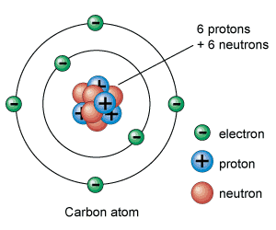
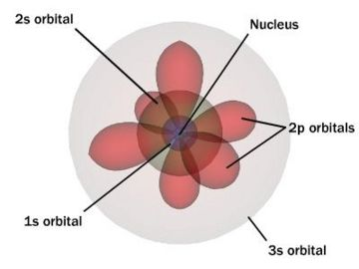
104. What’s the difference between orbit & orbital? Bohr said orbit for energy level. Now we have electrons in energy levels called ORBITALS or shells. Orbit implies radius and a “neat” simple spinning around the nucleus. Orbital means “zone”, which is fuzzier in shape.
NEAT ORBITS FUZZY ORBITALS

Slide 102
105. What’s the difference between SPECTRA + SPECTROGRAPH?
The word “open” has neon gas that is excited by electricity. The spectra given off we see as ORANGE light with our eyes. That’s the mixture of color we see as orange.
As seen through a refractive lens, we can see the unique colors that are broken apart by the prism of the lens.
For a few dollars more the device used to see this, with numerals to measure the wavelengths in nanometers (quantitative measuring)
Spectrograph for Hydrogen

Slide 103
Fill in the chart, using magnesium as an example of what to do.
 | Atom | Ground state electron configuration | Possible excited state configuration | # of electrons is always
106 | Mg #12 | 2-8-2 | 2-7-3 | 12
107 | Al #13
108 | C #6
109 | Ca #20
110 | Fe #26

Slide 104
Fill in the chart, using magnesium as an example of what to do.
 | Atom | Ground state electron configuration | Possible excited state configuration | # of electrons is always
106 | Mg #12 | 2-8-2 | 2-7-3 | 12
107 | Al #13 | 2-8-3 | 2-7-4 | 13
108 | C #6 | 2-4 | 2-3-1 | 6
109 | Ca #20 | 2-8-8-2 | 2-8-8-1-1 | 20
110 | Fe #26 | 2-8-14-2 | 2-8-13-3 | 26

Slide 105
Mark the correct electron configurations OK. Fix any that are wrong and state why they are wrong below. 111. Mg ground 2-8-2 112. F ground 2-7 114. He ground 2 115. Ne ground 2-8-8 116. Mg excited 1-9-2 117. He excited 1-1 118. Ne excited 2-8-7-1 119. F excited 2-8 120. P ground 2-9-4

Slide 106
Mark the correct electron configurations OK. Fix any that are wrong and state why they are wrong below. 111. Mg ground 2-8-2 OKAY 112. F ground 2-7 OKAY 113. He ground 2 OKAY 114. Ne ground 2-8-8 115. Mg excited 1-9-2 116. He excited 1-1 117. Ne excited 2-8-7-1 118. F excited 2-8 119. P ground 2-9-4

Slide 107
Mark the correct electron configurations OK. Fix any that are wrong and state why they are wrong below. 111. Mg ground 2-8-2 OKAY 112. F ground 2-7 OKAY 113. He ground 2 OKAY 114. Ne ground 2-8-8 X 2-8 only 115. Mg excited 1-9-2 X only 8e⁻ in 2nd orbital 116. He excited 1-1 OKAY 117. Ne excited 2-8-7-1 118. F excited 2-8 119. P ground 2-9-4

Slide 108
Mark the correct electron configurations OK. Fix any that are wrong and state why they are wrong below. 111. Mg ground 2-8-2 OKAY 112. F ground 2-7 OKAY 113. He ground 2 OKAY 114. Ne ground 2-8-8 X 2-8 only 115. Mg excited 1-9-2 X only 8e⁻ in 2nd orbital 116. He excited 1-1 OKAY 117. Ne excited 2-8-7-1 X 2-7-1 for neon 118. F excited 2-8 X only 9 total e⁻ for F 119. P ground 2-9-4 X only 8e⁻ in 2nd orbital

