Slide 1
Welcome to Bonding
OB: introduction to what bonding is, and learning to draw (lots of) Lewis Dot Diagrams.
Notes today for Bonding 1 to 20.

Slide 2
Types of bonds we will see:
Ionic Bonds - are between metal cations and nonmetal anions. The electrons are TRANSFERRED. Cation and anion charges sum to zero. Ions have FULL outer orbitals, they are isoelectric to noble gases.

Slide 3
Covalent bonds - between 2 or more NONMETALS Electrons are SHARED. There are NO IONS ever. No metals make covalent bonds. Bonding atoms usually get FULL outer orbitals most of the time

Slide 4
Metallic bonds - bonds that hold metal or metals together as a solid. These give rise to the 3 most important properties metals have. Metal element atoms can bond together; two or more metals can be melted together to form an alloy (mixture)

Slide 5
4. Intermolecular bonds - these are the relatively weak attractions between molecules (not inside of them). There are 3 different kinds of IMF, and I like these a lot.

Slide 6
5. The outermost electrons are the VALENCE electrons 6. The outermost orbital is the VALENCE ORBITAL.
7. Bonds always* form when atoms or ions end up ISOELECTRIC with the noble gases. (that means FULL ORBITALS) * Of course, there are exceptions, be patient.

Slide 7
Lewis Dot Diagrams… Provide a simple way to learn to “see” the electrons for bonding.
Before we learn bonding, we need to learn to draw atoms that can bond.
Only the outer most electrons are involved in bonding, not the inner electrons.
8. The DOTS we will draw represent the outermost or valence electrons.
9. The dots represent only the valence electrons, not all the electrons in an atom.

Slide 8
Electron Orbitals 10. The first orbital is tiny; it only holds up to 2 electrons.
11. The 2nd orbital is bigger; it holds up to 8 electrons

Slide 9
12. The third orbital is a bit trickier. It can be “full” when it has 8 electrons (like argon does), but, it can stretch out quite a bit, and hold up to 18 electrons, like krypton does. Many atoms have more than 8 electrons in the third orbital, but they are “FULL” with 8, or full with 18 electrons.
Most high school bonding remains simple, the larger atoms mostly follow the same rules, but we won’t draw 18 electrons in a diagram.

Slide 10
Electron Orbitals 12. The 4th, 5th, and 6th orbitals can also be full, or stretch and fill with a higher number of electrons.
Rule: Noble gases always and only have full orbitals. These will guide you to how many electrons are needed to fill up an orbital (to be perfect).

Slide 11
14. Together we’ll draw a few atoms, and ions, then YOU will continue these charts which will run from hydrogen to calcium.
Atom number | Atom symbol | Lewis Dot (atom) | Ion Symbol | Lewis Dot (ion)
1 | H | H | H⁺¹ | [H]⁺¹
Electron configuration | 1 | 1 | 0 | 0
2
Electron configuration

Slide 12
Fill in the boxes, try to follow the pattern that develops.
Atom number | Atom symbol | Lewis Dot (atom) | Ion Symbol | Lewis Dot (ion)
1 | H | H | H⁺¹ | [H]⁺¹
Electron configuration | 1 | 1 | 0 | 0
2 | He | He | Helium does not make ions | Helium does not make ions
Electron configuration | 2 | 2 | X | X

Slide 13
Atom number | Atom symbol | Lewis Dot (atom) | Ion Symbol | Lewis Dot (ion)
3 | Li | Li
Electron configuration | 2-1 | 2-1
4
Electron configuration
5
Electron configuration
6
Electron configuration

Slide 14
Atom number | Atom symbol | Lewis Dot (atom) | Ion Symbol | Lewis Dot (ion)
3 | Li | Li | Li⁺¹ | [ Li ]⁺¹
Electron configuration | 2-1 | 2-1 | “2-0” | “2-0”
4
Electron configuration
5
Electron configuration
6
Electron configuration

Slide 15
Atom number | Atom symbol | Lewis Dot (atom) | Ion Symbol | Lewis Dot (ion)
3 | Li | Li | Li⁺¹ | [ Li ]⁺¹
Electron configuration | 2-1 | 2-1 | “2-0” | “2-0”
4 | Be | Be
Electron configuration | 2-2 | 2-2
5
Electron configuration
6
Electron configuration

Slide 16
Atom number | Atom symbol | Lewis Dot (atom) | Ion Symbol | Lewis Dot (ion)
3 | Li | Li | Li⁺¹ | [ Li ]⁺¹
Electron configuration | 2-1 | 2-1 | “2-0” | “2-0”
4 | Be | Be | Be⁺² | [ Be ]⁺²
Electron configuration | 2-2 | 2-2 | 2-0 | 2-0
5
Electron configuration
6
Electron configuration

Slide 17
Atom number | Atom symbol | Lewis Dot (atom) | Ion Symbol | Lewis Dot (ion)
3 | Li | Li | Li⁺¹ | [ Li ]⁺¹
Electron configuration | 2-1 | 2-1 | “2-0” | “2-0”
4 | Be | Be | Be⁺² | [ Be ]⁺²
Electron configuration | 2-2 | 2-2 | 2-0 | 2-0
5 | B | B
Electron configuration | 2-3 | 2-3
6
Electron configuration

Slide 18
Atom number | Atom symbol | Lewis Dot (atom) | Ion Symbol | Lewis Dot (ion)
3 | Li | Li | Li⁺¹ | [ Li ]⁺¹
Electron configuration | 2-1 | 2-1 | “2-0” | “2-0”
4 | Be | Be | Be⁺² | [ Be ]⁺²
Electron configuration | 2-2 | 2-2 | 2-0 | 2-0
5 | B | B | Boron does not make ions in high school chemistry | Boron does not make ions in high school chemistry
Electron configuration | 2-3 | 2-3
6

Slide 19
Atom number | Atom symbol | Lewis Dot (atom) | Ion Symbol | Lewis Dot (ion)
3 | Li | Li | Li⁺¹ | [ Li ]⁺¹
Electron configuration | 2-1 | 2-1 | “2-0” | “2-0”
4 | Be | Be | Be⁺² | [ Be ]⁺²
Electron configuration | 2-2 | 2-2 | 2-0 | 2-0
5 | B | B | Boron does not make ions in high school chemistry | Boron does not make ions in high school chemistry
Electron configuration | 2-3 | 2-3
6 | C | C
Electron configuration | 2-4 | 2-4

Slide 20
Atom number | Atom symbol | Lewis Dot (atom) | Ion Symbol | Lewis Dot (ion)
3 | Li | Li | Li⁺¹ | [ Li ]⁺¹
Electron configuration | 2-1 | 2-1 | “2-0” | “2-0”
4 | Be | Be | Be⁺² | [ Be ]⁺²
Electron configuration | 2-2 | 2-2 | 2-0 | 2-0
5 | B | B | Boron does not make ions in high school chemistry | Boron does not make ions in high school chemistry
Electron configuration | 2-3 | 2-3
6 | C | C | Carbon does not make ions in high school chemistry | Carbon does not make ions in high school chemistry
Electron configuration | 2-4 | 2-4

Slide 21
Atom number | Atom symbol | Lewis Dot (atom) | Ion Symbol | Lewis Dot (ion)
7 | N | N
Electron configuration | 2-5 | 2-5
8
Electron configuration
9
Electron configuration
10
Electron configuration

Slide 22
Atom number | Atom symbol | Lewis Dot (atom) | Ion Symbol | Lewis Dot (ion)
7 | N | N | N⁻³ | [ N ]⁻³
Electron configuration | 2-5 | 2-5 | 2-8 | 2-8
8
9
10

Slide 23
Atom number | Atom symbol | Lewis Dot (atom) | Ion Symbol | Lewis Dot (ion)
7 | N | N | N⁻³ | [ N ]⁻³
Electron configuration | 2-5 | 2-5 | 2-8 | 2-8
8 | O | O
Electron configuration | 2-6 | 2-6
9
10

Slide 24
Atom number | Atom symbol | Lewis Dot (atom) | Ion Symbol | Lewis Dot (ion)
7 | N | N | N⁻³ | [ N ]⁻³
Electron configuration | 2-5 | 2-5 | 2-8 | 2-8
8 | O | O | O⁻² | [ O ]⁻²
Electron configuration | 2-6 | 2-6 | 2-8 | 2-8
9
10

Slide 25
Atom number | Atom symbol | Lewis Dot (atom) | Ion Symbol | Lewis Dot (ion)
7 | N | N | N⁻³ | [ N ]⁻³
Electron configuration | 2-5 | 2-5 | 2-8 | 2-8
8 | O | O | O⁻² | [ O ]⁻²
Electron configuration | 2-6 | 2-6 | 2-8 | 2-8
9 | F | F
Electron configuration | 2-7 | 2-7
10

Slide 26
Atom number | Atom symbol | Lewis Dot (atom) | Ion Symbol | Lewis Dot (ion)
7 | N | N | N⁻³ | [ N ]⁻³
Electron configuration | 2-5 | 2-5 | 2-8 | 2-8
8 | O | O | O⁻² | [ O ]⁻²
Electron configuration | 2-6 | 2-6 | 2-8 | 2-8
9 | F | F | F⁻¹ | [ F ]⁻¹
Electron configuration | 2-7 | 2-7 | 2-8 | 2-8
10

Slide 27
Atom number | Atom symbol | Lewis Dot (atom) | Ion Symbol | Lewis Dot (ion)
7 | N | N | N⁻³ | [ N ]⁻³
Electron configuration | 2-5 | 2-5 | 2-8 | 2-8
8 | O | O | O⁻² | [ O ]⁻²
Electron configuration | 2-6 | 2-6 | 2-8 | 2-8
9 | F | F | F⁻¹ | [ F ]⁻¹
Electron configuration | 2-7 | 2-7 | 2-8 | 2-8
10 | Ne | Ne | Neon does not make ions | Neon does not make ions
Electron configuration | 2-8 | 2-8

Slide 28
Atom number | Atom symbol | Lewis Dot (atom) | Ion Symbol | Lewis Dot (ion)
11 | Na | Na
Electron configuration | 2-8-1 | 2-8-1
12
13
14

Slide 29
Atom number | Atom symbol | Lewis Dot (atom) | Ion Symbol | Lewis Dot (ion)
11 | Na | Na | Na⁺¹ | [ Na ]⁺¹
Electron configuration | 2-8-1 | 2-8-1 | 2-8-0 | 2-8-0
12
13
14

Slide 30
Atom number | Atom symbol | Lewis Dot (atom) | Ion Symbol | Lewis Dot (ion)
11 | Na | Na | Na⁺¹ | [ Na ]⁺¹
Electron configuration | 2-8-1 | 2-8-1 | 2-8-0 | 2-8-0
12 | Mg | Mg
Electron configuration | 2-8-2 | 2-8-2
13
14

Slide 31
Atom number | Atom symbol | Lewis Dot (atom) | Ion Symbol | Lewis Dot (ion)
11 | Na | Na | Na⁺¹ | [ Na ]⁺¹
Electron configuration | 2-8-1 | 2-8-1 | 2-8-0 | 2-8-0
12 | Mg | Mg | Mg⁺² | [ Mg ]⁺²
Electron configuration | 2-8-2 | 2-8-2 | 2-8-0 | 2-8-0
13
14

Slide 32
Atom number | Atom symbol | Lewis Dot (atom) | Ion Symbol | Lewis Dot (ion)
11 | Na | Na | Na⁺¹ | [ Na ]⁺¹
Electron configuration | 2-8-1 | 2-8-1 | 2-8-0 | 2-8-0
12 | Mg | Mg | Mg⁺² | [ Mg ]⁺²
Electron configuration | 2-8-2 | 2-8-2 | 2-8-0 | 2-8-0
13 | Al | Al
Electron configuration | 2-8-3 | 2-8-3
14

Slide 33
Atom number | Atom symbol | Lewis Dot (atom) | Ion Symbol | Lewis Dot (ion)
11 | Na | Na | Na⁺¹ | [ Na ]⁺¹
Electron configuration | 2-8-1 | 2-8-1 | 2-8-0 | 2-8-0
12 | Mg | Mg | Mg⁺² | [ Mg ]⁺²
Electron configuration | 2-8-2 | 2-8-2 | 2-8-0 | 2-8-0
13 | Al | Al | Al⁺³ | [ Al ]⁺³
Electron configuration | 2-8-3 | 2-8-3 | 2-8-0 | 2-8-0
14

Slide 34
Atom number | Atom symbol | Lewis Dot (atom) | Ion Symbol | Lewis Dot (ion)
11 | Na | Na | Na⁺¹ | [ Na ]⁺¹
Electron configuration | 2-8-1 | 2-8-1 | 2-8-0 | 2-8-0
12 | Mg | Mg | Mg⁺² | [ Mg ]⁺²
Electron configuration | 2-8-2 | 2-8-2 | 2-8-0 | 2-8-0
13 | Al | Al | Al⁺³ | [ Al ]⁺³
Electron configuration | 2-8-3 | 2-8-3 | 2-8-0 | 2-8-0
14 | Si | Si | Silicon does not make ions in high school chemistry | Silicon does not make ions in high school chemistry
Electron configuration | 2-8-4 | 2-8-4

Slide 35
Atom number | Atom symbol | Lewis Dot (atom) | Ion Symbol | Lewis Dot (ion)
15 | P | P
Electron configuration | 2-8-5 | 2-8-5
16
17
18

Slide 36
Atom number | Atom symbol | Lewis Dot (atom) | Ion Symbol | Lewis Dot (ion)
15 | P | P | P⁻³ | [ P ]⁻³
Electron configuration | 2-8-5 | 2-8-5 | 2-8-8 | 2-8-8
16
17
18

Slide 37
Atom number | Atom symbol | Lewis Dot (atom) | Ion Symbol | Lewis Dot (ion)
15 | P | P | P⁻³ | [ P ]⁻³
Electron configuration | 2-8-5 | 2-8-5 | 2-8-8 | 2-8-8
16 | S | S
Electron configuration | 2-8-6 | 2-8-6
17
18

Slide 38
Atom number | Atom symbol | Lewis Dot (atom) | Ion Symbol | Lewis Dot (ion)
15 | P | P | P⁻³ | [ P ]⁻³
Electron configuration | 2-8-5 | 2-8-5 | 2-8-8 | 2-8-8
16 | S | S | S⁻² | [ S ]⁻²
Electron configuration | 2-8-6 | 2-8-6 | 2-8-8 | 2-8-8
17
18

Slide 39
Atom number | Atom symbol | Lewis Dot (atom) | Ion Symbol | Lewis Dot (ion)
15 | P | P | P⁻³ | [ P ]⁻³
Electron configuration | 2-8-5 | 2-8-5 | 2-8-8 | 2-8-8
16 | S | S | S⁻² | [ S ]⁻²
Electron configuration | 2-8-6 | 2-8-6 | 2-8-8 | 2-8-8
17 | Cl | Cl
Electron configuration | 2-8-7 | 2-8-7
18

Slide 40
Atom number | Atom symbol | Lewis Dot (atom) | Ion Symbol | Lewis Dot (ion)
15 | P | P | P⁻³ | [ P ]⁻³
Electron configuration | 2-8-5 | 2-8-5 | 2-8-8 | 2-8-8
16 | S | S | S⁻² | [ S ]⁻²
Electron configuration | 2-8-6 | 2-8-6 | 2-8-8 | 2-8-8
17 | Cl | Cl | Cl⁻¹ | [ Cl ]⁻¹
Electron configuration | 2-8-7 | 2-8-7 | 2-8-8 | 2-8-8
18

Slide 41
Atom number | Atom symbol | Lewis Dot (atom) | Ion Symbol | Lewis Dot (ion)
15 | P | P | P⁻³ | [ P ]⁻³
Electron configuration | 2-8-5 | 2-8-5 | 2-8-8 | 2-8-8
16 | S | S | S⁻² | [ S ]⁻²
Electron configuration | 2-8-6 | 2-8-6 | 2-8-8 | 2-8-8
17 | Cl | Cl | Cl⁻¹ | [ Cl ]⁻¹
Electron configuration | 2-8-7 | 2-8-7 | 2-8-8 | 2-8-8
18 | Ar | Ar | Argon does not make ions | Argon does not make ions
Electron configuration | 2-8-8 | 2-8-8

Slide 42
Atom number | Atom symbol | Lewis Dot (atom) | Ion Symbol | Lewis Dot (ion)
19 | K | K
Electron configuration | 2-8-8-1 | 2-8-8-1
20
Remember, Metals lose enough electrons to become isoelectric to a noble gas, Metal Cations end up with EMPTY valence orbitals.
Nonmetals gain enough electrons to become isoelectric to a noble gas, Nonmetal Anions end up with FULL outer orbitals.

Slide 43
Atom number | Atom symbol | Lewis Dot (atom) | Ion Symbol | Lewis Dot (ion)
19 | K | K | K⁺¹ | [ K ]⁺¹
Electron configuration | 2-8-8-1 | 2-8-8-1 | 2-8-8-0 | 2-8-8-0
20

Slide 44
Atom number | Atom symbol | Lewis Dot (atom) | Ion Symbol | Lewis Dot (ion)
19 | K | K | K⁺¹ | [ K ]⁺¹
Electron configuration | 2-8-8-1 | 2-8-8-1 | 2-8-8-0 | 2-8-8-0
20 | Ca | Ca
Electron configuration | 2-8-8-2 | 2-8-8-2
Remember, Metals lose enough electrons to become isoelectric to a noble gas, Metal Cations end up with EMPTY valence orbitals.
Nonmetals gain enough electrons to become isoelectric to a noble gas, Nonmetal Anions end up with FULL outer orbitals.

Slide 45
Atom number | Atom symbol | Lewis Dot (atom) | Ion Symbol | Lewis Dot (ion)
19 | K | K | K⁺¹ | [ K ]⁺¹
Electron configuration | 2-8-8-1 | 2-8-8-1 | 2-8-8-0 | 2-8-8-0
20 | Ca | Ca | Ca⁺² | [ Ca ]⁺²
Electron configuration | 2-8-8-2 | 2-8-8-2 | 2-8-8-0 | 2-8-8-0
Metals lose enough electrons to become isoelectric to a noble gas, they end up with EMPTY valence orbitals.
Nonmetals gain enough electrons to become isoelectric to a noble gas, they end up with full outer orbitals.

Slide 46
Bonding class #2
OB: Metallic Bonds, More Lewis Dots, and the Octet Rule.
Get your periodic tables open on your desk now please (not later)

Slide 47
21. When sodium chloride forms from the metal sodium and the nonmetal chlorine, the atoms must first form into ions. To do this, a sodium atom TRANSFERS an electron to a chlorine atom.
22a. The sodium becomes a sodium cation with a +1 charge
22b. The chlorine becomes a chloride anion, with a -1 charge
23. Let’s draw the Lewis dot diagrams for the atoms, the ions, and then the compound.
ATOMS ONLY IONS ONLY COMPOUND

Slide 48
23. Let’s draw the Lewis dot diagrams for the atoms, the ions, and then the compound.
SEPARATE SEPARATE SNUGGLY
ATOMS ONLY IONS ONLY COMPOUND

Slide 49
23. Let’s draw the Lewis dot diagrams for the atoms, the ions, and then the compound.
SEPARATE SEPARATE SNUGGLY
ATOMS ONLY IONS ONLY COMPOUND
The electron transfers

Slide 50
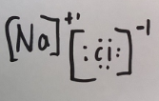
23. Let’s draw the Lewis dot diagrams for the atoms, the ions, and then the compound.
SEPARATE SEPARATE SNUGGLY
ATOMS ONLY IONS ONLY COMPOUND
The electron transfers
Always slightly askew.

Slide 51
24. Na atom changes from a 2-8-1 electron configuration to “2-8-0”, or really -- just 2-8 It loses, or transfers, one electron away, it becomes isoelectric to neon. 2-8-1 → 2-8 + 1e⁻
25. Sodium loses enough electrons to get the “perfect outer orbital”, same as the noble gases. Noble gases have perfect, or the most stable electron orbitals of all atoms.

Slide 52
26. The Cl atom has a 2-8-7 configuration. It gains an electron, to becomes the Cl⁻¹ anion with a 2-8-8 electron configuration. 2-8-7 + 1e⁻ → 2-8-8 isoelectric to argon
27. Both ions (Na⁺¹ & Cl⁻¹) get the perfect valence orbitals. Both ions become isoelectric to noble gases.

Slide 53
28. Ions tend to follow the octet rule.
29. The octet rule is that ions end up with 8 valence electrons (full outer orbitals). Ionic Bonding usually follows this rule. Most covalent bonds also follow this rule.
30. This is a rule, not a law. There are exceptions: some ions are too small for 8 electrons like Li⁺¹, or small atoms like H or B (boron is a moron)
There are other exceptions!

Slide 54
31. Fill in this chart…
Compound name | Compound Formula | Cation | Anion | Lewis Dot Diagram (with electron configurations)
Magnesium oxide
Lithium fluoride
Calcium chloride

Slide 55
31. Fill in this chart!
Compound name | Compound Formula | Cation | Anion | Lewis Dot Diagram (with electron configurations)
Magnesium oxide | MgO | Mg⁺² | O⁻²
Lithium fluoride
Calcium chloride

Slide 56
See how the ions are SNUGGLY? Ionic bonds are the tightest bond in chemistry.
Compound name | Compound Formula | Cation | Anion | Lewis Dot Diagram (with electron configurations)
Magnesium oxide | MgO | Mg⁺² | O⁻² | (Mg⁺² is 2-8 O⁻² is 2-8)
Lithium fluoride
Calcium chloride

Slide 57
Keep going…
Compound name | Compound Formula | Cation | Anion | Lewis Dot Diagram (with electron configurations)
Magnesium oxide | MgO | Mg⁺² | O⁻² | (Mg⁺² is 2-8 O⁻² is 2-8)
Lithium fluoride | LiF | Li⁺¹ | F⁻¹
Calcium chloride

Slide 58
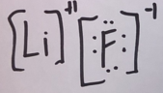
Cations end up with EMPTY valence orbitals, Anions end up with FULL octets.
Compound name | Compound Formula | Cation | Anion | Lewis Dot Diagram (with electron configurations)
Magnesium oxide | MgO | Mg⁺² | O⁻² | (Mg⁺² is 2-8 O⁻² is 2-8)
Lithium fluoride | LiF | Li⁺¹ | F⁻¹ | (Li⁺¹ is 2 F⁻¹ is 2-8)
Calcium chloride

Slide 59
This one will not be in a 1:1 ratio, stay sharp here.
Compound name | Compound Formula | Cation | Anion | Lewis Dot Diagram (with electron configurations)
Magnesium oxide | MgO | Mg⁺² | O⁻² | (Mg⁺² is 2-8 O⁻² is 2-8)
Lithium fluoride | LiF | Li⁺¹ | F⁻¹ | (Li⁺¹ is 2 F⁻¹ is 2-8)
Calcium chloride | CaCl₂ | Ca⁺² | Cl⁻¹

Slide 60
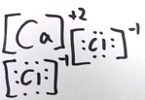
VOILA! You are now an ionic bonder!
Compound name | Compound Formula | Cation | Anion | Lewis Dot Diagram (with electron configurations)
Magnesium oxide | MgO | Mg⁺² | O⁻² | (Mg⁺² is 2-8 O⁻² is 2-8)
Lithium fluoride | LiF | Li⁺¹ | F⁻¹ | (Li⁺¹ is 2 F⁻¹ is 2-8)
Calcium chloride | CaCl₂ | Ca⁺² | Cl⁻¹ | (Ca⁺² is 2-8-8 both Cl⁻¹ are 2-8-8)

Slide 61
Compound name | Compound Formula | Cation | Anion | Lewis Dot Diagram (with electron configurations)
Sodium Sulfide
Cesium oxide
Last two of these.

Slide 62
Compound name | Compound Formula | Cation | Anion | Lewis Dot Diagram (with electron configurations)
Sodium Sulfide | Na₂S | Na⁺¹ | S⁻²
Cesium oxide

Slide 63
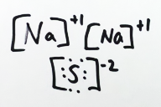
Compound name | Compound Formula | Cation | Anion | Lewis Dot Diagram (with electron configurations)
Sodium Sulfide | Na₂S | Na⁺¹ | S⁻² | (Both Na⁺¹ are 2-8, S⁻² is 2-8-8)
Cesium oxide

Slide 64
Compound name | Compound Formula | Cation | Anion | Lewis Dot Diagram (with electron configurations)
Sodium Sulfide | Na₂S | Na⁺¹ | S⁻² | (Both Na⁺¹ are 2-8, S⁻² is 2-8-8)
Cesium oxide | Cs₂O | Cs⁺¹ | O⁻²

Slide 65
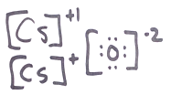
Compound name | Compound Formula | Cation | Anion | Lewis Dot Diagram (with electron configurations)
Sodium Sulfide | Na₂S | Na⁺¹ | S⁻² | (Both Na⁺¹ are 2-8, S⁻² is 2-8-8)
Cesium oxide | Cs₂O | Cs⁺¹ | O⁻² | (Both Cs⁺¹ are 2-8-18-18-8, O⁻² is 2-8)

Slide 66
32. Why is the formula for aluminum oxide Al₂O₃ and not some other ratio?
Al O
O
Al
O
Each metal atom is 2-8-3
They need to become 2-8 which is a +3 cation.
The octet rule!
Each nonmetal atom is 2-6
They need to become 2-8
Which is a -2 anion.
Follow the octet rule!

Slide 67
32. Why is the formula for aluminum oxide Al₂O₃ and not some other ratio?
Al O
Al O
O
2 Al’s transfer 6 electrons.
It takes 3 O’s to accept 6 electrons. The lowest ratio to meet this 6 electron transfer is 2:3 or Al₂O₃

Slide 68
33. Draw the UGLY Lewis dot diagram for Magnesium Nitride Aluminum Oxide

Slide 69
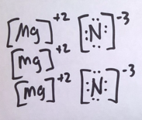
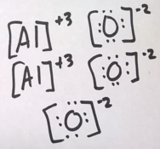
33. Draw the UGLY Lewis dot diagram for Magnesium Nitride Aluminum Oxide

Slide 70
Metallic Bonding
34. First, let’s name a few properties of metals…

Slide 71
Metallic Bonding
34. First, let’s name a few properties of metals… Metals are (you better learn the definitions of these ASAP)
Malleable Ductile Conduct electricity
Form into cations Conduct heat Have higher densities than nonmetals Lustrous Have lower Specific Heat Capacities than nonmetals

Slide 72
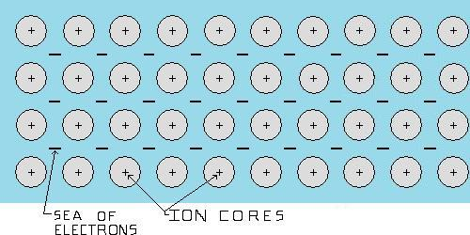
These main properties can be explained by how we “understand” the metals to be bonded together.
35. Metals are understood to be: PACKED CATIONS AWASH IN A SEA OF LOOSE VALENCE ELECTRONS.

Slide 73
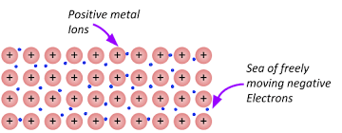
36. Metals are made up of NEUTRAL ATOMS. A “hunk” of metal is neutral. The positive protons are balanced by the negative electrons as in all atoms. # Protons = # Electrons
When the electrons become “loose” the metal remains neutral, but the mobile electrons can move to offset too much positive charge formed when the cations are smashed together.

Slide 74
37. Imagine smashing the metal with a hammer to make the metal exhibit its malleable nature. The cations will be crushed closer together – they would repel from each other causing a crack. The loose valence electrons flow to offset this excess positive charge.
Same when you squish it into a wire.

Slide 75
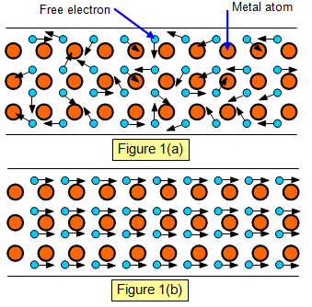
38. Imagine a flow of electrons (electricity) in from the left side. As electrons flow into the metal, there are too many electrons for the cations, so the excess electrons flow out the other side (the flow of electrons is electricity!). Metal… Metal with electrons flowing left → right…

Slide 76
Bonding Class #3
OB: introduction to covalent bonding
40. Covalent bonding is… when 2 or more nonmetals share their valence electrons to bond.
41. Atoms do not transfer electrons, like ions do.

Slide 77
42. Review… with ionic bonding, there is a TRANSFER of ELECTRONS from the METAL cation → NONMETAL anion They follow the octet rule. The Metal comes first in the formula. Ionic compounds come in formula units (FU’s), not molecules.

Slide 78
42. Review… with ionic bonding, there is a TRANSFER of ELECTRONS from the METAL cation → NONMETAL anion They follow the octet rule. The Metal comes first in the formula. Ionic compounds come in formula units (FU’s), not molecules.
43. In Covalent Bonding, there is a SHARING OF VALENCE ELECTRONS THE ATOMS FOLLOW THE OCTET RULE. 44. There are NO METALS in covalent bonds
45. Atoms bond covalently to form molecules

Slide 79
42. Review… with ionic bonding, there is a TRANSFER of ELECTRONS from METAL → NONMETAL They follow the octet rule. The Metal comes first in the formula. Ionic compounds come in formula units (FU’s), not molecules.

Slide 80
46. Molecules form using covalent bonds (sharing electrons) and follow the octet rule almost every time.
47. Let’s draw Lewis Dot Diagrams
H₂
F₂

Slide 81
46. Molecules form using covalent bonds (sharing electrons) and follow the octet rule almost every time.
47. Let’s draw Lewis Dot Diagrams
H₂ H H
F₂
Hydrogen is too small to follow the octet rule. It fills up the baby sized first orbital.

Slide 82
No brackets, these atoms are SHARING electrons.
47. Let’s draw Lewis Dot Diagrams
H₂ H H
F₂ F F
Hydrogen is too small to follow the octet rule. It fills up the baby sized first orbital.
Fluorine follows the octet rule.

Slide 83
48. In covalent bonds, all atoms get to share enough electrons so that they get full valence orbitals at least some of the time.

Slide 84
48. In covalent bonds, all atoms get to share enough electrons so that they get full valence orbitals at least some of the time.
The bonds in H₂ and F₂ are called SINGLE NONPOLAR COVALENT bonds because they only share one pair of electrons (one electron from each atom) AND because there is no difference between their electronegativity values Table S: H has EN Value of 2.2 2.2 – 2.2 = 0 difference F has EN Value of 4.0 4.0 – 4.0 = 0 difference no EN Value difference means that both atoms pull electrons equally, they are shared FAIRLY in the bond.

Slide 85
50. H₂ + F₂ both have SINGLE NONPOLAR COVALENT bonds because in both molecules the atoms share ONE PAIR of ELECTRONS
And… with no EN Value difference, the electrons are shared evenly, there is not a more negative or more positive “side” to the bond.

Slide 86
51. Draw the Lewis Dot Diagram for HCl and name the bond present.

Slide 87
51. Draw the Lewis Dot Diagram for HCl and name the bond present.
Chlorine gets to borrow one electron from hydrogen to fill its larger orbital (octet rule). Hydrogen atoms can’t get “8” electrons, they are too small, but it still follows the fill up my baby sized orbital when I bond rule.
This is a single polar covalent bond.
H Cl
Cl has 7 valence electrons, it needs to “borrow” one to get full.
H has ONE valence electron, it needs to “borrow” one to get full.

Slide 88
52. Draw the Lewis Dot Diagram for H₂O and name the bonds present.

Slide 89
52. Draw the Lewis Dot Diagram for H₂O and name the bond present.
Oxygen borrows one electron from each of the hydrogen atoms, to fill up its larger orbital (oxygen follows the octet rule).
Hydrogen atoms borrow the one electron they need to fill up the baby sized orbital too. Water is bent!
H O H
There are 2 bonds in water, both are SINGLE POLAR COVALENT

Slide 90
H Cl
Another way to draw this, without dots is called a structural diagram.
With a structural diagram, we only show the bonds, a short line indicates the sharing of one pair of electrons.
A single dash represents a single covalent bond.
53. Draw both molecules as structural diagrams.
H O H

Slide 91
53. Structural Diagrams
H Cl H―Cl
H O H
H―O
H
WATER has turned in space. Molecules can move and orient in “any direction”.
Each “dash” represents one pair of shared electrons.

Slide 92
54. For AMMONIA (NH₃) Draw the Lewis Dot and the Structural Diagram. NAME THE BONDS TOO.
Think first:
Nitrogen has 5 valence electrons, and they will be paired up in a Lewis dot diagram (and real life) because this is more stable.
To bond, one pair of electrons will have to “open up”, so N can connect with the 3 hydrogen atoms.
N

Slide 93
54. For AMMONIA (NH₃) Draw the Lewis Dot and the Structural Diagram. NAME THE BONDS TOO.
Think first:
N
2 + 2 + 1 changes to a 2 + 1 + 1 + 1 configuration. The nitrogen atom needs “three landing zones” for the 3 H atoms.
H
N
Bring in the 3 hydrogen atoms…
H
H

Slide 94
Nitrogen follows the octet rule, the three H atoms fill up their baby sized orbitals.
H
N
H
H
Ammonia as a Lewis Dot Diagram.

Slide 95
H
N
H
H―N―H
H
H
Ammonia as a Lewis Dot Diagram. Ammonia as a Structural Diagram
Each dash represents the sharing of one pair of electrons, each dash is a SINGLE BOND. Ammonia has three single bonds in each molecule.

Slide 96
3.0
H―N―H
2.2
2.2
H
2.2
Checking electronegativity values,
The difference of electronegativity in each of these bonds is 3.0 – 2.2 = 0.8, so… Each of these 3 bonds is single polar covalent

Slide 97
55. Draw Lewis Dot Diagram, and Structural Diagram for Methane, CH₄
Determine exactly what types of bonds are present in this molecule.

Slide 98
Draw Lewis Dot Diagram, and Structural Diagram for Methane, CH₄
Determine exactly what types of bonds are present in this molecule.
H
H
C
H
H

Slide 99
Draw Lewis Dot Diagram, and Structural Diagram for Methane, CH₄
Determine exactly what types of bonds are present in this molecule.
H
H
H
C
H
H―C―H
H
H

Slide 100
Draw Lewis Dot Diagram, and Structural Diagram for Methane, CH₄
Determine exactly what types of bonds are present in this molecule.
H
H
H―C―H
H
C
H
H
H
Electronegativity values of 2.2 for H 2.6 for N
there are 4 single polar covalent bonds in CH₄

Slide 101
No writing here, think: The greater the difference in electronegativity values between two atoms, the greater the polarity of the bond.
Greater EN difference means MORE POLAR bond
Smaller EN difference means LESS POLAR bond
These differences, or their relative strengths allow you to RANK polar bonds as more polar or less polar than others.

Slide 102
56. Fill in this chart, then RANK from the greatest polarity of the bond (1),to the weakest (5).
Molecule formula + name | EN #1 | EN #2 | EN diff | Polarity rank | Structural diagrams
H₂ hydrogen | 2.2 | 2.2 | 0 |  | H―H
PCl₃
OF₂
HBr
HI

Slide 103
56. Fill in this chart, then RANK from the greatest polarity of the bond (1),to the weakest (5).
Molecule formula + name | EN #1 | EN #2 | EN diff | Polarity rank | Structural diagrams
H₂ hydrogen | 2.2 | 2.2 | 0 |  | H―H
PCl₃ phosphorus trichloride
OF₂ oxygen difluoride
HBr hydrogen bromide
HI hydrogen iodide

Slide 104
Molecule formula + name | EN #1 | EN #2 | EN diff | Polarity rank | Structural diagrams
H₂ hydrogen | 2.2 | 2.2 | 0 |  | H―H
PCl₃ phosphorus trichloride | 2.2 | 3.2
OF₂ oxygen difluoride | 3.4 | 4.0
HBr hydrogen bromide | 2.2 | 3.0
HI hydrogen iodide | 2.2 | 2.7

Slide 105
Molecule formula + name | EN #1 | EN #2 | EN diff | Polarity rank | Structural diagrams
H₂ hydrogen | 2.2 | 2.2 | 0 |  | H―H
PCl₃ phosphorus trichloride | 2.2 | 3.2 | 1.0
OF₂ oxygen difluoride | 3.4 | 4.0 | 0.6
HBr hydrogen bromide | 2.2 | 3.0 | 0.8
HI hydrogen iodide | 2.2 | 2.7 | 0.5

Slide 106
Molecule formula + name | EN #1 | EN #2 | EN diff | Polarity rank | Structural diagrams
H₂ hydrogen | 2.2 | 2.2 | 0 | 0 nonpolar | H―H
PCl₃ phosphorus trichloride | 2.2 | 3.2 | 1.0 | 1 most polar | Cl―P―Cl
OF₂ oxygen difluoride | 3.4 | 4.0 | 0.6 | 3
HBr hydrogen bromide | 2.2 | 3.0 | 0.8 | 2 2nd most polar | H―Br
HI hydrogen iodide | 2.2 | 2.7 | 0.5 | 4 | H―I
Cl
O
F
F

Slide 107
57. Draw two Lewis Dot diagrams of oxygen atoms to start our thinking.
O O
58. How many electrons does EACH atom of oxygen need to complete the octet? Can they do this for each other?

Slide 108
57. Draw two Lewis Dot diagrams of oxygen atoms to start our thinking.
O O
58. How many electrons does EACH atom of oxygen need to complete the octet? Can they do this for each other?
They both “need” to borrow 2 electrons to become isoelectric to a noble gas. * and yes, they can!

Slide 109
59. Draw the Lewis Dot diagram for oxygen and memorize this forever.
O₂ is O O or O=O
DOUBLE NONPOLAR COVALENT BOND Why is this a NONPOLAR bond? _____

Slide 110
O O is this: O=O
DOUBLE NONPOLAR COVALENT BOND This a NONPOLAR bond because there is NO Difference in EN Value between the both oxygen atoms.
3.4 – 3.4 = 0 difference

Slide 111
Bonding Class #4
OB: become masterful with both the Double and the Triple Covalent Bonds, and to get more practice drawing structural diagrams for larger molecules

Slide 112
60. Looking at the HONClBrIF twins, in order, let’s figure out the kinds of bonds that they all have (draw structural diagrams first)
H₂
O₂
Cl₂
Br₂
I₂
F₂

Slide 113
60. Looking at the HONClBrIF twins, in order, let’s figure out the kinds of bonds that they all have (draw structural diagrams first)
H₂ | H―H
O₂ | O=O
Cl₂ | Cl―Cl
Br₂ | Br―Br
I₂ | I―I
F₂ | F―F

Slide 114
60. Looking at the HONClBrIF twins, in order, let’s figure out the kinds of bonds that they all have (draw structural diagrams first)
H₂ | H―H | Single non-polar covalent
O₂ | O=O | Double non-polar covalent
Cl₂ | Cl―Cl | Single non-polar covalent
Br₂ | Br―Br | Single non-polar covalent
I₂ | I―I | Single non-polar covalent
F₂ | F―F | Single non-polar covalent

Slide 115
61. Draw a Lewis Dot Diagram for a nitrogen atom | How many electrons does each atom need to meet the octet rule? | Draw a Lewis Dot Diagram for another nitrogen atom
62. Draw a molecule of nitrogen in this box

Slide 116
61. Draw a Lewis Dot Diagram for a nitrogen atom N | How many electrons does each atom need to meet the octet rule? Each nitrogen atom needs to gain 3 electrons for an octet. | Draw a Lewis Dot Diagram for another nitrogen atom N
62. Draw a molecule of nitrogen in this box

Slide 117
61. Draw a Lewis Dot Diagram for a nitrogen atom N | How many electrons does each atom need to meet the octet rule? Each nitrogen atom needs to gain 3 electrons for an octet. | Draw a Lewis Dot Diagram for another nitrogen atom N
62. Draw a molecule of nitrogen in this box
N N
N N
Lewis Dot Diagram and structural diagram. This is a triple nonpolar covalent bond.

Slide 118
Nitrogen makes a triple nonpolar covalent bond because…
Each atom of nitrogen needs to “borrow” 3 electrons from the other, so they share three pairs of electrons sharing three pairs = triple bond
Since each Nitrogen atom has an electronegativity of 3.0, there is NO DIFFERENCE in electronegativity values, these bond is NONPOLAR.

Slide 119
Let’s draw electron dot diagrams and then STRUCTURAL diagrams for these compounds. The first one is called ETHANE, with a formula of:
DOTS Structural
C₂H₆

Slide 120
Let’s draw electron dot diagrams and then STRUCTURAL diagrams for these compounds. The first one is called ETHANE, with a formula of:
DOTS Structural
C₂H₆
H H
C C
H
H
H H
C-C bonds are single nonpolar covalent
C-H bonds are single polar covalent

Slide 121
Let’s draw electron dot diagrams and then STRUCTURAL diagrams for these compounds. The first one is called ETHANE, with a formula of:
DOTS Structural
C₂H₆
H H
H H
C C
H
H
H―C―C―H
H H
H H
C-C bonds are single nonpolar covalent
C-H bonds are single polar covalent

Slide 122
65. Let’s draw electron dot diagrams and then STRUCTURAL diagrams for these compounds. This one is called ETHENE, with a formula of:
DOTS Structural
C₂H₄

Slide 123
65. Let’s draw electron dot diagrams and then STRUCTURAL diagrams for these compounds. This one is called ETHENE, with a formula of:
DOTS Structural
C₂H₄
H H
C C
H H
C=C bonds are double nonpolar covalent
C-H bonds are single polar covalent

Slide 124
65. Let’s draw electron dot diagrams and then STRUCTURAL diagrams for these compounds. This one is called ETHENE, with a formula of:
DOTS Structural
C₂H₄
H H
H H
C C
C C
H H
H H
C=C bonds are double nonpolar covalent
C-H bonds are single polar covalent

Slide 125
66. Let’s draw electron dot diagrams and then STRUCTURAL diagrams for these compounds. This is ETHYNE, with a formula of:
DOTS Structural
C₂H₂

Slide 126
66. Let’s draw electron dot diagrams and then STRUCTURAL diagrams for these compounds. This is ETHYNE, with a formula of:
DOTS Structural
C₂H₂
H
C C
H
C≡C bonds are triple nonpolar covalent
C-H bonds are single polar covalent

Slide 127
66. Let’s draw electron dot diagrams and then STRUCTURAL diagrams for these compounds. This is ETHYNE, with a formula of:
DOTS Structural
C₂H₂
C C
H―C C―H
H
H
C≡C bonds are triple nonpolar covalent
C-H bonds are single polar covalent

Slide 128
67. Let’s draw electron dot diagrams and then STRUCTURAL diagrams for these compounds. This one is called PROPANE, with a formula of:
DOTS Structural
C₃H₈

Slide 129
67. Let’s draw electron dot diagrams and then STRUCTURAL diagrams for these compounds. This one is called PROPANE, with a formula of:
DOTS Structural
C₃H₈
H H
H
H
C C C
H
H H
H
C-C bonds are single nonpolar covalent
C-H bonds are single polar covalent

Slide 130
67. Let’s draw electron dot diagrams and then STRUCTURAL diagrams for these compounds. This one is called PROPANE, with a formula of:
DOTS Structural
C₃H₈
H H
H
H H H
H
C C C
H
H―C―C―C―H
H H
H
H H H
C-C bonds are single nonpolar covalent
C-H bonds are single polar covalent

Slide 131
68. Let’s draw electron dot diagrams and then STRUCTURAL diagrams for these compounds. This one is called CARBON DIOXIDE, with a formula of:
DOTS Structural
CO₂

Slide 132
68. Let’s draw electron dot diagrams and then STRUCTURAL diagrams for these compounds. This one is called CARBON DIOXIDE, with a formula of:
DOTS Structural
CO₂
O
O
C
Both the O=C are double polar covalent bonds
Carbon dioxide is a STRAIGHT-LINE molecule which you need to remember.

Slide 133
68. Let’s draw electron dot diagrams and then STRUCTURAL diagrams for these compounds. This one is called CARBON DIOXIDE, with a formula of:
DOTS Structural
CO₂
O
O
C
O=C=O
Both the O=C are double polar covalent bonds
Carbon dioxide is a STRAIGHT-LINE molecule which you need to remember.

Slide 134
69. Let’s draw electron dot diagrams and then STRUCTURAL diagrams for these compounds. This one is called ARSENIC TRICHLORIDE, with a formula of:
DOTS Structural
AsCl₃

Slide 135
69. Let’s draw electron dot diagrams and then STRUCTURAL diagrams for these compounds. This one is called ARSENIC TRICHLORIDE, with a formula of:
DOTS Structural
AsCl₃
Cl
As
Cl
Cl
All three of the As–Cl bonds are single polar covalent bond

Slide 136
69. Let’s draw electron dot diagrams and then STRUCTURAL diagrams for these compounds. This one is called ARSENIC TRICHLORIDE, with a formula of:
DOTS Structural
AsCl₃
Cl
As
Cl
Cl―As―Cl
Cl
Cl
All three of the As–Cl bonds are single polar covalent bond

Slide 137
70. Let’s draw electron dot diagrams and then STRUCTURAL diagrams for these compounds. This one is called BUTANE, with a formula of:
DOTS Structural
C₄H₁₀

Slide 138
70. Let’s draw electron dot diagrams and then STRUCTURAL diagrams for these compounds. This one is called BUTANE, with a formula of:
DOTS Structural
C₄H₁₀
At some point, and I have reached this point, I’m done with dots. I promise to remember carbon MUST make 4 bonds, and that hydrogen can only make 1 bond. The dots are for thinking, we have thought about this enough, no more dots because we are smart, and we will remember this.
If you forget how to count to 4, and you will, you can’t belly ache about it.
H H H H
H―C―C―C―C―H
H H H H
The C―C bonds are all single nonpolar covalent
the C―H bonds are all single polar covalent too.

Slide 139
71. Let’s draw electron dot diagrams and then STRUCTURAL diagrams for these compounds. This one is called OXYGEN DIBROMIDE, with a formula of:
DOTS Structural
OBr₂

Slide 140
71. Let’s draw electron dot diagrams and then STRUCTURAL diagrams for these compounds. This one is called OXYGEN DIBROMIDE, with a formula of:
DOTS Structural
OBr₂
O
Br
Br
These bonds are SINGLE POLAR COVALENT bonds.
Electronegativity difference: 3.4 - 3.0 = 0.4
Just like with water, when one oxygen atoms bonds to 2 other atoms, the molecule is BENT.

Slide 141
71. Let’s draw electron dot diagrams and then STRUCTURAL diagrams for these compounds. This one is called OXYGEN DIBROMIDE, with a formula of:
DOTS Structural
OBr₂
O
Br
O
Br
Br
Br
These bonds are SINGLE POLAR COVALENT bonds.
Electronegativity difference: 3.4 - 3.0 = 0.4
Just like with water, when one oxygen atoms bonds to 2 other atoms, the molecule is BENT.

Slide 142
72. Let’s draw electron dot diagrams and then STRUCTURAL diagrams for these compounds. This is called CARBON TETRACHLORIDE, with a formula of:
DOTS Structural
CCl₄

Slide 143
72. Let’s draw electron dot diagrams and then STRUCTURAL diagrams for these compounds. This is called CARBON TETRACHLORIDE, with a formula of:
DOTS Structural
CCl₄
Cl
Cl
C
Cl
Cl
The EN difference between Cl–C is 3.2 – 2.6 = 0.6 These are FOUR single polar covalent bonds.

Slide 144
72. Let’s draw electron dot diagrams and then STRUCTURAL diagrams for these compounds. This is called CARBON TETRACHLORIDE, with a formula of:
DOTS Structural
CCl₄
Cl
Cl
Cl
C
Cl
Cl―C―Cl
Cl
Cl
The EN difference between Cl–C is 3.2 – 2.6 = 0.6 These are FOUR single polar covalent bonds.

Slide 145
73. Draw a Lewis Dot diagram for CaO calcium oxide, and tell what sort of bond or bonds are present.
CaO

Slide 146
73. Draw a Lewis Dot diagram for CaO calcium oxide, and tell what sort of bond or bonds are present.
CaO
+2
[Ca]
[ O ]
-2
These are IONIC BONDS. They’re NOT double bonds. The positive charge (+2) matches to the negative charge (-2) They must sum to zero and they do sum to zero.

Slide 147
Bonding Class #5
OB: Random Vocabulary, more practice with Lewis Dot diagrams, Structural Diagrams, and we get to meet the weird hybrid bonds of ozone, carbon monoxide, PCl₅, and NO₂
Fresh minds, periodic tables at the ready!

Slide 148
ALLOYS
74. Alloys are MIXTURES of either 2 or more metals, OR metals + nonmetals. They are not chemically bonded!
They get mixed most often by melting them together since metals are solids and don’t mix well otherwise.

Slide 149
ALLOYS
74. Alloys are MIXTURES of either 2 or more metals, OR metals + nonmetals. They are not chemically bonded!
They get mixed most often by melting them together since metals are solids and don’t mix well otherwise.
The ALLOY is not a new substance.
An ALLOY is a mixture of the original substances. The alloy has different properties than the original substances because they pack together in a different way, often “tighter”.
Most alloys are made for strength, non-corrosiveness, or beauty.

Slide 150
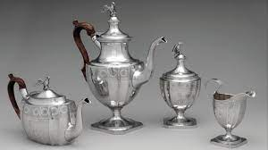
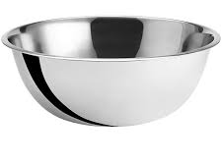
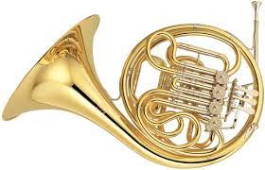
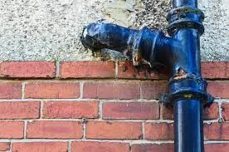
75. Examples of ALLOYS:
Sterling Silver made from SILVER + COPPER for strength
Cast Iron (IRON + CARBON) for strength and non-corrosiveness
Stainless steel (Fe + Cr) for strength and non-corrosiveness
Brass (ZINC + COPPER) for durability, beauty, and French horns.

Slide 151
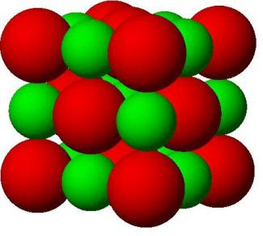
76. Coordination numbers in ionic solids.
Metals will only make IONIC bonds with nonmetals, like NaCl.
Each Na⁺¹ cation is surrounded by 6 Cl⁻¹ ions.
The reverse is also true,
Each Cl⁻¹ ion is surrounded by 6 Na⁺¹ cations

Slide 152
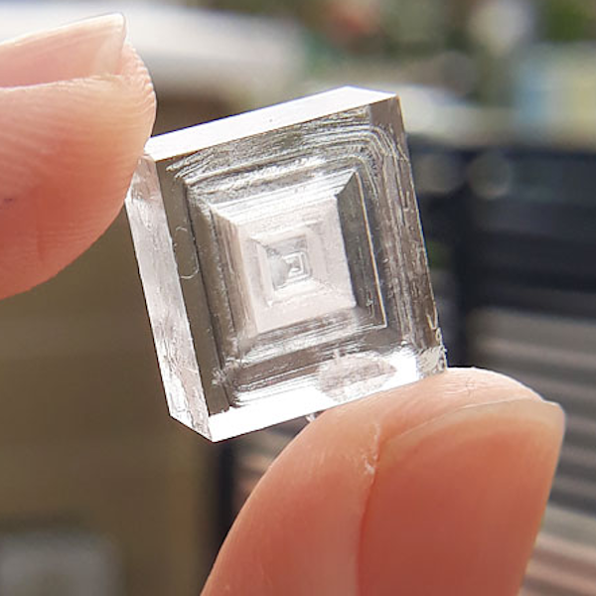
76. Coordination numbers in ionic solids.
Each Na⁺¹ cation is surrounded by 6 Cl⁻¹ ions.
Each Cl⁻¹ ion is surrounded by 6 Na⁺¹ cations
The sodium has a coordination number of 6.
The chloride also has a coordination number of 6.
77. Since both coordination numbers are 6, NaCl has a nice boxy shape.

Slide 153
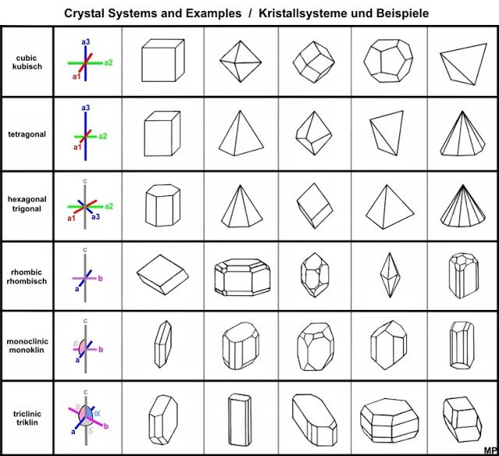
78.
Different Coordination Numbers form into different shaped crystals.

Slide 154
79. Coordination number the number of the “different” kind of ions surrounding one kind of ion in an ionic solid.

Slide 155
Let’s work on carbon monoxide now. How does it bond together?
CO₂ is so important, it’s a straight-line molecule with two double polar covalent bonds, but what about CO?
80. Start with the atom Lewis Dot Diagrams…
C O

Slide 156
This is incorrect, but a good “start” to your thinking about how this will work.
C O
80. Carbon monoxide makes a double polar covalent (and)…
Oxygen gets an octet, but carbon ends up with only 6 electrons, which is NOT okay.

Slide 157
C O
To make this work, the oxygen will “COORDINATE” things so that carbon can feel like it gets an octet too.
Then oxygen lends 2 more electrons to the middle of the molecule, forming what is called a …
C O

Slide 158
Carbon and oxygen first for a double polar covalent bond, then…
oxygen lends 2 more electrons to the middle of the molecule, forming what is called a COORDINATE COVALENT bond
C O

Slide 159
C O
81. The shorthand for this type of bond C=O 82. CO forms a double polar covalent bond AND a coordinate covalent bond.
~

Slide 160
83. Phosphorus pentachloride is up next, a real weirdo molecule…
It’s used as part of fertilizer preparation, and other chemical reactions. Common in chemistry world, new to you. Draw the dot diagram.

Slide 161
P
83.
Phosphorus Pentachloride PCl₅
Cl
Cl
Cl
Cl
Cl
This breaks the octet rule -- phosphorous ends up with TEN valence electrons, which is 2 too many! It’s an exception to the octet rule.

Slide 162
84. Boron has an electron configuration of 2-3
BF₃ strangely only make 3 bonds, which gives it just 6 total valence electrons, not an octet. Boron breaks the octet rule with TOO FEW ELECTRONS.
That’s okay for this exceptional atom (boron rhymes with … ☺)

Slide 163
John Adams High School, in Ozone Park, New York City. I graduated in 1978 on that sidewalk out in front of the school. We had 2 graduations that day, 975 kids and families were too many for one ceremony!

Slide 164
My sister and my brother both worked here, and they had the best crumb buns in the world. And the cookies were fab too.
Those stairs go up to the A train to Manhattan. In Queens this train runs on elevated tracks (called the EL). In Brooklyn and Manhattan this train runs underground (the subway)

Slide 165
85. Ozone and Oxygen, both pure oxygen, one you breathe to live, one you breathe to die. (sorry). O₃ vs. O₂
You already know oxygen has a double nonpolar covalent bond. No need to review, right?

Slide 166
85. Ozone and Oxygen, both pure oxygen, one you breathe to live, one you breathe to die. (sorry). O₃ vs. O₂
You already know oxygen has a double nonpolar covalent bond. No need to review, right?
86. Ozone is an ALLOTROPE of oxygen.
87. Allotropes are pure forms of an element but due to different bonding, they have different properties.

Slide 167
88
O
O
O
O
O
O
With ozone (and some other molecules, like NO₂) the electrons can’t get full octets all around. In this case, the oxygen atoms become “most” stable by making a double bond and a sort of single bond.
89. Originally it was described this way: the stable and unstable sides of the ozone bonds would “RESONATE” back and forth. Ozone has a resonating bond.

Slide 168
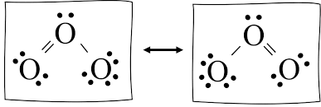
Draw this
O
O O
90. In reality, this switching back and forth is constant, and becomes, two “1½ bonds” all the time. Scientists know this because they can measure the bond lengths. Single bonds are longer than double bonds. These “resonating” bonds are 1½ sized all the time.
91. In reality, the valence electrons in ozone are shared between all 3 atoms in ozone, which is hard to draw, to describe, and breaks the rules. Getting the ozone bonding, the RESONATING bond correct on the regents is a personal thing for me. If you have any kindness in your heart for me, please remember this hybrid!

Slide 169
Bonding Class #6
92. Intermolecular Bonding: the weak attractions between molecules, they are much weaker than ionic or covalent bonds, or metallic bonds, but they are important and have a real effect on the compounds

Slide 170
93. There are three kinds of INTERMOLECULAR BONDS, These bonds are formed by the molecules with each other. These are all MUCH WEAKER than the inside the compound bonds, but they are important.

Slide 171
94. Weakest to strongest they are: electron dispersion force dipole interaction hydrogen bonding

Slide 172
95. The weakest is the electron dispersion force. It’s caused by the constant movement of the electrons in atoms, or in compounds. Sometimes it’s called Electron Dispersion Attraction. It’s best observed in group 17. All 4 of the halogens are diatomic, all have nonpolar bonds, but are gases, liquid, or solid at room temperature, due to the electron dispersion attraction

Slide 173
96 Example one: fluorine F₂
Each of these F₂ molecules has a 2-7 doubled electron configuration. Each atom has 9 electrons, the molecules have 18 electrons.
When these electrons all “move” to one side, for a nanosecond, there will be a temporary dipole created, a positive side, and a negative side of the molecule.
This allows for the weakest of temporary attractions to exist.
F₂ is a gas at STP, because at STP, the kinetic energy exceeds the attractive force of the electron dispersion attraction, so it’s a GAS.

Slide 174
Each Cl atom has a 2-8-7 electron configuration. Molecules of Cl₂ have 34 electrons.
When these electrons all “move” to one side, for a nanosecond, there are stronger temporary dipoles created. Stronger with Cl₂ than F₂, but not enough to make a difference at 273 K
Cl₂ is a gas at STP, because the kinetic energy exceeds the attractive force of the electron dispersion forces, chlorine is a
Electron Dispersion forces.
Example two: Chlorine Cl₂
GAS

Slide 175
Each Br atom has a 2-8-18-7 electron configuration. Br₂ molecules have 70 electrons!
These electrons all shift about so much that when a dipole is temporarily created, it’s much stronger than with F₂ or Cl₂.
At STP, electron dispersion force is strong enough to make Br₂ a liquid!
The weak but constant intermolecular attractions accumulate. This will impact the phase of the substance.
The 273 Kelvin kinetic energy cannot overcome the intermolecular attractions, Br₂ is a liquid at STP
Electron Dispersion forces.
Example 3: Bromine Br₂

Slide 176
Each of these I₂ molecules has 106 total electrons.
The electrons shift around so much, that a stronger temporary dipole forms so often that these I₂ molecules have the most moments of attraction of the halogens.
Although it is weak, so much electron dispersion attraction exists in I₂, they make I₂ a solid at STP.
The kinetic energy at 273 K DOES NOT exceed the attractive force of the electron dispersion forces, so Iodine is a SOLID
Electron Dispersion forces.
Example 4: Iodine I₂

Slide 177
97. At STP: The halogens, of group 17 can be
98. The difference in phases is only due to the amount of intermolecular attraction called the ELECTRON DISPERSION FORCE It’s caused by the temporary dipoles resulting from the momentary, random “dispersion” of the electrons.
Gas | F₂ & Cl₂
Liquid | Br₂
Solid | I₂

Slide 178
dipole attraction
99. A dipole occurs when a molecule has polar bonds and does not have radial symmetry. These form a near permanent dipole.

Slide 179
100a. Draw the Dipole Arrows for SCl₂ Does this molecule have radial symmetry?
S
Cl Cl

Slide 180
100a. Draw the Dipole Arrows for SCl₂ Does this molecule have radial symmetry?
This molecule has polar bonds, Cl has a higher electronegativity than the S.
The molecule DOES NOT have radial symmetry, it is a polar molecule.
The + and – sides are near permanently polar.
This creates a DIPOLE (2 poles, opposite charge).
S
Cl Cl

Slide 181
100b. Draw the Dipole Arrows for CH₄ Does this molecule have radial symmetry?
H
H C H
H

Slide 182
100b. Draw the Dipole Arrows for CH₄ Does this molecule have radial symmetry?
H
H C H
H
This molecule has polar bonds, C has a higher electronegativity than the H.
The molecule DOES have radial symmetry, it is a NONPOLAR molecule.
The whole outside of the molecule is balanced, not polar.
This molecule does NOT HAVE a DIPOLE

Slide 183
101. In SCl₂, the bonds are single polar covalent. The molecule itself is polar because it does not have radial symmetry. So, the sulfur will become positively charged most of the time, and the chlorine atoms will be negative most of the time.
+
This is a polar molecule with polar bonds.
It’s a dipole.
S
Cl Cl
–
–

Slide 184
102. Methane, which has polar bonds too, but it has radial symmetry.
Radial symmetry offsets that bond polarity, the molecule is nonpolar. This molecule can be cut in half AT ANY ANGLE and you get 2 equal halves.
This has radial symmetry The polar bonds are “BALANCED”
H
H C H
H

Slide 185
103. SCl₂ is a liquid at room temperature while CH₄ is a gas. Why???

Slide 186
103. SCl₂ is a liquid at room temperature while CH₄ is a gas. Why??? SCl₂ has dipole attraction, which is stronger than the kinetic energy shaking them at STP. It also has electron dispersion attraction (which is so much weaker than dipole attraction it doesn’t really matter).
CH₄ only has electron dispersion attraction with 10 electrons in total (not dipole attraction). Electron dispersion is too weak to hold these methane molecules together at STP.

Slide 187
104. Draw 5 SCl₂ molecules. Show the dipole attractions differently than the single polar covalent bonding.
S
Cl Cl

Slide 188
104. Draw 5 SCl₂ molecules. Show the dipole attractions differently than the single polar covalent bonding.
S
Cl Cl
S
Cl Cl
S
Cl Cl
S
Cl Cl
S
Cl Cl

Slide 189
105. Hydrogen bonding is exactly the same as dipole attraction, but hydrogen atoms must be present in the molecule.

Slide 190
106. H has a much smaller electronegativity value than most other atoms, so when it’s involved the dipole it creates is usually much stronger than when it’s missing.
The dipole of water is so much stronger than the dipole of sulfur dichloride because of the great difference in the electronegativity values. It’s so big, it gets a new name.
compound | atom 1 electronegativity | atom 1 electronegativity | Electronegativity difference | How polar are these molecules?
H₂O | H 2.2 | O 3.4 | 1.2 | More polar
SCl₂ | S 2.6 | Cl 3.2 | 0.6 | Less polar

Slide 191
107. The water has such a super–duper strong dipole, we give it a new name… hydrogen bonding.
S
Cl Cl
O
H H
Electronegativity values and differences
S 2.6 Cl 3.2 diff = 0.6 H 2.2 O 3.4 diff = 1.2 (! Huge)
SCl₂ has dipole attraction H₂O has super duper dipole which is called HYDROGEN BONDING

Slide 192
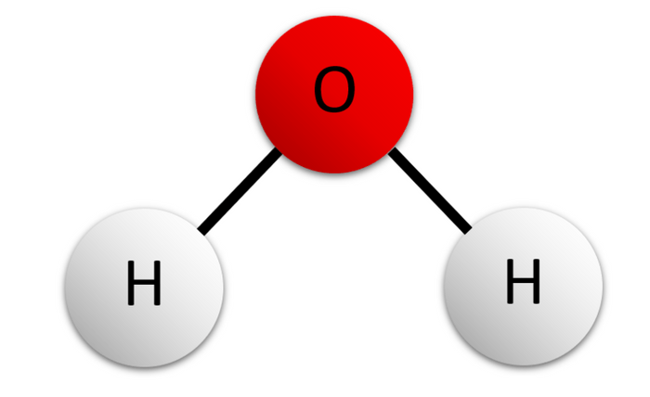
108. Draw SIX molecules of water like this one (randomly) then put in the hydrogen bonding between them…
–
+
+

Slide 193
108. Positive Hydrogen atoms attract to negative Oxygen atoms.
–
–
+
+
+
+
–
–
+
+
There are billions of hydrogen bonds in a glass of water. They hold the water molecules together.
+
+
–
–
+
+
+
+

Slide 194
109. bond type | example formulas
Ionic
Single nonpolar covalent
Single polar covalent
Double nonpolar covalent
Double polar covalent
Triple non polar covalent
Triple polar covalent
Coordinate covalent
Resonant
Ionic + Covalent at the same time
Breaks the octet rule (more than 8e⁻)
Breaks the octet rule (less than 8e⁻)

Slide 195
109. bond type | example formulas
Ionic | NaCl, CaO, KBr, MgO
Single nonpolar covalent | H_{2 ,} F₂, Cl₂, Br₂ H-H, F-F, Cl-Cl, and Br-Br
Single polar covalent | HCl, HF, HBr, HI
Double nonpolar covalent | O₂ O=O
Double polar covalent | CO₂ O=C=O
Triple non polar covalent | N₂ N≡N
Triple polar covalent | HCN (N to C is triple) H-C≡N
Coordinate covalent | CO (double polar cov, PLUS coordinate covalent)
Resonant | O₃ (ozone park!)
Ionic + Covalent at the same time | CuSO₄·5H₂O (also has hydrogen bonding!)
Breaks the octet rule (more than 8e⁻) | PCl₅
Breaks the octet rule (less than 8e⁻) | H₂ or LiF (the lithium) or BF₃

Slide 196
Bonding Class #7
OB: master relative oxidation numbers, review all bonding
A long, long time ago, in a galaxy, far, far away…
110. Relative Oxidation Numbers are those positive and negative numbers in the corners of the NONMETALS on the periodic table.
They help us decide what ratios of atoms to atoms that molecular compounds make.

Slide 197
111. Hydrogen has a +1 and a –1 oxidation number.
Oxygen has only a – 2 oxidation number.
To “make” molecules, you combine atoms to atoms, so that the sum of the oxidation number is zero. These are numbers, not ion charges!

Slide 198
111. Hydrogen has a +1 and a –1 oxidation number.
Oxygen has only a – 2 oxidation number.
To “make” molecules, you combine atoms to atoms, so that the sum of the oxidation number is zero. These are numbers, not ion charges!
H +1 -1
O
-2
Since oxygen is -2, it will take two +1 hydrogen atoms to sum to zero.
That is why the formula is H₂O is good.
That’s why H₃O or HO cannot form.
2:1 = H₂O 2 negative oxidation numbers cannot sum to zero.
The –1 oxidation number is not used here.

Slide 199
112. Determine the relative oxidation numbers in these molecules…
H⁺¹ Cl⁻¹ (+1) + (-1) = 0
C⁺⁴ O⁻² (+4) + 2x(-2) = 0
As⁺³ Cl⁻¹ (+3) + 3x(-1) = 0
BF₃
SiO₂
CO₂

Slide 200
112. Determine the relative oxidation numbers in these molecules…
H⁺¹ Cl⁻¹ (+1) + (-1) = 0
C⁺⁴ O⁻² (+4) + 2x(-2) = 0
As⁺³ Cl⁻¹ (+3) + 3x(-1) = 0
BF₃ | B⁺³ F⁻¹ F⁻¹ F^{-1 = zero}
SiO₂ | Si ⁺⁴ O⁻² O⁻² ^{= zero}
CO₂ | C⁺⁴ O⁻² O⁻² ^{= zero}

Slide 201
ex | Sulfur dioxide | SO₂ | S⁺⁴ O⁻² O^{-2 = zero}
ex | Chromate ion | CrO₄⁻² | Cr⁺⁶ O⁻² O⁻² O⁻² O⁻² ⁼ ⁻²

Slide 202
First put in the FORMULAS, then the relative oxidation numbers.
114 | Permanganate ion
115 | ammonia
116 | Sodium hydroxide
117 | Potassium chlorate
118 | Carbon monoxide
119 | Carbon dioxide

Slide 203
120 | Dihydrogen sulfate
121 | Nitrate ion
122 | Nitrogen dioxide
123 | Phosphorus trichloride

Slide 204
114 | Permanganate ion | MnO₄⁻¹ | Mn⁺¹ O⁻² O⁻² O⁻² O⁻² ⁼ ⁻¹
115 | ammonia | NH₃ | N⁻³ H⁺¹ H⁺¹ H⁺¹ ⁼ ⁰
116 | Sodium hydroxide | NaOH | Na⁺¹ O⁻² H⁺¹ ⁼ ⁰
117 | Potassium chlorate | KClO₃ | K⁺¹ Cl⁺⁵ O⁻² O⁻² O⁻² ⁼ ⁰
118 | Carbon monoxide | CO | C⁺² O⁻² ⁼ ⁰
119 | Carbon dioxide | CO₂ | C+4 O⁻² O⁻² ⁼ ⁰
120 | Dihydrogen sulfate | H₂SO₄ | H⁺¹ H⁺¹ S⁺⁶ O⁻² O⁻² O⁻² O⁻² ⁼ ⁰
121 | Nitrate ion | NO₃⁻¹ | N⁺⁵ O⁻² O⁻² O⁻² ⁼ ⁻¹
122 | Nitrogen dioxide | NO₂ | N⁺⁴ O⁻² O⁻² ⁼ ⁰
123 | Phosphorus trichloride | PCl₃ | P⁺³ Cl⁻¹ Cl⁻¹ Cl⁻¹ ⁼ ⁰

Slide 205
124. Explain the difference between bond polarity and molecular polarity. Who has the guts to stand and orate this answer?

Slide 206
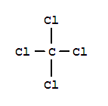
124. Bond polarity is due to a difference in electronegativity between two bonding atoms. For covalent bonds we have to check table S.
Molecular polarity has to do with molecular shape.
If a molecule has radial symmetry, it is a nonpolar molecule.
A molecule that doesn’t exhibit radial symmetry is polar.
A polar molecule water A nonpolar molecule CCl₄

Slide 207
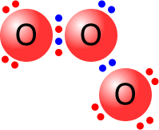
125. The bonds in ozone O₃ resonate back and forth, they are exceptional bonds called RESONATING BONDS.
In reality the bonds are “both” 1½ sized!

Slide 208
126. Once and for all, with a Lewis dot diagram, and one sentence, explain how carbon monoxide bonds together.
C O

Slide 209
C O
It’s called a double polar covalent bond (the bottom 2 pairs of electrons) and a coordinate covalent bond, which means oxygen just “lends” 2 electrons into the mix so carbon “gets” an octet too. ~
C
O

Slide 210
127 | Question | True or False?
A | Ionic bonds can form single, double or triple bonds.
B | Covalent bonds are always polar.
C | Oxygen molecules have one double polar covalent bond.
D | Nitrogen molecules have one double nonpolar covalent bonds.
E | Hydrogen atoms can make single or double bonds.
F | Nonpolar molecules can’t have polar bonding.
G | Water can sometimes form into a straight–line shape.
H | Oxygen atoms must make double bonds.
I | Molecules with only nonpolar bonds cannot form polar molecules
J | The weakest intermolecular bond is called dipole attraction.

Slide 211
127 | Question | True or False?
A | Ionic bonds can form single, double or triple bonds. | False, just ionic
B | Covalent bonds are always polar.
C | Oxygen molecules have one double polar covalent bond.
D | Nitrogen molecules have one double nonpolar covalent bonds.
E | Hydrogen atoms can make single or double bonds.
F | Nonpolar molecules can’t have polar bonding.
G | Water can sometimes form into a straight–line shape.
H | Oxygen atoms must make double bonds.
I | Molecules with only nonpolar bonds cannot form polar molecules
J | The weakest intermolecular bond is called dipole attraction.

Slide 212
140 | Question | True or False?
A | Ionic bonds can be single, double or triple bonds. | False, just ionic
B | Covalent bonds are always polar bonds. | False, H₂, Cl₂, etc.
C | Oxygen molecules have double polar covalent bonds.
D | Nitrogen molecules have double nonpolar covalent bonds.
E | Hydrogen atoms can make single or double bonds.
F | Nonpolar molecules can’t have polar bonding.
G | Water can sometimes form into a straight–line shape.
H | Oxygen atoms must make double bonds.
I | Molecules with nonpolar bonds only can never be polar molecules
J | The weakest intermolecular bond is called dipole attraction.

Slide 213
140 | Question | True or False?
A | Ionic bonds can be single, double or triple bonds. | False, just ionic
B | Covalent bonds are always polar bonds. | False, H₂, Cl₂, etc.
C | Oxygen molecules have double polar covalent bonds. | False, nonpolar
D | Nitrogen molecules have double nonpolar covalent bonds.
E | Hydrogen atoms can make single or double bonds.
F | Nonpolar molecules can’t have polar bonding.
G | Water can sometimes form into a straight–line shape.
H | Oxygen atoms must make double bonds.
I | Molecules with nonpolar bonds only can never be polar molecules
J | The weakest intermolecular bond is called dipole attraction.

Slide 214
140 | Question | True or False?
A | Ionic bonds can be single, double or triple bonds. | False, just ionic
B | Covalent bonds are always polar bonds. | False, H₂, Cl₂, etc.
C | Oxygen molecules have double polar covalent bonds. | False, nonpolar
D | Nitrogen molecules have double nonpolar covalent bonds. | False, triple
E | Hydrogen atoms can make single or double bonds.
F | Nonpolar molecules can’t have polar bonding.
G | Water can sometimes form into a straight–line shape.
H | Oxygen atoms must make double bonds.
I | Molecules with nonpolar bonds only can never be polar molecules
J | The weakest intermolecular bond is called dipole attraction.

Slide 215
140 | Question | True or False?
A | Ionic bonds can be single, double or triple bonds. | False, just ionic
B | Covalent bonds are always polar bonds. | False, H₂, Cl₂, etc.
C | Oxygen molecules have double polar covalent bonds. | False, nonpolar
D | Nitrogen molecules have double nonpolar covalent bonds. | False, triple
E | Hydrogen atoms can make single or double bonds. | False, just single
F | Nonpolar molecules can’t have polar bonding.
G | Water can sometimes form into a straight–line shape.
H | Oxygen atoms must make double bonds.
I | Molecules with nonpolar bonds only can never be polar molecules
J | The weakest intermolecular bond is called dipole attraction.

Slide 216
140 | Question | True or False?
A | Ionic bonds can be single, double or triple bonds. | False, just ionic
B | Covalent bonds are always polar bonds. | False, H₂, Cl₂, etc.
C | Oxygen molecules have double polar covalent bonds. | False, nonpolar
D | Nitrogen molecules have double nonpolar covalent bonds. | False, triple
E | Hydrogen atoms can make single or double bonds. | False, just single
F | Nonpolar molecules can’t have polar bonding. | False, CH₄ or CCl₄
G | Water can sometimes form into a straight–line shape.
H | Oxygen atoms must make double bonds.
I | Molecules with nonpolar bonds only can never be polar molecules
J | The weakest intermolecular bond is called dipole attraction.

Slide 217
140 | Question | True or False?
A | Ionic bonds can be single, double or triple bonds. | False, just ionic
B | Covalent bonds are always polar bonds. | False, H₂, Cl₂, etc.
C | Oxygen molecules have double polar covalent bonds. | False, nonpolar
D | Nitrogen molecules have double nonpolar covalent bonds. | False, triple
E | Hydrogen atoms can make single or double bonds. | False, just single
F | Nonpolar molecules can’t have polar bonding. | False, CH₄ or CCl₄
G | Water can sometimes form into a straight–line shape. | False, NEVER EVER
H | Oxygen atoms must make double bonds.
I | Molecules with nonpolar bonds only can never be polar molecules
J | The weakest intermolecular bond is called dipole attraction.

Slide 218
140 | Question | True or False?
A | Ionic bonds can be single, double or triple bonds. | False, just ionic
B | Covalent bonds are always polar bonds. | False, H₂, Cl₂, etc.
C | Oxygen molecules have double polar covalent bonds. | False, nonpolar
D | Nitrogen molecules have double nonpolar covalent bonds. | False, triple
E | Hydrogen atoms can make single or double bonds. | False, just single
F | Nonpolar molecules can’t have polar bonding. | False, CH₄ or CCl₄
G | Water can sometimes form into a straight–line shape. | False, NEVER EVER
H | Oxygen atoms must make double bonds. | False, any 2 bonds
I | Molecules with nonpolar bonds only can never be polar molecules
J | The weakest intermolecular bond is called dipole attraction.

Slide 219
140 | Question | True or False?
A | Ionic bonds can be single, double or triple bonds. | False, just ionic
B | Covalent bonds are always polar bonds. | False, H₂, Cl₂, etc.
C | Oxygen molecules have double polar covalent bonds. | False, nonpolar
D | Nitrogen molecules have double nonpolar covalent bonds. | False, triple
E | Hydrogen atoms can make single or double bonds. | False, just single
F | Nonpolar molecules can’t have polar bonding. | False, CH₄ or CCl₄
G | Water can sometimes form into a straight–line shape. | False, NEVER EVER
H | Oxygen atoms must make double bonds. | False, any 2 bonds
I | Molecules with nonpolar bonds only can never be polar molecules | False, NBr₃
J | The weakest intermolecular bond is called dipole attraction.

Slide 220
140 | Question | True or False?
A | Ionic bonds can be single, double or triple bonds. | False, just ionic
B | Covalent bonds are always polar bonds. | False, H₂, Cl₂, etc.
C | Oxygen molecules have double polar covalent bonds. | False, nonpolar
D | Nitrogen molecules have double nonpolar covalent bonds. | False, triple
E | Hydrogen atoms can make single or double bonds. | False, just single
F | Nonpolar molecules can’t have polar bonding. | False, CH₄ or CCl₄
G | Water can sometimes form into a straight–line shape. | False, NEVER EVER
H | Oxygen atoms must make double bonds. | False, any 2 bonds
I | Molecules with nonpolar bonds only can never be polar molecules | False, NBr₃
J | The weakest intermolecular bond is called dipole attraction. | False, electron dispersion

Slide 221
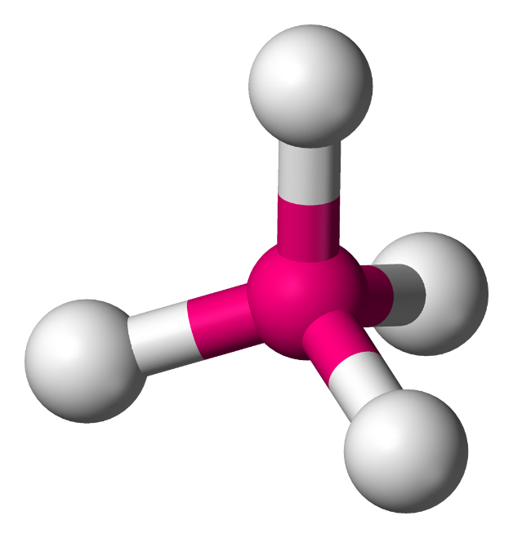
Models of Methane
CH₄

Slide 222
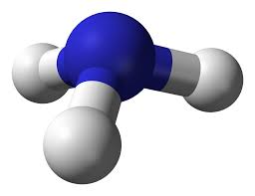
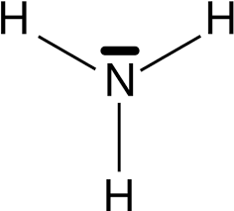
Models of Nitrogen
N₃

Slide 223
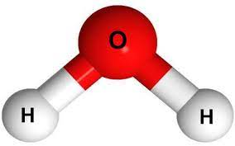
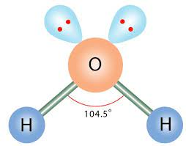
Models of Water
H₂O

Slide 224
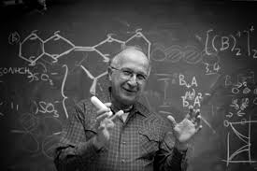
The end (sort of).
I once shook hands with this man, in Vestal High School. It’s a true highlight of my life. He’s Roald Hoffmann, Nobel Prize winner in Chemistry.
He studied bonding. All of it way over my head!

Slide 225
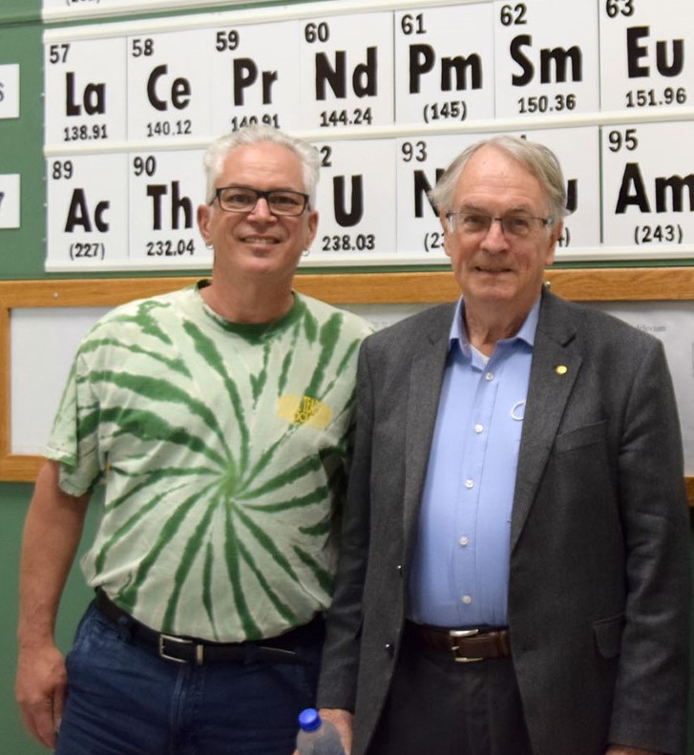
That is me with Stanley Whittingham
He earned his Nobel Prize for his work on the lithium-ion battery.
I understood his work a bit more. I got to shake his hand too.
That’s 2 Chemistry Nobel Prize winners, but who’s counting? (I am!)
So far there have been only 115 Chemistry Prizes awarded (shared by 192 scientists).

