Slide 1
Kinetics Class #1
Objective: Introduction to kinetics and equilibrium chemistry. Four factors that affect the rate of chemical reactions.
Take out reference tables please.

Slide 2
Some reactions are fast, like the very first one you saw on the first day. Some are really fast, remember the synthesis of water?
hydrogen gas + oxygen gas → water + energy

Slide 3
Some reactions are fast, like the very first one you saw on the first day. Some are really fast, remember the synthesis of water?
hydrogen gas + oxygen gas → water + energy
Some are slow, remember the decomposition of H₂O₂?
2. hydrogen peroxide → water + oxygen gas + energy

Slide 4
That second one was SO SLOW that it took a catalyst so we could watch it! 3. The catalyst was potassium iodide. Write it in the equation where it belongs… Hydrogen peroxide water + oxygen gas + E!
4. The CATALYST is not a reactant or product.
KI

Slide 5
5. Kinetics is the part of chemistry that studies the RATES of REACTION

Slide 6
5. Kinetics is the part of chemistry that studies the RATES of REACTION
6. We will again examine reactions that absorb energy when they occur, the ENDOTHERMIC REACTIONS

Slide 7
5. Kinetics is the part of chemistry that studies the RATES of REACTION
6. We will again examine reactions that absorb energy when they occur, the ENDOTHERMIC REACTIONS 7. And their opposites, reactions that emit energy as a product, called EXOTHERMIC REACTIONS

Slide 8
One of the simplest reactions we know is the combustion of methane.
CH_{4(G)} + 2O_{2(G)} → 2H₂O_{(G)} + CO_{2(G)} + energy
We know a lot about this reaction, let’s start naming things:
8. This reaction is _______________

Slide 9
One of the simplest reactions we know is the combustion of methane.
CH_{4(G)} + 2O_{2(G)} → 2H₂O_{(G)} + CO_{2(G)} + energy
We know a lot about this reaction, let’s start naming things:
8. This reaction is COMBUSTION It’s EXOTHERMIC, the heat is a PRODUCT

Slide 10
One of the simplest reactions we know is the combustion of methane.
CH_{4(G)} + 2O_{2(G)} → 2H₂O_{(G)} + CO_{2(G)} + energy
We know a lot about this reaction, let’s start naming things:
8. This reaction is COMBUSTION It’s EXOTHERMIC, the heat is a PRODUCT The heat of reaction (ΔH) is on table I, is –890.4 kJ/mole

Slide 11
One of the simplest reactions we know is the combustion of methane.
CH_{4(G)} + 2O_{2(G)} → 2H₂O_{(G)} + CO_{2(G)} + energy
We know a lot about this reaction, let’s start naming things:
8. This reaction is COMBUSTION It’s EXOTHERMIC, the heat is a PRODUCT The heat of reaction (ΔH) is on table I, is –890.4 kJ/mole 9. The forward reaction is EXOTHERMIC because energy is a PRODUCT.

Slide 12
One of the simplest reactions we know is the combustion of methane.
CH_{4(G)} + 2O_{2(G)} → 2H₂O_{(G)} + CO_{2(G)} + energy
10. At the bottom of Table I it says that “A minus sign (for ΔH) indicates an exothermic reaction.”

Slide 13
CH_{4(G)} + 2O_{2(G)} → 2H₂O_{(G)} + CO_{2(G)} + energy
11. The mole ratio of this equation would be: 1 : 2 : 2 : 1

Slide 14
CH_{4(G)} + 2O_{2(G)} → 2H₂O_{(G)} + CO_{2(G)} + energy
11. The mole ratio of this equation would be: 1 : 2 : 2 : 1
The thermochemical mole ratio would be 1 : 2 : 2 : 1 : 890.4 kJ

Slide 15
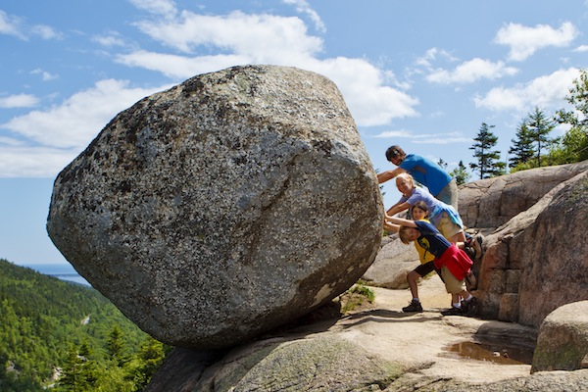
CH_{4(G)} + 2O_{2(G)} → 2H₂O_{(G)} + CO_{2(G)} + energy
12. Why is this chemical reaction irreversible? In high school most chemical reactions are “irreversible” because the energy required to go backwards is just not available. Once the heat comes out of this combustion, that energy is emitted to the Universe and won’t “come back”. Also, heat will not make this go backwards, it would take electricity and catalysts to reverse this. It is reversible, but it can’t go backwards by itself. Like that rock – it won’t go back up the hill by itself.

Slide 16
13

Slide 17
What is different here compared to the combustion of methane?
2H₂O_{(L)} + energy → O_{2(G)} + 2H_{2(G)}
14. Energy is a reactant,

Slide 18
What is different here compared to the combustion of methane?
2H₂O_{(L)} + energy → O_{2(G)} + 2H_{2(G)}
14. Energy is a reactant, this reaction is endothermic +ΔH find it on table I now…

Slide 19
What is different here compared to the combustion of methane?
2H₂O_{(L)} + energy → O_{2(G)} + 2H_{2(G)}
14. Energy is a reactant, this is endothermic +ΔH Wait… is it on table I? What is happening here???

Slide 20
What is different here compared to the combustion of methane?
2H₂O_{(L)} + energy → O_{2(G)} + 2H_{2(G)}
14. Energy is a reactant, this is endothermic +ΔH
15. Table I shows this… 2H_{2(G)} + O_{2(G)} → 2H₂O_{(L)} + -571.6 kJ It’s EXOTHERMIC! (?)

Slide 21
What is different here compared to the combustion of methane?
2H₂O_{(L)} + energy → O_{2(G)} + 2H_{2(G)}
This decomposition reaction is OPPOSITE, of table I where water is the product. You are allowed to do this reverse a reaction, but if you do, you must reverse the sign for ΔH

Slide 22
2H₂O_{(L)} + energy → O_{2(G)} + 2H_{2(G)}
17. The decomposition of water, is reversed from table I, so the ΔH for this is + 18. For this decomp reaction: ΔH = +571.6 kJ

Slide 23
2H₂O_{(L)} + energy → O_{2(G)} + 2H_{2(G)}
19. This reaction is the opposite from table I, energy is a reactant
This reaction is endothermic, +ΔH

Slide 24
 | Reaction | Actual ΔH | Exo or endo
ex | 2C₈H_{18(L)} + 25O_{2(G)} → 16CO_{2(G)} + 18H₂O_{(G)}
20 | N_{2(G)} + O_{2(G)} → 2NO_{(G)}
21 | C₂H_{2(G)} → 2C_{(S)} + H_{2(G)}
22 | 4Al_{(S)} + 3O_{2(G)} → 2Al₂O_{3(S)}

Slide 25
 | Reaction | Actual ΔH | Exo or endo
ex | 2C₈H_{18(L)} + 25O_{2(G)} → 16CO_{2(G)} + 18H₂O_{(G)} | -10943 kJ/mole | exo
20 | N_{2(G)} + O_{2(G)} → 2NO_{(G)}
21 | C₂H_{2(G)} → 2C_{(S)} + H_{2(G)}
22 | 4Al_{(S)} + 3O_{2(G)} → 2Al₂O_{3(S)}
From table I, exo, written here exactly as on table I

Slide 26
 | Reaction | Actual ΔH | Exo or endo
ex | 2C₈H_{18(L)} + 25O_{2(G)} → 16CO_{2(G)} + 18H₂O_{(G)} | -10943 kJ/mole | exo
20 | N_{2(G)} + O_{2(G)} → 2NO_{(G)} | +182.6 kJ/mole | endo
21 | C₂H_{2(G)} → 2C_{(S)} + H_{2(G)}
22 | 4Al_{(S)} + 3O_{2(G)} → 2Al₂O_{3(S)}

Slide 27
 | Reaction | Actual ΔH | Exo or endo
ex | 2C₈H_{18(L)} + 25O_{2(G)} → 16CO_{2(G)} + 18H₂O_{(G)} | -10943 kJ/mole | exo
20 | N_{2(G)} + O_{2(G)} → 2NO_{(G)} | +182.6 kJ/mole | endo
21 | C₂H_{2(G)} → 2C_{(S)} + H_{2(G)} (opposite of table I) | exo | exo
22 | 4Al_{(S)} + 3O_{2(G)} → 2Al₂O_{3(S)}
Table I shows the synthesis as endothermic. This is OPPOSITE

Slide 28
 | Reaction | Actual ΔH | Exo or endo
ex | 2C₈H_{18(L)} + 25O_{2(G)} → 16CO_{2(G)} + 18H₂O_{(G)} | -10943 kJ/mole | exo
20 | N_{2(G)} + O_{2(G)} → 2NO_{(G)} | +182.6 kJ/mole | endo
21 | C₂H_{2(G)} → 2C_{(S)} + H_{2(G)} (opposite of table I) | exo | exo
22 | 4Al_{(S)} + 3O_{2(G)} → 2Al₂O_{3(S)} | -3351 kJ/mole | exo

Slide 29
 | Reaction | Actual ΔH | Exo or endo
23 | C₃H_{8(G)} + 5O_{2(G)} → 3CO_{2(G)} + 4H₂O_{(G)}
24 | CO_{2(G)} → C_{(S)} + O_{2(G)}
25 | NaOH_{(S)} Na⁺¹_{(AQ)} + OH^{–1}_{(AQ)}
26 | 2NH_{3(G)} → N_{2(G)} + 3H_{2(G)}
H₂O

Slide 30
 | Reaction | Actual ΔH | Exo or endo
23 | C₃H_{8(G)} + 5O_{2(G)} → 3CO_{2(G)} + 4H₂O_{(G)} | -2219.2 kJ/mole | exo
24 | CO_{2(G)} → C_{(S)} + O_{2(G)}
25 | NaOH_{(S)} Na⁺¹_{(AQ)} + OH^{–1}_{(AQ)}
26 | 2NH_{3(G)} → N_{2(G)} + 3H_{2(G)}
H₂O

Slide 31
 | Reaction | Actual ΔH | Exo or endo
23 | C₃H_{8(G)} + 5O_{2(G)} → 3CO_{2(G)} + 4H₂O_{(G)} | -2219.2 kJ/mole | exo
24 | CO_{2(G)} → C_{(S)} + O_{2(G)} | +393.5 kJ/mole | endo
25 | NaOH_{(S)} Na⁺¹_{(AQ)} + OH^{–1}_{(AQ)}
26 | 2NH_{3(G)} → N_{2(G)} + 3H_{2(G)}
Table I shows the synthesis as exothermic. This is OPPOSITE
H₂O

Slide 32
 | Reaction | Actual ΔH | Exo or endo
23 | C₃H_{8(G)} + 5O_{2(G)} → 3CO_{2(G)} + 4H₂O_{(G)} | -2219.2 kJ/mole | exo
24 | CO_{2(G)} → C_{(S)} + O_{2(G)} | +393.5 kJ/mole | endo
25 | NaOH_{(S)} Na⁺¹_{(AQ)} + OH^{–1}_{(AQ)} | -44.51 kJ/mole | Exo
26 | 2NH_{3(G)} → N_{2(G)} + 3H_{2(G)}
H₂O
Table I shows this but it is NOT a reaction. Here ΔH is the Heat of SOLUTION

Slide 33
 | Reaction | Actual ΔH | Exo or endo
23 | C₃H_{8(G)} + 5O_{2(G)} → 3CO_{2(G)} + 4H₂O_{(G)} | -2219.2 kJ/mole | exo
24 | CO_{2(G)} → C_{(S)} + O_{2(G)} | +393.5 kJ/mole | endo
25 | NaOH_{(S)} Na⁺¹_{(AQ)} + OH^{–1}_{(AQ)} | -44.51 kJ/mole | Exo
26 | 2NH_{3(G)} → N_{2(G)} + 3H_{2(G)} | +91.8 kJ/mole | Endot
H₂O
Table I shows the synthesis of ammonia as exothermic, this is the opposite.

Slide 34
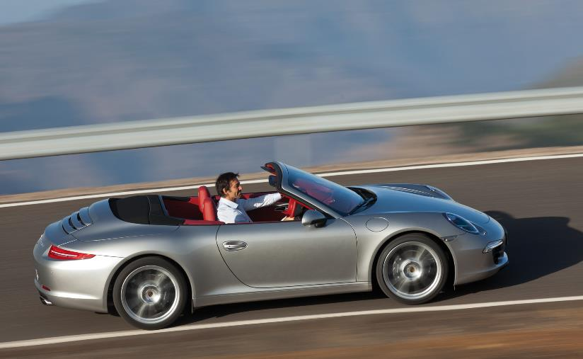
Let’s change gears. Do you know how to drive a car?
Safely, and not too fast?
Or is this more your speed?

Slide 35
To drive from Vestal to Johnson City High School it’s about 8 miles. That should take about 20 minutes.
8 miles 0.33 hours | = ~ 24 mph

Slide 36
It you drive fast, getting there in just 10 minutes…
8 miles 0.17 hours | = ~ 47 mph

Slide 37
It you drive fast, getting there in just 5 minutes…
8 miles .083 hours | = ~ 96 mph!
27. Time and rate are connected, but they are NOT THE SAME THING.

Slide 38
What is rate of reaction?
TIME IS HOW LONG IT TAKES to complete a chemical reaction, usually measured in seconds.
Rate is different. We will need this formula in the kinetics Clock Lab soon. Don’t forget this!
30. Time ≠ rate. Not in driving, or in chemistry.
Rate = | 1 time in seconds

Slide 39
31. Rate has a weird unit of | 1 time in seconds | or | sec⁻¹

Slide 40
These factors affect the rate of a reaction
32. Increase in Temperature hotter usually means the reaction will happen faster
33. Increase reactant surface area which allows the reactants to react faster
34. Increase the concentration of the reactants more stuff, more chance for a reaction to happen
35. Adding a catalyst

Slide 41
These factors affect the rate of a reaction
36. Increase in Temperature causes MORE COLLISIONS between the particles.
37. Increase reactant surface area causes MORE COLLISIONS between the particles.
38. Increase the concentration of the reactants causes MORE COLLISIONS between the particles.

Slide 42
39. Adding a catalyst
Catalysts have no affect on the collisions of particles, but they still speed up chemical reactions.
How they work will have to wait until tomorrow.

Slide 43
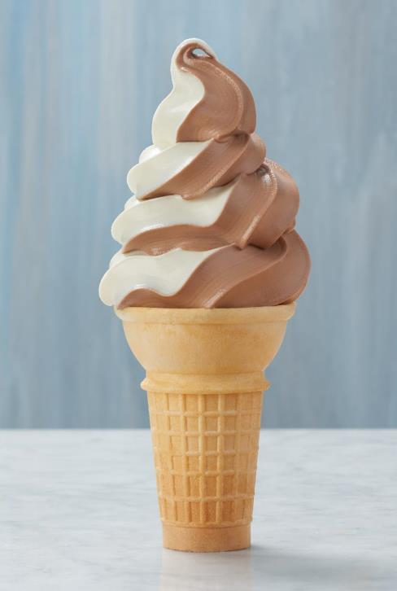
Kinetics Class #2
Objective: Potential Energy Diagrams are the graphs that show the flow of energy through chemical reactions. They come in 2 flavors, exothermic and endothermic.

Slide 44
40. The Law of Conservation of Energy
Energy cannot be created or destroyed in a chemical reaction or a physical change, but it can be transferred.

Slide 45
41. Potential energy diagrams show the flow of energy in a chemical reaction, from start to finish.

Slide 46
42. Draw the potential energy diagram showing the combustion of CH₄
Potential energy diagram for combustion of methane
Potential Energy
kJ/mole
0 kJ
Time zero
The time of the reaction
End of reaction

Slide 47
The reactants, in this case methane and oxygen, have some potential to explode. This “energy” is known, but we don’t know it in high school chem.
Potential energy diagram for combustion of methane
Potential Energy
kJ/mole
0 kJ
Time zero
The time of the reaction
End of reaction

Slide 48
You can carry around your methane and oxygen all day relatively safely. As long as you don’t add some heat, the explosion won’t happen. To react, the particles need to collide with sufficient energy and proper orientation. They don’t have that yet.
Potential energy diagram for combustion of methane
Potential Energy
kJ/mole
0 kJ
Time zero
The time of the reaction
End of reaction

Slide 49
If we begin to warm the reactants up (with some heat) this is what happens…
Dangerous, but no kaboom yet…
Potential energy diagram for combustion of methane
Potential Energy
kJ/mole
0 kJ
Time zero
The time of the reaction
End of reaction

Slide 50
Here we are literally at the “point of no return” – the TOP. Here the reaction can’t help but to go forward. It’s like being at the very top of the roller coaster as it crests the top of the first big hill!
Potential energy diagram for combustion of methane
Potential Energy
kJ/mole
0 kJ
Time zero
The time of the reaction
End of reaction

Slide 51
At this point the kaboom has started, we’ve ADDED the activation energy to START the reaction, and the reaction has “paid back” this start up energy. We’re back to where we started from an energy point of view, but, we’re not able to stop yet.
Potential energy diagram for combustion of methane
Potential Energy
kJ/mole
AE
0 kJ
Time zero
The time of the reaction
End of reaction

Slide 52
The kaboom keeps happening, the reaction releases all the heat it has to. The products form and they are dull, dull, dull (from an energy point of view).
Potential energy diagram for combustion of methane
Potential Energy
kJ/mole
AE
0 kJ
Time zero
The time of the reaction
End of reaction

Slide 53
The products, water & CO₂ are mostly unreactive. They have low potential energy. The reactants had a much greater potential energy. The difference between the PE reactants and PE products = ΔH. The ΔH is NEGATIVE because this is EXOTHERMIC.
Potential energy diagram for combustion of methane
Potential Energy
kJ/mole
AE
reactants
-ΔH
products
0 kJ
Time zero
The time of the reaction
End of reaction

Slide 54
Potential energy diagram for combustion of methane
Potential Energy
kJ/mole
AE
reactants
-ΔH
products
0 kJ
Time zero
End of reaction
The time of the reaction

Slide 55
Potential energy diagram vocabulary
43 | Potential Energy of Reactants | the kJ/mole of energy that the reactants start with
44 | Potential Energy of Products | the kJ/mole of energy that the products end up with
45 | ΔH | the difference in PE between reactants and products this PE diagram has a –ΔH
46 | Activation Energy (AE) | the energy required start the reaction (to get to the top of the hill)

Slide 56
47. Draw the potential energy diagram for the synthesis of C₂H_{2(G)} (look for that on table I now)
Potential energy diagram for formation of C₂H_{2(G)}
PE
kJ/mole
Time of reaction

Slide 57
47. Draw the potential energy diagram for the synthesis of C₂H_{2(G)} (this is endothermic)
Potential energy diagram for formation of C₂H_{2(G)}
PE Products
AE activation energy
PE
kJ/mole
ΔH = +227.4 kJ/mole
PE Reactants
Time of reaction
48. The green dot on the top of the hill is the ACTIVATED COMPLEX. The reactants have come apart but haven’t formed into products yet.

Slide 58
49. Draw the potential energy diagram for the solvation of sodium hydroxide
NaOH_{(S)} Na⁺¹_{(AQ)} + OH⁻¹_{(AQ)} + – 44.51 kJ
sodium hydroxide dissolving into water
water
Potential energy
kJ/mole
Time of the reaction…

Slide 59
49. Draw the potential energy diagram for the solvation of sodium hydroxide
NaOH_{(S)} Na⁺¹_{(AQ)} + OH⁻¹_{(AQ)} + – 44.51 kJ
sodium hydroxide dissolving into water
water
Represents the activation complex The transition between R & P
Potential energy
kJ/mole
reactants
AE
Time of the reaction…

Slide 60
49. Draw the potential energy diagram for the solvation of sodium hydroxide
NaOH_{(S)} Na⁺¹_{(AQ)} + OH⁻¹_{(AQ)} + – 44.51 kJ
sodium hydroxide dissolving into water
water
50. This energy is the HEAT of SOLUTION, not heat of reaction.
activation complex
Potential energy
kJ/mole
reactants
AE
-ΔH
We don’t know the actual levels, but we know that this difference is 44.51 kJ/mole
products
Time of the reaction…

Slide 61
More Kinetics Vocabulary
51 | Potential energy | The energy stored in the bonds of the reactants or the products
52 | Activation complex | A transitional state; the reactants are apart – but are not yet the products
53 | Activation energy | The minimum amount of energy it takes to start a reaction.
54 | ΔH | The difference between the potential energy of the reactants and products Heat of Reaction or Heat of Solution
55 | Potential energy diagram | A graph showing the flow of energy in a chemical reaction. These are exothermic or endothermic

Slide 62
56. Draw the potential energy diagram for the synthesis of aluminum oxide. Label the reactants, products, AE, AC, ΔH. Graph needs axis labels, and a title.
4Al_{(S)} + 3O_{2(G)} → 2Al₂O_{3(S)} + 3351 kJ
PE kJ/mole
Time of the reaction

Slide 63
56. Draw the potential energy diagram for the synthesis of aluminum oxide. Label the reactants, products, AE, AC, ΔH. Graph needs axis labels, and a title.
4Al_{(S)} + 3O_{2(G)} → 2Al₂O_{3(S)} + 3351 kJ
AC
Al + O₂
AE
PE kJ/mole
-ΔH
Al₂O₃
Time of the reaction

Slide 64
57. Draw the PE diagram for the solvation of sodium chloride.
NaCl + energy Na⁺¹ + Cl⁻¹ ΔH = +3.88 kJ/mole
Go!
water

Slide 65
57. Draw the PE diagram for the solvation of sodium chloride.
NaCl + energy Na⁺¹ + Cl⁻¹
water
Table salt dissolves in water, ΔH = +3.88 kJ/mole
PE kJ/mole
Time of reaction

Slide 66
57. Draw the PE diagram for the solvation of sodium chloride.
NaCl + energy Na⁺¹ + Cl⁻¹
water
Table salt dissolves in water, ΔH = +3.88 kJ/mole
Ions in solution
PE kJ/mole
+ΔH
salt
AE
Time of reaction

Slide 67
58. Draw the PE diagram for the combustion of propane. Indicate the PE of reactants, products, AE, AC, ΔH, and a title.
PE diagram for the combustion of propane ΔH = -2219.2 kJ/mole
P E
kJ/mole
Reaction time

Slide 68
58. Draw the PE diagram for the combustion of propane. Indicate the PE of reactants, products, AE, AC, ΔH, and a title.
PE diagram for the combustion of propane ΔH = -2219.2 kJ/mole
Activated complex
loose atoms of C + H + O
P E
kJ/mole
AE
C₃H₈ + O₂
-ΔH
CO₂ + H₂O
Reaction time

Slide 69
Kinetics Class #3
The affect of catalysts on chemical reactions

Slide 70
Draw the PE diagram for 59. The combustion of glucose and for The synthesis of HI gas.
Make 2 graphs, label PE of reactants and products, AE, AC, and ΔH (+ or -), and a title, with labels for the X and Y axis.
This should only take 2 minutes! Click ahead now

Slide 71
59.
Exothermic on left Endothermic on right
Combustion of glucose ΔH = -2804 kJ/mole
Synthesis of HI gas ΔH = +53.0 kJ/mole
PE
kJ/mole
PE
kJ/mole
time
time

Slide 72
59.
Exothermic on left Endothermic on right
Combustion of glucose ΔH = -2804 kJ/mole
Synthesis of HI gas ΔH = +53.0 kJ/mole
AC
PE
kJ/mole
PE
kJ/mole
R
AE
-ΔH
P
time
time

Slide 73
59.
Exothermic on left Endothermic on right
Combustion of glucose ΔH = -2804 kJ/mole
Synthesis of HI gas ΔH = +53.0 kJ/mole
AC
AC
PE
kJ/mole
PE
kJ/mole
P
R
AE
R
AE
+ΔH
-ΔH
P
time
time

Slide 74
60. What is a Catalyst?

Slide 75
60. What is a Catalyst?
A substance that speeds up a chemical reaction without changing the reaction in any other way.

Slide 76
60. What is a Catalyst?
A substance that speeds up a chemical reaction without changing the reaction in any other way. It doesn’t get used up, it doesn’t alter the amount of energy absorbed or released.
Catalysts lower the activation energy required to start a reaction, because Catalysts provide an alternate chemical pathway for the reaction.

Slide 77
61. Indicate WHAT HAPPENS IF YOU ADD A CATALYST TO THESE REACTIONS?
Exothermic on left Endothermic on right
Combustion of glucose ΔH = -2804 kJ/mole
Synthesis of HI gas ΔH = +53.0 kJ/mole
AC
AC
PE
kJ/mole
PE
kJ/mole
P
R
AE
R
AE
+ΔH
-ΔH
P
time
time

Slide 78
61. Indicate WHAT HAPPENS IF YOU ADD A CATALYST TO THESE REACTIONS?
Exothermic on left Endothermic on right
Combustion of glucose ΔH = -2804 kJ/mole
Synthesis of HI gas ΔH = +53.0 kJ/mole
AC
AC
PE
kJ/mole
PE
kJ/mole
P
R
AE
R
AE
+ΔH
-ΔH
P
time
time

Slide 79
62. Catalysts DO NOT change the number of collisions. Catalysts are said to work in 2 different ways….

Slide 80
62. Catalysts DO NOT change the number of collisions. Catalysts are said to work in 2 different ways…
63. Catalysts lower the activation energy of a reaction. This lets the reaction start in a less energetic way, so it can happen quicker than normal. Once it starts, it moves right along.
64. Catalysts provide “an alternate pathway” for the reaction to proceed. This lets this reaction happen quicker. (Like a shortcut).

Slide 81
65. Draw this demo titled: “Catalysts speed up the rate of a chemical reaction.”
2H₂O2 2H2O + O2 + ENERGY (exothermic)
KI
H₂O₂ solution
+ KI
Catalyst
The same reaction will happen at left, just MUCH SLOWER!

Slide 82
65. Draw this demo titled: “Catalysts speed up the rate of a chemical reaction.”
2H₂O2 2H2O + O2 + ENERGY (exothermic)
KI
Meh
LIKE WOW!
H₂O₂ solution
+ KI
Catalyst
Both reactions are exactly the same, except for speed.

Slide 83
Kinetics Class #4
Objective: Describing chemical reactions that are in dynamic equilibrium; learning how to “push” them forward, or reverse using LeChatelier's Principle.

Slide 84
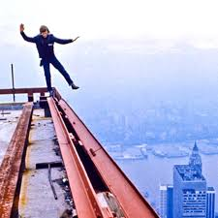
August 7, 1974
Phillipe Petit decides it’s his day.
He chooses to set up a high wire between the Twin Towers in NYC, and then to walk across this wire for about an hour.
Here he is, warming up.

Slide 85
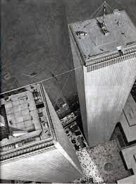
That little black smudge is him on the wire, between the two buildings.
I’ve been on the one to the left a bunch of times. It was an amazing view.
The black specks on the ground are small clumps of people walking to work.

Slide 86
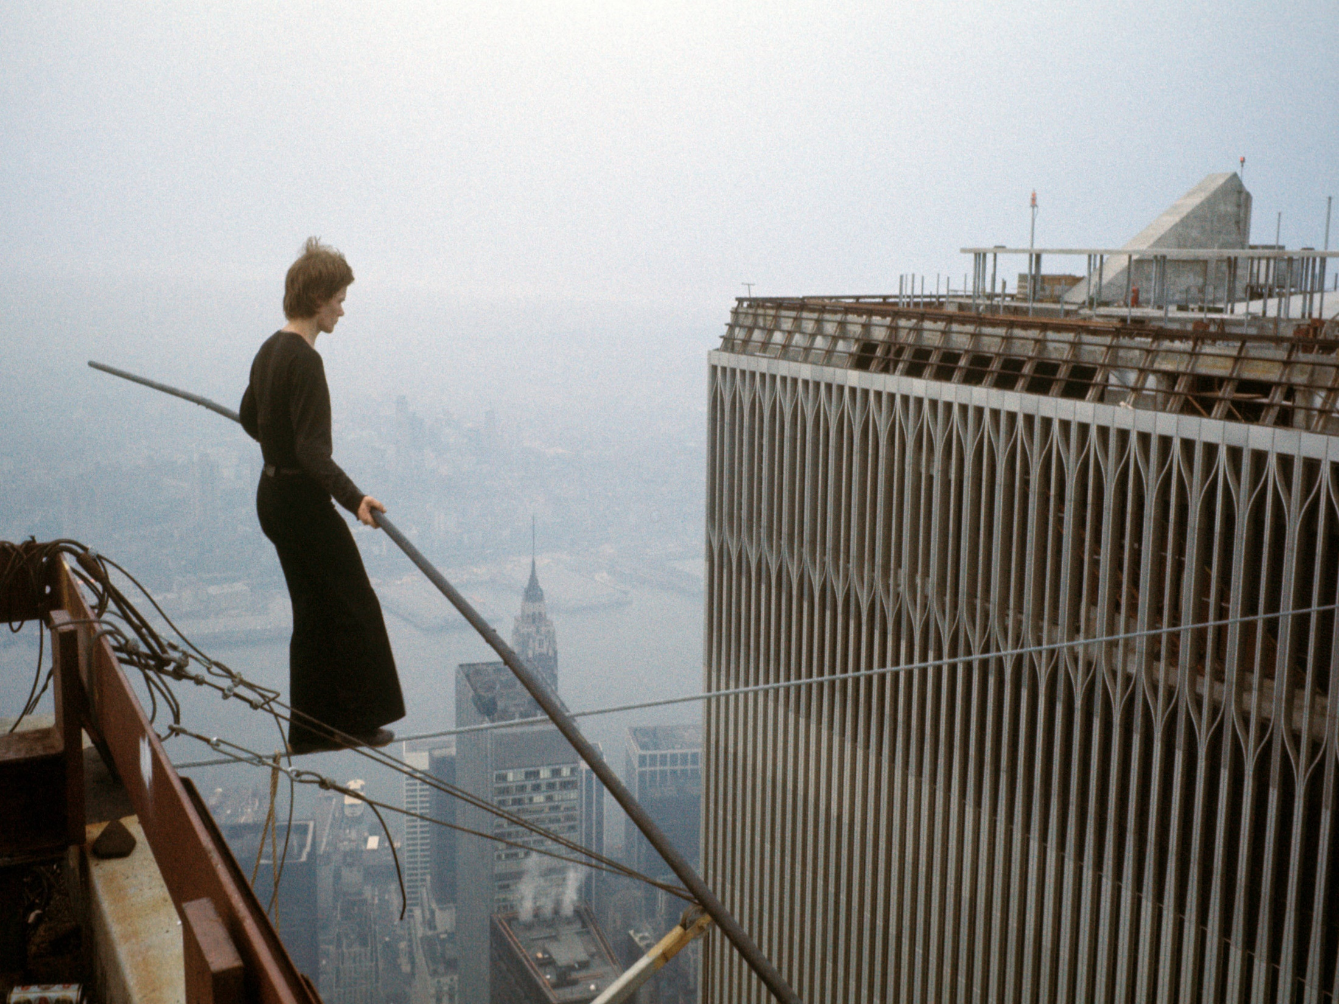

Slide 87
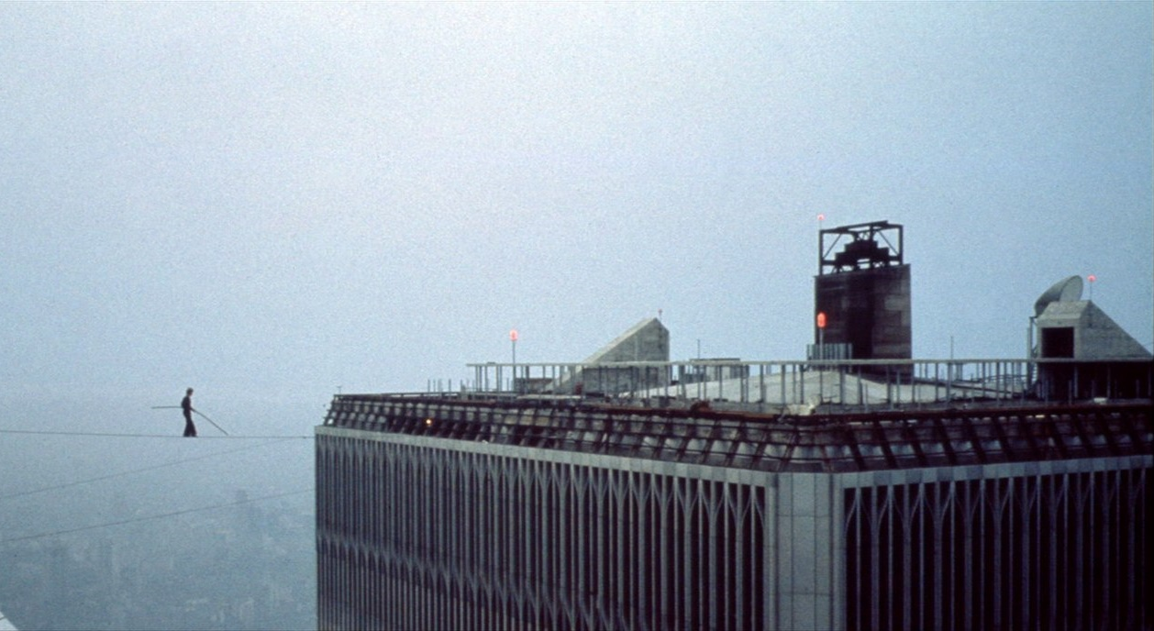
Phillipe sat, and also layed down on the wire during his show. Note, there is no net.
He once said: “I see three oranges, and I have to juggle. I see two towers, and I have to walk.”

Slide 88
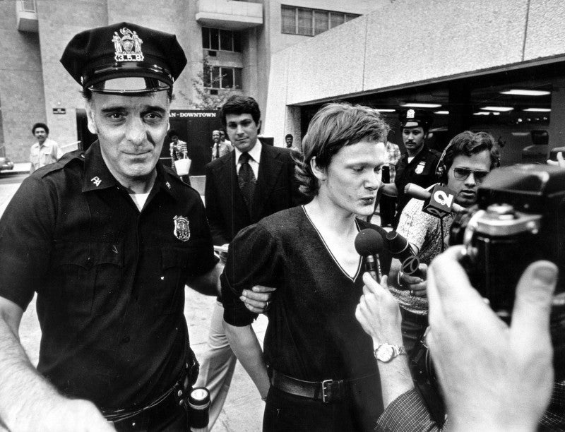
Monsieur Petit, is arrested for trespassing and disorderly conduct.
Charges were dropped after he promised a judge that he’d teach kids to walk a wire in Central Park.

Slide 89
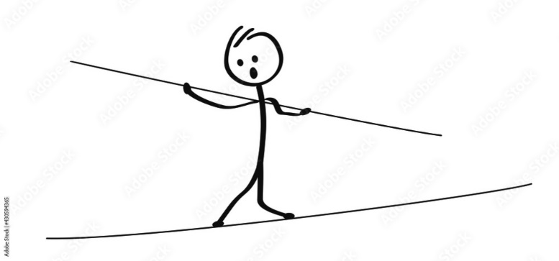
In some ways, a dynamic equilibrium is what Phillipe Petit was in while on that wire. No matter the stresses, he could not FALL OFF that wire.
Winds from the helicopters blew against him, so he twisted and adjusted his long pole, to keep his balance.
No matter the stress, wind from the left, less wind from the right, whatever, he bent and did what ever was needed to stay alive.
He had to accommodate all stress and change is stance, and get into a new balance, he kept his equilibrium.

Slide 90
66. Most chemical reactions are “one way”, meaning that once they happen, they are done. Spontaneous reversals in chemistry are not common, because most reactions are without enough energy to go the other way.
67. Some reactions are reversible because their energy requirements are much LOWER in both directions.
68. The ∆H is very low in BOTH directions.
69. One of the most important chemical reactions that is reversible, is the simultaneous synthesis and decomposition of ammonia shown below…
N_{2(G)} + 3H_{2(G)} ⇌ 2NH_{3(G)} + energy

Slide 91
70. Dynamic equilibrium is when the rate of the forward reaction is equal to the rate of the reverse reaction.
In this reaction… N_{2(G)} + 3H_{2(G)} ⇌ 2NH_{3(G)} + energy
The rate that synthesis occurs is the same as the rate of the reverse decomp.
72. It’s constantly changing and constantly staying the same.

Slide 92
73. In a dynamic equilibrium situation, you DO NOT necessarily have equal masses, or equal moles, on opposite sides of the ⇌
74. The rate of the forward reaction = the rate of the reverse reaction. 75. It is possible to have equal masses or equal moles on both sides, but that is NOT a condition, it’s only a possibility.
dynamic equilibrim

Slide 93
76. LeChatelier's Principle:
A chemical system in dynamic equilibrium will stay at equilibrium, and if a chemical stress is applied, the system will shift to counter act this stress, until a new equilibrium is reached.

Slide 94
77. You can disrupt a chemical equilibrium by
increasing or decreasing temperature
increasing or decreasing pressure
adding or removing stuff
78. The chemical system must accommodate this stress, and a NEW, different dynamic equilibrium will form.

Slide 95
79. What happens if we pump in extra NH_{3(G)} to this closed system?
nitrogen + hydrogen ⇌ ammonia + energy
Add Ammonia

Slide 96
79. What happens if we pump in extra NH_{3(G)} to this closed system?
nitrogen + hydrogen ⇌ ammonia + energy
Add Ammonia
If you imagine the forward reaction happens 100x per minute, the reverse reaction also happens 100x per minute, this stays in balance, it’s in dynamic equilibrium
Always changing, always staying the same.

Slide 97
79. What happens if we pump in extra NH_{3(G)} to this closed system?
nitrogen + hydrogen ⇌ ammonia + energy
← Add Ammonia
Adding ammonia would make no difference to the synthesis reaction. That would happen 100x per minute.
The reverse reaction happen more often (maybe 125x per minute) for a while – until a new balance is found.
This stress causes a “reverse shift” for a bit.

Slide 98
N₂ + 3H₂ ⇌ 2NH₃ + energy
80. This closed system is in dynamic equilibrium. Let’s apply different stresses, and see which way the system will “push” to create a new dynamic equilibrium.
Add nitrogen
Add hydrogen
Add ammonia
Add energy (heat)
Add pressure

Slide 99
N₂ + 3H₂ ⇌ 2NH₃ + energy
80. This closed system is in dynamic equilibrium. Let’s apply different stresses, and see which way the system will “push” to create a new dynamic equilibrium.
Add nitrogen
Add hydrogen
Add ammonia
Add energy (heat)
Add pressure
More nitrogen makes for more collisions between hydrogen and nitrogen, pushing this reaction FORWARD

Slide 100
N₂ + 3H₂ ⇌ 2NH₃ + energy
80. This closed system is in dynamic equilibrium. Let’s apply different stresses, and see which way the system will “push” to create a new dynamic equilibrium.
Add nitrogen
Add hydrogen
Add ammonia
Add energy (heat)
Add pressure
More hydrogen makes for more collisions between hydrogen and nitrogen, pushing this reaction FORWARD also

Slide 101
N₂ + 3H₂ ⇌ 2NH₃ + energy
80. This closed system is in dynamic equilibrium. Let’s apply different stresses, and see which way the system will “push” to create a new dynamic equilibrium.
Add nitrogen
Add hydrogen
Add ammonia
Add energy (heat)
Add pressure
More ammonia can only decompose, so this shifts to the REVERSE, until a new dynamic equilibrium forms.

Slide 102
N₂ + 3H₂ ⇌ 2NH₃ + energy
80. This closed system is in dynamic equilibrium. Let’s apply different stresses, and see which way the system will “push” to create a new dynamic equilibrium.
Add nitrogen
Add hydrogen
Add ammonia
Add energy (heat)
Add pressure
More heat only favors more decomposition, this shifts to the REVERSE also, until a new dynamic equilibrium forms.

Slide 103
N₂ + 3H₂ ⇌ 2NH₃ + energy
80. This closed system is in dynamic equilibrium. Let’s apply different stresses, and see which way the system will “push” to create a new dynamic equilibrium.
Add nitrogen
Add hydrogen
Add ammonia
Add energy (heat)
Add pressure
MORE PRESSURE favors less moles of gas. There are 4 moles of gas at left, only 2 moles of gas at right.

Slide 104
N₂ + 3H₂ ⇌ 2NH₃ + energy
81. Remove nitrogen
Remove hydrogen
Remove ammonia
Remove energy (cool system)
Lower pressure

Slide 105
N₂ + 3H₂ ⇌ 2NH₃ + energy
81. Remove nitrogen
Remove hydrogen
Remove ammonia
Remove energy (cool system)
Lower pressure
Less N₂ means less collisions and less synthesis. This favors the REVERSE reaction.

Slide 106
N₂ + 3H₂ ⇌ 2NH₃ + energy
81. Remove nitrogen
Remove hydrogen
Remove ammonia
Remove energy (cool system)
Lower pressure
Less H₂ means less collisions and less synthesis. This favors the REVERSE reaction also.

Slide 107
N₂ + 3H₂ ⇌ 2NH₃ + energy
81. Remove nitrogen
Remove hydrogen
Remove ammonia
Remove energy (cool system)
Lower pressure
Less NH₃ means less decomposition but the forward synthesis keeps going. This favors the FOWARD reaction.

Slide 108
N₂ + 3H₂ ⇌ 2NH₃ + energy
81. Remove nitrogen
Remove hydrogen
Remove ammonia
Remove energy (cool system)
Lower pressure
Less heat means less decomposition but the forward synthesis keeps going. This favors the FOWARD reaction.

Slide 109
N₂ + 3H₂ ⇌ 2NH₃ + energy
81. Remove nitrogen
Remove hydrogen
Remove ammonia
Remove energy (cool system)
Lower pressure
Less pressure favors MORE MOLES of GAS, so this goes in REVERSE for a while.

Slide 110
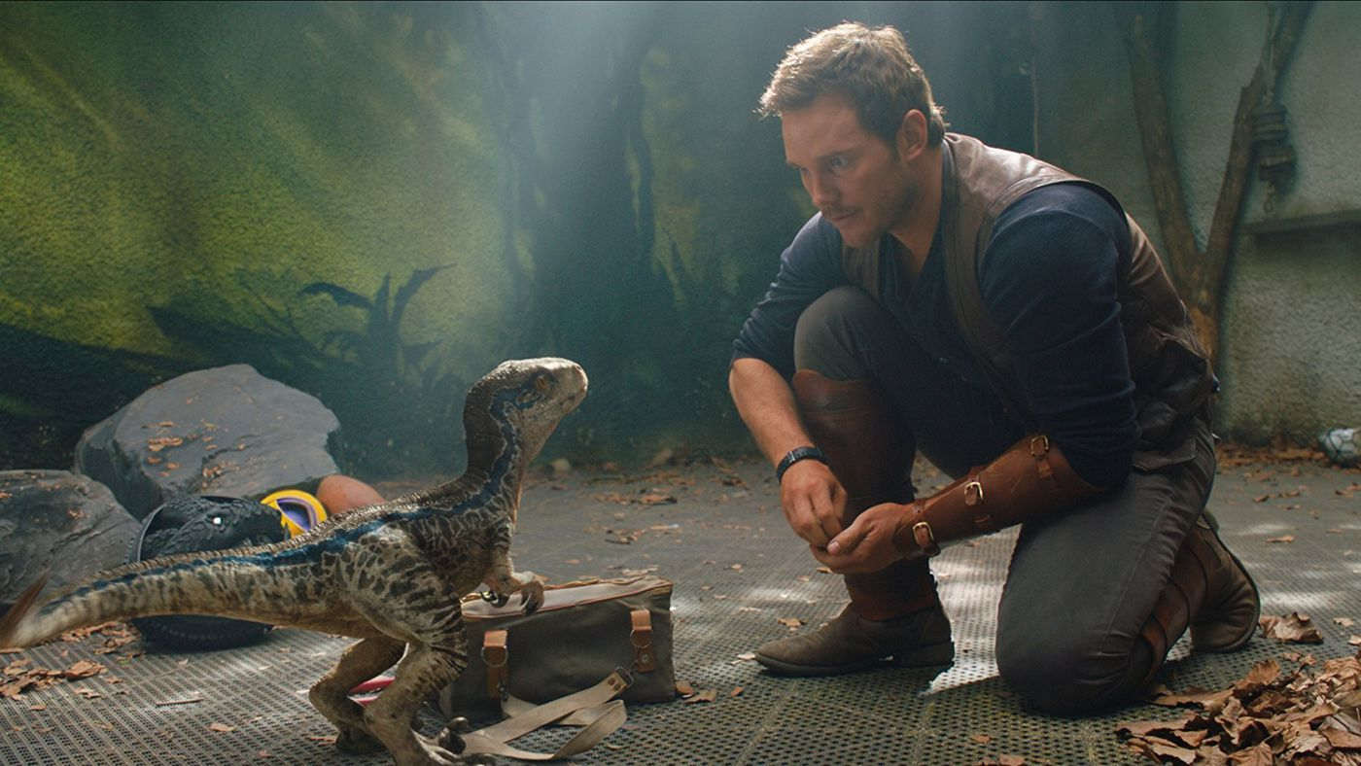
4Al_{(S)} + 3O_{2(G)} ⇌ 2Al₂O_{3(S)} + Energy
This is NOT really a dynamic equilibrium. We will believe in ghosts, or dinosaurs now. If the reaction has the double arrows, we will use the concepts of dynamic equilibrium and LeChatelier’s Principle to “play” with the theory. This will NOT reverse with just heat, but here it can.

Slide 111
4Al_{(S)} + 3O_{2(G)} ⇌ 2Al₂O_{3(S)} + Energy
83. The forward reaction is exothermic; the reverse reaction is endothermic.
84. The forward reaction is synthesis; the reverse is decomposition.
85. We cannot know how many grams of aluminum, oxygen, or aluminum oxide are on either side of the double arrows, but we KNOW that the rate of synthesis (forward) is equal to the rate of the decomposition (reverse). Both reactions continue, but the mass on either side remain constant. Let’s stress this out now…

Slide 112
4Al_{(S)} + 3O_{2(G)} ⇌ 2Al₂O_{3(S)} + Energy
86 | Add aluminum oxide
87 | Remove oxygen
88 | Remove heat (cool system)
89 | Add aluminum
90 | Add Heat
91 | Increase pressure

Slide 113
4Al_{(S)} + 3O_{2(G)} ⇌ 2Al₂O_{3(S)} + Energy
86 | ← Add aluminum oxide
87 | Remove oxygen
88 | Remove heat (cool system)
89 | Add aluminum
90 | Add Heat
91 | Increase pressure

Slide 114
4Al_{(S)} + 3O_{2(G)} ⇌ 2Al₂O_{3(S)} + Energy
86 | ← Add aluminum oxide
87 | ← Remove oxygen
88 | Remove heat (cool system)
89 | Add aluminum
90 | Add Heat
91 | Increase pressure

Slide 115
4Al_{(S)} + 3O_{2(G)} ⇌ 2Al₂O_{3(S)} + Energy
86 | ← Add aluminum oxide
87 | ← Remove oxygen
88 | Remove heat (cool system) →
89 | Add aluminum
90 | Add Heat
91 | Increase pressure

Slide 116
4Al_{(S)} + 3O_{2(G)} ⇌ 2Al₂O_{3(S)} + Energy
86 | ← Add aluminum oxide
87 | ← Remove oxygen
88 | Remove heat (cool system) →
89 | Add aluminum →
90 | Add Heat
91 | Increase pressure

Slide 117
4Al_{(S)} + 3O_{2(G)} ⇌ 2Al₂O_{3(S)} + Energy
86 | ← Add aluminum oxide
87 | ← Remove oxygen
88 | Remove heat (cool system) →
89 | Add aluminum →
90 | ← Add Heat
91 | Increase pressure

Slide 118
4Al_{(S)} + 3O_{2(G)} ⇌ 2Al₂O_{3(S)} + Energy
86 | ← Add aluminum oxide
87 | ← Remove oxygen
88 | Remove heat (cool system) →
89 | Add aluminum →
90 | ← Add Heat
91 | Increase pressure →

Slide 119
92. Pressure only effects gases. Pressure does not effect solids, liquids, or aqueous.
93. If a stress “stops” or slows down a forward reaction, the reverse keeps happening.
94. If a stress “stops” or slows down a reverse reaction, the forward keeps happening.
95. A new balance, or equilibrium will always be reached.

Slide 120
This is NOT a real dynamic equilibrium, but we will “make believe” because of the double arrows.
CH_{4(G)} + 2O_{2(G)} ⇌ CO_{2(G)} + 2H₂O_{(G)} + energy
96 | Add methane
97 | Add water
98 | Add heat
99 | Remove carbon dioxide
100 | Remove heat
101 | Remove methane
102 | Add carbon dioxide
103 | Increase pressure
104 | Decrease pressure

Slide 121
This is NOT a real dynamic equilibrium, but we will “make believe” because of the double arrows.
CH_{4(G)} + 2O_{2(G)} ⇌ CO_{2(G)} + 2H₂O_{(G)} + energy
96 | Add methane →
97 | Add water
98 | Add heat
99 | Remove carbon dioxide
100 | Remove heat
101 | Remove methane
102 | Add carbon dioxide
103 | Increase pressure
104 | Decrease pressure

Slide 122
This is NOT a real dynamic equilibrium, but we will “make believe” because of the double arrows.
CH_{4(G)} + 2O_{2(G)} ⇌ CO_{2(G)} + 2H₂O_{(G)} + energy
96 | Add methane →
97 | ← Add water
98 | Add heat
99 | Remove carbon dioxide
100 | Remove heat
101 | Remove methane
102 | Add carbon dioxide
103 | Increase pressure
104 | Decrease pressure

Slide 123
This is NOT a real dynamic equilibrium, but we will “make believe” because of the double arrows.
CH_{4(G)} + 2O_{2(G)} ⇌ CO_{2(G)} + 2H₂O_{(G)} + energy
96 | Add methane →
97 | ← Add water
98 | ← Add heat
99 | Remove carbon dioxide
100 | Remove heat
101 | Remove methane
102 | Add carbon dioxide
103 | Increase pressure
104 | Decrease pressure

Slide 124
This is NOT a real dynamic equilibrium, but we will “make believe” because of the double arrows.
CH_{4(G)} + 2O_{2(G)} ⇌ CO_{2(G)} + 2H₂O_{(G)} + energy
96 | Add methane →
97 | ← Add water
98 | ← Add heat
99 | Remove carbon dioxide →
100 | Remove heat
101 | Remove methane
102 | Add carbon dioxide
103 | Increase pressure
104 | Decrease pressure

Slide 125
This is NOT a real dynamic equilibrium, but we will “make believe” because of the double arrows.
CH_{4(G)} + 2O_{2(G)} ⇌ CO_{2(G)} + 2H₂O_{(G)} + energy
96 | Add methane →
97 | ← Add water
98 | ← Add heat
99 | Remove carbon dioxide →
100 | Remove heat →
101 | Remove methane
102 | Add carbon dioxide
103 | Increase pressure
104 | Decrease pressure

Slide 126
This is NOT a real dynamic equilibrium, but we will “make believe” because of the double arrows.
CH_{4(G)} + 2O_{2(G)} ⇌ CO_{2(G)} + 2H₂O_{(G)} + energy
96 | Add methane →
97 | ← Add water
98 | ← Add heat
99 | Remove carbon dioxide →
100 | Remove heat →
101 | ← Remove methane
102 | Add carbon dioxide
103 | Increase pressure
104 | Decrease pressure

Slide 127
This is NOT a real dynamic equilibrium, but we will “make believe” because of the double arrows.
CH_{4(G)} + 2O_{2(G)} ⇌ CO_{2(G)} + 2H₂O_{(G)} + energy
96 | Add methane →
97 | ← Add water
98 | ← Add heat
99 | Remove carbon dioxide →
100 | Remove heat →
101 | ← Remove methane
102 | ← Add carbon dioxide
103 | Increase pressure
104 | Decrease pressure

Slide 128
This is NOT a real dynamic equilibrium, but we will “make believe” because of the double arrows.
CH_{4(G)} + 2O_{2(G)} ⇌ CO_{2(G)} + 2H₂O_{(G)} + energy
96 | Add methane →
97 | ← Add water
98 | ← Add heat
99 | Remove carbon dioxide →
100 | Remove heat →
101 | ← Remove methane
102 | ← Add carbon dioxide
103 | X Increase pressure X
104 | Decrease pressure
There are equal numbers of moles of gas on both sides, increasing pressure does not FAVOR either forward or reverse here.

Slide 129
This is NOT a real dynamic equilibrium, but we will “make believe” because of the double arrows.
CH_{4(G)} + 2O_{2(G)} ⇌ CO_{2(G)} + 2H₂O_{(G)} + energy
96 | Add methane →
97 | ← Add water
98 | ← Add heat
99 | Remove carbon dioxide →
100 | Remove heat →
101 | ← Remove methane
102 | ← Add carbon dioxide
103 | X Increase pressure X
104 | X Decrease pressure X
There are equal numbers of moles of gas on both sides, increasing pressure does not FAVOR either forward or reverse here.

Slide 130
Review for Kinetics
Time to think.
#105 in notes.

Slide 131
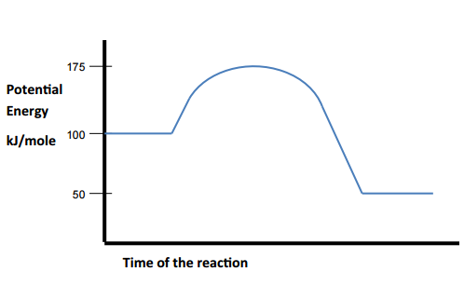
Questions
105. Is this an exo or endothermic reaction?
106. What is the potential energy of the activated complex?
107. What is the PE of the products?
108. What is the ΔH?
109. What would be a possible activation energy with a catalyst?

Slide 132
Questions
105. Is this an exo or endothermic reaction? exo
106. What is the potential energy of the activated complex? 175 kJ/mole
107. What is the PE of the products? 50 kJ/mole
108. What is the ΔH? -50 kJ/mole
109. What would be a possible activation energy with a catalyst? Less than 75 kJ/mole

Slide 133
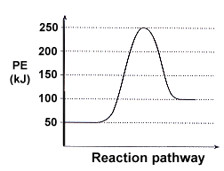
110. What is the PE of the reactants?
111. What is the activation energy for this reaction?
112. Is this reaction exo or endothermic?
114. What are possible AE values for this reaction with a catalyst?
115. What is the ΔH for this reaction?
116. Would the ΔH for this reaction change with a catalyst?

Slide 134
110. What is the PE of the reactants? 50 kJ/mole
111. What is the activation energy for this reaction? 200 kJ/mole
112. Is this reaction exo or endothermic? endothermic
114. What are possible AE values for this reaction with a catalyst? Less than 200, more than 50 kJ/mole
115. What is the ΔH for this reaction? +50 kJ/mole
116. Would the ΔH for this reaction change with a catalyst? No, only the AE changes.

Slide 135
117. In this dynamic equilibrium… Which way does each stress push the reaction with all of these stresses?
3A_{(G)} + B_{(S)} ⇌ 3C_{(G)} + D_{(G)} + energy
Add heat
Add B
Inc. pressure
Remove D
Add C

Slide 136
117. In this dynamic equilibrium… Which way does each stress push the reaction with all of these stresses?
3A_{(G)} + B_{(S)} ⇌ 3C_{(G)} + D_{(G)} + energy
Add heat
Add B
Inc. pressure
Remove D
Add C

Slide 137
118. State in plain language, and in complete sentences, LeChatelier’s Principle
119. State the 4 stresses that can be applied to a dynamic equilibrium.

Slide 138
118. LeChatelier’s Principle
Chemical systems at equilibrium tend to stay at equilibrium. When a chemical stress is put upon a chemical system in equilibrium, it will shift to relieve that stress, and a new dynamic equilibrium forms.
119. Stresses include changes in pressure, temperature, and adding/removing reactants.

Slide 139
120. Of the 4 factors that would that speed up a chemical reaction, three of them work one way, but the 4th factor works a different way.

Slide 140
120. Of the 4 factors that would that speed up a chemical reaction, three of them work one way, but the 4th factor works a different way.
1. Increase temp = more collisions
2. Increase surface area of reactants = more collisions
3. Increase concentration of reactants = more collisions
4. Using a catalyst lowers the Activation Energy required, or provides an alternate pathway. THIS DOES NOT make more collisions.
All 4 make reaction rate increase. All 4 make reaction time decrease. | You get that these are NOT the same, right? Ask now if you don’t (please).

Slide 141
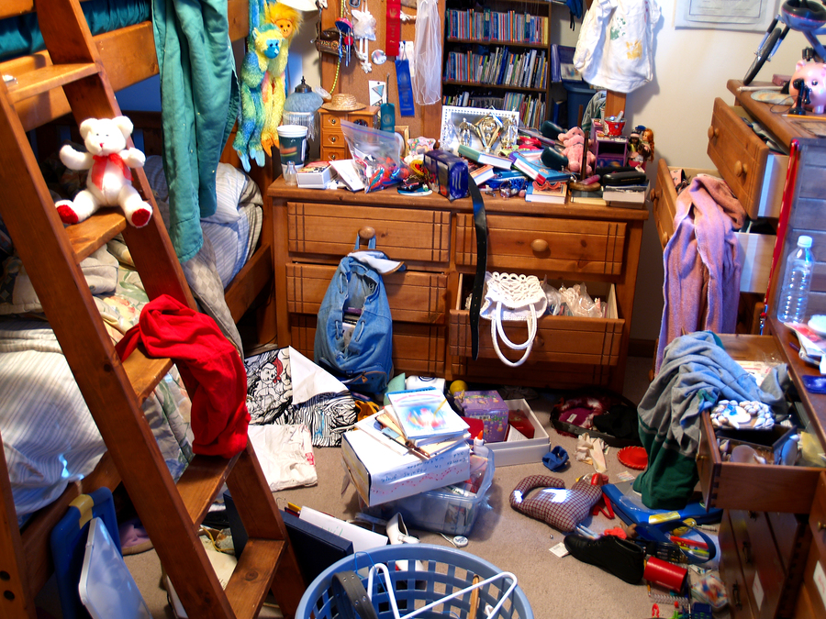
121. Entropy is the measure of disorder in a chemical system.
Much disorder = HIGH ENTROPY
In AP Chem it has units and numbers, in our course it is just a definition.

Slide 142
121. Entropy is the measure of disorder in a chemical system.
Much disorder = HIGH ENTROPY
No disorder = LOW ENTROPY

Slide 143
122. Compare the phases of matter for entropy
Solid
Liquid
Gas

Slide 144
122. Compare the phases of matter for entropy
Solid | Lowest entropy (most order)
Liquid | Medium entropy
Gas | Highest entropy (most disorder)

Slide 145
123. Three solid compounds are at the same temperature and pressure, which has the most entropy, which has the least entropy, and why?
C₄H₁₀ butane
MgO magnesium oxide
C₁₂H₂₂O₁₁ Sucrose (sugar)

Slide 146
123. Three solid compounds are at the same temperature and pressure, which has the most entropy, which has the least entropy, and why?
C₄H₁₀ butane | Medium Entropy. They hold 14 atoms together in total.
MgO magnesium oxide | Most Entropy, these are the smallest particles. They are the least organized because they only hold two ions together.
C₁₂H₂₂O₁₁ Sucrose (sugar) | Least Entropy, these are the largest particles. They are the MOST organized because they hold 45 atoms together.

Slide 147
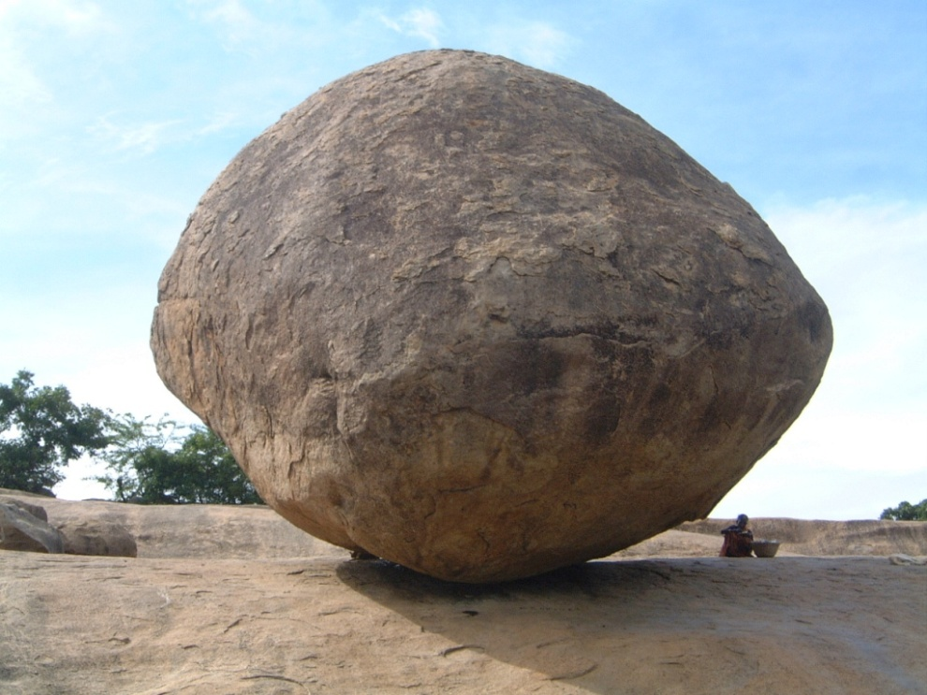
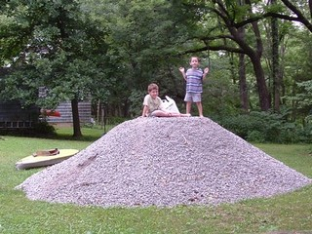
Which is more likely – boulders crumbling, or pebbles reforming big rocks?

Slide 148
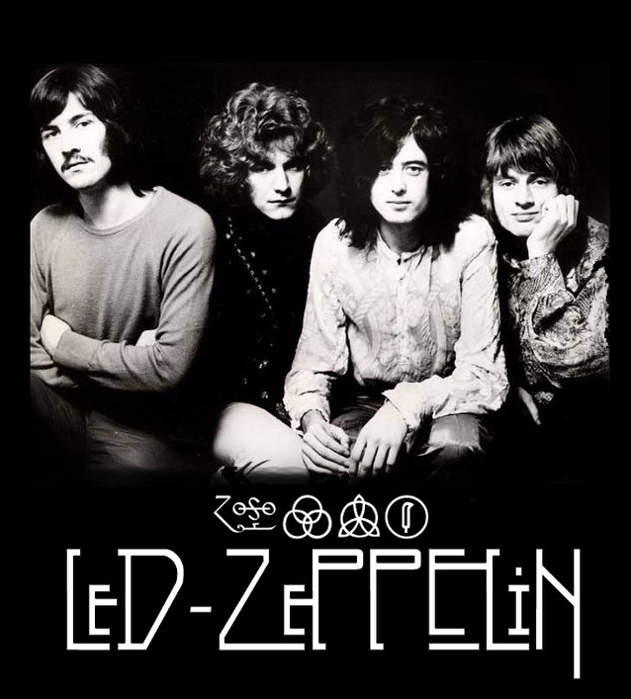
124. If mountains crumble to the sea, there will still be you & me. (from Thank You, by Led Zeppelin) 125. From the NYS Curriculum:
Systems in nature tend to undergo changes toward lower energy and higher entropy.

Slide 149
2H_{2(G)} + C_{(S)} ⇌ CH_{4(G)}
What’s equal in a dynamic equilibrium? (Mass, liters, density, what?)

Slide 150
2H_{2(G)} + C_{(S)} ⇌ CH_{4(G)}
What’s equal in a dynamic equilibrium? (Mass, liters, density, what?) The rate of the forward reaction is equal to the rate of the reverse reaction. That’s it.

Slide 151
2H_{2(G)} + C_{(S)} ⇌ CH_{4(G)}
In this is in dynamic equilibrium. Do the number of molecules of hydrogen or methane change? (or number of carbon atoms?) Explain why or why not.

Slide 152
2H_{2(G)} + C_{(S)} ⇌ CH_{4(G)}
In this is in dynamic equilibrium. Do the number of molecules of hydrogen or methane change? (or number of carbon atoms?) Explain why or why not. No, because the rate of synthesis equals the rate of decomposition. There is always the same number of everything, but sometimes the “stuff” is one side of the arrows, or the other.

Slide 153
Draw and completely label an EXOthermic potential energy diagram
and an
ENDOthermic potential energy diagram

Slide 154
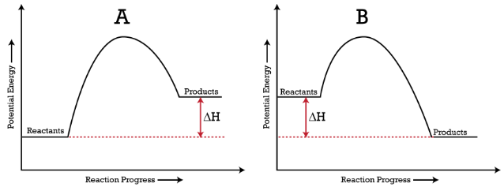
Endo on the left, products have MORE energy than they started with, they had to ABSORB energy.
Exo on the right, products have LESS energy than they started with , they had to RELEASE energy.

Slide 155
Which way do these stresses cause this equilibrium to shift, forward or reverse?
CO_{(G)} + 2H_{2(G)} ⇌ CH₃OH_{(G)} + energy
Increase pressure
Increase temperature
Add CO
Remove Hydrogen
Add a catalyst
Decrease pressure
Decrease temperature
Remove methanol

Slide 156
Which way do these stresses cause this equilibrium to shift, forward or reverse?
CO_{(G)} + 2H_{2(G)} ⇌ CH₃OH_{(G)} + energy
Increase pressure
Increase temperature
Add CO
Remove Hydrogen
X Add a catalyst X
Decrease pressure
Decrease temperature
Remove methanol

Slide 157
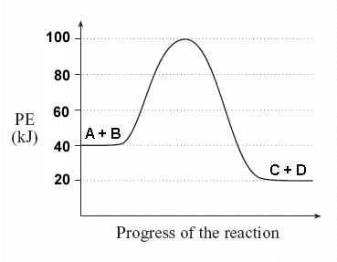
This is a potential energy diagram.
Answer me this…
What is the ∆H?
What is the AE?
What is energy of the activated complex?

Slide 158
This is a potential energy diagram.
Answer me this…
∆H = – 20 kJ/mole
AE = 60 kJ/mole
activated complex has 100 kJ/mole

Slide 159
Which of these solids have the lowest entropy and the highest entropy - at STP?
CO₂
C₃H₈
Na₃Al(SO₄)₃∙12H₂O

Slide 160
Which of these solids have the lowest entropy and the highest entropy - at STP?
CO₂ (most entropy, fewest bonds)
C₃H₈
Na₃Al(SO₄)₃∙12H₂O (lowest entropy, most bonds)

Slide 161
If a reaction takes 25.0 seconds to occur, what is the rate of reaction?
25.0 seconds
0.0400 seconds
0.0400 seconds⁻¹
400. seconds ⁻¹

Slide 162
If a reaction takes 25.0 seconds to occur, what is the rate of reaction?
25.0 seconds
0.0400 seconds
0.0400 seconds⁻¹
400. seconds ⁻¹ rate =
1 seconds
1 25.0 sec
=
=
Do the math!

Slide 163
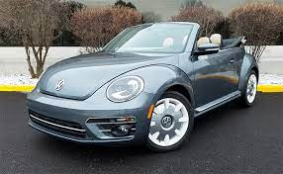
Gasoline burns in my punch-buggy engine, which statement is true?
Energy is a reactant, ∆H is negative
Energy is a product, ∆H is negative
Energy is a reactant, ∆H is positive
Energy is a product, ∆H is positive

Slide 164
Gasoline burns in my punch-buggy engine, which statement is true?
Energy is a reactant, ∆H is negative
Energy is a product, ∆H is negative
Energy is a reactant, ∆H is positive
Energy is a product, ∆H is positive

Slide 165
What are the 3 ways to stress a dynamic equilibrium? Add or remove energy, add or remove reactants, increase or decrease the pressure of gases.
What are the 4 ways to increase the rate of a chemical reaction?

Slide 166
What are the 3 ways to stress a dynamic equilibrium? Add or remove energy, add or remove reactants, increase or decrease the pressure of gases.
What are the 4 ways to increase the rate of a chemical reaction? Increase collisions by using hotter stuff, by using smaller sized particles, or by using more concentrated solutions, or by adding a catalyst.

Slide 167
State LeChatelier’s Principle

Slide 168
A chemical system at equilibrium stays at equilibrium. If a chemical stress is added to a system at dynamic equilibrium, the system shifts to accommodate that stress, and a new dynamic equilibrium will form.

