Slide 1
Matter Class #1
OB: We will determine what matter is, what are the phases of matter, and describe physical properties of matter. We’ll also cover lots of vocabulary that you MUST MASTER ASAP (put it on a leash!)
There is NOTHING the matter with you, one silly joke per day is all you get.

Slide 2
1. Define Matter –
2. All matter is in one of these 4 “states” or phases:
A. B.
C. D.

Slide 3
1. Define Matter – ANYTHING THAT TAKES UP SPACE AND HAS MASS.
2. All matter is in one of these 4 “states” or phases:
A. SOLIDS B. LIQUIDS
C. GASES D. AQUEOUS

Slide 4
3. The word AQUEOUS means…

Slide 5
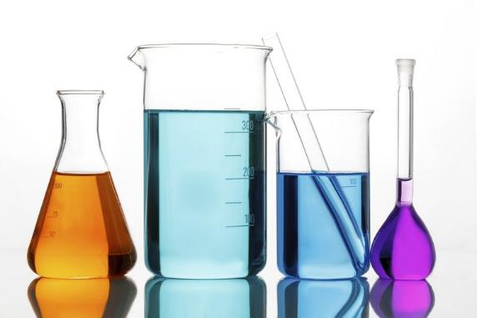
3. The word AQUEOUS means…
DISSOLVED into WATER (not other liquids, just water)
Things that are aqueous are SOLUTION - like salt water, or tea, or acids.

Slide 6
4. Matter can be PURE or MIXED.
Pure matter includes the _________________ from the ______________ ________________ and all of the millions of _________________
5. Mixed Matter is just

Slide 7
4. Matter can be PURE or MIXED.
Pure matter includes the ELEMENTS from the PERIODIC TABLE and all of the millions of COMPOUNDS
5. Mixed Matter is just PHYSICAL BLENDS OF PURE SUBSTANCES

Slide 8
6. What are physical properties of matter? Qualities that can be…
__________ and are ______________

Slide 9
6. What is a physical property of matter? Qualities that can be…
CONSTANT and are MEASURABLE

Slide 10
7. Examples of physical properties include…

Slide 11
7. Examples of physical properties include…
Density
Boiling Point (or condensing point)
Freezing point (or melting point)
Hardness
Magnetic attraction (or not)
Solubility in water (aqueous)
Solubility in other solvents (oils, ethers, etc.)
and many more.

Slide 12
8. Physical Changes are also called __________ changes.

Slide 13
8. Physical Changes are also called PHASE changes.

Slide 14
9. PHYSICAL CHANGES are PHASE CHANGES name all six phase changes…
SOLID LIQUID GAS

Slide 15
SOLID LIQUID GAS
MELTING
VAPORIZING

Slide 16
SOLID LIQUID GAS
MELTING
VAPORIZING
FREEZING
CONDENSING

Slide 17
SOLID LIQUID GAS
MELTING
VAPORIZING
FREEZING
CONDENSING
SUBLIMATION
DEPOSITION

Slide 18
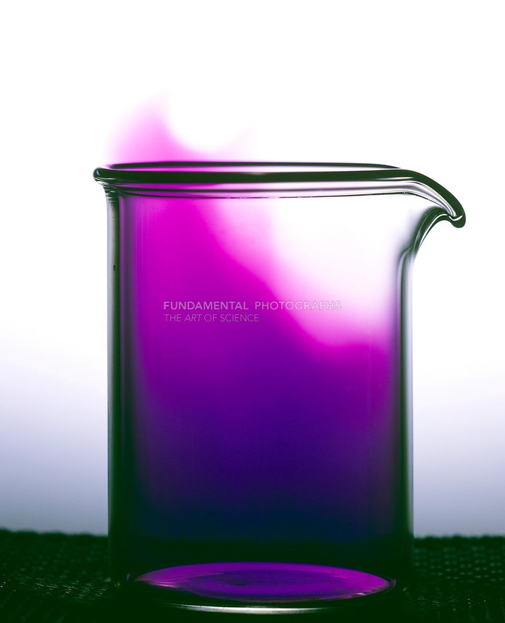
Get up, it’s time for a neat demo
Iodine, the element, which is a solid at normal temperature, will be made to sublimate into iodine gas, without becoming a liquid first.
That means it will Sublimate.
Then it will undergo Deposition.

Slide 19
10. Chemical & Physical Changes in matter
No new matter forms. No new properties form. Same formulas.
Physical Changes
Chemical Changes
A rearrangement of the atoms or particles of the substance
New matter forms. New properties form. Different formulas.
11. Physical changes are just phase changes. Chemical changes are reactions, which make new stuff.

Slide 20
12. What are MIXTURES?
Mixtures are…
The properties of matter in a mixture…

Slide 21
12. What are MIXTURES?
Mixtures are… PHYSICAL BLENDS OF PURE MATTER
The properties of matter in a mixture… CONSTANT. THEY ARE STILL PRESENT. NO NEW COMPOUNDS ARE FORMED WHEN MAKING A MIXTURE. NO NEW PROPERTIES FORM EITHER.

Slide 22
14. Mixtures are either the same throughout or are randomly mixed together.
15. Mixtures that are mixed the SAME THROUGHOUT are called…
16. Mixtures that are mixed DIFFERENTLY THROUGHOUT are called…

Slide 23
15. Mixtures that are mixed the SAME THROUGHOUT are called… HOMOGENEOUS
16. Mixtures that are mixed DIFFERENTLY THROUGHOUT are called… HETEROGENOUS

Slide 24
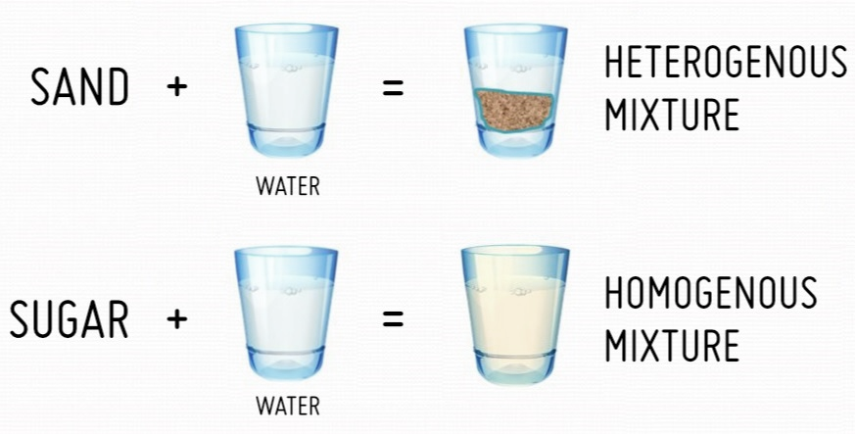
Examples
17
18

Slide 25
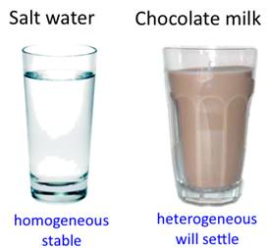
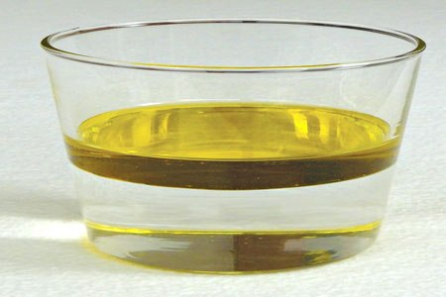
Salty Water Chocolate milk Oil & white vinegar
Homogeneous stays mixed perfectly
Heterogenous, will settle apart soon
Heterogeneous, will not mix at all
19. Salt water is homogeneous – it’s the same throughout.
20. Chocolate milk is heterogeneous, because the chocolate will settle to the bottom. (It does start mostly homogeneous)
21. Oil and vinegar are heterogeneous; they will not mix.

Slide 26
22. Mixtures can come in ALL PHASES. Examples of mixtures
Solution phase | examples | Contains this | Mixed with this
Solids | Steel | Carbon | Iron
 | Brass | Zinc | Copper
Liquids | Wine | Ethanol | Fruit juice
 | Vinegar | Acetic acid | Water
Gas | Air | Oxygen | Nitrogen
Aqueous | Salty water | Table salt | Water
 | Kool Aid | Sugar + Food color | Water

Slide 27
Matter Class #2 OB: Matter Vocabulary, Compounds + Elements, the Law of Conservation of Matter

Slide 28
23
MATTER
Mixtures (two flavors ☺)
Pure substances all homogeneous

Slide 29
23
MATTER
Mixtures (two flavors ☺)
Pure substances all homogeneous
Elements examples: Mg, Ca, Fe
Compounds examples: H₂0, CO₂, NaCl

Slide 30
23
MATTER
Mixtures (two flavors ☺)
Pure substances all homogeneous
Homogeneous
examples:
air, tap water, includes all solutions
Elements examples: Mg, Ca, Fe
Heterogeneous sugar + salt, sand + water, concrete, soup
Compounds examples: H₂0, CO₂, NaCl

Slide 31
The Law of Conservation of Matter
Matter cannot be created or destroyed in a chemical reaction, or in a physical change.
What is a physical change again?
24

Slide 32
The Law of Conservation of Matter
Matter cannot be created or destroyed in a chemical reaction, or in a physical change.
What is a physical change again?
A phase change.
24

Slide 33
Write this word equation on the line to start:
Sodium and Chlorine yields Sodium Chloride
25. The sodium + chlorine are called ____________
26. Sodium Chloride is the __________________
27. The mass of the the mass of the ____________ _____________
because all chemical reactions follows the…
=

Slide 34
Write this word equation on the line to start:
Sodium and Chlorine yields Sodium Chloride
25. The sodium + chlorine are called REACTANTS
26. Sodium Chloride is the PRODUCT
27. The mass of the the mass of the
=

Slide 35
Write this word equation on the line to start:
Sodium and Chlorine yields Sodium Chloride
25. The sodium + chlorine are called REACTANTS
26. Sodium Chloride is the PRODUCT
27. The mass of the the mass of the REACTANTS PRODUCTS
because all chemical reactions follows the… Law of Conservation of Matter
=

Slide 36
If you completely react 46 grams of sodium with 70 grams of chlorine gas, how many grams of sodium chloride form? _____

Slide 37
If you completely react 46 grams of sodium with 70 grams of chlorine gas, how many grams of sodium chloride form? _____
46 g Na + 70 g Cl → 116 grams of NaCl

Slide 38
29. If you completely react 8 g hydrogen with 64 g of oxygen, how many grams of water will form?

Slide 39
29. If you completely react 8 g hydrogen with 64 g of oxygen, how many grams of water will form?
8 g hydrogen + 64 g oxygen → 72 g water

Slide 40
30. If 4 g hydrogen reacts with sufficient oxygen and forms 36 grams water, how many grams of oxygen was used up in this reaction?

Slide 41
30. If 4 g hydrogen reacts with sufficient oxygen and forms 36 grams water, how many grams of oxygen was used up in this reaction? 4 g hydrogen + 32 g oxygen → 36 grams H₂O

Slide 42
31. Fill in the blank with the correct value.
____ g H₂ + 28 g N₂ → 34 g NH₃

Slide 43
31. Fill in the blank with the correct value.
6 g H₂ + 28 g N₂ → 34 g NH₃

Slide 44
32. Fill in the blank with the correct value.
223 g Fe + 96 grams O₂ → ___ g Fe₂O₃ (rust)

Slide 45
32. Fill in the blanks with the correct values.
223 g Fe + 96 grams O₂ → 319 g Fe₂O₃ (rust)

Slide 46
How to counting atoms in chemical formulas.
Rust has this formula: Fe₂O₃ It has __ atoms of iron bonded to _{__ atoms of oxygen} for a total of __ atoms in this compound.

Slide 47
How to counting atoms in chemical formulas.
Rust has this formula: Fe₂O₃ It has 2 atoms of iron bonded to _{3 atoms of oxygen} for a total of 5 atoms in this compound.

Slide 48
How to counting atoms in chemical formulas.
34. Carbon dioxide is CO₂ It has __ atom of carbon bonded to __ atoms of oxygen, for a total of _{__ atoms in this compound.}

Slide 49
How to counting atoms in chemical formulas.
34. Carbon dioxide is CO₂ It has 1 atom of carbon bonded to 2 atoms of oxygen, for a total of _{3 atoms in this compound.}

Slide 50
35. How many atoms are in each compounds?
H₂O ___________
NaCl ___________
CO₂ ___________
H₃PO₄ ___________
H₂SO₄ ___________
C₆H₁₂O₆ ___________

Slide 51
35. How many atoms are in each compounds? H₂O = 3 = 2 hydrogen atoms + 1 oxygen atom
NaCl
CO₂
H₃PO₄
H₂SO₄
C₆H₁₂O₆

Slide 52
35. How many atoms are in each compounds? H₂O = 3 = 2 hydrogen atoms + 1 oxygen atom
NaCl = 2 = 1 sodium atom + 1 chlorine atom
CO₂
H₃PO₄
H₂SO₄
C₆H₁₂O₆

Slide 53
35. How many atoms are in each compounds? H₂O = 3 = 2 hydrogen atoms + 1 oxygen atom
NaCl = 2 = 1 sodium atom + 1 chlorine atom
CO₂ = 3 = 1 carbon atom + 2 oxygen atoms
H₃PO₄
H₂SO₄
C₆H₁₂O₆

Slide 54
35. How many atoms are in each compounds? H₂O = 3 = 2 hydrogen atoms + 1 oxygen atom
NaCl = 2 = 1 sodium atom + 1 chlorine atom
CO₂ = 3 = 1 carbon atom + 2 oxygen atoms
H₃PO₄ = 8 = 3 H + 1 P + 4 O
H₂SO₄
C₆H₁₂O₆

Slide 55
35. How many atoms are in each compounds? H₂O = 3 = 2 hydrogen atoms + 1 oxygen atom
NaCl = 2 = 1 sodium atom + 1 chlorine atom
CO₂ = 3 = 1 carbon atom + 2 oxygen atoms
H₃PO₄ = 8 = 3 H + 1 P + 4 O
H₂SO₄ = 2 + 1 + 4
C₆H₁₂O₆

Slide 56
35. How many atoms are in each compounds? H₂O = 3 = 2 hydrogen atoms + 1 oxygen atom
NaCl = 2 = 1 sodium atom + 1 chlorine atom
CO₂ = 3 = 1 carbon atom + 2 oxygen atoms
H₃PO₄ = 8 = 3 H + 1 P + 4 O
H₂SO₄ = 7 = 2 + 1 + 4
C₆H₁₂O₆ = 24 = 6 + 12 + 6

Slide 57
36. These are harder, how many atoms of each kind, how many all together in each compound?
SnO₂ H₃PO₄
KHCO₃ Li₂C₂O₄
Ca(OH)₂ Al(OH)₃
Al₂(Cr₂O₇)₃ (NH₄)₂SO₃

Slide 58
36. These are harder, how many atoms of each kind, how many all together in each compound?
SnO₂ H₃PO₄
KHCO₃ Li₂C₂O₄
Ca(OH)₂ Al(OH)₃
Al₂(Cr₂O₇)₃ (NH₄)₂SO₃
3 total = Sn + 2 O

Slide 59
36. These are harder, how many atoms of each kind, how many all together in each compound?
SnO₂ H₃PO₄
KHCO₃ Li₂C₂O₄
Ca(OH)₂ Al(OH)₃
Al₂(Cr₂O₇)₃ (NH₄)₂SO₃
3 total = Sn + 2 O
8 = 3 H + 1 P + 4 O

Slide 60
36. These are harder, how many atoms of each kind, how many all together in each compound?
SnO₂ H₃PO₄
KHCO₃ Li₂C₂O₄
Ca(OH)₂ Al(OH)₃
Al₂(Cr₂O₇)₃ (NH₄)₂SO₃
3 total = Sn + 2 O
8 = 3 H + 1 P + 4 O
6 total = K + 1 H + 1 C + 3 O

Slide 61
36. These are harder, how many atoms of each kind, how many all together in each compound?
SnO₂ H₃PO₄
KHCO₃ Li₂C₂O₄
Ca(OH)₂ Al(OH)₃
Al₂(Cr₂O₇)₃ (NH₄)₂SO₃
3 total = Sn + 2 O
8 = 3 H + 1 P + 4 O
6 total = K + 1 H + 1 C + 3 O
8 = 2 Li + 2 C + 4 O

Slide 62
36. These are harder, how many atoms of each kind, how many all together in each compound?
SnO₂ H₃PO₄
KHCO₃ Li₂C₂O₄
Ca(OH)₂ Al(OH)₃
Al₂(Cr₂O₇)₃ (NH₄)₂SO₃
3 total = Sn + 2 O
8 = 3 H + 1 P + 4 O
6 total = K + 1 H + 1 C + 3 O
8 = 2 Li + 2 C + 4 O
5 total = 1 Ca + O + H and O + H again

Slide 63
36. These are harder, how many atoms of each kind, how many all together in each compound?
SnO₂ H₃PO₄
KHCO₃ Li₂C₂O₄
Ca(OH)₂ Al(OH)₃
Al₂(Cr₂O₇)₃ (NH₄)₂SO₃
3 total = Sn + 2 O
8 = 3 H + 1 P + 4 O
6 total = K + 1 H + 1 C + 3 O
8 = 2 Li + 2 C + 4 O
7 = 1 Al + O + H + O + H + O + H (three times!)
5 total = 1 Ca + O + H and O + H again

Slide 64
36. These are harder, how many atoms of each kind, how many all together in each compound?
SnO₂ H₃PO₄
KHCO₃ Li₂C₂O₄
Ca(OH)₂ Al(OH)₃
Al₂(Cr₂O₇)₃ (NH₄)₂SO₃
3 total = Sn + 2 O
8 = 3 H + 1 P + 4 O
6 total = K + 1 H + 1 C + 3 O
8 = 2 Li + 2 C + 4 O
7 = 1 Al + O + H + O + H + O + H (three times!)
5 total = 1 Ca + O + H and O + H again
29 = 2 Al + 2 Cr + 7 O and 2 Cr + 7 O and 2 Cr + 7 O again (three times!)

Slide 65
36. These are harder, how many atoms of each kind, how many all together in each compound?
SnO₂ H₃PO₄
KHCO₃ Li₂C₂O₄
Ca(OH)₂ Al(OH)₃
Al₂(Cr₂O₇)₃ (NH₄)₂SO₃
3 total = Sn + 2 O
8 = 3 H + 1 P + 4 O
6 total = K + 1 H + 1 C + 3 O
8 = 2 Li + 2 C + 4 O
7 = 1 Al + O + H + O + H + O + H (three times!)
5 total = 1 Ca + O + H and O + H again
29 = 2 Al + 2 Cr + 7 O and 2 Cr + 7 O and 2 Cr + 7 O again (three times!)
14 = N + 4 H + N + 4 H + 1 S + 3 O

Slide 66
Matter Class #3
Objectives: How can we separate mixtures apart into pure substances?
Also, how can we tell if a chemical reaction has occurred?
Lab pushed back to Friday. It will be better with a bit more knowledge. This is bumped up, one period of class notes, one period of chem “art”.

Slide 67
37. Mixtures are just physical blends of pure substances, they could be
Elements + Elements, or
Elements + Compounds, or
Compounds + Compounds, etc.
38. Compounds are chemically bonded atoms, which make new substances, with new properties.
39. Mixtures retain the properties of the parts, no new substances and no new properties either.

Slide 68
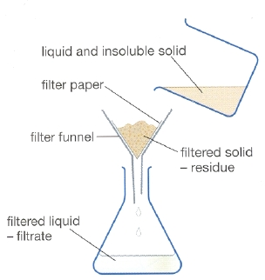
Since mixtures are just physically mixed, you should be able to separate them with just physical means (not chemical).
For instance, to separate the mixture of sand and water, you could filter them apart.
40. The “principle” that allows us to do this is that the sand is much bigger than the water particles, and sand gets stuck in the filter paper. We…
TAKE ADVANTAGE OF A DIFFERENCE IN THEIR PHYSICAL PROPERTIES.

Slide 69
41. If you have an aqueous solution of ethanol and water and need to separate them, you can’t filter them, both particles are too small to be caught in a filter paper. You can take advantage of the fact that they have a different boiling point (about 100°C for water, about 81°C for the alcohol).
Ethanol vapor
°
81°C
°
°
Ethanol and water solution
Hot water
°
DRAW INTO NOTES
Heat up to 81°C, only the ethanol boils away, the water just gets hot.

Slide 70
42. Using a distillation apparatus, you can control the temperature of heating, boiling away only the ethanol. The ethanol vaporizes, rises up, and is pushed into the condensing tube, dripping pure ethanol into the beaker. This will leave the hot water in the flask. You separate the mixture by taking advantage of the physical property difference between water and ethanol called boiling point.
Thermometer 81°C
Vaporized ethanol
Condensing tube
Water + ethanol
Controlled Heat
Ethanol collects in beaker

Slide 71
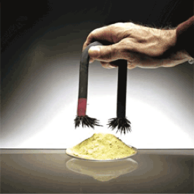
Solid sulfur and solid iron cannot be filtered apart, nor can they be distilled apart. THINK…
43. Here, the iron is separated from sulfur, by taking advantage of the magnetic attraction of iron to the magnet, which sulfur does not have.

Slide 72
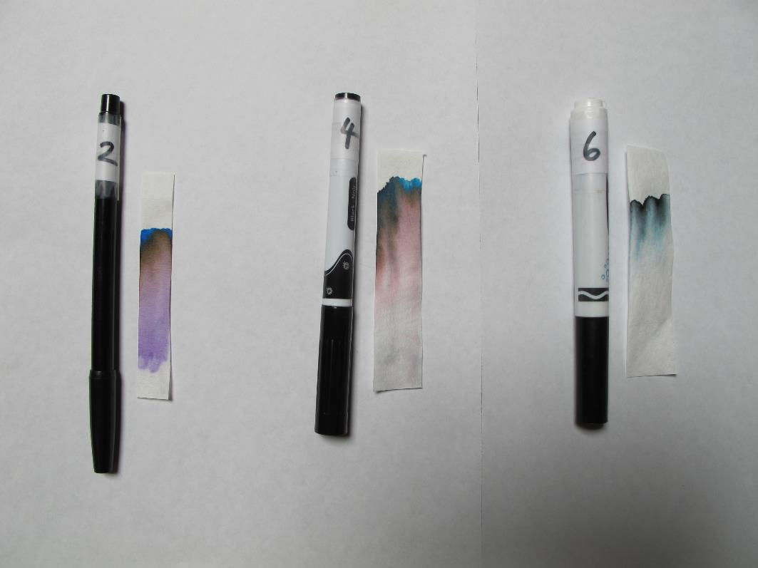
44. Something that we will do is called PAPER CHROMATOGRAPHY. It will allow the separate of colors by taking advantage of both solubility of ink in water, and density of particles. Some inks are permanent (insoluble in water) and won’t move. Some are able to dissolve into water. When the color particles lift up, the particles travel based upon their density. Some black markers are not all black (we will see soon what colors are hiding in the black looking mixture).

Slide 73
45. You could also separate mixtures by taking advantage of differences in
Freezing Points, Density, Melting Points, Etc.

Slide 74
Let’s switch to chemical reactions now.

Slide 75
46. A chemical reaction is when 2 or more substances are combined in a chemical reaction, and we get… ________________________ that form, and
these have __________ properties than the reactants had.

Slide 76
46. A chemical reaction is when 2 or more substances are combined in a chemical reaction, and we get… NEW PURE SUBSTANCES that form, and
these have DIFFERENT properties than the reactants had.

Slide 77
TOPIC-B
We need to notice if a chemical reaction happened or not.
There are several indicators that a chemical reaction has probably happened.
Indicators are a heads up, not PROOF. Thinking is still required.
47. How will we recognize if a chemical reaction has probably happened? We will use.. The acronym TOPIC-B to remember what to look for.

Slide 78
48. If these things “happen”, a chemical reaction probably happened.
T – temperature change - if substances get hotter or colder

Slide 79
48. If these things “happen”, a chemical reaction probably happened.
T – temperature change - if substances get hotter or colder
O – odor change - if the substances changes in smell

Slide 80
48. If these things “happen”, a chemical reaction probably happened.
T – temperature change - if substances get hotter or colder
O – odor change - if the substances changes in smell
P – precipitate - if you mix solutions, solids form

Slide 81
48. If these things “happen”, a chemical reaction probably happened.
T – temperature change - if substances get hotter or colder
O – odor change - if the substances changes in smell
P – precipitate - if you mix solutions, solids form
I – irreversibility – technically SPONTANEOUSLY irreversible. Most reactions are “one way”, if they occur, they stay changed. Reactions do not usually reverse easily.

Slide 82
48. If these things “happen”, a chemical reaction probably happened.
T – temperature change - if substances get hotter or colder
O – odor change - if the substances changes in smell
P – precipitate - if you mix solutions, solids form
I – irreversibility – technically SPONTANEOUSLY irreversible. Most reactions are “one way”, if they occur, they stay changed. Reactions do not usually reverse easily.
C – color change – if your substances changes color

Slide 83
48. If these things “happen”, a chemical reaction probably happened.
T – temperature change - if substances get hotter or colder
O – odor change - if the substances changes in smell
P – precipitate - if you mix solutions, solids form
I – irreversibility – technically SPONTANEOUSLY irreversible. Most reactions are “one way”, if they occur, they stay changed. Reactions do not usually reverse easily.
C – color change – if your substances changes color
B – bubbles - if your substances create new bubbles of gas

Slide 84
Notes away, time for Chromatography Fun.
You will enjoy this.

Slide 85
Matter Class #4 Objective: Particle Diagrams for solids, liquids, gases, atoms, molecules, compounds, and mixtures. Put on your thinking hats.

Slide 86
49. A particle diagram shows the idea of chemical substances in a cartoon sort of way
The diagrams are not realistic in shape, but with some imagination and thinking, you can understand what they are going to show.
You need to be aware of these vocabulary words to move forward. Think, or ask now.
SOLID – LIQUID – GAS
ATOM – COMPOUND – MIXTURE – DIATOMIC ELEMENTS
These particle diagrams will show all seven of these, you need to be able to recognize them, and draw them too.

Slide 87
50. Particle diagrams for a GAS, a LIQUID, and SOLID
Gas particles don’t touch each other, they “float” in space. Liquids are at the bottom of the container, but not arranged orderly. Solid matter has particles in a very orderly pattern, they do not conform to the shape of the container.

Slide 88
51. Gases have indefinite volume, and indefinite shape. They fill any container of any size you put them in. They take the shape of the container.

Slide 89
51. Gases have indefinite volume, and indefinite shape. They fill any container of any size you put them in. They take the shape of the container. 52. Liquids have a definite volume, and indefinite shape. They take the shape of the bottom of the container they are put into.

Slide 90
51. Gases have indefinite volume, and indefinite shape. They fill any container of any size you put them in. They take the shape of the container. 52. Liquids have a definite volume, and indefinite shape. They take the shape of the bottom of the container they are put into. 53. Solids have a definite volume and a definite shape, one that does not conform to the container.

Slide 91
Atoms, diatomic elements, and molecules… which are which?

Slide 92
54. Particles are small shapes. A single shape alone indicates an _____________
55. When 2 or more shapes touch, this symbolizes a __________________.
56. If the 2 shapes that touch are IDENTICAL, that indicates a __________ __________

Slide 93
54. Particles are small shapes. A single shape alone indicates an ATOM
55. When 2 or more shapes touch, this symbolizes a COMPOUND.
56. If the 2 shapes that touch are IDENTICAL, that indicates a DIATOMIC ELEMENT

Slide 94
57. Draw some atoms, some compounds and some diatomic elements.
58. How will you remember the 7 elements that are diatomic?
They are the HONClBrIF Twins!

Slide 96
Gas, Molecules, like NH₃ or SO₃

Slide 97
Gas, Molecules, like NH₃ or SO₃
Solid: organized and does not conform to shape of container.

Slide 98
Gas, Molecules, like NH₃ or SO₃
Solid: organized and does not conform to shape of container.
Liquid: a bit random, takes the shape of the bottom of the container.

Slide 99
Gas, like CO₂
Gas, Molecules, like NH₃ or SO₃
Solid: organized and does not conform to shape of container.
Liquid: a bit random, takes the shape of the bottom of the container.

Slide 100
Gas, like CO₂
HONClBrIF Twins, Diatomic Elements
Gas, Molecules, like NH₃ or SO₃
Solid: organized and does not conform to shape of container.
Liquid: a bit random, takes the shape of the bottom of the container.

Slide 101
REVIEW OF MATTER
Know it all, be one with the matter. You can do it. Take out a sheet of paper, number it 1 to 12+1 J
Or do this at home!

Slide 102
59. A physical change is another way to say
a compound forms
a phase change happens
matter is turned into other matter
you change the shape by squishing or pushing matter

Slide 103
59. A physical change is another way to say
a compound forms
a phase change happens
matter is turned into other matter
you change the shape by squishing or pushing matter

Slide 104
60. Match these up
GAS
LIQUID
SOLID
Definite shape definite volume
Indefinite shape, indefinite volume
Indefinite shape, definite volume

Slide 105
60. Match these up
GAS
LIQUID
SOLID
Definite shape definite volume
Indefinite shape, indefinite volume
Indefinite shape, definite volume

Slide 106
61. Define Heterogeneous

Slide 107
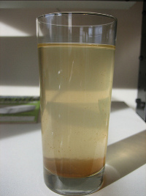
61. Define Heterogeneous NOT the same throughout, like raisin bran cereal, or sand and water.

Slide 108
62. Which CAN be decomposed by a chemical change?
A. Co B. CO C. Hg D. Fe

Slide 109
62. Which CAN be decomposed by a chemical change?
A. Co B. CO C. Hg D. Fe

Slide 110
63. How can we separate a mixture of salty water? A. A chemical reaction B. Filter paper C. With a magnet D. With a distillation apparatus

Slide 111
63. How can we separate a mixture of salty water? A. A chemical reaction B. Filter paper C. With a magnet D. With a distillation apparatus Take advantage of a difference in boiling point between salt and water.

Slide 112
64. Convert the melting point of copper into centigrade degrees. Use a formula.

Slide 113
64. Convert the melting point of copper into centigrade degrees. Use a formula. K = C + 273
1358 = C + 273
1085° = C

Slide 114
65. If 502 grams of iron completely combines with 216 grams of oxygen to form rust, how many grams of rust form?

Slide 115
65. If 502 grams of iron completely combines with 216 grams of oxygen to form rust, how many grams of rust form? 502 g + 216 g = 718 grams rust

Slide 116
66. When 2 elements chemically combine into a product, the product… A. has the same properties as the reactants B. has a blend of properties of the reactants C. has new, unique properties, unlike the reactants D. may or may not be similar, it depends on the elements combining

Slide 117
66. When 2 elements chemically combine into a product, the product… A. has the same properties as the reactants B. has a blend of properties of the reactants C. has new, unique properties, unlike the reactants D. may or may not be similar, it depends on the elements combining

Slide 118
67. Count the number of atoms in these formulas A. aluminum permanganate Al(MnO₄)₃ B. ammonium carbonate (NH₄)₂CO₃ C. nickel (III) acetate Ni(C₂H₃O₂)₃

Slide 119
67. Count the number of atoms in these formulas A. aluminum permanganate Al(MnO₄)₃ 16 B. ammonium carbonate (NH₄)₂CO₃ 14 C. nickel (III) acetate Ni(C₂H₃O₂)₃ 22

Slide 120
68. Name the phase changes
Solid to Gas
Liquid to Gas
Solid to Liquid
Gas to Solid
Liquid to Solid
Gas to Liquid

Slide 121
68. Name the phase changes
Solid to Gas - sublimation
Liquid to Gas - vaporization
Solid to Liquid - melting
Gas to Solid - deposition
Liquid to Solid - freezing
Gas to Liquid - condensation

Slide 122
69. State standard temperature in both Kelvin and in Centigrade.

Slide 123
69. State standard temperature in both Kelvin and in Centigrade. Table A shows this.
273 Kelvin, or 0°C

Slide 124
70. Calculate (with a formula) the volume of 375 grams of sodium metal.

Slide 125
70. Calculate (with a formula) the volume of 375 grams of sodium metal.
D =
Mass Volume
375 grams Volume
0.97 g/cm³ =
0.97 g/cm³ (V) = 375 grams
V = 387 cm³ (3 sf)
0.97 g/cm³ = 0.97 g/cm³

Slide 126
C₇H_{16(L)} + 11O_{2(G)} → 7CO_{2(G)} + 8H₂O_{(G)}
This is a balanced equation for the combustion of heptane.
71. Which of the four are reactants? 72. Which are the products?
73. How many atoms in heptane?

Slide 127
C₇H_{16(L)} + 11O_{2(G)} → 7CO_{2(G)} + 8H₂O_{(G)}
Reactants in blue, products are in red
71. Which of the four are reactants? 72. Which are the products?
73. How many atoms in heptane? C₇H₁₆ has 7 + 16 = 23 atoms

Slide 128
74. Name some ways to separate mixtures, (use the “one liner” that tells us how to do it).

Slide 129
74. Name some ways to separate mixtures, (use the “one liner” that tells us how to do it). Take advantage of a difference in physical properties.
Use a filter, a magnet, evaporate or boil away water, a distillation apparatus, chromatography, use tweezers, melt them apart, etc.

Slide 130
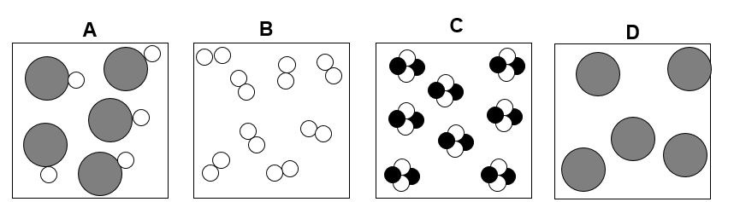
75. Which box or boxes contain
A diatomic element? A mixture?
A monoatomic element? A compound?

Slide 131
75. Which box or boxes contain
A diatomic element? B A mixture? none
A monoatomic element? D A compound? A + C

