Slide 1
Welcome to Nuclear Chemistry Previously we have been focusing on how the electrons of atoms and ions do their thing. Electrons are shared, transferred, and allow for bonding.
1. Nuclear Chem is about the NUCLEUS, not the electrons. And, nuclear chem is weird.

Slide 2
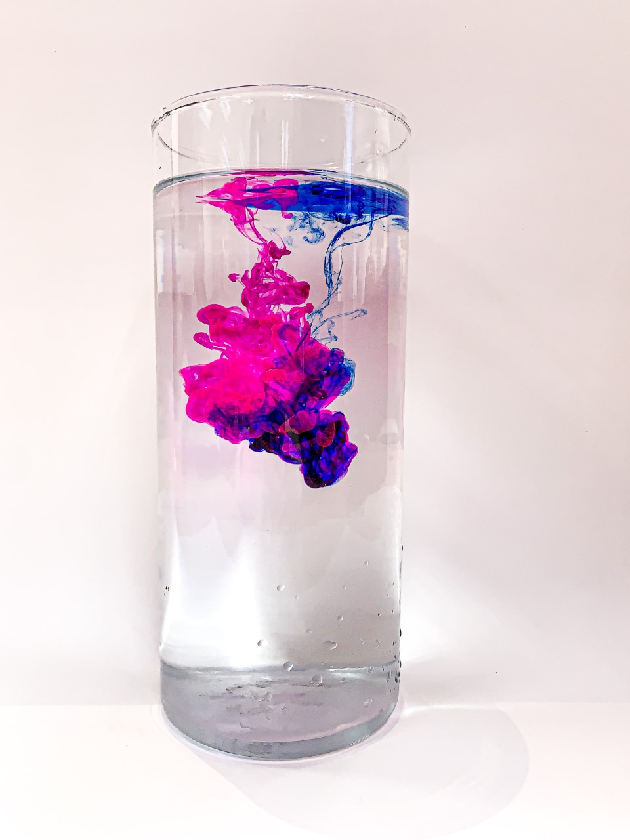
The Vestal Student Art Show was recently released online due to us being outside of school.
I love art, and I love that students put it all on the line and have the guts to put their stuff up for show to all.
All of it was good, and I’m not the real judge. If I were, each kid would get the blue ribbon for imagination and courage. Still, if I had to choose “Best in Show” - this would be it.
Katie Stump is your classmate. Her photograph stands out (to me) and I wanted to share it here, and I’m sure she’s a little embarrassed too, but I don’t care. Take a bow, be proud, and motivate the rest of us to be the best we can be.
Thank you.

Slide 3
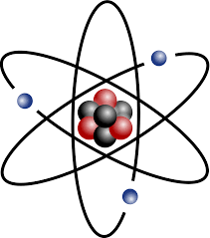
A quick reminder…
Atoms have neutrons and protons in the nucleus, and the electrons fly around outside. There are always the same number of protons as electrons (the positives = the negatives). 2. The ATOMIC NUMBER is the number of protons.
3. Atomic MASS in high school is measured in AMU’s.
Each proton = 1 AMU Each neutron = 1 AMU
Atomic Mass = # protons PLUS # neutrons (in AMU)

Slide 4
4. Example…
Mercury has mass of 201 AMU = (protons plus neutrons) 201
minus 80 protons - 80
equals the number of neutrons 121
Since there are 80 positive protons, there are also 80 negative electrons
You should be able to determine the number of protons, neutrons and electrons for any atom on the periodic table.

Slide 5
Every atom has a unique number of protons (& electrons too).
5. If you are an atom with 12 protons, you MUST be Mg.
6. If you have 29 protons, you’re COPPER.
7. Atoms with 92 protons, can only be URANIUM.
---------------------------------
8. Every atom has a certain number of neutrons, but there are many isotopes.
9. Isotopes are atoms of an element with a different number of neutrons (but the SAME number of protons and electrons).

Slide 6
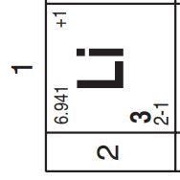
10. How many protons, neutrons and electrons are in lithium from the Periodic table?

Slide 7
10. How many protons, neutrons and electrons are in lithium from the Periodic table?
Atomic mass 6.941 rounds to 7 AMU
We ALWAYS ROUND to the NEAREST WHOLE number high school.

Slide 8
10. How many protons, neutrons and electrons are in lithium from the Periodic table?
Atomic mass 6.941 rounds to 7 AMU
Atomic Number is 3, that means 3 protons (and 2 - 1 = 3 electrons too)

Slide 9
10. How many protons, neutrons and electrons are in lithium from the Periodic table? Lithium (p + n) mass: 7 AMU minus the protons: -

Slide 10
10. How many protons, neutrons and electrons are in lithium from the Periodic table? Lithium (p + n) mass: 7 AMU minus the protons: - 3 protons

Slide 11
10. How many protons, neutrons and electrons are in lithium from the Periodic table? Lithium (p + n) mass: 7 AMU minus the protons: - 3 protons 4 neutrons

Slide 12
11. Determine protons, neutrons and electron count for C-12

Slide 13
11. Determine protons, neutrons and electron count for C-12 Carbon-12 (p plus n) mass: 12 AMU minus the protons: -

Slide 14
11. Determine protons, neutrons and electron count for C-12 Carbon-12 (p plus n) mass: 12 AMU minus the protons: - 6 protons

Slide 15
11. Determine protons, neutrons and electron count for C-12 Carbon-12 (p plus n) mass: 12 AMU minus the protons: - 6 protons
6 neutrons

Slide 16
Determine protons, neutrons and electron count for C-14
Carbon-14 (p plus n) mass: 14 AMU minus the protons: -

Slide 17
Determine protons, neutrons and electron count for C-14
Carbon-14 (p plus n) mass: 14 AMU minus the protons: - 6 protons

Slide 18
Determine protons, neutrons and electron count for C-14
Carbon-14 (p plus n) mass: 14 AMU minus the protons: - 6 protons
8 neutrons
This is different that C-12, so different that this isotope of carbon is radioactive (unstable).

Slide 19
12. Determine protons, neutrons and electron counts for P-31 (stable P) and then P-32 (radioactive P)

Slide 20
12. Determine protons, neutrons and electron counts for P-31 (stable P) and then P-32 (radioactive P) Phosphorous-31 (p plus n) mass: 31 AMU minus the protons: -
Phosphorous-32 (p plus n) mass: 32 AMU minus the protons: -

Slide 21
12. Determine protons, neutrons and electron counts for P-31 (stable P) and then P-30 (radioactive P) Phosphorous-31 (p plus n) mass: 31 AMU minus the protons: - 15 protons
Phosphorous-32 (p plus n) mass: 32 AMU minus the protons: - 15 protons

Slide 22
12. Determine protons, neutrons and electron counts for P-31 (stable P) and then P-32 (radioactive P) Phosphorous-31 (p plus n) mass: 31 AMU minus the protons: - 15 protons
16 neutrons
Phosphorous-32 (p plus n) mass: 32 AMU minus the protons: - 15 protons
17 neutrons

Slide 23
What is the neutron to proton ratio for each isotope? Phosphorous-31 has 16 neutrons to 15 protons (stable)
Phosphorous-32 has 17 neutrons to 15 protons (unstable)

Slide 24
14. Of the 118 known elements, there are about 1500 known ISOTOPES. There are 3 different isotopes of even tiny HYDROGEN. Every atom has several or more isotopes.
Of these 1500 isotopes, about 1350 of them are stable.
Stable means that the neutron to proton ratio falls into a “zone of stability”.
17. About 150 isotopes are UNSTABLE. Their n° : p⁺ ratio is funky, and they need to FIX this ratio to become stable.

Slide 25
18. FIXING this neutron to proton ratio means they will EMIT RADIATION, or parts of their nucleus.
19. Emitting radiation means emitting a variety of nuclear particles and/or energy, which will change the neutron to proton ratio.
The International Symbol for Radiation
(danger)

Slide 26
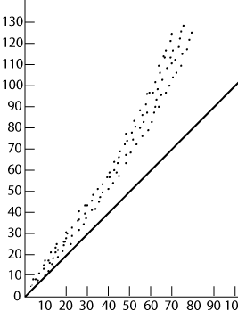
20. The Neutron:Proton ratio for
Small atoms: ~1:1
Larger atoms: ~1½ n°:1p⁺¹
All nuclei with ratios outside this band are unstable, and that’s what we’ll look at during nuclear chem.
Band of Stable neutron : proton ratios
1:1
#n°
#p⁺

Slide 27
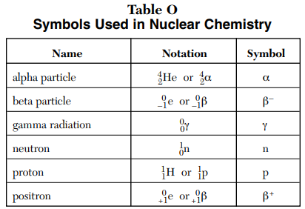
Table O Table O lists all of the radioactive particles we need
Radioactive emission is mostly particles, but can be energy as well. The radiation that we need to familiarize ourselves with is in Table O.

Slide 28
21. FILL IN THIS CHART about RADIOACTIVE PARTICLES and energy.
Table O | Mass | Charge | Symbols | Penetrating power
ALPHA
BETA
GAMMA
NEUTRON
PROTON
POSITRON

Slide 29
21. FILL IN THIS CHART about RADIOACTIVE PARTICLES and energy.
Table O | Mass | Charge | Symbols | Penetrating power
ALPHA | 4 AMU | +2 |  | WEAKEST
BETA
GAMMA
NEUTRON
PROTON
POSITRON

Slide 30
21. FILL IN THIS CHART about RADIOACTIVE PARTICLES and energy.
Table O | Mass | Charge | Symbols | Penetrating power
ALPHA | 4 AMU | +2 |  | WEAKEST
BETA | ZERO in HS | -1 |  | STRONG
GAMMA
NEUTRON
PROTON
POSITRON

Slide 31
21. FILL IN THIS CHART about RADIOACTIVE PARTICLES and energy.
Table O | Mass | Charge | Symbols | Penetrating power
ALPHA | 4 AMU | +2 |  | WEAKEST
BETA | ZERO in HS | -1 |  | STRONG
GAMMA | ZERO | NEUTRAL |  | STRONGEST
NEUTRON
PROTON
POSITRON

Slide 32
21. FILL IN THIS CHART about RADIOACTIVE PARTICLES and energy.
Table O | Mass | Charge | Symbols | Penetrating power
ALPHA | 4 AMU | +2 |  | WEAKEST
BETA | ZERO in HS | -1 |  | STRONG
GAMMA | ZERO | NEUTRAL |  | STRONGEST
NEUTRON | 1 AMU | NEUTRAL |  | ---
PROTON
POSITRON

Slide 33
21. FILL IN THIS CHART about RADIOACTIVE PARTICLES and energy.
Table O | Mass | Charge | Symbols | Penetrating power
ALPHA | 4 AMU | +2 |  | WEAKEST
BETA | ZERO in HS | -1 |  | STRONG
GAMMA | ZERO | NEUTRAL |  | STRONGEST
NEUTRON | 1 AMU | NEUTRAL |  | ---
PROTON | 1 AMU | +1 |  | ---
POSITRON

Slide 34
21. FILL IN THIS CHART about RADIOACTIVE PARTICLES and energy.
Table O | Mass | Charge | Symbols | Penetrating power
ALPHA | 4 AMU | +2 |  | WEAKEST
BETA | ZERO in HS | -1 |  | STRONG
GAMMA | ZERO | NEUTRAL |  | STRONGEST
NEUTRON | 1 AMU | NEUTRAL |  | ---
PROTON | 1 AMU | +1 |  | ---
POSITRON | ZERO in HS | +1 |  | SIMILAR TO BETA

Slide 35
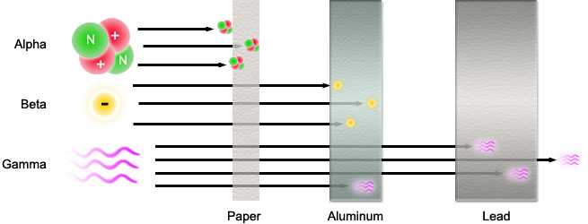
22. Can you be protected from RADIATION? What stops different kinds of radiation?

Slide 36
22. Can you be protected from RADIATION? What stops different kinds of radiation?
Different kinds of radiation have different PENETRATING POWER. Nothing stops that GAMMA radiation, you can’t hide.

Slide 37
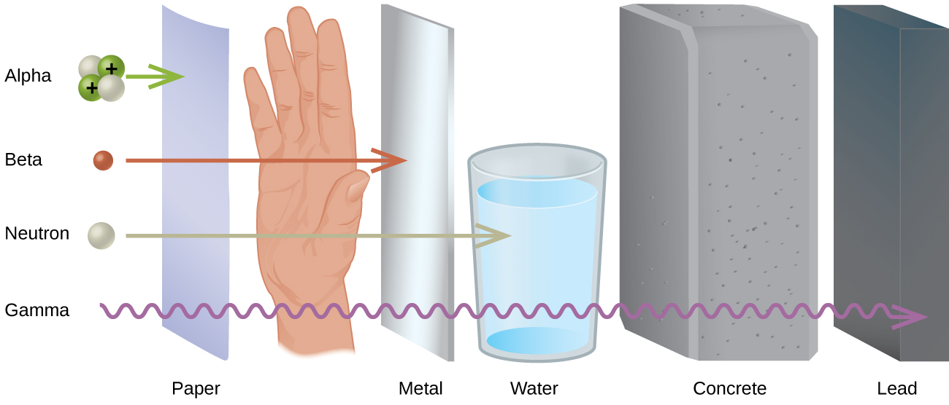
23. What can stop neutrons?
24. What stops gamma radiation? Nothing.

Slide 38
Radiation is emitted by unstable isotopes in an attempt to obtain a more stable neutron to proton ratio in the nucleus.
Emitting different types of radiation changes that ratio in different ways.

Slide 39
27. Some isotopes make one change, or emit radiation once, and they become stable.
28. Some isotopes make 2 or more different radioactive particles – in two or more steps, before they get stable.
29. The types of emissions, and the amount of time it takes to emit this radiation, is very well known to scientists.

Slide 40
Nothing can speed up this process, or slow it down.
It happens on its own, naturally.
When a nucleus emits radiation, and changes its neutron to proton ratio, it “becomes” a different kind of atom, it TRANSMUTES into a new kind of atom.
This process is called NATURAL TRANSMUTATION or RADIOACTIVE DECAY.

Slide 41
Nuclear Class 2
Natural Transmutation or Radioactive decay, Table N, and HALF LIFE problems

Slide 42
Radiation, comes in 6 forms, all listed in table O.
34. Unstable radioisotope nuclei literally spit out parts of themselves, to change the ratio of n° : p⁺ in their nuclei, to get stable.
35. Doing this changes them from one kind of an atom to another, which is called transmutation.

Slide 43
Let’s start doing some stuff, let’s look at table N.
The LAST radioisotope is called Uranium-238
The 238 is the atomic mass of this isotope. It has 238 amu or 238 total protons plus neutrons in the nucleus.
It’s on this Table N list because that is an unstable ratio.

Slide 44
Let’s start doing some stuff, let’s look at table N.
The LAST radioisotope is called Uranium-238
The 238 is the atomic mass of this isotope. It has 238 amu or 238 total protons plus neutrons in the nucleus.
It’s on this Table N list because that is an unstable ratio.
36.
238
U
238
92
U
This is really… this

Slide 45
Let’s start doing some stuff, let’s look at table N.
The LAST radioisotope is called Uranium-238
The 238 is the atomic mass of this isotope. It has 238 amu or 238 total protons plus neutrons in the nucleus.
It’s on this Table N list because that is an unstable ratio. What is that ratio you might ask (I was hoping someone would ask right now)
36.
238
U
238
92
U
This is really… this
Of those 238 total, 92 are protons
238 p⁺ plus n°

Slide 46
Table N says that this stuff will undergo ALPHA decay.
That means it emits an alpha particle as radiation to adjust the neutron to proton ratio, to get stable.
Table O shows us the symbols. It’s a chemical equation but with simple math to figure everything out.
238
92
U
An alpha particle of radiation + ??
Radiation emission causes transmutation

Slide 47
Table N says that this stuff will undergo ALPHA decay.
That means it emits an alpha particle as radiation to adjust the neutron to proton ratio, to get stable.
Table O shows us the symbols. It’s a chemical equation but with simple math to figure everything out.
238
92
U
An alpha particle of radiation + ??
Radiation emission causes transmutation
37.
??
238
92
U
4 2
+
He

Slide 48
238
92
U
4 2
+
He
Into the Grey Box, do the math::: 238 = 4 + X X = 234

Slide 49
238
92
U
4 2
+
234
He
Into the Grey Box, do the math::: 238 = 4 + X X = 234

Slide 50
238
92
U
4 2
+
234
He
Into the Grey Box, do the math::: 238 = 4 + X X = 234
Into the Orange Box, do the math::: 92 = 2 + X X = 90

Slide 51
238
92
U
4 2
+
234
90
He
Into the Grey Box, do the math::: 238 = 4 + X X = 234
Into the Orange Box, do the math::: 92 = 2 + X X = 90
And now into the Blue box, what element is #90?

Slide 52
238
92
U
4 2
+
234 | Th
90
He
Into the Grey Box, do the math::: 238 = 4 + X X = 234
Into the Orange Box, do the math::: 92 = 2 + X X = 90
And now into the Blue box, what element is #90?
Thorium

Slide 53
37.
238
92
U
+
Th
4 2
He
234
90
A lot of things just happened, let’s look at them all.

Slide 54
37.
238
92
U
+
Th
4 2
He
234
90
Radioactive U-238 emits an alpha particle in an attempt to get stable.
With 2 less protons, and 2 less neutrons, the uranium has TRANSMUTED into thorium-234
The numbers on the top make sense: 238 = 4 + 234
The numbers on the bottom make sense too: 92 = 2 + 90
This is called natural transmutation, or alpha decay, or slightly more vaguely, just radioactive decay.
Weirdly, this uranium atom just became an atom of thorium.

Slide 55
Let’s look at the radioisotope carbon 14. Determine it’s DECAY MODE, and then write out the decay equation.
14
C

Slide 56
Let’s look at the radioisotope carbon 14. Determine it’s DECAY MODE, and then write out the decay equation.
14
6
C

Slide 57
Let’s look at the radioisotope carbon 14. Determine it’s DECAY MODE, and then write out the decay equation.
14
6
C
0
-1
+
e

Slide 58
Let’s look at the radioisotope carbon 14. Determine it’s DECAY MODE, and then write out the decay equation.
14
6
C
0
-1
+
e

Slide 59
Let’s look at the radioisotope carbon 14. Determine it’s DECAY MODE, and then write out the decay equation.
14
6
C
0
-1
14
7
N
+
e
39. C-14 emits beta radiation, or, it undergoes beta decay. The carbon-14 transmutes into nitrogen-14.

Slide 60
40. Determine the decay mode for Ca-37, then write the decay reaction for calcium 37.
37
Ca

Slide 61
40. Determine the decay mode for Ca-37, then write the decay reaction for calcium 37.
37
20
Ca

Slide 62
40. Determine the decay mode for Ca-37, then write the decay reaction for calcium 37.
37
20
Ca
0
+1
+
e
41. Radioactive Ca-37 emitted a positron from it’s nucleus and it transmuted into _______

Slide 63
40. Determine the decay mode for Ca-37, then write the decay reaction for calcium 37.
37
20
Ca
0
+1
+
37
19
K
e
41. Radioactive Ca-37 emitted a positron from it’s nucleus and it transmuted into K-37. It undergoes positron decay. This is a form of natural transmutation because it JUST HAPPENS, with no help from you.

Slide 64
Write out these decay equations. Use tables N + O.
42.
226
Ra

Slide 65
Radium-226 is atom 88, it undergoes alpha decay.
42.
226
88
Ra

Slide 66
Radium-226 is atom 88, it undergoes alpha decay.
42.
226
88
Ra
4 2
He +

Slide 67
Radium-226 is atom 88, it undergoes alpha decay.
226
88
Ra
4 2
222
86
Rn
42.
He +
Radium 226 transmutes into radon-222 by emitting an alpha particle
43.

Slide 68
226
88
Ra
4 2
222
86
Rn
42.
He +
Radium 226 transmutes into radon-222 by emitting an alpha particle
43.
137
Cs

Slide 69
Cesium-137 undergoes beta decay
226
88
Ra
4 2
222
86
Rn
42.
He +
Radium 226 transmutes into radon-222 by emitting an alpha particle
43.
137
55
Cs

Slide 70
Cesium-137 undergoes beta decay
226
88
Ra
4 2
222
86
Rn
42.
He +
Radium 226 transmutes into radon-222 by emitting an alpha particle
137
55
Cs
0
-1
43.
e

Slide 71
Cesium-137 undergoes beta decay
226
88
Ra
4 2
222
86
Rn
42.
He +
Radium 226 transmutes into radon-222 by emitting an alpha particle
0
-1
137
56
Ba
137
55
Cs
+
43.
e
Cs-137 undergoes natural beta decay and transmutes into barium 137

Slide 72
226
88
Ra
4 2
222
86
Rn
42.
He +
Radium 226 transmutes into radon-222 by emitting an alpha particle
0
-1
137
56
Ba
137
55
Cs
+
43.
e
Cs-137 undergoes natural beta decay and transmutes into barium 137
44.
53
Fe

Slide 73
Iron-53 is unstable and undergoes positron decay.
226
88
Ra
4 2
222
86
Rn
42.
He +
Radium 226 transmutes into radon-222 by emitting an alpha particle
0
-1
137
56
Ba
137
55
Cs
+
43.
e
Cs-137 undergoes natural beta decay and transmutes into barium 137
44.
53
26
Fe

Slide 74
Iron-53 is unstable and undergoes positron decay.
226
88
Ra
4 2
222
86
Rn
42.
He +
Radium 226 transmutes into radon-222 by emitting an alpha particle
0
-1
137
56
Ba
137
55
Cs
+
43.
e
Cs-137 undergoes natural beta decay and transmutes into barium 137
44.
53
26
Fe
0
+1
+
e

Slide 75
226
88
Ra
4 2
222
86
Rn
42.
He +
Radium 226 transmutes into radon-222 by emitting an alpha particle
0
-1
137
56
Ba
137
55
Cs
+
e
43.
Cs-137 undergoes natural beta decay and transmutes into barium 137
44.
53
26
Fe
0
+1
53
25
Mn
+
e
Iron-53 emits positron radiation and transmutes into a manganese isotope: Mn-53

Slide 76
Write out these decay equations. Use tables N + O.
45.
198
Au

Slide 77
Write out these decay equations. Use tables N + O.
45.
198
79
Au

Slide 78
Write out these decay equations. Use tables N + O.
45.
198
79
Au
0
-1
e

Slide 79
Write out these decay equations. Use tables N + O.
198
79
Au
0
-1
198
80
Hg
45.
+
e

Slide 80
Write out these decay equations. Use tables N + O.
198
79
Au
0
-1
198
80
Hg
45.
+
e
46.
19
Ne

Slide 81
Write out these decay equations. Use tables N + O.
198
79
Au
0
-1
198
80
Hg
45.
+
e
46.
19
10
Ne

Slide 82
Write out these decay equations. Use tables N + O.
198
79
Au
0
-1
198
80
Hg
45.
+
e
46.
19
10
Ne
0
+1
+
e

Slide 83
Write out these decay equations. Use tables N + O.
198
79
Au
0
-1
198
80
Hg
45.
+
e
19
10
Ne
0
+1
19
9
F
46.
+
e

Slide 84
Write out these decay equations. Use tables N + O.
198
79
Au
0
-1
198
80
Hg
45.
+
e
19
10
Ne
0
+1
19
9
F
46.
+
e
47.
220
Fr

Slide 85
Write out these decay equations. Use tables N + O.
198
79
Au
0
-1
198
80
Hg
45.
+
e
19
10
Ne
0
+1
19
9
F
46.
+
e
47.
220
87
Fr

Slide 86
Write out these decay equations. Use tables N + O.
198
79
Au
0
-1
198
80
Hg
45.
+
e
19
10
Ne
0
+1
19
9
F
46.
+
e
47.
220
87
Fr
4 2
He +

Slide 87
Write out these decay equations. Use tables N + O.
198
79
Au
0
-1
198
80
Hg
45.
+
e
19
10
Ne
0
+1
19
9
F
46.
+
e
47.
220
87
Fr
4 2
216
85
At
He +

Slide 88
A beta particle is similar to an electron, but is not an electron.
It has no mass in high school, and it has -1 charge. Since it’s from inside a nucleus, it’s not an electron, it’s a beta particle.
Here’s how that works.
48. A neutron emits a negative charge of “no mass”, (beta particle) and…
Beta⁻¹
neutronº

Slide 89
A beta particle is similar to an electron, but is not an electron.
It has no mass in high school, and it has -1 charge. Since it’s from inside a nucleus, it’s not an electron, it’s a beta particle.
Here’s how that works.
48. A neutron emits a negative charge of “no mass”, (beta particle) and the neutron becomes a proton.
Beta⁻¹
The positive and the negative SUM to neutral.
neutronº
proton⁺¹

Slide 90
A POSITRON particle like a POSITIVE ELECTRON, but is not an electron.
It has no mass in high school, and it has +1 charge.
Here’s how that works.
49. A proton emits a positive charge of “no mass”, (positron particle)...
Positron +1
proton⁺¹

Slide 91
A POSITRON particle like a POSITIVE ELECTRON, but is not an electron.
It has no mass in high school, and it has +1 charge.
Here’s how that works.
49. A proton emits a positive charge of “no mass”, (positron particle) and the proton becomes a neutron.
The positive and the neutral SUM to positive.
Positron +1
proton⁺¹
neutronº

Slide 92
50. A half life is the amount of time it takes for one half of a given radioisotope to transmute.
Which isotopes or atoms will actually decay is a mystery. But, statistically, half of the isotopes will transmute in a given half life.

Slide 93
Look at Table N
What are the half life times for these isotopes?
 | Nuclide | Half Life | Units mean
51 | Au-198
52 | Carbon-14
53 | Calcium-37
54 | U-238
55 | Plutonium-239

Slide 94
Look at Table N
What are the half life times for these isotopes?
 | Nuclide | Half Life | Units mean
51 | Au-198 | 2.695 d | Days
52 | Carbon-14
53 | Calcium-37
54 | U-238
55 | Plutonium-239

Slide 95
Look at Table N
What are the half life times for these isotopes?
 | Nuclide | Half Life | Units mean
51 | Au-198 | 2.695 d | Days
52 | Carbon-14 | 5715 y | Years
53 | Calcium-37
54 | U-238
55 | Plutonium-239

Slide 96
Look at Table N
What are the half life times for these isotopes?
 | Nuclide | Half Life | Units mean
51 | Au-198 | 2.695 d | Days
52 | Carbon-14 | 5715 y | Years
53 | Calcium-37 | 182 ms | Milli-seconds
54 | U-238
55 | Plutonium-239

Slide 97
Look at Table N
What are the half life times for these isotopes?
 | Nuclide | Half Life | Units mean
51 | Au-198 | 2.695 d | Days
52 | Carbon-14 | 5715 y | Years
53 | Calcium-37 | 182 ms | Milli-seconds
54 | U-238 | 4.47 x 10⁹ y | Years (4,470,000,000)
55 | Plutonium-239

Slide 98
Look at Table N
What are the half life times for these isotopes?
 | Nuclide | Half Life | Units mean
51 | Au-198 | 2.695 d | Days
52 | Carbon-14 | 5715 y | Years
53 | Calcium-37 | 182 ms | Milli-seconds
54 | U-238 | 4.47 x 10⁹ y | Years (4,470,000,000)
55 | Plutonium-239 | 2.410 x 10⁴ y | Years (24,200)

Slide 99
56. The half life of radioactive gold-198 is 2.695 days. That means…
100 g Au-198
start
Copy all of the above, leave space on top and bottom for more text.

Slide 100
56. The half life of radioactive gold-198 is 2.695 days. That means in one half life, half of the gold transmuted.
50 g Au-198 & 50 g Hg-198
100 g Au-198
start
After 1 HL
2.695 days
Only ½ of the gold is left

Slide 101
56. After 2 half lives, another half of the remaining gold transmuted too.
50 g Au-198 & 50 g Hg-198
25 g Au-198 & 75 g Hg-198
100 g Au-198
start
After 1 HL
2.695 days
After 2 HL
5.390 days
Only ¼ of the gold is left

Slide 102
56. After 3 half lives pass, we have yet ANOTHER HALF of the gold transmuting away…
50 g Au-198 & 50 g Hg-198
25 g Au-198 & 75 g Hg-198
12.5 g Au-198 & 87.5 g Hg-198
100 g Au-198
start
After 1 HL
2.695 days
After 2 HL
5.390 days
After 3 HL
8.085 days
Only ¹/₈ of the gold is left.

Slide 103
56. After 4 half lives pass, we have just half of a half of a half of a half, or ¹/₁₆ of the original gold left.
50 g Au-198 & 50 g Hg-198
25 g Au-198 & 75 g Hg-198
12.5 g Au-198 & 87.5 g Hg-198
6.25 g Au-198 & 93.75 g Hg-198
100 g Au-198
start
After 1 HL
2.695 days
After 2 HL
5.390 days
After 3 HL
8.085 days
After 4 HL
10.78 days
Only ¹/₁₆ of the gold is left.

Slide 104
57. That ALSO means…
50 g Au-198 & 50 g Hg-198
100 g Au-198
start
After 1 HL
2.695 days
100%
50%
Or
¹/₂ unchanged

Slide 105
57. That ALSO means…
50 g Au-198 & 50 g Hg-198
25 g Au-198 & 75 g Hg-198
100 g Au-198
start
After 1 HL
2.695 days
After 2 HL
5.390 days
100%
50%
Or
¹/₂ unchanged
25%
Or
¹/₄ unchanged

Slide 106
57. That ALSO means…
50 g Au-198 & 50 g Hg-198
25 g Au-198 & 75 g Hg-198
12.5 g Au-198 & 87.5 g Hg-198
100 g Au-198
start
After 1 HL
2.695 days
After 2 HL
5.390 days
After 3 HL
8.085 days
100%
50%
Or
¹/₂ unchanged
25%
Or
¹/₄ unchanged
12.5%
Or
¹/₈ unchanged

Slide 107
57. That ALSO means…
50 g Au-198 & 50 g Hg-198
25 g Au-198 & 75 g Hg-198
12.5 g Au-198 & 87.5 g Hg-198
6.25 g Au-198 & 93.75 g Hg-198
100 g Au-198
start
After 1 HL
2.695 days
After 2 HL
5.390 days
After 3 HL
8.085 days
After 4 HL
10.78 days
100%
50%
Or
¹/₂ unchanged
25%
Or
¹/₄ unchanged
12.5%
Or
¹/₈ unchanged
6.25%
Or
¹/₁₆ unchanged

Slide 108
In half life problems, first
Always make the T-chart.
You can solve for the percent transmuted, or percent left untransmuted.
You can solve for the grams transmuted, or grams left unchanged.
You can solve for the fraction transmuted, or the fraction left unchanged.
You could solve for the time in (seconds to years) that passed.
You could solve for how many more years until (something happens)
It’s all math, and it’s all in the T-chart.

Slide 109
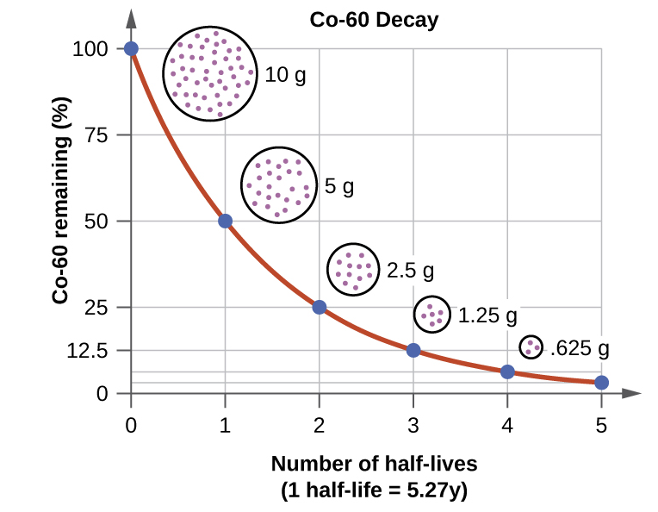
We will do what are called HALF LIFE PROBLEMS, our first one is coming up in a moment. Since the radioactive isotopes will emit radiation (decay) at a very, very regular rate, there is SIMPLE math here.
You MUST make a T-chart each time or you will likely get the problem incorrect.
Finally, in high school, to keep the math even simpler, we will only do math on whole number of half life increments.

Slide 110
58. You accumulate 22.0 grams of the radioisotope carbon-14 How long before only 2.75 grams of the C-14 remains unchanged?
Every ½ life problem demands you draw a T-Chart. Every single one, even this one.

Slide 111
58. You accumulate 22.0 grams of the radioisotope carbon-14 How long before only 2.75 grams of the C-14 remains unchanged?
22.0 g
NOW
This is how we start (every half life problem).

Slide 112
58. You accumulate 22.0 grams of the radioisotope carbon-14 How long before only 2.75 grams of the C-14 remains unchanged?
22.0 g
11.0 g
NOW
1 half life
In one half life you have only 11.0 grams, or half of the starting 22.0 grams.

Slide 113
58. You accumulate 22.0 grams of the radioisotope carbon-14 How long before only 2.75 grams of the C-14 remains unchanged?
22.0 g
11.0 g
5.50 g
NOW
1 half life
2 half lives
After 2 Half-lives, the original mass of C-14 has transmuted into just 5.50 grams.

Slide 114
58. You accumulate 22.0 grams of the radioisotope carbon-14 How long before only 2.75 grams of the C-14 remains unchanged?
22.0 g
11.0 g
5.50 g
2.75 g
NOW
1 half life
3 half lives
2 half lives
After THREE Half-lives for 22.0 g of C-14 to transmutes so much that there is just 2.75 grams remaining unchanged.
That means…

Slide 115
58. You accumulate 22.0 grams of the radioisotope carbon-14 How long before only 2.75 grams of the C-14 remains unchanged?
22.0 g
11.0 g
5.50 g
2.75 g
NOW
1 half life
3 half lives
2 half lives
After THREE Half-lives for 22.0 g of C-14 to transmutes so much that there is just 2.75 grams remaining unchanged. Since each half life of this radioisotope is 5715 years,
5715 years X 3 = 17,145 years
It will take 17,145 years for this to happen.

Slide 116
59. The doctor wants to inject you with some radioactive I-131 to measure your thyroid uptake. She injects you with 2.00 grams. How long until you have just 0.125 g left in you?
2.00 g
NOW

Slide 117
59. The doctor wants to inject you with some radioactive I-131 to measure your thyroid uptake. She injects you with 2.00 grams. How long until you have just 0.125 g left in you?
2.00 g
1.00 g
START
1
After one half life, there is1.00 gram left – 1.00 grams of I-131 transmuted.

Slide 118
59. The doctor wants to inject you with some radioactive I-131 to measure your thyroid uptake. She injects you with 2.00 grams. How long until you have just 0.125 g left in you?
2.00 g
1.00 g
0.500 g
START
1
2
After 2 half lives pass, there is just 0.500 grams of the I-131 left.

Slide 119
59. The doctor wants to inject you with some radioactive I-131 to measure your thyroid uptake. She injects you with 2.00 grams. How long until you have just 0.125 g left in you?
2.00 g
1.00 g
0.500 g
0.250 g
START
1
2
3
After 3 half lives we have just 0.250 grams of I-131 left.

Slide 120
59. The doctor wants to inject you with some radioactive I-131 to measure your thyroid uptake. She injects you with 2.00 grams. How long until you have just 0.125 g left in you?
2.00 g
1.00 g
0.500 g
0.250 g
0.125 g
START
1
2
3
4
It takes 4 half lives for this 2.00 g radioactive iodine to transmute away so that only 0.125 g remains. Each half life is 8.07 days, so…
4 X 8.021 days = about 32.084 days, or about 1 month.

Slide 121
60. You put 400.0 grams of Fe-53 in your pocket. How long until you have 12.5 grams of this iron left? What has the other 387.5 grams become?
400.0 g
NOW

Slide 122
60. You put 400.0 grams of Fe-53 in your pocket. How long until you have 12.5 grams of this iron left? What has the other 387.5 grams become?
400.0 g
400.0 g
200.0 g
NOW
1
After 1 half life, there’s 200.0 g left, keep going.

Slide 123
60. You put 400.0 grams of Fe-53 in your pocket. How long until you have 12.5 grams of this iron left? What has the other 387.5 grams become?
400.0 g
400.0 g
200.0 g
100.0 g
NOW
1 2
2 half lives pass, we need to keep going.

Slide 124
60. You put 400.0 grams of Fe-53 in your pocket. How long until you have 12.5 grams of this iron left? What has the other 387.5 grams become?
400.0 g
400.0 g
200.0 g
100.0 g
50.0 g
NOW
1 2 3
3 half lives pass, not quite.

Slide 125
60. You put 400.0 grams of Fe-53 in your pocket. How long until you have 12.5 grams of this iron left? What has the other 387.5 grams become?
400.0 g
400.0 g
200.0 g
100.0 g
50.0 g
25.0 g
NOW
1 2 3 4
4 Half lives pass, almost…

Slide 126
60. You put 400.0 grams of Fe-53 in your pocket. How long until you have 12.5 grams of this iron left? What has the other 387.5 grams become?
400.0 g
400.0 g
200.0 g
100.0 g
50.0 g
25.0 g
12.5 g
NOW
1 2 3 4 5
5 half lives must pass for this to happen. Each half life of Iron-53 is 8.51 minutes.
This process takes...
8.51 minutes X 5 = 42.6 minutes

Slide 127
60. You put 400.0 grams of Fe-53 in your pocket. How long until you have 12.5 grams of this iron left? What has the other 387.5 grams become?
400.0 g
400.0 g
200.0 g
100.0 g
50.0 g
25.0 g
12.5 g
NOW
1 2 3 4 5
Let’s do the second part of this, which is the radioactive decay of Fe-53.

Slide 128
60. You put 400.0 grams of Fe-53 in your pocket. How long until you have 12.5 grams of this iron left? What has the other 387.5 grams become?
400.0 g
400.0 g
200.0 g
100.0 g
50.0 g
25.0 g
12.5 g
NOW
1 2 3 4 5
This is called positron decay.
53 26
Fe
0 +1
53 25
Mn
e
+

Slide 129
61. If a scientist purifies 1.0 gram of radium-226, how many years must pass before only 0.50 gram of the original radium-226 sample remains unchanged?

Slide 130
61. If a scientist purifies 1.0 gram of radium-226, how many years must pass before only 0.50 gram of the original radium-226 sample remains unchanged? Only one half life must pass to transmute 1.0 grams into 0.5 grams, so just LOOK at table N: Radium 226 has a half life of 1599 years.
62. Based on Reference Table N, what fraction of a radioactive Sr-90 sample would remain unchanged after 58.2 years? A. ½ B. ¼ C. 1/8 D. 1/16

Slide 131
62. Based on Reference Table N, what fraction of a radioactive Sr-90 sample would remain unchanged after 58.2 years? A. ½ B. ¼ C. 1/8 D. 1/16
Whole Half Quarter
¹/₁ ¹/₂ ¹/₄
START 29.1yr 58.2 years

Slide 132
63. What is the half-life and decay mode of Rn-222?
A. 1.910 days and alpha decay B. 1.910 days and beta decay
C. 3.823days and alpha decay D. 3.823 days and beta decay

Slide 133
63. What is the half-life and decay mode of Rn-222?
A. 1.910 days and alpha decay B. 1.910 days and beta decay
C. 3.823days and alpha decay D. 3.823 days and beta decay LOOK at table N: 3.823 days, Alpha Radiation emitted, choice C
64. What is the half-life of sodium-25 if 1.00 gram of a 16.00-gram sample of sodium-25 remains unchanged after 237 seconds? A. 47.4 s B. 59.3 s C. 79.0 s D. 118 s

Slide 134
63. What is the half-life and decay mode of Rn-222?
A. 1.910 days and alpha decay B. 1.910 days and beta decay
C. 3.823days and alpha decay D. 3.823 days and beta decay LOOK at table N: 3.823 days, Alpha Radiation emitted, choice C
64. What is the half-life of sodium-25 if 1.00 gram of a 16.00-gram sample of sodium-25 remains unchanged after 237 seconds? A. 47.4 s B. 59.3 s C. 79.0 s D. 118 s
16.00 g becomes 8.00 g , which becomes 4.00 g, which becomes 2.00 g, which becomes 1.00 g. That is 4 half lives.
237 seconds divided by 4 = 59.3 seconds (choice B)

Slide 135
Nuclear chem class #3
Artificial Transmutations
What is FISSION?
What is FUSION? How does the Sun work? How do nuclear power plants make energy? How do Nuclear Bombs Work?

Slide 136
These three are all decay reactions… all are natural transmutations.
65.
238 92
U

Slide 137
These three are all decay reactions… all are natural transmutations.
65.
238 92
U
4 2
He

Slide 138
These three are all decay reactions… all are natural transmutations.
65.
238 92
U
4 2
He
+
234 90
Th
The U-238 undergoes alpha decay, transmuting into thorium-234.

Slide 139
These three are all decay reactions… all are natural transmutations.
65.
238 92
U
4 2
He
+
234 90
Th
The U-238 undergoes alpha decay, transmuting into thorium-234.
3 1
H
66.

Slide 140
These three are all decay reactions… all are natural transmutations.
65.
238 92
U
4 2
He
+
234 90
Th
The U-238 undergoes alpha decay, transmuting into thorium-234.
3 1
H
0 -1
e
66.

Slide 141
These three are all decay reactions… all are natural transmutations.
65.
238 92
U
4 2
He
+
234 90
Th
The U-238 undergoes alpha decay, transmuting into thorium-234.
3 1
H
0 -1
e
+
3 2
He
66.
The H-3 undergoes beta decay, transmuting into helium-3.

Slide 142
These three are all decay reactions… all are natural transmutations.
65.
238 92
U
4 2
He
+
234 90
Th
The U-238 undergoes alpha decay, transmuting into thorium-234.
3 1
H
0 -1
e
+
3 2
He
66.
The H-3 undergoes beta decay, transmuting into helium-3.
67.
19 10
Ne

Slide 143
These three are all decay reactions… all are natural transmutations.
65.
238 92
U
4 2
He
+
234 90
Th
The U-238 undergoes alpha decay, transmuting into thorium-234.
3 1
H
0 -1
e
+
3 2
He
66.
The H-3 undergoes beta decay, transmuting into helium-3.
67.
19 10
Ne
0 +1
e

Slide 144
These three are all decay reactions… all are natural transmutations.
65.
238 92
U
4 2
He
+
234 90
Th
The U-238 undergoes alpha decay, transmuting into thorium-234.
3 1
H
0 -1
e
+
3 2
He
66.
The H-3 undergoes beta decay, transmuting into helium-3.
67.
19 10
Ne
0 +1
e
+
19 9
F
The Ne-19 undergoes positron decay, transmuting into fluorine-19.

Slide 145
68. Artificial transmutation is caused by humans. It is a forced reaction, and does not occur naturally. It often involves the release of massive amounts of energy inside a nuclear reactor or a nuclear bomb. Some are less powerful
The first artificial transmutation reactions were carried out by some of the “regular” characters in our class. In 1919 Ernest (“Gold Foil”) Rutherford “bombs” some nitrogen atoms with alpha particles.

Slide 146
4 2
69.
14 7
N +
He

Slide 147
4 2
17 8
69.
14 7
N +
He
O +
1 1
p
N-14 bombarded with alpha particles artificially transmutes into O-17 & a proton
The thing to see here is that the Radioisotope IS NOT ALONE in the front of the arrow. It doesn’t JUST HAPPEN, you had to bombard that N-14 with this alpha particle. Stuff like this can’t just happen, it’s artificial!

Slide 148
In 1932 James Chadwick bombards beryllium-9 with alpha particles…
4 2
Be +
70.
9 4
He

Slide 149
In 1932 James Chadwick bombards beryllium-9 with alpha particles…
9 4
4 2
He
12 6
C +
1 0
n
70.
Be +
Alpha particles are blasted into beryllium atoms, artificially transmuting into carbon-12 and emitting a neutron in the process.
You don’t have to “know” what happens, just understand (count) that it works.

Slide 150
In 1934 the Curie’s bomb Al-27 with alpha particles, and form the first artificially created radioisotope.
4 2
He
27 13
Al +
71.

Slide 151
In 1934 the Curie’s bomb Al-27 with alpha particles, and form the first artificially created radioisotope.
4 2
He
30 15
1 0
n
27 13
Al +
P +
71.
Aluminum atoms are bombarded with alpha particles, causing the aluminum to artificially transmute into radioactive phosphorous while emitting a neutron.
The radioactive phosphorous will undergo natural transmutation.

Slide 152
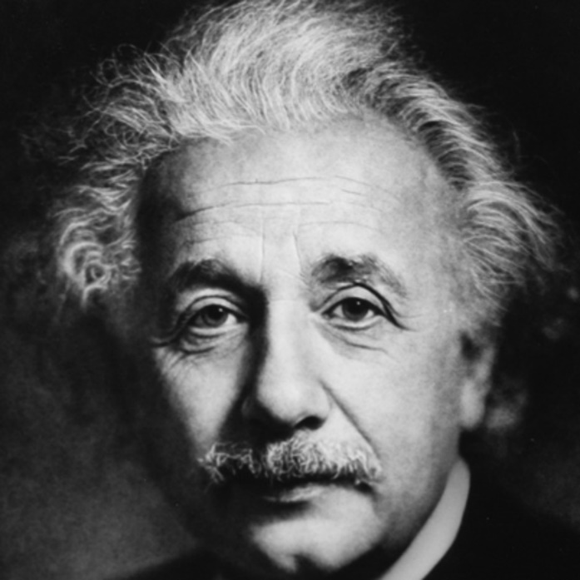
These examples of artificial transmutation release little energy. Some artificial transmutations are nuclear bombs, or reactions that power a nuclear power plant. They release LOTS of energy.
According to Albert Einstein, energy and matter are the same thing, just in different forms. His famous equation,
E = mc² Which means: energy equals mass times the speed of light, squared.
72.

Slide 153
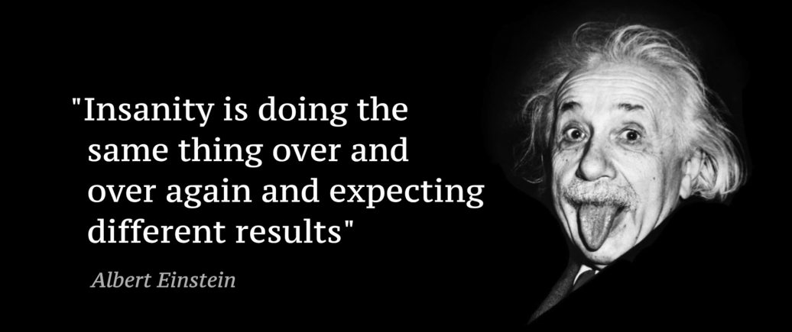
E = mc² Which means: energy equals mass times the speed of light squared.
He proved that in a nuclear reaction, some matter could be converted into a lot of energy. This is the basis for nuclear reactors and nuclear bombs.
In chemistry, matter cannot be created or destroyed. In nuclear chemistry it can be “lost” by conversion to energy.

Slide 154
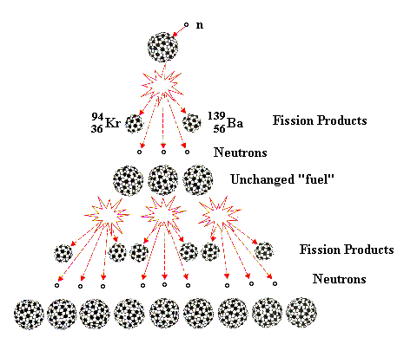
In a “chain reaction” like the splitting of U-235 by inserting a neutron into it, causes the SPLITTING of the Uranium-236 atom into Kr, Ba, and 3 more neutrons.
These 3 neutrons smash into three more U-235’s.
That causes a total of 9 more neutrons to be emitted, which then smash into nine more atoms of U-236, causing 27 neutrons to form, and this keeps going.
Each cycle releases energy as some mass (the mass defect) is converted into energy by E=mc²

Slide 155
73. The splitting of atoms by artificial transmutation is called FISSION.
74. The mass of the products are LESS THAN the mass of the reactants, just slightly less. This slight amount of missing mass, is called the MASS DEFECT, which is converted into energy.

Slide 156
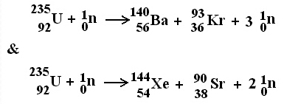
Below are 2 different artificial transmutations that SPLIT the ATOM.
+ Energy
+ Energy

Slide 157
In a fission reaction, a larger nucleus is bombarded, usually by neutrons, which forms an even larger and much more unstable nucleus which splits apart (the splitting of the atom is called FISSION). This is NOT NATURAL, it was forced by a scientist.
It’s 1 kind of artificial transmutation

Slide 158
76. The daughter nuclei that form are often radioactive as well, and will themselves undergo natural transmutation.
77. In addition, extra neutrons are released, along with energy. The extra neutrons will crash into other larger nuclei, setting off a bigger reaction than the first cycle.

Slide 159
78. That repeats, and even more neutrons are released, making the next cycle larger and more energetic.
79. If sufficient fuel is available, the cycles get bigger and bigger, releasing more & more energy per cycle, until a huge explosion occurs. (nuclear bomb sized)
80. In a nuclear power plant, this reaction can be controlled, and slowed down so that the explosion is much smaller, but lasts for years at a time, generating heat to make electricity In a bomb, all of the energy can be released in a few seconds.

Slide 160
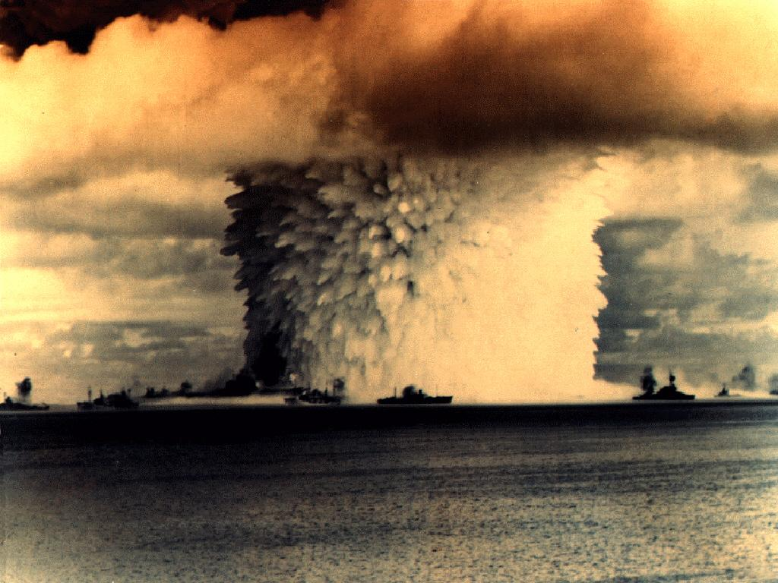
This photo is of a nuclear bomb test in the Pacific Ocean, probably in the mid-1940’s. This is a small bomb compared to what is available now.
Those are giant sized ships from a navy, watching a nuclear test explosion from a “safe” distance.

Slide 161
81. Another type of artificial transmutation reaction is FUSION
82. It’s the squishing together of smaller atoms and making larger ones. There is a loss of mass during this process as well (the Mass Defect) and it releases even more energy than fission reactions.

Slide 162
83. The Sun is powered by fusion.
The fusion on the Sun is a different fusion than humans can make happen.
We can’t get temperature and pressure high enough to squish normal hydrogen atoms into helium atoms. We can manage to squish radioactive (larger) hydrogen atoms into helium.

Slide 163
84. The Sun squashes 4 hydrogen's into helium this way:
4 H
1 1
4 2
He + 2 e + energy!
0 -1

Slide 164
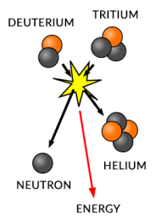
85. Humans have managed to create this OTHER type of fusion.
86. Both types of FUSION release gigantic amounts of energy. Deuterium + Tritium Under extreme heat & pressure caused by a “regular” nuclear explosion, triggers this fusion explosion.
³H
²H

Slide 165
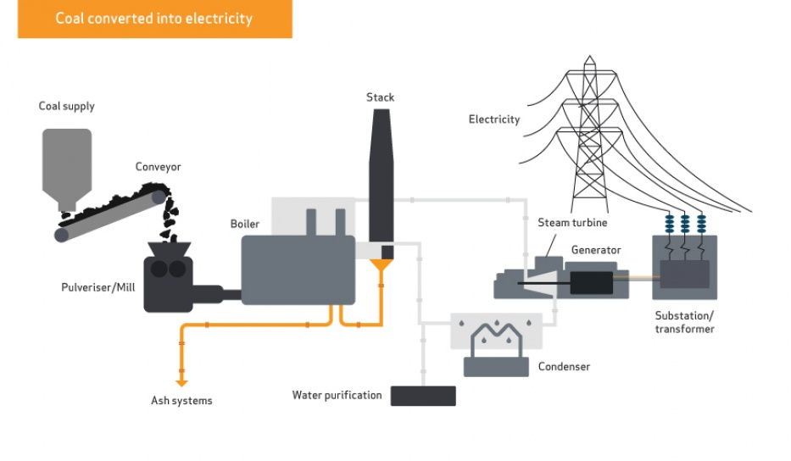
How does a nuclear power plant make electricity?
87. First, how does a power plant make electricity?
Heat produced by burning turns water into steam. Steam is shot at the turbine blades, which spin like crazy. The spinning rotates magnets in the generator, around thick copper wire, which creates the electric current.
Waste includes carbon dioxide (green house gas), ash, and heat lost to the air. In the gases, often there are chemicals that lead to acid rain, such as sulfates.

Slide 166
How does a nuclear power plant work?
Simple (not really). The nuclear fission reaction creates heat, which makes water turn into steam, to turn turbine blades, to spin the generator, to make electricity. Somewhat the same way as the coal plant does, but without making any greenhouse gases, or acid rain, or ash (not too shabby).

Slide 167
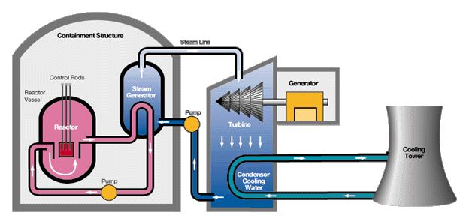
There is the “inside” the containment dome part.
And the outside the containment dome part. Don’t mix these up.

Slide 168
The containment dome is (hopefully) strong enough to keep the radiation in, and everything else out.
Inside the reactor vessel is where the fission reaction happens. Uranium 235 is bombed with neutrons and the chain reaction starts.

Slide 169
This reaction should start a nuclear explosion, a chain reaction leads quickly to a massive energy release because of the small but measurable mass defect. Because of E=mc², this mass loss should cause a huge explosion, but it doesn’t.
Inside the vessel are control rods, that control the reaction. They are able to be pushed in or out of the reactor. They absorb neutrons, which slows down or moderates the reaction. It keeps it hot, but not too hot. Often they are cadmium or silver or indium metals.

Slide 170
The water in the pink pipes gets super heated, and the heat transfers to the water in the blue steam generator.
The steam it makes is pumped to the turbines which spin and make a current.

Slide 171
Hopefully this water in red stays in the pipes and never escapes. It’s touching the nuclear material and gets rather radioactive itself. All the radiation is supposed to stay inside the containment dome.
The water in the turbine area cools down from steam back into water, to be reheated into steam again by more heat from the reactor. This water should stay un-radioactive if all goes well.

Slide 172
STEAM
Cool water, from the really big lake, or from an ocean comes in here to help cool the water down. This water absorbs the excess heat from the turbine steam so it can be recycled.
The environmental water is heated and then run through the cooling tower to disperse the heat as steam to the air. Lots more heat is pumped back to the ocean/lake nearby.

Slide 173
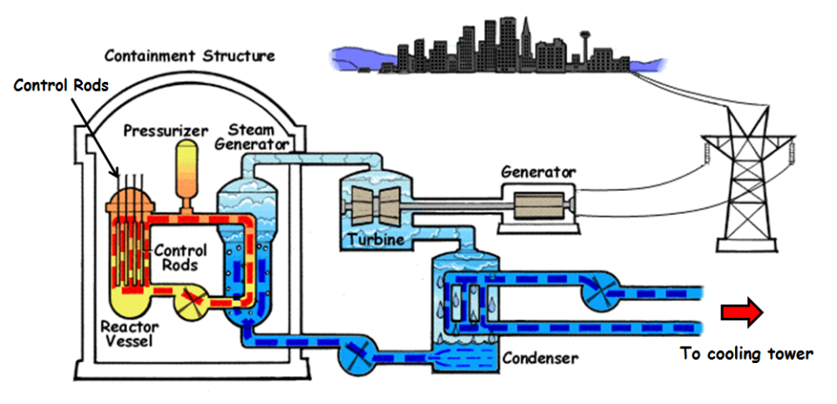

Slide 174
89. Nuclear Power Plants
A fission reaction is started in the reactor core. It’s controlled with cadmium rods that can absorb excess neutrons. Once the reaction starts, the cadmium “eats” neutrons, so that the reaction goes, but doesn’t really GROW (like a bomb does).
Lots of heat is created, steam reaches 450°C. The water that touches this material is highly radioactive and remains sealed in the “inner” water loop. The steam pulls heat from the core.
The steam transfers it’s heat to a middle loop of water, making that boil as well, although not quite as hot. That steam spins the turbine blades. Once past the blades, this steam is condensed back to water, so it can absorb maximum heat when it approaches that inner water pipe.
The blades spin the magnets in the generator, which induces an electric current.
Water from outside (ocean or large lake) cools the middle loop steam back to water before it picks up heat from the inner core steam. This cooling loop produces the only constant “waste”, which is hot water, which is real pollution, but is hardly a terrible problem.
The radioactive waste is a terrible problem. It’s radioactive, for 20,000 or more years, so it has to be put out of our environment, and guarded from terrorists pretty much forever. If it gets into the environment, it can kill or cause cancer.
The spent fuel is cooled for several years, then put into long term concrete storage on site at nuclear power plants.

Slide 175
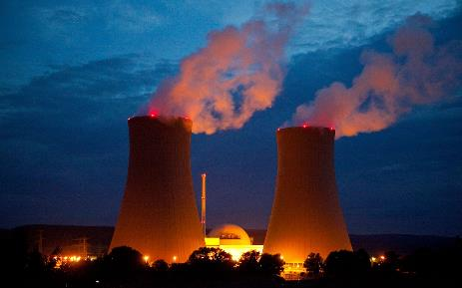
90. Nuclear Energy Pros:
Does not emit large amounts of CO₂ or other greenhouse gases
A consistent and reliable energy source
Allows countries to become energy independent
Low operating costs once setup
91. Nuclear Energy Cons:
Environmental impact of radioactive waste
Requires mining & refining uranium & transporting it to plant
Radioactive waste disposal
Potential for deadly and costly nuclear disasters
High initial cost to develop a nuclear plant
Limited by the availability of uranium
Can be a precursor to nuclear weapons

Slide 176
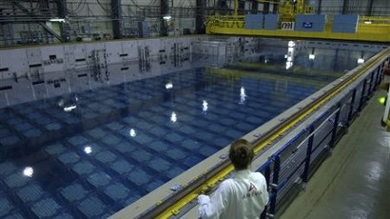
92. Right now, the general plan is to store in underwater at nuclear plants, while we figure out what else to do with it. In Japan this did not work well, as the water boils away if it is not kept very cool. That leads to LEAKS.

Slide 177
93. How does radioactive carbon dating work?
On Earth there is a certain amount of radioactive carbon by percent. It’s measurable if you’re college level smart and you have some fancy tools. There is a “normal” level of radioactive carbon in our environment, and it’s been stable a long time.
The ratio of radioactive carbon to stable carbon is a constant. Although some is always transmuting, there is always more being made, by a variety of means, all involving the bombardment of carbon with high energy particles from the Sun.
The ratio is known and measurable (it about one in one trillion atoms of carbon are radioactive). If this ratio were to be different, that would be measurable too.
High energy neutrons + N_{2(G)} → C-14 + protons

Slide 178
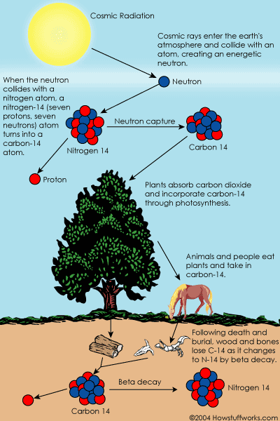
This radioactive carbon is everywhere in small quantities.
In plants and in the animals that eat the plants, and in animals that eat both plants and animals.
Even though it’s always decaying back into nitrogen, it’s also being replaced constantly too.
There is a constant amount of C-14 in the world.

Slide 179
If an animal eats regularly, and all animals do (except for one kind), they all have a constant ratio of radioactive to stable carbon.
94. Which kind of animal DOES NOT EAT regularly?

Slide 180
Dead birds don’t eat, so once they die, the ratio of C-14 to C-12 begins to change. Since it is measurable (if you’re a scientist) you can calculate how long it must have taken to change that ratio by the amount it changed. Since you also know the half life of C-14, you can calculate when the last time that bird was still eating (when it died).

Slide 181
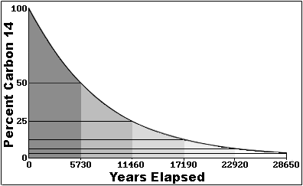
Since all living things have a constant amount of C-14, that is measurable, in them, once they die (and stop eating) the radioactive decay begins without replacing the C-14.
95. The longer that animal is dead, the lower the C-14 to C-12 ratio becomes.
If a scientist measures the bones of a dead animal to have just half of the expected C-14, that means the animal stopped eating one half life of C-14 ago, or 5715 years ago.

Slide 182
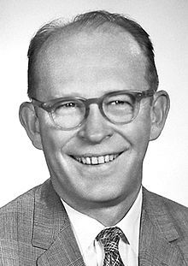
Willard F. Libbey wins the Nobel Prize in Chemistry in 1960 for work he did in the 1940’s with Radioactive C-14 to date previously living organisms.
It is very accurate to at least 50,000 years. Older materials can still be measured, but there is some error possible due to the fact that very little C14 will be measurable.
Some larger samples have been scientifically measured to longer, but not much older than that. Dinosaurs cannot be measured using the C-14 method.

Slide 183
96. The La Brea Tar Pits, near Los Angeles, California

Slide 184
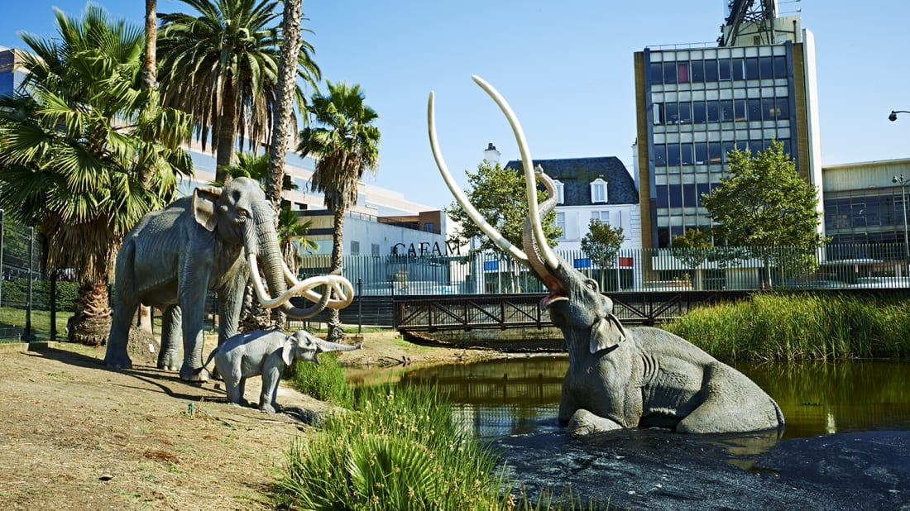
Museum Models, sunk in the tar, near LA, California. This shows a mastodon stuck and about to sink into the tar, where it will NOT ROT. Once in a while these animals pop back out and scientists can wash them off and examine perfectly preserved specimens. The ratio of C-14 to C-12 tell how long ago they stopped eating.

Slide 185
Nuclear Medicine
There are only 2 uses for nuclear radiation that are discussed in high school.
97. Use of Iodine-131 for the diagnosis of thyroid disorders. This radioactive isotope is injected into a person, then after a given period of time a special “picture” is taken, a radiograph, which measures the amount of radiation in someone’s throat (that’s where the thyroid gland is). Since it’s chemically identical, just different mass (that’s why it’s radioactive), the thyroid gland picks it up (or doesn’t) and doctors can assess your glandular activity.

Slide 186
Nuclear Medicine
98. Use of cobalt-60 to treat some cancers. This isotope produces excess beta radiation, which can be aimed as a sort of invisible beam of killer rays, which gets pointed at tumors inside people. The beta particles kill most all cells they pass though, but they also can kill some cancers. The plan is to zap the tumors precisely, and kill as few of the good cells at possible. Pain and sickness followed by (hopefully) smaller or no tumors.

