Slide 1
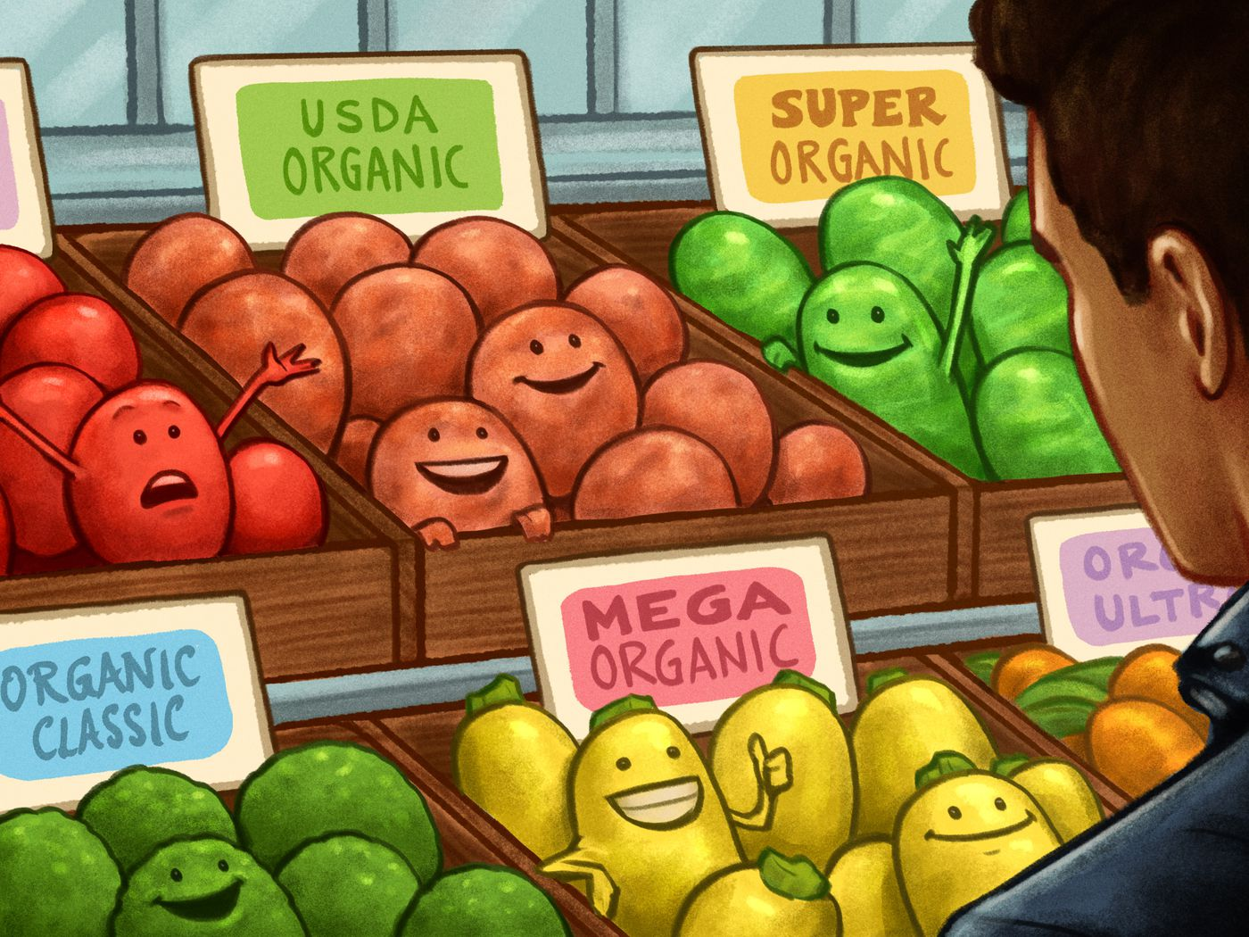
Welcome to Organic Chem
Take out table P + Q now.

Slide 2
All chemistry we have been doing is technically “inorganic” chem.
Organic Chem was once thought to be made up of molecules that could only form from living organisms (plants and animals). They had “the spark of life” and could not be man made.
Humorously (and truthfully) the first organic molecule synthesized was urea. Now scientists and college students can make them all. All meaning billions of possibilities, not all have been made yet. In theory they can all be made.
The organic molecules we will study are more complex than the simpler compounds we have learned so far, but we get a bunch of tables to help us name them.
We use specific rules to name them all. Our tables will help us.
Organic chemistry is the real class in college that students cry in all of the time.
We will make it relatively easy, and you shouldn’t cry over this.

Slide 3
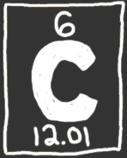
Carbon.
1. Carbon is the first atom of organic chem.
2. Carbon can make single, double and triple bonds to other carbon atoms.
3. There are NO METALS in organic chem. 4. Look at table P, fill in the boxes for the prefixes that indicate how many carbon atoms are in a molecule.
OUR FRIEND

Slide 4
5. Carbon makes 4 bonds because it has a 2-4 electron configuration, it needs 4e– for an octet, for bonding stability.
6. Carbon atoms make 4 bonds. They can be:
→ 4 single bonds
→ 2 single bonds + 1 double bond
→ 2 double bonds
→ 1 single + 1 triple bond
4 bonds, every time, no matter what.
7. Hydrogen atoms have 1 electron and can only make a single bond.

Slide 5
8. What is the name and the formula of the simplest hydrocarbon? (It has one carbon atom and 4 H atoms)

Slide 6
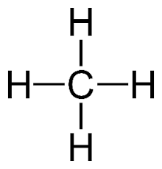
8. What is the name and the formula of the simplest hydrocarbon? (It has one carbon atom and 4 H atoms)
CH₄
METHANE

Slide 7
9. Hydrocarbons are the simplest molecules in organic chem, made up of only hydrogen and carbon atoms.
10. Table Q is titled: HOMOLOGOUS SERIES OF HYDROCARBONS 11. Homologous HOMO + LOGOUS which means SAME BODY TYPE

Slide 8
12. The three “body types” or SERIES are |  | Example carbon bonding
ALKANES
ALKENES
ALKYNES

Slide 9
12. The three “body types” or SERIES are |  | Example carbon bonding
ALKANES | Which have ONLY single bonds carbon to carbon | C – C
ALKENES | Which have a double bonded carbon to carbon | C = C
ALKYNES | Which have a triple bonded carbon to carbon | C ≡ C

Slide 10
14. Name the SINGLE BONDED CARBON hydrocarbons 1 to 10 carbons long, draw the structural diagrams and structural formulas, for each.
# C | Name | Structural Diagram | Molecular formula and Condensed structural formula
1
2
3

Slide 11
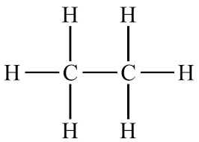
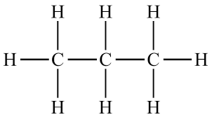
14. Name the SINGLE BONDED CARBON hydrocarbons 1 to 10 carbons long, draw the structural diagrams and structural formulas, for each.
# C | Name | Structural Diagram | Molecular formula and Condensed structural formula
1 | methane |  | CH₄ CH₄
2 | ethane |  | C₂H₆ CH₃CH₃
3 | propane |  | C₃H₈ CH₃CH₂CH₃

Slide 12
14. Name the SINGLE BONDED CARBON hydrocarbons 1 to 10 carbons long, draw the structural diagrams and structural formulas, for each.
# C | Name | Structural Diagram | Molecular formula and Condensed structural formula
4
5
6

Slide 13
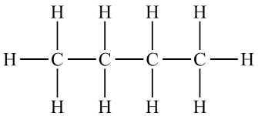
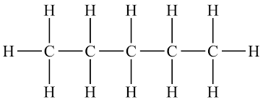
14. Name the SINGLE BONDED CARBON hydrocarbons 1 to 10 carbons long, draw the structural diagrams and structural formulas, for each.
# C | Name | Structural Diagram | Molecular formula and Condensed structural formula
4 | butane |  | C₄H₁₀ CH₃(CH₂)₂CH₃
5 | pentane |  | C₅H₁₂ CH₃(CH₂)₃CH₃
6 | hexane |  | C₆H₁₄ CH₃(CH₂)₄CH₃

Slide 14
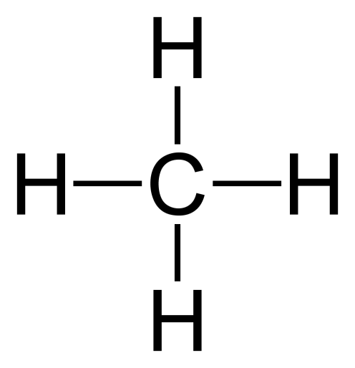
I am already starting to get tired of all the “H” atoms.
How about this, if you’re smart, you can just KNOW that carbon must bond to H, and we’ll agree to draw in each dash representing a bond to a H atom, but we’ll leave the “H” atoms out.
This is always okay, but this is the same thing from now on.

Slide 15
14. Name the SINGLE BONDED CARBON hydrocarbons 1 to 10 carbons long, draw the structural diagrams and structural formulas, for each.
# C | Name | Structural Diagram | Molecular formula and Condensed structural formula
7
8

Slide 16
14. Name the SINGLE BONDED CARBON hydrocarbons 1 to 10 carbons long, draw the structural diagrams and structural formulas, for each.
# C | Name | Structural Diagram | Molecular formula and Condensed structural formula
7 | heptane |  | C₇H₁₆ CH₃(CH₂)₅CH₃
8 | octane |  | C₈H₁₈ CH₃(CH₂)₆CH₃

Slide 17
14. Name the SINGLE BONDED CARBON hydrocarbons 1 to 10 carbons long, draw the structural diagrams and structural formulas, for each.
# C | Name | Structural Diagram | Molecular formula and Condensed structural formula
9
10

Slide 18
14. Name the SINGLE BONDED CARBON hydrocarbons 1 to 10 carbons long, draw the structural diagrams and structural formulas, for each.
# C | Name | Structural Diagram | Molecular formula and Condensed structural formula
9 | nonane |  | C₉H₂₀ CH₃(CH₂)₇CH₃
7 | decane |  | C₁₀H₂₂ CH₃(CH₂)₈CH₃

Slide 19
Organic Vocabulary
15. Organic chem: chemical compounds that at one time were thought to be made only by living organisms like plants or animals. This is not true, nor was it.
16. Carbon: the central atom in organic chem, it makes 4 bonds because of its electron configuration of 2-4. It can make single or double or triple bonds to itself.
17. Hydrocarbons: simple molecules in organic chem, made up only of Hydrogen and carbon atoms, hence the name.
18. Homologous Series of Hydrocarbons (title to Table Q): having the “same body type” molecules made up of only H + C. Contain ONLY single bonds, or a double bond, or a triple bond.

Slide 20
19. The first series of Hydrocarbons is ALKANES. (you just drew all ten of them) Alkanes have ONLY single bonds between the carbons. No double bonds or triple bonds allowed.
Their GENERAL FORMULA is C_{n}H_{2n+2}
Example: The alkane with 4 carbon atoms (butane) would have 2n+2 hydrogen atoms, Butane has a molecular formula of C₄H₁₀

Slide 21
20. The 2nd homologous series of hydrocarbons are called ________.
21. The general formula for alkenes is ____________
They have less H’s than alkanes because of the double C=C bond.
22. An alkene with 5 carbon atoms has the molecular formula of __________

Slide 22
20. The 2nd homologous series of hydrocarbons are called alkenes.
21. The general formula for alkenes is C_{n}H_{2n}
They have less H’s than alkanes because of the double C=C bond.
22. An alkene with 5 carbon atoms has the molecular formula of C₅H₁₀

Slide 23
23. In our class ______________________________ double bond, but in the real world, multiple double bonds are possible in one molecule.
24. Methene is NOT possible because in order to have a double bond between 2 carbon atoms you need 2 carbon atoms. ______________
25. Draw ethene and propene now

Slide 24
23. In our class alkenes will contain JUST ONE double bond, but in the real world, multiple double bonds are possible in one molecule.
24. Methene is NOT possible because in order to have a double bond between 2 carbon atoms you need 2 carbon atoms. Meth = 1.
25. Draw ethene and propene now

Slide 25
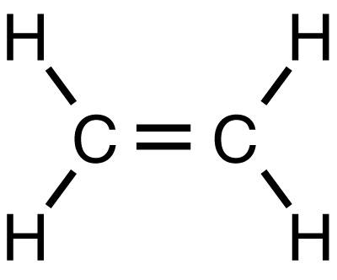
Ethene
Hydrogen atoms at an angle is cool, or you can stick with the 90° angles, it’s just a drawing.

Slide 26
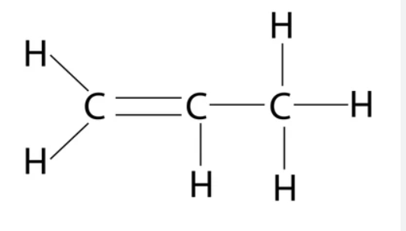
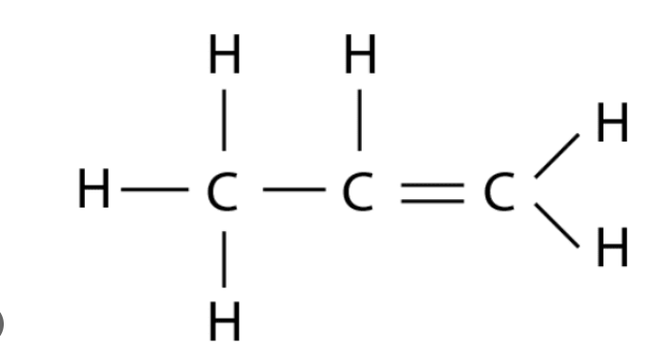
Ethene
Hydrogen atoms at an angle is cool, or you can stick with the 90° angles, it’s just a drawing.
Propene
Double bond left or right, same thing, molecules float!
30. Both of these ethene molecules are the same, there is no “left or right”. Molecules turn in space.

Slide 27
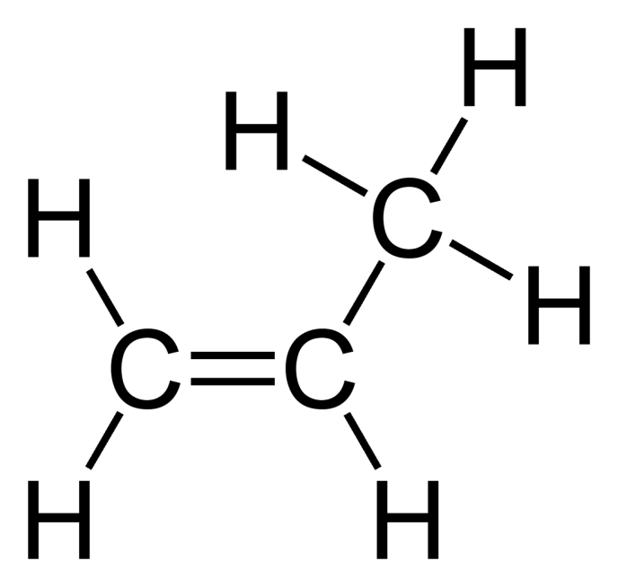
Propene
Straight lines, or bent, the chain is 3 carbons single bonded, in a row.
That’s all that matters.

Slide 28
31. Draw butene.

Slide 29
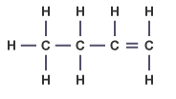
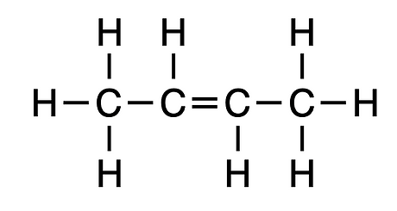
31
32 | 1-butene | 2-butene
33 | CH₃CH₂CHCH₂ | CH₃CHCHCH₃
34 | Isomers share a Molecular Formula: C₄H₈

Slide 30
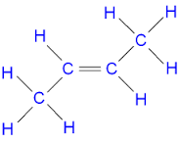
This is also 2-butene, but with a bit more style.
Unnecessary but not incorrect. FOUR CARBONS with a double bond from the 2nd to the 3rd carbon atom.
Formula: C₄H₈
CH₃CHCHCH₃

Slide 31
 | Draw these molecules next
35 | 1-pentene
36 | 2-pentene

Slide 32
 | Draw these molecules next
35 | 1-pentene
36 | 2-pentene
These are isomers
C₅H₁₀

Slide 33
 | Draw these molecules next
37 | 1-hexene
38 | 3-hexene

Slide 34
 | Draw these molecules next
37 | 1-hexene
38 | 3-hexene
These are isomers
C₆H₁₂

Slide 35
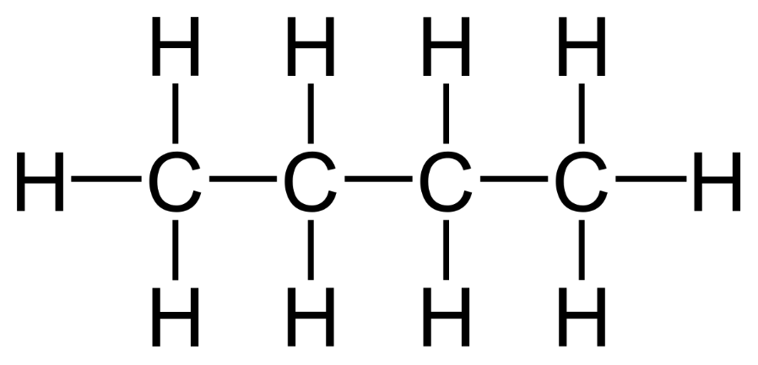
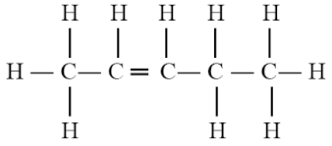
Name these (bad boys) big molecules…
39
40
41
=

Slide 36
Name these (bad boys) big molecules…
39
40
41
=
2-octene
3-heptene
2-pentene

Slide 37
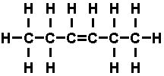
42. Draw the condensed structural formulas for 3-hexene
43. Draw the condensed structural formulas for 2-octene
=

Slide 38
42. CH₃CH₂CHCHCH₂CH₃ or CH₃CH₂(CH)₂CH₂CH₃
43. CH₃CHCHCH₂CH₂CH₂CH₂CH₃ or CH₃(CH)₂(CH₂)₄CH₃
=

Slide 39
44. The 3rd group of hydrocarbons are the ALKYNES
That’s a small change in the name. In our class ALKYNES only have one triple bond.
Naming and drawing will be just like the alkenes, the number tells where the triple bond is placed.
45. There is no “methyne”, you need at least two carbon atoms to triple bond together.

Slide 40
46. Draw ethyne and propyne.

Slide 41
46. Draw ethyne
Ethyne has one triple bonded carbon pair.

Slide 42
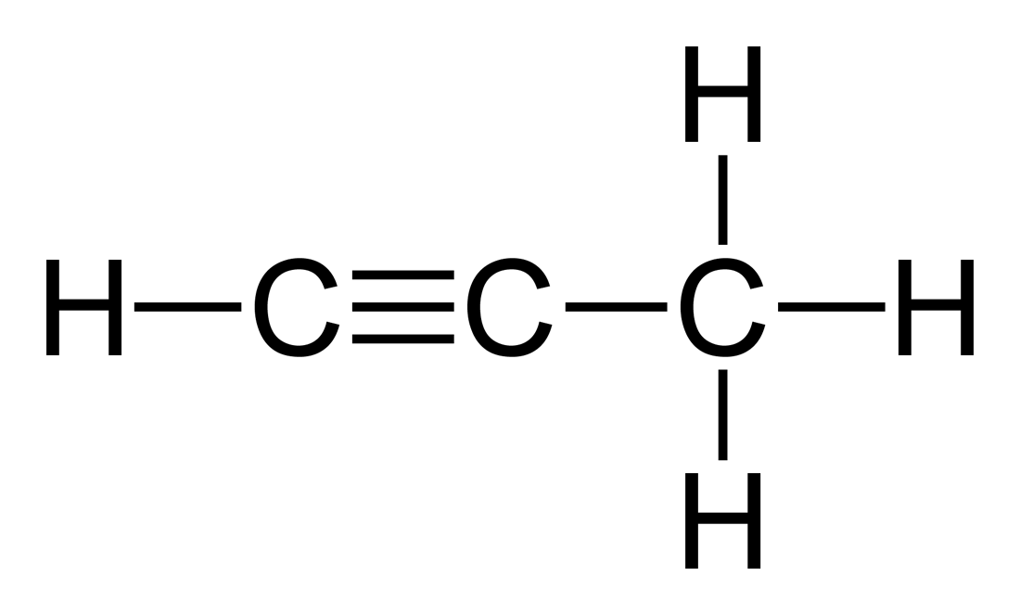
46. Draw ethyne and propyne.
Ethyne has one triple bonded carbon pair.
Propyne has one triple bonded carbon pair also.

Slide 43
47. Let’s draw 1-butyne and 2-butyne next (put your triple bond in the right place!)

Slide 44
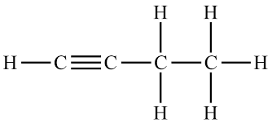
47. Let’s draw 1-butyne and 2-butyne next (put your triple bond in the right place!)
That’s 1-butyne at left. counting from the right side.
Just keep track of the “first” carbon, left/right doesn’t matter.

Slide 45
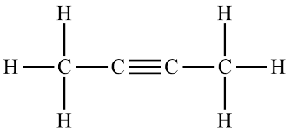
47. Let’s draw 1-butyne and 2-butyne next (put your triple bond in the right place!)
That’s 1-butyne at left. counting from the right side.
Just keep track of the “first” carbon, left/right doesn’t matter.
At right is 2-butyne
The triple bond is between carbon 2 and 3, counting from EITHER direction.

Slide 46
48. Let’s draw some more…
1-pentyne
2-pentyne
1-heptyne
3-heptyne

Slide 47
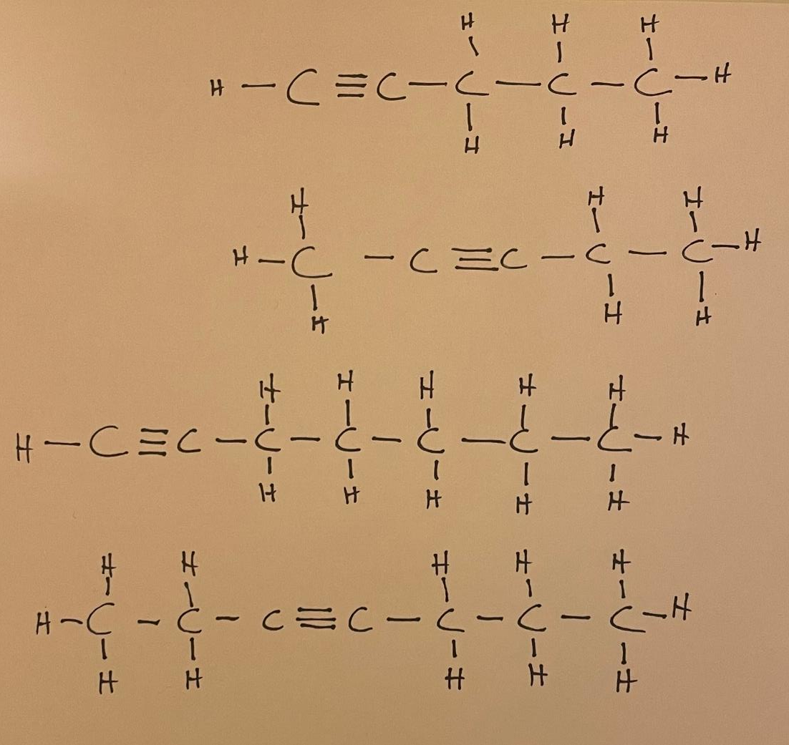
48. Let’s draw some more…
1-pentyne
2-pentyne
1-heptyne
3-heptyne

Slide 48
What is the general formula for alkynes? If an alkyne has 9 carbons, what is the formula?

Slide 49
What is the general formula for alkynes? C_{n}H_{2n-2} If an alkyne has 9 carbons, what is the formula? C₉H₁₆
stop

Slide 50
Organic Chem Class #3
Objective: How to add halogens into all three kinds of hydrocarbons. Take out Table R
Why do Pirates Love Organic Chem?

Slide 51
Organic Chem Class #3
Objective: How to add halogens into all three kinds of hydrocarbons. Take out Table R
Why do Pirates Love Organic Chem?
They really like table ARRRRGGHHHHH!

Slide 52
50. Table R lists all FUNCTIONAL GROUPS
Functional groups are added to hydrocarbons to make them fancier, to make them more difficult, to make them smell better or worse, to give them a wide variety of new properties.
52. The first, functional group we will add to hydrocarbons are the halogens of group 17.

Slide 53
53. HALOGENS | symbols | Organic Chem Prefix names
fluorine | F | fluoro
chlorine | Cl | chloro
bromine | Br | bromo
iodine | I | iodo

Slide 54
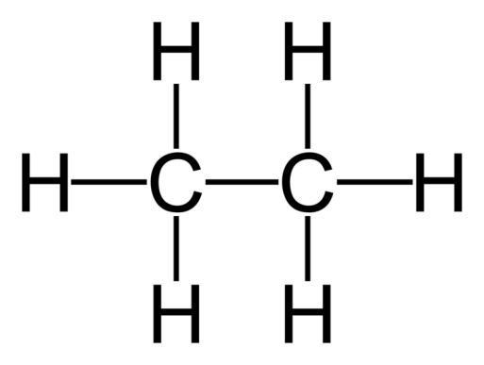
54. Draw then name these molecules now.
Br
Cl

Slide 55
54. Draw then name these molecules now.
Br
Cl
Bromo-ethane
Chloro-ethane

Slide 56
55. Let’s name these molecules now.
F
F F
F

Slide 57
55. Let’s name these molecules now.
F
F F
F
1,2 di-fluoro-ethane
1,1 di-fluoro-ethane

Slide 58
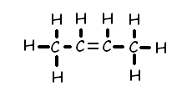
56. Draw and name this molecule.
Cl
Cl
First: Name the “base chain”, then we’ll figure out the first name after.

Slide 59
56. Draw and name this molecule.
Cl
Cl
The base chain is a 2-butene. Four carbon atoms, the double bond is between #2 and #3
Chlorine at the #2 carbon, and # 4 carbon atoms.
This is 1,3 dichloro 2pentene.

Slide 60
56. Draw and name this molecule.
Cl
Cl
The base chain is a 2-butene. Four carbon atoms, the double bond is between #2 and #3
Chlorine atoms at the #2 carbon, and # 4 carbon atoms, so…
1,3 dichloro 2pentene.

Slide 61
57. Let’s name this molecule.

Slide 62
1,2 dibromo butane
57. Let’s name this molecule.

Slide 63
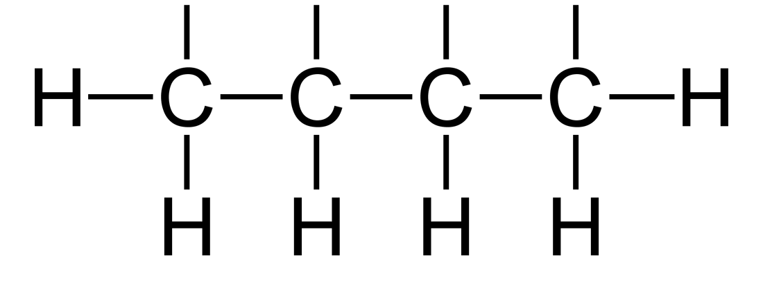
The rules to naming these halo-carbons is easy 58a. NAME the base chain name, the “LAST NAME” of the molecule.
58b. A Double or Triple bonds sets the carbon atom count; The halogens get numbered based on the carbon atom count.
58c. If you have no double or triple bond, set the carbon count with the LOWEST number combination.
58d. The halogens are numbered but they are named in ALPHABETICAL order.
H Br F F
59. Draw & name this molecule

Slide 64
59. Draw & name this molecule
H Br F F
4 carbon atoms, all single bonded. Last name = butane.
Count right to left, lowest numbers are correct.
Alphabetical on the halogens.
3-bromo,1,2-difluoro butane
(3+1+2 = 6)
WRONG: Named backwards would be 2 bromo, 3,4 difluoro butane. (2+3+4 = 9)

Slide 65
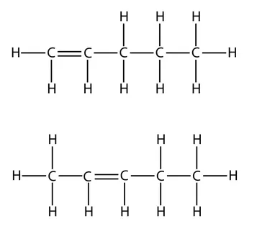
60. Draw and name these.
Br
Br
I
I
I

Slide 66
60. Draw and name these.
2,5 dibromo-1pentene
Br
Br
I
I
I

Slide 67
60. Draw and name these.
2,5 dibromo-1pentene
Br
Br
1,4,4 tri-iodo 2pentene
I
I
I

Slide 68
61. Draw the next 3 molecules
1,1dibromo-2,2 difluroethane
difluoroethyne
5bromo-4,4 dichloro-7,8,8trifluoro-1,2,3,7 tetra-iodo-1octene

Slide 69
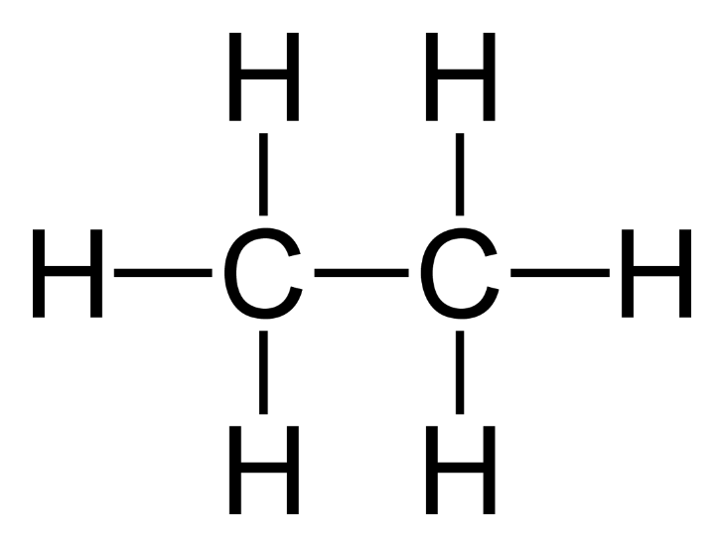
61. Draw the next 3 molecules
1,1dibromo-2,2 difluroethane
difluoroethyne
5bromo-4,4 dichloro-7,8,8trifluoro-1,2,3,7 tetra-iodo-1octene
Br
F
Br
F
F
F
Cl
F
F
I
I
I
Cl
Br
I
F

Slide 70
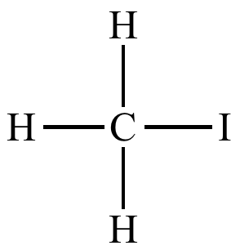
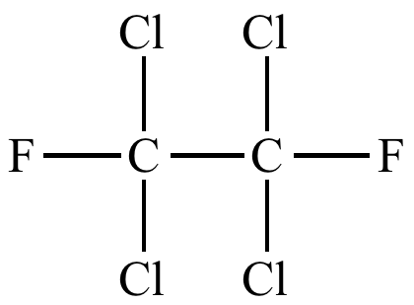
F
62. Name these…
F
Br
Br
F
Br
Br
F
F
Cl
Cl
F
F
Br

Slide 71
Iodomethane
1,1,2,2tetrachloro-1,2difluoroethane
F
F
Br
Br
F
1,2dibromo-1,5difloro-2pentene
dibromomethane
Br
Br
F
1,6,8 tribromo 2,4 dichloro-6,7,8,8 tetrafluoro octane
F
Cl
Cl
F
F
Br

Slide 72
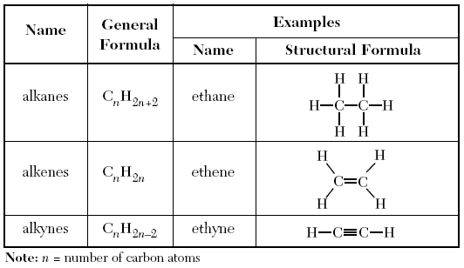
63. Take out Table Q, we need to “fix” it. You write the blue text…
Kind of alkane
Saturated
Unsaturated
Unsaturated
REACTIONS
Substitution
Addition
Addition

Slide 73
All the example hydrocarbons in table Q have 2 carbon atoms each.
64. Alkanes are SATURATED these 2 carbon atoms can “hold” the most hydrogen atoms = 6 H, because they only have SINGLE BONDS.

Slide 74
All the example hydrocarbons in table Q have 2 carbon atoms each.
64. Alkanes are SATURATED these 2 carbon atoms can “hold” the most hydrogen atoms = 6 H, because they only have SINGLE BONDS.
65. Alkenes and Alkynes are UNSATURATED these have a double or triple bond, so the “hold” less hydrogen atoms (4 H or 2 H) than alkanes.

Slide 75
66. Alkanes are saturated, they can’t be “added” to.
67. Alkanes can undergo substitution reactions only. (but not addition reactions).
68. Alkenes and Alkynes are unsaturated, they undergo addition reactions only. (but not substitution reactions).

Slide 76
69. Substitute in fluorine to ethane in a substitution reaction.
+ F₂
F + HF
Ethane + Fluorine → Fluoro-ethane + hydrogen monofluoride

Slide 77
70. Show the propane + iodine undergo a substitution reaction (our choice here is to substitute onto the central carbon atom)

Slide 78
70. Show the propane + iodine undergo a substitution reaction (our choice here is to substitute onto the central carbon atom)
+ I₂ →
+ HI
I
2-iodopropane and hydrogen monoiodide are the products.

Slide 79
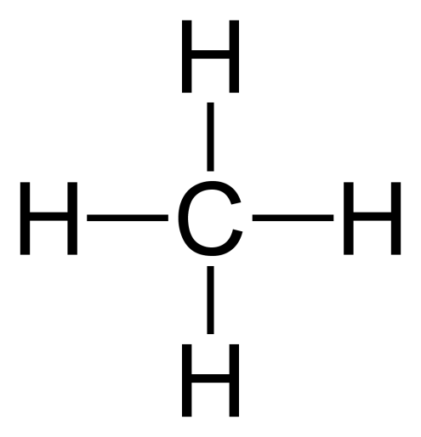
71a. Multiple substitution reactions with saturated methane and chlorine.
+ Cl₂
Cl + HCl
Methane + chlorine → chloromethane + HCl

Slide 80
71b. Multiple substitution reactions with saturated methane and chlorine.
Cl + Cl₂
Chloromethane + chlorine makes

Slide 81
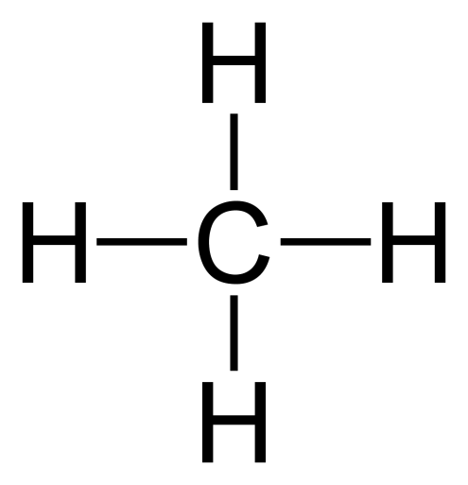
71b. Multiple substitution reactions with saturated methane and chlorine.
Cl + Cl₂
Cl + HCl
Cl
Chloromethane + chlorine makes dichloromethane + HCl

Slide 82
71c. Multiple substitution reactions with saturated methane and chlorine.
Cl + Cl₂
Cl
Dichloromethane + chlorine →

Slide 83
71c. Multiple substitution reactions with saturated methane and chlorine.
Cl
Cl + Cl₂
Cl + HCl
Cl
Cl
Dichloromethane + chlorine → trichloromethane + HCl

Slide 84
71d. Multiple substitution reactions with saturated methane and chlorine.
Cl
Cl + Cl₂
Cl
Trichloromethane + chlorine →

Slide 85
71d. Multiple substitution reactions with saturated methane and chlorine.
Cl
Cl
Cl + Cl₂
Cl
Cl + HCl
Cl
Cl
Trichloromethane + chlorine → Tetrachlormethane & HCl
This is the organic name. You could also call this carbon tetrachloride, same thing.

Slide 86
72. Halogens can be substituted into saturated hydrocarbons, alkanes.
73. It happens ONE HALOGEN AT A TIME.

Slide 87
74. When you combine halogens with unsaturated hydrocarbons (alkenes/alkynes) a different reaction happens called an ADDITION REACTION
That’s because when the double bond “opens up” to a single bond, and it opens up 2 spots for BOTH halogens to join the molecule, or, a triple bond opens up into a double bond, and again, you ADD both halogens at once.

Slide 88
75. Addition reactions… Ethene + Bromine → (unsaturated hydrocarbon + halogen…)

Slide 89
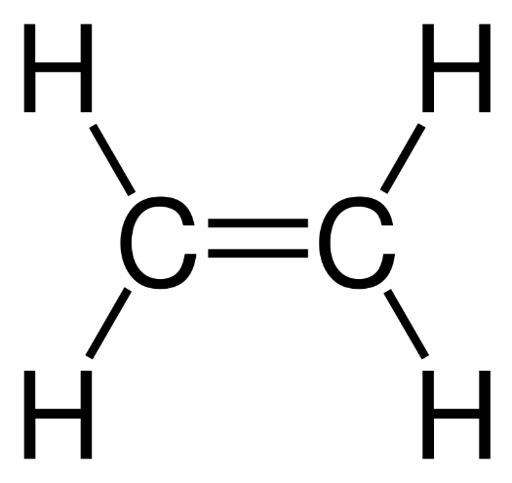
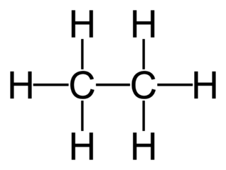
75. Addition reactions… Ethene + Bromine → (unsaturated hydrocarbon + halogen…)
+ Br₂ →
Br
Br
1,2 dibromoethane

Slide 90
76. Addition reactions… 2-pentene + fluorine → (unsaturated hydrocarbon + halogen…)

Slide 91
76. Addition reactions… 2-pentene + fluorine → (unsaturated hydrocarbon + halogen…)
+ F₂ →
F F
2,3 difluoro pentane

Slide 92
77. Addition reactions… Ethyne + chlorine → (unsaturated hydrocarbon + halogen…)

Slide 93
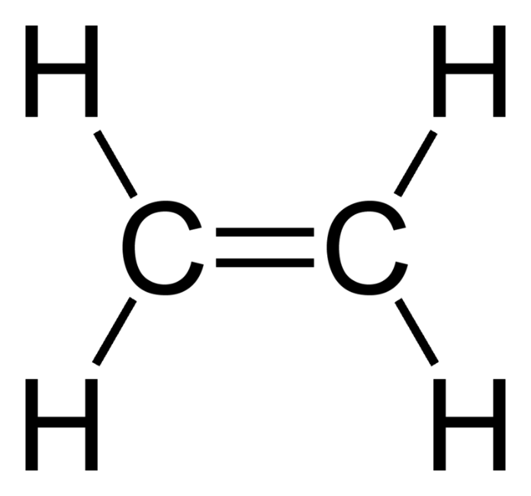
77. Addition reactions… Ethyne + chlorine → (unsaturated hydrocarbon + halogen…)
+ Cl₂ →
Cl
Cl
1,2 dichloro ethene

Slide 94
78. Addition reactions… 1-pentyne + iodine → (unsaturated hydrocarbon + halogen…)

Slide 95
78. Addition reactions… 1-pentyne + iodine → (unsaturated hydrocarbon + halogen…)
Product is
1,2 di-iodo
1-pentene

Slide 96
Alcohols & Ethers 79. Draw their functional groups (column 2 only)

Slide 97
Alcohols
80. Alcohols have an “–OH” group which is NOT a hydroxide. Alcohols are MOLECULAR not ionic.
When the hydroxide anion is ionically bonded to a metal, that’s an Arrhenius base. (NaOH, or KOH)
Alcohols are not bases.

Slide 98
83. Draw METHANOL (one carbon alcohol) and then ETHANOL (2 carbon alcohol)

Slide 99
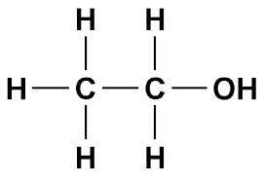
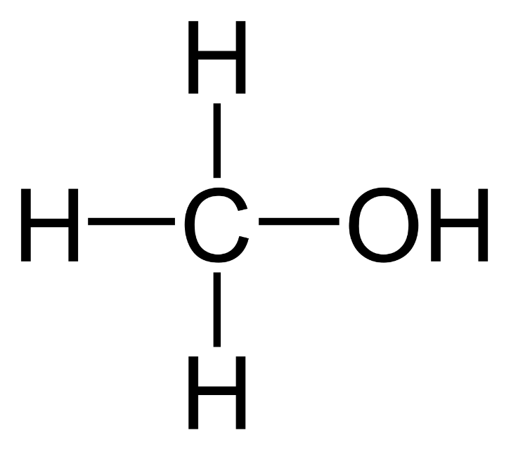
83. Draw METHANOL (one carbon alcohol)
83. Draw METHANOL (one carbon alcohol) and then ETHANOL (2 carbon alcohol)
Notice the – OH functional group. These are NOT ionic, they are molecular.

Slide 100
83. Write the condensed structural formaulas for both of these alcohol molecules.
CH₃OH methanol
The –OH really means
–O–H
But we abbreviate it and just “know” that the oxygen and hydrogen make a single covalent bond.
It’s prettier that way.
CH₃CH₂OH ethanol

Slide 101
84. Draw ethanol two times, once with the “–OH” group on the right side, once on the left bottom.

Slide 102
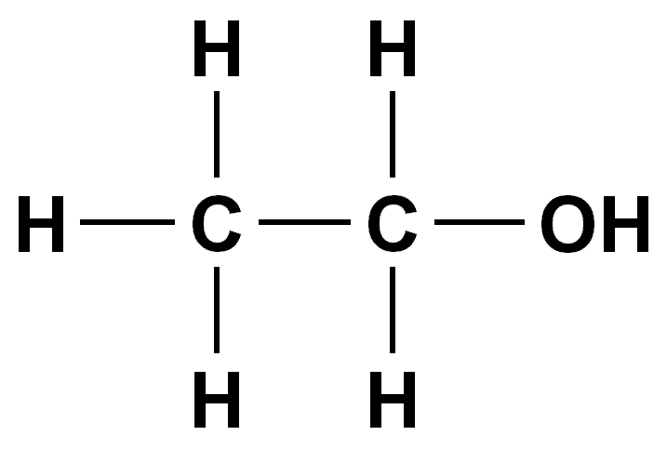
84. Draw ethanol two times, once with the “–OH” group on the right side, once on the left bottom.
These are identical.
The alcohol group is on the #1 carbon in both molecules.

Slide 103
85. Draw both propanol molecules, one with the –OH group on the 1st carbon atom, then put it onto the 2nd carbon atom. Name both.

Slide 104
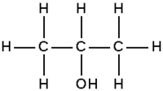
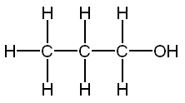
85. Draw both of the propanol molecules, one with the –OH group on the first carbon atom, then put it onto the second carbon atom. Name both.
1-propanol 2-propanol
86. These are different ISOMERS, which means they have the same chemical formula (C₃H₈O), but different structures. They are not identical.

Slide 105
87. Draw & name the three 5 carbon alcohol molecules

Slide 106
87. Draw & name the three 5 carbon alcohol molecules
H H H H H
Name the base chain (count carbon atoms)
Enumerate where the alcohol group is located.
Alcohol names always end with an -anol
suffix
H
1-pentanol
C
C
C
C
C
OH
H H H H H
H H H H H
2-pentanol
H
C
C
C
C
C
H
H H H OH H
H H H H H
3-pentanol
H
C
C
C
C
C
H
H H OH H H

Slide 107
88. These are ALL the alcohols in our class, none are missing.
# C atoms names of the alcohol molecules
1 methanol
2 ethanol
3 1-propanol, 2-propanol
4 1-butanol, 2-butanol
5 1-pentanol, 2-pentanol, 3-pentanol
6 1-hexanol, 2-hexanol, 3-hexanol
7 1-heptanol, 2-heptanol, 3-heptanol, 4-heptanol
8 1-octanol, 2-octanol, 3-octanol, 4-octanol
9 1-nonanol, 2-nonanol, 3-nonanol, 4-nonanol, 5-nonanol
10 1-decanol, 2-decanol, 3-decanol, 4-decanol, 5-decanol

Slide 108
89. Why is there not an alcohol molecule named 4-pentanol? (Draw it, you can)

Slide 109
89. Why is there not an alcohol molecule named 4-pentanol? (Draw it, you can)
H H H OH H
2 3 4 5 RIGHT?
No! Count from the short end! This is 2-pentanol

Slide 110
Ethers
Ether molecules are easy to recognize because they have a single atom of oxygen in the middle, and make single bonds left and right 90. Ethers functional group looks like this: –– O –– 91. and a general formula that looks like this: R–– O ––R’
92. Which means an R group is attached to an oxygen atom, which has a different R prime group on the other side.

Slide 111
Let’s first see about these “R” groups.
They are just hydrocarbon chains, of one to 10 carbon atoms long.
In high school they are only simple “alkane-like” chains, nothing fancy, only single bonds.

Slide 112
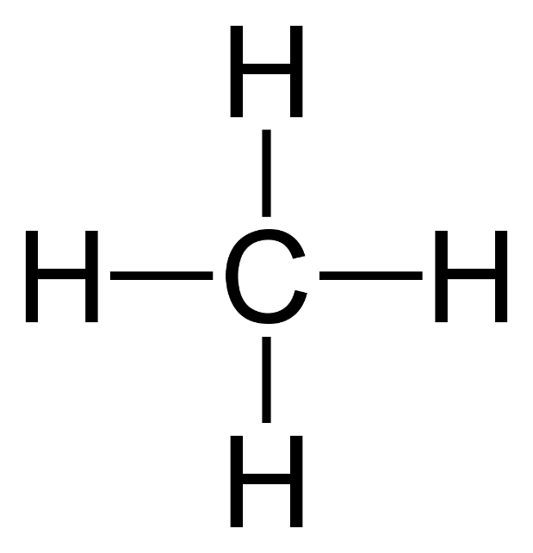
93. Draw…Methane is CH₄
You can’t “ADD” a methane to an oxygen in an ether. There is no place for the oxygen to bond.
Methane Methyl
But if we remove a hydrogen atom, we can attach what’s left of it to the oxygen atoms.

Slide 113
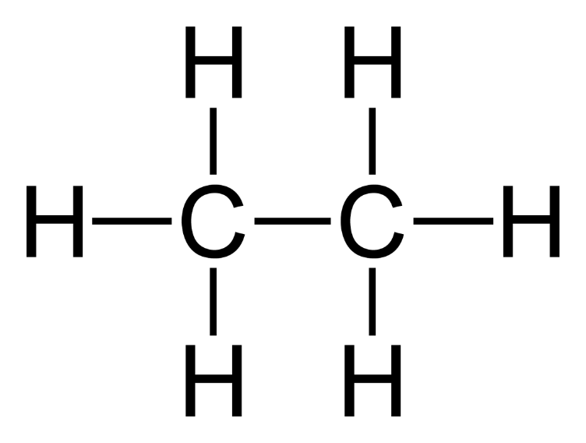
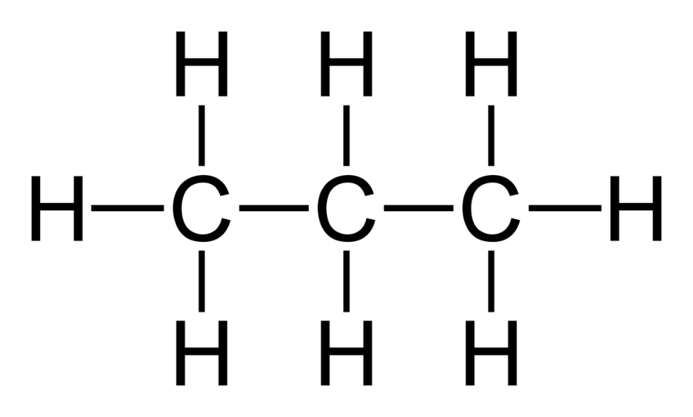
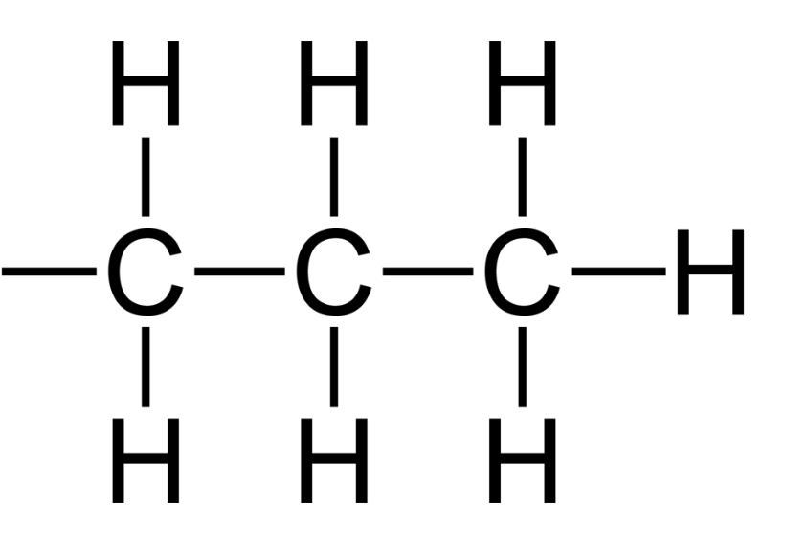
94 - 95
Ethane Ethyl
Propane Propyl

Slide 114
96
Butane becomes
Butyl

Slide 115
97. And then would come…
Pentane… pentyl Hexane… hexyl
Heptane… heptyl Octane… octyl
Nonane… nonyl Decane… decyl

Slide 116
98. Draw these ethers: Methyl ethyl ether Propyl butyl ether Pentyl methyl ether

Slide 117
98. Draw these ethers: Methyl ethyl ether Propyl butyl ether
Pentyl methyl ether
O
O
O

Slide 118
99. Draw these ethers too: Diethyl ether Dimethyl ether Hexyl ethyl ether

Slide 119
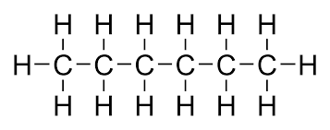
99. Draw these ethers too: Diethyl ether Dimethyl ether Hexyl ethyl ether
O
Only a goof ball would say ethyl ethyl or methyl methyl
O
O

Slide 120
100. THINK, In OUR high school chem class…
What’s the smallest possible ether?
What’s the biggest ether?
What is the 2d biggest ether? Can there be double bonds, or triple bonds in our ethers? Can there be alcohols or halogens be attached to our ethers? Can there be two functional groups right next to each other? Can there be 2 or more alcohol groups on one molecule?

Slide 121
100. THINK, In OUR high school chem class…
What’s the smallest possible ether? Dimethyl ether
What’s the biggest ether? Didecyl ether
What is the 2d biggest ether? Nonyl decyl ether Can there be double bonds, or triple bonds in our ethers? Never Can there be alcohols or halogens be attached to our ethers? Nope Can there be two functional groups right next to each other? No, no, no Can there be 2 or more alcohol groups on one molecule? Stop, no!

Slide 122
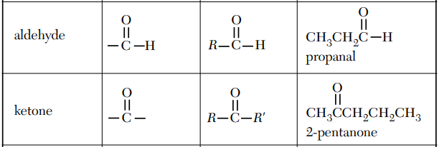
101. Aldehydes + Ketones we will examine together, since they are nearly the same thing. When they both have the same number of carbon atoms, they are ISOMERS.
102. Both have a C=O bond, just in different places. Add this red & blue and that box at left into your table R now
END
Isomers
MIDDLE

Slide 123
103. Aldehydes always have the C=O at the end of a hydrocarbon chain. Write: R–CHO
104. Ketones always have the C=O in the middle of a hydrocarbon chain. Write R–CO–R’
O R — C —H
O R — C — R’

Slide 124
105. Draw & name the 3-carbon aldehyde, and the 3-carbon ketone now

Slide 125
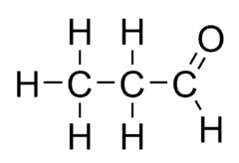
105. Draw & name the 3-carbon aldehyde, and the 3-carbon ketone now
3 carbon aldehyde propanal
CH₃CH₂CHO
3 carbon ketone propanone
CH₃COCH₃

Slide 126
106. Draw METHANAL
ETHANAL
BUTANAL
BUTANONE
2-PENTANONE
3-PENTANONE

Slide 127
METHANAL ETHANAL BUTANONE
BUTANAL
3-PENTANONE
2-PENTANONE
O
O
H
H
C
H
H
C
C
H
H H O H
H
H
C
C
C
C
H
H H H
H H H O
H H O H H
H
C
C
C
C
H
H
C
C
C
C
C
H
H H H
H H H H
H H H O H
H
C
C
C
C
C
H
H H H H

