Slide 1
Objective: Introduction to phases chemistry, how substances change phase from solid, liquid and gas. (etc.) Notes for class -1 through 23.

Slide 2
Intro to phases chemistry 1. Fill in all 6 phases changes by name. .

Slide 3
Objective: Intro to phases chemistry
melting
freezing

Slide 4
Objective: Intro to phases chemistry
melting
vaporizing
freezing
condensing

Slide 5
Objective: Intro to phases chemistry
Sublimation
melting
vaporizing
freezing
condensing
Deposition

Slide 6
2. Indicate the “important” temperatures for water (as standard pressure), and all three phases.

Slide 7
2. Indicate the “important” temperatures for water (as standard pressure), and all three phases.
solid
Cold Hot liquid liquid
gas

Slide 8
2. Indicate the “important” temperatures for water (as standard pressure), and all three phases.
solid
Cold Hot liquid liquid
gas
273 K 0°C 373 K 100°C

Slide 9
2. Indicate the “important” temperatures for water (as standard pressure), and all three phases.
solid
Cold Hot liquid liquid
gas
273 K 0°C 373 K 100°C
This is the MELTING POINT
and the FREEZING POINT
It’s the cold phase change
This is the BOILING POINT
and the CONDENSING POINT
It’s the hot phase change

Slide 10
3. A heating curve shows the specific ENERGY associated with the different PHASE CHANGES for any substance, as heat is ADDED.

Slide 11
3. A heating curve shows the specific ENERGY associated with the different PHASE CHANGES for any substance, as heat is ADDED.
4. A Cooling curves show the ENERGY associated with the different PHASE CHANGES for any substance, as heat is REMOVED

Slide 12
3. A heating curve shows the specific ENERGY associated with the different PHASE CHANGES for any substance, as heat is ADDED.
4. A Cooling curves show the ENERGY associated with the different PHASE CHANGES for any substance, as heat is REMOVED
5. The necessary information for either a HEATING or COOLING curve includes the MELTING and the BOILING point

Slide 13
3. A heating curve shows the specific ENERGY associated with the different PHASE CHANGES for any substance, as heat is ADDED.
4. A Cooling curves show the ENERGY associated with the different PHASE CHANGES for any substance, as heat is REMOVED
5. The necessary information for either a HEATING or COOLING curve includes the MELTING and the BOILING point
6. The melting point = the FREEZING point.
7. The boiling point = the CONDENSING point.

Slide 14
8. We will draw the heating curve for water. Note: Start the graph at absolute zero!
The Heating Curve for WATER
Temp
In
Kelvin
Heat added at a constant rate →

Slide 15
The Heating Curve for WATER
373
Temp
In
Kelvin
273
Heat added at a constant rate →

Slide 16
8. “A” is cold, but not zero Kelvin. Very cold ice, but it warms up…
The Heating Curve for WATER
373
Temp
In
Kelvin
B
273
A
Heat added at a constant rate →

Slide 17
8. BC represents MELTING ice, at the melting point… which is ONE temperature.
The Heating Curve for WATER
373
Temp
In
Kelvin
B
273
C
A
Heat added at a constant rate →

Slide 18
8. CD represents water warming from very cold, to hot hot hot!
The Heating Curve for WATER
D
373
Temp
In
Kelvin
B
273
C
A
Heat added at a constant rate →

Slide 19
8. DE is the vaporization of the liquid water into steam, at the ONE boiling point.
The Heating Curve for WATER
D
373
E
Temp
In
Kelvin
B
273
C
A
Heat added at a constant rate →

Slide 20
8. EF shows steam getting as HOT AS YOU CAN MAKE IT….
The Heating Curve for WATER
F
D
373
E
Temp
In
Kelvin
B
273
C
A
Heat added at a constant rate →

Slide 21
9. Let’s fill in the boxes and grasp what is happening here with energy. First row…
The Heating Curve for WATER
F
D
373
E
Temp
In
Kelvin
B
273
C
A
Heat added at a constant rate →

Slide 22
The Heating Curve for WATER
F
D
373
E
Temp
In
Kelvin
SEGMENT | TEMPERATURE CHANGE | KINETIC ENERGY CHANGE | POTENTIAL ENERGY CHANGE | PHASE OR PHASES PRESENT
AB
BC
CD
DE
EF
B
273
C
A

Slide 23
The Heating Curve for WATER
F
D
373
E
Temp
In
Kelvin
SEGMENT | TEMPERATURE CHANGE | KINETIC ENERGY CHANGE | POTENTIAL ENERGY CHANGE | PHASE OR PHASES PRESENT
AB | ↑ | ↑ | ↔ | solid
BC
CD
DE
EF
B
273
C
A

Slide 24
The Heating Curve for WATER
F
D
373
E
Temp
In
Kelvin
SEGMENT | TEMPERATURE CHANGE | KINETIC ENERGY CHANGE | POTENTIAL ENERGY CHANGE | PHASE OR PHASES PRESENT
AB | ↑ | ↑ | ↔ | solid
BC | ↔ | ↔ | ↑ | S→L
CD
DE
EF
B
273
C
A

Slide 25
The Heating Curve for WATER
F
D
373
E
Temp
In
Kelvin
SEGMENT | TEMPERATURE CHANGE | KINETIC ENERGY CHANGE | POTENTIAL ENERGY CHANGE | PHASE OR PHASES PRESENT
AB | ↑ | ↑ | ↔ | solid
BC | ↔ | ↔ | ↑ | S→L
CD | ↑ | ↑ | ↔ | liquid
DE
EF
B
273
C
A

Slide 26
The Heating Curve for WATER
F
D
373
E
Temp
In
Kelvin
SEGMENT | TEMPERATURE CHANGE | KINETIC ENERGY CHANGE | POTENTIAL ENERGY CHANGE | PHASE OR PHASES PRESENT
AB | ↑ | ↑ | ↔ | solid
BC | ↔ | ↔ | ↑ | S→L
CD | ↑ | ↑ | ↔ | liquid
DE | ↔ | ↔ | ↑ | L→G
EF
B
273
C
A

Slide 27
The Heating Curve for WATER
F
D
373
E
Temp
In
Kelvin
SEGMENT | TEMPERATURE CHANGE | KINETIC ENERGY CHANGE | POTENTIAL ENERGY CHANGE | PHASE OR PHASES PRESENT
AB | ↑ | ↑ | ↔ | solid
BC | ↔ | ↔ | ↑ | S→L
CD | ↑ | ↑ | ↔ | liquid
DE | ↔ | ↔ | ↑ | L→G
EF | ↑ | ↑ | ↔ | gas
B
273
C
A

Slide 28
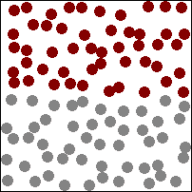
10. Temperature is deemed hotter when the particles are moving _____________________.
11. Colder temperatures indicate that the substance’s particles are moving _______________.
12. The “energy of motion” is called _________________ energy.
← cooler
hotter→

Slide 29
10. Temperature is deemed hotter when the particles are moving FASTER.
11. Colder temperatures indicate that the substance’s particles are moving _______________.
12. The “energy of motion” is called _________________ energy.
← cooler
hotter→

Slide 30
10. Temperature is deemed hotter when the particles are moving FASTER.
11. Colder temperatures indicate that the substance’s particles are moving SLOWER.
12. The “energy of motion” is called _________________ energy.
← cooler
hotter→

Slide 31
10. Temperature is deemed hotter when the particles are moving FASTER.
11. Colder temperatures indicate that the substance’s particles are moving SLOWER.
12. The “energy of motion” is called KINETIC energy.
← cooler
hotter→

Slide 32
14. What ever the Temperature does, the Kinetic Energy ___________.
15. If the temperature increases, the kinetic energy _______________.
16. If the temperature decreases, the kinetic energy ________________.
17. If the temperature stays steady, then the kinetic energy __________________.

Slide 33
14. What ever the Temperature does, the Kinetic Energy DOES TOO.
15. If the temperature increases, the kinetic energy _______________.
16. If the temperature decreases, the kinetic energy ________________.
17. If the temperature stays steady, then the kinetic energy __________________.

Slide 34
14. What ever the Temperature does, the Kinetic Energy DOES TOO.
15. If the temperature increases, the kinetic energy INCREASES TOO.
16. If the temperature decreases, the kinetic energy ________________.
17. If the temperature stays steady, then the kinetic energy __________________.

Slide 35
14. What ever the Temperature does, the Kinetic Energy DOES TOO.
15. If the temperature increases, the kinetic energy INCREASES TOO.
16. If the temperature decreases, the kinetic energy DECREASES TOO.
17. If the temperature stays steady, then the kinetic energy __________________.

Slide 36
14. What ever the Temperature does, the Kinetic Energy DOES TOO.
15. If the temperature increases, the kinetic energy INCREASES TOO.
16. If the temperature decreases, the kinetic energy DECREASES TOO.
17. If the temperature stays steady, then the kinetic energy STAYS STEADY TOO.

Slide 37
18. During a phase change on the heating curve, segment BC, heat energy is being added at a constant rate, but the temperature (and the Kinetic Energy) stay steady. The Law of Conservation of Energy says: Energy cannot be created or destroyed in a chemical reaction, or during a physical change, but it can be transferred. How do we explain heat energy being added while the Kinetic Energy remains steady?

Slide 38
Heat Energy is added, the energy of the system MUST increase, if the kinetic energy does not increase, then the POTENTIAL ENERGY increases.

Slide 39
Potential Energy is the energy of PHASE.
GAS | Highest POTENTIAL ENERGY | Increasing PE Decreasing PE
LIQUID | Medium POTENTIAL ENERGY
SOLID | Lowest POTENTIAL ENERGY

Slide 40
19. Which phase has the most potential energy? Solid Liquid Gas
20. Which phase has the LEAST potential energy? Solid Liquid Gas
21. During a phase change for H₂O, solid to liquid, energy is added, but the temperature remain at 273 Kelvin. What energy increases during this phase change? ____________
22. The ice has a ______________ potential energy, while the liquid has a __________________ Potential Energy.
23. Can both kinetic and potential energy change at the same time?

Slide 41
19. Which phase has the most potential energy? Solid Liquid Gas
20. Which phase has the LEAST potential energy? Solid Liquid Gas
21. During a phase change for H₂O, solid to liquid, energy is added, but the temperature remain at 273 Kelvin. What energy increases during this phase change? ____________
22. The ice has a ______________ potential energy, while the liquid has a __________________ Potential Energy.
23. Can both kinetic and potential energy change at the same time?

Slide 42
19. Which phase has the most potential energy? Solid Liquid Gas
20. Which phase has the LEAST potential energy? Solid Liquid Gas
21. During a phase change for H₂O, solid to liquid, energy is added, but the temperature remain at 273 Kelvin. What energy increases during this phase change? ____________
22. The ice has a ______________ potential energy, while the liquid has a __________________ Potential Energy.
23. Can both kinetic and potential energy change at the same time?

Slide 43
19. Which phase has the most potential energy? Solid Liquid Gas
20. Which phase has the LEAST potential energy? Solid Liquid Gas
21. During a phase change for H₂O, solid to liquid, energy is added, but the temperature remain at 273 Kelvin. What energy increases during this phase change? POTENTIAL
22. The ice has a ______________ potential energy, while the liquid has a __________________ Potential Energy.
23. Can both kinetic and potential energy change at the same time?

Slide 44
19. Which phase has the most potential energy? Solid Liquid Gas
20. Which phase has the LEAST potential energy? Solid Liquid Gas
21. During a phase change for H₂O, solid to liquid, energy is added, but the temperature remain at 273 Kelvin. What energy increases during this phase change? POTENTIAL
22. The ice has a LOWER potential energy, while the liquid has a HIGHER Potential Energy.
23. Can both kinetic and potential energy change at the same time?

Slide 45
19. Which phase has the most potential energy? Solid Liquid Gas
20. Which phase has the LEAST potential energy? Solid Liquid Gas
21. During a phase change for H₂O, solid to liquid, energy is added, but the temperature remain at 273 Kelvin. What energy increases during this phase change? POTENTIAL
22. The ice has a LOWER potential energy, while the liquid has a HIGHER Potential Energy.
23. Can both kinetic and potential energy change at the same time? NO

Slide 46
Lastly, using just your arms to dance
Let’s do low kinetic energy first.
Next, let’s do high kinetic energy.
Last, something to think about… Why is it good to believe that you have LOW KINETIC ENERGY, but also believe you’re HIGH KINETIC ENERGY? …Oh, Read the PHASES BASICS TONIGHT…

Slide 47
Phases Class 2 Starts next…
Notes # 24 - 36

Slide 48
24. Draw the cooling curve for rubidium.
The COOLING Curve for RUBIDIUM
Temp
In
Kelvin
Heat is removed at a constant rate →

Slide 49
24. AB is hot hot hot steam cooling down to the condensation point (boiling point too)
The COOLING Curve for RUBIDIUM
A
961
B
Temp
In
Kelvin
312
Heat REMOVED at a constant rate →

Slide 50
24. BC is the condensing point (one temp) B to C is gas to liquid
The COOLING Curve for RUBIDIUM
A
C
961
B
Temp
In
Kelvin
312
Heat REMOVED at a constant rate →

Slide 51
24. CD is hot liquid to cold liquid
The COOLING Curve for RUBIDIUM
A
C
961
B
Temp
In
Kelvin
312
D
Heat REMOVED at a constant rate →

Slide 52
24. DE the coldest liquid “freezes” into a solid
The COOLING Curve for RUBIDIUM
A
C
961
B
Temp
In
Kelvin
E
312
D
Heat REMOVED at a constant rate →

Slide 53
24. EF the solid rubidium gets as cold as you can make it (above absolute zero!)
The COOLING Curve for RUBIDIUM
A
C
961
B
Temp
In
Kelvin
E
312
D
F
Heat REMOVED at a constant rate →

Slide 54
25. Fill in the boxes, same as for heating curve, but “upside down”
The COOLING Curve for RUBIDIUM
A
C
961
B
Temp
In
Kelvin
9. Fill in this chart to describe what’s happening
SEGMENT | TEMP CHANGE | KINETIC ENERGY CHANGE | POTENTIAL ENERGY CHANGE | PHASE OR PHASES PRESENT
AB
BC
CD
DE
EF
E
312
D
F
Heat REMOVED at a constant rate →

Slide 55
The COOLING Curve for RUBIDIUM
A
C
961
B
Temp
In
Kelvin
9. Fill in this chart to describe what’s happening
SEGMENT | TEMP CHANGE | KINETIC ENERGY CHANGE | POTENTIAL ENERGY CHANGE | PHASE OR PHASES PRESENT
AB | ↓ | ↓ | ↔ | gas
BC
CD
DE
EF
E
312
D
F
Heat REMOVED at a constant rate →

Slide 56
The COOLING Curve for RUBIDIUM
A
C
961
B
Temp
In
Kelvin
9. Fill in this chart to describe what’s happening
SEGMENT | TEMP CHANGE | KINETIC ENERGY CHANGE | POTENTIAL ENERGY CHANGE | PHASE OR PHASES PRESENT
AB | ↓ | ↓ | ↔ | gas
BC | ↔ | ↔ | ↓ | G →L
CD
DE
EF
E
312
D
F
Heat REMOVED at a constant rate →

Slide 57
The COOLING Curve for RUBIDIUM
A
C
961
B
Temp
In
Kelvin
9. Fill in this chart to describe what’s happening
SEGMENT | TEMP CHANGE | KINETIC ENERGY CHANGE | POTENTIAL ENERGY CHANGE | PHASE OR PHASES PRESENT
AB | ↓ | ↓ | ↔ | gas
BC | ↔ | ↔ | ↓ | G →L
CD | ↓ | ↓ | ↔ | liquid
DE
EF
E
312
D
F
Heat REMOVED at a constant rate →

Slide 58
The COOLING Curve for RUBIDIUM
A
C
961
B
Temp
In
Kelvin
9. Fill in this chart to describe what’s happening
SEGMENT | TEMP CHANGE | KINETIC ENERGY CHANGE | POTENTIAL ENERGY CHANGE | PHASE OR PHASES PRESENT
AB | ↓ | ↓ | ↔ | gas
BC | ↔ | ↔ | ↓ | G →L
CD | ↓ | ↓ | ↔ | liquid
DE | ↔ | ↔ | ↓ | L → S
EF
E
312
D
F
Heat REMOVED at a constant rate →

Slide 59
The COOLING Curve for RUBIDIUM
A
C
961
B
Temp
In
Kelvin
9. Fill in this chart to describe what’s happening
SEGMENT | TEMP CHANGE | KINETIC ENERGY CHANGE | POTENTIAL ENERGY CHANGE | PHASE OR PHASES PRESENT
AB | ↓ | ↓ | ↔ | gas
BC | ↔ | ↔ | ↓ | G →L
CD | ↓ | ↓ | ↔ | liquid
DE | ↔ | ↔ | ↓ | L → S
EF | ↓ | ↓ | ↔ | solid
E
312
D
F
Heat REMOVED at a constant rate →

Slide 60
30. On one graph, draw the heating curve for lead and the cooling curve for bismuth (!)

Slide 61
30. The heating curve for lead and the cooling curve for bismuth
From Table S
LEAD
Melting point: 600 K
Boiling point: 2022 K
BISMUTH Melting point: 544 K
Boiling point: 1837 K
Now draw one graph at a time, heating curve for lead first.
2022
1837
Temp
In
Kelvin
600
544
Heat added (or Heat Removed) at a constant rate →

Slide 62
30. The heating curve for lead and the cooling curve for bismuth
F
D
2022
1837
E
Temp
In
Kelvin
B
600
544
C
A
Heat added (or removed) at a constant rate →

Slide 63
30. The heating curve for lead and the cooling curve for bismuth
F
D
2022
1837
A
E
C
B
Temp
In
Kelvin
B
600
544
C
E
D
F
A
Heat added (or removed) at a constant rate →

Slide 64
SPECIAL NOTE: The HOT phase change (the higher one) is ALWAYS LONGER than the COLD phase change. ALWAYS. The hot phase change is a bigger energy event.
F
D
2022
1837
A
E
C
B
Temp
In
Kelvin
B
600
544
C
E
D
F
A
Heat added (or removed) at a constant rate →

Slide 65
The characteristics of solids, liquids and gases?
31. True or False, nearly every substance can be a solid, liquid or a gas?

Slide 66
The characteristics of solids, liquids and gases?
31. True or False, nearly every substance can be a solid, liquid or a gas?
32. An exceptions is wood, which is a mixed solid, but combusts before it melts. All elements and nearly all compounds can be at any phase with proper temperature and pressure conditions.

Slide 67
The characteristics of solids, liquids and gases?
31. True or False, nearly every substance can be a solid, liquid or a gas?
32. An exceptions is wood, which is a mixed solid, but combusts before it melts. All elements and nearly all compounds can be at any phase with proper temperature and pressure conditions.
33. Where do we find the element melting and boiling points? _______

Slide 68
The characteristics of solids, liquids and gases?
31. True or False, nearly every substance can be a solid, liquid or a gas?
32. An exceptions is wood, which is a mixed solid, but combusts before it melts. All elements and nearly all compounds can be at any phase with proper temperature and pressure conditions.
33. Where do we find the element melting and boiling points? TABLE S
34. Where do we find the element freezing and condensing points? ____

Slide 69
The characteristics of solids, liquids and gases?
31. True or False, nearly every substance can be a solid, liquid or a gas?
32. An exceptions is wood, which is a mixed solid, but combusts before it melts. All elements and nearly all compounds can be at any phase with proper temperature and pressure conditions.
33. Where do we find the element melting and boiling points? TABLE S
Where do we find the element freezing and condensing points? Table S! Melting point = Freezing point. Boiling point = Condensation point.

Slide 70
Fill in this chart outlining some important details of the 3 phases.
35 | Particle Attraction | Particle Movement | Particles are... | Relative Density | Compressibility
Solid
Liquid
Gas
Work straight across →

Slide 71
Particles in Solids, Liquids and Gases
35 | Particle Attraction | Particle Movement | Particles are... | Relative Density | Compressibility
Solid | strong | none other than a slight vibration | stuck together | usually the highest | almost zero
Liquid
Gas
Work straight across →

Slide 72
Particles in Solids, Liquids and Gases
35 | Particle Attraction | Particle Movement | Particles are... | Relative Density | Compressibility
Solid | strong | none other than a slight vibration | stuck together | usually the highest | almost zero
Liquid
Gas

Slide 73
Particles in Solids, Liquids and Gases
35 | Particle Attraction | Particle Movement | Particles are... | Relative Density | Compressibility
Solid | strong | none other than a slight vibration | stuck together | usually the highest | almost zero
Liquid | pretty strong | particles flow all over each other | sticky but not stuck | usually medium | almost zero
Gas

Slide 74
Particles in Solids, Liquids and Gases
35 | Particle Attraction | Particle Movement | Particles are... | Relative Density | Compressibility
Solid | strong | none other than a slight vibration | stuck together | usually the highest | almost zero
Liquid | pretty strong | particles flow all over each other | sticky but not stuck | usually medium | almost zero
Gas | weak, nearly nonexistent | rapid, in straight lines, with many collisions | Hardly ever touching except to collide off of each other | always the lowest | gases compress a lot!

Slide 75
36. Draw the particle diagrams of a solid, liquid and a gas in the boxes below.
SOLID | LIQUID | GAS

Slide 76
36. Draw the particle diagrams of a solid, liquid and a gas in the boxes below.
SOLID | LIQUID | GAS

Slide 77
36. Draw the particle diagrams of a solid, liquid and a gas in the boxes below.
SOLID Particles are rigidly arranged, orderly, repetitively spaced. They have a definite shape. They DO NOT take shape of container. | LIQUID Particles in constant motion and touch each other. They do not have definite shape. They DO TAKE the shape of the container. | GAS Particles are in fast motion, only touching when colliding. They have no shape, they FILL any container they’re in.

Slide 78
Phases Class 3 Starts next…
37 - 68

Slide 79
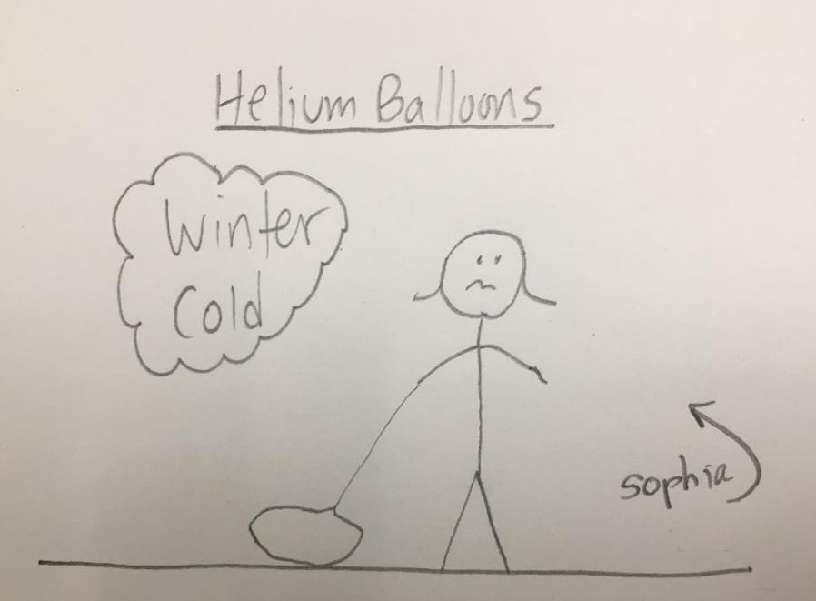
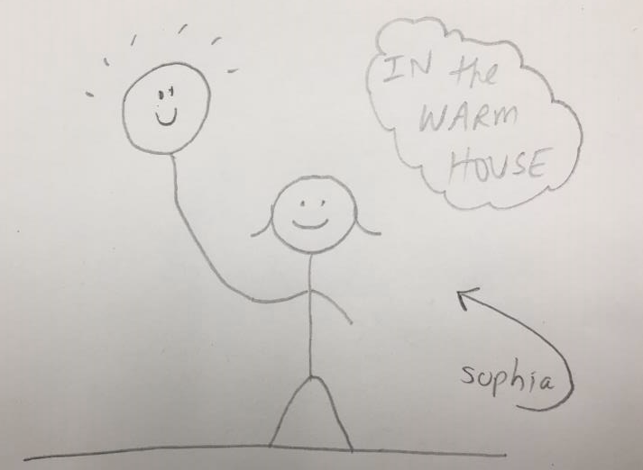
True Story

Slide 80
Gas (air) Pressure
37. Gas (air) Pressure is caused by the ___________ of the particles.
38. The more collisions the __________ the pressure. If you put your balloon outside in the winter it shrinks. The cold atmosphere absorbs the energy out of the balloon gas, and the helium atoms slow down. Since they are slower, the collisions are both ______________ and _______________.
This makes for _____________ pressure, which makes good kids cry.

Slide 81
Gas (air) Pressure
37. Gas (air) Pressure is caused by the COLLISIONS of the particles.
38. The more collisions the __________ the pressure. If you put your balloon outside in the winter it shrinks. The cold atmosphere absorbs the energy out of the balloon gas, and the helium atoms slow down. Since they are slower, the collisions are both ______________ and _______________.
This makes for _____________ pressure, which makes good kids cry.

Slide 82
Gas (air) Pressure
37. Gas (air) Pressure is caused by the COLLISIONS of the particles.
38. The more collisions the GREATER the pressure. If you put your balloon outside in the winter it shrinks. The cold atmosphere absorbs the energy out of the balloon gas, and the helium atoms slow down. Since they are slower, the collisions are both ______________ and _______________.
This makes for _____________ pressure, which makes good kids cry.

Slide 83
Gas (air) Pressure
37. Gas (air) Pressure is caused by the COLLISIONS of the particles.
38. The more collisions the GREATER the pressure. If you put your balloon outside in the winter it shrinks. The cold atmosphere absorbs the energy out of the balloon gas, and the helium atoms slow down. Since they are slower, the collisions are both WEAKER and FEWER.
This makes for _____________ pressure, which makes good kids cry.

Slide 84
Gas (air) Pressure
37. Gas (air) Pressure is caused by the COLLISIONS of the particles.
38. The more collisions the GREATER the pressure. If you put your balloon outside in the winter it shrinks. The cold atmosphere absorbs the energy out of the balloon gas, and the helium atoms slow down. Since they are slower, the collisions are both WEAKER and FEWER.
This makes for LOWER pressure, which makes good kids cry.

Slide 85
Gas (air) Pressure
39. If you bring the balloon into a warm house, the heat “recharges” the energy in the helium, causing both ____________________________ and more ___________________________, which expands the balloons,
and that makes kids _________________ again.

Slide 86
Gas (air) Pressure
39. If you bring the balloon into a warm house, the heat “recharges” the energy in the helium, causing both STRONGER and more FREQUENT, which expands the balloons, and that makes kids SMILE again.
J
COLD
L
WARM

Slide 87
Gas (or air) pressure is measured in four units in chemistry. Most are weirdo, but you will learn them all. Take out table A. 40. Normal or Standard Pressure is ___ atmospheres, which is shortened to ___________.

Slide 88
Gas (or air) pressure is measured in four units in chemistry. Most are weirdo, but you will learn them all. Take out table A. 40. Normal or Standard Pressure is 1.0 atmospheres, which is shortened to 1.0 atm.
41. Or it’s ______ kilopascals. Normal is abbreviated as ____________.

Slide 89
Gas (or air) pressure is measured in four units in chemistry. Most are weirdo, but you will learn them all. Take out table A. 40. Normal or Standard Pressure is 1.0 atmospheres, which is shortened to 1.0 atm.
41. Or it’s 101.3 kilopascals. Normal is abbreviated as 101.3 kPa. 42. In America we use ______________________units. Normal is ____.

Slide 90
Gas (or air) pressure is measured in four units in chemistry. Most are weirdo, but you will learn them all. Take out table A. 40. Normal or Standard Pressure is 1.0 atmospheres, which is shortened to 1.0 atm.
41. Or it’s 101.3 kilopascals. Normal is abbreviated as 101.3 kPa. 42. In America we use POUNDS PER SQUARE INCH units. Normal is 14.7 psi.

Slide 91
43. Pressure was originally measured by a device called a _________________________. Since they used mercury and a metric ruler, normal was originally decided to be _____________________
by a nice guy named _________________________________.

Slide 92
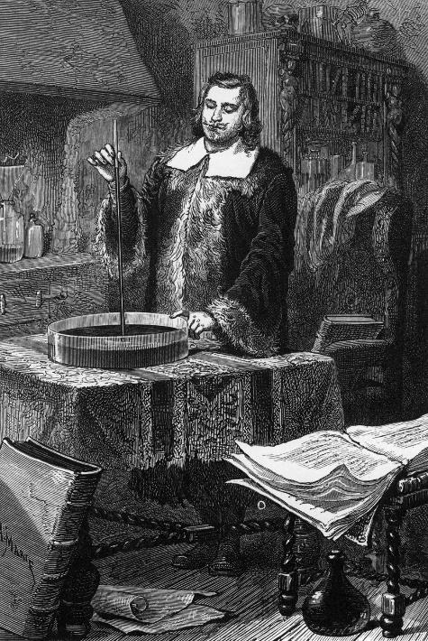
43. Pressure was originally measured by a device called a BAROMETER. Since they used mercury and a metric ruler, normal was declared to be 760 mm OF MERCURY
by a nice guy named EVANGLISTA TORRICELLI

Slide 93
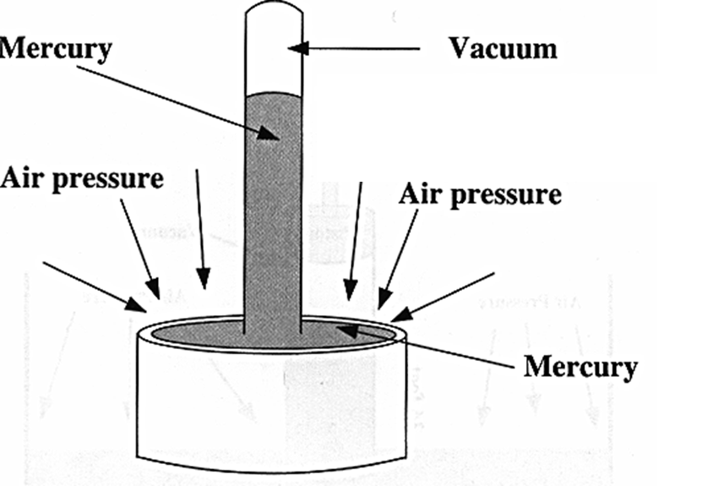
When the WHOLE atmosphere is pressing down on you, you “feel” 1 atm of pressure.
You don’t feel it because you were born into it and never once noticed it.
Each square inch of your skin, and your eyes too, are being pressed with 14.7 pounds.
When the air presses down onto the bowl of mercury, it pushes up through the vacuum tube.
Using a metric ruler, it was decided that when the Hg pushed up to 760 mm in height, that meant that the air pressure was normal, or STANDARD.

Slide 94
Right now, take out your reference tables to page 1.
Under Table A, write this into your table for safekeeping:
1 atm = 101.3 kPa = 760 mm Hg = 14.7 psi

Slide 95
A PHASE diagram will show the phase of a substance at a variety of temperatures and pressures. phase diagram for water
4
1
2
Pressure
(kPa)
3
Temp in °C

Slide 96
The phase diagram for water
4
44. Point 1 is the
45. Point 2 is the
101.3
1
2
Pressure
In kPa
3
0
100
Temp in °C

Slide 97
The phase diagram for water
44. Point 1 is the NORMAL FREEZING POINT FOR WATER
45. Point 2 is the NORMAL BOILING POINT FOR WATER
4
101.3
1
2
Pressure
In kPa
3
0
100
Temp in °C

Slide 98
The phase diagram for water
46. Point 3 is the
47. Point 4 is the
4
101.3
1
2
Pressure
In kPa
3
0
100
Temp in °C

Slide 99
The phase diagram for water
46. Point 3 is the TRIPLE POINT. ALL 3 PHASES, AND ALL 6 PHASE CHANGES OCCUR AT THE SAME TIME.
47. Point 4 is the CRITICAL POINT gas and liquid cannot be discerned.
4
101.3
1
2
Pressure
In kPa
3
0
100
Temp in °C

Slide 100
The phase diagram for water
48. The dotted line is normal pressure or standard pressure
4
101.3
1
2
Pressure
In kPa
3
0
100
Temp in °C

Slide 101
The phase diagram for water
49
Draw the arrows and names of phase changes.
4
freezing
condensing
melting
vaporizing
101.3
1
2
Pressure
In kPa
deposition
3
sublimation
0
100
Temp in °C

Slide 102
NORMAL FREEZING POINT
WATER WILL NORMALLY FREEZE OR MELT at 0⁰C at NORMAL PRESSURE OF 101.3 kPa. The normal freezing point = the normal melting point

Slide 103
NORMAL FREEZING POINT
WATER WILL NORMALLY FREEZE OR MELT at 0⁰C at NORMAL PRESSURE OF 101.3 kPa. The normal freezing point = the normal melting point
NORMAL BOILING POINT
WATER WILL NORMALLY BOIL OR CONDENSE at 100⁰C at NORMAL PRESSURE OF 101.3 kPa. Normal boiling point = Normal condensing point

Slide 104
TRIPLE POINT is a weird point. At this point, 273.16 K & 4.58 kPa water exists in all 3 phases
AT THE SAME TIME! All of the phase changes will occur at once. It’s not too cold, and not quite zero pressure.

Slide 105
CRITICAL POINT: AT THIS WEIRD POINT 374 Kelvin and 22,080 kPa (for water)
It can no longer be determined if this is a gas a liquid beyond this point.

Slide 106
Take out Table H (for Happy). 50. The title for this table is _____________________________ _______________________
51. The four liquids are: ____________________________ ___________________________
52. Another name for ethanoic acid is ___________________________________
53. Ethanol is _____________________________ _________________________
54. Propanone is a ketone. A similar, common, ketone is _________________ _________
55. Wata is _________________ __________________________________________
56. The Y axis scale in in ______________, and each box is equal to __________________
57. The X axis scale is in __________________, and each box is equal to _______________
58. There are 4 graphs on this table only to _______________. I promise to look at only ____________ graph at a time. I promise!

Slide 107
Take out Table H (for Happy). 50. The title for this table is VAPOR PRESSURE OF 4 LIQUIDS
51. The four liquids are: ____________________________ ___________________________
52. Another name for ethanoic acid is ___________________________________
53. Ethanol is _____________________________ _________________________
54. Propanone is a ketone. A similar, common, ketone is _________________ _________
55. Wata is _________________ __________________________________________
56. The Y axis scale in in ______________, and each box is equal to __________________
57. The X axis scale is in __________________, and each box is equal to _______________
58. There are 4 graphs on this table only to _______________. I promise to look at only ____________ graph at a time. I promise!

Slide 108
Take out Table H (for Happy). 50. The title for this table is VAPOR PRESSURE OF 4 LIQUIDS
51. The four liquids are: PROPANONE, ETHANOL, WATER, and ETHANOIC ACID
52. Another name for ethanoic acid is ___________________________________
53. Ethanol is _____________________________ _________________________
54. Propanone is a ketone. A similar, common, ketone is _________________ _________
55. Wata is _________________ __________________________________________
56. The Y axis scale in in ______________, and each box is equal to __________________
57. The X axis scale is in __________________, and each box is equal to _______________
58. There are 4 graphs on this table only to _______________. I promise to look at only ____________ graph at a time. I promise!

Slide 109
Take out Table H (for Happy). 50. The title for this table is VAPOR PRESSURE OF 4 LIQUIDS
51. The four liquids are: PROPANONE, ETHANOL, WATER, and ETHANOIC ACID
52. Another name for ethanoic acid is ETHANOIC ACID or VINEGAR
53. Ethanol is _____________________________ _________________________
54. Propanone is a ketone. A similar, common, ketone is _________________ _________
55. Wata is _________________ __________________________________________
56. The Y axis scale in in ______________, and each box is equal to __________________
57. The X axis scale is in __________________, and each box is equal to _______________
58. There are 4 graphs on this table only to _______________. I promise to look at only ____________ graph at a time. I promise!

Slide 110
Take out Table H (for Happy). 50. The title for this table is VAPOR PRESSURE OF 4 LIQUIDS
51. The four liquids are: PROPANONE, ETHANOL, WATER, and ETHANOIC ACID
52. Another name for ethanoic acid is ETHANOIC ACID or VINEGAR
53. Ethanol is ALCOHOL that’s IN WINE AND BEER, etc.
54. Propanone is a ketone. A similar, common, ketone is _________________ _________
55. Wata is _________________ __________________________________________
56. The Y axis scale in in ______________, and each box is equal to __________________
57. The X axis scale is in __________________, and each box is equal to _______________
58. There are 4 graphs on this table only to _______________. I promise to look at only ____________ graph at a time. I promise!

Slide 111
Take out Table H (for Happy). 50. The title for this table is VAPOR PRESSURE OF 4 LIQUIDS
51. The four liquids are: PROPANONE, ETHANOL, WATER, and ETHANOIC ACID
52. Another name for ethanoic acid is ETHANOIC ACID or VINEGAR
53. Ethanol is ALCOHOL that’s IN WINE AND BEER, etc.
54. Propanone is a ketone. A similar, common, ketone is ACETONE, nail polish remover
55. Wata is _________________ __________________________________________
56. The Y axis scale in in ______________, and each box is equal to __________________
57. The X axis scale is in __________________, and each box is equal to _______________
58. There are 4 graphs on this table only to _______________. I promise to look at only ____________ graph at a time. I promise!

Slide 112
Take out Table H (for Happy). 50. The title for this table is VAPOR PRESSURE OF 4 LIQUIDS
51. The four liquids are: PROPANONE, ETHANOL, WATER, and ETHANOIC ACID
52. Another name for ethanoic acid is ETHANOIC ACID or VINEGAR
53. Ethanol is ALCOHOL that’s IN WINE AND BEER, etc.
54. Propanone is a ketone. A similar, common, ketone is ACETONE, nail polish remover
55. Wata is WATER, you knew that!
56. The Y axis scale in in ______________, and each box is equal to __________________
57. The X axis scale is in __________________, and each box is equal to _______________
58. There are 4 graphs on this table only to _______________. I promise to look at only ____________ graph at a time. I promise!

Slide 113
Take out Table H (for Happy). 50. The title for this table is VAPOR PRESSURE OF 4 LIQUIDS
51. The four liquids are: PROPANONE, ETHANOL, WATER, and ETHANOIC ACID
52. Another name for ethanoic acid is ETHANOIC ACID or VINEGAR
53. Ethanol is ALCOHOL that’s IN WINE AND BEER, etc.
54. Propanone is a ketone. A similar, common, ketone is ACETONE, nail polish remover
55. Wata is WATER, you knew that!
56. The Y axis scale in in kPa, and each box is equal to 10 kPa
57. The X axis scale is in __________________, and each box is equal to _______________
58. There are 4 graphs on this table only to _______________. I promise to look at only ____________ graph at a time. I promise!

Slide 114
Take out Table H (for Happy). 50. The title for this table is VAPOR PRESSURE OF 4 LIQUIDS
51. The four liquids are: PROPANONE, ETHANOL, WATER, and ETHANOIC ACID
52. Another name for ethanoic acid is ETHANOIC ACID or VINEGAR
53. Ethanol is ALCOHOL that’s IN WINE AND BEER, etc.
54. Propanone is a ketone. A similar, common, ketone is ACETONE, nail polish remover
55. Wata is WATER, you knew that!
56. The Y axis scale in in kPa, and each box is equal to 10 kPa
57. The X axis scale is in CENTIGRADE, and each box is equal to 5°C
58. There are 4 graphs on this table only to _______________. Promise to look at only ____________ graph at a time. I promise!

Slide 115
Take out Table H (for Happy). 50. The title for this table is VAPOR PRESSURE OF 4 LIQUIDS
51. The four liquids are: PROPANONE, ETHANOL, WATER, and ETHANOIC ACID
52. Another name for ethanoic acid is ETHANOIC ACID or VINEGAR
53. Ethanol is ALCOHOL that’s IN WINE AND BEER, etc.
54. Propanone is a ketone. A similar, common, ketone is ACETONE, nail polish remover
55. Wata is WATER, you knew that!
56. The Y axis scale in in kPa, and each box is equal to 10 kPa
57. The X axis scale is in CENTIGRADE, and each box is equal to 5°C
58. There are 4 graphs on this table only to CONFUSE YOU. Promise to look at only ONE graph at a time.

Slide 116
Vapor pressure is the measure of the extra pressure in a closed system caused by the evaporation of a liquid → gas.
A story will help you with this, pens and pencils down…

Slide 117
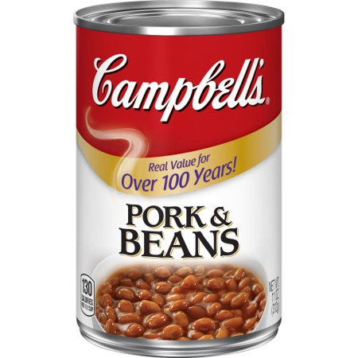
60. The can and this bottle are both examples of CLOSED systems. Heating them up could cause an EXPLOSION due to the increasing VAPOR pressure.
This pressure increases because heat turns the water into steam, with higher kinetic energy, causing stronger and more particle COLLISIONS.
Time for a story from 1972 J

Slide 118
61. What is the vapor pressure for water at 20°C? _______ (about room temperature)
62. The pressure in the gap is now ~ _________________

Slide 119
61. What is the vapor pressure for water at 25°C? ABOUT 3 kPa
62. The pressure in this gap is now 101.3 plus 3 kPa. THAT’S ~104.3 kPa.

Slide 120
63. What is the vapor pressure if you raise the temp to 70°C? _____________

Slide 121
63. What is the vapor pressure if you raise the temp to 70°C? _____________ VAPOR PRESSURE is 30 kPa, TOTAL PRESSURE INCREASES TO ABOUT 131.3 kPa.

Slide 122
64. If the bottle is pressure rated to 165 kPa and you heat it up to 90°C, what will happen?

Slide 123
64. If the bottle is pressure rated to 165 kPa and you heat it up to 90°C, what will happen? AT 90°C, VAPOR PRESSURE INCREASES TO 70 kPa, COMBINED to the 101.3 kPa air pressure it started with, that means that the bottle will PROBABLY EXPLODE.

Slide 124
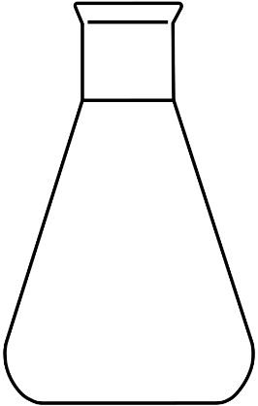
3 corked bottles containing equal amounts of a liquid (sealed systems).
ETHANOL ETHANONIC ACID PROPANONE
# | Temp | Ethanol VP in kPa | Ethanoic Acid VP in kPa | Propanone VP in kPa
65 | 25°C
66 | 45°C
67 | 75°C
65. Work left to right…

Slide 125
3 corked bottles containing equal amounts of a liquid (sealed systems).
ETHANOL ETHANONIC ACID PROPANONE
# | Temp | Ethanol VP in kPa | Ethanoic Acid VP in kPa | Propanone VP in kPa
65 | 25°C | 8 kPa | 3 kPa | 31 kPa
66 | 45°C
67 | 75°C
66. Work left to right…

Slide 126
3 corked bottles containing equal amounts of a liquid (sealed systems).
ETHANOL ETHANONIC ACID PROPANONE
# | Temp | Ethanol VP in kPa | Ethanoic Acid VP in kPa | Propanone VP in kPa
65 | 25°C | 8 kPa | 3 kPa | 31 kPa
66 | 45°C | 22 kPa | 6 kPa | 70 kPa
67 | 75°C
67. Work left to right…

Slide 127
68. Which bottle would burst first if they’re all heated up together slowly?
ETHANOL ETHANONIC ACID PROPANONE
# | Temp | Ethanol VP in kPa | Ethanoic Acid VP in kPa | Propanone VP in kPa
65 | 25°C | 8 kPa | 3 kPa | 31 kPa
66 | 45°C | 22 kPa | 6 kPa | 70 kPa
67 | 75°C | 88 kPa | 23 kPa | 180 kPa

Slide 128
68. Propanone bursts first, it has the highest Vapor Pressure.
ETHANOL ETHANONIC ACID PROPANONE
# | Temp | Ethanol VP in kPa | Ethanoic Acid VP in kPa | Propanone VP in kPa
65 | 25°C | 8 kPa | 3 kPa | 31 kPa
66 | 45°C | 22 kPa | 6 kPa | 70 kPa
67 | 75°C | 88 kPa | 23 kPa | 180 kPa

Slide 129
Phases Class 4 Starts next…
69 - 97 (the end)

Slide 130
68. Once more, vapor pressure is described as:

Slide 131
68. Once more, vapor pressure is described as: The extra pressure inside of a closed system, caused by the evaporation of a liquid.
Some liquids evaporate easier (higher VP) Some liquids evaporate worse (lower VP).

Slide 132
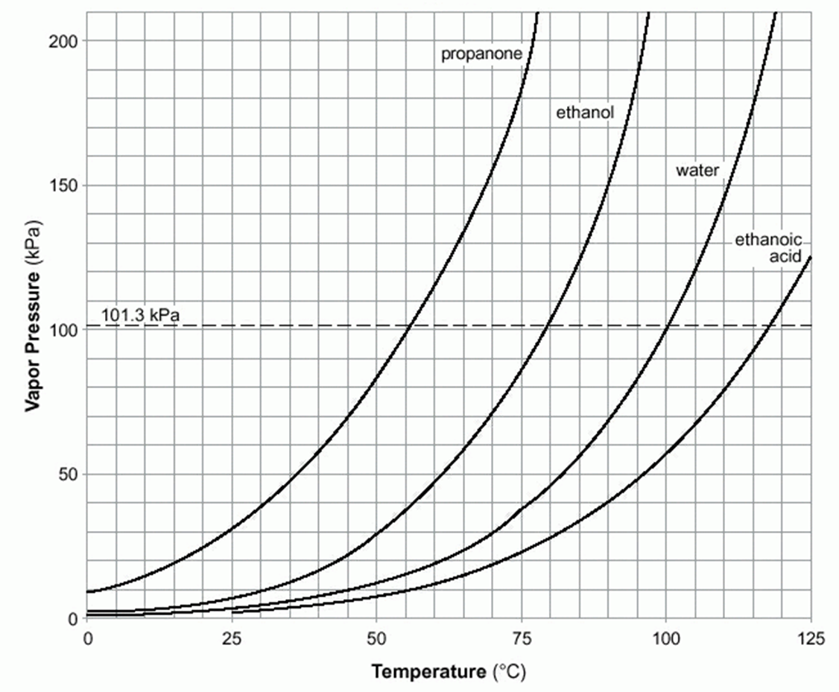
Let’s look at table H again
70. Point 1 is called 71. Point 2 is called the 72. Point 3 is called the 73. Point 4 is called the 74. Point 5 is called 75. Point 6 is called the
5
2
1
3
4
6

Slide 133
Let’s look at table H again
70. Point 1 is called normal boiling point of water 71. Point 2 is called the 72. Point 3 is called the normal boiling point of ethanoic acid 73. Point 4 is called the a boiling point of water at the Witch’s house in Boulder 74. Point 5 is called a boiling point of water deep in a cave where there is high pressure. 75. Point 6 is called the approximate boiling point of water atop of Mr. Everest, where there is very low air pressure.
5
2
1
3
4
6

Slide 134
Let’s look at table H again
70. Point 1 is called normal boiling point of water 71. Point 2 is called the normal boiling point of propanone (water is in the liquid phase here) 72. Point 3 is called the normal boiling point of ethanoic acid 73. Point 4 is called the a boiling point of water at the Witch’s house in Boulder 74. Point 5 is called a boiling point of water deep in a cave where there is high pressure. 75. Point 6 is called the approximate boiling point of water atop of Mr. Everest, where there is very low air pressure.
5
2
1
3
4
6

Slide 135
Let’s look at table H again
70. Point 1 is called normal boiling point of water 71. Point 2 is called the normal boiling point of propanone (water is in the liquid phase here) 72. Point 3 is called the normal boiling point of ethanoic acid 73. Point 4 is called the a boiling point of water at the Witch’s house in Boulder 74. Point 5 is called a boiling point of water deep in a cave where there is high pressure. 75. Point 6 is called the approximate boiling point of water atop of Mr. Everest, where there is very low air pressure.
5
2
1
3
4
6

Slide 136
Let’s look at table H again
70. Point 1 is called normal boiling point of water 71. Point 2 is called the normal boiling point of propanone (water is in the liquid phase here) 72. Point 3 is called the normal boiling point of ethanoic acid 73. Point 4 is called the a lower boiling point of water at a lower pressure than normal 74. Point 5 is called a boiling point of water deep in a cave where there is high pressure. 75. Point 6 is called the approximate boiling point of water atop of Mr. Everest, where there is very low air pressure.
5
2
1
3
4
6

Slide 137
Let’s look at table H again
70. Point 1 is called normal boiling point of water 71. Point 2 is called the normal boiling point of propanone (water is in the liquid phase here) 72. Point 3 is called the normal boiling point of ethanoic acid 73. Point 4 is called the a lower boiling point of water at a lower pressure than normal 74. Point 5 is called a boiling point of water deep in a cave where there is high pressure. 75. Point 6 is called the approximate boiling point of water atop of Mr. Everest, where there is very low air pressure.
5
2
1
3
4
6

Slide 138
Let’s look at table H again
70. Point 1 is called normal boiling point of water 71. Point 2 is called the normal boiling point of propanone (water is in the liquid phase here) 72. Point 3 is called the normal boiling point of ethanoic acid 73. Point 4 is called the a lower boiling point of water at a lower pressure than normal 74. Point 5 is called a boiling point of water deep in a cave where there is high pressure. 75. Point 6 is called the approximate boiling point of water atop of Mr. Everest, where there is very low air pressure.
5
2
1
3
4
6

Slide 139
76. In fact, the curve labeled water represents _____________ of the ________ of water at different pressures.
77. What is the boiling point of ethanol at 70 kPa?
It turns out that in addition to telling the vapor pressure for these 4 liquids, at different temperatures, you can read this graph backwards. If you know the pressure, it will tell you the boiling point of each liquid too.
78. What is the boiling point of ethanol at 60 kPa?
79. What is the boiling point of propanone at 70 kPa?
80. What is the boiling point of ethanol at 150 kPa?
81. What is the boiling point of water at 180 kPa? 82. What is the boiling point of ethanol at 30 kPa?

Slide 140
76. In fact, the curve labeled water represents ALL of the BOILING POINTS of water at different pressures.
77. What is the boiling point of ethanol at 70 kPa? 70°C
It turns out that in addition to telling the vapor pressure for these 4 liquids, at different temperatures, you can read this graph backwards. If you know the pressure, it will tell you the boiling point of each liquid too.
78. What is the boiling point of ethanol at 60 kPa? 65°C
79. What is the boiling point of propanone at 70 kPa? 45°C
80. What is the boiling point of ethanol at 150 kPa? 90°C
81. What is the boiling point of water at 180 kPa? 115°C 82. What is the boiling point of ethanol at 30 kPa? 50°C

Slide 141
78. What is the boiling point of ethanol at 60 kPa? 65°C
79. What is the boiling point of propanone at 70 kPa? 45°C
80. What is the boiling point of ethanol at 150 kPa? 90°C
81. What is the boiling point of water at 180 kPa? 115°C 82. What is the boiling point of ethanol at 30 kPa? 50°C

Slide 142
78. What is the boiling point of ethanol at 60 kPa? 65°C5°C
79. What is the boiling point of propanone at 70 kPa? 45°C
80. What is the boiling point of ethanol at 150 kPa? 90°C
81. What is the boiling point of water at 180 kPa? 115°C 82. What is the boiling point of ethanol at 30 kPa? 50°C

Slide 143
78. What is the boiling point of ethanol at 60 kPa? 65°C5°C
79. What is the boiling point of propanone at 70 kPa? 45°C
80. What is the boiling point of ethanol at 150 kPa? 90°C
81. What is the boiling point of water at 180 kPa? 115°C 82. What is the boiling point of ethanol at 30 kPa? 50°C

Slide 144
78. What is the boiling point of ethanol at 60 kPa? 65°C5°C
79. What is the boiling point of propanone at 70 kPa? 45°C C
80. What is the boiling point of ethanol at 150 kPa? 90°C90° C
81. What is the boiling point of water at 180 kPa? 115°C 82. What is the boiling point of ethanol at 30 kPa? 50°C

Slide 145
78. What is the boiling point of ethanol at 60 kPa? 65°C5°C
79. What is the boiling point of propanone at 70 kPa? 45°C C
80. What is the boiling point of ethanol at 150 kPa? 90°C90° C
81. What is the boiling point of water at 180 kPa? 115°C 11 82. What is the boiling point of ethanol at 30 kPa? 50°C

Slide 146
78. What is the boiling point of ethanol at 60 kPa? 65°C5°C
79. What is the boiling point of propanone at 70 kPa? 45°C C
80. What is the boiling point of ethanol at 150 kPa? 90°C90° C
81. What is the boiling point of water at 180 kPa? 115°C 11 82. What is the boiling point of ethanol at 30 kPa? 50°C0°C

Slide 147
Table H can also tell us what phase the liquids are at. Pick a point and determine if you are in front of the curve (exceeding the BP - so gas phase) or behind the curve (not at the BP yet - so liquid phase).
83. Mark Point “A” at Normal pressure and 65°C. What phase is water? SOLID LIQUID GAS
84. Mark Point “B” at 90 kPa and 95°C. What phase is water? SOLID LIQUID GAS

Slide 148
Table H can also tell us what phase the liquids are at. Pick a point and determine if you are in front of the curve (exceeding the BP - so gas phase) or behind the curve (not at the BP yet - so liquid phase).
83. Mark Point “A” at Normal pressure and 115°C. What phase is water? SOLID LIQUID GAS
84. Mark Point “B” at 90 kPa and 95°C. What phase is water? SOLID LIQUID GAS

Slide 149
Table H can also tell us what phase the liquids are at. Pick a point and determine if you are in front of the curve (exceeding the BP - so gas phase) or behind the curve (not at the BP yet - so liquid phase).
83. Mark Point “A” at Normal pressure and 115°C. What phase is water? SOLID LIQUID GAS
84. Mark Point “B” at 90 kPa and 95°C. What phase is water? SOLID LIQUID GAS

Slide 150
Table H can also tell us what phase the liquids are at. Pick a point and determine if you are in front of the curve (exceeding the BP - so gas phase) or behind the curve (not at the BP yet - so liquid phase).
83. Mark Point “A” at Normal pressure and 115°C. What phase is water? SOLID LIQUID GAS
84. Mark Point “B” at 90 kPa and 95°C. What phase is water? SOLID LIQUID GAS

Slide 151
85. Point 1, what phase is propanone? ___
86. Point 2, what phase is propanone? ___ What phase is ethanol? _______
87. At point 3, what phase is water? _____ What phase is ethanoic acid? _______
88. Point 4, what phase is ethanoic acid? _______ What phase is ethanol? ______
89. Point 5, what phase is ethanol? ______ What phase is water? ______________
90. Point 6, what phase are all of these substances? ________________
2
5
4
1
3
6

Slide 152
85. Point 1, what phase is propanone? LIQ
86. Point 2, what phase is propanone? ___ What phase is ethanol? _______
87. At point 3, what phase is water? _____ What phase is ethanoic acid? _______
88. Point 4, what phase is ethanoic acid? _______ What phase is ethanol? ______
89. Point 5, what phase is ethanol? ______ What phase is water? ______________
90. Point 6, what phase are all of these substances? ________________
2
5
4
1
3
6

Slide 153
85. Point 1, what phase is propanone? LIQ
86. Point 2, what phase is propanone? GAS What phase is ethanol? LIQ
87. At point 3, what phase is water? _____ What phase is ethanoic acid? _______
88. Point 4, what phase is ethanoic acid? _______ What phase is ethanol? ______
89. Point 5, what phase is ethanol? ______ What phase is water? ______________
90. Point 6, what phase are all of these substances? ________________
2
5
4
1
3
6

Slide 154
85. Point 1, what phase is propanone? LIQ
86. Point 2, what phase is propanone? GAS What phase is ethanol? LIQ
87. At point 3, what phase is water? GAS What phase is ethanoic acid? LIQ
88. Point 4, what phase is ethanoic acid? _______ What phase is ethanol? ______
89. Point 5, what phase is ethanol? ______ What phase is water? ______________
90. Point 6, what phase are all of these substances? ________________
2
5
4
1
3
6

Slide 155
85. Point 1, what phase is propanone? LIQ
86. Point 2, what phase is propanone? GAS What phase is ethanol? LIQ
87. At point 3, what phase is water? GAS What phase is ethanoic acid? LIQ
88. Point 4, what phase is ethanoic acid? LIQ What phase is ethanol? GAS
89. Point 5, what phase is ethanol? ______ What phase is water? ______________
90. Point 6, what phase are all of these substances? ________________
2
5
4
1
3
6

Slide 156
85. Point 1, what phase is propanone? LIQ
86. Point 2, what phase is propanone? GAS What phase is ethanol? LIQ
87. At point 3, what phase is water? GAS What phase is ethanoic acid? LIQ
88. Point 4, what phase is ethanoic acid? LIQ What phase is ethanol? GAS
89. Point 5, what phase is ethanol? GAS What phase is water? LIQ + GAS
90. Point 6, what phase are all of these substances? ________________
2
5
4
1
3
6

Slide 157
85. Point 1, what phase is propanone? LIQ
86. Point 2, what phase is propanone? GAS What phase is ethanol? LIQ
87. At point 3, what phase is water? GAS What phase is ethanoic acid? LIQ
88. Point 4, what phase is ethanoic acid? LIQ What phase is ethanol? GAS
89. Point 5, what phase is ethanol? GAS What phase is water? LIQ + GAS
90. Point 6, what phase are all of these substances? ALL GASES
2
5
4
1
3
6

Slide 158
Air and Gas Pressure Conversion Math (take out table A)
91. On a cold day the air pressure in Vestal is higher than normal (cold air is more dense than warm air, it “settles” onto the Earth a bit more than usual). The pressure registers at 1.20 atm. Convert 1.20 atm into kilopascals.

Slide 159
Air and Gas Pressure Conversion Math (take out table A)
91. On a cold day the air pressure in Vestal is higher than normal (cold air is more dense than warm air, it “settles” onto the Earth a bit more than usual). The pressure registers at 1.20 atm. Convert 1.20 atm into kilopascals.
1.20 atm 1

Slide 160
Air and Gas Pressure Conversion Math (take out table A)
91. On a cold day the air pressure in Vestal is higher than normal (cold air is more dense than warm air, it “settles” onto the Earth a bit more than usual). The pressure registers at 1.20 atm. Convert 1.20 atm into kilopascals.
1.20 atm 1
X =
101.3 kPa 1 atm

Slide 161
Air and Gas Pressure Conversion Math (take out table A)
91. On a cold day the air pressure in Vestal is higher than normal (cold air is more dense than warm air, it “settles” onto the Earth a bit more than usual). The pressure registers at 1.20 atm. Convert 1.20 atm into kilopascals.
1.20 atm 1
X = 122 kPa
101.3 kPa 1 atm

Slide 162
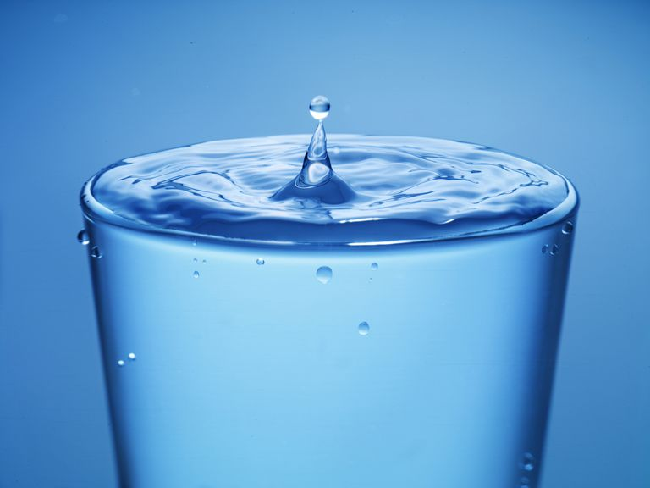
Time out. It’s time for 2 demos to PROVE that gases are REAL (from a UE 4th grader) and that gases exert pressure.
You should do both demos at home, tonight, for your family.

Slide 163
92. Convert 145 kPa into atmospheres.

Slide 164
92. Convert 145 kPa into atmospheres.
145 kPa 1

Slide 165
92. Convert 145 kPa into atmospheres.
145 kPa 1
X = 1.43 atm
1 atm 101.3 kPa

Slide 166
92. Convert 145 kPa into atmospheres.
145 kPa 1
X = 1.43 atm
1 atm 101.3 kPa

Slide 167
93. Convert 905 mm Hg into kPa.

Slide 168
93. Convert 905 mm Hg into kPa.
905 mm Hg 1

Slide 169
93. Convert 905 mm Hg into kPa.
905 mm Hg 1
101.3 kPa 760 mm Hg
X =

Slide 170
93. Convert 905 mm Hg into kPa.
905 mm Hg 1
101.3 kPa 760 mm Hg
X = 121 kPa

Slide 171
94. Convert 31.0 kPa (pressure on Mr. Everest) into atmospheres.

Slide 172
94. Convert 31.0 kPa (pressure on Mr. Everest) into atmospheres.
31.0 kPa 1

Slide 173
94. Convert 31.0 kPa (pressure on Mr. Everest) into atmospheres.
31.0 kPa 1
X
1 atm 101.3 kPa
=

Slide 174
94. Convert 31.0 kPa (pressure on Mr. Everest) into atmospheres.
31.0 kPa 1
X
1 atm 101.3 kPa
=
0.306 atm
3 SF

Slide 175
95. Convert the high pressure of 2.68 atm into pounds per square inch.

Slide 176
95. Convert the high pressure of 2.68 atm into pounds per square inch.
2.68 atm 1

Slide 177
95. Convert the high pressure of 2.68 atm into pounds per square inch.
2.68 atm 1
X
14.7 psi 1 atm
=

Slide 178
95. Convert the high pressure of 2.68 atm into pounds per square inch.
2.68 atm 1
X
14.7 psi 1 atm
=
39.4 psi

Slide 179
96. The maximum pressure inside an official NBA basketball is 8.50 psi, convert that to mm of Hg.

Slide 180
96. The maximum pressure inside an official NBA basketball is 8.50 psi, convert that to mm of Hg.
8.50 psi 1

Slide 181
96. The maximum pressure inside an official NBA basketball is 8.50 psi, convert that to mm of Hg.
8.50 psi 1
X
760 mm Hg 14.7 psi
=

Slide 182
96. The maximum pressure inside an official NBA basketball is 8.50 psi, convert that to mm of Hg.
8.50 psi 1
X
760 mm Hg 14.7 psi
=

Slide 183
96. The maximum pressure inside an official NBA basketball is 8.50 psi, convert that to mm of Hg.
8.50 psi 1
X
760 mm Hg 14.7 psi
=
=
6460 14.7
= 439 mm Hg

Slide 184
Kinetic Molecular Theory
This theory explains how gases “work”.
How do gases exist as gases?
How they stay gases?
How the particles of gas act (atoms or molecules)?
How should we understand gases in our minds?

Slide 185
97. The kinetic molecular theory of gases states that gases
A. are made up of small particles such as atoms or molecules
B. and that these particles will act as if they are small, hard spheres. They aren’t really, they do have shapes, and aren’t spheres, but they act as if this is true.

Slide 186
C. They have no attraction for or any repulsion for any other gas particles. This is not true either. The attraction and repulsion gas particles have for one another is very small. It only has some impact when gases are crazy cold and slow moving. Generally it has no real effect on gases.
D. The particles move very fast, and only in straight lines. It’s very geometric, no spiraling particles.

Slide 187
E. All collisions are elastic: when the gas particles hit each other all their energy is transferred, none is lost. This is not true, but the loss of energy is small, and the addition of energy all the time from the Sun, and the Earth more than makes up for it. Gases generally stay gases.
F. Collisions result in pressures being exerted. The more collisions the higher the pressure. The stronger the collisions, the higher the gas pressure too.

Slide 188
G. Particles are separated by vast distances from each other relative to the size of the particles. Gases are mostly empty space, and particle size is insignificant. The particles do take up some space, but it’s very tiny. In theory, the particles act as if they take up no space at all, but that’s silly. Gas atoms and molecules have real volume, crazy small but not zero.

