Slide 1
Intro to the first of 5 chemical reactions
In a chemical reaction, sometimes bonds are broken and sometimes new bonds form, and sometimes both happen. Every time a reaction occurs new substances form. These new substances have their own properties that are not like the properties of the reactants. There are 5 of kinds of reactions that we learn about.
The first kind of reaction is called the SYNTHESIS REACTION.
It may be called a combination reaction

Slide 2
2. In a synthesis reaction, smaller reactants combine to form larger products.
3. The “ABSTRACT” is X + Y → XY
4. The Reactants form into Products.

Slide 3
Vocabulary
Reactants are the substances that we start with, they react together and form the products.
Products are what we end up with.
In a synthesis reaction, we have 2 or more reactants that form into one larger product.
Energy is required to start all chemical reactions.
If more energy comes out of the reaction with the products we call these EXOTHERMIC reactions. If it requires more energy to start than comes out with the products, those reactions are called ENDOTHERMIC reactions.

Slide 4
Demo of Synthesis… coming in a few minutes.
Remember on the first day we blew up a balloon filled with hydrogen (lighter than air) and it created a fireball?
We are going to do it again, with more chemistry in mind, and we need to protect our ears!

Slide 5
Before we do this reaction again, we can first describe it several ways.
10. A word equation describes the reaction with words, no symbols, no numbers, as simply as possible. Name each substance properly, reactants forming into products.
11. The word equation for this reaction will be: __________________________________________________________________

Slide 6
11. The word equation for this reaction will be: Hydrogen and oxygen gases form into water
Or
Hydrogen and oxygen gases form dihydrogen monoxide
Or
Hydrogen and oxygen gases synthesize into water
Etc. Simple, clear, fewer words, in a non-confusing way.
Don’t say it backwards: Water forms from hydrogen and oxygen gases combining.

Slide 7
To balance a chemical reaction you must start with the correct chemical symbols. We call this the SKELETON.
This shows all of the substances written in proper form, it is not likely to be balanced.
The word equation gives us the skeleton:
12. Hydrogen and oxygen gases make water __________________________________________________

Slide 8
The + sign means these reactants react.
The arrow sign → means react into YOU DO NOT WRITE IN THE DASHES, those are for thinking, and teaching, not for balancing.
12. Hydrogen and oxygen gases make water… __H_{2(G)} + __O_{2(G)} → __H₂O_{(G)}
This is not balanced. Note the phase symbols.

Slide 9
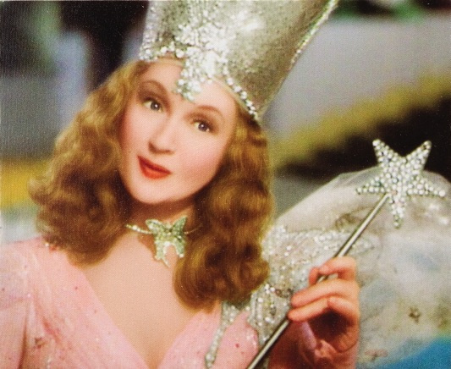
14. Glinda says… “It’s always best to start at the beginning.”
15. Rewrite the skeleton reaction from above again. Then we’ll balance it.
__H_{2(G)} + __O_{2(G)} → __H₂O_{(G)}

Slide 10
15. Balanced….
Hydrogen and oxygen gases make water…
2H_{2(G)} + O_{2(G)} → 2H₂O_{(G)}

Slide 11
15. Balanced….
Hydrogen and oxygen gases make water…
2H_{2(G)} + O_{2(G)} → 2H₂O_{(G)}
16. There are the same number of atoms on the reactant side as the product side. Matter can’t be created or destroyed in a chemical reaction (or physical change).

Slide 12
Just do it.
Stop torturing the students Charlie, blow up the balloon already.

Slide 13
17. Balanced Thermochemical equation….
This is an EXOTHERMIC REACTION
2H_{2(G)} + O_{2(G)} → 2H₂O_{(G)} + Energy
Although energy was required to start this reaction, the energy given off was much greater; the “NET ENERGY” is a product. This is an EXOTHERMIC reaction. Energy is a product.

Slide 14
18. An important chemical adage is “When bonds form, energy is released.”
In this case, it took energy to break the bonds between the hydrogen atoms, and between the oxygen atoms, but MORE energy was released when the bonds inside the water formed.
19. To break bonds, energy must be absorbed.

Slide 15
2H_{2(G)} + O_{2(G)} → 2H₂O_{(G)} + Energy
Energy is required to break the bonds holding the H₂ together, and to break the bonds holding the O₂ together.
“To break bonds, energy is absorbed.”
21. When the water forms, these bonds are so stable, that a lot of energy is released.
“When bonds form energy is released.”

Slide 16
From the word equation, write the skeleton equation, then balance the chemical reaction. Add phase symbols where you can.
22. Sodium + chlorine yields sodium chloride

Slide 17
22. Sodium + chlorine yields sodium chloride
Na + Cl₂ → NaCl (skeleton)

Slide 18
22. Sodium + chlorine yields sodium chloride
Na + Cl₂ → NaCl (skeleton)
2Na_{(S)} + Cl_{2(G)} → 2NaCl_{(S)} (balanced)

Slide 19
Iron + Oxygen synthesizes to iron III oxide. Unless you’re a genius, write out the ions.

Slide 20
23. Iron + Oxygen synthesizes to iron III oxide (rust) Fe⁺³ O⁻²
_Fe_{(S)} + _O_{2(G)} → _Fe₂O_{3(S)}

Slide 21
23. Iron + Oxygen synthesizes to iron III oxide (rust) Fe⁺³ O⁻²
4Fe_{(S)} + 3O_{2(G)} → 2Fe₂O_{3(S)}

Slide 22
24. Aluminum + Sulfur synthesize into aluminum sulfide Al⁺³ S⁻²

Slide 23
24. Aluminum + Sulfur synthesize into aluminum sulfide Al⁺³ S⁻²
_Al_{(S)} + _S_{(S)} → _Al₂S_{3(S)}

Slide 24
24. Aluminum + Sulfur synthesize into aluminum sulfide Al⁺³ S⁻²
2Al_{(S)} + 3S_{(S)} → Al₂S_{3(S)}

Slide 25
25. Potassium and bromine make potassium bromide K⁺¹ Br⁻¹

Slide 26
25. Potassium and bromine make potassium bromide K⁺¹ Br⁻¹
_K_{(S)} + _Br_{2(L)} → _KBr_{(S)}

Slide 27
25. Potassium and bromine make potassium bromide K⁺¹ Br⁻¹
2K_{(S)} + Br_{2(L)} → 2KBr_{(S)}

Slide 28
26. Four skeleton equations… Balance them now.
_C + _O₂ → _CO
_Cu + _O₂ → _Cu₂O
_Zn + _O₂ → _ZnO
_Al + _O₂ → _Al₂O₃

Slide 29
26. Four skeleton equations… Balance them now.
2C + O₂ → 2CO
_Cu + _O₂ → _Cu₂O
_Zn + _O₂ → _ZnO
_Al + _O₂ → _Al₂O₃

Slide 30
26. Four skeleton equations… Balance them now.
2C + O₂ → 2CO
4Cu + O₂ → 2Cu₂O
_Zn + _O₂ → _ZnO
_Al + _O₂ → _Al₂O₃

Slide 31
26. Four skeleton equations… Balance them now.
2C + O₂ → 2CO
4Cu + O₂ → 2Cu₂O
2Zn + O₂ → 2ZnO
_Al + _O₂ → _Al₂O₃

Slide 32
26. Four skeleton equations… Balance them now.
2C + O₂ → 2CO
4Cu + O₂ → 2Cu₂O
2Zn + O₂ → 2ZnO
4Al + 3O₂ → 2Al₂O₃

Slide 33
Decomposition reactions
27. Decomposition reactions are the opposite of synthesis, here a larger reactant is broken down into 2 or more smaller products
In a decomposition reaction there is always ONE REACTANT, and 2 or more products
Example: Lead II oxide decomposes into lead and oxygen
2PbO_{(S)} → 2Pb _{(S)} + O_{2(G)} (balanced)

Slide 34
28. Decomposition reactions require one reactant to break down into 2 or more smaller products
29. Abstract: AB → A + B
30. Demonstration Reaction Word Equation
hydrogen peroxide decomposes into water & oxygen gass
31. Skeleton __H₂O_{2(L)} → __H₂O_{(L)} + __O_{2(G)}

Slide 35
32. Balance this equation.
__H₂O_{2(L)} → __H₂O_{(L)} + __O_{2(G)}

Slide 36
32. Balanced Chemical Reaction
2H₂O_{2(AQ)} → 2H₂O_{(L)} + O_{2(G)}
Count… 4 H’s & 4 O’s in reactants. 4 H’s and 4 O’s in the products
This reaction is SO SLOW, that watching it is for the birds
33. You need to add a CATALYST

Slide 37
34. SHOW the CATALYST where it belongs.
2H₂O_{2(AQ)} → 2H₂O_{(L)} + O_{2(G)} + energy
KI

Slide 38
34. SHOW the CATALYST where it belongs.
2H₂O_{2(AQ)} → 2H₂O_{(L)} + O_{2(G)} + energy
KI
35. The exact same reaction occurs with a catalyst as without, when things happen fast, they appear to be different.
There is NO DIFFERENCE in amount of the products, or amount of energy released, it’s just FASTER.

Slide 39
36. With no catalyst, a reaction will…
With a catalyst the same reaction will occur, just…
The catalyst is

Slide 40
36. With no catalyst, a reaction will… occur.
With a catalyst the same reaction will occur, just… faster!
The catalyst is NOT A REACTANT

Slide 41
Change these word equations into decomposition skeleton equations, then balance them with PHASE SYMBOLS. Write the ions out! Criss cross!
37.
Magnesium nitride decomposes into magnesium & nitrogen. Mg⁺² N⁻³

Slide 42
37. Magnesium nitride decomposes into magnesium & nitrogen.
Mg₃N_{2(S)} → 3Mg_{(S)} + N_{2(G)}

Slide 43
38. Magnesium carbonate decomposes into carbon dioxide & magnesium oxide Mg⁺² CO₃⁻² Mg⁺² O⁻²

Slide 44
38. Magnesium carbonate decomposes into carbon dioxide & magnesium oxide Mg⁺² CO₃⁻² Mg⁺² O⁻²
MgCO_{3(S)} → CO_{2(G)} + MgO_{(S)}

Slide 45
39. Iron (II) oxide decomposes write out the ions!

Slide 46
39. Iron (II) oxide decomposes write out the ions! Fe⁺² O⁻²

Slide 47
39. Iron (II) oxide decomposes write out the ions! Fe⁺² O⁻²
2FeO_{(S)} → 2Fe_{(S)} + O_{2(G)}

Slide 48
40. AMMONIA gas decomposes NH_{3(G)} →

Slide 49
40. AMMONIA gas decomposes NH_{3(G)} → N_{2(G)} + H_{2(G)}

Slide 50
40. AMMONIA gas decomposes 2NH_{3(G)} → N_{2(G)} + 3H_{2(G)}

Slide 51
41. Hydrogen monochloride gas decomposes HCl_{(G)} →

Slide 52
41. Hydrogen monochloride gas decomposes HCl_{(G)} → H_{2(G)} + Cl_{2(G)}

Slide 53
41. Hydrogen monochloride gas decomposes 2HCl_{(G)} → H_{2(G)} + Cl_{2(G)}

Slide 54
42. Dinitrogen Pentoxide gas decomposes into nitrogen and oxygen gases.

Slide 55
42. Dinitrogen Pentoxide gas decomposes into nitrogen and oxygen gases. N₂O_{5(G)} →

Slide 56
42. Dinitrogen Pentoxide gas decomposes into nitrogen and oxygen gases. 2N₂O_{5(G)} → 2N_{2(G)} + 5O_{2(G)}

Slide 57
42.
Dinitrogen Pentoxide Decomposes into nitrogen and oxygen.
2N₂O_{5(G)} → 2N_{2(G)} + 5O_{2(G)}

Slide 58
Single Replacement Reactions (I Love Janet so I Love Table J too.) 43. Single Replacement reactions (SR) start with you adding atoms of an element into one aqueous solution. That makes them EASY to recognize.

Slide 59
44. Aqueous means dissolved into water.
45. Ionic compounds have metal cations and nonmetal anions, that dissolve into water, AND ionize like this:
NaCl_{(S)}
water

Slide 60
44. Aqueous means dissolved into water.
45. Ionic compounds have metal cations and nonmetal anions, that dissolve into water, AND ionize like this:
NaCl_{(S)} Na⁺¹_{(AQ)} + Cl⁻¹_{(AQ)}
water

Slide 61
NaCl_{(S)} Na⁺¹_{(AQ)} + Cl⁻¹_{(AQ)}
46. The salt disappears (it dissolves). At the particle level, the NaCl separates into positive and negative ions, which swim in the water.
This is a PHYSICAL CHANGE: S → AQ
water

Slide 62
47. When salts dissolve into water, there are no reactants or products.
This is not a chemical reaction. This is a MIXTURE.
Because it’s in water, and homogenous, it’s an aqueous solution.
We have lots of aqueous solutions in chem.

Slide 63
Imagine this…
This is a beaker of water with green SODIUM Na⁺¹ cations
And red CHLORIDE Cl⁻¹ anions
The ions are swimming in solution, in a 1:1 ratio.
In a real solution, there are billions of pairs of ions, not this few.
NaCl_{(AQ)}

Slide 64
48. Another ionic compound that dissolves and ionizes in water is SILVER NITRATE. We’ll put some atoms of COPPER into it, which is a single replacement reaction set up.
Cu_{(S)} + AgNO_{3(AQ)} →

Slide 65
48. Another ionic compound that dissolves and ionizes in water is SILVER NITRATE. We’ll put some atoms of COPPER into it, which is a single replacement reaction set up.
Cu_{(S)} + AgNO_{3(AQ)} →
Nitrate is the anion part
COPPER is the
ATOMS part
Silver is the cation part
All Single Replacement Reactions have 3 parts. Always the same. Atoms + AQ

Slide 66
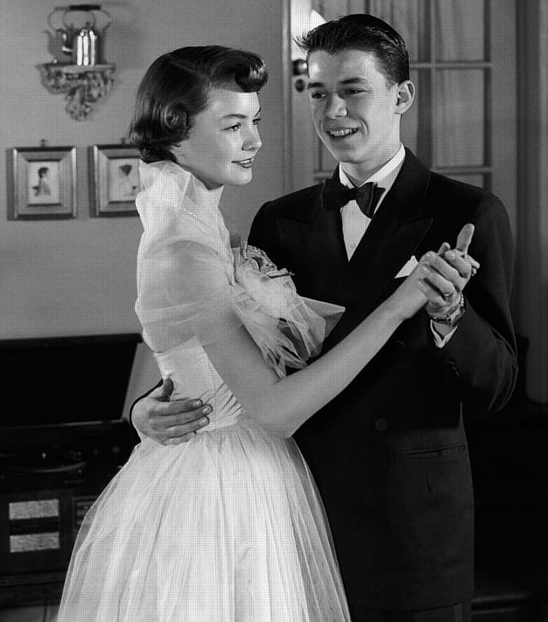
Time for a story…
Cu_{(S)} + AgNO_{3(AQ)} →
Nitrate is the anion part
COPPER is the
ATOMS part
Silver is the cation part

Slide 67
49. The copper REPLACES the silver in the solution, the silver is bumped out.
Cu_{(S)} + AgNO_{3(AQ)} → CuNO_{3(AQ)} + Ag_{(S)}
50. The Nitrate anion basically hangs out, we call it a “SPECTATOR ION”.
Now: Take out table J for Janet. (I love my wife)

Slide 68
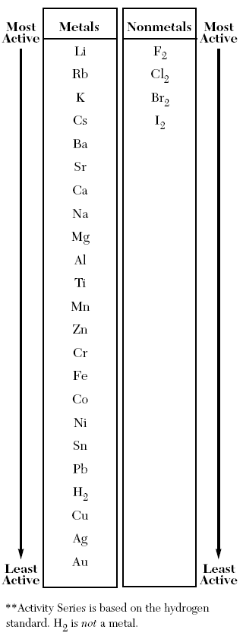
51. A single replacement reaction always has 3 parts, the ATOMS, the CATION and the ANION.
52. Two of the 3 are ALWAYS on one side of table J. The other is on the other side, or not even on the table (who cares!)
COPPER and SILVER are on the LEFT SIDE.
53. Copper is MORE REACTIVE than silver, so it bumps the silver out and takes it’s place in the solution.

Slide 69
54. Copper is MORE REACTIVE than silver, so it will bump the silver out of solution, and takes its place dancing with the nitrate ion.
Cu_{(S)} + AgNO_{3(AQ)} → CuNO_{3(AQ)} + Ag_{(S)}

Slide 70
Table J tells us if the reaction will happen, or not.

Slide 71
Single Replacement Reaction #2
Magnesium metal into HYDROCHLORIC ACID.
First, look at table K. That’s a list of acid names and formulas. Don’t forget it. Which one is the first one?
IONIC COMPOUNDS make ionic solutions but how can HCl be ionic?

Slide 72
First, remember when ionic compounds go into water, they dissolve, and IONIZE, like this:
55. NaCl_{(S)} Na⁺¹_{(AQ)} + Cl⁻¹_{(AQ)}
water

Slide 73
First, remember when ionic compounds go into water, they dissolve, and IONIZE, like this:
55. NaCl_{(S)} Na⁺¹_{(AQ)} + Cl⁻¹_{(AQ)}
56. Acids are complicated. Hydrogen forms a covalent bond to chlorine in HCl, but when you put it into water, it comes apart ionically! Acids are a whole special branch of chemistry. This is what happens, and for now, that’s all you need to know.
56. HCl_{(G)} H⁺¹_{(AQ)} + Cl⁻¹_{(AQ)}
water
water

Slide 74
Mg_{(S)} + HCl_{(AQ)} →
Atoms Cation/Anion
57. The 3 parts, the perfect set up for a single replacement reaction.
Watch the demo!

Slide 75
Mg_{(S)} + HCl_{(AQ)} →
Mg is more reactive (higher on table J) so… Mg replaces the H in solution, bumping the H out as a gas.
The chloride is our spectator ion.

Slide 76
First write the skeleton properly.
Mg_{(S)} + HCl_{(AQ)} → MgCl_{2(AQ)} + H_{2(G)}
Here we have Mg⁺² cation, so we need 2 Cl⁻¹ anions.

Slide 77
Balance this next.
Mg_{(S)} + HCl_{(AQ)} → MgCl_{2(AQ)} + H_{2(G)}

Slide 78
Mg_{(S)} + 2HCl_{(AQ)} → MgCl_{2(AQ)} + H_{2(G)}
58. The Mg replaces the H in solution, the chloride is the spectator ion. All this talk of table J…

Slide 79
Love + Table J Charlie gets married with a Band of Gold (Au) from Janet…

Slide 80
59. draw
Charlie’s Wedding Band is Made of
Solid gold!
HCl_{(AQ)}

Slide 81
Table J tells us when reactions will happen, or not.
60. Au_{(S)} + HCl _{(AQ)} → X no reaction
61. Why? Because Au is lower on table J than H is, Gold is not active enough to bump out the hydrogen from solution!

Slide 82
Balance these SR reactions or write an X for no reaction
62.
Mg_{(S)}+ Zn(NO₃)_{2(AQ)} →

Slide 83
Balance these SR reactions or write an X for no reaction
62.
Mg_{(S)}+ Zn(NO₃)_{2(AQ)} → Mg(NO₃)_{2(AQ)} + Zn_{(S)}
Mg is higher on J than Zn, so Mg replaces the Zn in solution. Mg⁺² cation gets 2 nitrate anions.
Switch ‘em. Fix em’. Balance ‘em.
This is already balanced!

Slide 84
Balance these SR reactions or write an X for no reaction
63.
Na_{(S)} + Sn(NO₃)_{2(AQ)} →

Slide 85
Balance these SR reactions or write an X for no reaction
63.
Na_{(S)} + Sn(NO₃)_{2(AQ)} → NaNO_{3(AQ)} + Sn_{(S)} Switch ‘em. Fix em’. Balance ‘em.

Slide 86
Balance these SR reactions or write an X for no reaction
63.
2Na_{(S)} + Sn(NO₃)_{2(AQ)} → 2NaNO_{3(AQ)} + Sn_{(S)}

Slide 87
64.
Cl_{2(G)} + KBr_{(AQ)} → Switch ‘em. Fix em’. Balance ‘em.

Slide 88
64.
Cl_{2(G)} + KBr_{(AQ)} →
65. This is an ANION REPLACEMENT type of SR. The chlorine replaces the bromine. The potassium hangs out as a spectator ion.
The phase symbol here for bromine is liquid.

Slide 89
64.
Cl_{2(G)} + 2KBr_{(AQ)} → 2KCl_{(AQ)} + Br_{2(L)}
Cl replaces Br in solution, Br₂ is a HONClBrIF twin. The K⁺¹ is the spectator ion.
Balanced!

Slide 90
Balance these…
66.
Zn_{(S)}+ H₂SO_{4(AQ)} →
Zinc is higher on J than H is, so zinc replaces the H in solution, H₂ gas escapes. Switch ‘em. Fix em’. Balance ‘em.

Slide 91
Balance these…
66.
Zn_{(S)}+ H₂SO_{4(AQ)} → ZnSO_{4(AQ)} + H_{2(G)}
Already balanced! Easy again!

Slide 92
Balance these…
67.
Li_{(S)} + Co(NO₃)_{3(AQ)} → Switch ‘em. Fix em’. Balance ‘em.

Slide 93
Balance these…
67.
3Li_{(S)} + Co(NO₃)_{3(AQ)} → 3LiNO_{3(AQ)} + Co_{(S)}
Balanced!

Slide 94
Balance these…
68.
Ag_{(S)}+ KCl_{(AQ)} → Switch ‘em. Fix em’. Balance ‘em.

Slide 95
Balance these…
68.
Ag_{(S)}+ KCl_{(AQ)} → X no reaction
Ag is BELOW K on table J, Ag can’t bump out the potassium, it’s not reactive enough to do that’s, so we get nothing, no reaction happens. The silver metal gets wet with the KCl_{(AQ)}

Slide 96
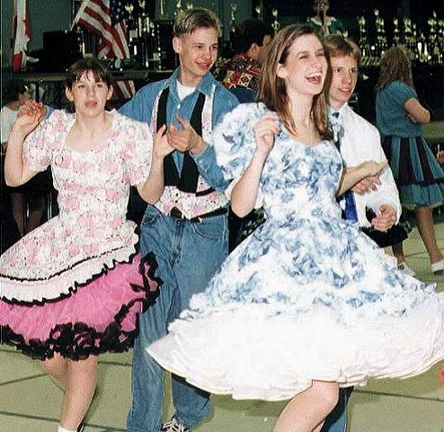
Double Replacement Reactions
The Vestal KB, 2006…

Slide 97
Double Replacement Reactions
69. Two AQ solutions starts a double replacement reaction. AQ + AQ →
70. The cations switch anions with each other.

Slide 98
Double Replacement Reactions
71. In the abstract:
AB_{(AQ)} + XY_{(AQ)} → AY_{(AQ)} + XB_{(S)}

Slide 99
72. The reaction occurs if a precipitate forms in the products.
73. If no precipitate forms, a mixture forms, but no chemical reaction occurred.
Let’s watch a DR reaction…
Copper (II) nitrate + lithium chromate solutions combine…

Slide 100
Copper (II) nitrate + lithium chromate solutions combine…
74. First we must write the formulas correctly (watch charges)
Make sure you have lots of room, these are LLOOOONNNNNGGGGG equations!
Cu⁺² NO₃⁻¹ Li⁺¹ CrO₄⁻²
_Cu(NO₃)_{2(AQ)} + _Li₂CrO_{4(AQ)} →
Switched, fixed, balanced…

Slide 101
Copper (II) nitrate + lithium chromate solutions combine…
74. Switched, cations get new anions. Cations stay in front. Now fix the formulas, check the ions out.
Cu⁺² NO₃⁻¹ Li⁺¹ CrO₄⁻² Cu⁺² CrO₄⁻² Li⁺¹ NO₃⁻¹
_Cu(NO₃)_{2(AQ)} + _Li₂CrO_{4(AQ)} → _CuCrO₄₍ ₎ + LiNO₃₍ ₎

Slide 102
Copper (II) nitrate + lithium chromate solutions combine…
74. Balanced easy!
_Cu(NO₃)_{2(AQ)} + _Li₂CrO_{4(AQ)} → 2CuCrO₄₍ ₎ + LiNO₃₍ ₎
Switched, fixed, balanced, now F’em.

Slide 103
Copper (II) nitrate + lithium chromate solutions combine…
74. Balanced easy!
_Cu(NO₃)_{2(AQ)} + _Li₂CrO_{4(AQ)} → 2CuCrO_{4(S)} + LiNO_{3(AQ)}
Done.

Slide 104
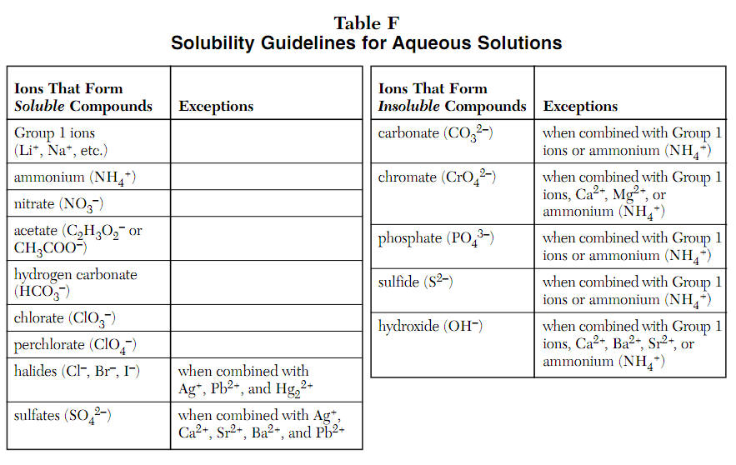
Label the tops of each of the 4 columns, AQ or S, like this now.
AQ
S
AQ
S

Slide 105
Label the tops of each of the 4 columns, AQ or S, like this now.
AQ
S
AQ
S

Slide 106
78. Second Word equation:
Sodium chloride + lead (II) acetate solutions combine… write out all ions to get formulas correct. Then do it again for the products.

Slide 107
79. Sodium chloride + lead (II) acetate solutions combine into sodium acetate and lead (II) chloride
Na⁺¹ Cl⁻¹ Pb⁺² C₂H₃O₂⁻¹
__NaCl_{(AQ)} + __Pb(C₂H₃O₂)_{2(AQ)} →

Slide 108
79. Sodium chloride + lead (II) acetate solutions combine into sodium acetate and lead (II) chloride
Na⁺¹ Cl⁻¹ Pb⁺² C₂H₃O₂⁻¹ Na⁺¹ C₂H₃O₂⁻¹ Pb⁺² Cl⁻¹
__NaCl_{(AQ)} + __Pb(C₂H₃O₂)_{2(AQ)} →_NaC₂H₃O₂₍ ₎ + _PbCl₂₍ ₎

Slide 109
79. Sodium chloride + lead (II) acetate solutions combine into sodium acetate and lead (II) chloride
the skeleton is fine now, start talking to yourself.
2NaCl_{(AQ)} + __Pb(C₂H₃O₂)_{2(AQ)}→_NaC₂H₃O₂₍ ₎ + _PbCl₂₍ ₎
2 Na in front, 1 Na in back – fix this by putting a 2 in front of the sodium acetate. Start over.

Slide 110
Sodium chloride + lead (II) acetate solutions combine into sodium acetate and lead (II) chloride
2NaCl_{(AQ)} + Pb(C₂H₃O₂)_{2(AQ)} → 2NaC₂H₃O_{2(AQ)} + PbCl_{2(S)}
Table F if your name is chloride, you are probably insoluble (S) but there are exceptions. For instance, Na is an exception (the reactant NaCl is AQ).
Lead IS an exception, PbCl₂ is (S)

Slide 111
81. Write the IONS and FORMULAS. Are these AQ or S in water?
Compound | IONS | FORMULA | AQ or S ?
Silver chloride | Ag⁺¹ Cl⁻¹ | AgCl | S
Magnesium nitrate
Sodium hydroxide
Strontium sulfate
Calcium nitrate
Barium acetate
Aluminum chlorate
Lead (II) bromide
Lithium sulfide
Ammonium chromate
Barium sulfate

Slide 112
81. Write the formulas. Are these AQ or S in water?
Compound | IONS | FORMULA | AQ or S ?
Silver chloride | Ag⁺¹ Cl⁻¹ | AgCl | S
Magnesium nitrate | Mg⁺² NO₃⁻¹ | Mg(NO₃)₂ | AQ
Sodium hydroxide
Strontium sulfate
Calcium nitrate
Barium acetate
Aluminum chlorate
Lead (II) bromide
Lithium sulfide
Ammonium chromate
Barium sulfate

Slide 113
81. Write the formulas. Are these AQ or S in water?
Compound | IONS | FORMULA | AQ or S ?
Silver chloride | Ag⁺¹ Cl⁻¹ | AgCl | S
Magnesium nitrate | Mg⁺² NO₃⁻¹ | Mg(NO₃)₂ | AQ
Sodium hydroxide | Na⁺¹ OH⁻¹ | NaOH | AQ
Strontium sulfate
Calcium nitrate
Barium acetate
Aluminum chlorate
Lead (II) bromide
Lithium sulfide
Ammonium chromate
Barium sulfate

Slide 114
81. Write the formulas. Are these AQ or S in water?
Compound | IONS | FORMULA | AQ or S ?
Silver chloride | Ag⁺¹ Cl⁻¹ | AgCl | S
Magnesium nitrate | Mg⁺² NO₃⁻¹ | Mg(NO₃)₂ | AQ
Sodium hydroxide | Na⁺¹ OH⁻¹ | NaOH | AQ
Strontium sulfate | Sr⁺² SO₄⁻² | SrSO₄ | S
Calcium nitrate
Barium acetate
Aluminum chlorate
Lead (II) bromide
Lithium sulfide
Ammonium chromate
Barium sulfate

Slide 115
81. Write the formulas. Are these AQ or S in water?
Compound | IONS | FORMULA | AQ or S ?
Silver chloride | Ag⁺¹ Cl⁻¹ | AgCl | S
Magnesium nitrate | Mg⁺² NO₃⁻¹ | Mg(NO₃)₂ | AQ
Sodium hydroxide | Na⁺¹ OH⁻¹ | NaOH | AQ
Strontium sulfate | Sr⁺² SO₄⁻² | SrSO₄ | S
Calcium nitrate | Ca⁺² NO₃⁻¹ | Ca(NO₃)₂ | AQ
Barium acetate
Aluminum chlorate
Lead (II) bromide
Lithium sulfide
Ammonium chromate
Barium sulfate

Slide 116
81. Write the formulas. Are these AQ or S in water?
Compound | IONS | FORMULA | AQ or S ?
Silver chloride | Ag⁺¹ Cl⁻¹ | AgCl | S
Magnesium nitrate | Mg⁺² NO₃⁻¹ | Mg(NO₃)₂ | AQ
Sodium hydroxide | Na⁺¹ OH⁻¹ | NaOH | AQ
Strontium sulfate | Sr⁺² SO₄⁻² | SrSO₄ | S
Calcium nitrate | Ca⁺² NO₃⁻¹ | Ca(NO₃)₂ | AQ
Barium acetate | Ba⁺² C₂H₃O₂⁻¹ | Ba(C₂H₃O₂)₂ | AQ
Aluminum chlorate
Lead (II) bromide
Lithium sulfide
Ammonium chromate
Barium sulfate

Slide 117
81. Write the formulas. Are these AQ or S in water?
Compound | IONS | FORMULA | AQ or S ?
Silver chloride | Ag⁺¹ Cl⁻¹ | AgCl | S
Magnesium nitrate | Mg⁺² NO₃⁻¹ | Mg(NO₃)₂ | AQ
Sodium hydroxide | Na⁺¹ OH⁻¹ | NaOH | AQ
Strontium sulfate | Sr⁺² SO₄⁻² | SrSO₄ | S
Calcium nitrate | Ca⁺² NO₃⁻¹ | Ca(NO₃)₂ | AQ
Barium acetate | Ba⁺² C₂H₃O₂⁻¹ | Ba(C₂H₃O₂)₂ | AQ
Aluminum chlorate | Al⁺³ ClO₃⁻¹ | Al(ClO₃)₃ | AQ
Lead (II) bromide
Lithium sulfide
Ammonium chromate
Barium sulfate

Slide 118
81. Write the formulas. Are these AQ or S in water?
Compound | IONS | FORMULA | AQ or S ?
Silver chloride | Ag⁺¹ Cl⁻¹ | AgCl | S
Magnesium nitrate | Mg⁺² NO₃⁻¹ | Mg(NO₃)₂ | AQ
Sodium hydroxide | Na⁺¹ OH⁻¹ | NaOH | AQ
Strontium sulfate | Sr⁺² SO₄⁻² | SrSO₄ | S
Calcium nitrate | Ca⁺² NO₃⁻¹ | Ca(NO₃)₂ | AQ
Barium acetate | Ba⁺² C₂H₃O₂⁻¹ | Ba(C₂H₃O₂)₂ | AQ
Aluminum chlorate | Al⁺³ ClO₃⁻¹ | Al(ClO₃)₃ | AQ
Lead (II) bromide | Pb⁺² Br⁻¹ | PbBr₂ | S
Lithium sulfide
Ammonium chromate
Barium sulfate

Slide 119
81. Write the formulas. Are these AQ or S in water?
Compound | IONS | FORMULA | AQ or S ?
Silver chloride | Ag⁺¹ Cl⁻¹ | AgCl | S
Magnesium nitrate | Mg⁺² NO₃⁻¹ | Mg(NO₃)₂ | AQ
Sodium hydroxide | Na⁺¹ OH⁻¹ | NaOH | AQ
Strontium sulfate | Sr⁺² SO₄⁻² | SrSO₄ | S
Calcium nitrate | Ca⁺² NO₃⁻¹ | Ca(NO₃)₂ | AQ
Barium acetate | Ba⁺² C₂H₃O₂⁻¹ | Ba(C₂H₃O₂)₂ | AQ
Aluminum chlorate | Al⁺³ ClO₃⁻¹ | Al(ClO₃)₃ | AQ
Lead (II) bromide | Pb⁺² Br⁻¹ | PbBr₂ | S
Lithium sulfide | Li⁺¹ S⁻² | Li₂S | AQ
Ammonium chromate
Barium sulfate

Slide 120
81. Write the formulas. Are these AQ or S in water?
Compound | IONS | FORMULA | AQ or S ?
Silver chloride | Ag⁺¹ Cl⁻¹ | AgCl | S
Magnesium nitrate | Mg⁺² NO₃⁻¹ | Mg(NO₃)₂ | AQ
Sodium hydroxide | Na⁺¹ OH⁻¹ | NaOH | AQ
Strontium sulfate | Sr⁺² SO₄⁻² | SrSO₄ | S
Calcium nitrate | Ca⁺² NO₃⁻¹ | Ca(NO₃)₂ | AQ
Barium acetate | Ba⁺² C₂H₃O₂⁻¹ | Ba(C₂H₃O₂)₂ | AQ
Aluminum chlorate | Al⁺³ ClO₃⁻¹ | Al(ClO₃)₃ | AQ
Lead (II) bromide | Pb⁺² Br⁻¹ | PbBr₂ | S
Lithium sulfide | Li⁺¹ S⁻² | Li₂S | AQ
Ammonium chromate | NH₄⁺¹ CrO₄⁻² | (NH₄)₂CrO₄ | AQ
Barium sulfate

Slide 121
81. Write the formulas. Are these AQ or S in water?
Compound | IONS | FORMULA | AQ or S ?
Silver chloride | Ag⁺¹ Cl⁻¹ | AgCl | S
Magnesium nitrate | Mg⁺² NO₃⁻¹ | Mg(NO₃)₂ | AQ
Sodium hydroxide | Na⁺¹ OH⁻¹ | NaOH | AQ
Strontium sulfate | Sr⁺² SO₄⁻² | SrSO₄ | S
Calcium nitrate | Ca⁺² NO₃⁻¹ | Ca(NO₃)₂ | AQ
Barium acetate | Ba⁺² C₂H₃O₂⁻¹ | Ba(C₂H₃O₂)₂ | AQ
Aluminum chlorate | Al⁺³ ClO₃⁻¹ | Al(ClO₃)₃ | AQ
Lead (II) bromide | Pb⁺² Br⁻¹ | PbBr₂ | S
Lithium sulfide | Li⁺¹ S⁻² | Li₂S | AQ
Ammonium chromate | NH₄⁺¹ CrO₄⁻² | (NH₄)₂CrO₄ | AQ
Barium sulfate | Ba⁺² SO₄⁻² | BaSO₄ | S

Slide 122
Turn these equation openings into balanced Double Replacement reactions now.
82. Potassium phosphate + calcium chloride solutions combine into…

Slide 123
82. Potassium phosphate + calcium chloride solutions combine into potassium chloride and calcium phosphate
K⁺¹ PO₄⁻³ Ca⁺² Cl⁻¹ _K₃PO_{4(AQ)} + _CaCl_{2(AQ)} →

Slide 124
82. Potassium phosphate + calcium chloride solutions combine into potassium chloride and calcium phosphate
K⁺¹ PO₄⁻³ Ca⁺² Cl⁻¹ K⁺¹ Cl⁻¹ Ca⁺² PO₄⁻³ _K₃PO_{4(AQ)} + _CaCl_{2(AQ)} → _KCl₍ ₎ + _Ca₃(PO₄)₂₍ ₎ switched, fixed, now balance and F all of the products.

Slide 125
82. Potassium phosphate + calcium chloride solutions combine into potassium chloride and calcium phosphate
K⁺¹ PO₄⁻³ Ca⁺² Cl⁻¹ K⁺¹ Cl⁻¹ Ca⁺² PO₄⁻³ 2K₃PO_{4(AQ)} + 3CaCl_{2(AQ)} → 6KCl₍ ₎ + _Ca₃(PO₄)₂₍ ₎
BALANCED! A 2:3:6:1 ratio that we all see can’t be reduced.
Now for table F

Slide 126
82. Potassium phosphate + calcium chloride solutions combine into potassium chloride and calcium phosphate
2K₃PO_{4(AQ)} + 3CaCl_{2(AQ)} → 6KCl_{(AQ)}+ _Ca₃(PO₄)₂₍ ₎
Table F says if your last name is phosphate, you are OFTEN INSOLUBLE but there are exceptions.
Calcium IS NOT an exception, this is insoluble, or forms a SOLID.

Slide 127
82. Potassium phosphate + calcium chloride solutions combine into potassium chloride and calcium phosphate
2K₃PO_{4(AQ)} + 3CaCl_{2(AQ)} → 6KCl_{(AQ)}+ _Ca₃(PO₄)_{2(S)}
This is DR, the proof is the precipitate.

Slide 128
Finish the equation, balance and complete the phase symbols for both products. Write charges, write skeleton first
Ba⁺² Cl⁻¹ Rb⁺¹ OH⁻¹
83.
_BaCl_{2(AQ)} + _RbOH_{(AQ)} →

Slide 129
Finish the equation, balance and complete the phase symbols for both products. Write charges, write skeleton first
Ba⁺² Cl⁻¹ Rb⁺¹ OH⁻¹ Ba⁺² OH⁻¹ Rb⁺¹ Cl⁻¹
_BaCl_{2(AQ)} + _RbOH_{(AQ)} → _Ba(OH)₂₍ ₎ + _RbCl₍ ₎

Slide 130
Finish the equation, balance and complete the phase symbols for both products. Write charges, write skeleton first
_BaCl_{2(AQ)} + 2RbOH_{(AQ)} → _Ba(OH)₂₍ ₎ + 2RbCl₍ ₎ Balanced… Now for Table F

Slide 131
Finish the equation, balance and complete the phase symbols for both products. Write charges, write skeleton first
_BaCl_{2(AQ)} + 2RbOH_{(AQ)} → _Ba(OH)_{2(AQ)} + 2RbCl₍ ₎
Table F says if your last name is hydroxide, you are likely insoluble (S). There are exceptions, like rubidium in group 1 – the reactant. Barium is AN EXCEPTION also, so the barium hydroxide is AQ.

Slide 132
_BaCl_{2(AQ)} + 2RbOH_{(AQ)} → _Ba(OH)_{2(AQ)} + 2RbCl_{(AQ )}
Table F says if your first name is in group 1, like Rb, you are soluble without exception (AQ).
What??? Two AQ in one reaction??? What is going on here?

Slide 133
_BaCl_{2(AQ)} + 2RbOH_{(AQ)} → _Ba(OH)_{2(AQ)} + 2RbCl_{(AQ )}
Sometimes there are 2 AQ products, which really means, that this is NOT A CHEMICAL REACTION, this is just a mixture.
You balanced this for “fun”, there are no real products. In real life you’d have 4 ions floating in water, no SOLID, there is no PRECIPTITATE, ergo: no reaction.

Slide 134
Combustion Reactions
84. Combustion reactions require a hydrocarbon to combine rapidly with oxygen, forming carbon dioxide and water, and lots of energy.
There is little challenge recognizing these reactions, the only difference is what hydrocarbon you start with. The oxygen, and the products, NEVER vary.
85. Hydrocarbon is a compound made of carbon and hydrogen only.

Slide 135
86. Every single combustion reaction looks like this:
Hydrocarbon + oxygen → carbon dioxide + water
87. Examples of hydrocarbons: methane, propane, butane, octane, wax. Gases, liquids, or solids possible.
.

Slide 136
First example: the simplest of all hydrocarbons, methane will combust.
Write this skeleton reaction, then balance it… (don’t write the dashes, they are for thinking)
.
_CH_{4(G)} + _O_{2(G)} → _CO_{2(G)} + _H₂O_{(G)}

Slide 137
_CH_{4(G)} + 2O_{2(G)} → _CO_{2(G)} + 2H₂O_{(G)}
Do a John Dalton, simple whole number ratio check: 1:2:1:2 ratio, all good. Due to the heat released, the water is a gas too.
.

Slide 138
89. Balance. Propane combusts.
_C₃H_{8(G)} + _O_{2(G)} →

Slide 139
89. Write the products
_C₃H_{8(G)} + 5O_{2(G)} → 3CO_{2(G)} + 4H₂O_{(G)} BALANCED! 1:5:3:4 – a nice can’t be reduced ratio John Dalton is happy.

Slide 140
89. Ethane combusts (balance)
_C₂H_{6(G)} + _O_{2(G)} →

Slide 141
89. Products are always the same.
_C₂H_{6(G)} + _O_{2(G)} → _CO_{2(G)} + _H₂O_{(G)}

Slide 142
89. Write the products
2C₂H_{6(G)} + 7O_{2(G)} → 4CO_{2(G)} + 6H₂O_{(G)}
I’m Happy.
John Dalton is happy.
2:7:4:6 cannot be reduced.
Pharrell is Happy.

Slide 143
90. Oxygenated hydrocarbon: a compound made of carbon, hydrogen and oxygen. These compounds also combust, but the balancing is a little trickier.
Now there’s oxygen in the reactants and in both of the products too.

Slide 144
91. Combustion reactions require a hydrocarbon (or oxygenated hydrocarbon) to combine with oxygen, forming carbon dioxide, water + HEAT

Slide 145
Demo for Combustion of Methanol
92. Word Equation:
Methanol & oxygen yields carbon dioxide & water
(Methanol is an alcohol, but NOT “the alcohol” in wine and beer)
Methanol formula is CH₃OH
That’s weird, but we write alcohol formulas in the “organic chem style”.
Count the atoms carefully.

Slide 146
93. Methanol combusts.
_CH₃OH_{(G)}+ _O_{2(G)} →

Slide 147
93. Write the products first
_CH₃OH_{(G)}+ _O_{2(G)} → _CO_{2(G)} + _H₂O_{(G)} now balance this (use Glinda’s help)

Slide 148
93. Write the products first
2CH₃OH_{(G)}+ 3O_{2(G)} → 2CO_{2(G)} + 4H₂O_{(G)}
What says John Dalton?
Uncle John says 2:3:2:4 can’t be reduced – great! Everyone’s happy now.

Slide 149
Balance this combustion reaction.
94. Butane (C₄H₁₀) combusts.

Slide 150
Write the other reactant, and the 2 products - they are always the same.
94. Butane (C₄H₁₀) combusts. _C₄H₁₀ + _O₂ → _CO₂ + _H₂O

Slide 151
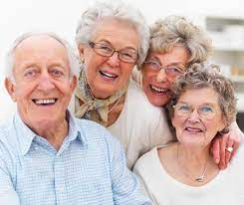
Write the other reactant, and the 2 products - they are always the same.
94. Butane (C₄H₁₀) combusts. 2C₄H₁₀ + 13O₂ → 8CO₂ + 10H₂O
And John Dalton says? Perfect 2:13:8:10 can’t be reduced ratio. Even us oldies are happy.

Slide 152
95. Octane (C₈H₁₈) combusts.

Slide 153
95. Octane (C₈H₁₈) combusts.
_C₈H_{18(L)} + _O_{2(G)} → _CO_{2(G)} + _H₂O_{(G)}

Slide 154
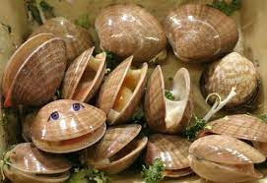
95. Octane combusts phases omitted for space, octane is Liquid, the others are all gas
2C₈H₁₈ + 25O₂ → 16CO₂ + 18H₂O Even the clams are happy now. Review slides follow next. You do them at home.
liquid gas gas gas

Slide 155
OB: recognizing chemical reactions, balancing practice. REVIEW
Get your reference tables and white paper too.
Studying means writing, not looking. Studying is ACTIVE, not passive.

Slide 156
Synthesis and Decomposition Reactions:
SYNTH: 2 or more small things make one larger product
Or the reverse,
DECOMP: One large reactant breaks down into 2 or more smaller products.
96. Write balanced chemical equations from these 2 word equations.
Phosphorous + chlorine gas form into phosphorous pentachloride gas.
Manganese VII oxide forms manganese and oxygen gas

Slide 157
96. SKELETON REACTION
_P_{(S)} + _Cl_{2(G)} → _PCl_{5(G)} Phosphorous and chlorine form phosphorous pentachloride

Slide 158
96. Start talking to yourself
_P_{(S)} + _Cl_{2(G)} → _PCl_{5(G)}
One P in reactants, and One P in products (good)
Two Cl’s in reactants, but 5 in products.
Odd is broken.
Put a 2 in front of PCl₅, start over.

Slide 159
96. Start talking to yourself
_P_{(S)} + _Cl_{2(G)} → 2PCl_{5(G)}
One P in reactants, and 2 P’s in products
Fix this by putting a 2 in front of phosphorous,
Start over.

Slide 160
96. Start talking to yourself
2P_{(S)} + _Cl_{2(G)} → 2PCl_{5(G)}
2 P’s in reactants, and 2 P’s in products (good)
2 Cl’s in reactants, 10 Cl’s in products,
Fix this by putting a 5 in front of Cl₂.

Slide 161
96. Start talking to yourself
2P_{(S)} + 5Cl_{2(G)} → 2PCl_{5(G)}
2 P’s in reactants, and 2 P’s in products (good)
10 Cl’s in reactants, 10 Cl’s in products (good)
John Dalton check: 2:5:2 (everyone’s happy now)

Slide 162
96. SKELETON REACTION
_Mn₂O_{7(S)} → _Mn_{(S)} + _O_{2(G)} Manganese VII oxide form manganese and oxygen gas

Slide 163
96. Start talking to yourself
_Mn₂O_{7(S)} → _Mn_{(S)} + _O_{2(G)}
2 Mn in reactants, 1 Mn in products,
Fix with a 2 in front of the Mn

Slide 164
96. Start talking to yourself
_Mn₂O_{7(S)} → 2Mn_{(S)} + _O_{2(G)}
2 Mn in reactants, 2 Mn in products (good)
7 O’s in reactant, just 2 in front of O₂. (not good)
Seven is ODD, it’s broken, double it by putting a 2 in front of Mn₂O₇

Slide 165
96. Start talking to yourself
2Mn₂O_{7(S)} → 2Mn_{(S)} + _O_{2(G)}
4 Mn in reactants, 2 Mn in products (not good)
Fix this by changing the 2 in front of Mn to a 4,
start again

Slide 166
96. Start talking to yourself
2Mn₂O_{7(S)} → 4Mn_{(S)} + _O_{2(G)}
4 Mn in reactants, 4 Mn in products (good)
14 O’s in reactant, just 2 in product. How do we get 14 O’s in product? Put a 7 in front of O₂. Done.

Slide 167
96. Start talking to yourself
2Mn₂O_{7(S)} → 4Mn_{(S)} + 7O_{2(G)}
4 Mn in reactants, 4 Mn in products (good)
John Dalton says: 2:4:7 can’t be reduced. All good.

Slide 168
Single Replacement Reactions (table J)
Always start with one aqueous solution + “atoms”, and end with a different aqueous solution and different atoms. Atoms can be diatomic. Sometimes it’s a cation switch, or an anion switch; sometimes No Reaction Occurs, Look at table J. Write Skeletons, then Balance these reactions
97. Sodium goes into silver nitrate solution

Slide 169
97. Sodium goes into silver nitrate solution
_Na_{(S)} + _AgNO_{3(AQ)} →
This is the set up for SR, Na is higher than Ag on Table J, Na is more reactive and will REPLACE Ag in solution. Then Silver gets bumped out as a solid.

Slide 170
97. Sodium goes into silver nitrate solution
_Na_{(S)} + _AgNO_{3(AQ)} → _NaNO_{3(AQ)} + _Ag_{(S)}
Here, Na⁺¹ and NO₃⁻¹ fit in a 1:1 ratio.
This is balanced as is. Easy!
John Dalton says 1:1:1:1 (wow!)

Slide 171
98. Bromine is added to lithium iodide solution
Let’s get the ions first…
Br₂ is a HONClBrIF twin, and not ionic as a reactant here.
Li⁺¹ and I⁻¹ are the reactant AQ, in a 1:1 ratio, so LiI_{(AQ)}

Slide 172
98. Bromine is added to lithium iodide solution
_Br_{2(L)} + _LiI_{(AQ)} →
Perfect set up for SR. Atoms going into an AQ solution.
Br is higher than I on table J, bromine will replace the I in solution.

Slide 173
98. Bromine is added to lithium iodide solution
_Br_{2(L)} + _LiI_{(AQ)} → _LiBr_{(AQ)} + _I_{2(S)}
Products:
Li⁺¹ and Br⁻¹ make a 1:1 ratio at LiBr and it’s AQ
Iodine I₂ is a HONClBrIF twin here.

Slide 174
98. Bromine is added to lithium iodide solution
_Br_{2(L)} + _LiI_{(AQ)} → _LiBr_{(AQ)} + _I_{2(S)}
Start talking:
2 Br’s in reactants, put a 2 in front of LiBr, start over.

Slide 175
98. Bromine is added to lithium iodide solution
_Br_{2(L)} + _LiI_{(AQ)} → 2LiBr_{(AQ)} + _I_{2(S)}
Start talking:
2 Br’s in reactants, 2 Br in products (good)
1 Li in reacant, but 2 Li’s in products.
Fix this by putting a 2 in front of LiBr, start again.

Slide 176
98. Bromine is added to lithium iodide solution
_Br_{2(L)} + 2LiI_{(AQ)} → 2LiBr_{(AQ)} + _I_{2(S)}
Start talking:
2 Br’s in reactants, 2 Br in products (good)
2 Li in reactant, 2 Li’s in products (good)
2 I’s in reactants, and 2 I’s already in products (yay)
What about John Dalton?

Slide 177
98. Bromine is added to lithium iodide solution
_Br_{2(L)} + 2LiI_{(AQ)} → 2LiBr_{(AQ)} + _I_{2(S)}
What about John Dalton? 1:2:2:1 John’s happy!

Slide 178
99. Tin is added to barium nitrate solution

Slide 179
99. Tin is added to barium nitrate solution _Sn_{(S)} + _Ba(NO₃)_{2 (AQ)} → This is a perfect set up for SR. Atoms going into AQ solution Tin and Barium on right side of table J.
Sn is lower than Ba (Ba is more reactive than the tin)
What happens here?

Slide 180
99. Tin is added to barium nitrate solution _Sn_{(S)} + _Ba(NO₃)_{2 (AQ)} → X no reaction
What happens here? NOTHING!
The tin can’t bump out the barium.

Slide 181
Double Replacement Reactions
Start with two AQ ionic solutions, end with a different AQ solution and a precipitate
If your 2 AQ solutions → 2 new AQ’s, then you formed a mixture, no reaction occurred
Vocab: soluble, insoluble, precipitate, aqueous, cations, anions.
Turn these two word equations into balanced chemical equations.
100. Lithium nitrate and potassium chloride solutions are poured together
101. Lead (II) hydrogen carbonate and Cobalt (III) sulfate solutions are poured together

Slide 182
Double Replacement Reactions
Start with two AQ ionic solutions, end with a different AQ solution and a precipitate
If your 2 AQ solutions → 2 new AQ’s, then you formed a mixture, no reaction occurred
Vocab: soluble, insoluble, precipitate, aqueous, cations, anions.
Turn these two word equations into balanced chemical equations.

Slide 183
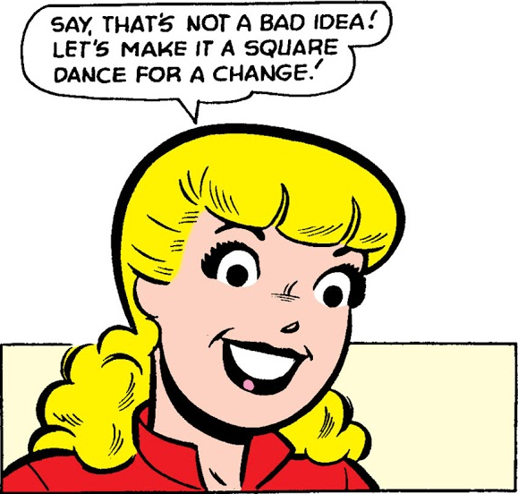
100. Lithium nitrate and potassium chloride solutions are poured together… The cations will switch anions… Lithium nitrate and potassium chloride Cations in BLUE, switch partners

Slide 184
100. Lithium nitrate and potassium chloride solutions form into lithium chloride and potassium nitrate.
Write the ions, then get busy.
Li⁺¹ NO₃⁻¹ K⁺¹ Cl⁻¹
_LiNO_{3(AQ)} + _KCl_{(AQ)} →
Now switch ‘em!

Slide 185
100. Lithium nitrate and potassium chloride solutions form into lithium chloride and potassium nitrate.
Li⁺¹ NO₃⁻¹ K⁺¹ Cl⁻¹
_LiNO_{3(AQ)} + _KCl_{(AQ)} → _KNO₃₍ ₎ + LiCl₍ ₎
Now fix ‘em!

Slide 186
100. Lithium nitrate and potassium chloride solutions form into lithium chloride and potassium nitrate.
Li⁺¹ NO₃⁻¹ K⁺¹ Cl⁻¹
_LiNO_{3(AQ)} + _KCl_{(AQ)} → _KNO₃₍ ₎ + LiCl₍ ₎
These are already fixed, both are in a 1:1 ratio.
Switched, fixed, now balance ‘em!

Slide 187
100. Lithium nitrate and potassium chloride solutions form into lithium chloride and potassium nitrate.
Li⁺¹ NO₃⁻¹ K⁺¹ Cl⁻¹
_LiNO_{3(AQ)} + _KCl_{(AQ)} → _KNO_{3(AQ)} + LiCl₍ ₎
These are already balanced too.
Now Table F’em.
If you’re name is K, you’re AQ, no exceptions. If your name is nitrate, you’re AQ no exceptions as well.

Slide 188
100. Lithium nitrate and potassium chloride solutions form into lithium chloride and potassium nitrate.
Li⁺¹ NO₃⁻¹ K⁺¹ Cl⁻¹
_LiNO_{3(AQ)} + _KCl_{(AQ)} → _KNO_{3(AQ)} + LiCl_{(AQ)}
These are already balanced too.
Now Table F’em.
If you’re name is Li, you’re AQ, no exceptions. If your name is chloride, you’re AQ and Li IS NOT an exceptions.

Slide 189
100. Lithium nitrate and potassium chloride solutions form into lithium chloride and potassium nitrate.
Li⁺¹ NO₃⁻¹ K⁺¹ Cl⁻¹
_LiNO_{3(AQ)} + _KCl_{(AQ)} → _KNO_{3(AQ)} + LiCl_{(AQ)}
What happened? 2 AQ products = NO REACTION
This is just a mixture.

Slide 190
101. Lead (II) hydrogen carbonate + Cobalt (III) sulfate solutions are poured together
Write the ions, get busy.

Slide 191
101. Lead (II) hydrogen carbonate + Cobalt (III) sulfate solutions are poured together
Pb⁺² HCO₃⁻¹ Co⁺³ SO₄⁻²

Slide 192
101. Lead (II) hydrogen carbonate + Cobalt (III) sulfate solutions are poured together
Pb⁺² HCO₃⁻¹ Co⁺³ SO₄⁻²
_Pb(HCO₃)_{2(AQ)} + _Co₂(SO₄)_{3(AQ)} →
Now switch the anions around quick…

Slide 193
101. Lead (II) hydrogen carbonate + Cobalt (III) sulfate solutions are poured together
Pb⁺² HCO₃⁻¹ Co⁺³ SO₄⁻²
_Pb(HCO₃)_{2(AQ)} + _Co₂(SO₄)_{3(AQ)} → _PbSO₄₍ ₎+ _CoHCO₃₍ ₎
Switched, but not fixed. Check ion charges in products…
Pb and SO₄ are okay (+2 and -2 makes a 1:1 ratio)
Co⁺³ and HCO₃⁻¹ need parenthesis!

Slide 194
101. Lead (II) hydrogen carbonate + Cobalt (III) sulfate solutions are poured together
Pb⁺² HCO₃⁻¹ Co⁺³ SO₄⁻²
_Pb(HCO₃)_{2(AQ)} + _Co₂(SO₄)_{3(AQ)} → _PbSO₄₍ ₎+ _Co(HCO₃)₃₍ ₎
Switched and fixed. Now balance this…
1 Pb in front, 1 in back, good.
2 hydrogen carbonate up front, but 3 in back,
The odd one is broken, put a 2 in front of the Co(HCO₃)₃

Slide 195
101. Lead (II) hydrogen carbonate + Cobalt (III) sulfate solutions are poured together
Pb⁺² HCO₃⁻¹ Co⁺³ SO₄⁻²
_Pb(HCO₃)_{2(AQ)} + _Co₂(SO₄)_{3(AQ)} → _PbSO₄₍ ₎+ 2Co(HCO₃)₃₍ ₎
1 Pb in front, 1 in back, good.
2 hydrogen carbonate up front, but 6 in back,
Put a 3 in front of the Pb(HCO₃)₂ start over again.

Slide 196
101. Lead (II) hydrogen carbonate + Cobalt (III) sulfate solutions are poured together
Pb⁺² HCO₃⁻¹ Co⁺³ SO₄⁻²
3Pb(HCO₃)_{2(AQ)} + _Co₂(SO₄)_{3(AQ)} → _PbSO₄₍ ₎+ 2Co(HCO₃)₃₍ ₎
3 Pb in front, 1 in back, not good.
Put a 3 in front of the PbSO₄ start over again.

Slide 197
101. Lead (II) hydrogen carbonate + Cobalt (III) sulfate solutions are poured together
Pb⁺² HCO₃⁻¹ Co⁺³ SO₄⁻²
3Pb(HCO₃)_{2(AQ)} + _Co₂(SO₄)_{3(AQ)} → 3PbSO₄₍ ₎+ 2Co(HCO₃)₃₍ ₎
3 Pb in front, 3 in back, good.
6 hydrogen carbonates up front, and 6 out back (good)
2 cobalts up front, 2 cobalts in products (good)
3 sulfates up front, 3 sulfates in products (good and balanced!)

Slide 198
101. Lead (II) hydrogen carbonate + Cobalt (III) sulfate solutions are poured together
Pb⁺² HCO₃⁻¹ Co⁺³ SO₄⁻²
3Pb(HCO₃)_{2(AQ)} + _Co₂(SO₄)_{3(AQ)} → 3PbSO₄₍ ₎+ 2Co(HCO₃)₃₍ ₎
This is in a 3:1:3:2 ratio, John Dalton is happy.
Now let’s go to table F!

Slide 199
101. Lead (II) hydrogen carbonate + Cobalt (III) sulfate solutions are poured together
Pb⁺² HCO₃⁻¹ Co⁺³ SO₄⁻²
3Pb(HCO₃)_{2(AQ)} + _Co₂(SO₄)_{3(AQ)} → 3PbSO_{4(S)}+ 2Co(HCO₃)₃₍ ₎
Switched and fixed. Now balance this…
PbSO₄ Sulfates are usually AQ, but Pb⁺² is an exception - so this is a SOLID.

Slide 200
101. Lead (II) hydrogen carbonate + Cobalt (III) sulfate solutions are poured together
Pb⁺² HCO₃⁻¹ Co⁺³ SO₄⁻²
3Pb(HCO₃)_{2(AQ)} + _Co₂(SO₄)_{3(AQ)} → 3PbSO_{4(S)}+ 2Co(HCO₃)_{3(AQ)}
Switched and fixed. Now balance this…
Co(HCO₃)₃ If your last name is hydrogen carbonate, you are AQ without exception.

Slide 201
Combustion are always a hydrocarbon + oxygen forming water and carbon dioxide with heat.
Vocab: hydrocarbon, oxygenated hydrocarbon, complete combustion, incomplete combustion, exothermic and endothermic.
Balance these two combustion reactions:
102. Hexane combusts (C₆H₁₄)
103. Propanol combusts (C₃H₅OH) this is a type of alcohol.

Slide 202
First the skeletons, then balance these:
102. Hexane combusts (C₆H₁₄)
_C₆H_{14(L)} + _O_{2(G)} → _CO_{2(G)} + _H₂O_{(G)}

Slide 203
First the skeletons, then balance these:
102. Hexane combusts (C₆H₁₄)
_C₆H_{14(L)} + _O_{2(G)} → _CO_{2(G)} + _H₂O_{(G)}
6 C’s in front, so put a 6 in front of the CO₂
Start over

Slide 204
First the skeletons, then balance these:
102. Hexane combusts (C₆H₁₄)
_C₆H_{14(L)} + _O_{2(G)} → 6CO_{2(G)} + _H₂O_{(G)}
6 C’s in hexane, now 6 in CO₂ good
14 H’s in hexane, just 2 in water, put a 7 in front of water.

Slide 205
First the skeletons, then balance these:
102. Hexane combusts (C₆H₁₄)
_C₆H_{14(L)} + _O_{2(G)} → 6CO_{2(G)} + 7H₂O_{(G)}
6 C’s in hexane, now 6 in CO₂ good
14 H’s in hexane, 14 in water, good.
2 O’s in front, but 12 + 7 out back that’s 19 (odd = bad!)
Double the seven to a 14, start over.

Slide 206
First the skeletons, then balance these:
102. Hexane combusts (C₆H₁₄)
_C₆H_{14(L)} + _O_{2(G)} → 6CO_{2(G)} + 14H₂O_{(G)}
6 C’s in hexane, now 6 in CO₂ good
14 H’s in hexane, 28 in water, not good.
Put a 2 in front of the hexane, begin again!

Slide 207
First the skeletons, then balance these:
102. Hexane combusts (C₆H₁₄)
2C₆H_{14(L)} + _O_{2(G)} → 6CO_{2(G)} + 14H₂O_{(G)}
12 C’s in hexane, but only 6 in CO₂ not good
Change the 6 in CO₂ into a 12, start over.

Slide 208
First the skeletons, then balance these:
102. Hexane combusts (C₆H₁₄)
2C₆H_{14(L)} + _O_{2(G)} → 12CO_{2(G)} + 14H₂O_{(G)}
12 C’s in hexane, 12 in CO₂ good
28 H’s in hexane, 28 in water, good.
2 O’s in oxygen, and 24 + 14 = 38 oxygens in product.
Fix this by putting a 19 in front of O₂, balanced!

Slide 209
First the skeletons, then balance these:
102. Hexane combusts (C₆H₁₄)
2C₆H_{14(L)} + 19O_{2(G)} → 12CO_{2(G)} + 14H₂O_{(G)}
Balanced!
And John Dalton? 2:19:12:14, all good there.

Slide 210
103. Propanol combusts (C₃H₅OH) this is a type of alcohol.
SKELETON FIRST
_C₃H₅OH_{(L)} + _O_{2(G)} → _CO_{2(G)} + _H₂O_{(G)}
Now start talking to yourself…

Slide 211
103. Propanol combusts (C₃H₅OH) this is a type of alcohol.
_C₃H₅OH_{(L)} + _O_{2(G)} → _CO_{2(G)} + _H₂O_{(G)}
3 C’s in propanol, put a 3 in front of CO₂. start over

Slide 212
103. Propanol combusts (C₃H₅OH) this is a type of alcohol.
SKELETON FIRST
_C₃H₅OH_{(L)} + _O_{2(G)} → 3CO_{2(G)} + _H₂O_{(G)}
3 C’s in propanol, 3 in CO₂. Good
5+1 = 6 H’s in propanol, put a 3 in front of water,
start over again.

Slide 213
103. Propanol combusts (C₃H₅OH) this is a type of alcohol.
SKELETON FIRST
_C₃H₅OH_{(L)} + _O_{2(G)} → 3CO_{2(G)} + 3H₂O_{(G)}
3 C’s in propanol, 3 in CO₂. Good
5+1 = 6 H’s in propanol, 6 in water good.
There’s 1 + 2 O’s in front, but SIX + THREE in back.
Super tricky. 3 to 9. If we leave propanol alone, can we get 8 more oxygens up front? (yes)

Slide 214
103. Propanol combusts (C₃H₅OH) this is a type of alcohol.
SKELETON FIRST
_C₃H₅OH_{(L)} + 4O_{2(G)} → 3CO_{2(G)} + 3H₂O_{(G)}
3 C’s in propanol, 3 in CO₂. Good
5+1 = 6 H’s in propanol, 6 in water good.
Now there are 1 + 8 oxygen in front, and 6 + 3 out back. 9 = 9, balanced. John?

Slide 215
103. Propanol combusts (C₃H₅OH) this is a type of alcohol.
SKELETON FIRST
_C₃H₅OH_{(L)} + 4O_{2(G)} → 3CO_{2(G)} + 3H₂O_{(G)}
John? 1:4:3:3 - all good.

Slide 216
104. In Complete combustion, only carbon dioxide forms CH_{4(G)} + 2O_{2(G)} → CO_{2(G)} + 2H₂O_{(G)}
In all of our combustion reactions we always have a hydrocarbon (sometimes an oxygenated hydrocarbon) combining rapidly with oxygen gas, and forming carbon dioxide and water and energy as products. Always.
But…

Slide 217
105. With incomplete combustion carbon monoxide will form because there is insufficient oxygen to make only carbon dioxide.
2CH_{4(G)} + 3O_{2(G)} → 2CO_{(G)} + 4H₂O_{(G)}
_{Or}
3CH_{4(G)} + 5O_{2(G)} → CO + 2CO_{2(G)} + 6H₂O_{(G)}
Carbon monoxide is poison. There are many other incomplete combustion equations that would also balance.

