Slide 1
SOLUTIONS Class #1
Objective: Describing what solutions are, how they form, and how we can measure their strength – or concentration.
Get a calculator and reference tables out.

Slide 2
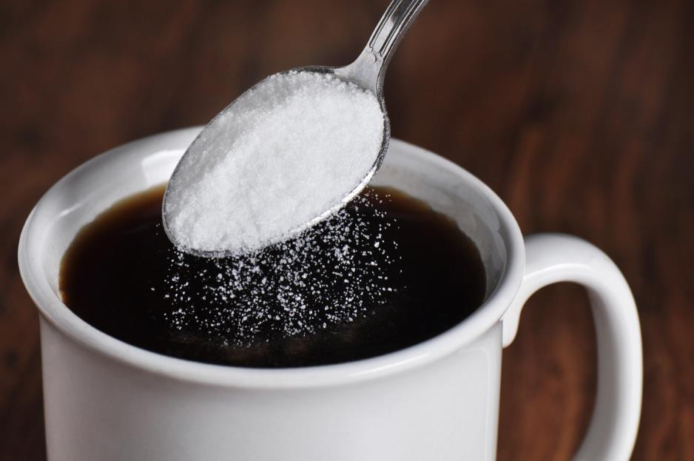
1. A solution is a homogeneous mixture.
2. A solution forms when a solute is dissolved into a solvent.
If you make this solution
Sugar is the SOLUTE Coffee is the SOLVENT

Slide 3
4. When a solution holds the maximum amount of solute it is a SATURATED solution.
5. If there is less than the maximum amount of solute in the solution it is UNSATURATED

Slide 4
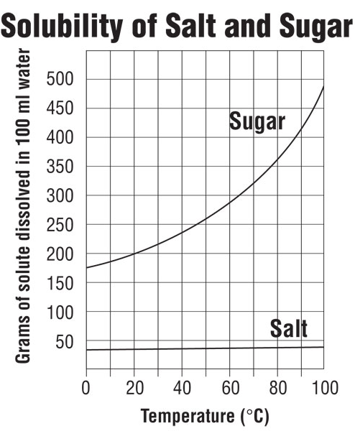
Hot solvents usually hold more solute than cold.
This graph shows data for 100 mL solutions
6. Compare a 10°C sugar solution to a 90°C sugar solution…
At 10°C you can fit ___ g sugar into solution.
At 90°C you can fit ___ g sugar into solution.

Slide 5
Hot solvents usually hold more solute than cold.
This graph shows data for 100 mL solutions
6. Compare a 10°C sugar solution to a 90°C sugar solution…
At 10°C you can fit 175 g sugar into solution.
At 90°C you can fit 425 g sugar into solution. Hotter solutions “juggle” molecules or ions faster. The hotter solutions can hold more solute than colder solutions.
7. It’s hard to see here, but the NaCl solubility increases just a tiny bit (38 g → 40 g) in a100 mL solution, a small increase.

Slide 6
8. Most solutions you think about will be aqueous which means dissolved in _______
9. But they can also be gases like ____ or even solids _________ such as BRASS or CAST IRON.

Slide 7
8. Most solutions you think about will be aqueous which means dissolved in WATER
9. But they can also be gases like AIR or even solids ALLOYS such as BRASS or CAST IRON ).

Slide 8
When you try to dissolve stuff into solution, there are 3 factors that will affect this rate (either making it faster or slower.
DEMONSTRATION one
Let’s watch 2 forms of the same compound Copper (II) sulfate
First, CHUNKS of CuSO₄ into room temperature water
Next, POWDERED CuSO₄ into room temperature water
150 mL of water - and stir them.

Slide 9
When you try to dissolve stuff into solution, there are 3 factors that will affect this rate (either making it faster or slower.
DEMONSTRATION one
Let’s watch 2 forms of the same compound Copper (II) sulfate
First, CHUNKS of CuSO₄ into room temperature water
Next, POWDERED CuSO₄ into room temperature water
150 mL of water - and stir them.
Powdered dissolves faster: greater surface area means more water touches more solute, MORE COLLISIONS BETWEEN particles, so faster dissolving.

Slide 10
When you try to dissolve stuff into solution, there are 3 factors that will affect this rate (either making it faster or slower.
DEMONSTRATION 2
Watch Alka-seltzer dissolve into water.
One tablet into 150 mL HOT water
One tablet into 150 mL COLD water
Which dissolves faster?

Slide 11
When you try to dissolve stuff into solution, there are 3 factors that will affect this rate (either making it faster or slower.
DEMONSTRATION 2
Watch Alka-seltzer dissolve into water.
One tablet into 150 mL HOT water
One tablet into 150 mL COLD water
Which dissolves faster?
The hotter water dissolved the alka-seltzer faster.
Hotter molecules with MORE KINETIC ENERGY, produce MORE COLLISIONS between the two, increasing the rate of solvation.

Slide 12
When you try to dissolve stuff into solution, there are 3 factors that will affect this rate (either making it faster or slower.
DEMONSTRATION three
Let’s watch a cube of SUGAR go into into 150 mL water
One cube into water no stirring
One cube into same amount of water, with stirring
Which dissolves faster?

Slide 13
When you try to dissolve stuff into solution, there are 3 factors that will affect this rate (either making it faster or slower.
DEMONSTRATION three
Let’s watch a cube of SUGAR go into into 150 mL water
One cube into water no stirring
One cube into same amount of water, with stirring
Which dissolves faster?
The stirred sugar dissolved faster. Faster moving water created MORE COLLISIONS between the sugar cube and water, resulting in faster dissolving. This higher kinetic energy was caused by the agitation.

Slide 14
10. SMALLER PARTICLES = MORE SURFACE AREA More collisions gives FASTER DISSOLVING
11. HOTTER TEMP = HIGHER KE = MORE MOTION More collisions gives FASTER DISSOLVING
12. AGITATION = HIGHER KE = MORE MOTION More collisions gives FASTER DISSOLVING
14. The rate of solvation increases with more surface area (smaller particles), higher temperatures and with more agitation.

Slide 15
How much solute will dissolve into a solution?
It depends first on
15. The actual solubility – does this stuff dissolve into water? (ionic compounds are on table F)
16. The Temperature of the solvent (usually, hotter solvents fit more solute in solution)
17. Pressure (higher pressure = higher solubility, only for gases)

Slide 16
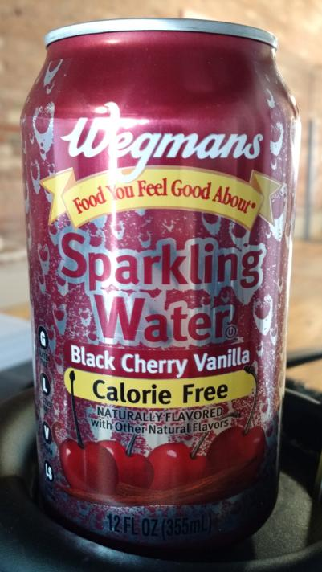
Draw the H₂O molecule
19. Then draw the CO₂ molecule. (structural diagrams)

Slide 17
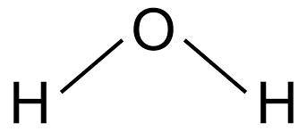
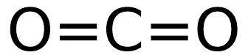
Draw the H₂O molecule
19. Then draw the CO₂ molecule.

Slide 18
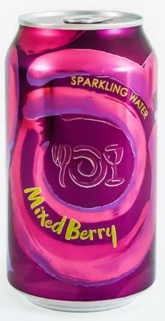
20. How does Wegman’s even get CO₂ into water? Doesn’t like dissolve like? YES
21. Water is “bent” and polar. Carbon dioxide has radial symmetry and is nonpolar.
These molecules should not be able to form a solution. The ONLY way to mix them is under HIGH PRESSURE (and then they quickly seal the can).

Slide 19
There are several ways to measure how strong a solution is in chemistry.
22. Qualitatively we can say things like strong or weak
23. Or we could use “better” words like
concentrated or dilute
24. With numbers and units, in a quantitative measure, we will use MOLARITY

Slide 20
25. Molarity is the expression of concentration of a solution as measured by the number of moles of solute in a liter of solution.
M =
# moles solute Liters of solution

Slide 21
26. What is the concentration of a NaNO₃ solution containing 4.50 moles of solute in 1220 mL volume?

Slide 22
26. What is the concentration of a NaNO₃ solution containing 4.50 moles of solute in 1220 mL volume? 27.
Molarity = | # moles solute Liters of solution
Molarity = | 4.50 moles 1.22 Liters
Molarity = | 3.69 M

Slide 23
26. What is the concentration of a NaNO₃ solution containing 4.50 moles of solute in 1220 mL volume? 27. Say: this solution has a 3.69 Molarity Write: 3.69 M NaNO_{3(AQ)} Think: this solution is the same as a 1-liter AQ solution containing 3.69 mole NaNO₃ solute per liter.
Molarity = | # moles solute Liters of solution
Molarity = | 4.50 moles 1.22 Liters
Molarity = | 3.69 M

Slide 24
28. What is the concentration of a 1650 mL salty water solution containing 125 g NaCl?

Slide 25
28. What is the concentration of a 1650 mL salty water solution containing 125 g NaCl?
Convert grams of NaCl to moles first. Then convert mL into liters. Only use moles & liters.
Molarity = | # moles solute Liters of solution

Slide 26
28. What is the concentration of a 1650 mL salty water solution containing 125 g NaCl?
Convert grams of NaCl to moles first. Then convert mL into liters. Only use moles & liters.
Molarity = | # moles solute Liters of solution
125 g NaCl 1
X
1 mole NaCl 58 g NaCl
= 2.16 moles NaCl
MOLAR MASS NaCl
Na 1 x 23g = 23 g
Cl 1 x 36 g = 35 g
58 g/mole

Slide 27
28. What is the concentration of a 1650 mL salty water solution containing 125 g NaCl?
Convert grams of NaCl to moles first. Then convert mL into liters. Only use moles & liters.
Molarity = | 2.16 moles Liters of solution
1650 mL solution 1
1 Liter 1000 mL
= 1.65 Liters
X

Slide 28
28. What is the concentration of a 1650 mL salty water solution containing 125 g NaCl?
NOW: DO THE MATH
Molarity = | 2.16 moles 1.65 Liters
Molarity = | 1.31 M

Slide 29
28. What is the concentration of a 1650 mL salty water solution containing 125 g NaCl?
NOW: DO THE MATH
Molarity = | 2.16 moles 1.65 Liters
Molarity = | 1.31 M
Say: this sodium chloride solution has a 1.31 molarity
Write: 1.31 M NaCl(AQ)
Think: this solution contains the equivalent of 1.31 moles NaCl per liter of solution

Slide 30
29. If you add 43.5 g NaCl to enough water to form a 648 mL solution, what is its concentration? (figure out moles, and liters first, then write the formula, or else)
CONVERT MOLES FIRST
M =
# moles NaCl Liters of solution

Slide 31
29. If you add 43.5 g NaCl to enough water to form a 648 mL solution, what is its concentration? (figure out moles, and liters first, then write the formula, or else)
CONVERT MOLES FIRST
THEN CONVERT LITERS
43.5 g NaCl 1
1 mole NaCl 58 g NaCl
X
= 0.750 mole
M =
# moles NaCl Liters of solution

Slide 32
29. If you add 43.5 g NaCl to enough water to form a 648 mL solution, what is its concentration? (figure out moles, and liters first, then write the formula, or else)
CONVERT MOLES FIRST
THEN CONVERT LITERS
Now fill in the formula and do the math
43.5 g NaCl 1
1 mole NaCl 58 g NaCl
X
= 0.750 mole
M =
# moles NaCl Liters of solution
648 mL 1
1 Liter 1000 mL
= 0.648 Liters
X

Slide 33
29. If you add 43.5 g NaCl to enough water to form a 648 mL solution, what is its concentration? (figure out moles, and liters first, then write the formula, or else)
CONVERT MOLES FIRST
THEN CONVERT LITERS
0.750 moles 0.648 Liters
M =
M = 1.16 M
SAY: This has a 1.16 molarity
WRITE: 1.16 M NaCl_{(AQ)}
THINK: This is equivalent to a solution with 1.16 moles of salt per liter
43.5 g NaCl 1
1 mole NaCl 58 g NaCl
X
= 0.750 mole
648 mL 1
1 Liter 1000 mL
= 0.648 Liters
X

Slide 34
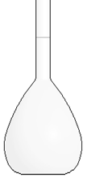
30. You put 111 g KCl solid into a volumetric flask. You fill the flask to 250. mL, what is the molarity of this solution? Start with the formula, or you know what might happen!

Slide 35
30. You put 111 g KCl solid into a volumetric flask. You fill the flask to 250. mL, what is the molarity of this solution?
Molarity = | # moles solute Liters of solution

Slide 36
30. You put 111 g KCl solid into a volumetric flask. You fill the flask to 250. mL, what is the molarity of this solution?
Molarity = | # moles solute Liters of solution
111 g KCl 1
1 mole KCl 74 g KCl
X
= 1.50 moles KCl

Slide 37
30. You put 111 g KCl solid into a volumetric flask. You fill the flask to 250. mL, what is the molarity of this solution?
Molarity = | # moles solute Liters of solution
111 g KCl 1
1 mole KCl 74 g KCl
X
= 1.50 moles KCl
250. mL solution 1
1 Liter 1000 mL
X
= 0.250 Liters

Slide 38
30. You put 111 g KCl solid into a volumetric flask. You fill the flask to 250. mL, what is the molarity of this solution?
Molarity = | # moles solute Liters of solution
111 g KCl 1
1 mole KCl 74 g KCl
X
= 1.50 moles KCl
250. mL solution 1
1 Liter 1000 mL
X
= 0.250 Liters
Molarity = | 1.50 moles 0.250 Liters | =

Slide 39
30. You put 111 g KCl solid into a volumetric flask. You fill the flask to 250. mL, what is the molarity of this solution?
Molarity = | # moles solute Liters of solution
111 g KCl 1
1 mole KCl 74 g KCl
X
= 1.50 moles KCl
250. mL solution 1
1 Liter 1000 mL
X
= 0.250 Liters
Molarity = | 1.50 moles 0.250 Liters | = 6.00 M
Fill with water to 250 mL
111 grams KCl first

Slide 40
31. You put 74.0 g KCl solid into a flask. You fill the flask to 1600. mL, what is the molarity of this solution?
74.0 g KCl = 1.00 moles KCl 1600. mL = 1.600 Liters
M =
# moles KCl Liters of solution
=
MOLAR MASS KCl
K 1 x 39g = 39 g
Cl 1 x 36 g = 35 g
74 g/mole

Slide 41
31. You put 74.0 g KCl solid into a flask. You fill the flask to 1600. mL, what is the molarity of this solution?
74.0 g KCl = 1.00 moles KCl 1600. mL = 1.600 Liters
M =
# moles KCl Liters of solution
=
1.00 moles KCl 1.600 Liters solution
=

Slide 42
31. You put 74.0 g KCl solid into a flask. You fill the flask to 1600. mL, what is the molarity of this solution?
74.0 g KCl = 1.00 moles KCl 1600. mL = 1.600 Liters
M =
# moles KCl Liters of solution
=
1.00 moles KCl 1.600 Liters solution
=
SAY: This is a 0.625 Molar KCl_{(AQ)} WRITE 0.625 M KCl_{(AQ)}
THINK: The solution contains 0.625 moles KCl/Liter

Slide 43
32. Calculate the molarity of 750. mL LiBr_{(AQ)} that has 215 g LiBr solute.

Slide 44
32. Calculate the molarity of 750. mL LiBr_{(AQ)} that has 215 g LiBr solute.
MOLAR MASS | and then convert gram to moles
LiBr Li 1 x 7g = 7 g Br 1 x 80 g = 80 g 87 g/mole

Slide 45
32. Calculate the molarity of 750. mL LiBr_{(AQ)} that has 215 g LiBr solute.
MOLAR MASS | and then convert gram to moles
LiBr Li 1 x 7g = 7 g Br 1 x 80 g = 80 g 87 g/mole
215 grams 1 | X | 1 mole LiBr 87 grams LiBr | = | 2.47 moles LiBr

Slide 46
32. Calculate the molarity of 750. mL LiBr_{(AQ)} that has 215 g LiBr solute.
MOLAR MASS | and then convert gram to moles
LiBr Li 1 x 7g = 7 g Br 1 x 80 g = 80 g 87 g/mole
Then Liters
215 grams 1 | X | 1 mole LiBr 87 grams LiBr | = | 2.47 moles LiBr

Slide 47
32. Calculate the molarity of 750. mL LiBr_{(AQ)} that has 215 g LiBr solute.
MOLAR MASS | Convert gram to moles
LiBr Li 1 x 7g = 7 g Br 1 x 80 g = 80 g 87 g/mole
Then Liters
215 grams 1 | X | 1 mole LiBr 87 grams LiBr | = | 2.47 moles LiBr
750. mL solution 1
1 Liter 1000 mL
X
= 0.750 Liters

Slide 48
32. Calculate the molarity of 750. mL LiBr_{(AQ)} that has 215 g LiBr solute.
MOLAR MASS | Convert gram to moles
LiBr Li 1 x 7g = 7 g Br 1 x 80 g = 80 g 87 g/mole
Then Liters
Now molarity…
215 grams 1 | X | 1 mole LiBr 87 grams LiBr | = | 2.47 moles LiBr
750. mL solution 1
1 Liter 1000 mL
X
= 0.750 Liters

Slide 49
32. Calculate the molarity of 750. mL LiBr_{(AQ)} that has 215 g LiBr solute.
MOLAR MASS | Convert gram to moles
LiBr Li 1 x 7g = 7 g Br 1 x 80 g = 80 g 87 g/mole
Then Liters
Now molarity…
215 grams 1 | X | 1 mole LiBr 87 grams LiBr | = | 2.47 moles LiBr
750. mL solution 1
1 Liter 1000 mL
X
= 0.750 Liters
M = | 2.47 moles 0.750 Liters | = 3.29 M

Slide 50
32. Calculate the molarity of 750. mL LiBr_{(AQ)} that has 215 g LiBr solute.
MOLAR MASS
LiBr Li 1 x 7g = 7 g Br 1 x 80 g = 80 g 87 g/mole
Now molarity M = | # moles solute Liters solution

Slide 51
Let’s totally change gears now. Take out Table G
SOLUBILITY CURVES at Standard Pressure

Slide 52
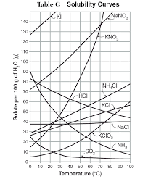
33. How many grams of sodium nitrate are in a 100 mL aqueous solution that is saturated at 10°C?
Find NaNO₃ curve. Find 10°C.
Slide Upwards until you find their meeting point.
(80 grams)

Slide 53
34. How many grams of NaNO₃ fit into 325 mL of water at 10°C? 80 g in 100 mL

Slide 54
34. How many grams of NaNO₃ fit into 325 mL of water at 10°C? 80 g in 100 mL from TABLE G
NaNO₃ water
80 g 100 mL
10°C

Slide 55
34. How many grams of NaNO₃ fit into 325 mL of water at 10°C? 80 g in 100 mL from TABLE G
NaNO₃ water
80 g 100 mL
X g 325 mL
10°C
=
That proportion is set by how well this stuff dissolves into solution. We can use the proportion to figure out how much fits into this bigger solution by cross multiplying and solving for X grams.

Slide 56
34. How many grams of NaNO₃ fit into 325 mL of water at 10°C? 80 g in 100 mL from TABLE G
NaNO₃ water
80 g 100 mL
X g 325 mL
10°C
=
100 X = 26,000
X = 260.
X = 260. grams NaNO₃

Slide 57
35. What is the MOLARITY of this solution of 260. g NaNO₃ in 325 mL? Start with a formula
M =
# moles NaNO₃ Liters of solution

Slide 58
35. What is the MOLARITY of this solution of 260. g NaNO₃ in 325 mL? Do the conversions you need…
M =
# moles NaNO₃ Liters of solution
260. g NaNO₃ 1
1 mole NaNO₃ 85 g NaNO₃
x
325 mL 1
x
1 Liter 1000 mL

Slide 59
35. What is the MOLARITY of this solution of 260. g NaNO₃ in 325 mL?
M =
# moles KCl Liters of solution
260. g NaNO₃ 1
1 mole NaNO₃ 85 g NaNO₃
x
= 3.06 moles
325 mL 1
x
1 Liter 1000 mL
= 0.325 Liters

Slide 60
35. What is the MOLARITY of this solution of 260. g NaNO₃ in 325 mL? Plug in the conversions, do the math
M =
# moles KCl Liters of solution
M =
3.06 moles KCl 0.325 Liters

Slide 61
35. What is the MOLARITY of this solution of 260. g NaNO₃ in 325 mL? Plug in the conversions, do the math
M =
# moles KCl Liters of solution
= 9.42 M
M =
3.06 moles KCl 0.325 Liters

Slide 62
36. Solutions Vocabulary to Memorize by Tomorrow
Solute – the stuff dissolved into the solvent of a solution (the salt of salty water)
Solvent – the part of the solution that the solute is dissolved into, the water of salty water.
Saturated – when a solution is holding the maximum solute at that temperature.
Unsaturated – when a solution is holding LESS THAN the maximum solute for that temp.
Table G – the solubility guidelines for 10 compounds over all liquid water temps.
Molarity – the measured concentration of a solution in moles/Liter units.
Molarity Formula: M =
What units go into this formula (only) – MOLES of solute and LITERS - not grams or mL!
moles of solute Liters of solution

Slide 63
Solutions Class #3
Objective: More practice with molarity problems, and how to make a solution properly (and wrong!),
and then – how to make a new solution from a solution that you have in the stock room on a shelf.

Slide 64
37. Calculate the molarity of a solution containing 259 g KBr_{(AQ)} with total volume of 750. mL (the molar mass KBr = 119 g/mole)

Slide 65
37. Calculate the molarity of a solution containing 259 g KBr_{(AQ)} with total volume of 750. mL (the molar mass KBr = 119 g/mole)
M =
# moles KBr Liters of solution
=
2.18 Moles KBr 0.750 Liters solution
To get here you had to remember to convert the grams → moles with the molar mass.

Slide 66
37. Calculate the molarity of a solution containing 259 g KBr_{(AQ)} with total volume of 750. mL (the molar mass KBr = 119 g/mole)
M =
# moles KBr Liters of solution
=
2.18 Moles KBr 0.750 Liters solution
This is a 2.91 M KBr_{(AQ)} solution
It has a Molarity of 2.91

Slide 67
38. How many grams of sodium chloride are in a 100 mL aqueous solution that is saturated at 90°C?

Slide 68
38. How many grams of sodium chloride are in a 100 mL aqueous solution that is saturated at 90°C?
Exactly 40 grams fits into 100 mL.

Slide 69
39. How many grams of sodium chloride are in an 885 mL aqueous solution that is saturated at 90°C? Do this as shown, no variations allowed.

Slide 70
39. How many grams of sodium chloride are in an 885 mL aqueous solution that is saturated at 90°C?
NaCl water
40 g 100 mL
90°C

Slide 71
39. How many grams of sodium chloride are in an 885 mL aqueous solution that is saturated at 90°C?
NaCl water
40 g 100 mL
X g 885 mL
90°C
=

Slide 72
39. How many grams of sodium chloride are in an 885 mL aqueous solution that is saturated at 90°C?
NaCl water
40 g 100 mL
X g 885 mL
90°C
=
100 x = 35,400
X = 354 grams NaCl

Slide 73
40. What’s the molarity of this saturated solution of NaCl_{(AQ)}? (First convert these 354 grams of NaCl into moles)

Slide 74
40. What’s the molarity of this saturated solution of NaCl_{(AQ)}? (First convert these 354 grams of NaCl into moles)
354 g NaCl 1
X
= 6.10 moles NaCl
1 mole NaCl 58 g NaCl
moles Liters
M =

Slide 75
40. What’s the molarity of this saturated solution of NaCl_{(AQ)}? (First convert these 354 grams of NaCl into moles)
354 g NaCl 1
X
= 6.10 moles NaCl
1 mole NaCl 58 g NaCl
6.10 moles 0.885 Liters
M =

Slide 76
40. What’s the molarity of this saturated solution of NaCl_{(AQ)}? (First convert these 354 grams of NaCl into moles)
354 g NaCl 1
X
= 6.10 moles NaCl
1 mole NaCl 58 g NaCl
6.10 moles 0.885 Liters
= 6.89 M NaCl_{(AQ)}
M =

Slide 77
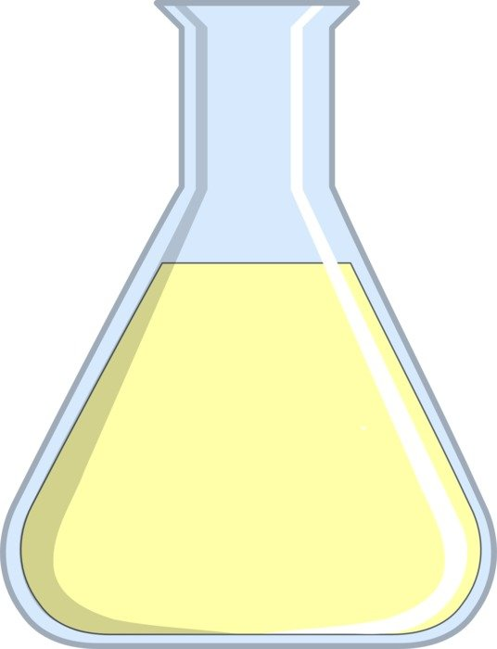
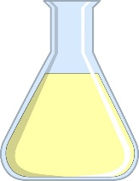
41. If you had two SATURATED NaCl_{(AQ)} One 25 mL, and another of 1275 mL… Would they both taste exactly the same? Would they both conduct electricity? Would they be “the same”?
Saturated NaCl_{(AQ)}

Slide 78
41. If you had two SATURATED NaCl_{(AQ)} One 25 mL, and another of 1275 mL… Would they both taste exactly the same? YES Would they both conduct electricity? YES Would they be “the same”? EXACTLY
IDENTICAL
Except for size

Slide 79
If you had two SATURATED NaCl_{(AQ)} One 25 mL, and another of 1275 mL, How would they both taste? How would they both conduct electricity? Would they be “the same”?
IDENTICAL
Except for size

Slide 80
42. How many grams of NaCl are required to form a 2.50 L of 0.900 M NaCl_{(AQ)}? (a formula will guide you)

Slide 81
42. How many grams of NaCl are required to form a 2.50 L of 0.900 M NaCl_{(AQ)}? (a formula will guide you)
M =
X moles NaCl Liters of solution

Slide 82
42. How many grams of NaCl are required to form a 2.50 L of 0.900 M NaCl_{(AQ)}? (a formula will guide you)
M =
X moles NaCl Liters of solution
0.900M = 1
X moles NaCl 2.50 Liters
Solve for # moles, hint: put Molarity over 1, then cross multiply

Slide 83
40. How many grams of NaCl are required to form a 2.50 L of 0.900 M NaCl_{(AQ)}? (a formula will guide you)
M =
X moles NaCl Liters of solution
0.900M = 1
X moles NaCl 2.50 Liters
X moles = 2.25 moles NaCl is 58 g/mole, so… 2.25 moles x 58 g = 131 g NaCl (3 SF) 1 1 mole

Slide 84
43. Calculate the grams of KOH required to make a 3.20 Liter solution of KOH_{(AQ)} with 1.20 M concentration. (always write a formula)

Slide 85
43. Calculate the grams of KOH required to make a 3.20 Liter solution of KOH_{(AQ)} with 1.20 M concentration. (always write a formula)
M =
# moles KOH Liters of solution

Slide 86
43. Calculate the grams of KOH required to make a 3.20 Liter solution of KOH_{(AQ)} with 1.20 M concentration. (always write a formula)
M =
# moles KOH Liters of solution
1.20 M = 1
# moles KOH 3.20 Liters

Slide 87
43. Calculate the grams of KOH required to make a 3.20 Liter solution of KOH_{(AQ)} with 1.20 M concentration. (always write a formula)
M =
# moles KOH Liters of solution
1.20 M = 1
# moles KOH 3.20 Liters
# moles = 3.84 moles KOH

Slide 88
43. Calculate the grams of KOH required to make a 3.20 Liter solution of KOH_{(AQ)} with 1.20 M concentration. (always write a formula)
M =
# moles KOH Liters of solution
1.20 M = 1
# moles KOH 3.20 Liters
# moles = 3.84 moles KOH
3.84 moles KOH 1
x
56 g KOH 1 mole KOH
= 215 g KOH

Slide 89
44. How can we prepare this 3.20 Liter solution of KOH_{(AQ)} with 1.20 M concentration? The wrong way is the way will seem right, at first!

Slide 90
44. How can we prepare this 3.20 Liter solution of KOH_{(AQ)} with 1.20 M concentration? The wrong way is to get 3.20 Liters and add 215 g of KOH into it. If you do that, the KOH SLIGHTLY increase the volume over 3.20 liters.

Slide 91
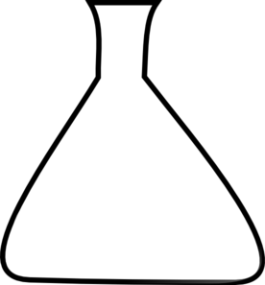
45. The right way is to put the KOH_{(S)} in the beaker, then FILL IT UP to the exact mark of 3.20 Liters. Now the solute is part of the total volume, and your are good.
3.20 Liter mark
2. Fill with water, UP TO the measured mark
← FIRST
215 grams of KOH_{(S)} first

Slide 92
46. How would you mix up 2.65 liters of 2.50 M KNO_{3(AQ)} from scratch?

Slide 93
46. How would you mix up 2.65 liters of 2.50 M KNO_{3(AQ)} from scratch? Scratch uses the M formula
M =
# moles KNO₃ Liters of solution

Slide 94
46. How would you mix up 2.65 liters of 2.50 M KNO_{3(AQ)} from scratch? Scratch uses the M formula
M =
# moles KNO₃ Liters of solution
2.50M = 1
# moles KNO₃ 2.65 Liters

Slide 95
46. How would you mix up 2.65 liters of 2.50 M KNO_{3(AQ)} from scratch? Scratch uses the M formula
M =
# moles KNO₃ Liters of solution
2.50M = 1
# moles KNO₃ 2.65 Liters
moles KNO₃ = 6.63 moles KNO₃ needed.

Slide 96
46. How would you mix up 2.65 liters of 2.50 M KNO_{3(AQ)} from scratch? Scratch uses the M formula
M =
# moles KNO₃ Liters of solution
2.50M = 1
# moles KNO₃ 2.65 Liters
moles KNO₃ = 6.63 moles KNO₃ needed.
6.63 moles KNO₃ 1
101 grams KNO₃ 1 mole KNO₃
X
= 670. grams KNO₃

Slide 97
46. How would you mix up 2.65 liters of 2.50 M KNO_{3(AQ)} from scratch? Scratch uses the M formula
6.63 moles KNO₃ 1
101 grams KNO₃ 1 mole KNO₃
X
= 670. grams KNO₃
First…
670. grams of KNO_{3(S)} into the beaker,
Then, fill with the water, UP TO THE 2.65 LITER MARK.
2.65 Liters exactly
2
670. grams of KNO_{3(S)} first

Slide 98
Using a 2.50M KNO_{3(AQ)} how would you make 1.64 Liters of 1.15 M KNO_{3(AQ)} ?
To do this kind of a problem we’ll need a new formula, that’s not on our reference tables.
Let’s add it to the reference tables and come back to this question in a few minutes.

Slide 99
Take out your reference table, back page, and add this dilution formula to the concentration box, with red notes.
Concentration
For mixing solutions from scratch, or measuring solution concentration.
For mixing up a new solution from a stock solution you have on-hand
M₁V₁ = M₂V₂
Molarity =
Moles of solute Liters of solution

Slide 100
This requires the dilution formula + what do all those letters & numbers mean.
47. The DILUTION FORMULA is: M₁V₁ = M₂V₂
The symbols mean:
M₁ is Molarity of the original stock solution
V₁ is Volume of the original stock solution (unknown)
M₂ is Molarity of the new solution you want to make
V₂ is Volume of new solution that you want to make

Slide 101
48. Using a 2.50M KNO_{3(AQ)} how would you make 1.64 Liters of 1.15 M KNO_{3(AQ)} ? Write: M₁V₁ = M₂V₂

Slide 102
48. Using a 2.50M KNO_{3(AQ)} how would you make 1.64 Liters of 1.15 M KNO_{3(AQ)} ? Write: M₁V₁ = M₂V₂
M₁V₁ = M₂V₂
(2.50 M)(V₁) = (1.15 M)(1.64 L)

Slide 103
48. Using a 2.50M KNO_{3(AQ)} how would you make 1.64 Liters of 1.15 M KNO_{3(AQ)} ? Write: M₁V₁ = M₂V₂
M₁V₁ = M₂V₂
(2.50 M)(V₁) = (1.15 M)(1.64 L)
(1.15 M)(1.64 L) 2.50 M
V₁ =

Slide 104
48. Using a 2.50M KNO_{3(AQ)} how would you make 1.64 Liters of 1.15 M KNO_{3(AQ)} ? Write: M₁V₁ = M₂V₂
M₁V₁ = M₂V₂
(2.50 M)(V₁) = (1.15 M)(1.64 L)
(1.15 M)(1.64 L) 2.50 M
V₁ =
V₁ =0.754 Liters of stock

Slide 105
You need 0.754 L (754 mL) of stock, but that’s NOT how to make this solution.
FIRST: put in the 754 mL stock
SECOND: fill up with pure water to the 1.64 L mark (1640 mL) because that is the TOTAL VOLUME of solution you want.
Your solution is part stock, and part water. This is important: we don’t really have flasks that have a 1.64 Liter “mark”. Volumetric flasks come with 50 mL, 100 mL, 250 mL, 500 mL, 1000 mL and 2000 mL marks only. 1640 mL is a math problem, a real chemist would have to make 2000 mL of this solution and use what he wanted.

Slide 106
49. How do you prepare a 135 mL NaCl_{(AQ)} solution of 1.00 molarity from a stock solution of 5.50 M?
M₁V₁ = M₂V₂

Slide 107
49. How do you prepare a 135 mL NaCl_{(AQ)} solution of 1.00 molarity from a stock solution of 5.50 M?
M₁V₁ = M₂V₂
(5.50 M)(X mL) = (1.00 M)(135 mL)
x mL =

Slide 108
49. How do you prepare a 135 mL NaCl_{(AQ)} solution of 1.00 molarity from a stock solution of 5.50 M?
M₁V₁ = M₂V₂
(5.50 M)(X mL) = (1.00 M)(135 mL)
x mL =
(1.00 M)(135 mL) 5.50 M

Slide 109
49. How do you prepare a 135 mL NaCl_{(AQ)} solution of 1.00 molarity from a stock solution of 5.50 M?
M₁V₁ = M₂V₂
(5.50 M)(X mL) = (1.00 M)(135 mL)
x mL =
x mL = 24.5 mL stock (is that it?)
(1.00 M)(135 mL) 5.50 M

Slide 110
50. Short answer: NO. Let’s think.
We want a 135 mL solution, this math tells us HOW MUCH STOCK solution to start with. So…
2. Fill up to exactly 135 mL with water.
water
Stock solution
1. Put your 24.5 mL STOCK SOLUTION into a new beaker.
In “real life” there are not 135 mL beakers that you can measure this exactly with. You have to use a legit volumetric flask and make a “normal” volume of a solution.

Slide 111
51. Hydrochloric acid solution comes to the school very concentrated – at 12.0 M! Using this stock solution, exactly what should your teacher do to make up 2.00 L of 2.25 M HCl solution? start with a formula

Slide 112
51. Hydrochloric acid solution comes to the school very concentrated – at 12.0 M! Using this stock solution, exactly what should your teacher do to make up 2.00 L of 2.25 M HCl solution? start with a formula
M₁V₁ = M₂V₂
(12.0 M)(x L) = (2.25 M)(2.00 L)
x L =
(2.25 M)(2.00 L) 12.0 M

Slide 113
51. Hydrochloric acid solution comes to the school very concentrated – at 12.0 M! Using this stock solution, exactly what should your teacher do to make up 2.00 L of 2.25 M HCl solution? start with a formula
M₁V₁ = M₂V₂
(12.0 M)(x L) = (2.25 M)(2.00 L)
x L =
(2.25 M)(2.00 L) 12.0 M
X = 0.375 L = 375 mL

Slide 114
To mix this solution up, you would first pour 0.375 Liters of the stock HCl_{(AQ)} (375 mL), into a big beaker, then you’d pour in enough water to dilute it to 2.00 liters (up to the 2000 mL mark).
375 mL stock + enough water = 2000 mL new solution

Slide 115
Solutions Class #4
Objective: Another way to measure low concentrations of very weak solutions called PARTS PER MILLION, and the colligative properties of water

Slide 116
No Writing, think about this, you put 1502 grams NaCl into a swimming pool of 312,000 liters of water. What is the molarity of this solution? (the answer is stupidly small to make a point)
1502 g NaCl 1
X
1 mole NaCl 58 g NaCl
= 25.9 moles salt

Slide 117
No Writing, think about this, you put 1502 grams NaCl into a swimming pool of 312,000 liters of water. What is the molarity of this solution? (the answer is stupidly small to make a point)
1502 g NaCl 1
X
1 mole NaCl 58 g NaCl
= 25.9 moles salt
25.9 moles 312,000 Liters

Slide 118
No Writing, think about this, you put 1502 grams NaCl into a swimming pool of 312,000 liters of water. What is the molarity of this solution? (the answer is stupidly small to make a point)
1502 g NaCl 1
X
1 mole NaCl 58 g NaCl
= 25.9 moles salt
25.9 moles 312,000 Liters
M = 0.0000830 Molar NaCl_{(AQ)}
830 ten millionths Molar!! Sort of a stupid number.
It’s true, but the number is way too small to “make any sense” to us.

Slide 119
We need a different way to measure strength of really weak solutions, called PPM
52. PPM stands for: PARTS PER MILLION
The formula is on the back of your reference table, look for it now, copy it into your notes here
53 ……… PPM = X 1,000,000
grams of solute grams of solution

Slide 120
54. You put 1502 grams NaCl into a swimming pool of 312,000 liters of water. What is the molarity of this solution? What’s the concentration of this in PPM? use the formula

Slide 121
54. You put 1502 grams NaCl into a swimming pool of 312,000 liters of water. What is the molarity of this solution? What’s the concentration of this in PPM? use the formula
grams solute grams solution
PPM = x 1,000,000 =
NOTE:
1 liter = 1000 mL
1 mL = 1 gram
1000 mL = 1000 grams

Slide 122
54. You put 1502 grams NaCl into a swimming pool of 312,000 liters of water. What is the molarity of this solution? What’s the concentration of this in PPM? use the formula
grams solute grams solution
PPM = x 1,000,000 =
1502 g NaCl 312,000,000 g solution
PPM = x 1,000,000 =

Slide 123
54. You put 1502 grams NaCl into a swimming pool of 312,000 liters of water. What is the molarity of this solution? What’s the concentration of this in PPM? use the formula
grams solute grams solution
PPM = x 1,000,000 =
1502 g NaCl 312,000,000 g solution
PPM = x 1,000,000 =
PPM = 4.81 parts per million NaCl in solution (3 SF)

Slide 124
55. Sometimes low concentration environmental poisons are measured this way.
MOLARITY AND PPM are mathematically interchangeable, just try to use “normal” numbers.

Slide 125
56. There are 3 properties of called the colligative properties.
57. They are the properties that are affected by dissolving solutes into the solvent. All solutions will have colligative properties, but we will ONLY discuss water in our class
58. The 3 colligative properties of water are:

Slide 126
58. The 3 colligative properties of water are:
BOILING POINT
FREEZING POINT
VAPOR PRESSURE

Slide 127
59. The reason for these properties are HYDROGEN BONDING Remember, if it’s a property of water, there’s only one reason!

Slide 128
60. For water to boil, energy must break the _______ bonds.
61. If solute like NaCl ions are dissolved into water, the hydrogen bonds still need to break, but now, the water must also overcome the polar attractions to the ___ too.
62. Water has a BP of ____. Salty water will have a ______ BP.

Slide 129
60. For water to boil, energy must break the hydrogen bonds.
61. If solute like NaCl ions are dissolved into water, the hydrogen bonds still need to break, but now, the water must also overcome the polar attractions to the ions too.
62. Water has a BP of 373 K. Salty water will have a HIGHER BP.

Slide 130
63. For water to freeze, the molecules must make those neat little 6-molecule rings to solidify. The molecules are hydrogen bonded to each other.
When solute is dissolved into the water, these particles literally get in the way of the hydrogen bonding. Water can’t freeze at a normal 273 K, it has to be colder in order for the ions to be pushed aside as ice forms. The more solute (polar molecules like sugar, or ions) the colder the water has to be in order to freeze.
Na⁺¹

Slide 131
Vapor pressure is a hard vocabulary word. Learn it now (finally).
65. Draw this diagram and labels…
66. Vapor pressure is the extra pressure caused by the evaporation of a liquid in a closed system (like a bell jar).
67. Water has a very low vapor pressure.
68. What is the vapor pressure of water at 25 centigrade?
Why does water have LOW VAPOR PRESSURE?
What impact would polar molecules, or ions, (solute) have on vapor pressure?
Air Pressure
101.3 kPa
Air Pressure
101.3 kPa
Extra pressure
water

Slide 132
Vapor pressure is a hard vocabulary word. Learn it now (finally).
65. Draw this diagram and labels…
66. Vapor pressure is the extra pressure caused by the evaporation of a liquid in a closed system (like a bell jar).
67. Water has a very low vapor pressure.
68. What is the vapor pressure of water at 25 centigrade?
Why does water have LOW VAPOR PRESSURE? Hydrogen bonding (duh!)
What impact would polar molecules, or ions, (solute) have on vapor pressure?
The more polar molecules, or ions, the worse evaporation would be, so the lower the vapor pressure would be.
Air Pressure
101.3 kPa
Air Pressure
101.3 kPa
Extra pressure
water

Slide 133
Vapor pressure is odd. The more concentrated a solution is, the the lower the evaporation rate.
The higher vapor pressure means that the molecules evaporate faster or easier because there are less hydrogen bonds in the solution.

Slide 134
73 The boiling point ELEVATION for water is | 0.50 K/mole particles per liter
74 The freezing point DEPRESSION for water is | 1.86 K/mole particles per liter
Put these constants on the back page of your reference tables above and below the word “Concentration”. These constants must be provided, they are not on the reference tables, but it’s nice to have them handy.

Slide 135
The hardest thing for students to grasp is how many particles end up in solution based upon some important info like 2.0 M CaCl_{2(AQ)}
We will practice a lot. If you miss this part, the rest will always be wrong. Practice this table over and over until you “get it”. Particles can be moles of ions, or moles of molecules (if the compound is NOT ionic)
 | Formula | Numbers of moles of particles*
ex | 1.0 M NaCl_{(AQ)} | 1 mole Na⁺¹ and 1 mole Cl⁻¹ = 2 moles ions
75 | 2.0 M NaCl_{(AQ)} | __ moles Na⁺¹ and __ moles Cl⁻¹ = __ moles ions
76 | 3.0 M NaCl_{(AQ)} | __ moles Na⁺¹ and __ moles Cl⁻¹ = __ moles ions
77 | 2.0 M CaCl_{2(AQ)} | __ moles Ca⁺² and __ moles Cl⁻¹ = __ moles ions
78 | 3.0 M CaCl_{2(AQ)} | __ moles Ca⁺² and __ moles Cl⁻¹ = __ moles ions

Slide 136
The hardest thing for students to grasp is how many particles end up in solution based upon some important info like 2.0 M CaCl_{2(AQ)}
We will practice a lot. If you miss this part, the rest will always be wrong. Practice this table over and over until you “get it”. Particles can be moles of ions, or moles of molecules (if the compound is NOT ionic)
 | Formula | Numbers of moles of particles*
ex | 1.0 M NaCl_{(AQ)} | 1 mole Na⁺¹ and 1 mole Cl⁻¹ = 2 moles ions
75 | 2.0 M NaCl_{(AQ)} | 2 moles Na⁺¹ and 2 moles Cl⁻¹ = 4 moles ions
76 | 3.0 M NaCl_{(AQ)} | 3 moles Na⁺¹ and 3 moles Cl⁻¹ = 6 moles ions
77 | 2.0 M CaCl_{2(AQ)} | 2 moles Ca⁺² and 4 moles Cl⁻¹ = 6 moles ions
78 | 3.0 M CaCl_{2(AQ)} | 3 moles Ca⁺² and 6 moles Cl⁻¹ = 2 moles ions

Slide 137
 | Formula | Numbers of moles of particles*
79 | 2.50 M NaCl_{(AQ)} | __ mole Na⁺¹ & __ mole Cl⁻¹ = ___ moles ions
80 | 1.25 M NaCl_{(AQ)} | ___ moles Na⁺¹ & ___ moles Cl⁻¹ = ___ moles ions
81 | 1.75 M NaCl_{(AQ)} | ___ moles Na⁺¹ & ___ moles Cl⁻¹ = ___ moles ions
82 | 2.25 M CaCl_{2(AQ)} | ___ moles Ca⁺² & ___ moles Cl⁻¹ = ___ moles ions
83 | 3.0 M Al(OH)_{3(AQ)} | __ mole Al⁺³ & __ moles OH⁻¹ = ___ moles ions
84 | 1.0 M NH_{3(AQ)} | = ___ mole of MOLEULES
85 | 2.50 M C₁₂H₂₂O_{11(AQ)} | = ___ moles of MOLECULES
86 | 1.0 M AgCl | ***

Slide 138
 | Formula | Numbers of moles of particles*
79 | 2.50 M NaCl_{(AQ)} | 2.5 mole Na⁺¹ & 2.5 mole Cl⁻¹ = 5.00 moles ions
80 | 1.25 M NaCl_{(AQ)} | 1.25 moles Na⁺¹ & 1.25 moles Cl⁻¹ = 2.50 moles ions
81 | 1.75 M NaCl_{(AQ)} | 1.75 moles Na⁺¹ & 1.75 moles Cl⁻¹ = 3.50 moles ions
82 | 2.25 M CaCl_{2(AQ)} | 2.25 moles Ca⁺² & 4.5 moles Cl⁻¹ = 6.75 moles ions
83 | 3.0 M Al(OH)_{3(AQ)} | 3 moles Al⁺³ and 9 moles OH⁻¹ = 12.0 moles ions
84 | 1.0 M NH_{3(AQ)} | 1 mole of MOLEULES (it’s not ionic)
85 | 2.50 M C₁₂H₂₂O_{11(AQ)} | 2.50 moles of MOLECULES (it’s not ionic)
86 | 1.0 M AgCl | ZERO moles of ions – it’s NOT AQUEOUS!

Slide 139
87. Calculate the temperature that a 1.00 liter, 2.00 M NaCl_{(AQ)} solution will boil in Kelvin.
BP Elevation is 0.50 K/mole of particles per liter

Slide 140
87. Calculate the temperature that a 1.00 liter, 2.00 M NaCl_{(AQ)} solution will boil in Kelvin.
BP Elevation is 0.50 K/mole of particles per liter
Start BP + BP Elevation = New BP

Slide 141
87. Calculate the temperature that a 1.00 liter, 2.00 M NaCl_{(AQ)} solution will boil in Kelvin.
BP Elevation is 0.50 K/mole of particles per liter
Start BP + BP Elevation = New BP
373 K + (4 x 0.50 K) = 375 K
A 2.00 molar solution has 2 moles of solute, each NaCl formula unit makes 2 ions, THIS IS 2.00 M X 2 moles per formula unit = 4

Slide 142
88. Calculate the Kelvin BP of a 1.00 Liter, 3.00 M CaCl_{2(AQ)}.

Slide 143
88. Calculate the Kelvin BP of a 1.00 Liter, 3.00 M CaCl_{2(AQ)}. Start BP + BP Elevation = New BP

Slide 144
88. Calculate the Kelvin BP of a 1.00 Liter, 3.00 M CaCl_{2(AQ)}. Start BP + BP Elevation = New BP 373 K + (9 x 0.50 K) = 377.5 K Each mole of calcium chloride yields 3 moles of ions,
3 moles of calcium chloride yields 9 moles of ions.
Each mole of ions elevates the BP by 0.50 K
The New BP will be equal to the original BP for water + the BP elevation 373 K + (9 x 0.50 K) = 373 K + 4.5 K = 377.5 K (the heck with SF)

Slide 145
89. Calculate the temperature that a 1.00 liter, 2.00 M NaCl_{(AQ)} solution will freeze in Kelvin. FP Depression = 1.86 K/ mole of particles per liter

Slide 146
89. Calculate the temperature that a 1.00 liter, 2.00 M NaCl_{(AQ)} solution will freeze in Kelvin. FP Depresssion = 1.86 K/ mole of particles per liter Start FP - FP Depression = New FP

Slide 147
89. Calculate the temperature that a 1.00 liter, 2.00 M NaCl_{(AQ)} solution will freeze in Kelvin. FP Depresssion = 1.86 K/ mole of particles per liter Start FP - FP Depression = New FP 273 K - (4 x 1.86 K) = 266 K Each mole of particles will depress the freezing point by 1.86 K, so
the FP changes to: 273 – (4 x 1.86 K) = 273 k – 7.44 K = 266 K (with 3 SF)

Slide 148
90. Calculate the FP in Kelvin of a 1.00 Liter, 3.00 M CaCl_{2(AQ)}.

Slide 149
90. Calculate the FP in Kelvin of a 1.00 Liter, 3.00 M CaCl_{2(AQ)}. Start FP - FP Depression = New FP

Slide 150
90. Calculate the FP in Kelvin of a 1.00 Liter, 3.00 M CaCl_{2(AQ)}. Start FP - FP Depression = New FP 273 K - (9 x 1.86 K) = 256 K

Slide 151
90. Calculate the FP in Kelvin of a 1.00 Liter, 3.00 M CaCl_{2(AQ)}. Start FP - FP Depression = New FP 273 K - (9 x 1.86 K) = 256 K Each mole of sodium sulfide yields 3 moles of ions,
3 moles of sodium sulfide yields 9 moles of ions.
Each mole of ions depresses the FP by 1.86 K
The New BP will be equal to the original FP for water - the FP depression 273 K + (9 x 1.86 K) = 273 K – 16.7 K = 256 K (3 SF)

Slide 152
91. Express the concentration of this solution in parts per million: 98.0 g of lithium chromate (Li₂CrO₄) is dissolved into an aqueous solution with total volume of 57,800 liters.
PPM =

Slide 153
91. Express the concentration of this solution in parts per million: 98.0 g of lithium chromate (Li₂CrO₄) is dissolved into an aqueous solution with total volume of 57,800 liters.
PPM =
grams solute grams solution
X 1,000,000 =

Slide 154
91. Express the concentration of this solution in parts per million: 98.0 g of lithium chromate (Li₂CrO₄) is dissolved into an aqueous solution with total volume of 57,800 liters.
PPM =
98.0 g 57,800,000 g
X 1,000,000 =

Slide 155
91. Express the concentration of this solution in parts per million: 98.0 g of lithium chromate (Li₂CrO₄) is dissolved into an aqueous solution with total volume of 57,800 liters.
PPM =
98.0 g 57,800,000 g
X 1,000,000 = 1.70 PPM

Slide 156
We can rank the vapor pressure of these solutions from lowest to highest by comparing the number of moles of particles per liter in each. Rank these 1.0 liter aqueous solutions by vapor pressure.
 | Aqueous solution2 | Number of moles of particles per liter | VP Rank
92 | 1.00 M NaCl
93 | 1.00 M CaCl₂
94 | 1.00 M NBr₃
95 | 1.00 M Al(NO₃)₃

Slide 157
We can rank the vapor pressure of these solutions from lowest to highest by comparing the number of moles of particles per liter in each. Rank these 1.0 liter aqueous solutions by vapor pressure.
 | Aqueous solution2 | Number of moles of particles per liter | VP Rank
92 | 1.00 M NaCl | 2
93 | 1.00 M CaCl₂ | 3
94 | 1.00 M NBr₃ | 1 (molecular!)
95 | 1.00 M Al(NO₃)₃ | 4

Slide 158
We can rank the vapor pressure of these solutions from lowest to highest by comparing the number of moles of particles per liter in each. Rank these 1.0 liter aqueous solutions by vapor pressure.
 | Aqueous solution2 | Number of moles of particles per liter | VP Rank
92 | 1.00 M NaCl | 2 | 2nd highest
93 | 1.00 M CaCl₂ | 3 | 3rd highest
94 | 1.00 M NBr₃ | 1 (molecular!) | Highest VP evaporates best or easiest
95 | 1.00 M Al(NO₃)₃ | 4 | Lowest VP evaporates worst

Slide 159
Let us examine the dissociation of ionic compounds into water. Count ions!
 | Compound | Write the Formula | What ions are formed when this is put into water
96 | Sodium carbonate
97 | Ammonium sulfide
98 | Aluminum nitrate
99 | Lead (IV) acetate
100 | Silver chloride

Slide 160
Let us examine the dissociation of ionic compounds into water. Count ions!
 | Compound | Write the Formula | What ions are formed when this is put into water
96 | Sodium carbonate | Na₂CO₃
97 | Ammonium sulfide | (NH₄)₂S
98 | Aluminum nitrate | Al(NO₃) ₃
99 | Lead (IV) acetate | Pb(C₂H₃O₂)₄
100 | Silver chloride | AgCl

Slide 161
Let us examine the dissociation of ionic compounds into water. Count ions!
 | Compound | Write the Formula | What ions are formed when this is put into water
96 | Sodium carbonate | Na₂CO₃ | TWO Na⁺¹ + CO₃⁻²
97 | Ammonium sulfide | (NH₄)₂S | TWO NH₄⁺¹ + S⁻²
98 | Aluminum nitrate | Al(NO₃) ₃ | Al⁺³ + THREE NO₃⁻¹
99 | Lead (IV) acetate | Pb(C₂H₃O₂)₄ | Pb⁺⁴ + FOUR C₂H₃O₂NO₃⁻¹
100 | Silver chloride | AgCl | none ! It’s not AQ!

Slide 162
101. What is the freezing point of a 1.00 liter solution of 1.00 M Tin (IV) nitrate? Round to nearest WHOLE KELVIN Temp

Slide 163
101. What is the freezing point of a 1.00 liter solution of 1.00 M Tin (IV) nitrate? Round to nearest WHOLE KELVIN Temp
1 mole of Sn(NO₃)_{4(AQ)} → 5 moles of ions in solution

Slide 164
101. What is the freezing point of a 1.00 liter solution of 1.00 M Tin (IV) nitrate? Round to nearest WHOLE KELVIN Temp
1 mole of Sn(NO₃)_{4(AQ)} → 5 moles of ions in solution
273 Kelvin – (5 x 1.86 K) = new FP
273 K – (9.3 K) = 263.7 Kelvin = 264 K

Slide 165
102. In a solution labeled 2.46 M KCl_{(AQ)} that is exactly 2.00 Liters in volume, how many grams of KCl are in this solution?

Slide 166
102. In a solution labeled 2.46 M KCl_{(AQ)} that is exactly 2.00 Liters in volume, how many grams of KCl are in this solution? This label “means” 2.46 moles of KCl per liter. You have 2 liters, so this means 2 x 2.46 moles = 4.92 moles of KCl the molar mass of KCl is (39 + 35 = ) 74 g/mole so,

Slide 167
102. In a solution labeled 2.46 M KCl_{(AQ)} that is exactly 2.00 Liters in volume, how many grams of KCl are in this solution? This label “means” 2.46 moles of KCl per liter. You have 2 liters, so this means 2 x 2.46 moles = 4.92 moles of KCl the molar mass of KCl is (39 + 35 = ) 74 g/mole so,
4.92 moles KCl 1
X
74 g KCl 1 mole KCl
= 364 g KCl (3 SF)

Slide 168
According to an article in the New England Journal of Medicine, mercury toxicity begins at 0.100 PPM.
103. If someone dropped 125 grams of Hg_{(L)} into the school pool, that is 102,900 liters, would the mercury level be safe or over the limit of safety?

Slide 169
103. If someone dropped 125 grams of Hg_{(L)} into the school pool, that is 102,900 liters, would the mercury level be safe or over the limit of safety?
Short answer: NO.
PPM = x 1,000,000
PPM = x 1,000,000
PPM = 1.21 PPM this is UNSAFE!
grams Hg grams solution
125 g Hg 102,900,000 g

Slide 170
104. What is the molarity of a solution when 278 g KCl is dissolved into a solution of 5000. mL total volume? (start with a formula if you know what’s good for you!)

Slide 171
104. What is the molarity of a solution where 278 g KCl is dissolved into a solution of 5000. mL total volume? (start with a formula if you know what’s good for you!)
moles of solute liters of solution
M =
M = = 0.752 molar (3sf)
3.76 moles KCl 5.000 liters

Slide 172
105. How do you prepare a 25.5 mL 0.850 Molar NaOH_{(AQ)}, if you start with a stock solution of 6.40 M?
Do math, then draw a diagram to show how to “make” this.

Slide 173
105. How do you prepare a 25.5 mL 0.850 Molar NaOH_{(AQ)}, if you start with a stock solution of 6.40 M?
Do math, then draw a diagram to show how to “make” this.
M₁V₁ = M₂V₂
(6.40 M)(V₁) = (O.850 M)(25.5 mL)
V₁ = 3.39 mL stock (3 sf)
Next slide please… this is NOT it.

Slide 174
3.39 mL stock + sufficient water to fill to 25.5 mL
That’s the 25.5 mL fill up to here line
SECOND: fill to 25.5 mL total volume (with water)
FIRST: put 3.39 mL stock solution into beaker.

Slide 175
106. You dissolve 2.25 moles of KBr into water forming a 1.00 liter solution. What is this solution’s BP and FP? (Round to nearest WHOLE Kelvin temperature)
BP
FP

Slide 176
106. You dissolve 2.25 moles of KBr into water forming a 1.00 liter solution. What is this solution’s BP and FP? KBr ionizes into 2 moles per mole of KBr ( K⁺¹ and Br⁻¹) 2.25 moles KBr forms 2.25 x 2 = 4.50 moles of ions
BP
FP

Slide 177
106. You dissolve 2.25 moles of KBr into water forming a 1.00 liter solution. What is this solution’s BP and FP? KBr ionizes into 2 moles per mole of KBr ( K⁺¹ and Br⁻¹) 2.25 moles KBr forms 2.25 x 2 = 4.50 moles of ions
BP The original BP was 373 Kelvin, so the NEW BP is… 373 + (4.5 x 0.50K) = 373 + 2.25 = 375.25 K = 375 K
FP

Slide 178
106. You dissolve 2.25 moles of KBr into water forming a 1.00 liter solution. What is this solution’s BP and FP? KBr ionizes into 2 moles per mole of KBr ( K⁺¹ and Br⁻¹) 2.25 moles KBr forms 2.25 x 2 = 4.50 moles of ions
BP The original BP was 373 Kelvin, so the NEW BP is… 373 + (4.5 x 0.50K) = 373 + 2.25 = 375.25 K = 375 K
FP The original FP was 273 Kelvin, so the NEW FP is… 273 – (4.5 x 1.86K) = 273 – 8.37 = 264.63 K = 265 K

Slide 179
107. If you have a 2.40 M HCl stock solution, how do you make a 50.0 mL of 3.00 M HCl solution from it? A diagram might help you think through this math.

Slide 180
107. If you have a 2.40 M HCl stock solution, how do you make a 50.0 mL of 3.00 M HCl solution from it? A diagram might help you think through this math.
M₁V₁ = M₂V₂
(2.40 M)(V₁) = (3.00 M)(50.0 mL)
V₁ = 62.5 mL stock ???? What???
Next slide please…

Slide 181
107. V₁ = 62.5 mL stock (3 SF)
WAIT: If you put 62.5 mL of stock in how can the total solution be just 50.0 mL???
You can’t: you can’t make this happen, YOU CAN ONLY MAKE MORE DILUTE SOLUTIONS!
X
FIRST: put 62.5 mL stock HCl.

Slide 182
108. Three ions are shown below. Draw in 3 water molecules properly oriented to each of these three ions.
Ca⁺²
Cl⁻¹
Cl⁻¹

Slide 183
108. Three ions are shown below. Draw in 3 water molecules properly oriented to each of these three ions.
H H
O
O
O
H H
Ca⁺²
H H
Cl⁻¹
O
H H
H H
H H
O
O
O
H H
Cl⁻¹
H H
H H
O
O

Slide 184
109. You prepare a 235 mL saturated solution of ammonium chloride at 20.°C. You go to lunch and come back in an hour. The room temperature has warmed up this solution by 5.0°C . How would you best describe this solution at 25. °C ?
A. Saturated at 25.°C B. Supersaturated at 25.°C C. Unsaturated at 25.°C D. Still saturated at 20.°C

Slide 185
109. You prepare a 235 mL saturated solution of ammonium chloride at 20.°C. You go to lunch and come back in an hour. The room temperature has warmed up this solution by 5.0°C . How would you best describe this solution at 25. °C ?
A. Saturated at 25.°C B. Supersaturated at 25.°C C. Unsaturated at 25.°C D. Still saturated at 20.°C The solution becomes unsaturated because at 25.0°C this amount of water can hold more NH₄Cl than when it was at a cooler temp. The Molarity is constant.

Slide 186
110. If you have lots of sulfur solid floating on your pond (or lots of water strider bugs), and you wanted to clear the surface, you could add some soap. Explain in a decent English sentence how this works.

Slide 187
110. If you have lots of sulfur solid floating on your pond (or lots of water strider bugs), and you wanted to clear the surface, you could add some soap. Explain in a decent English sentence how this works.
Surfactants are weird molecules that disrupt the hydrogen bonding. One part is ionic (and very polar). That side dissolves into water, but they are NONPOLAR on the other.
They dissolve into water on one side, and the other side just gets “in the way of hydrogen bonding” on the other side.
They create “holes” in the surface.

Slide 188
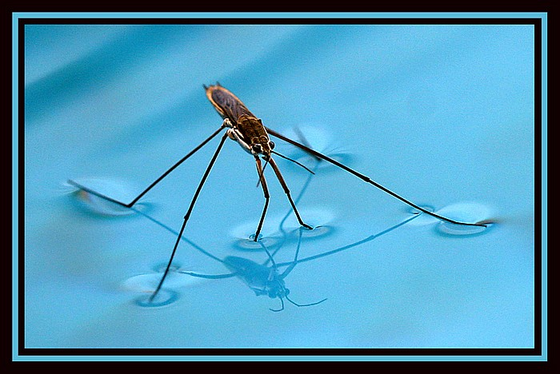
Once the bugs/sulfur gets through the surface, down to the bottom that will sink. There is NO SURFACE on the inside of the water, only at the top.

Slide 189
111. Oil floats on water. Explain why it floats, why it does not sink, and more importantly, and why it does not mix.

Slide 190
111. Oil floats on water. Explain why it floats, why it does not sink, and more importantly, and why it does not mix. Oil is less dense than water, so it would float, not sink.
Oil is a nonpolar molecule, and since like dissolves like (water is polar) oil and water will not mix together, they are immiscible.

Slide 191
112. Using a 1.00 M stock of sugar water, tell how to make up a 26.0 mL solution of 0.350 M.

Slide 192
112. Using a 1.00 M stock of sugar water, tell how to make up a 26.0 mL solution of 0.350 M. M₁V₁ = M₂V₂

Slide 193
112. Using a 1.00 M stock of sugar water, tell how to make up a 26.0 mL solution of 0.350 M. M₁V₁ = M₂V₂
(1.00 M)(V₁) = (0.350 M)(26.0 mL)
V₁ = 9.10 mL stock solution
plus…
Enough water to fill it all the way to 26.0 mL

