Slide 1
You need a calculator now.
1st class, start Thermochem 1-31 in notes

Slide 2
Thermochemistry
Thermochemistry concerns itself with how energy is __________ or __________ in chemical reactions, or in a _______________.
Since we just learned about phases, we’ll start with them first, then move to chemical reactions.
Physical changes, or Phase changes can be either exothermic or endothermic, depending if they either release or emit heat energy, or if they absorb heat.

Slide 3
Thermochemistry
Thermochemistry concerns itself with how energy is RELEASED or ABSORBED in chemical reactions, or in A PHYSICAL CHANGE.
Since we just learned about phases, we’ll start with them first, then move to chemical reactions.
Physical changes, or Phase changes, are either exo- or endo-thermic. Exothermic changes release or emit heat energy. Endothermic changes absorb heat energy.

Slide 4
1. Exothermic means to _____ heat energy.
2. Endothermic means to ________ heat energy.
3. To melt solids into liquids you need to _________ heat energy.
4. To freeze liquids into solids you need to _______________ heat energy.

Slide 5
1. Exothermic means to EMIT heat energy.
2. Endothermic means to ________ heat energy.
3. To melt solids into liquids you need to ________ heat energy.
4. To freeze liquids into solids you need to _______________ heat energy.

Slide 6
1. Exothermic means to EMIT heat energy.
2. Endothermic means to ABSORB heat energy.
3. To melt solids into liquids you need to ________ heat energy.
4. To freeze liquids into solids you need to _______________ heat energy.

Slide 7
1. Exothermic means to EMIT heat energy.
2. Endothermic means to ABSORB heat energy.
3. To melt solids into liquids you need to ABSORB heat energy.
4. To freeze liquids into solids you need to ________ heat energy.

Slide 8
1. Exothermic means to EMIT heat energy.
2. Endothermic means to ABSORB heat energy.
3. To melt solids into liquids you need to ABSORB heat energy.
4. To freeze liquids into solids you need to REMOVE or EMIT heat energy.

Slide 9
5. To vaporize a liquid into a gas you need to ____ heat energy.
6. To condense a gas into a liquid you need to ________ heat energy.
7. For sublimation, when a solid turns directly into a gas you need to ____ heat energy.

Slide 10
5. To vaporize a liquid into a gas you need to ADD heat energy.
6. To condense a gas into a liquid you need to ________ heat energy.
7. For sublimation, when a solid turns directly into a gas you need to ____ heat energy.

Slide 11
5. To vaporize a liquid into a gas you need to ADD heat energy.
6. To condense a gas into a liquid you need to RELEASE heat energy.
7. For sublimation, when a solid turns directly into a gas you need to ____ heat energy.

Slide 12
5. To vaporize a liquid into a gas you need to ADD heat energy.
6. To condense a gas into a liquid you need to RELEASE heat energy.
7. For sublimation, when a solid turns directly into a gas you need to ADD heat energy.

Slide 13
8. For deposition, when a gas turns directly into a solid you need to _________ heat energy.
9. When substances are hotter, their particles are moving FASTER.

Slide 14
8. For deposition, when a gas turns directly into a solid you need to RELEASE heat energy.
9. When substances are hotter, their particles are moving ________.

Slide 15
8. For deposition, when a gas turns directly into a solid you need to RELEASE heat energy.
9. When substances are hotter, their particles are moving FASTER.

Slide 16
10. The hotter particles have _______ Kinetic energy than colder ones.
11. Colder substances have ________ moving particles.
12. Colder substances have _________ Kinetic energy than hotter ones.

Slide 17
10. The hotter particles have HIGHER Kinetic energy than colder ones.
11. Colder substances have ________ moving particles.
12. Colder substances have _________ Kinetic energy than hotter ones.

Slide 18
10. The hotter particles have HIGHER Kinetic energy than colder ones.
11. Colder substances have SLOWER moving particles.
12. Colder substances have _________ Kinetic energy than hotter ones.

Slide 19
10. The hotter particles have HIGHER Kinetic energy than colder ones.
11. Colder substances have SLOWER moving particles.
12. Colder substances have LOWER Kinetic energy than hotter ones.

Slide 20
14. During a phase change the temperature is steady, so what energy changes?

Slide 21
14. During a phase change the temperature is steady, so what energy changes? POTENTIAL ENERGY
15. The POTENTIAL energy INCREASES during melting.
16. The ___________ energy __________ during condensing.

Slide 22
14. During a phase change the temperature is steady, so what energy changes? POTENTIAL ENERGY
15. The POTENTIAL energy INCREASES during melting.
16. The POTENTIAL energy DECREASES during condensing.

Slide 23
The heating curve for water
F
Boiling Point
D
E
Melting Point
B
C
A
Heat is added at a constant rate
 | Segment | Temperature & Kinetic Energy INC or DEC or STEADY? | Phase or Phases Present | Exothermic or Endothermic? | Potential Energy INC or DEC or STEADY?
17 | AB
18 | BC
19 | CD
20 | DE
21 | EF

Slide 24
The heating curve for water
F
Boiling Point
D
E
Melting Point
B
C
A
Heat is added at a constant rate
 | Segment | Temperature & Kinetic Energy INC or DEC or STEADY? | Phase or Phases Present | Exothermic or Endothermic? | Potential Energy INC or DEC or STEADY?
17 | AB | INCREASING | SOLID | ENDO | STEADY
18 | BC
19 | CD
20 | DE
21 | EF

Slide 25
The heating curve for water
F
Boiling Point
D
E
Melting Point
B
C
A
Heat is added at a constant rate
 | Segment | Temperature & Kinetic Energy INC or DEC or STEADY? | Phase or Phases Present | Exothermic or Endothermic? | Potential Energy INC or DEC or STEADY?
17 | AB | INCREASING | SOLID | ENDO | STEADY
18 | BC | STEADY | Solid to Liquid | ENDO | INCREASING
19 | CD
20 | DE
21 | EF

Slide 26
The heating curve for water
F
Boiling Point
D
E
Melting Point
B
C
A
Heat is added at a constant rate
 | Segment | Temperature & Kinetic Energy INC or DEC or STEADY? | Phase or Phases Present | Exothermic or Endothermic? | Potential Energy INC or DEC or STEADY?
17 | AB | INCREASING | SOLID | ENDO | STEADY
18 | BC | STEADY | Solid to Liquid | ENDO | INCREASING
19 | CD | INCREASING | Liquid | ENDO | STEADY
20 | DE
21 | EF

Slide 27
The heating curve for water
F
Boiling Point
D
E
Melting Point
B
C
A
Heat is added at a constant rate
 | Segment | Temperature & Kinetic Energy INC or DEC or STEADY? | Phase or Phases Present | Exothermic or Endothermic? | Potential Energy INC or DEC or STEADY?
17 | AB | INCREASING | SOLID | ENDO | STEADY
18 | BC | STEADY | Solid to Liquid | ENDO | INCREASING
19 | CD | INCREASING | Liquid | ENDO | STEADY
20 | DE | STEADY | Liquid to Gas | ENDO | INCREASING
21 | EF

Slide 28
The heating curve for water
F
Boiling Point
D
E
Melting Point
B
C
A
Heat is added at a constant rate
 | Segment | Temperature & Kinetic Energy INC or DEC or STEADY? | Phase or Phases Present | Exothermic or Endothermic? | Potential Energy INC or DEC or STEADY?
17 | AB | INCREASING | SOLID | ENDO | STEADY
18 | BC | STEADY | Solid to Liquid | ENDO | INCREASING
19 | CD | INCREASING | Liquid | ENDO | STEADY
20 | DE | STEADY | Liquid to Gas | ENDO | INCREASING
21 | EF | INCREASING | GAS | ENDO | STEADY

Slide 29
The heating curve for water
F
Boiling Point
D
E
Melting Point
B
C
A
Heat is added at a constant rate
22. Why is BC shorter than DE? MELTING IS EASIER, LESS ENERGY IS REQUIRED COMPARED TO VAPORIZING (BOILING)
23. To melt ONE GRAM of SOLID ICE into one gram of liquid water requires the HEAT OF FUSION, FOR WATER IT’S ONLY 334 JOULES/GRAM ADDED IN
24. To freeze ONE GRAM of liquid water into SOLID ICE requires the HEAT OF FUSION, FOR WATER IT’S ONLY 334 JOULES/GRAM REMOVED

Slide 30
The heating curve for water
F
Boiling Point
D
E
Melting Point
B
C
A
Heat is added at a constant rate
22. Why is BC shorter than DE? MELTING IS EASIER, LESS ENERGY IS REQUIRED COMPARED TO VAPORIZING (BOILING)
23. To melt ONE GRAM of SOLID ICE into one gram of liquid water requires the HEAT OF FUSION, FOR WATER IT’S ONLY 334 JOULES/GRAM ADDED IN
24. To freeze ONE GRAM of liquid water into SOLID ICE requires the HEAT OF FUSION, FOR WATER IT’S ONLY 334 JOULES/GRAM REMOVED

Slide 31
The heating curve for water
F
Boiling Point
D
E
Melting Point
B
C
A
Heat is added at a constant rate
22. Why is BC shorter than DE? MELTING IS EASIER, LESS ENERGY IS REQUIRED COMPARED TO VAPORIZING (BOILING)
23. To melt ONE GRAM of SOLID ICE into one gram of liquid water requires the HEAT OF FUSION, FOR WATER IT’S ONLY 334 JOULES/GRAM ADDED IN
24. To freeze ONE GRAM of liquid water into SOLID ICE requires the HEAT OF FUSION, FOR WATER IT’S ONLY 334 JOULES/GRAM REMOVED

Slide 32
The heating curve for water
F
Boiling Point
D
E
Melting Point
B
C
A
Heat is added at a constant rate
22. Why is BC shorter than DE? MELTING IS EASIER, LESS ENERGY IS REQUIRED COMPARED TO VAPORIZING (BOILING)
23. To melt ONE GRAM of SOLID ICE into one gram of liquid water requires the HEAT OF FUSION, FOR WATER IT’S ONLY 334 JOULES/GRAM ADDED IN
24. To freeze ONE GRAM of liquid water into SOLID ICE requires the HEAT OF FUSION, FOR WATER IT’S ONLY 334 JOULES/GRAM REMOVED

Slide 33
25. Table B has three important physical constants for water. Fill in this chart now.
Constant | Value with units | Will make one gram of H₂O...
Heat of Fusion
Heat of Vaporization
Specific Heat Capacity

Slide 34
25. Table B has three important physical constants for water. Fill in this chart now.
Constant | Value with units | Will make one gram of H₂O...
Heat of Fusion | 334 J/g | MELT or FREEZE one gram of H₂O, NO TEMP CHANGE
Heat of Vaporization | 2260 J/g | VAPORIZE or CONDENSE one gram of H₂O, NO TEMP CHANGE
Specific Heat Capacity | 4.18 J/g·K | Change temp of one gram of H₂O by 1 Kelvin (or 1°C) hotter or colder

Slide 35
The heating curve for water
F
Boiling Point
D
E
Melting Point
B
C
A
Heat is added at a constant rate
If we consider just ONE GRAM OF WATER… 26. To move from B to C, we would need to ADD ________ of energy.
27. To move from D to E, we would need to ADD ________ of energy.

Slide 36
The heating curve for water
F
Boiling Point
D
E
Melting Point
B
C
A
Heat is added at a constant rate
If we consider just ONE GRAM OF WATER… 26. To move from B to C, we would need to ADD 334 Joules of energy.
27. To move from D to E, we would need to ADD ________ of energy.

Slide 37
The heating curve for water
F
Boiling Point
D
E
Melting Point
B
C
A
Heat is added at a constant rate
If we consider just ONE GRAM OF WATER… 26. To move from B to C, we would need to ADD 334 Joules of energy.
27. To move from D to E, we would need to ADD 2260 Joules of energy.

Slide 38
The heating curve for water
F
Boiling Point
D
E
Melting Point
B
C
A
Heat is added at a constant rate
28. Moving from B to C is __________thermic.
29. Moving from D to E is __________thermic.

Slide 39
The heating curve for water
F
Boiling Point
D
E
Melting Point
B
C
A
Heat is added at a constant rate
28. Moving from B to C is ENDOTHERMIC – ADDING IN HEAT.
29. Moving from D to E is __________thermic.

Slide 40
The heating curve for water
F
Boiling Point
D
E
Melting Point
B
C
A
Heat is added at a constant rate
28. Moving from B to C is ENDOTHERMIC – ADDING IN HEAT.
29. Moving from D to E is ENDOTHERMIC – ADDING IN HEAT.

Slide 41
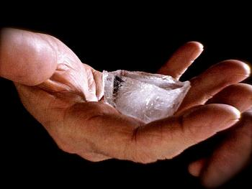
30. It takes 334 Joules to melt one gram of ice, at the melting point. There is no temperature change, this happens at 273 Kelvin or 0°C. How much energy does it take to melt a real sized ice cube of 73.5 grams?

Slide 42
30. It takes 334 Joules to melt one gram of ice, at the melting point. There is no temperature change, this happens at 273 Kelvin or 0°C. How much energy does it take to melt a real sized ice cube of 73.5 grams?
q = mH_{F}

Slide 43
30. It takes 334 Joules to melt one gram of ice, at the melting point. There is no temperature change, this happens at 273 Kelvin or 0°C. How much energy does it take to melt a real sized ice cube of 73.5 grams?
q = mH_{F} q = (73.5g)(334 J/g)

Slide 44
30. It takes 334 Joules to melt one gram of ice, at the melting point. There is no temperature change, this happens at 273 Kelvin or 0°C. How much energy does it take to melt a real sized ice cube of 73.5 grams?
q = mH_{F} q = (73.5g)(334 J/g) q = 24549 J = 24,500 Joules with 3 SF

Slide 45
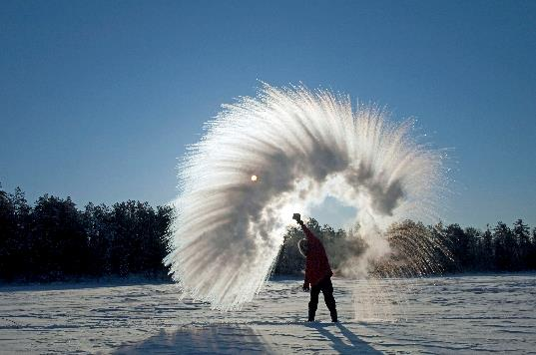
31. How much energy does it take to freeze 125 grams of pure water into ice if the water is at 0°C to start?

Slide 46
31. How much energy does it take to freeze 125 grams of pure water into ice if the water is at 0°C to start?
q = mH_{F}

Slide 47
31. How much energy does it take to freeze 125 grams of pure water into ice if the water is at 0°C to start?
q = mH_{F} q = (125g)(334 J/g)

Slide 48
31. How much energy does it take to freeze 125 grams of pure water into ice if the water is at 0°C to start?
q = mH_{F} q = (125g)(334 J/g) q = 41750 J = 41,800 Joules with 3 SF
Note: this is ENERGY REMOVED from the water.

Slide 49
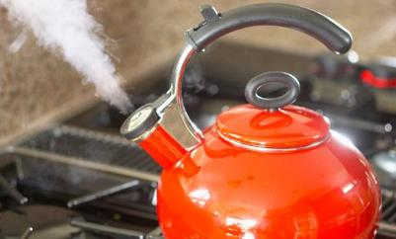
32. It takes 2260 Joules to vaporize one gram of H₂O at the boiling point. There is no temperature change, this happens at 373 Kelvin or 100°C. How much energy does it take to vaporize 73.5 grams of water into steam?
First, take out the BACK PAGE of your reference tables, and let’s insert this RED ink into your table.
All ∆T
Cold: S ↔ L
Hot: L ↔ G

Slide 50
32. It takes 2260 Joules to vaporize one gram of H₂O at the boiling point. There is no temperature change, this happens at 373 Kelvin or 100°C. How much energy does it take to vaporize 73.5 grams of water into steam?

Slide 51
32. It takes 2260 Joules to vaporize one gram of H₂O at the boiling point. There is no temperature change, this happens at 373 Kelvin or 100°C. How much energy does it take to vaporize 73.5 grams of water into steam?
q = mH_{V}

Slide 52
32. It takes 2260 Joules to vaporize one gram of H₂O at the boiling point. There is no temperature change, this happens at 373 Kelvin or 100°C. How much energy does it take to vaporize 73.5 grams of water into steam?
q = mH_{V} q = (73.5g)(2260 J/g)

Slide 53
32. It takes 2260 Joules to vaporize one gram of H₂O at the boiling point. There is no temperature change, this happens at 373 Kelvin or 100°C. How much energy does it take to vaporize 73.5 grams of water into steam?
q = mH_{V} q = (73.5g)(2260 J/g) q = 166,110 J = 166,000 Joules with 3 SF

Slide 54
33. If you are dumb and stick your finger into the steam coming out of a tea kettle, and 2.75 grams of steam condenses into 2.75 grams of water on your hand, how much energy do you absorb?

Slide 55
33. If you are dumb and stick your finger into the steam coming out of a tea kettle, and 2.75 grams of steam condenses into 2.75 grams of water on your hand, how much energy do you absorb?
q = mH_{V}

Slide 56
33. If you are dumb and stick your finger into the steam coming out of a tea kettle, and 2.75 grams of steam condenses into 2.75 grams of water on your hand, how much energy do you absorb?
q = mH_{V} q = (2.75g)(2260 J/g)

Slide 57
33. If you are dumb and stick your finger into the steam coming out of a tea kettle, and 2.75 grams of steam condenses into 2.75 grams of water on your hand, how much energy do you absorb?
q = mH_{V} q = (2.75g)(2260 J/g) q = 6215 J = 6220 Joules with 3 SF

Slide 58
34. Which phase change takes more energy, COLD or HOT? vaporizing
35. If heat is added AT A CONSTANT RATE, why is BC shorter than DE on a heating curve for water? Because it takes LONGER to ADD more energy if it goes in at a CONSTANT RATE. BC needs 334 J/g while DE needs 2260 J/g
The heating curve for water
F
Boiling Point
D
E
Melting Point
B
C
A
Heat is added at a constant rate

Slide 59
34. Which phase change takes more energy? HOT - vaporizing
35. If heat is added AT A CONSTANT RATE, why is BC shorter than DE on a heating curve for water? Because it takes LONGER to ADD more energy if it goes in at a CONSTANT RATE. BC needs 334 J/g while DE needs 2260 J/g
The heating curve for water
F
Boiling Point
D
E
Melting Point
B
C
A
Heat is added at a constant rate

Slide 60
34. Which phase change takes more energy? HOT - vaporizing
35. If heat is added AT A CONSTANT RATE, why is BC shorter than DE on a heating curve for water? Because it takes LONGER to ADD more energy if it goes in at a CONSTANT RATE. BC needs 334 J/g while DE needs 2260 J/g
The heating curve for water
F
Boiling Point
D
E
Melting Point
B
C
A
Heat is added at a constant rate

Slide 61
36. The reverse is always true in thermochem, to melt 1.0 g H₂O means you need to ADD…
37. To freeze 1.0 g H₂O means you need to…
38. It takes 2260 Joules per gram to either…

Slide 62
36. The reverse is always true in thermochem, to melt 1.0 g H₂O means you need to ADD 334 Joules.
37. To freeze 1.0 g H₂O means you need to… REMOVE 334 Joules.
38. It takes 2260 Joules per gram to either… VAPORIZE OR CONDENSE 1.0 GRAMS H₂O (added) (removed)

Slide 63
36. The reverse is always true in thermochem, to melt 1.0 g H₂O means you need to ADD 334 Joules.
37. To freeze 1.0 g H₂O means you need to REMOVE 334 Joules.
38. It takes 2260 Joules per gram to either… VAPORIZE OR CONDENSE 1.0 GRAMS H₂O (added) (removed)

Slide 64
36. The reverse is always true in thermochem, to melt 1.0 g H₂O means you need to ADD 334 Joules.
37. To freeze 1.0 g H₂O means you need to REMOVE 334 Joules.
38. It takes 2260 Joules per gram to either VAPORIZE OR CONDENSE 1.0 GRAM H₂O (heat added) (heat removed)

Slide 65
39. The amount of energy need to change the temperature of one gram of pure water from 275 Kelvin to 276 Kelvin means we must add
275 K 276 K

Slide 66
39. The amount of energy need to change the temperature of one gram of pure water from 275 Kelvin to 276 Kelvin means we must add
4.18 Joules
275 K 276 K

Slide 67
40. To change the temperature of 1.0 gram of H₂O from 365 K to 366 K,
you need to add
365 K 366 K

Slide 68
40. To change the temperature of 1.0 gram of H₂O from 365 K to 366 K,
you need to add
4.18 Joules
365 K 366 K

Slide 69
41. If you let one gram of hot water, at 368 Kelvin, to cool down to 367 Kelvin, how much heat is radiated out of this water?
368 K 367 K

Slide 70
41. If you let one gram of hot water, at 368 Kelvin, to cool down to 367 Kelvin, how much heat is radiated out of this water?
4.18 Joules
368 K 367 K

Slide 71
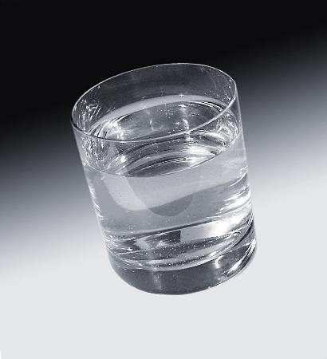
42. If you put 375 grams of tap water at 294 Kelvin into the fridge to cool it all down to 275 Kelvin, how much energy needed to be removed from this water?

Slide 72
42. If you put 375 grams of tap water at 294 K into the fridge to cool it all down to 275 K, how much energy needed to be removed from this water? q = mCΔT

Slide 73
42. If you put 375 grams of tap water at 294 K into the fridge to cool it all down to 275 K, how much energy needed to be removed from this water? q = mCΔT
q = (375 g)(4.18 J/g·K)(19.0 K)

Slide 74
42. If you put 375 grams of tap water at 294.0 K into the fridge to cool it all down to 275.0 K, how much energy needed to be removed from this water? q = mCΔT
q = (375 g)(4.18 J/g·K)(19.0 K) q = 29,782.5 J = 29,800 J (3 SF)

Slide 75
43. Let’s say you have a centigrade thermometer but need to do a temperature change thermochem problem. What do you have to do? Assume the temp change is 24.0°C to 95.0°C. Convert these to Kelvin.
C
K
100 Boiling point 373
44. The ∆T in °C = ___________
45. The ∆T in K = ___________
46. The hot temps have different numbers, and so do the cold temps, but the ∆T is always going to be
95.0°C
K
24.0°C
K
0 Melting point 273

Slide 76
43. Let’s say you have a centigrade thermometer but need to do a temperature change thermochem problem. What do you have to do? Assume the temp change is 24.0°C to 95.0°C. Convert these to Kelvin.
C
K
100 Boiling point 373
44. The ∆T in °C = 71°C
45. The ∆T in K = 71 K
46. The hot temps have different numbers, and so do the cold temps, but the ∆T is always going to be The Same Value, different units.
95.0°C
368 K
24.0°C
297 K
0 Melting point 273
∆T °C = ∆T K

Slide 77
47. There are ________ units of energy between freezing and boiling in Celsius: 48. There are ______ units of energy between freezing and boiling in Kelvin: 49. The _____________ = _____________

Slide 78
47. There are 100 units of energy between freezing and boiling in Celsius: 0°C → 100°C 48. There are 100 units of energy between freezing and boiling in Kelvin: 273 K → 373 K 49. The ∆T °C = ∆T K

Slide 79
47. There are 100 units of energy between freezing and boiling in Celsius: 0°C → 100°C 48. There are 100 units of energy between freezing and boiling in Kelvin: 273 K → 373 K 49. The ∆T °C = ∆T K

Slide 80
47. There are 100 units of energy between freezing and boiling in Celsius: 0°C → 100°C 48. There are 100 units of energy between freezing and boiling in Kelvin: 273 K → 373 K 49. The ∆T°C = ∆T K

Slide 81
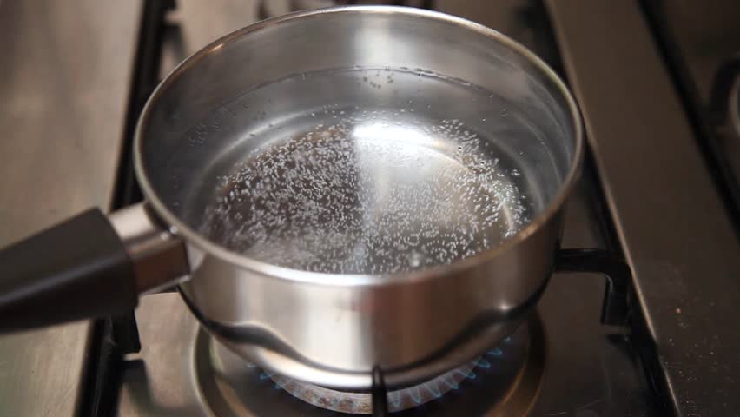
50. A pot has 650. grams of water at room temp, or 24.0°C. You think to make some mac & cheese and turn on the stove to heat the water. Your BFF shows up with pizza so you turn off the stove. The water is at 95.0°C. How much energy would your Dad say you wasted heating up this water for nothing?

Slide 82
50. A pot has 650. grams of water at room temp, or 24.0°C. You think to make some mac & cheese and turn on the stove to heat the water. Your BFF shows up with pizza so you turn off the stove. The water is at 95.0°C. How much energy would your Dad say you wasted heating up this water for nothing? q = mCΔT q = (650. g)(4.18 J/g·K)(71.0 K) q = 192907 J = 193,000 J (3 SF)

Slide 83
50. A pot has 650. grams of water at room temp, or 24.0°C. You think to make some mac & cheese and turn on the stove to heat the water. Your BFF shows up with pizza so you turn off the stove. The water is at 95.0°C. How much energy would your Dad say you wasted heating up this water for nothing? q = mCΔT q = (650. g)(4.18 J/g·K)(71.0 K) q = 192907 J = 193,000 J (3 SF)

Slide 84
50. A pot has 650. grams of water at room temp, or 24.0°C. You think to make some mac & cheese and turn on the stove to heat the water. Your BFF shows up with pizza so you turn off the stove. The water is at 95.0°C. How much energy would your Dad say you wasted heating up this water for nothing? q = mCΔT q = (650. g)(4.18 J/g·K)(71.0 K) q = 192907 J = 193,000 J (3 SF)

Slide 85
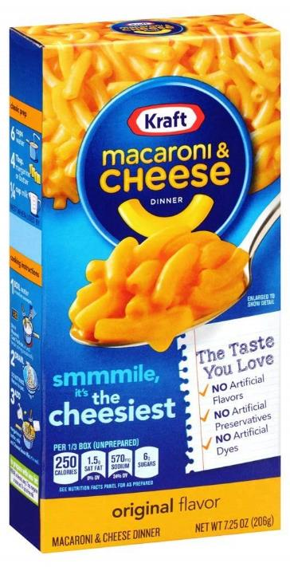
51. You want some mac & cheese so you put 650. grams of water at 24.0°C onto the stove top. You begin to text your BFF and “forget” about eating for a while. Your Mom yells “Who left this pot on the stove?!” You realize that you have vaporized 35.0 grams of your water while distracted. You turn off the stove and decide to eat out instead. How much energy did it take to all of this?

Slide 86
51. You want some mac & cheese so you put 650. grams of water at 24.0°C onto the stove top. You begin to text your BFF and “forget” about eating for a while. Your Mom yells “Who left this pot on the stove?!” You realize that you have vaporized 35.0 grams of your water while distracted. You turn off the stove and decide to eat out instead. How much energy did it take to all of this?
FIRST Use q = mCΔT to WARM UP all of the water

Slide 87
51. You want some mac & cheese so you put 650. grams of water at 24.0°C onto the stove top. You begin to text your BFF and “forget” about eating for a while. Your Mom yells “Who left this pot on the stove?!” You realize that you have vaporized 35.0 grams of your water while distracted. You turn off the stove and decide to eat out instead. How much energy did it take to all of this?
FIRST Use q = mCΔT to WARM UP all of the water q = (650. g)(4.18 J/g·K)(76.0 K) q = 206,492 J = 206,000 J (3 SF) THEN Use q = mH_{V} to VAPORIZE some of the water

Slide 88
51. You want some mac & cheese so you put 650. grams of water at 24.0°C onto the stove top. You begin to text your BFF and “forget” about eating for a while. Your Mom yells “Who left this pot on the stove?!” You realize that you have vaporized 35.0 grams of your water while distracted. You turn off the stove and decide to eat out instead. How much energy did it take to all of this?
FIRST Use q = mCΔT to WARM UP all of the water q = (650. g)(4.18 J/g·K)(76.0 K) q = 206,492 J = 206,000 J (3 SF) THEN Use q = mH_{V} to VAPORIZE some of the water q = (35.0 g)(2260 J/g) q = 79,100 J (3 SF)
Then SUM UP THE TOTAL for one answer….

Slide 89
51. You want some mac & cheese so you put 650. grams of water at 24.0°C onto the stove top. You begin to text your BFF and “forget” about eating for a while. Your Mom yells “Who left this pot on the stove?!” You realize that you have vaporized 35.0 grams of your water while distracted. You turn off the stove and decide to eat out instead. How much energy did it take to all of this?
FIRST Use q = mCΔT to WARM UP all of the water q = (650. g)(4.18 J/g·K)(76.0 K) q = 206,492 J = 206,000 J (3 SF) THEN Use q = mH_{V} to VAPORIZE some of the water q = (35.0 g)(2260 J/g) q = 79,100 J (3 SF)
Then SUM UP THE TOTAL for one answer….
206,000 J + 79,100 J
285,100 J
285,000 J (3SF)

Slide 90
Quick Class today - notes #52 - #60
You must have a calculator. Get it out now.
You must have your reference tables we will write on it now.
Friday: 3-question quiz, T-2 HW due
Miss Grace Nassimbwa

Slide 92
52. Take out table T (on the bottom of the back page of your reference table). Copy this:
Water Constants and Formulas
H_{F} = 334 J/g H_{V} = 2260 J/g q = mH_{F} q = mH_{V} C = 2.10 J/g∙K C = 4.18 J/g∙K C = 1.90 J/g∙K q = mCΔT q = mCΔT q = mCΔT
MP/FP BP/CP 273 K/0⁰C 373 K/100⁰C
Then we should talk about it for one minute, okay?

Slide 93
53. How many joules of energy are required to freeze 355 mL of water at 273K?

Slide 94
53. How many joules of energy are required to freeze 355 mL of water at 273K? FREEZING IS THE COLD PHASE CHANGE one mL of water = one gram of water
Use q = mH_{F}

Slide 95
53. How many joules of energy are required to freeze 355 mL of water at 273K? FREEZING IS THE COLD PHASE CHANGE one mL of water = one gram of water
Use q = mH_{F} q = (355 g)(334 J/g)

Slide 96
53. How many joules of energy are required to freeze 355 mL of water at 273K? FREEZING IS THE COLD PHASE CHANGE one mL of water = one gram of water
Use q = mH_{F} q = (355 g)(334 J/g)

Slide 97
53. How many joules of energy are required to freeze 355 mL of water at 273K? FREEZING IS THE COLD PHASE CHANGE one mL of water = one gram of water
Use q = mH_{F} q = (355 g)(334 J/g)
q = 118570 J = 119,000 Joules with 3 SF

Slide 98
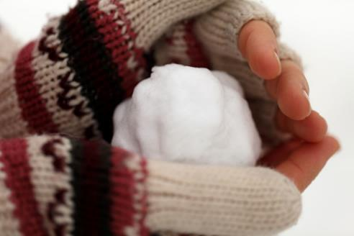
54. How many joules required to melt a snow ball of 415 g?

Slide 99
54. How many joules required to melt a snow ball of 415 g?
Use q = mH_{F}

Slide 100
54. How many joules required to melt a snow ball of 415 g?
Use q = mH_{F}
q = (415 g)(334 J/g)

Slide 101
54. How many joules required to melt a snow ball of 415 g?
Use q = mH_{F}
q = (415 g)(334 J/g)

Slide 102
54. How many joules required to melt a snow ball of 415 g?
Use q = mH_{F}
q = (415 g)(334 J/g)
q = 138610 J = 139,000 Joules with 3 SF

Slide 103
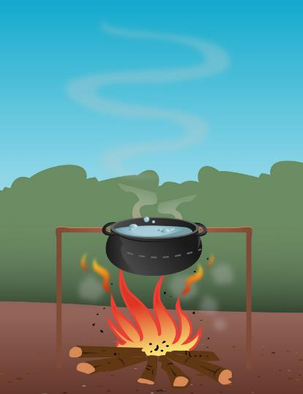
55. How many joules does it take to warm up 375 grams of water by 7.50 Kelvin?

Slide 104
55. How many joules does it take to warm up 375 grams of water by 7.50 Kelvin?
Use q = mCΔT to WARM UP the water

Slide 105
55. How many joules does it take to warm up 375 grams of water by 7.50 Kelvin?
Use q = mCΔT to WARM UP the water q = (375 g)(4.18 J/g·K)(7.50 K)

Slide 106
55. How many joules does it take to warm up 375 grams of water by 7.50 Kelvin?
Use q = mCΔT to WARM UP the water q = (375 g)(4.18 J/g·K)(7.50 K) q = 11,756.25 J = 11,800 Joules (3 SF)

Slide 107
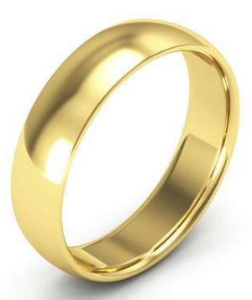
56. What is the specific heat capacity constant for GOLD if it takes 271 joules to warm up a ring with mass of 34.2 g from room temp of 294.0 K to a “too hot to wear” temperature of 355.5 Kelvin?

Slide 108
56. What is the specific heat capacity constant for GOLD if it takes 271 joules to warm up a ring with mass of 34.2 g from room temp of 294.0 K to a “too hot to wear” temperature of 355.5 Kelvin?
Use q = mCΔT

Slide 109
56. What is the specific heat capacity constant for GOLD if it takes 271 joules to warm up a ring with mass of 34.2 g from room temp of 294.0 K to a “too hot to wear” temperature of 355.5 Kelvin?
Use SOLVE FOR q = mCΔT 271 J = (34.2 g)(C)(61.5 K)

Slide 110
56. What is the specific heat capacity constant for GOLD if it takes 271 joules to warm up a ring with mass of 34.2 g from room temp of 294.0 K to a “too hot to wear” temperature of 355.5 Kelvin?
Use SOLVE FOR q = mCΔT 271 J = (34.2 g)(C)(61.5 K) = C → → → = 0.129 J/g·K
271 J (34.2 g)(61.5 K)

Slide 111
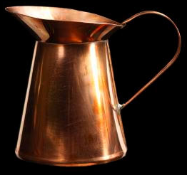
57. What is the specific heat capacity constant of copper, if it takes 951 joules to warm up 41.63 grams of copper from 294.5 K up to 352.9 Kelvin?

Slide 112
57. What is the specific heat capacity constant of copper, if it takes 951 joules to warm up 41.63 grams of copper from 294.5 K up to 352.9 Kelvin?
Use q = mCΔT

Slide 113
57. What is the specific heat capacity constant of copper, if it takes 951 joules to warm up 41.63 grams of copper from 294.5 K up to 352.9 Kelvin?
Use SOLVE FOR q = mCΔT 951 J = (41.63 g)(C)(58.4 K)
ΔT
352.9 K
- 294.5 K
58.40 K

Slide 114
57. What is the specific heat capacity constant of copper, if it takes 951 joules to warm up 41.63 grams of copper from 294.5 K up to 352.9 Kelvin?
Use SOLVE FOR q = mCΔT 951 J = (41.63 g)(C)(58.4 K) = C → → → = 0.391 J/g·K
notice the units!
951 Joules (41.63 g)(58.4 K)

Slide 115
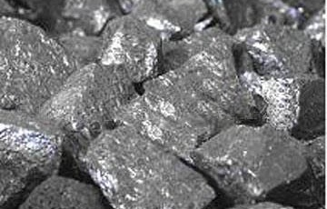
58. What is the heat of fusion constant for an unknown if it takes 6750 Joules to melt 28.0 grams of it?

Slide 116
58. What is the heat of fusion constant for an unknown if it takes 6750 Joules to melt 28.0 grams of it?
Use q = mH_{F}

Slide 117
58. What is the heat of fusion constant for an unknown if it takes 6750 Joules to melt 28.0 grams of it?
Use SOLVE FOR q = mH_{F} 6750 J = (28.0 g)(H_{F})

Slide 118
58. What is the heat of fusion constant for an unknown if it takes 6750 Joules to melt 28.0 grams of it?
Use SOLVE FOR q = mH_{F} 6750 J = (28.0 g)(H_{F}) = H_{F} → → → 241 J/g
6750 J 28.0 g

Slide 119
59. How many grams of water can be frozen when you remove 87,500 joules from it?

Slide 120
59. How many grams of water can be frozen when you remove 87,500 joules from it?
Use SOLVE FOR q = mH_{F}

Slide 121
59. How many grams of water can be frozen when you remove 87,500 joules from it?
Use SOLVE FOR q = mH_{F} 87,500 J = (m)(334 J/g)

Slide 122
59. How many grams of water can be frozen when you remove 87,500 joules from it?
Use SOLVE FOR q = mH_{F} 87,500 J = (m)(334 J/g) = m → → → 261.970 g = 262 g with 3 SF
87,500 J 334 J/g

Slide 123
60. If 92.0 grams of a substance absorbs 27,496 Joules and the temperature increased from 12.3°C to 83.8°C, what is the specific heat capacity constant of this unknown?

Slide 124
60. If 92.0 grams of a substance absorbs 27,496 Joules and the temperature increased from 12.3°C to 83.8°C, what is the specific heat capacity constant of this unknown?
Use q = mCΔT

Slide 125
60. If 92.0 grams of a substance absorbs 27,496 Joules and the temperature increased from 12.3°C to 83.8°C, what is the specific heat capacity constant of this unknown?
Use SOLVE FOR q = mCΔT 27,496 J = (92.0 g)(C)(71.5 K)
ΔT
83.8 C
- 12.3 C
71.5 C
The ΔT C = ΔT K

Slide 126
60. If 92.0 grams of a substance absorbs 27,496 Joules and the temperature increased from 12.3°C to 83.8°C, what is the specific heat capacity constant of this unknown?
Use SOLVE FOR q = mCΔT 27,496 J = (92.0 g)(C)(71.5 K) = C → → → = 4.18 J/g·K 3 SF
WHAT IS THIS UNKNOWN?
27,496 J (92.0 g)(71.5 K)

Slide 127
60. If 92.0 grams of a substance absorbs 27,496 Joules and the temperature increased from 12.3°C to 83.8°C, what is the specific heat capacity constant of this unknown?
Use SOLVE FOR q = mCΔT 27,496 J = (92.0 g)(C)(71.5 K) = C → → → = 4.18 J/g·K 3 SF
WHAT IS THIS UNKNOWN? Probably water!
27,496 J (92.0 g)(71.5 K)

Slide 128
We will stop here, and begin the C of Cu Lab
In this lab we will experimentally measure the specific heat capacity constant for copper.
What is the C of H₂O?
Let’s go through the set up now, and get some goggles and a partner (2 partners, or solo)

Slide 129
Your teacher is a bit under the weather, but okay. He has a sore throat but the rest of him is tip top.
I’d prefer to not talk too much, but I can.
Notes today, #61 to #76 + a cool demo in the middle.
We DO NOT have a short quiz today, I changed that.
HW#5 Due Monday.
C of Cu Lab due Tuesday.
HW 3 and 2 due yesterday and today

Slide 130
61. You put a 155 gram snowball at – 4.00°C into the back of your friend’s jacket. It ultimately warms up to his body temperature of 37.0°C. How much energy did that take?
step | called | formula | Do the math
1 |  | q = mC∆T
2 |  | q = mH_{F}
3 |  | q = mC∆T
Total Joules required →

Slide 131
61. You put a 155 gram snowball at – 4.00°C into the back of your friend’s jacket. It ultimately warms up to his body temperature of 37.0°C. How much energy did that take?
step | called | formula | Do the math
1 | warming ice* | q = mC∆T | q = (155 g)(2.10 J/g·K)(4.00 K) = 1302 J
2 | melting ice | q = mH_{F} | q = (155 g)(334 J/g) = 51770 J
3 | warming water | q = mC∆T | q = (155 g)(4.18 J/g·K)(37.0 K) = 23972 J
Total Joules required → |  |  | total = 76774 = 76,800 Joules with 3 SF

Slide 132
61. You put a 155 gram snowball at – 4.00°C into the back of your friend’s jacket. It ultimately warms up to his body temperature of 37.0°C. How much energy did that take?
step | called | formula | Do the math
1 | warming ice* | q = mC∆T | q = (155 g)(2.10 J/g·K)(4.00 K) = 1302 J
2 | melting ice | q = mH_{F} | q = (155 g)(334 J/g) = 51770 J
3 | warming water | q = mC∆T | q = (155 g)(4.18 J/g·K)(37.0 K) = 23972 J
Total Joules required → |  |  | total = 76774 = 76,800 Joules with 3 SF

Slide 133
61. You put a 155 gram snowball at – 4.00°C into the back of your friend’s jacket. It ultimately warms up to his body temperature of 37.0°C. How much energy did that take?
step | called | formula | Do the math
1 | warming ice* | q = mC∆T | q = (155 g)(2.10 J/g·K)(4.00 K) = 1302 J
2 | melting ice | q = mH_{F} | q = (155 g)(334 J/g) = 51770 J
3 | warming water | q = mC∆T | q = (155 g)(4.18 J/g·K)(37.0 K) = 23972 J
Total Joules required → |  |  | total = 76774 = 76,800 Joules with 3 SF

Slide 134
61. You put a 155 gram snowball at – 4.00°C into the back of your friend’s jacket. It ultimately warms up to his body temperature of 37.0°C. How much energy did that take?
step | called | formula | Do the math
1 | warming ice* | q = mC∆T | q = (155 g)(2.10 J/g·K)(4.00 K) = 1302 J
2 | melting ice | q = mH_{F} | q = (155 g)(334 J/g) = 51770 J
3 | warming water | q = mC∆T | q = (155 g)(4.18 J/g·K)(37.0 K) = 23972 J
Total Joules required → |  |  | total = 76774 = 76,800 Joules with 3 SF

Slide 135
62. You allow 5.75 grams of steam to condense at 373 K onto a piece of glass, then it cools down to room temp of 23.5°C. How much energy is emitted by this H₂O?
step | called | formula | Do the math
1
2
Total Joules required →

Slide 136
62. You allow 5.75 grams of steam to condense at 373 K onto a piece of glass, then it cools down to room temp of 23.5°C. How much energy is emitted by this H₂O?
step | called | formula | Do the math
1 | Condensing | q = mH_{V} | q = (5.75 g)(2260 J/g) = 12995 J
2
Total Joules required →

Slide 137
62. You allow 5.75 grams of steam to condense at 373 K onto a piece of glass, then it cools down to room temp of 23.5°C. How much energy is emitted by this H₂O?
step | called | formula | Do the math
1 | Condensing | q = mH_{V} | q = (5.75 g)(2260 J/g) = 12995 J
2 | Cooling water | q = mC∆T | q = (5.75 g)(4.18 J/gK)(76.5 K) = 1839 J
Total Joules required →

Slide 138
62. You allow 5.75 grams of steam to condense at 373 K onto a piece of glass, then it cools down to room temp of 23.5°C. How much energy is emitted by this H₂O?
step | called | formula | Do the math
1 | Condensing | q = mH_{V} | q = (5.75 g)(2260 J/g) = 12995 J
2 | Cooling water | q = mC∆T | q = (5.75 g)(4.18 J/gK)(76.5 K) = 1839 J
Total Joules required → |  |  | 14834 J = 14,800 J with 3 SF

Slide 139
63. The title to table I is

Slide 140
63. The title to table I is Heats of Reaction at 101.3 kPa and 298 K

Slide 141
63. The title to table I is Heats of Reaction at 101.3 kPa and 298 K
64. There are 25 reactions and

Slide 142
63. The title to table I is Heats of Reaction at 101.3 kPa and 298 K
64. There are 25 reactions and A whole bunch of PHYSICAL CHANGES (or phase changes) on this table.

Slide 143
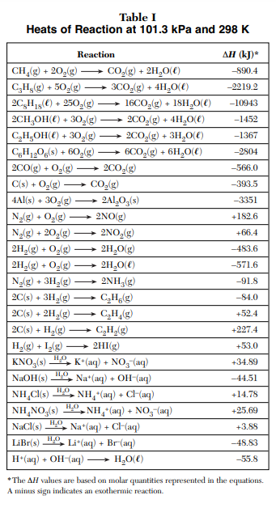
LABEL THE TABLE NOW…
Combustion reactions
Synthesis reactions
Solution formation (physical change)
Solid → Aqueous
Something too weird to tell you about for a month or two.

Slide 144
63. The title to table I is Heats of Reaction at 101.3 kPa and 298 K
64. There are 25 reactions and A whole bunch of PHYSICAL CHANGES (or phase changes) on this table.
65. All have what is called the ∆H. What is that?

Slide 145
63. The title to table I is Heats of Reaction at 101.3 kPa and 298 K
64. There are 25 reactions and A whole bunch of PHYSICAL CHANGES (or phase changes) on this table.
65. All have what is called the ∆H. What is that? The CHANGE IN ENERGY, how exothermic, or how endothermic each is, in units of energy called KILOJOULES

Slide 146
66. Some of the ∆H are negative, like the first one. What does that little asterisk* mean at the top of the table, next to ∆H?
A -∆H means that this reaction is EXOTHERMIC
67. A +∆H means that this reaction is ENDOTHEMIC
68. Can energy be positive or negative? NO Energy is like MONEY, you can have it, or not, but you can’t have “negative” money. Energy is, or it’s absent. A negative sign just means exothermic.

Slide 147
66. Some of the ∆H are negative, like the first one. What does that little asterisk* mean at the top of the table, next to ∆H?
A -∆H means that this reaction is EXOTHERMIC
67. A +∆H means that this reaction is ENDOTHEMIC
68. Can energy be positive or negative? NO Energy is like MONEY, you can have it, or not, but you can’t have “negative” money. Energy is, or it’s absent. A negative sign just means exothermic.

Slide 148
66. Some of the ∆H are negative, like the first one. What does that little asterisk* mean at the top of the table, next to ∆H?
A -∆H means that this reaction is EXOTHERMIC
67. A +∆H means that this reaction is ENDOTHEMIC
68. Can energy be positive or negative? NO Energy is like MONEY, you can have it, or not, but you can’t have “negative” money. Energy is, or it’s absent. A negative sign just means exothermic.

Slide 149
66. Some of the ∆H are negative, like the first one. What does that little asterisk* mean at the top of the table, next to ∆H?
A -∆H means that this reaction is EXOTHERMIC
67. +∆H means that this reaction is ENDOTHEMIC
68. Can energy be positive or negative? NO Energy is like MONEY, you can have it, or not, but you can’t have “negative” money. Energy is, or it’s absent. A negative sign just means exothermic.

Slide 150
69. These signs are just indicators as to energy being absorbed: + ∆H
70. Or if it is energy being emitted: ̶ ∆H
71. The demo had a + ∆H

Slide 151
69. These signs are just indicators as to energy being absorbed: + ∆H
70. Or if it is energy being emitted: ̶ ∆H
71. The demo had a + ∆H

Slide 152
69. These signs are just indicators as to energy being absorbed: + ∆H
70. Or if it is energy being emitted: ̶ ∆H
71. The demo had a + ∆H

Slide 153
69. These signs are just indicators as to energy being absorbed: + ∆H
70. Or if it is energy being emitted: ̶ ∆H
71. The demo had a + ∆H

Slide 154
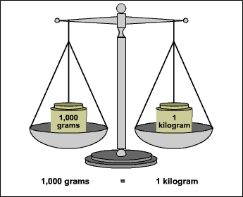
72. Look at the first reaction in Table I. What type of reaction is that? COMBUSTION
73. These reactions are always EXOTHERMIC, that’s why the ∆H is NEGATIVE
74. What is kJ? KILO-JOULES, a BIG UNIT OF ENERGY
75. 1 KILO-JOULE = 1000 JOULES
76. 1000 grams = 1 KILOGRAM 1000 meters = 1 KILOMETER

Slide 155
72. Look at the first reaction in Table I. What type of reaction is that? COMBUSTION
73. These reactions are always …, that’s why the ∆H is NEGATIVE
74. What is kJ? KILO-JOULES, a BIG UNIT OF ENERGY
75. 1 KILO-JOULE = 1000 JOULES
76. 1000 grams = 1 KILOGRAM 1000 meters = 1 KILOMETER

Slide 156
72. Look at the first reaction in Table I. What type of reaction is that? COMBUSTION
73. These reactions are always EXOTHERMIC, that’s why the ∆H is NEGATIVE
74. What is kJ? KILO-JOULES, a BIG UNIT OF ENERGY
75. 1 KILO-JOULE = 1000 JOULES
76. 1000 grams = 1 KILOGRAM 1000 meters = 1 KILOMETER

Slide 157
72. Look at the first reaction in Table I. What type of reaction is that? COMBUSTION
73. These reactions are always EXOTHERMIC, that’s why the ∆H is NEGATIVE
74. What is kJ? KILO-JOULES, a BIG UNIT OF ENERGY
75. 1 KILO-JOULE = 1000 JOULES
76. 1000 grams = 1 KILOGRAM 1000 meters = 1 KILOMETER

Slide 158
72. Look at the first reaction in Table I. What type of reaction is that? COMBUSTION
73. These reactions are always EXOTHERMIC, that’s why the ∆H is NEGATIVE
74. What is kJ? KILO-JOULES, a BIG UNIT OF ENERGY
75. 1 KILO-JOULE = 1000 JOULES
76. 1000 grams = 1 KILOGRAM 1000 meters = 1 KILOMETER

Slide 159
72. Look at the first reaction in Table I. What type of reaction is that? COMBUSTION
73. These reactions are always EXOTHERMIC, that’s why the ∆H is NEGATIVE
74. What is kJ? KILO-JOULES, a BIG UNIT OF ENERGY
75. 1 KILO-JOULE = 1000 JOULES
76. 1000 grams = 1 KILOGRAM 1000 meters = 1 KILOMETER

Slide 160
Start Class #4
Notes #77 through 96.
Calculators & reference tables necessary.
Phones & ear buds away, or else.

Slide 161
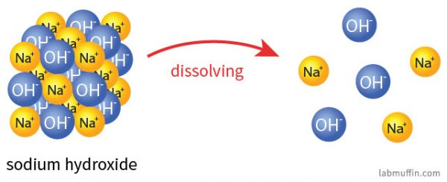
77. How many joules are released when one mole of NaOH dissolves into water? ______________
78. How many joules are absorbed when one mole of NaCl dissolves into water? _________________
DISSOLVES IN WATER
LOOSE MOBILE IONS in water
SOLID

Slide 162
77. How many joules are released when one mole of NaOH dissolves into water? 44.51 kiloJoules
78. How many joules are absorbed when one mole of NaCl dissolves into water? _________________
44.51 kJ 1
X
1000 J 1 kJ
= 44,510 Joules
DISSOLVES IN WATER
LOOSE MOBILE IONS in water
SOLID

Slide 163
78. How many joules are absorbed when one mole of NaCl dissolves into water?

Slide 164
78. How many joules are absorbed when one mole of NaCl dissolves into water? 3.88 kJ
3.88 kJ 1
X
1000 J 1 kJ
= 3,880 Joules

Slide 165
79. How many kJ of energy are released when one mole of LiBr is dissolved into water?

Slide 166
79. How many kJ of energy are released when one mole of LiBr is dissolved into water? 48.83 kJ

Slide 167
80. When you dissolve 11.9 moles of LiBr into water, how many kJ are released?

Slide 168
80. When you dissolve 11.9 moles of LiBr into water, how many kJ are released?
LiBr energy
1 48.83 kJ
11.9 X kJ
MR
=

Slide 169
80. When you dissolve 11.9 moles of LiBr into water, how many kJ are released?
LiBr energy
1 48.83 kJ
11.9 X kJ
MR
=
X = (48.83)(11.9)

Slide 170
80. When you dissolve 11.9 moles of LiBr into water, how many kJ are released?
LiBr energy
1 48.83 kJ
11.9 X kJ
MR
=
X = (48.83)(11.9)
X = 581.077 kJ
X = 581 kJ with 3 SF

Slide 171
81. How much energy is JOULES is absorbed when 52.61 moles of KNO₃ is dissolved into water?

Slide 172
81. How much energy is JOULES is absorbed when 52.61 moles of KNO₃ is dissolved into water?
KNO₃ energy
1 34.89 kJ
52.61 X kJ
MR
=

Slide 173
81. How much energy is JOULES is absorbed when 52.61 moles of KNO₃ is dissolved into water?
KNO₃ energy
1 34.89 kJ
52.61 X kJ
MR
=
X = (34.89)(52.61) = 1835.5629 kJ
X = 1836 kJ with 4 SF

Slide 174
81. How much energy is JOULES is absorbed when 52.61 moles of KNO₃ is dissolved into water?
KNO₃ energy
1 34.89 kJ
52.61 X kJ
MR
=
X = (34.89)(52.61) = 1835.5629 kJ
X = 1836 kJ with 4 SF
1836 kJ 1
X
1000 J 1 kJ
= 1,836,000 Joules

Slide 175
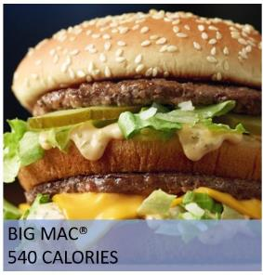
82. What is the unit of energy that food is measured as?

Slide 176
82. What is the unit of energy that food is measured as? FOOD CALORIES, Calories with a capital “C”
83. There is a scientific value of energy that sounds like that, called the calorie, with a lower case “c”
84. There are 1000 calories in one food Calorie.
85. In our class a food calorie is called a Calorie with a Capital C. It’s really a KILO-CALORIE because there are 1000 cal = 1 C

Slide 177
82. What is the unit of energy that food is measured as? FOOD CALORIES, Calories with a capital “C”
83. There is a scientific value of energy that sounds like that, called the calorie, with a lower case “c”
84. There are 1000 calories in one food Calorie.
85. In our class a food calorie is called a Calorie with a Capital C. It’s really a KILO-CALORIE because there are 1000 cal = 1 C

Slide 178
82. What is the unit of energy that food is measured as? FOOD CALORIES, Calories with a capital “C”
83. There is a scientific value of energy that sounds like that, called the calorie, with a lower case “c”
84. There are 1000 calories in one food Calorie.
85. In our class a food calorie is called a Calorie with a Capital C. It’s really a KILO-CALORIE because there are 1000 cal = 1 C

Slide 179
84. There are 1000 calories in one food Calorie.
85. In our class a food calorie is called a Calorie with a Capital C. It’s really a KILO-CALORIE because there are
So…
540 C 1
X
1000 cal 1C
= 540,000 calories
Food Calories Scientific calories

Slide 180
86. Now we have 4 units of energy:
→ →
→ →

Slide 181
86. Now we have 4 units of energy:
→ calorie → Calorie (kilocalorie)
→ joule → kilo-Joule
87. These are the three important equalities we can make from these:

Slide 182
87. These are the three important equalities we can make from these:
→ 1 cal = 4.18 Joules
→ 1000 Joules = 1 kilo-Joule
→ 1000 calories = 1 Calorie (kilocalorie)
Let’s ADD these to your reference tables now, underneath table B

Slide 183
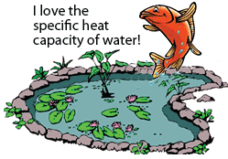
88. Write out the specific heat capacity constant for
water here: 4.18 J/g·K
What does that all mean?
It takes 4.18 Joules to make a gram of pure water change temperature by 1 Kelvin, or 1 Centigrade, Hotter or Colder.

Slide 184
88. Write out the specific heat capacity constant for
water here: 4.18 J/g·K
What does that all mean?
It takes 4.18 Joules to make a gram of pure water change temperature by 1 Kelvin, or 1 Centigrade, Hotter or Colder.

Slide 185
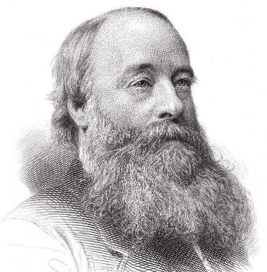
90. It takes 4.18 joules to make one gram of water change temp by 1°C or 1 K.
91. It takes 1 calorie (small “c”) to make one gram of water change temp by 1°C or 1 K.
This is James P. Joule, the man they named the unit of energy after. Note his gigantic mustache!

Slide 186
90. It takes 4.18 joules to make one gram of water change temp by 1°C or 1 K.
91. It takes 1 calorie (small “c”) to make one gram of water change temp by 1°C or 1 K.
This is James P. Joule, the man they named the unit of energy after. Note his gigantic mustache!

Slide 187
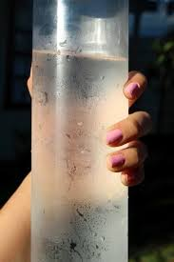
92. It takes 354 calories to make 354 g H₂O at 7°C to warm to 8°C. How many joules is 354 cal?
7°C 8°C

Slide 188
92. It takes 354 calories to make 354 g H₂O at 7°C to warm to 8°C. How many joules is 354 cal?
354 cal 1
X
7°C 8°C

Slide 189
92. It takes 354 calories to make 354 g H₂O at 7°C to warm to 8°C. How many joules is 354 cal?
354 cal 1
4.18 J 1 cal
=
X
1479.72 J = 1480 joules with 3 SF
7°C 8°C

Slide 190
93. Convert 3429 cal into kilojoules.

Slide 191
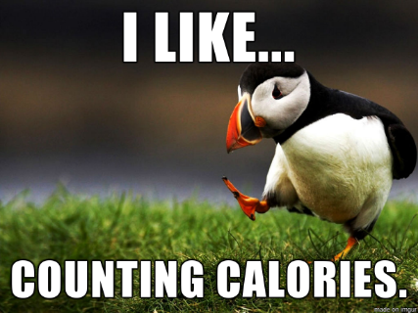
93. Convert 3429 cal into kilojoules.
3429 cal 1

Slide 192
93. Convert 3429 cal into kilojoules.
3429 cal 1
4.18 J 1 cal
= 14333.22 J = 14330 joules with 4 SF
don’t stop!
X

Slide 193
93. Convert 3429 cal into kilojoules.
3429 cal 1
4.18 J 1 cal
= 14333.22 J = 14330 joules with 4 SF
X
14330 J 1
1 kJ 1000 J
X
= 14.33 kJ with 4 SF

Slide 194
94. When 1.0 moles of NaCl dissolve into water the ∆H is 3.88 kJ. That energy is absorbed. Convert that amount of energy into joules, then into cals, and then into Calories.

Slide 195
94. When 1.0 moles of NaCl dissolve into water the ∆H is 3.88 kJ. That energy is absorbed. Convert that amount of energy into joules, then into cals, and then into Calories.
3.88 kJ 1

Slide 196
94. When 1.0 moles of NaCl dissolve into water the ∆H is 3.88 kJ. That energy is absorbed. Convert that amount of energy into joules, then into cals, and then into Calories.
3.88 kJ 1
1000 J 1 kJ
X
= 3880 Joules
3880 J 1

Slide 197
94. When 1.0 moles of NaCl dissolve into water the ∆H is 3.88 kJ. That energy is absorbed. Convert that amount of energy into joules, then into cals, and then into Calories.
3.88 kJ 1
1000 J 1 kJ
X
= 3880 Joules
3880 J 1
1 cal 4.18 J
X
= 928 cals
928 cal 1

Slide 198
94. When 1.0 moles of NaCl dissolve into water the ∆H is 3.88 kJ. That energy is absorbed. Convert that amount of energy into joules, then into cals, and then into Calories.
3.88 kJ 1
1000 J 1 kJ
X
= 3880 Joules
3880 J 1
1 cal 4.18 J
X
= 928 cals
928 cal 1
1 C 1000 cal
X
= 0.928 Calories

Slide 199
95. When one mole of methane combusts, how many kilojoules are released?
96. Convert that amount of kJ into joules, then into cals, and then into Calories.

Slide 200
95. When one mole of methane combusts, how many kilojoules are released? 890.4 kiloJoules
96. Convert that amount of kJ into joules, then into cals, and then into Calories.

Slide 201
95. When one mole of methane combusts, how many kilojoules are released? 890.4 kiloJoules
96. Convert that amount of kJ into joules, then into cals, and then into Calories.
890.4 kJ 1

Slide 202
95. When one mole of methane combusts, how many kilojoules are released? 890.4 kiloJoules
96. Convert that amount of kJ into joules, then into cals, and then into Calories.
890.4 kJ 1
1000 J 1 kJ
X
= 890,400 Joules
890,400 J 1

Slide 203
95. When one mole of methane combusts, how many kilojoules are released? 890.4 kiloJoules
96. Convert that amount of kJ into joules, then into cals, and then into Calories.
890.4 kJ 1
1000 J 1 kJ
X
= 890,400 Joules
890,400 J 1
1 cal 4.18 J
X
= 213,000 cal
213,000 cal 1

Slide 204
95. When one mole of methane combusts, how many kilojoules are released? 890.4 kiloJoules
96. Convert that amount of kJ into joules, then into cals, and then into Calories.
890.4 kJ 1
1000 J 1 kJ
X
= 890,400 Joules
890,400 J 1
1 cal 4.18 J
X
= 213,000 cal
213,000 cal 1
1 C 1000 cal
X
= 213 Calories

Slide 205
Walk around Practice
You have 12 questions out back (pick a color, all the same)
You can do these, or you can’t.
One or two might be difficult, think hard, or realize that you better pay attention tomorrow when you learn how to do the last sort of problems.
12 questions and we’re done. Don’t rush, get them done right.

Slide 206
Start Last thermochem class
Notes # 97 - 125

Slide 207
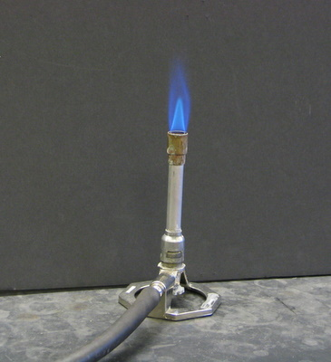
97. If you combust 8.44 moles of methane, how many kilojoules are released?

Slide 208
97. If you combust 8.44 moles of methane, how many kilojoules are released?
CH₄ energy
1 890.4 kJ
8.44 X kJ
MR
=

Slide 209
97. If you combust 8.44 moles of methane, how many kilojoules are released?
CH₄ energy
1 890.4 kJ
8.44 X kJ
MR
=
X = (890.4)(8.44) = 7514.976 kJ
X = 7510 kJ with 3 SF

Slide 210
98. If you combust 40.8 moles of glucose, how many kJ are released? (look at table I)

Slide 211
98. If you combust 40.8 moles of glucose, how many kJ are released? (look at table I)
glucose energy
1 2804 kJ
40.8 X kJ
MR
=

Slide 212
98. If you combust 40.8 moles of glucose, how many kJ are released? (look at table I)
glucose energy
1 2804 kJ
40.8 X kJ
MR
=
X = (2804)(40.8) = 114403.2 kJ
X = 114,000 kJ with 3 SF

Slide 213
99. Liquid octane (reaction #3 on Table I) combusts in car engines. If you burn up 12.890 moles of C₈H₁₈, how many kilojoules are released?

Slide 214
99. Liquid octane (reaction #3 on Table I) combusts in car engines. If you burn up 12.890 moles of C₈H₁₈, how many kilojoules are released?
octane energy
2 10943 kJ
=
12.890 X kJ
MR
Special note here: Watch this Mole Ratio!

Slide 215
99. Liquid octane (reaction #3 on Table I) combusts in car engines. If you burn up 12.890 moles of C₈H₁₈, how many kilojoules are released?
octane energy
2 10943 kJ
=
12.890 X kJ
MR
Special note here: Watch this Mole Ratio!
2X = (10943)(12.890) = 141055.27 kJ

Slide 216
99. Liquid octane (reaction #3 on Table I) combusts in car engines. If you burn up 12.890 moles of C₈H₁₈, how many kilojoules are released?
octane energy
2 10943 kJ
=
12.890 X kJ
MR
Special note here: Watch this Mole Ratio!
2X = (10943)(12.890) = 141055.27 kJ
X = 70527.635 kJ
X = 70,528 kJ with 5 SF

Slide 217
2C₈H₁₈ + 25O₂ → 16CO₂ +18H₂O
100. What is the mole ratio of this third reaction on table I? 2 : 25 : 16 : 18
101. What is the THERMOCHEMICAL mole ratio of this 3rd reaction on table I? 2 : 25 : 16 : 18 : 10943 kJ

Slide 218
2C₈H₁₈ + 25O₂ → 16CO₂ +18H₂O
100. What is the mole ratio of this third reaction on table I? 2 : 25 : 16 : 18
101. What is the THERMOCHEMICAL mole ratio of this 3rd reaction on table I? 2 : 25 : 16 : 18 : 10943 kJ

Slide 219
2C₈H₁₈ + 25O₂ → 16CO₂ +18H₂O
100. What is the mole ratio of this third reaction on table I? 2 : 25 : 16 : 18
101. What is the THERMOCHEMICAL mole ratio of this 3rd reaction on table I? 2 : 25 : 16 : 18 : 10943 kJ

Slide 220
102. When 7.50 moles of aluminum oxide form, how many kJ are released? 4Al + 3O₂ → 2Al₂O₃ ∆H = -3351 kJ or…
change that to this…

Slide 221
102. When 7.50 moles of aluminum oxide form, how many kJ are released? 4Al + 3O₂ → 2Al₂O₃ ∆H = -3351 kJ or…
4Al + 3O₂ → 2Al₂O₃ + 3351 kJ

Slide 222
102. When 7.50 moles of aluminum oxide form, how many kJ are released? 4Al + 3O₂ → 2Al₂O₃ ∆H = -3351 kJ or…
4Al + 3O₂ → 2Al₂O₃ + 3351 kJ
Al₂O₃ energy
2 3351 kJ
7.50 X kJ
MR
=

Slide 223
102. When 7.50 moles of aluminum oxide form, how many kJ are released? 4Al + 3O₂ → 2Al₂O₃ ∆H = -3351 kJ or…
4Al + 3O₂ → 2Al₂O₃ + 3351 kJ
Al₂O₃ energy
2 3351 kJ
7.50 X kJ
MR
=
2X = (3351)(7.50) = 25132.5 kJ
X = 12,600 kJ with 3 SF

Slide 224
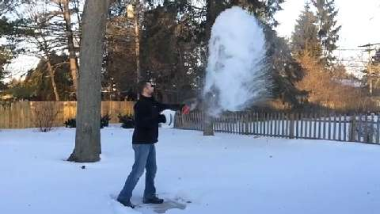
103. How many calories are removed when 45.8 grams of ice forms from water at 273K?

Slide 225
103. How many calories are removed when 45.8 grams of ice forms from water at 273K?
Use q = mH_{F}

Slide 226
103. How many calories are removed when 45.8 grams of ice forms from water at 273K?
Use SOLVE FOR q = mH_{F} q = (45.8 g)(334 J/g)

Slide 227
103. How many calories are removed when 45.8 grams of ice forms from water at 273K?
Use SOLVE FOR q = mH_{F} q = (45.8 g)(334 J/g) q = 15297.2 Joules = 15,300 J with 3 SF
15,300 J 1

Slide 228
103. How many calories are removed when 45.8 grams of ice forms from water at 273K?
Use SOLVE FOR q = mH_{F} q = (45.8 g)(334 J/g) q = 15297.2 Joules = 15,300 J with 3 SF
15,300 J 1
1 cal 4.18 J
X
= 3660 cal with 3 SF

Slide 229
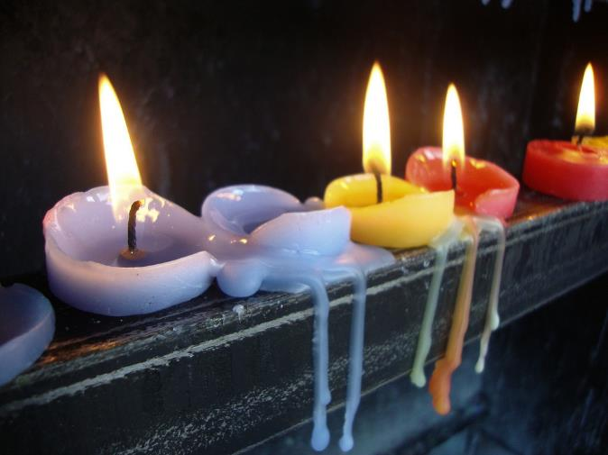
104. What is the HEAT OF FUSION for candle wax if it takes 3388 Joules to melt a whole birthday candle with mass of 23.04 grams?
These candles are burning (combustion) and they are melting. This question is about the melting, a physical change.

Slide 230
104. What is the HEAT OF FUSION for candle wax if it takes 3388 Joules to melt a whole birthday candle with mass of 23.04 grams?
Use q = mH_{F}

Slide 231
104. What is the HEAT OF FUSION for candle wax if it takes 3388 Joules to melt a whole birthday candle with mass of 23.04 grams?
Use SOLVE FOR q = mH_{F} 3388 J = (23.04 g)(H_{F})

Slide 232
104. What is the HEAT OF FUSION for candle wax if it takes 3388 Joules to melt a whole birthday candle with mass of 23.04 grams?
Use SOLVE FOR q = mH_{F} 3388 J = (23.04 g)(H_{F}) = H_{F} H_{F} = 147 J/g
3388 J 23.04 g

Slide 233
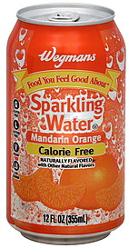
105. When a 355 mL can of seltzer, is warmed from a temperature of 293 K by adding 64,000 Joules
of energy to it, what is the final temperature? Assume the seltzer is just water.

Slide 234
105. When a 355 mL can of seltzer, is warmed from a temperature of 293 K by adding 64,000 Joules
of energy to it, what is the final temperature? Assume the seltzer is just water.
q = mCΔT

Slide 235
105. When a 355 mL can of seltzer, is warmed from a temperature of 293 K by adding 64,000 Joules
of energy to it, what is the final temperature? Assume the seltzer is just water.
q = mCΔT 64,000 J = (355 g)(4.18 J/g·K)(ΔT)

Slide 236
105. When a 355 mL can of seltzer, is warmed from a temperature of 293 K by adding 64,000 Joules
of energy to it, what is the final temperature? Assume the seltzer is just water.
q = mCΔT 64,000 J = (355 g)(4.18 J/g·K)(ΔT) 64,000 J (355 g)(4.18 J/g·K)
= ΔT

Slide 237
105. When a 355 mL can of seltzer, is warmed from a temperature of 293 K by adding 64,000 Joules
of energy to it, what is the final temperature? Assume the seltzer is just water.
q = mCΔT 64,000 J = (355 g)(4.18 J/g·K)(ΔT) 64,000 J (355 g)(4.18 J/g·K) 64,000 J 1483.9 J/K
= ΔT = ΔT = 43 K

Slide 238
105. When a 355 mL can of seltzer, is warmed from a temperature of 293 K by adding 64,000 Joules
of energy to it, what is the final temperature? Assume the seltzer is just water.
q = mCΔT 64,000 J = (355 g)(4.18 J/g·K)(ΔT) 64,000 J (355 g)(4.18 J/g·K) 64,000 J 1483.9 J/K
= ΔT = ΔT = 43 K
293 K + 43 K 336 K SF L

Slide 239
106. How many grams of water can be heated by 25.5 K when it absorbs 17,500 joules?

Slide 240
106. How many grams of water can be heated by 25.5 K when it absorbs 17,500 joules? Use q = mC∆T

Slide 241
106. How many grams of water can be heated by 25.5 K when it absorbs 17,500 joules? Use q = mC∆T solve for 17,500 J = m(4.18 J/g·K)(25.5 K)

Slide 242
106. How many grams of water can be heated by 25.5 K when it absorbs 17,500 joules? Use q = mC∆T solve for 17,500 J = m(4.18 J/g·K)(25.5 K)
17,500 J (4.18 J/g·K)(25.5 K)
= m

Slide 243
106. How many grams of water can be heated by 25.5 K when it absorbs 17,500 joules? Use q = mC∆T solve for 17,500 J = m(4.18 J/g·K)(25.5 K)
17,500 J (4.18 J/g·K)(25.5 K)
= m = 164 grams with 3 SF

Slide 244
107. When 51.1 g Cu cools, it emits 1788 Joules, to cools down. If it starts at 381.5 Kelvin, what is its final temperature if the C_{Cu} = 0.391 J/g·K ? (this one is the hardest so far!) Think!

Slide 245
107. When 51.1 g Cu cools, it emits 1788 Joules, to cools down. If it starts at 381.5 Kelvin, what is its final temperature if the C_{Cu} = 0.391 J/g·K ? (this one is the hardest so far!) Think!
q = mCΔT 1788 J = (51.1 g)(0.391 J/g·K)(ΔT)

Slide 246
107. When 51.1 g Cu cools, it emits 1788 Joules, to cools down. If it starts at 381.5 Kelvin, what is its final temperature if the C_{Cu} = 0.391 J/g·K ? (this one is the hardest so far!) Think!
q = mCΔT 1788 J = (51.1 g)(0.391 J/g·K)(ΔT)

Slide 247
107. When 51.1 g Cu cools, it emits 1788 Joules, to cools down. If it starts at 381.5 Kelvin, what is its final temperature if the C_{Cu} = 0.391 J/g·K ? (this one is the hardest so far!) Think!
q = mCΔT 1788 J = (51.1 g)(0.391 J/g·K)(ΔT) 1788 J 19.9801 J/K
= ΔT

Slide 248
107. When 51.1 g Cu cools, it emits 1788 Joules, to cools down. If it starts at 381.5 Kelvin, what is its final temperature if the C_{Cu} = 0.391 J/g·K ? (this one is the hardest so far!) Think!
q = mCΔT 1788 J = (51.1 g)(0.391 J/g·K)(ΔT) 1788 J 19.9801 J/K
= ΔT

Slide 249
107. When 51.1 g Cu cools, it emits 1788 Joules, to cools down. If it starts at 381.5 Kelvin, what is its final temperature if the C_{Cu} = 0.391 J/g·K ? (this one is the hardest so far!) Think!
q = mCΔT 1788 J = (51.1 g)(0.391 J/g·K)(ΔT) 1788 J 19.9801 J/K
= ΔT = 89.4 K

Slide 250
107. When 51.1 g Cu cools, it emits 1788 Joules, to cools down. If it starts at 381.5 Kelvin, what is its final temperature if the C_{Cu} = 0.391 J/g·K ? (this one is the hardest so far!) Think!
q = mCΔT 1788 J = (51.1 g)(0.391 J/g·K)(ΔT) 1788 J 19.9801 J/K
= ΔT = 89.4 K
381.5 K - 89.4 K 292 K

Slide 251
108. A 246.4 gram snowball at 273.0 K first melts, then warms to 26.55°. How many joules did it take to do that?

Slide 252
108. A 246.4 gram snowball at 273.0 K first melts, then warms to 26.55°. How many joules did it take to do that?
step | called | formula | Do the math
2 | melting ice | q = mH_{F}
3 | warming water | q = mC∆T
Total Joules required →

Slide 253
108. A 246.4 gram snowball at 273.0 K first melts, then warms to 26.55°. How many joules did it take to do that?
step | called | formula | Do the math
2 | melting ice | q = mH_{F} | q = (246.4 g)(334 J/g) = 82297.6 J
3 | warming water | q = mC∆T
Total Joules required →

Slide 254
108. A 246.4 gram snowball at 273.0 K first melts, then warms to 26.55°. How many joules did it take to do that?
step | called | formula | Do the math
2 | melting ice | q = mH_{F} | q = (246.4 g)(334 J/g) = 82297.6 J
3 | warming water | q = mC∆T | q = (246.4g)(4.18 J/g·K)(26.55 K) = 23972 J
Total Joules required →

Slide 255
108. A 246.4 gram snowball at 273.0 K first melts, then warms to 26.55°. How many joules did it take to do that?
step | called | formula | Do the math
2 | melting ice | q = mH_{F} | q = (246.4 g)(334 J/g) = 82297.6 J
3 | warming water | q = mC∆T | q = (246.4g)(4.18 J/g·K)(26.55 K) = 27345 J
Total Joules required → |  |  | total = 109642.8 109,600 Joules with 4 SF

Slide 256
109. There is no easy way to directly measure the energy that is in food. An indirect way has been figured out, using a machine called a 110. Let’s draw it now…

Slide 257
109. There is no easy way to directly measure the energy that is in food. An indirect way has been figured out, using a machine called a BOMB CALORIMETER 110. Let’s draw it now…

Slide 258
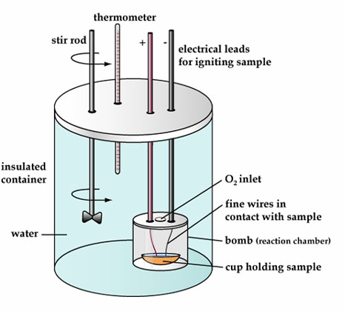
Food goes into the cup. It’s sealed in the “bomb” with oxygen. The electricity leads are attached. This is placed into a certain mass of pure water, at measured temperature. The stirrer moves the water around and makes sure it’s all at the same temperature. At some point you spark and burn the food. Heat is released into the water and the temperature rises.
Using q = mC∆T, calculate the number joules required to make that temperature change, convert to cal, then Calories.

Slide 259
111. Let’s assume that there is exactly 2120. mL of water in our bomb calorimeter and it’s at exactly 295.0 K. After burning up our food sample, the temperature of the water rises to 354.5 K. How many Calories of energy are in this food sample? On Wednesday evening at Midway Lanes here in Vestal, I had a good time watching the VHS Bowling Team duke it out with the UE Tiger team. As best I can tell, we knocked them down like bowling pins.
More importantly, I saw comradery, fun, laughing, and some fancy necklace wearing! Go Bears!

Slide 260
111. Let’s assume that there is exactly 2120. mL of water in our bomb calorimeter and it’s at exactly 295.0 K. After burning up our food sample, the temperature of the water rises to 354.5 K. How many Calories of energy are in this food sample? q = mCΔT

Slide 261
111. Let’s assume that there is exactly 2120. mL of water in our bomb calorimeter and it’s at exactly 295.0 K. After burning up our food sample, the temperature of the water rises to 354.5 K. How many Calories of energy are in this food sample? q = mCΔT
q = (2120. g)(4.18 J/g·K)(59.50 K)

Slide 262
111. Let’s assume that there is exactly 2120. mL of water in our bomb calorimeter and it’s at exactly 295.0 K. After burning up our food sample, the temperature of the water rises to 354.5 K. How many Calories of energy are in this food sample? q = mCΔT
q = (2120. g)(4.18 J/g·K)(59.50 K)

Slide 263
111. Let’s assume that there is exactly 2120. mL of water in our bomb calorimeter and it’s at exactly 295.0 K. After burning up our food sample, the temperature of the water rises to 354.5 K. How many Calories of energy are in this food sample? q = mCΔT
q = (2120. g)(4.18 J/g·K)(59.50 K)
q = 527,265.2 J

Slide 264
111. Let’s assume that there is exactly 2120. mL of water in our bomb calorimeter and it’s at exactly 295.0 K. After burning up our food sample, the temperature of the water rises to 354.5 K. How many Calories of energy are in this food sample? q = mCΔT
q = (2120. g)(4.18 J/g·K)(59.50 K)
q = 527,265.2 J
527,300 J 1

Slide 265
111. Let’s assume that there is exactly 2120. mL of water in our bomb calorimeter and it’s at exactly 295.0 K. After burning up our food sample, the temperature of the water rises to 354.5 K. How many Calories of energy are in this food sample? q = mCΔT
q = (2120. g)(4.18 J/g·K)(59.50 K)
q = 527,265.2 J
527,300 J 1
1 cal 4.18 J
X
= 126,148.32 cal
= 126,100 cal (keep going)

Slide 266
111. Let’s assume that there is exactly 2120. mL of water in our bomb calorimeter and it’s at exactly 295.0 K. After burning up our food sample, the temperature of the water rises to 354.5 K. How many Calories of energy are in this food sample?
126,100 cal 1
1 C 1000 cal
X
= 126.1 Calories

Slide 267
112. Copy the simple Cooling Curve for Chromium, labels, titles, axis labels, etc.

Slide 268
112.
A
Cooling curve for Chromium metal
C
B
K E L V I N
117. A. What temps are on the Y axis?
B. What’s PE doing BC and CD?
C. What’s KE doing AB and DE
D. Why is BC longer than DE?
E. Which thermochem formula do you use for BC?
F. How about for EF?
E
D
F
Heat removed at a constant rate (time)

Slide 269
112.
A
Cooling curve for Chromium metal
C
2944
B
K E L V I N
117. A. What temps are on the Y axis?
B. What’s PE doing BC and CD?
C. What’s KE doing AB and DE
D. Why is BC longer than DE?
E. Which thermochem formula do you use for BC?
F. How about for EF?
E
2180
D
F
Heat removed at a constant rate (time)

Slide 270
112.
A
Cooling curve for Chromium metal
PE
C
2944
B
K E L V I N
PE
117. A. What temps are on the Y axis?
B. What’s PE doing BC and CD?
D. Why is BC longer than DE?
E. Which thermochem formula do you use for BC?
F. How about for EF?
E
2180
D
F
Heat removed at a constant rate (time)

Slide 271
112.
A
Cooling curve for Chromium metal
PE
C
2944
B
K E L V I N
PE
117. A. What temps are on the Y axis?
B. What’s PE doing BC and CD?
C. What’s KE doing AB and DE
D. Why is BC longer than DE?
E. Which thermochem formula do you use for BC?
F. How about for EF?
E
2180
D
F
Heat removed at a constant rate (time)

Slide 272
112.
A
Cooling curve for Chromium metal
KE
PE
C
2944
B
K E L V I N
PE
117. A. What temps are on the Y axis?
B. What’s PE doing BC and CD?
C. What’s KE doing AB and DE
D. Why is BC longer than DE?
E. Which thermochem formula do you use for BC?
F. How about for EF?
KE
E
2180
D
F
Heat removed at a constant rate (time)

Slide 273
112.
A
Cooling curve for Chromium metal
KE
PE
C
2944
B
K E L V I N
PE
117. D. Why is BC longer than DE?
BC represents the condensation phase change for chromium gas to liquid, which is a “bigger” energy event that the freezing of chromium.
KE
E
2180
D
F
Heat removed at a constant rate (time)

Slide 274
113. Propane gas, C₃H₈ combusts according to Table I. How much energy (in kJ) is released when 5.75 moles C₃H₈ combusts? (find this - Table I, it’s the 2nd reaction)

Slide 275
113. Propane gas, C₃H₈ combusts according to Table I. How much energy (in kJ) is released when 5.75 moles C₃H₈ combusts? (find this - Table I, it’s the 2nd reaction) C₃H₈ + 5 O₂ → 3CO₂ + 4 H₂O ΔH = -2219.2 kJ
Which is: C₃H₈ + 5 O₂ → 3CO₂ + 4 H₂O + 2219.2 kJ exothermic, energy is a product

Slide 276
113. Propane gas, C₃H₈ combusts according to Table I. How much energy (in kJ) is released when 5.75 moles C₃H₈ combusts? (find this - Table I, it’s the 2nd reaction) C₃H₈ + 5 O₂ → 3CO₂ + 4 H₂O ΔH = -2219.2 kJ
Which is: C₃H₈ + 5 O₂ → 3CO₂ + 4 H₂O + 2219.2 kJ exothermic, energy is a product
C₃H₈ energy
1 2219.2 kJ
MR

Slide 277
113. Propane gas, C₃H₈ combusts according to Table I. How much energy (in kJ) is released when 5.75 moles C₃H₈ combusts? (find this - Table I, it’s the 2nd reaction) C₃H₈ + 5 O₂ → 3CO₂ + 4 H₂O ΔH = -2219.2 kJ
Which is: C₃H₈ + 5 O₂ → 3CO₂ + 4 H₂O + 2219.2 kJ exothermic, energy is a product
C₃H₈ energy
1 2219.2 kJ
5.75 X kJ
MR
=

Slide 278
113. Propane gas, C₃H₈ combusts according to Table I. How much energy (in kJ) is released when 5.75 moles C₃H₈ combusts? (find this - Table I, it’s the 2nd reaction) C₃H₈ + 5 O₂ → 3CO₂ + 4 H₂O ΔH = -2219.2 kJ
Which is: C₃H₈ + 5 O₂ → 3CO₂ + 4 H₂O + 2219.2 kJ exothermic, energy is a product
C₃H₈ energy
1 2219.2 kJ
5.75 X kJ
MR
=
X = 12760.4 kJ
X = 12,800 kJ with 3 SF

Slide 279
114. How much energy is absorbed by the reaction of 99.0 moles of HI_{(G)} forming?

Slide 280
114. How much energy is absorbed by the reaction of 99.0 moles of HI_{(G)} forming? H_{2(G)} + I_{2(G)} → 2HI _{(G)} ΔH = +53.0 kJ 53.0 kJ + H_{2(G)} + I_{2(G)} → 2HI _{(G)} (energy is a reactant)

Slide 281
114. How much energy is absorbed by the reaction of 99.0 moles of HI_{(G)} forming? H_{2(G)} + I_{2(G)} → 2HI _{(G)} ΔH = +53.0 kJ 53.0 kJ + H_{2(G)} + I_{2(G)} → 2HI _{(G)} (energy is a reactant)
MR
HI energy
2 53.0 kJ

Slide 282
114. How much energy is absorbed by the reaction of 99.0 moles of HI_{(G)} forming? H_{2(G)} + I_{2(G)} → 2HI _{(G)} ΔH = +53.0 kJ 53.0 kJ + H_{2(G)} + I_{2(G)} → 2HI _{(G)} (energy is a reactant)
MR
HI energy
2 53.0 kJ
99.0 X kJ
=

Slide 283
114. How much energy is absorbed by the reaction of 99.0 moles of HI_{(G)} forming? H_{2(G)} + I_{2(G)} → 2HI _{(G)} ΔH = +53.0 kJ 53.0 kJ + H_{2(G)} + I_{2(G)} → 2HI _{(G)} (energy is a reactant)
MR
HI energy
2 53.0 kJ
99.0 X kJ
2X = 5247 kJ
X = 2623.5 kJ
X = 2620 kJ with 3 SF
=

Slide 284
115. When 45.0 g of an unknown metal absorbs 1.51 kJ of heat. The temperature changes from 268 K to 345 K. What is the specific heat capacity constant for this metal? Note: KILOJOULES!

Slide 285
115. When 45.0 g of an unknown metal absorbs 1.51 kJ of heat. The temperature changes from 268 K to 345 K. What is the specific heat capacity constant for this metal? Note: KILOJOULES! Use q = mC∆T

Slide 286
115. When 45.0 g of an unknown metal absorbs 1.51 kJ of heat. The temperature changes from 268 K to 345 K. What is the specific heat capacity constant for this metal? Note: KILOJOULES! Use q = mC∆T 1510 J = (45.0 g)(C)(77.0 K) =

Slide 287
115. When 45.0 g of an unknown metal absorbs 1.51 kJ of heat. The temperature changes from 268 K to 345 K. What is the specific heat capacity constant for this metal? Note: KILOJOULES! Use q = mC∆T 1510 J = (45.0 g)(C)(77.0 K) = C = 0.435 J/g·K
1510 J (45.0 g)(77.0 K)

Slide 288
115. When 45.0 g of an unknown metal absorbs 1.51 kJ of heat. The temperature changes from 268 K to 345 K. What is the specific heat capacity constant for this metal? Note: KILOJOULES! Use q = mC∆T 1510 J = (45.0 g)(C)(77.0 K) = C = 0.436 J/g·K
1510 J (45.0 g)(77.0 K)

Slide 289
116. The Law of Conservation of Matter (or mass) Matter cannot be created or destroyed in a chemical reaction, or a physical change. (that’s a phase change) 117. The Law of Conservation of Energy Energy cannot be created or destroyed in a chemical reaction, or a physical change, but it can be transferred. (that’s a phase change)

Slide 290
116. The Law of Conservation of Matter (or mass) Matter cannot be created or destroyed in a chemical reaction, or a physical change. (that’s a phase change) 117. The Law of Conservation of Energy Energy cannot be created or destroyed in a chemical reaction, or a physical change, but it can be transferred. (that’s a phase change)

Slide 291
116. The Law of Conservation of Matter (or mass) Matter cannot be created or destroyed in a chemical reaction, or a physical change. (that’s a phase change) 117. The Law of Conservation of Energy Energy cannot be created or destroyed in a chemical reaction, or a physical change, but it can be transferred.

Slide 292
118. Which takes more energy? Melting 50.0 g of ice or vaporizing 50.0 g of water into steam?

Slide 293
118. Which takes more energy? Melting 50.0 g of ice or vaporizing 50.0 g of water into steam? Melting a single gram takes 334 J/g.
Vaporizing a single gram takes 2260 J/g while The hot phase change always takes more energy – for any number of grams

Slide 294
119. Which takes more energy? Heating 23.0 mL of water from 274 K to 299 K This ∆T is 25°C Or Heating 23.0 mL of water from 299 K to 323 K? This ∆T is 24°C = less energy

Slide 295
119. Which takes more energy? Heating 23.0 mL of water from 274 K to 299 K This ∆T is 25°C Or Heating 23.0 mL of water from 299 K to 323 K? This ∆T is 24°C = less energy

Slide 296
119. Which takes more energy? Heating 23.0 mL of water from 274 K to 299 K This ∆T is 25°C Or Heating 23.0 mL of water from 299 K to 323 K? This ∆T is 24°C A smaller ∆T would require less energy.

Slide 297
120. Which takes more energy? Vaporizing 21.0 g water from 373 K liquid to gas q = mH_{V} = (21.0 g)(2260 J/g) = 47,460 J (more) or Changing the temp of 100.0 g H₂O by 97.0 K? q = mC∆T = (21.0 g)(4.18 J/g·K)(97.0 K) = 8510 J (less)

Slide 298
120. Which takes more energy? Vaporizing 21.0 g water from 373 K liquid to gas q = mH_{V} = (21.0 g)(2260 J/g) = 47,460 J or Changing the temp of 100.0 g H₂O by 97.0 K?

Slide 299
120. Which takes more energy? Vaporizing 21.0 g water from 373 K liquid to gas q = mH_{V} = (21.0 g)(2260 J/g) = 47,460 J (more energy) or Changing the temp of 100.0 g H₂O by 97.0 K? q = mC∆T = (100.0 g)(4.18 J/g·K)(97.0 K) = 40546 J (less energy)

Slide 300
121. Which has the LOWEST AVERAGE KINETIC ENERGY? A. 100 mL water at 51.0°C B. 100 mL water at 50.0°C C. 175 mL water at 49.0°C D. 175 mL water at 23.0°C

Slide 301
121. Which has the LOWEST AVERAGE KINETIC ENERGY? A. 100 mL water at 51.0°C B. 100 mL water at 50.0°C C. 175 mL water at 49.0°C D. 175 mL water at 23.0°C Lowest temp = Lowest kinetic energy

Slide 302
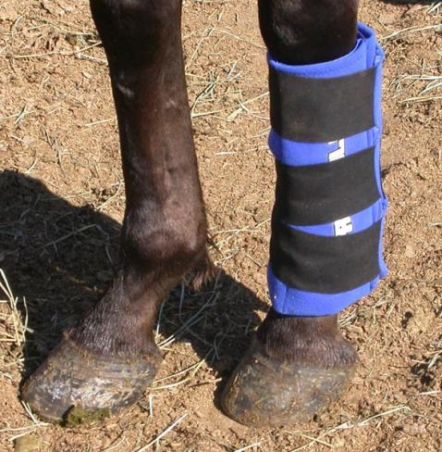
This horse has a boo boo.
That’s an ICE PACK on his leg.
122. Describe the thermochem:
Heat flows from ice pack → leg
Cold flows from ice pack → leg
Heat flows from leg → ice pack
Cold flows from leg → ice pack

Slide 303
122. Describe the thermochem:
Heat flows from ice pack → leg
Cold flows from ice pack → leg
Heat flows from leg → ice pack
Cold flows from leg → ice pack Heat leaves a warm body - and you feel colder. You don’t “get” cold, you get less warm

Slide 304
123. The old chemistry adage goes like this: When bonds form ENERGY IS RELEASED. 124. A good example of this is… The synthesis of water. A balloon explodes as the water and carbon dioxide bonds form. A small amount of water forms with a toot!
125. The ∆T°C = ∆T K even though the temperatures are different numbers! Don’t forget this!

Slide 305
123. The old chemistry adage goes like this: When bonds form ENERGY IS RELEASED. 124. A good example of this is… The synthesis of water. A balloon explodes as the water and carbon dioxide bonds form. A small amount of water forms with a toot!
125. The ∆T°C = ∆T K even though the temperatures are different numbers! Don’t forget this!

Slide 306
123. The old chemistry adage goes like this: When bonds form ENERGY IS RELEASED. 124. A good example of this is… The synthesis of water. A balloon explodes as the water bonds together.
125.

Slide 307
123. The old chemistry adage goes like this: When bonds form ENERGY IS RELEASED. 124. A good example of this is… The synthesis of water. A balloon explodes as the water bonds together.
125. ∆T°C = ∆T K even though the temperatures are different numbers!

