Slide 1
WATER
This slide show covers everything that you have to know about water.
Power down your cell phones – batteries work by redox, which we won’t cover for at least 30 days.
Let’s start today with just pens/pencils, reference tables, and the water notes.

Slide 2
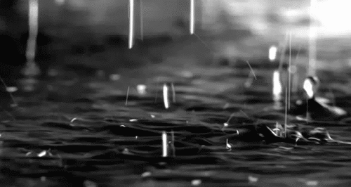
Objective: what are the important properties of water, and what causes them?
What do you already know about water?
Formula? Shape? What atoms? What kind of bonds are between atoms in the molecule? What type of bonding between is between the water molecules? What is the density of water? Or its freezing and boiling points?

Slide 3
1. A water molecule is BENT – they do not have radial symmetry. The molecules are polar. Water has polar bonds – due to a great difference in the electronegativity values of oxygen and hydrogen.
O H
H
These red dipole arrows indicate that the electrons move mostly towards the oxygen atom, and that leaves both of the hydrogen atoms more positive.

Slide 4
2. Draw 7 molecules of water (randomly, they are not soldiers!) and with COLORED PENCIL LINES indicate the hydrogen bonding BETWEEN MOLECULES.
O H
H
O H
H

Slide 5
1 + 2. Draw 7 molecules of water (randomly, they are not soldiers!) and with DOTTED LINES indicate the hydrogen bonding BETWEEN MOLECULES.
O H
H
O H
H
O H
H
O H
H
O H
H
O H
H
O H
H
BLUE Hydrogen bonds
Between molecules

Slide 6
3. Hydrogen bonding: is the intermolecular attraction between polar molecules containing polar bonds containing hydrogen atoms. They help create super duper dipoles, or intermolecular magnetic attraction between molecules.

Slide 7
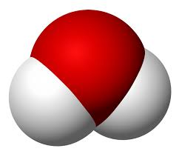
Get 6 magnetic water molecules. 4. Which atoms are Red ?
White ?
Attach six “water molecules” into a ring shape.

Slide 8
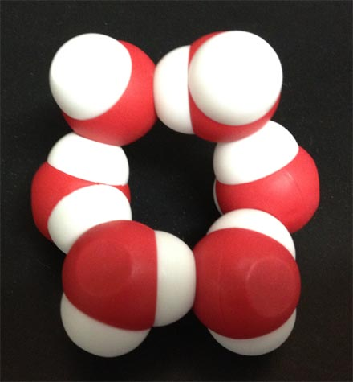
5. Water forms a HEXAGON
See the hole there?
When the temp gets so cold that ice forms, it starts as a 6 molecule ring, that grows in all directions.

Slide 9
6. If you squish the magnets (water molecules) in your hands and move them slowly they take up less space than when in the ring shape.
The density of pure water is _______ or you could say it this way _______

Slide 10
6. If you squish the magnets (water molecules) in your hands and move them slowly they take up less space than when in the ring shape.
The density of pure water is 1 g/cm³ or you could say it this way 1 g/mL 1 mL = 1cm³ of volume

Slide 11
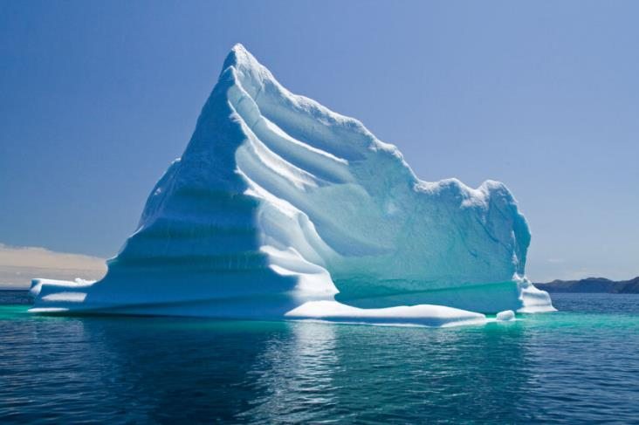
7. The density of ICE is ___________________________________ since ice floats in liquid water.
8. The hole in the ring creates a slightly greater ________ for the six molecules of water that the liquid water just doesn’t have.

Slide 12
7. The density of ICE is LESS THAN THE DENSITY OF WATER since ice floats in liquid water.
8. The hole in the ring creates a slightly greater VOLUME for the six molecules of water that the liquid water just doesn’t have.

Slide 13
9. Liquid water freezes at what temp? 273 K or 0 °C
10. To melt one gram of ice → one gram of water it would take adding the HEAT OF FUSION
11. For water, that constant is 334 Joules/gram

Slide 14
9. Liquid water freezes at what temp? 273 K or 0 °C
10. To melt one gram of ice → one gram of water it would take adding the HEAT OF FUSION
11. For water, that constant is 334 Joules/gram

Slide 15
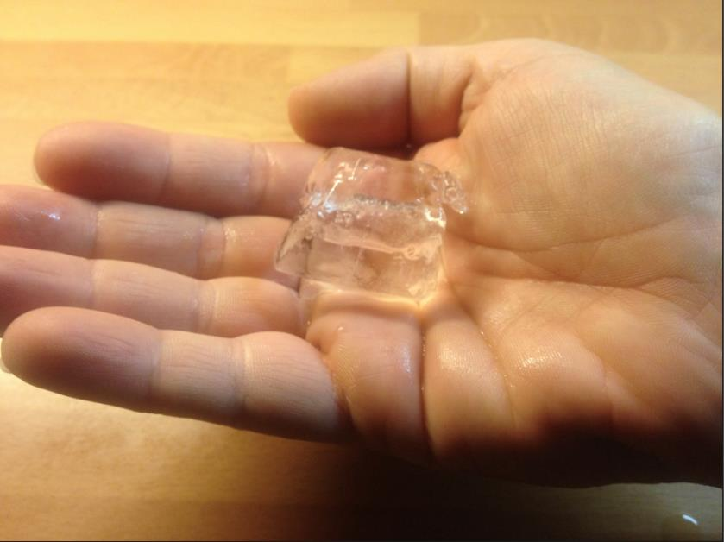
12. If you put an ice cube in your hand - does your hand get cold? Or does the heat leave your hand?
Why does your hand get cold?

Slide 16
12. The HEAT ENERGY is transferred from HAND TO ICE. The cold is the lack of heat, or in effect, cold is NOTHING.
Why does your hand get cold? Your hand feels colder, but that’s just the way we talk. The heat energy leaves your hand, it has less kinetic energy as the heat transfers to the ice cube.

Slide 17
14. How many water molecules does it take to form a normal crystal of ice?
15. How many points does a normal SNOWFLAKE have? What’s the number ??????

Slide 18
14. How many water molecules does it take to form a normal crystal of ice? SIX
15. How many points does a normal SNOWFLAKE have? SIX What’s the number ??????
How many question marks are right there??????

Slide 19
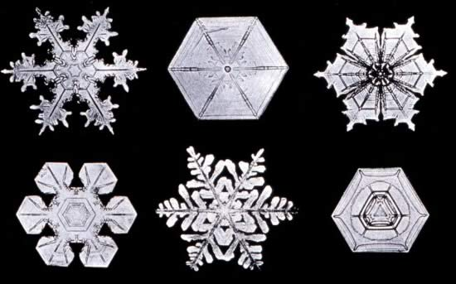
snowflakes

Slide 20
The Most Important Properties Of Water (and what causes them) 16. Water has a high BOILING POINT This is due to _______________________

Slide 21
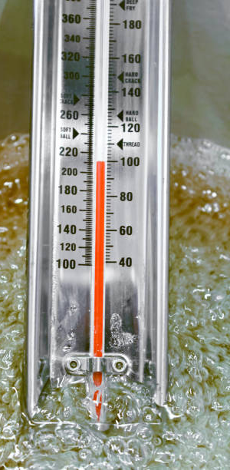
The Most Important Properties Of Water (and what causes them) 16. Water has a high BOILING POINT This is due to HYDROGEN BONDING The intermolecular attraction of the hydrogen bonds hold the water molecules loose enough for them to move, but tight enough so that it’s hard to separate them apart into a gas. That takes lots of energy.

Slide 22
The Most Important Properties Of Water (and what causes them)
17. Water has a LOW VAPOR PRESSURE This is due to __________________

Slide 23
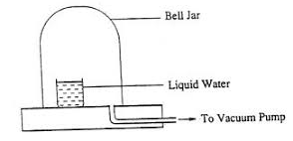
The Most Important Properties Of Water (and what causes them)
17. Water has a LOW VAPOR PRESSURE This is due to HYDROGEN BONDING The intermolecular hydrogen bonds hold the water molecules together which makes it harder for water to evaporate than molecules that have less intermolecular attraction.

Slide 24
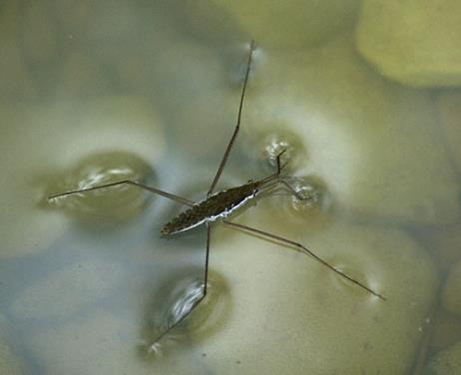
18. Water has SURFACE TENSION This is due to ______________________

Slide 25
18. Water has SURFACE TENSION This is due to HYDROGEN BONDING.
The intermolecular hydrogen bonds hold the water molecules tight to themselves and not at all to the air. This creates a “skin” or what is called surface tension. I hate those bugs, don’t you?

Slide 26
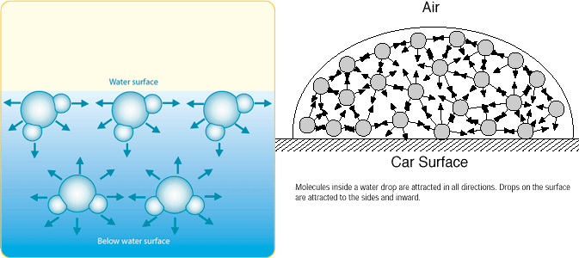
19. Surface tension… is created when the attractive forces between the water molecules are “unbalanced”. At the surface there is great side to side attraction but no attraction in the up direction where there is NO water.
Inside the bulk of the water the hydrogen bonding is the same in every direction, so no surface or edge forms.

Slide 27
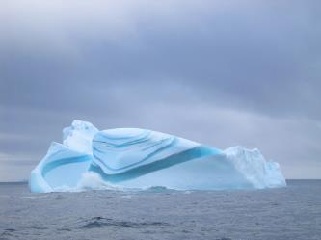
20. Solid water (ice) can FLOAT on liquid water. This is due to ___________________

Slide 28
20. Solid water (ice) can FLOAT on liquid water. This is due to HYDROGEN BONDING. Water molecules form rings of six, which creates a small “hole” in the center of them. It makes frozen water slightly less dense than liquid water. Liquid water molecules fit together more tightly, so liquid water is denser than ice.
Many love stories are emotional disasters. This one made lots of $$. Love, thanks to hydrogen bonding.

Slide 29
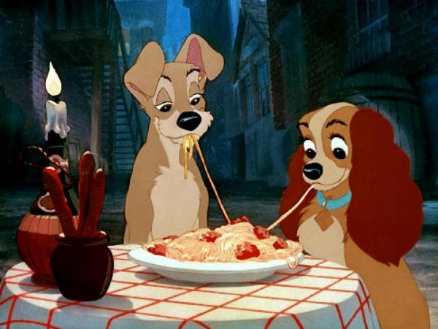
20. Solid water (ice) can FLOAT on liquid water. This is due to HYDROGEN BONDING.
All love stories are great.
Sometimes they make you cry.
That’s okay.
Lady and the Tramp.

Slide 30
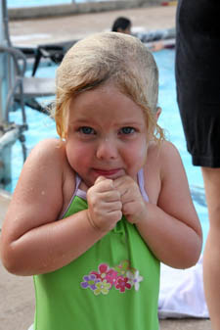
21. Water has a very high SPECIFIC HEAT CAPACITY CONSTANT
This is due to _____________________
Without a pool heater this is what it looks like at the Vestal Public Pool most of the summer.
Even on sunny days.
Why? Because… it takes a lot of combustion to warm up the millions of grams of water by each degree in a pool.

Slide 31
21. Water has a very high SPECIFIC HEAT CAPACITY CONSTANT
This is due to HYDROGEN BONDING
Without a pool heater this is what it looks like at the Vestal Public Pool most of the summer.
Even on sunny days.
Why? Because… it takes a lot of combustion to warm up the millions of grams of water by each degree in a pool.
22. The “C” of H₂O is 4.18 J/g·K

Slide 32
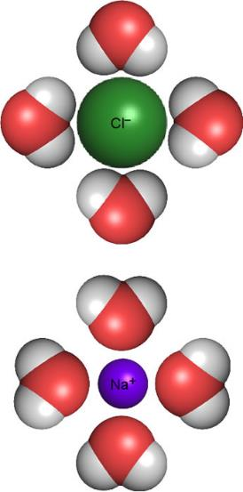
23. Water has THE ABILITY TO CREATE SOLUTIONS, this is CALLED SOLVATION – NOT SALVATION! This is due to ____________________

Slide 33
23. Water has THE ABILITY TO CREATE SOLUTIONS, this is CALLED SOLVATION – NOT SALVATION! This is due to HYDROGEN BONDING
24. This can be stated more casually as Like Dissolves Like

Slide 34
Like dissolves like.
25. This means that POLAR water can only dissolve POLAR MOLECULES or (most) ionic compounds.
Or
26. Oils, and other nonpolar solvents, can only dissolve other nonpolar solutes (but not water which is polar)

Slide 35
27. Water has the ability to form HYDRATED IONIC COMPOUNDS. This is due to ____________________
28. Examples of these are:

Slide 36
27. Water has the ability to form HYDRATED IONIC COMPOUNDS. This is due to HYDROGEN BONDING
28. Examples of these are CuSO₄·5H₂O and MgSO₄·7H₂O
What are those dots??? They indicate HYDROGEN BONDING between ionic compounds and the water.

Slide 37
29. WATER VOCABULARY Words to Memorize by Tomorrow.
1 Solvation: the process of dissolving into a liquid
2 Solute: this dissolves into the solvent of a solution
Solvent: the solute dissolves into this part, usually the “bigger” part of a solution
4. Aqueous: a solution that is dissolved in water
5. Soluble: able to dissolve 6 Insoluble: unable to dissolve, or precipitates when formed in water in DR
7 Saturated: solution holding maximum solute in solution (Charlie chocolate milk)
8 Unsaturated: solution that can dissolve more solute in solution (Janet choc. milk)

Slide 38
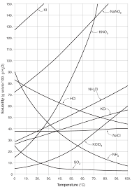
Water Class #2 Objective: Mastering Table G – the Solubility Curves for 10 Compounds
Take it out now please

Slide 39
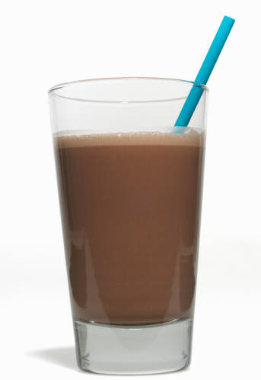
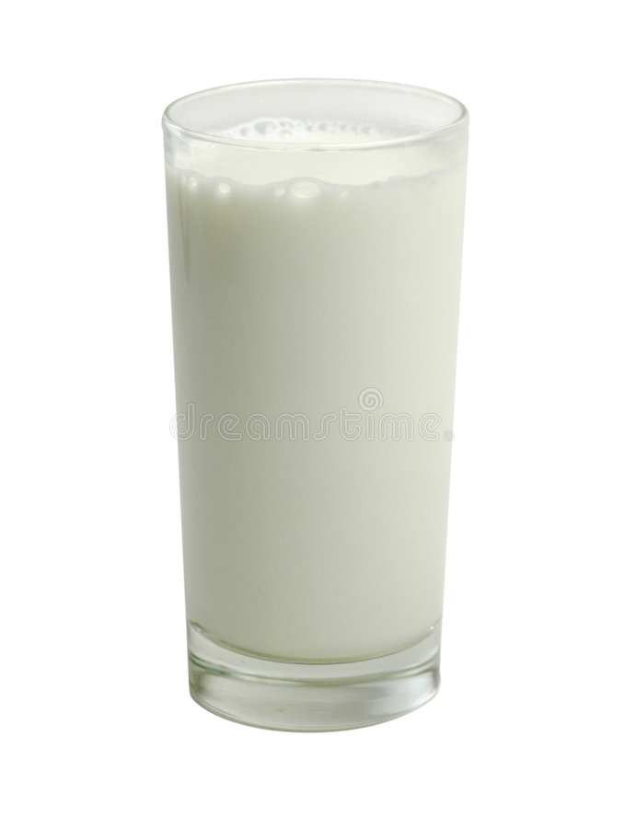
When you come to my house for chocolate milk and cookies, the cookies will be first rate chocolate chips.
Depending upon who makes the chocolate milk, me, or my wife Janet, you will either want to come back, or maybe not.
MINE
Janet’s

Slide 40
How concentrated a solution is makes a difference in chemistry. That solution could be chocolate milk, or salty water. Or sugar in coffee.
All solutions contain solutes dissolved into solvents.
30. For salty water, which is the solute – which is the solvent?
31. For chocolate milk, which is the solute – which is the solvent?

Slide 41
How concentrated a solution is makes a difference in chemistry. That solution could be chocolate milk, or salty water. Or sugar in coffee.
All solutions contain solutes dissolved into solvents.
30. For salty water, SALT IS THE SOLUTE, water is the solvent
31. Chocolate milk, CHOCOLATE SAUCE is the SOLUTE, milk is the solvent?
Each solvent can “HOLD” only a certain amount of solute at any temperature. That’s the solubility of the solution

Slide 42
The table shows how much of 10 different compounds can dissolve into 100 mL of AQ solution, at ANY temperature that water is still LIQUID.
Relax, we only look at one curve at a time, don’t get scared.
Table G
Solubility Curves at Standard Pressure

Slide 43
32. Table G is titled: SOLUBILITY CURVES- at standard pressure which is: 101.3 kPa
33. The Y axis (up/down) is solubility
______________________________
34. Which really means:
______________________________
Gently cross it out and replace it now.
35. The X axis has these units
____
Table G
Solubility Curves at Standard Pressure

Slide 44
32. Table G is titled: SOLUBILITY CURVES- at standard pressure which is: 101.3 kPa
33. The Y axis (up/down) is solubility
Grams of solute/100 grams of water 34. Which really means:
Grams of solute/100 mL of water
Gently cross it out and replace it now →
35. The X axis has these units
°C
Why doesn’t it go lower than zero or higher than 100? Below 0 and the water begins to freeze solid, over 100 and the solution is boiling away into steam.
Table G
Solubility Curves at Standard Pressure

Slide 45
36. How many grams of KCl fits into 100 mL of water at 10°C? ____
37. How many grams of KClO₃ fits into 100 mL of water at 40°C? _______
38. How many grams of potassium nitrate fits into 100 mL of AQ solution at 50°C? ____
Table G
Solubility Curves at Standard Pressure

Slide 46
36. How many grams of KCl fits into 100 mL of water at 10°C? 30 grams
37. How many grams of KClO₃ fits into 100 mL of water at 40°C? _______
38. How many grams of potassium nitrate fits into 100 mL of AQ solution at 50°C? ____
Table G
Solubility Curves at Standard Pressure

Slide 47
36. How many grams of KCl fits into 100 mL of water at 10°C? 30 grams
37. How many grams of KClO₃ fits into 100 mL of water at 40°C? 15 grams
38. How many grams of potassium nitrate fits into 100 mL of AQ solution at 50°C? ____
Table G
Solubility Curves at Standard Pressure

Slide 48
36. How many grams of KCl fits into 100 mL of water at 10°C? 30 grams
37. How many grams of KClO₃ fits into 100 mL of water at 40°C? 15 grams
38. How many grams of potassium nitrate fits into 100 mL of AQ solution at 50°C? 84 grams
Table G
Solubility Curves at Standard Pressure

Slide 49
39. A. How many compounds are on this graph? ____
B. How many lines go “up” as the temperature rises? _____
C. How many lines go “down” as the temperature rises? ________
D. How many of these compounds are IONIC? ________
E. How many of these compounds are MOLECULAR? ___________
Table G
Solubility Curves at Standard Pressure

Slide 50
39. A. How many compounds are on this graph? TEN
B. How many lines go “up” as the temperature rises? SEVEN
C. How many lines go “down” as the temperature rises? THREE
D. How many of these compounds are IONIC? ________
E. How many of these compounds are MOLECULAR? ___________
Table G
Solubility Curves at Standard Pressure

Slide 51
39. A. How many compounds are on this graph? TEN
B. How many lines go “up” as the temperature rises? SEVEN
C. How many lines go “down” as the temperature rises? THREE
D. How many of these compounds are IONIC? SEVEN
E. How many of these compounds are MOLECULAR? THREE
Table G
Solubility Curves at Standard Pressure

Slide 52
39. A. How many compounds are on this graph? TEN
B. How many lines go “up” as the temperature rises? SEVEN
C. How many lines go “down” as the temperature rises? THREE
D. How many of these compounds are IONIC? SEVEN
E. How many of these compounds are MOLECULAR? THREE 40. How do we make sense of these statements???
Table G
Solubility Curves at Standard Pressure

Slide 53
40. How do we make sense of these statements??? Ionic compound solubility in water increases with higher temperature.
Molecular compound solubility in water decreases with higher temperature.
Table G
Solubility Curves at Standard Pressure

Slide 54
41. How many lines can you look at on this graph at any time? ____
42. When an ionic compound like KI or NaCl goes into water, what particles end up in the water? ________
43. When something like sugar C₁₂H₂₂O₁₁ go into water, what particles end up in the liquid water? ____________
Table G
Solubility Curves at Standard Pressure

Slide 55
41. How many lines can you look at on this graph at any time? ONE
42. When an ionic compound like KI or NaCl goes into water, what particles end up in the water? ________
43. When something like sugar C₁₂H₂₂O₁₁ go into water, what particles end up in the liquid water? ____________
Table G
Solubility Curves at Standard Pressure

Slide 56
41. How many lines can you look at on this graph at any time? ONE
42. When an ionic compound like KI or NaCl goes into water, what particles end up in the water? LOOSE MOBILE IONS
43. When something like sugar C₁₂H₂₂O₁₁ go into water, what particles end up in the liquid water? ____________
Table G
Solubility Curves at Standard Pressure

Slide 57
41. How many lines can you look at on this graph at any time? ONE
42. When an ionic compound like KI or NaCl goes into water, what particles end up in the water? LOOSE MOBILE IONS
43. When something like sugar C₁₂H₂₂O₁₁ go into water, what particles end up in the liquid water? LOOSE MOBILE MOLECULES
Table G
Solubility Curves at Standard Pressure

Slide 58
44. How many g of NH₃ fit into 100 mL of water at 90°C?
45. When water (or any solvent) holds the maximum amount of solute at a given temperature, this solution is said to be:
____________________________

Slide 59
44. How many g of NH₃ fit into 100 mL of water at 90°C? 10 grams NH₃
45. When water (or any solvent) holds the maximum amount of solute at a given temperature, this solution is said to be:
SATURATED Like Charlie Chocolate Milk.

Slide 60
46. How many grams of ammonia fit into 50 mL of water at 90°C

Slide 61
46. How many grams of ammonia fit into 50 mL of water at 90°C
NH₃ water
10 g 100 mL
x g 50 mL
90°C
=

Slide 62
46. How many grams of ammonia fit into 50 mL of water at 90°C
NH₃ water
10 g 100 mL
x g 50 mL
90°C
=
100 x = 500
x = 5 g NH₃
This was very easy, half the solution, half the solute, duh!
Same process of proportion works every other time too, but with a calculator.

Slide 63
47. How many grams of KCl fit into 100 mL of water at 10°C?
48. How many grams of KCl fit into 350 mL of water at 10°C?

Slide 64
47. How many grams of KCl fit into 100 mL of water at 10°C? 30g
48. How many grams of KCl fit into 350 mL of water at 10°C?
10°C
KCl water
30 g 100 mL
=
x g 350 mL
100 x = 10500
x = 105 g KCl (3 SF)

Slide 65
49. How many grams of NH₃ fit into 100 mL of water at 10°C?
50. How many grams of NH₃ fit into 12.0 mL of water at 10°C? ____ (show work!)

Slide 66
49. How many grams of NH₃ fit into 100 mL of water at 10°C? 70 grams
50. How many grams of NH₃ fit into 12.0 mL of water at 10°C? ____ (show work!)
10°C
NH₃ water
70 g 100 mL
=
x g 12.0mL
100 x = 840
x = 8.4 g NH₃

Slide 67
This question is the same type, but asked a bit differently:
51. How many grams of KClO₃ solute fits into 844 mL of water at 373 Kelvin? (show work)

Slide 68
This question is the same type, but asked a bit differently:
51. How many grams of KClO₃ solute fits into 844 mL of water at 373 Kelvin? (show work)
100°C
KClO₃ water
60 g 100 mL
=
x g 844 mL
100 x = 50640
x = 506 g KClO₃
(3 SF)

Slide 69
52. How many grams of sodium nitrate will it take to saturate 64.0 mL of water at 283 Kelvin?

Slide 70
52. How many grams of sodium nitrate will it take to saturate 64.0 mL of water at 283 Kelvin?
NaNO₃ water
80 g 100 mL
x g 64.0 mL
10°C
=
100 x = 5120
x = 51.2 g NaNO₃ (3 SF)

Slide 71
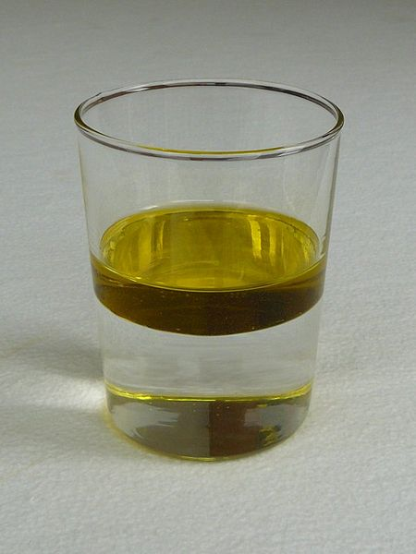
Water Class #3
Objective: More table G practice, more Water Vocabulary, and oil in water!

Slide 72
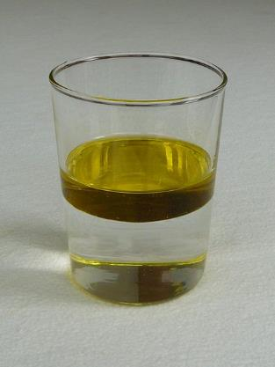
Shade in the 2 liquids in the tube. Label them OIL & Water
53 _________
54. _______________
55. They do not mix because __________________

Slide 73
Shade in the 2 liquids in the tube. Label them OIL & Water
53 OIL on top
54. WATER on bottom
55. They do not mix because LIKE DISSOLVES LIKE
56. In this case the OIL is NONPOLAR and the WATER is POLAR.

Slide 74
Shade in the 2 liquids in the tube. Label them OIL & Water
53 OIL on top
54. WATER on bottom
55. They do not mix because LIKE DISSOLVES LIKE
56. In this case the OIL is NONPOLAR and the WATER is POLAR.
THEY ARE ____________
57. The reason that the oil is ON TOP and not on under the water is:
Oil has a lower density than water.

Slide 75
Shade in the 2 liquids in the tube. Label them OIL & Water
53 OIL on top
54. WATER on bottom
55. They do not mix because LIKE DISSOLVES LIKE
56. In this case the OIL is NONPOLAR and the WATER is POLAR.
THEY ARE IMMISCIBLE 57. The reason that the oil is ON TOP and not on under the water is:
Oil has a lower density than water.

Slide 76
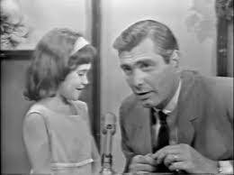
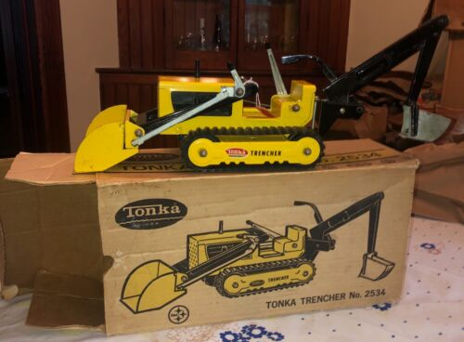
Immiscible and
Miscible Solutions
A box of biscuits
A box of mixed biscuits and a biscuit mixer.

Slide 77
58 Immiscible two liquids that cannot mix due to a polarity difference, like water and oil. Water is polar, oil is nonpolar.
59 Miscible

Slide 78
58 Immiscible two liquids that cannot mix due to a polarity difference, like water and oil. Water is polar, oil is nonpolar.
59 Miscible two liquids that can mix because they have the same polarity, like vegetable oil and olive oil (both nonpolar) or water and ethyl alcohol (both polar)

Slide 79
60. When a solution holds the most solute possible in the solvent it is said to be __________________________
61. If the solution holds LESS than that maximum amount of solute, it’s called: ______________________________
62. Charlie Chocolate milk would be _____________ while Janet’s is ______________

Slide 80
60. When a solution holds the most solute possible in the solvent it is said to be SATURATED
61. If the solution holds LESS than that maximum amount of solute, it’s called: UNSATURATED
62. Charlie Chocolate milk would be SATURATED while Janet’s is UNSATURATED

Slide 81
63. 100 mL HCl_{(AQ)} at 80°C contains 37 g of HCl. Is this saturated or unsaturated?

Slide 82
63. 100 mL HCl_{(AQ)} at 80°C contains 37 g of HCl. It is unsaturated 48 g could fit.

Slide 83
64. Is a 100 mL NaNO_{3(AQ)} at 25°C saturated if it contains 93 g NaNO₃?

Slide 84
64. Is a 100 mL NaNO_{3(AQ)} at 25°C saturated if it contains 93 g NaNO₃? UNSATURATED This solution could hold 95 g of NaNO₃

Slide 85
65. How many grams of NaCl will saturate a 100 mL solution at 90°C?

Slide 86
65. How many grams of NaCl will saturate a 100 mL solution at 90°C? 40 grams

Slide 87
66. If you put 43 g NaCl into 100 mL, what would happen?

Slide 88
66. If you put 43 g NaCl into 100 mL, what would happen? 40 grams will dissolve, the other 3 grams falls to the bottom of the beaker.

Slide 89
67. Will a 100 mL NaCl_{(AQ)} at 90°C be saturated if it contains 43 g NaCl?

Slide 90
67. Will a 100 mL NaCl_{(AQ)} at 90°C be saturated if it contains 43 g NaCl? Yes - it will be a saturated solution.
AND… the 3 grams keeps dissolving, and the water keeps dropping more NaCl out so that 40g is always dissolved.

Slide 91
68
NaCl_{(S)} Na⁺¹_{(AQ)} + Cl⁻¹_{(AQ)}
3 grams remains solid
30 grams remains dissolved
Salt dissolves into solution, it become LOOSE MOBILE IONS.
Salt precipitates out of solution becoming solid.
This process will not stop, as long at there is liquid water and the temperature holds. It’s called… Dynamic Equilibrium
Always changing and always staying the same.
Always dissolving and always precipitating, at the same rate.

Slide 92
Are these solutions saturated or unsaturated? If unsaturated, how many more grams of solute can fit?
 | Temp | Solute | If a solution contains this Mass in g | Is it Saturated or Unsaturated? | If unsaturated, how many more grams are needed to saturate this solution?
69 | 30°C | HCl | 60 g
70 | 60°C | KNO₃ | 100 g
71 | 10°C | NaNO₃ | 80 g
72 | 90°C | NH₄Cl | 73 g
73 | 20°C | KCl | 20 g
74 | 5°C | NaCl | 31 g
Temp | Mass of solute | Solute | Sat or Unsat? | # grams
30°C | 60 g | HCl | Un | ~7 g
60°C | 100 g | KNO₃ | Un | ~5 g
60°C | 125 g | NaNO₃ | Sat | X
90°C | 10 g | NH₃ | Sat | X
20°C | 30 g | KCl | Un | ~ 3 g
5°C | 36 g | NaCl | un | ~ 2 g

Slide 93
Are these solutions saturated or unsaturated? If unsaturated, how many more grams of solute can fit?
 | Temp | Solute | If a solution contains this Mass in g | Is it Saturated or Unsaturated? | If unsaturated, how many more grams are needed to saturate this solution?
69 | 30°C | HCl | 60 g | UN | ~7 grams more
70 | 60°C | KNO₃ | 100 g
71 | 10°C | NaNO₃ | 80 g
72 | 90°C | NH₄Cl | 73 g
73 | 20°C | KCl | 20 g
74 | 5°C | NaCl | 31 g
Temp | Mass of solute | Solute | Sat or Unsat? | # grams
30°C | 60 g | HCl | Un | ~7 g
60°C | 100 g | KNO₃ | Un | ~5 g
60°C | 125 g | NaNO₃ | Sat | X
90°C | 10 g | NH₃ | Sat | X
20°C | 30 g | KCl | Un | ~ 3 g
5°C | 36 g | NaCl | un | ~ 2 g

Slide 94
Are these solutions saturated or unsaturated? If unsaturated, how many more grams of solute can fit?
 | Temp | Solute | If a solution contains this Mass in g | Is it Saturated or Unsaturated? | If unsaturated, how many more grams are needed to saturate this solution?
69 | 30°C | HCl | 60 g | UN | ~7 grams more
70 | 60°C | KNO₃ | 100 g | UN | ~5 grams more
71 | 10°C | NaNO₃ | 80 g
72 | 90°C | NH₄Cl | 73 g
73 | 20°C | KCl | 20 g
74 | 5°C | NaCl | 31 g
Temp | Mass of solute | Solute | Sat or Unsat? | # grams
30°C | 60 g | HCl | Un | ~7 g
60°C | 100 g | KNO₃ | Un | ~5 g
60°C | 125 g | NaNO₃ | Sat | X
90°C | 10 g | NH₃ | Sat | X
20°C | 30 g | KCl | Un | ~ 3 g
5°C | 36 g | NaCl | un | ~ 2 g

Slide 95
Are these solutions saturated or unsaturated? If unsaturated, how many more grams of solute can fit?
 | Temp | Solute | If a solution contains this Mass in g | Is it Saturated or Unsaturated? | If unsaturated, how many more grams are needed to saturate this solution?
69 | 30°C | HCl | 60 g | UN | ~7 grams more
70 | 60°C | KNO₃ | 100 g | UN | ~5 grams more
71 | 10°C | NaNO₃ | 80 g | SAT | zero
72 | 90°C | NH₄Cl | 73 g
73 | 20°C | KCl | 20 g
74 | 5°C | NaCl | 31 g
Temp | Mass of solute | Solute | Sat or Unsat? | # grams
30°C | 60 g | HCl | Un | ~7 g
60°C | 100 g | KNO₃ | Un | ~5 g
60°C | 125 g | NaNO₃ | Sat | X
90°C | 10 g | NH₃ | Sat | X
20°C | 30 g | KCl | Un | ~ 3 g
5°C | 36 g | NaCl | un | ~ 2 g

Slide 96
Are these solutions saturated or unsaturated? If unsaturated, how many more grams of solute can fit?
 | Temp | Solute | If a solution contains this Mass in g | Is it Saturated or Unsaturated? | If unsaturated, how many more grams are needed to saturate this solution?
69 | 30°C | HCl | 60 g | UN | ~7 grams more
70 | 60°C | KNO₃ | 100 g | UN | ~5 grams more
71 | 10°C | NaNO₃ | 80 g | SAT | zero
72 | 90°C | NH₄Cl | 73 g | SAT | zero
73 | 20°C | KCl | 20 g
74 | 5°C | NaCl | 31 g
Temp | Mass of solute | Solute | Sat or Unsat? | # grams
30°C | 60 g | HCl | Un | ~7 g
60°C | 100 g | KNO₃ | Un | ~5 g
60°C | 125 g | NaNO₃ | Sat | X
90°C | 10 g | NH₃ | Sat | X
20°C | 30 g | KCl | Un | ~ 3 g
5°C | 36 g | NaCl | un | ~ 2 g

Slide 97
Are these solutions saturated or unsaturated? If unsaturated, how many more grams of solute can fit?
 | Temp | Solute | If a solution contains this Mass in g | Is it Saturated or Unsaturated? | If unsaturated, how many more grams are needed to saturate this solution?
69 | 30°C | HCl | 60 g | UN | ~7 grams more
70 | 60°C | KNO₃ | 100 g | UN | ~5 grams more
71 | 10°C | NaNO₃ | 80 g | SAT | zero
72 | 90°C | NH₄Cl | 73 g | SAT | zero
73 | 20°C | KCl | 20 g | UN | ~13 grams more
74 | 5°C | NaCl | 31 g
Temp | Mass of solute | Solute | Sat or Unsat? | # grams
30°C | 60 g | HCl | Un | ~7 g
60°C | 100 g | KNO₃ | Un | ~5 g
60°C | 125 g | NaNO₃ | Sat | X
90°C | 10 g | NH₃ | Sat | X
20°C | 30 g | KCl | Un | ~ 3 g
5°C | 36 g | NaCl | un | ~ 2 g

Slide 98
Are these solutions saturated or unsaturated? If unsaturated, how many more grams of solute can fit?
 | Temp | Solute | If a solution contains this Mass in g | Is it Saturated or Unsaturated? | If unsaturated, how many more grams are needed to saturate this solution?
69 | 30°C | HCl | 60 g | UN | ~7 grams more
70 | 60°C | KNO₃ | 100 g | UN | ~5 grams more
71 | 10°C | NaNO₃ | 80 g | SAT | zero
72 | 90°C | NH₄Cl | 73 g | SAT | zero
73 | 20°C | KCl | 20 g | UN | ~13 grams more
74 | 5°C | NaCl | 31 g | UN | ~6 grams more
Temp | Mass of solute | Solute | Sat or Unsat? | # grams
30°C | 60 g | HCl | Un | ~7 g
60°C | 100 g | KNO₃ | Un | ~5 g
60°C | 125 g | NaNO₃ | Sat | X
90°C | 10 g | NH₃ | Sat | X
20°C | 30 g | KCl | Un | ~ 3 g
5°C | 36 g | NaCl | un | ~ 2 g

Slide 99
75. Below are 2 NaCl formula units that have ionized into water. Draw 3 water molecules surrounding each ion showing proper orientation towards these ions. Note their charges indicated in the little circles.
Cl⁻¹
Na⁺¹
Cl⁻¹
Na⁺¹

Slide 100
75.
H H
O
H H
O
H H
O
H H
O
Cl⁻¹
Na⁺¹
H H
O
H H
O
H H
O
H H
O
Cl⁻¹
Na⁺¹
H H
O
H H
O

Slide 101
76. Explain in one sentence why the water molecules are going to orient themselves to the ions in solution.

Slide 102
76. Explain in one sentence why the water molecules are going to orient themselves to the ions in solution.
The water molecules have a + side (hydrogen) and a ̶ side (oxygen).
The ions have charges too, positive and negative.
It’s expected that the positives would be attracted to the negatives, and vice versa.

Slide 103
Surfactants
77. Soap is a surfactant. It can break the surface tension of water.
78. Surfactant = surface acting agent.

Slide 104
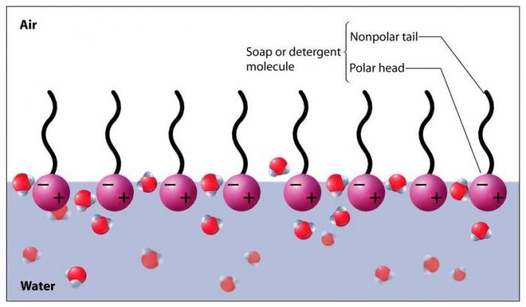
79. Soap is partially soluble (polar) + partially insoluble (nonpolar)
80. The polar “head” gets dissolved; the nonpolar “tail” creates gaps in the surface hydrogen bonding.
This allows water to escape “out of” the surface, or stuff to “fall through” the surface of the water.
81. Surfactants create gaps in the surface hydrogen bonding.

Slide 105
82. Oil molecules (vegetable oil, motor oil, mineral oil, etc.) are all nonpolar. When oil is put into (polar) water, why can’t the oil dissolve into the water like salts, or polar sugar molecules?
LIKE DISSOLVES LIKE, the water is polar, the oil is nonpolar. The water “can’t catch” the oil droplets, they slip through the waters grasp.
The oil floats because it has lower density than the water.

Slide 106
82. Oil molecules (vegetable oil, motor oil, mineral oil, etc.) are all nonpolar. When oil is put into (polar) water, why can’t the oil dissolve into the water like salts, or polar sugar molecules?
LIKE DISSOLVES LIKE, the water is polar, the oil is nonpolar. The water “can’t catch” the oil droplets, they slip through the water’s grasp.
The oil floats because oil has lower density than the water.

Slide 107
83. How many grams of KClO₃ fits into 100 mL of water at 90°C?
84. How many grams of KClO₃ fits into 100 mL of water at 40°C?

Slide 108
83. How many grams of KClO₃ fits into 100 mL of water at 90°C? 52 g
84. How many grams of KClO₃ fits into 100 mL of water at 40°C? 35 g

Slide 109
THINK HARD NOW…
85. If you have a saturated KClO_{3(AQ)} at 90°C and put it into a cooler and the temperature drops to just 40°C, what could possibly happen to all that KClO₃ that was in solution?

Slide 110
If you have a saturated KClO_{3(AQ)} at 90°C and put it into a cooler and the temperature drops to just 40°C, what could possibly happen to all that KClO₃ that was in solution?
About 52 grams of KClO₃would be in solution when 90°C but only about 15 grams fits in solution at 40°C .
52 grams - 15 grams 37 grams precipitates

Slide 111
86. A 100 mL saturated solution of KNO₃ is at 60°C. It is cooled to 20°C. Describe what happens. Do the math too

Slide 112
86. A 100 mL saturated solution of KNO₃ is at 60°C. It is cooled to 20°C. Describe what happens. Do the math too
At 60°C the solution holds 105 grams of this solute.
At 20°C the solution holds 35 grams of this solute.
The difference (105 – 35 = 70 grams)
70 grams precipitates out of solution because this cold solution can’t hold all of those grams.

Slide 113
86. A 100 mL saturated solution of KNO₃ is at 60°C. It is cooled to 20°C. Describe what happens. Do the math too
At 60°C the solution holds 105 grams of this solute.
At 20°C the solution holds 35 grams of this solute.
The difference (105 – 35 = 70 grams)
70 grams precipitates out of solution because this cold solution can’t hold all of those grams.
The rate of precipitation = the rate of solvation This is dynamic equilibrium

Slide 114
The Last Water Class
Objective: a final review of water including some vocabulary and some symbolic representations of deep thinking.

Slide 115
87. What happens when you put 140 g KI into 100 mL water at 10°C?
88. Does this “STOP”? 89. What does happen?
Draw a picture of this and label it all properly too.
90. SATURATED SOLUTION KI_{(AQ)}
91. EXCESS SOLUTE KI_{(S)}

Slide 116
87. What happens when you put 140 g KI into 100 mL water at 10°C? 135 grams dissolves into the water 5 grams falls to the bottom of the beaker.
88. Does this “STOP”? NO! 89. What does happen? It keeps dissolving into solution and precipitating out of solution.
Draw a picture of this and label it all properly too.
90. SATURATED SOLUTION KI_{(AQ) 135 g AQ}
91. EXCESS SOLUTE KI_{(S) 5 g S}

Slide 117
92. In a ________________ the rate of the ________ reaction is equal to the rate of the _______ reaction.

Slide 118
92. In a dynamic equilibrium the rate of the forward reaction is equal to the rate of the reverse reaction.
93. In this case we could say that the

Slide 119
92. In a dynamic equilibrium the rate of the forward reaction is equal to the rate of the reverse reaction.
93. In this case we could say that the rate of rate of SOLVATION PRECIPITATION
=

Slide 120
94. When NaCl_{(S)} → Na⁺¹_{(AQ)} + Cl⁻¹_{(AQ)} this is called _________________ or _______________
95. Does sugar, C₁₂H₂₂O₁₁ do this? _____ How does sugar dissolve into water?
H₂O

Slide 121
94. When NaCl_{(S)} → Na⁺¹_{(AQ)} + Cl⁻¹_{(AQ)} this is called IONIZATION or DISSOCIATION
95. Does sugar, C₁₂H₂₂O₁₁ do this? _____ How does sugar dissolve into water?
H₂O

Slide 122
94. When NaCl_{(S)} → Na⁺¹_{(AQ)} + Cl⁻¹_{(AQ)} this is called IONIZATION or DISSOCIATION
95. Does sugar, C₁₂H₂₂O₁₁ do this? NO! How does sugar dissolve into water? BY BREAKING INTO MOLECUES, NOT INTO IONS. Sugar is not ionic.
H₂O

Slide 123
96. Electrolytes The hardest vocab word of the year
To be an electrolyte, First, you must be IONIC
Second, you must become AQUEOUS in water
Which provides LOOSE MOBILE IONS in solution
Loose mobile ions conduct ELECTRICITY
IONIC but NOT AQ is not an electrolyte (AgCl or CuS say)
AQ but not IONIC is not an electrolyte (sugar water)

Slide 124
 | Substance | Is this an electrolyte? | Will this conduct electricity?
97 | NaCl_{(AQ)}
98 | NaCl_{(S)}
99 | NaOH_{(AQ)}
100 | NaOH_{(S)}
101 | AgCl_{(AQ)}
102 | AgCl_{(S)}
103 | C₁₂H₂₂O_{11(AQ)}

Slide 125
 | Substance | Is this an electrolyte? | Will this conduct electricity?
97 | NaCl_{(AQ)} | Yes | Yes
98 | NaCl_{(S)} | Yes | No, no loose ions
99 | NaOH_{(AQ)}
100 | NaOH_{(S)}
101 | AgCl_{(AQ)}
102 | AgCl_{(S)}
103 | C₁₂H₂₂O_{11(AQ)}

Slide 126
 | Substance | Is this an electrolyte? | Will this conduct electricity?
97 | NaCl_{(AQ)} | Yes | Yes
98 | NaCl_{(S)} | Yes | No, no loose ions
99 | NaOH_{(AQ)} | Yes | Yes
100 | NaOH_{(S)} | Yes | No, no loose ions
101 | AgCl_{(AQ)}
102 | AgCl_{(S)}
103 | C₁₂H₂₂O_{11(AQ)}

Slide 127
 | Substance | Is this an electrolyte? | Will this conduct electricity?
97 | NaCl_{(AQ)} | Yes | Yes
98 | NaCl_{(S)} | Yes | No, no loose ions
99 | NaOH_{(AQ)} | Yes | Yes
100 | NaOH_{(S)} | Yes | No, no loose ions
101 | AgCl_{(AQ)} | Does not exist check table F | No, no loose ions
102 | AgCl_{(S)} | No | No
103 | C₁₂H₂₂O_{11(AQ)}

Slide 128
 | Substance | Is this an electrolyte? | Will this conduct electricity?
97 | NaCl_{(AQ)} | Yes | Yes
98 | NaCl_{(S)} | Yes | No, no loose ions
99 | NaOH_{(AQ)} | Yes | Yes
100 | NaOH_{(S)} | Yes | No, no loose ions
101 | AgCl_{(AQ)} | Does not exist check table F | No, no loose ions
102 | AgCl_{(S)} | No | No
103 | C₁₂H₂₂O_{11(AQ)} | No | No, no loose ions this is NOT IONIC

Slide 129
104. Is Be(OH)₂ an electrolyte? Can it conduct electricity?
105. What about Be(OH)_{2(L)} (melted beryllium hydroxide) Will that be able to conduct electricity?
106. How is that possible?
107. If liquid Be(OH)₂ can conduct electricity, is it an electrolyte?

Slide 130
104. Is Be(OH)₂ an electrolyte? NO, it’ s not AQ in water Can it conduct electricity? No loose ions = no electrical conduction
105. What about Be(OH)_{2(L)} (melted beryllium hydroxide) Will that be able to conduct electricity? YES!
106. How is that possible? MELTED = LOOSE IONS
107. If liquid Be(OH)₂ can conduct electricity, is it an electrolyte? NO, electrolytes must be aqueous. This is NOT AQUEOUS - check table F.

Slide 131
108. When sodium chloride goes into water, we would write the “equation” this way:
NaCl_{(S)} Na⁺¹_{(AQ)} + Cl⁻¹_{(AQ)}
109. This is called ________________ or _______________
110. Does sugar do this? _____ What does sugar do? ____________________________________
H₂O

Slide 132
108. When sodium chloride goes into water, we would write the “equation” this way:
NaCl_{(S)} Na⁺¹_{(AQ)} + Cl⁻¹_{(AQ)}
109. This is called IONIZATION or DISSOCIATION
Does sugar do this? NO! What does sugar do? IT DISSOLVES INTO MOLECULES. Sugar is NOT IONIC, it dissolves because the molecules are POLAR, but it dissolves into LOOSE MOBILE MOLECULES
H₂O

Slide 133
111. Show the dissociation or the ionization for sodium nitrate in water with phase symbols:

Slide 134
111. Show the dissociation or the ionization for sodium nitrate in water with phase symbols:
water
NaNO_{3(S)} Na⁺¹_{(AQ)} + NO₃⁻¹_{(AQ)}

Slide 135
112. Show the dissociation or the ionization for potassium phosphate in water with phase symbols:

Slide 136
112. Show the dissociation or the ionization for potassium phosphate in water with phase symbols:
water
Na₃PO_{4(S)} 3Na⁺¹_{(AQ)} + PO₄⁻³_{(AQ)}
This is BALANCED…, one mole of Na₃PO₄ becomes THREE moles of Na⁺¹ cations and ONE mole of PO₄⁻³ anions.
An ionic compound that is AQ in water turns into LOOSE MOBILE IONS in solution.

